Slide 1
Evaluation
and
Treatment
of
Fungal & Tubercular Infections
of the Spine
Youmans chap. 291

Slide 2
Epidemiology
The spine is involved in 50% of skeletal TB cases.
In HIV-negative patients, about 3% to 5% of TB infections are skeletal.
In HIV-positive patients, about 60% of cases involve the bone.
Spinal TB, also known as Pott’s disease, most often affects the lumbar and lower thoracic spine.
Spinal TB can cause bony destruction of the vertebral body, spinal deformity, or paraplegia (paraparesis).
Pulmonary insufficiency may occur secondary to associated deformity of the thorax.
TB may also involve
the spinal cord in the form of an abscess or tuberculoma.
the subarachnoid space in the form of arachnoiditis.
The thoracolumbar spine is the region most commonly affected, followed by the thoracic, lumbar, and cervical regions of the spine.

Slide 3
In children with spinal TB, the risk for late kyphosis depends on
The age (<5 years).
Thoracic.
More than two vertebrae.
End-plate damage.
Pattern of involvement.
Dislocation of facets and posterior retropulsion of the diseased fragments are adverse prognostic factors for kyphosis progression.
Vertebral collapse
In children Buckling (invaginating or angulatory) collapse at the lower dorsal and dorsolumbar spine.
In adults, when the lumbar spine is involved, the pattern of vertebral collapse is different from that of the dorsolumbar spine and is telescoping (nonkyphotic vertebral body collapse) in nature.

Slide 5
kyphosis of more than 45 degrees not be allowed because
It puts the posterior spinal muscles at a mechanical disadvantage, adding to the deforming forces.
It contributes to the occurrence of paraplegia.
Prophylactic stabilization procedures should therefore be considered to prevent further progression of kyphosis.
Predisposing factors for TB
Age (elderly patients)
Malnutrition
Hypogammaglobulinemia
Diabetes mellitus
HIV infection
Malignancy, renal failure
Intravenous drug abuse
Longterm use of antirheumatic agents (steroids, anti−tumor necrosis factor [TNF]-α blockers, B-cell−depleting therapeutic agents, and methotrexate)
Anticancer chemotherapeutic agents.

Slide 6
Fungal infection of spine
Vertebral osteomyelitis is the most common form of fungal bone infection.
Risk Factors
Use of immunosuppressive drugs,
Widespread use of broad-spectrum antibiotics,
Use of indwelling catheters,
Increasing use of intravenous therapy, central parenteral nutrition,
Surgery
Hemodialysis
AIDS.
The most common pathogens are
Candida albicans is the most common organism to be involved in vertebral osteomyelitis.
Aspergillus fumigatus
Cryptococcus neoformans
Blastomyces dermatitidis
Coccidioides immitis

Slide 7
CLINICAL FEATURES
TB spine
Tubercular spondylitis has an insidious onset, which differentiates it from pyogenic spondylodiscitis.
The average duration from onset of symptoms to diagnosis is 4 months
The most common presenting symptom is
Local pain, usually progressive and refractory to treatment.
Associated with paravertebral muscle spasm and rigidity.
At a later stage, there may be bony collapse and segmental instability causing pain.
Night pain (“night cries”) may develop due to instability becoming overt in the absence of muscle spasm, often waking the patient from sleep.
Radicular pain maybe present owing to compression of the nerve roots from bony collapse or abscesses.
Constitutional symptoms of malaise, anorexia, weight loss and fever are classically described in < ½ the patients with spinal TB.
Nocturnal rise in body temperature and night sweats are more often present in spinal TB.

Slide 8
Tubercular Abscess
Unlike a pyogenic abscess, a tubercular abscess does not always exhibit the classical features of “Redness, Heat, Pain” and is commonly referred to as a “cold” abscess.
A cold abscess is a well-defined fluctuant swelling. It may be warm and slightly tender.
The overlying skin, which is often stretched and shiny, may burst and develop into a draining sinus.
The discharge varies
In color from white to yellow.
In consistency from watery to thick caseous material.
Sometimes, secondary infection may occur in a tubercular abscess and in these may have all the features of a pyogenic abscess.

Slide 10
Spinal Deformity
In children, The infection preferentially affects the anterior column of the spine in 90% of patients. As the infection progresses, there is destruction of the vertebral body.
The healthy superior vertebra rotates and descends so that its anterior surface contacts with the superior surface of the inferior healthy vertebra. This leads to kyphotic deformity, which can gradually increase with time.
The deformity produced is varyingly described as
“knuckle deformity,” when one vertebral segment collapses.
“Gibbus deformity,” when two or three segments collapse.
“Angular kyphosis,” when more than three segments of collapse.
The progression of deformity in spinal TB has two distinct phases:
Phase I includes the changes during the active stage of the disease.
Phase II includes deformity progression that occurs after successful treatment of the acute phase of the disease.

Slide 11
Neurological Deficit
The neurological deficits can range from subtle gait disturbances to complete paraplegia with sphincter involvement.
The neurological deficits occurring in spinal TB have traditionally been classified as
“early onset” (occurring during the active phase of the disease, typically during first 2 years).
“late onset” (occurring many years later and after successful treatment of the acute phase of the disease).
In the active disease phase, neurological deficits are thought to be produced by
Extrinsic compression of the spinal cord or nerve roots by the abscess or granulation tissue, bony compression, or dislocation of the vertebrae.
Intrinsic infection of the spinal cord from meningeal infection, intramedullary infection, inflammatory edema.
Spinal cord infarction due to endarteritis or infective thrombosis in the spinal vessels.

Slide 12
Late-onset neurological deficits are likely caused by repetitive trauma from bony compression, constrictive scarring of the dura; or disease reactivation.
The late onset of neurological deficits was attributed to cord compression, pure cord distraction, stenosis, and instability above or below the level of the angular kyphosis.
Stages of Neurological defecit
The infective focus begins in the vertebral body anterior to the spinal cord.
As the abscess enlarges, it produces compression of the anterior aspect of the spinal cord (This can present as increasing spasticity in an otherwise asymptomatic patient).
As compression progresses, weakness may develop.
Significant anterior column compression will also affect the lateral columns of the spinal cord and later produce sensory deficits.
With further increase in compression, the posterior columns are also affected, leading to complete loss of sensation and sphincter disturbance.
In longstanding compression, the spasticity is often replaced by flaccidity with flexor spasms.

Slide 15
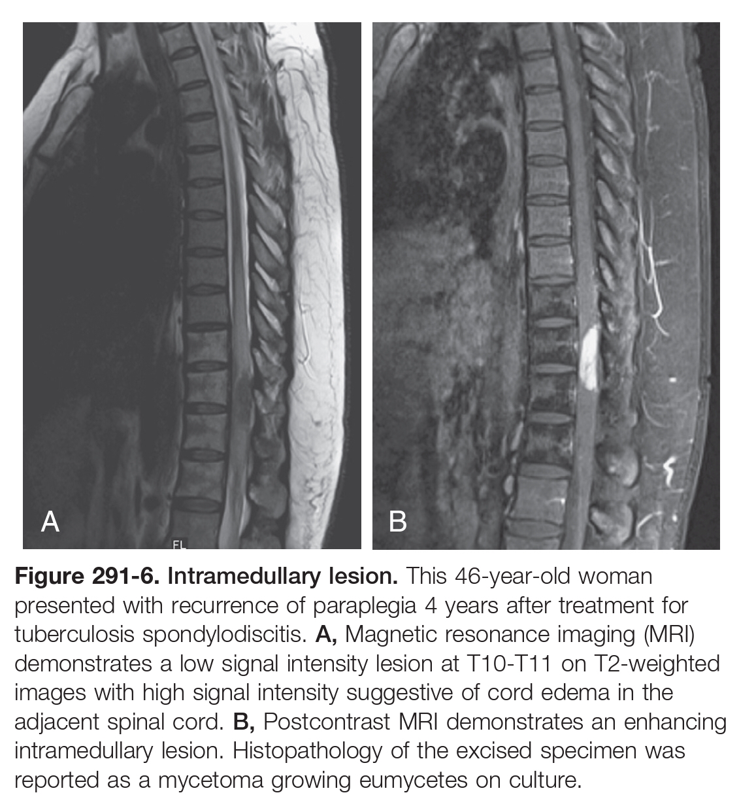

Slide 16
WORK-UP
ESR
CRP
Tuberculin skin testing
Serological Tests
Imaging study
It can take up to 3 to 4 months for spinal TB lesions to show up on plain radiographs.
CT Scan for Bony lesions
MRI has the best sensitivity and specificity for diagnosing spinal TB.
Classical findings on MRI include
The presence of marrow edema,
Disk space preservation,
Subligamentous extension of abscess, Paravertebral septate abscess, epidural extension,
Endplate erosions, and discitis.

Slide 17
Fluorodeoxyglucose–positron emission tomography (FDG-PET) and PET-CT
Used for
Earlier diagnosis of spinal TB.
Possible differentiation of TB from malignancy.
Assessing response to treatment.
Histopathology
Cold abscesses can be aspirated for diagnosis.
Deep-seated abscesses can be aspirated under ultrasound or CT guidance.
Tissue collected can be sent for smear and staining, histopathology, culture and sensitivity, and polymerase chain reaction (PCR).
Smear examination with Ziehl-Neelsen staining for AFB.
Histopathologically, caseating granulomas and epithelioid giant cells are characteristic of TB.
Multiplex real-time PCR
Faster and more sensitive for detection of M. tuberculosis DNA and simultaneous identification of mutations that confer rifampicin resistance, which is predictive of multidrug-resistant TB.

Slide 18
CLINICAL FEATURES AND DIAGNOSIS OF FUNGAL INFECTIONS
Patients at higher risk for fungal infection of the spine:
History of previous fungemia,
Immunosuppression,
Diabetes,
Central venous catheterization,
Intravenous drug abuse,
Parenteral nutrition,
Implanted prosthetic devices places.
MRI in immunocompromised patients
Hypointensity on T1
Lack of hyperintensity on T2 due to
Depressed immune response in immunocompromised individuals.
The absence of proteolytic enzymes.
Paramagnetic and ferromagnetic properties of the fungus
CT in patients with fungal osteomyelitis typically reveals hypodensities in the bone with small irregular bone islands, as opposed to the appearance of metastatic tumor, in which bone is completely replaced by tumor in larger segments.
سودة مصخمة

Slide 19
Fungal infection memmic TB spine by:
Involvement of the posterior elements.
The imaging characteristics of spinal TB and fungal infections are similar to those of a neoplasm, and thus the clinical history must be closely correlated not only to differentiate between pyogenic and nonpyogenic causes of spondylitis but also to distinguish the findings from a neoplasm.
M. tuberculosis, can form paraspinal masses.
Coccidioides infections
Are most commonly to cause Paravertebral soft tissue swelling and involvement of the posterior elements.
Vertebral body lytic lesions associated with the formation of soft tissue abscesses.
Blastomyces infection commonly to cause Vertebral body collapse and gibbus formation & paraspinal masses.
Cryptococcus infection can cause Vertebral body lytic lesions associated with the formation of soft tissue abscesses.

Slide 20
With many radiographic similarities between fungal and tubercular infections of the spine, it can be difficult to distinguish between these lesions for targeting therapy.
Histopathologic examination is the standard for establishing the appropriate diagnosis.
Identifying the correct diagnosis can be aided by other testing methods, such as
the carbohydrate assimilation test for Candida.
the phenol oxidase reaction for Cryptococcus.

Slide 21
TREATMENT
Fungal Infections of Spine
Antifungal therapy should be started simultaneously.
Nonoperative management is the mainstay of some fungal infections of the spine, but some pathogens are best treated by surgical intervention for evacuation of abscesses, resulting in higher clearance rates.
Patients with spinal instability, neurological deficit, or sepsis are also best managed by operative treatment.
Debridement and pharmacological agents used
Amphotericin B (0.25 to 1 mg/kg per day) 2-3 weeks followed by
Fluconazole (6 mg/kg per day), for a total duration of 6 to 12 months
Operative intervention is rarely needed in patients suffering from Cryptococcus infection of the spine.

Slide 22
TREATMENT
Spinal Tuberculosis
The current treatment of spinal TB is primarily medical.
Surgical intervention is an adjunct in selected patients.
The antitubercular drugs are broadly classified into (for 12 to 15 months).
1st line agents: Isoniazid, rifampicin, pyrazinamide, and ethambutol
2nd line agents: Kanamycin, amikacin, cycloserine, capreomycin, ethionamide, prothionamide, quinolones, and para-aminosalicylic acid which are used for the treatment of multidrug-resistant TB and in patients with intolerance to first- line agents.

Slide 23
Pott’s Paraplegia
The neurological deficits associated with spinal TB has been traditionally classified either as
paraplegia of early onset, which occurs with the active stage of the disease within the first 2 years, or
paraplegia of late onset, which occurs many years later after apparent quiescence of the disease.
Patients with minimal extradural spinal cord compression and predominantly fluid in the extradural space on MRI will respond well to chemotherapy alone.
Indication for surgery
Patients with MRI evidence of extradural compression by granulation or caseous tissue with little fluid component.
Those with circumferential compression and evidence of myelomalacia, compression by disk, or sequestrum.
Rapid onset and progression of the neurological deficit is suggestive of mechanical compression due to instability from subluxation or dislocation.
Panvertebral involvement and intramedullary lesions are less common indications for surgical intervention.

Slide 24
Both anterior and posterior instrumentation attain good results for correction of the deformity and maintaining correction, foci clearance, spinal cord decompression, and pain relief in the treatment of thoracic and lumbar spinal TB, provided that the operative indication is accurately identified.
However, the posterior approach may be superior to anterior instrumentation to correct deformity and maintain that correction

