Slide 1
Arteriovenous Malformations and Fistulas of
the Spine
Youmans Chap. 412

Slide 2
VASCULAR ANATOMY
Anterior spinal artery ASA runs in the anterior median sulcus and supplies the anterior two thirds of the spinal cord, including
Anterior horn cells,
Anterior and lateral corticospinal tracts,
Spinothalamic tract.
It end at the conus medullaris.
In the cervical spine, radiculomedullary feeders from the vertebral and subclavian arteries augment blood flow to the ASA, mainly at C5 or C6.
In the dorsal and lumber spine a total of 6 to 10 additional radiculomedullary feeders that derive from the aorta and iliac arteries reinforce the ASA.
The most prominent of these is the great anterior segmental medullary artery, (the artery of Adamkiewicz), which usually arises on the left between T8 and L2.
On an anteroposterior projection, this artery is 0.5 to 1 mm in diameter and has an ascending segment that makes a classical “hairpin” turn into the descending ASA in the midline.

Slide 3
The main watershed area of the spinal cord is at T2-T4 in which Profound hypotension may lead to ischemia and infarction in this region.
Posterior spinal Artery PSA
Arise from the vertebral arteries and descend along while supplying the posterolateral cord, including the posterior columns.
Radiculomedullary vessels from the vertebral, cervical, intercostal, and lumbar arteries, which also make the hairpin turn as they join the PSAs, lateral to the midline and thinner in diameter, augment these branches.
At the conus medullaris, the paired PSAs merge with the ASA to form the cruciate anastomosis.

Slide 4
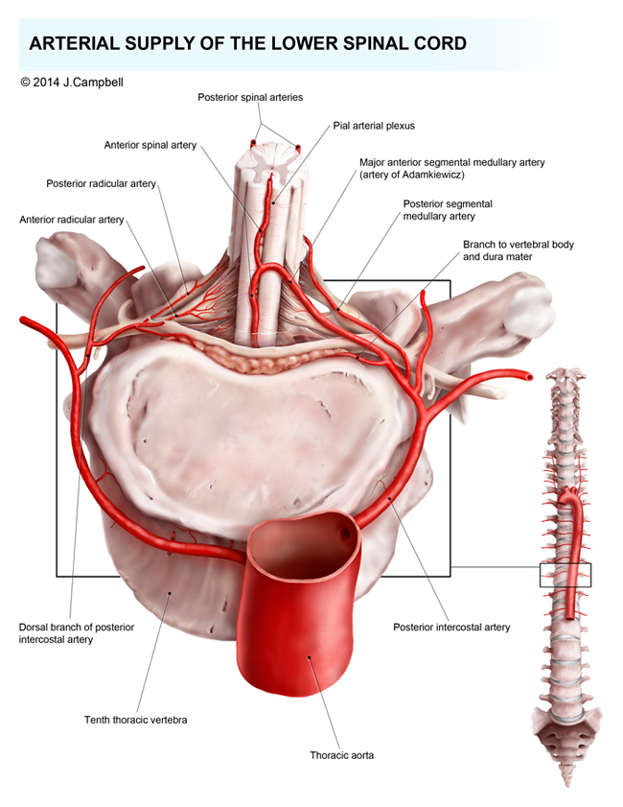

Slide 5
The venous drainage of the cord involves intradural and extradural portions and follows a distribution similar to that of the arteries.
The intradural portion is further subdivided into the intramedullary and pial veins.
The extradural veins include veins of the spinal column and Batson’s plexus.
The anterior and posterior spinal veins are the two major midline longitudinal trunks and are filled by sulcal veins.
Anterior median and anterolateral veins drain the ventral portion of the cord,
Posterior median and posterolateral veins drain the posterior funiculi and dorsal horns.
It is important to note that the transition of a median vein into a radicular vein shows the same hairpin turns as the arteries described previously.
Drainage of blood from the spine occurs through the valveless internal and external venous vertebral plexus, which is connected to the azygos and hemiazygos venous systems.

Slide 9
Two main types of spinal vascular lesions:
venous angioma (angioma racemosum venosum)
arteriovenous angioma (angioma racemosum arteriovenosum).
The venous type
Consisted of a mass of turgid pial veins,
Located in the posterior aspect and below the midthoracic portion of the spinal cord.
The arteriovenous type
Fistulous capillary bed,
Located most commonly in the cervical or lumbar.

Slide 10
Classifications
Di Chiro accounted for 4 types of spinal AVMs:
Type I “single coiled vessel” the most common. سنگل
Type II “glomus” AVMs that involved a clear nidus. زوج وزوجة
Type III “juvenile” AVMs, were extensive and encompassed an entire somite. جابت طفل
Type IV “perimedullary fistulas” that are located primarily on the ventral surface of the spinal cord and receive arterial contributions from the anterior spinal artery.
Type I lesions
Account for 80% to 85% of all spinal vascular malformations.
The nidus was not apparent at arteriography.
Types II and III malformations
Accounts for 15%-20% of all spinal vascular malformations.
The nidus are present at arteriography.

Slide 11
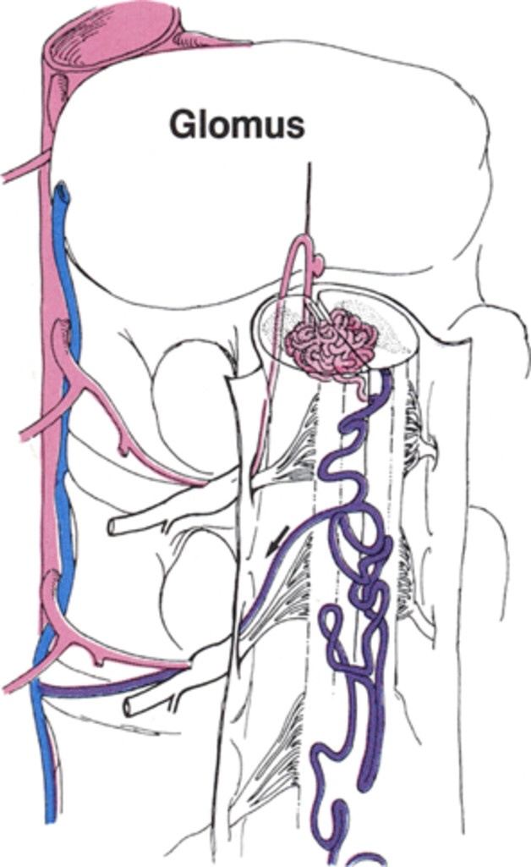
Glomus Type
An intramedullary nidus that is often restricted to a short segment of the spinal cord.
Usually in the anterior half of the spinal cord.
Feeding vessels may arise from the anterior or posterior spinal arteries.
These lesions exhibit high flow and may be associated with aneurysms within the nidus or on a feeding artery.

Slide 12
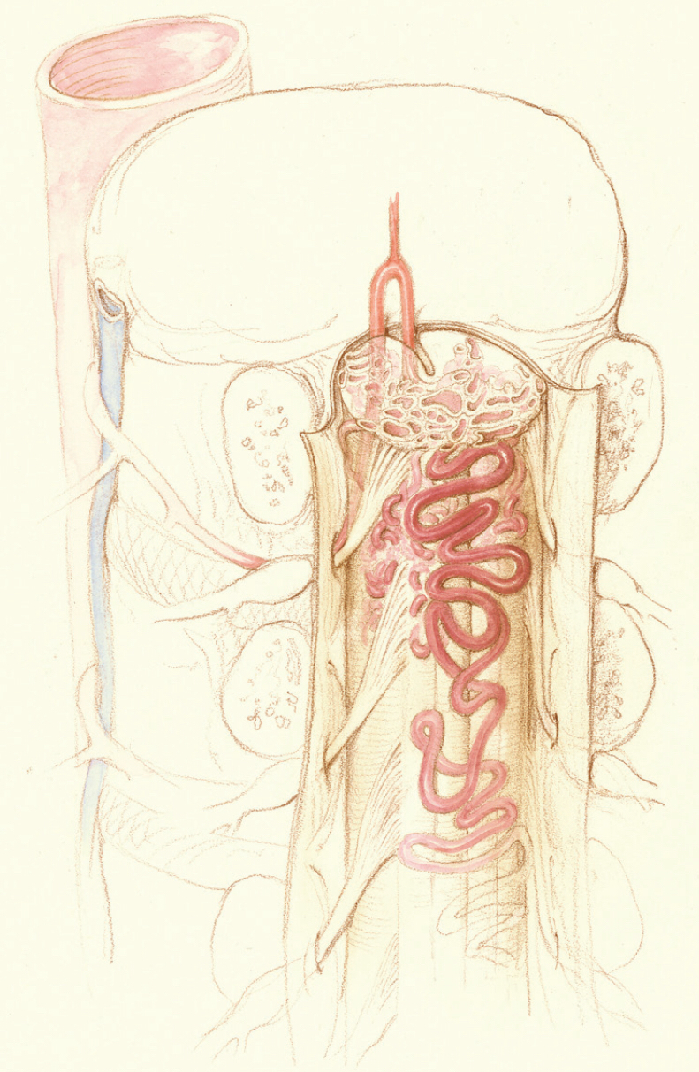
Juvenile (Extradural-Intradural) Type
These lesions are mimic cerebral AVMs.
They often are found in children and young adults.
Have multiple feeding vessels.
Have a large nidus that may involve an entire segment or more of the spinal cord.
Often involve the soft tissues, including bone, muscle, skin, and dura in a metameric distribution.
They have very rapid arteriovenous shunting.

Slide 13
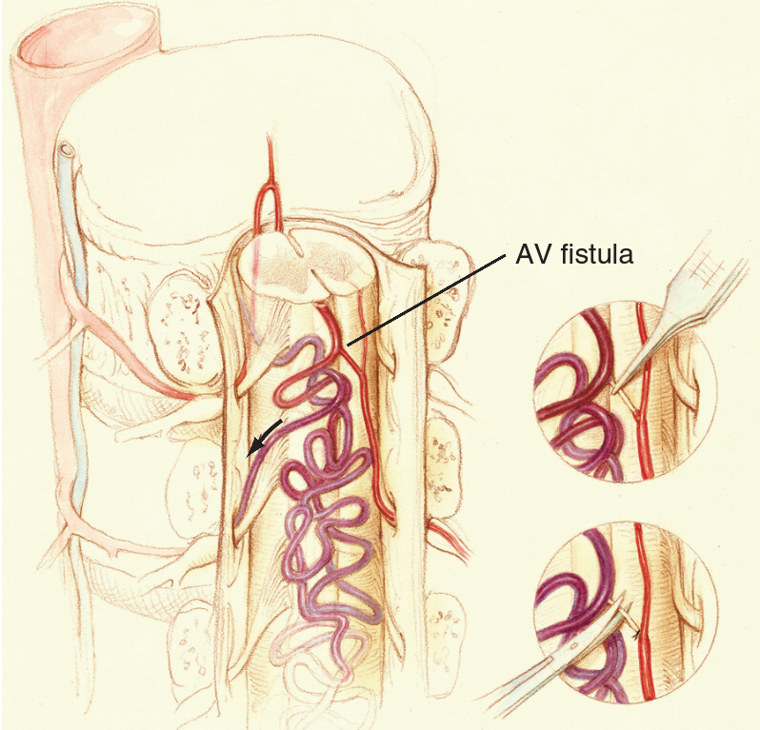
Perimedullary (Pial) Type.
Direct connection between an anterior or posterior spinal artery and the coronal venous plexus which they lie within the subarachnoid space and may be ventral or dorsal to the cord.
Distinguished from glomus AVMs by their lack of an intramedullary component and the lack of intervening small branches between arteries and veins.
These fistulas are often associated with a venous varix at the point of fistulous communication.

Slide 14
These AVFs have been categorized by into three additional subtypes.
Type I lesions are slow flow and relatively mild venous hypertension.
Type II are composed of multiple feeding branches arising from the anterior spinal artery, thereby resulting in a higher flow lesion.
Type III fistulas are characterized as giant fistulas with prominent dilation of the venous network.

Slide 15
Merland classifications of of Perimedullary AVF
Type | AVF | Feeding Artery | Draining vien
I | Single small pial | Single from ASA | Pial vein to ascending venous drainage
II | Several discrete | Several from ASA, PSA | Pial vein to rostral venous drainage
III | Single giant pial | Multiple huge dilated from ASA, PSA | Enlarge vein to the epidural system
Type | Location | Blood flow | Cause of myelopathy | Treatment
I | Anterior conus medullaris or proximal filum | Slow | Venous HT | Surgery
II | Conus antero or posterolaterally | Moderate to high | Venous HT and Hrrg | Surgery, embolization or both
III | Cervical, thoracic, lumber | Rapid to high | Hrrg, cord compression by varix | Surgery, embolization or both

Slide 16
Kim and Spetzler accounts for six types of lesions:
AVF
extradural AVFs,
intradural dorsal AVFs,
intradural ventral AVFs,
AVM
extradural-intradural AVMs,
intramedullary AVMs,
conus medullaris AVMs.

Slide 17
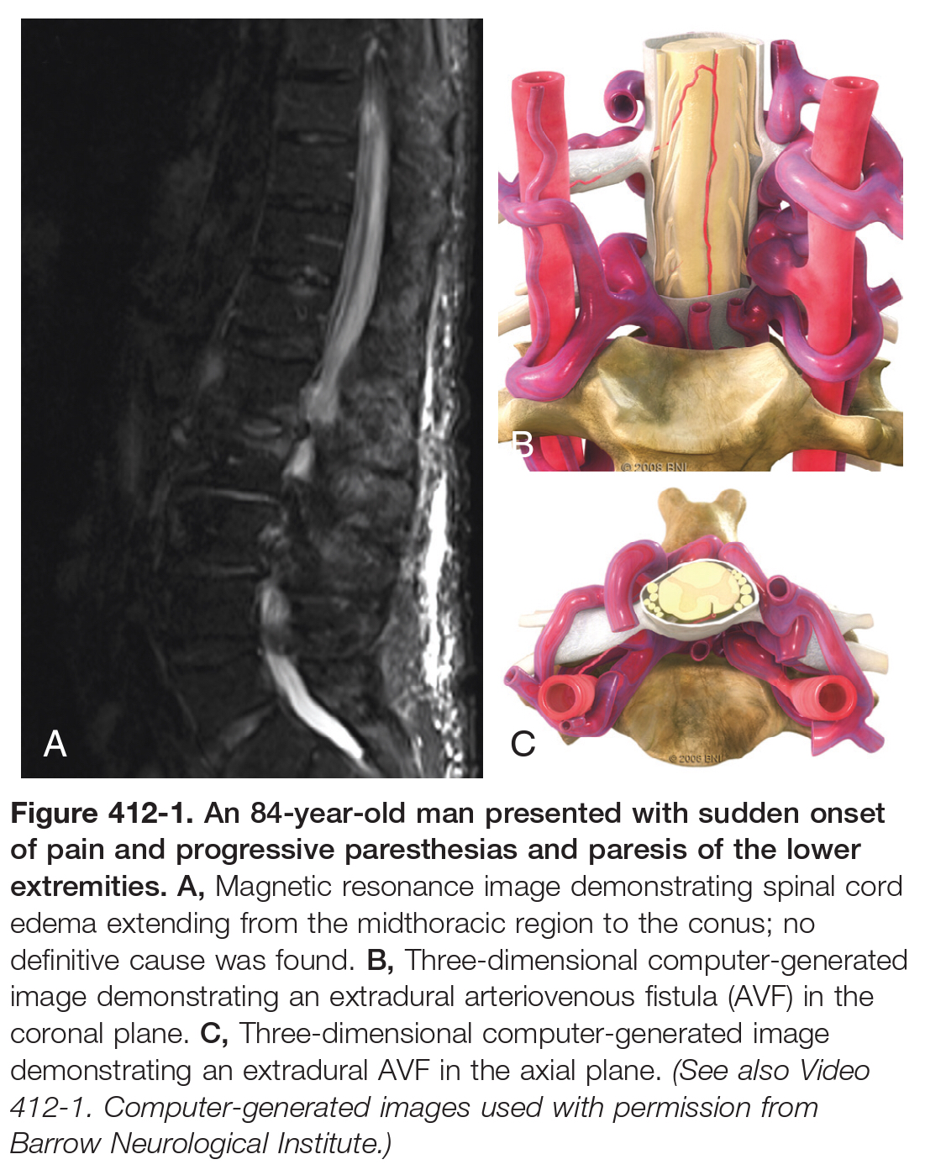
Extradural AVF
Epidural segment of a radicular artery.
Epidural venous plexus.
With an extensive network of veins in the epidural space,
Result in marked venous engorgement and compression on the thecal sac and nearby nerve roots.
Myelopathic symptoms due to vascular steal phenomenon, with blood supply shunted away from the spinal cord

Slide 18
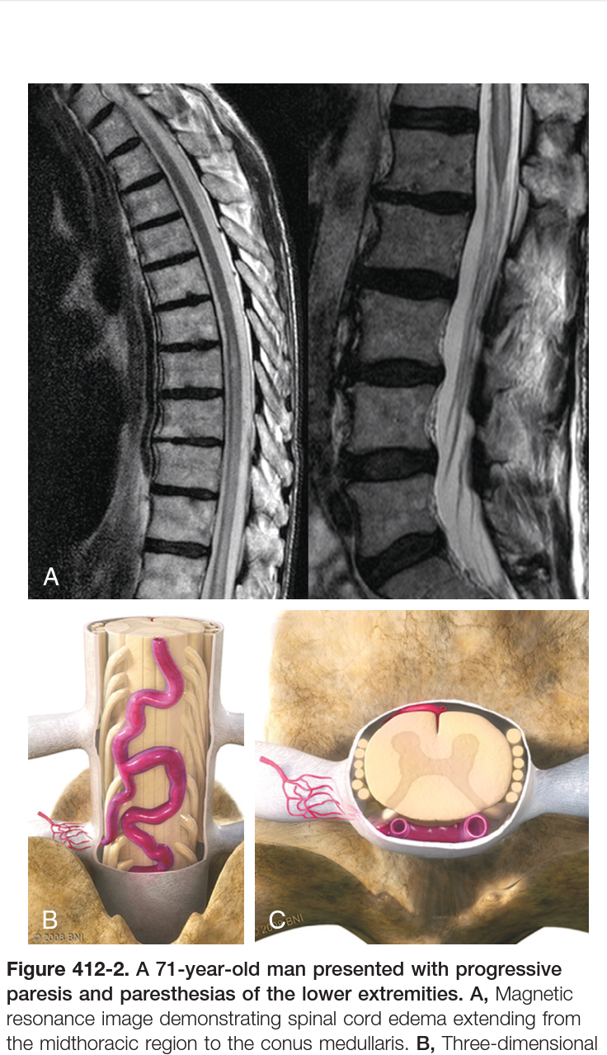
Intradural Dorsal AVF
Most common spinal vascular malformations.
Direct connection between a radicular artery, and a medullary or radicular vein.
Local mass effect → venous congestion → myelopathy.
Hemorrhage → sudden acute myelopathy.
The mechanism of venous outflow obstruction originate from
spontaneous thrombosis,
trauma,
surgery in the region.

Slide 19
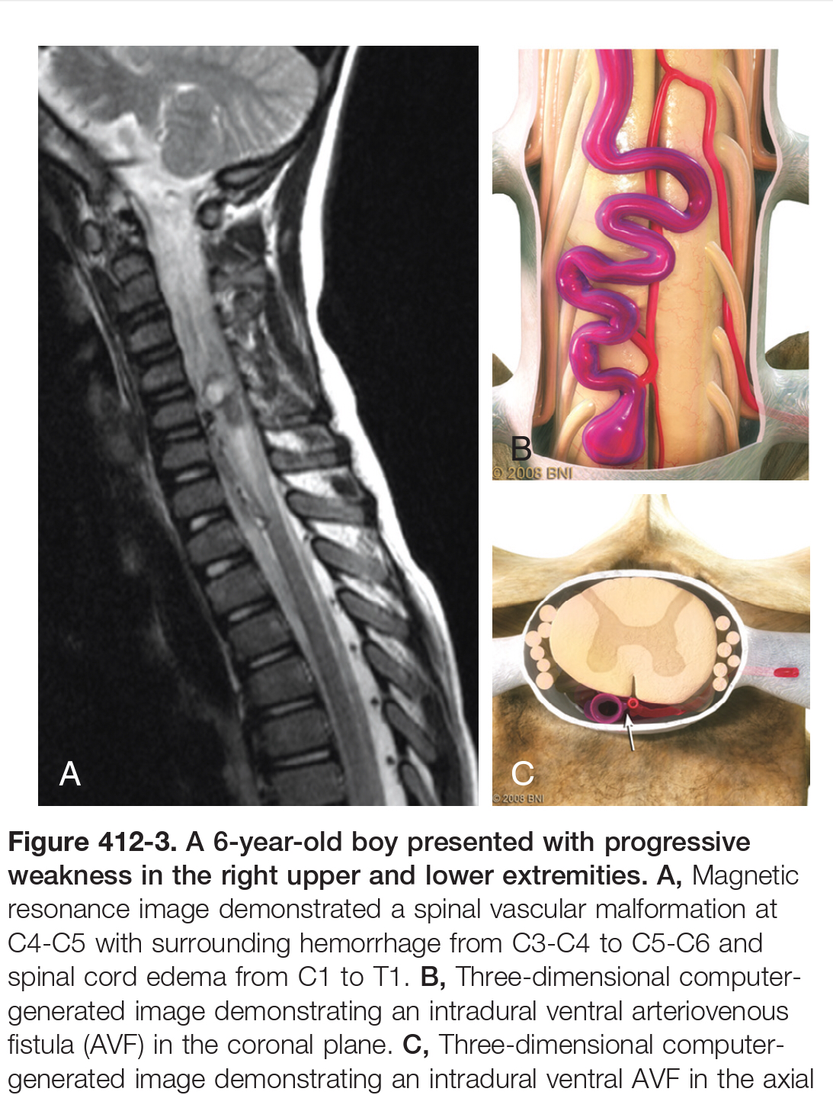
Intradural Ventral AVF
Connection lies between the anterior spinal artery and a midline venous plexus.
On spine angiograms:
Midline fistulous pouch in intradural ventral AVFs.
Lateral fistulous pouch in intradural dorsal AVFs.

Slide 20
Anson and Spetzler subclassified these fistulas to 3 types
Type A lesions are small, simple fistulas with a single feeding artery from the anterior spinal artery.
Type B lesions are larger with a primary feeder from the anterior spinal artery but also with small feeders from adjacent arteries.
Type C lesions are giant fistulas with multiple arterial pedicles and immensely engorged venous outflow channels.
Naturally Type C lesions are high-flow shunts with striking vascular steal from spinal cord tissue, which causes overt myelopathy and spinal cord ischemia.

Slide 21
Extradural-Intradural AVM
Are extensive AVMs that can encompass an entire somite of the spine and involve bone, muscle, skin, and nerve tissue.
They reside in the extradural and intradural space and even extend beyond the spine.
These AVMs correspond to juvenile type III lesions also called metameric.
When these lesions are so extensive as to encompass an entire somite, they are referred to as Cobb’s syndrome.
Through mass effect, venous congestion within the spinal cord, and arterial steal phenomenon, these lesions often lead to progressive myelopathy and neurological deficit.

Slide 23
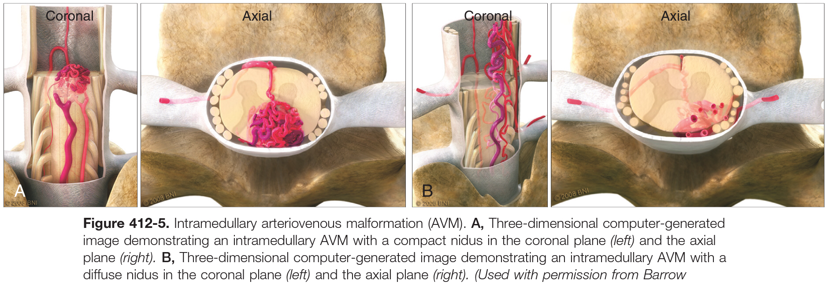
Intramedullary AVM
Intramedullary AVMs are true AVMs of the spinal cord parenchyma that are similar to cerebral AVMs.
known as the type II (“glomus”) AVMs.
Their feeding arteries are from either the posterior or anterior spinal artery and intervening nidus.
Their drainage is through a coronal venous plexus.
They can be further described as “compact” or “diffuse,” and cause symptoms with either acute hemorrhage or steal phenomenon from the spinal cord parenchyma, which, can cause progressive myelopathy.

Slide 24
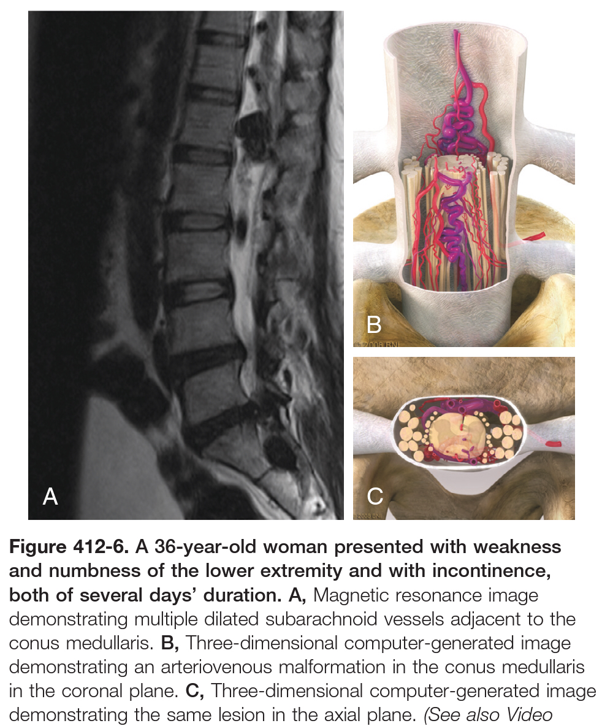
Conus Medullaris AVM
Receive multiple feeders from both the anterior and posterior spinal arteries.
Dilated venous structures in turn exhibit mass effect on the region and result in myelopathy, venous compression, venous congestion, and arterial steal on the conus, or they can result in a cauda equine syndrome as a result of compression on nerve roots as they exit the conus.
These lesions can manifest with both upper and lower motor neuron signs.
Disruption of the fistula often results in marked improvement of symptoms.

Slide 25
Clinical presentation of AVFs
AVFs are aquired
Most patients are men who develop symptoms beyond the age of 40 years.
Patients rarely present with upper extremity involvement because of the strong predilection for dural AVFs to occur in the lower thoracic and lumbar regions of the spine.
The history is often significant for low back or radicular pain followed by the gradual, but progressive, onset of myelopathic symptoms.
Patients complain of increasing weakness and sensory disturbance and bowel and bladder dysfunction.
Importantly, worsening symptoms with walking or when in certain positions, neurogenic claudication, is similar to the neurogenic claudication occasionally associated with lumbar stenosis.
Acute deterioration occurs from rupture of the fistula, which is more likely with dural AVFs in the cervical region.

Slide 26
Intradural Arteriovenous Malformations
Spinal AVMs appear to be congenital lesions resulting from aberrant vascular embryogenesis.
M = F
Symptom onset is usually earlier in life.
Distributed throughout the long axis of the spine.
The high-flow and high-pressure characteristics of spinal AVMs can result in venous hypertension and hemorrhage.
Symptom onset is often subacute or acute, with the most dramatic presentations due to hemorrhage.
Patients with hemorrhage complain of an acute onset of back or suboccipital pain, meningismus, or a loss of consciousness.
Sudden deterioration in motor function is also common.
Subarachnoid or intramedullary hemorrhage is the initial finding on diagnostic imaging.
Children appear to be more prone to hemorrhage.

Slide 27
Comparison between dural AVF and intradural AVM
 | Dural AVF | Intradural AVM
 | Sporadic | Congenital
Age at dx | 40 years | Earlier in life
Sex | Male predominant | M=F
Distribution | Lower thoracic and lumbar regions of the spine. | Throughout the long axis of the spine.
1st symptom | Paresis | SAH
Onset | Gradual | Acute
Upper limbs Affected | No | Yes

Slide 29
Foix-Alajouanine Syndrome
Acute neurological deterioration from extreme venous hypertension and possibly subsequent venous thrombosis.
Caused by untreated type I dural AVFs that led to extreme venous hypertension.
It is a true emergency because relief of the venous hypertension before it progresses to thrombosis can reverse neurological deficits, whereas failure to do so leads to irreversible spinal cord injury.

Slide 30
Management
Glomus Arteriovenous Malformations
Most glomus AVMs are resected by the posterior approach and require a standard laminectomy extending one level above and one level below the nidus.
For lesions with more anterolateral extension, sectioning of the dentate ligaments allows the cord to be gently rolled to the contralateral side.
Resection begins with sacrifice of the most superficial abnormal vasculature.
The intramedullary component is accessed by myelotomy, which is tailored to the most superficial location of the lesion: midline dorsal, dorsal root entry zone, lateral, or anterior midline.
Mobilization of the nidus proceeds within the gliotic plane, with coagulation and sectioning of small feeding vessels and draining veins as they enter and leave the nidus, but with preservation of major draining veins until the conclusion of resection.

