Slide 1
OSSIFICATION OF THE POSTERIOR LONGITUDINAL LIGAMENT OPLL Youmans chap 284

Slide 2
EPIDEMIOLOGY
The enthesopathies are conditions that result in progressive inflammation of the tendons and ligaments of the axial or appendicular skeleton (or both) and subsequent degeneration and calcification.
Although OPLL is a rare condition, it is a signifcant cause of myelopathy in middle-aged and older people.
M:F —> 2 : 1
Location : Midcervical (C3-C5) > midthoracic (T4-T7)
PATHOPHYSIOLOGY
OPLL is an ectopic ossifcation that causes cervical myelopathy
The most characteristic feature in this condition is abnormal calcifcation and ossifcation of the spinal ligaments.
50% of patients with diffuse idiopathic skeletal hyperostosis (DISH) concomitant OPLL was found on cervical radiographs.

Slide 3
Pathologic Changes in Gray Matter
The anterior horns are moderately flattened and show loss of nerve cells and a proliferation of glial cells.
The spinal cord damage is pathologically classified into four categories on the basis of the degree of destruction (stages 0-3).
In stages 0 and 1
Major pathologic changes in the gray matter and the degree of compression of the spinal cord are well correlated with deformity of the anterior horn (surgical treatment is recommended at stage 1).
In stages 2 and 3
Neurons are almost completely obliterated, and necrosis with cavity formation is frequently observed, Destruction of the spinal cord is considered irreversible.
Stages of spinal cord damage by OPLL • stage 0: normal or mild compression of the anterior horn without neuronal loss. • stage 1: mild compression of the anterior horn with partial neuronal loss. • stage 2: marked deformity of anterior horn; severe neuronal loss. • stage 3: severe spinal cord damage.

Slide 4
Pathologic Changes in White Matter
The main pathologic changes in the spinal cord caused by OPLL are found in the gray matter rather than the white matter.
The most intensively damaged part of the spinal cord extends from the middle part of the gray matter to the ventral part of the posterior column with cavity formation.
PATHOLOGIC FEATURES OF SPINAL CORD LESIONS CAUSED BY OPLL
The spinal cord is markedly ﬂattened as a result of compression by the ossifed mass, and the compression is most severe at the level of the intervertebral disk. The diameter of the spinal cord in transverse section is reduced to 2 mm in some severe cases

Slide 5
Mechanism of Spinal Cord Damage
Direct compression that is mechanically induced by ossification.
Secondary circulatory disturbance should be taken into consideration as important causes of the damage to the spinal cord occlusion of the anterior spinal artery.
Changes within the spinal cord involve the postero-lateral gray matter more than white matter, suggesting an ischemic basis for the neurologic involvement.
Clinical Manifestations
Symptoms caused by OPLL are those of cervical myelopathy and cervical radiculopathy, axial discomfort around the neck, and limitation of the cervical motion.
Pain or numbness in the upper extremities.
Sensory changes in the upper extremities ,and changes in reﬂexes in the upper extremities.
Myelopathy.
Changes in reﬂexes in the lower extremities.

Slide 6
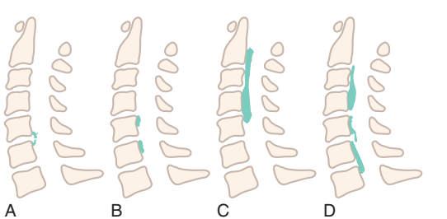
DIAGNOSTIC IMAGING
OPLL is diagnosed with lateral plain radiography of the cervical spine
OPLL is classifedinto four types:
Focal ossifcation at the posterior margin of vertebral body
Segmental ossifcation, in which each change does not extend beyond the adjacent intervertebral disk level
Continuous ossifcation over several levels
Mixed ossifcation
Computed tomography (CT) is the most sensitive method of imaging

Slide 8
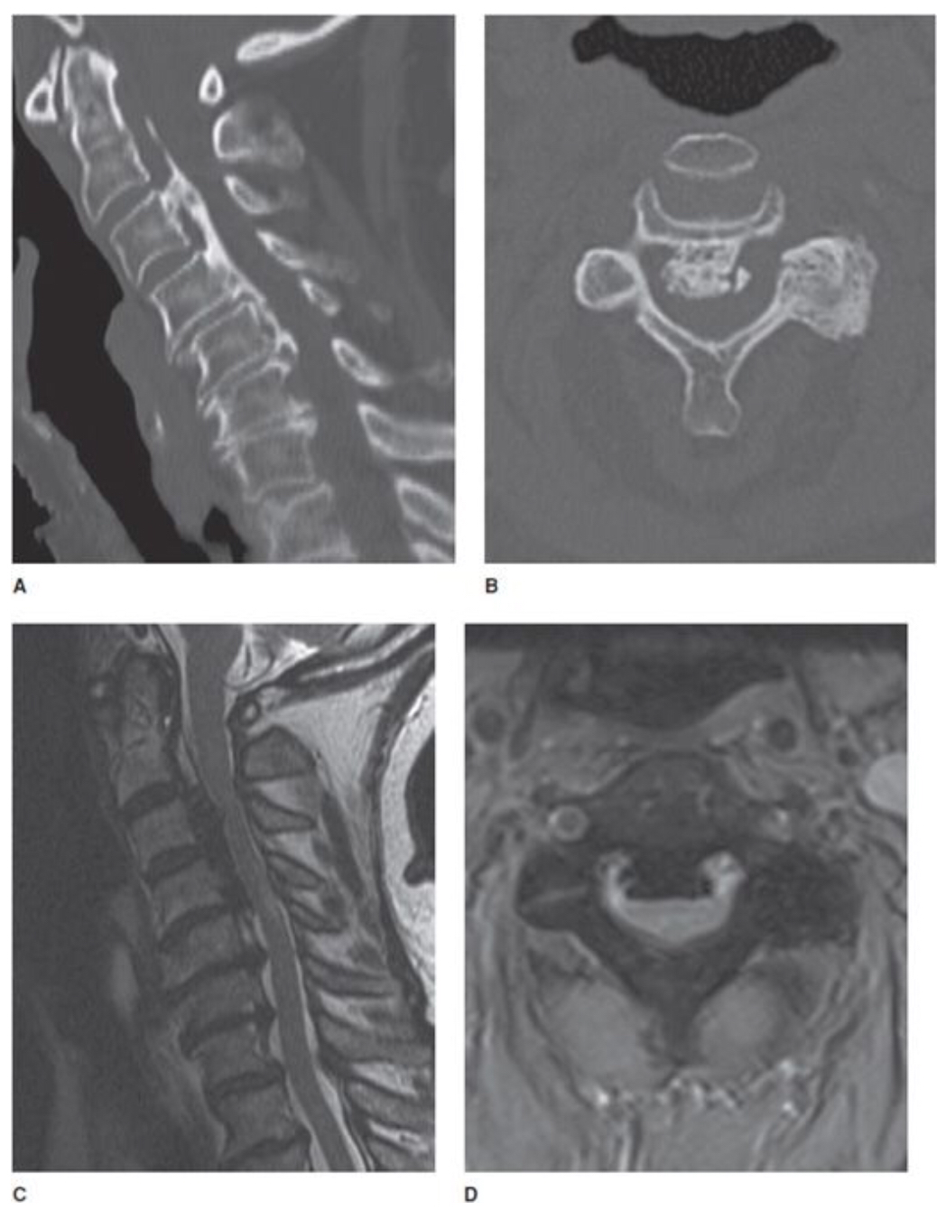
Ossification of the posterior longitudinal ligament (OPLL).
(A) Sagittal CT image shows extensive flowing ossification along the PLL causing narrowing of the central canal.
(B) Axial CT image shows large ossification from OPLL.
(C) Sagittal T2-weighted image shows prominent low signal ossification along the PLL.
(D) Axial GRE shows low signal PLL ossification in a typical “bowtie” configuration.

Slide 11
TREATMENT
Conservative Treatment
Cervical orthosis
Rehabilitation
NSAID
Muscular relaxants
Prostaglandin E1 may be indicated when circulatory disturbance in and around the spinal cord.
Choice of Surgical Procedure
There are two surgical procedures for OPLL:
Direct removal of OPLL via an anterior approach.
Decompression, in which laminoplasty or laminectomy techniques via a posterior approach.
Patients with a localized OPLL may be candidates for one- or two-level subtotal corpectomy, removal or floating of OPLL, and anterior fusion.
Patients with an extensive OPLL generally require posterior decompression as a safer procedure, for example, by laminoplasty.

Slide 12
Surgical Treatment
Indications
Advanced myelopathy
Mild myelopathy with severe compression of the spinal cord
Progression of symptoms or delayed development of myelopathy after a period of observation in a patient who was initially nonmyelopathic.
Contra indications
Chronic complete quadriplegia and advanced OPLL.
Advanced age and significant medical comorbidities.
Disk arthroplasty in terms of surgical technique.

Slide 13
Posterior Approach: Laminoplasty
Indication
Laminectomy or laminoplasty may be preferable in cases of extensive OPLL that is continuous or mixed over several levels.
Advantages
Posterior decompression may carry less risk than a radical anterior approach.
This procedure may be superior to conventional wide laminectomy because
It may result in preserved stability of the cervical spine,
Prevention of recurrent canal stenosis caused by scar formation (so-called laminectomy membrane),
Less frequent axial pain.

Slide 14
Anterior Procedure: No Associated Dural Ossifcation
Indication
The anterior approach with direct removal of OPLL is the procedure of choice in cases of segmental OPLL.
With the help of an operating microscope, drilling and removal of the osteophyte and OPLL, together with the hypertrophied PLL,are performed in appropriate corpectomy;
To achieve fxation,either an allograft with an anterior plate or a cylindrical titanium interbody cage is placed.

Slide 15
Anterior Procedure: Dural Ossifcation.
Dural ossification is classified into three types according to the shape of dural ossifcation in relation to OPLL
Each type is defined on axial and sagittal CT by re-formation as follows:
Isolated type, a small ventral hyperdense mass is in the canal without related OPLL .
Double-layer type, anterior and posterior rims of hyperdense ossifcation are separated by central hyperdense areas .
En bloc type, a hyperdense mass has a downward and upward tail along the dura mater.
The operative technique is similar to the usual anterior approach for OPLL except for leaving dural ossification without manipulation.
Note
The patient is instructed to wear a rigid cervical collar for at least 4-6 weeks after surgery (and up to 3 months in some cases).

Slide 16
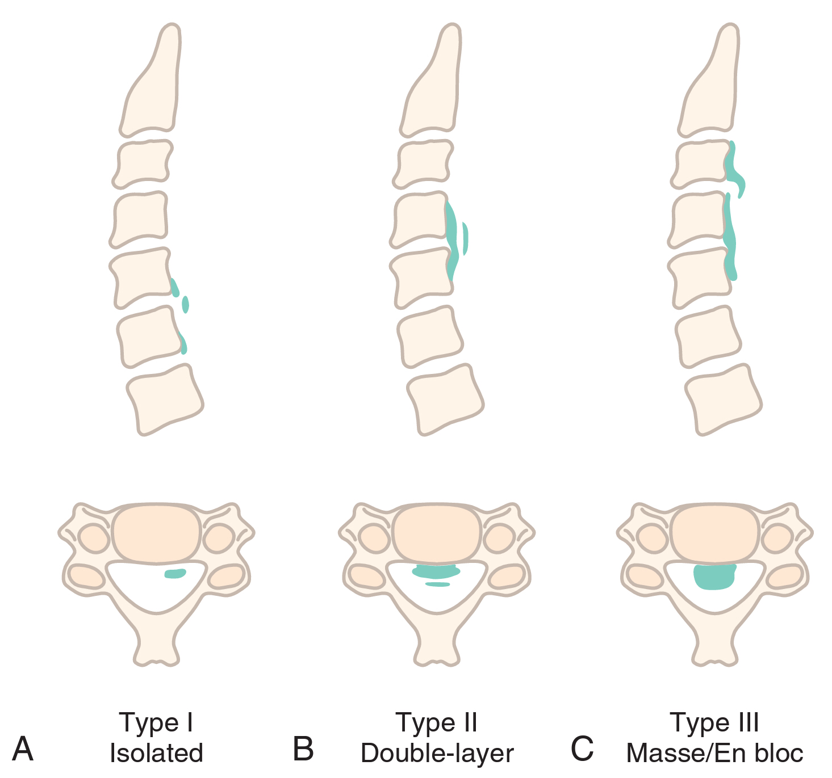
A, Type I: isolated dural ossification, without relation to OPLL.
B, Type II: double-layer dural ossification, which occurs with OPLL at the same level; the two pathologic processes are separated by an epidural space.
C, Type III: en bloc ossification of dura mater with meningeal tail.

Slide 18
Anterior floating method
Anterior floating method involves anterior mobilization of the OPLL segment and is safer and less invasive than removal of OPLL.
The method minimizes the risk of dural tear and resultant CSF leak.
It reduces hemorrhage from the anterior internal vertebral venous plexus.
Long-term follow-ups demonstrate that the residual ossification ceases its growth following this procedure.

Slide 20
Surgery-Related Outcomes, Complications
The most common intraoperative complication of the anterior procedure for OPLL was cerebrospinal fluid (CSF) leakage.
This may be explained for several cases of OPLL, both continuous or mixed types and segmental types, that were associated with dural ossification.
Complications
Direct injury to the spinal cord
Postoperative hematoma
Glottic edema or vocal cord palsy due to prolonged retraction of the larynx and recurrent laryngeal nerve
CSF leakage

