Slide 1
Spinal Cord Injury
Youmans Chap.277

Slide 2
Neurogenic Shock and Spinal Shock
Neurogenic shock refers to hypotension and bradycardia due to interruption of the descending sympathetic tracts after severe CNS damage (brain or cervical or high thoracic [T6 or above] SCI.
Neurogenic shock is typified by preserved urine output and warm extremities.
Mechanism :
Excessive pooling of blood in the organs due to the loss of the descending sympathetic tracts and loss of the reflex vasoconstrictor effect of arterial baroreceptors
Treatment :
Fluid administration is generally considered first-line therapy in this situation, although restricted heart rate makes patients with neurogenic shock susceptible to fluid overload.
Early consideration of vasoactive agents is thus recommended.
This approach is recommended to maintain systolic blood pressure above 90 mm Hg, to optimize spinal cord perfusion by maintaining mean arterial pressures higher than 85 mm Hg for the first 7 days after injury.

Slide 3
Spinal shock, is characterized by the loss of reflexes, bladder function, and muscle tone below the level of injury.
Spinal shock usually lasts for days or weeks after SCI, the average duration being 4 to 12 weeks.
Some defined the termination of spinal shock as the appearance of
the bulbocavernosus reflex,
the recovery of deep tendon reflexes,
the return of reflex detrusor functions.
Mechanism :
Lack of the counteracting muscular effects of the lower extremities, which is due to peripheral nerve unresponsiveness to brain stimulation, resulting in venous pooling
Four phase model for spinal shock:
Areflexia or hyporeflexia (0 to 24 hours),
Initial reflex return (1 to 3 days),
Early hyperreflexia (4 days to 1 month),
Spasticity (1 to 12 months).

Slide 4
Nonsurgical and Post surgical Management of Low Back Pain Youmans Chap. 281

Slide 5
Pharmacologic Treatment
Acetaminophen (paracetamol) is recommended as a first-line treatment of both chronic and acute LBP.
NSAIDs provide analgesia and reduce inflammation through the inhibition of the cyclooxygenase (COX)-1 and -2 enzymes. By comparison, selective NSAIDs (coxibs) solely attenuate COX-2 and as a result are associated with fewer gastrointestinal complications than traditional nonselective NSAIDs.
Opioids provide the most potent form of analgesia for patients suffering from LBP, also be considered in patients such as the elderly, who are at increased risk of renal, cardiac, and gastrointestinal complications with the use of NSAIDs.
Antiepileptics : medications such as
Gabapentin and Pregabalin modulate aberrant neurotransmission, gabapentin has little or no improvement in pain scores and functional outcomes.
Topiramate is thought to attenuate neuropathic pain, topiramate resulted in a moderate improvement in pain and a slight recovery in functional outcomes.

Slide 6
Antidepressants (duloxetine)
may be effective in the treatment of the neuropathic element of chronic LBP.
The benefits of antidepressants in the setting of chronic LBP are distinct from their effects on mood and are mediated through the inhibition of nociceptive neurotransmitter reuptake (norepinephrine and serotonin) within the central and peripheral nervous systems.
Skeletal muscle relaxants
Predominantly used in the treatment of spasticity caused by musculoskeletal conditions or upper motor neuron lesions,
commonly prescribed muscle relaxants include baclofen, dantrolene, tizanidine, carisoprodol, and cyclobenzaprine.

Slide 7
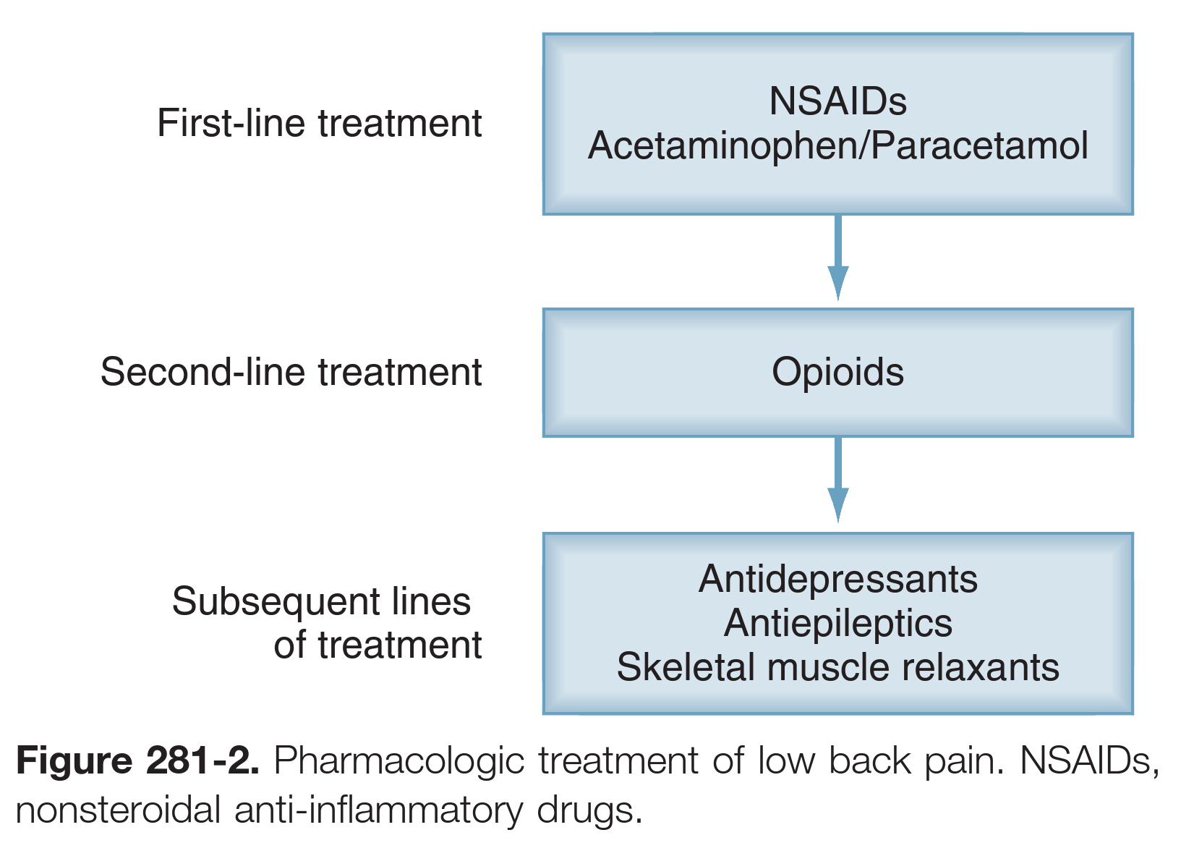

Slide 8
Complication Avoidance in spine surgery Youmans Chap. 282

Slide 9
INFECTION
The most common pathogens isolated from wound cultures are skin flora, including Staphylococcus aureus, Staphylococcus epidermidis.
Rates of infection after :
Discectomy or foraminotomy are lower than 1%.
Laminectomies produce 1% to 5%.
Instrumentation 3% to 12%.
General signs and symptoms of infection include fever, vital sign instability, erythema around the wound, drainage from incision, worsening pain, and neurologic deficits.
C-reactive protein (CRP) levels, normally peaking 2 to 3 days after surgery and normalizing by day 5 to day 14.
Erythrocyte sedimentation rate (ESR) it is less specific; it peaks broadly 5 days after a surgical procedure and can remain elevated for more than a month.
Chronic infections may cause anemia, and low blood counts may be the primary presenting laboratory abnormality.

Slide 10
Risk Factor
Diabetes, obesity, age older than 60, prolonged operative time, history of surgical site infection, and posterior surgical approach.
Other risk factors include
Intraoperative blood loss of more than 1 L.
Malnutrition.
Smoking.
long-term steroid use.
The majority of these risk factors contribute to patient risk either singly or in tandem by inducing a state of immunosuppression, by impairing wound healing, or by increasing exposure to potential pathogens.

Slide 11
Management
Preoperative administration of antibiotics, particularly in cases involving spinal instrumentation.
Cefazolin first-generation cephalosporin for uncomplicated cases in patients with no history of antibiotic resistance or allergy. covers gram-positive bacteria, as well as some gram-negative species such as Escherichia coli and Proteus mirabilis. It also has excellent tissue penetration, even working its way into the disk space.
Vancomycin used for gram-positive coverage and may also be augmented with gentamicin for additional gram-negative coverage , better disk space penetration.
For patients allergic to cefazolin.
Who have a history of infection with resistant organisms.
Wound irrigation with antibiotics is an important component of most surgical procedures, to remove remaining blood products or residual nonviable tissue.
Treatment for suspected infection usually requires immediate exploration and débridement of all abscess and necrotic tissue.

Slide 12
Infection related Instrumentation :
In chronic cases, in which scans demonstrate adequate fusion, removal of hardware may be considered to reduce recurrence of infection.
The more difficult question is whether to remove exposed hardware in the setting of acute infections or in patients without evidence of fusion.
Although treatment of the infection is unlikely to be successful without removal of implants,
Removing instrumentation before fusion can exacerbate progression of deformity and lead to pseudoarthrosis.
If the infection is diagnosed within 90 days of initial surgery, débridement with retention of hardware is recommended, along with treatment of infection, followed by suppressive antibiotic therapy, until fusion occurs.
In cases of acute infection with exposure of implants, immediate aggressive antibiotic therapy through open surgical irrigation and postoperative antibiotic treatment may salvage hardware for long-term retention.

Slide 13
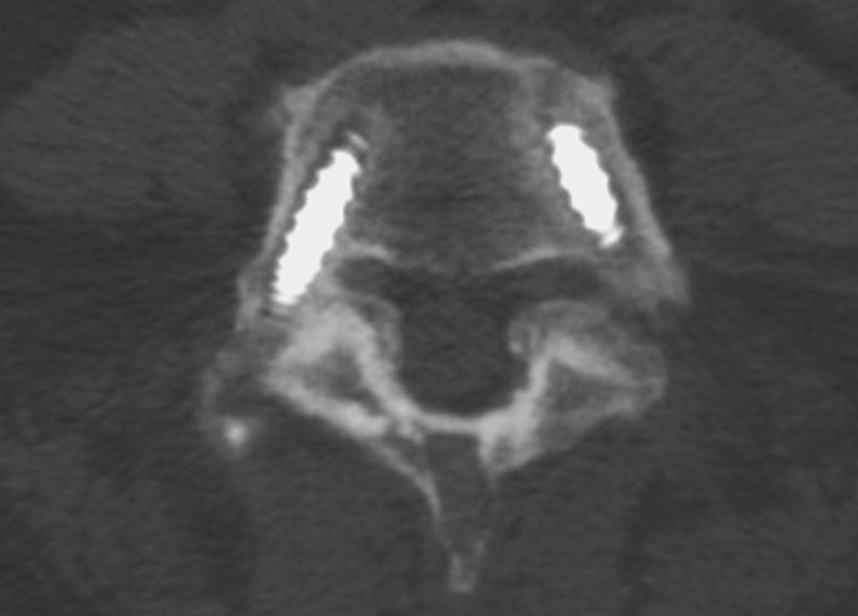
Figure282-1. Axial computed tomographic section showing expected lucencies around pedicle screws.
The patient developed symptoms of recurrent radiculopathy and fever 3 months after an index surgical procedure. The implants were found to be infected, which necessitated their explantation.

Slide 14
VENOUS THROMBOEMBOLISM
Susceptible to at least one component of Virchow’s triad:
Hypercoagulability
Hemodynamic changes (stasis)
Endothelial injury or dysfunction
Risk factors for VTE in the general population include
Congenital conditions causing a hypercoaguable state (e.g., the presence of factor V Leiden, homocysteinuria, protein C deficiency),
Malignancy, trauma, estrogen therapy (either oral contraceptives or estrogen replacement therapy),
Obesity, immobilization/bed rest, pregnancy, older age (>65), and smoking.
Factors specific to patients undergoing spine surgery include
Combined anterior/posterior surgical approach,
Prolonged operative time (>4 hours),
Medical comorbid conditions such as chronic anemia, diabetes, congestive heart failure, and renal failure.

Slide 15
Signs of DVT include
Pain, warmth, swelling, and redness in an extremity.
Fever is an unreliable indicator of DVT.
ECG Findings
Sinus tachycardia, right axis deviation, and right bundle branch block.
Prevention measures
Mechanical preventive measures such as early mobilization, compression stockings, and sequential compression devices are effective for the prevention of VTE.
Chemoprophylaxis may not be necessary in most elective spine surgery because many patients have low risk profiles and return to normal ambulation soon after surgery. However, unfractionated heparin, low-molecular-weight heparin (LMWH), or low-dose warfarin may be beneficial.
LMWH can be used even before elective surgery for patients at high risk. the risk for bleeding complications is low if LMWH therapy begins on postoperative day 1.
Inferior vena cava filter to decrease the risk of large emboli migrating to the lung.
There may even be protective value in placing such filters before major spine surgery for patients at high risk for thromboembolic complications.

Slide 16
VISION LOSS
Postoperative vision loss (POVL) includes four subtypes:
Ocular injury.
Includes corneal abrasion and is typically the result of positioning or physical trauma to the eye. occur most commonly after spine surgery, symptoms typically are self-limited, not result in permanent visual deficit.
Central retinal artery occlusion.
Central retinal artery occlusion results in monocular blindness, often as a result of embolic events, has also been associated with vasculopathies and poor positioning with excessive pressure placed on the orbit.
Cortical blindness.
Cortical blindness is thought to be associated with cardiovascular events and intraoperative hypoperfusion of cerebral tissue without any ocular pathology.
Ischemic optic neuropathy (ION).
Subdivided into two groups according to the location of the ischemia.
Anterior ION is the result of injury just behind the optic disc.
Posterior ION occurs in the midorbital region of the optic nerve and is the most common type of POVL in spine surgery.

Slide 17
Important risk factors for development of POVL include
Positioning and complexity of surgery.
Prone positioning is thought to be a significant risk factor by contributing to increased orbital pressure from the headrest or venous congestion from the dependent position of the orbit.
Prone positioning without Mayfield pins was associated with higher incidences than anterior surgical approaches.
The incidence of POVL is three times higher with spinal fusion procedures than with simple decompression.
Inadequate perfusion is also thought to play a role; intraoperative hypotension and high blood loss are common findings associated with POVL.
Other potential risk factors are related to preexisting illnesses known to affect circulation: hypertension, diabetes, coronary artery disease, cerebrovascular disease, and hyperlipidemia.

Slide 18
Recommendations
Preoperatively, the surgeon should review and optimize a patient’s medical comorbid conditions, particularly diabetes mellitus and glaucoma.
Intraoperatively, the surgeon must place the patient’s head in a rest or clamp that minimizes direct pressure on the orbits, such as a Mayfield head holder.
Positioning the head so that the orbits are above the level of the heart reduces venous congestion and intraocular pressure. If this position is not feasible for the intended procedure, it may be beneficial to employ rest periods during surgery to allow for elevation and adjustment of the position of the orbits.
The surgeon could consider staging procedures if the duration of the surgery is expected to exceed 6 hours or the blood loss is anticipated to exceed 1L.
Emerging evidence suggests that intraoperative intravascular volume replacement with colloidal solutions is preferable to using only crystalloid solutions.

