Slide 1
Neurocutaneous Tumor Syndromes Youman chap. 217

Slide 2
TYPE 1 NEUROFIBROMATOSIS
Most common
Autosomal dominant but Half of people affected have sporadic (de novo).
Mutations in the neurofibromin protein, chromosome 17.
Those with smaller mutations may have a more benign expression of the disease, whereas those with large deletions in the gene for neurofibromin are at a higher risk for developmental delay and subsequent intellectual disability.
Diagnosed clinically…genetic testing for confirmation may still be indicated in borderline or controversial cases.
These patients may have many non-neurosurgical lesions.
Type 1 neurofibromatosis =
sum of letter of ( neurofibromatosis ) —> 17 which is the chromosome

Slide 3
Diagnostic criteria for NF1 ; two or more must be present to establish the diagnosis.

Slide 4
The lesions most likely to necessitate neurosurgical care include :
Plexiform or other neurofibromas
Extend across the length of a nerve and may involve multiple nerve fascicles or multiple branches of a large nerve.
These tumors are observed on physical examination in approximately 25% of patients with NF1.
Diffuse, involving multiple spinal nerve roots at different levels. Because of their size, they can cause nerve root or spinal cord compression, which are indications for surgical intervention.
The goal of surgery
Arrest or alleviate symptoms, rather than to perform a gross total resection, which can lead to severe morbidity.
Spinal fusion is often needed to prevent spinal deformity.
Pain or rapid enlargement of a known mass is a classic symptom indicative of progression to malignant peripheral nerve sheath tumors (MPNST).

Slide 5
B. Optic pathway gliomas
OPGs in NF1 typically follow a more indolent clinical course than do sporadic OPGs.
Occur in up to 15%
C. Brainstem gliomas
Brainstem gliomas in NF1 follow a characteristically indolent course.
D. Cerebellar gliomas.
Most commonly low grade (pilocytic astrocytoma), but anaplastic astrocytomas, gangliogliomas, and pleomorphic xanthoastrocytomas have also been described.
They tend to be located in the subependymal white matter of the fourth ventricle, as opposed to sporadic tumors, which tend to occur in the vermis or hemispheres.
NF1-associated cerebellar gliomas are actually more malignant.

Slide 7
Clinical and CT findings. Bilateral axillary freckles (A) and iris hamartomas, also known as Lisch nodules (B, arrowheads) were detected, both meeting the criteria for a diagnosis of NF1. Axial and three-dimensional CT images (C and D, respectively) showing an occipital calvarial bone defect situated along the left lambdoid suture, measuring 3.1 cm at its largest diameter.

Slide 8
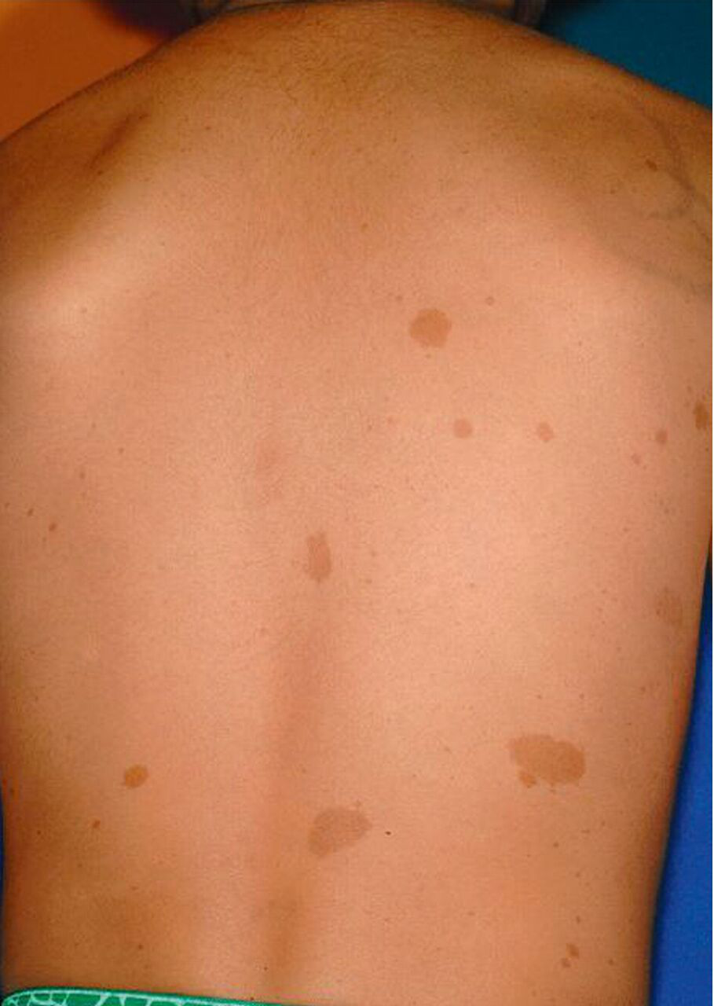
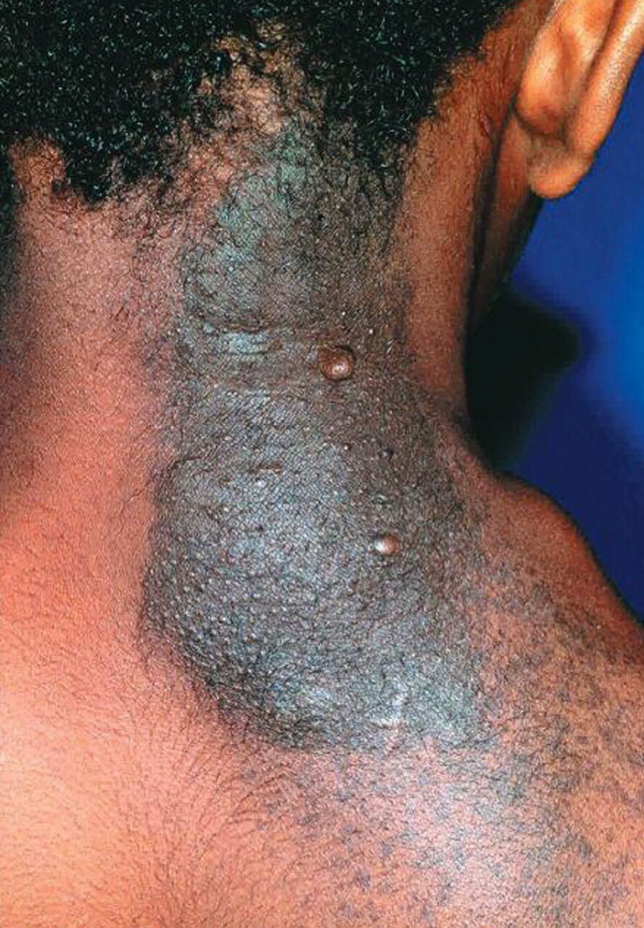
A
B
C
A= Lisch nodule…iris hamartoma
B= Café au lait
C= Plexiform neurofibroma

Slide 10
TYPE 2 NEUROFIBROMATOSIS
NF2 is considered a phakomatosis.
Autosomal dominant
Mutations of the NF2 tumor suppressor gene on chromosome 22.
The NF2 gene produces the protein merlin, The result of abnormal merlin function is multiple CNS tumors, including bilateral acoustic schwannomas, intracranial and spinal meningiomas, and other spinal cord tumors.
For patients with a confirmed diagnosis of NF2, interval screening should consist of
Annual hearing evaluation with brainstem auditory evoked response;
Annual ophthalmologic examinations;
Annual dermatologic examinations;
MRI of the neuraxis beginning at age 10, repeated every 2 years up to age 20, then repeated every 3 to 5 years afterward

Slide 11
Clinical Features and Management
Cutaneous manifestations are less common in NF2 than in NF1.
Acoustic schwannomas when bilateral, are pathognomonic for NF2 and are seen in up to 95% of patients with NF2.
Microsurgical resection indicated in
Patients with large tumors that cause symptoms of brainstem compression or hydrocephalus.
SRS has been shown to be highly successful in patients with unilateral acoustic schwannomas.
NF2-associated intracranial meningiomas have an
Earlier onset
Higher grade
Up to 90% of patients with NF2 may develop spinal tumors,
Most commonly meningiomas or schwannomas
Intramedullary tumors such as ependymomas are also common

Slide 12
(No Family Hx)

Slide 14
TUBEROUS SCLEROSIS COMPLEX
Autosomal dominant with multisystem manifestations, affecting the CNS, heart, kidneys, liver, skin, and lungs.
Patients with TSC have mutations in either
chromosome 9q (TSC1) which encode the proteins hamartin or
chromosome 16p (TSC2) which encode the proteins tuberin.
Triad of seizures, developmental delay, and facial angiofibromas (formerly known as adenoma sebaceum), but the complete triad manifests in fewer than half of affected individuals.
Classic non-CNS symptoms include
renal angiomyolipomas,
cardiac rhabdomyomas,
pulmonary lymphangiomyomatosis,
renal cell carcinoma, renal cysts,
skin lesions include
Ash leaf spots (hypopigmented macules)
Shagreen patches
Subungual fibromas
Facial angiofibromas (adenoma sebaceum)

Slide 15
CNS manifestations include
Cortical tubers
Cortical tubers are hamartomas composed of abnormal neurons and glia that develop as a result of disorganized cell proliferation.
Located in the cortex and tend to be stable in size.
Act as seizure foci.
Many patients with TSC who have seizures have multiple tubers, and other intracranial abnormalities, such as cortical dysplasia.
Subependymal nodules
Subependymal nodules are small, usually asymptomatic calcifications projecting from the ependymal surface of the lateral ventricles.
They are histopathologically similar to SEGAs but do not show enhancement with contrast on imaging.
There is significant debate regarding the ability of subependymal nodules to evolve into SEGAs

Slide 16
C. Subependyma giant cell astrocytomas (SEGAs)
Slow growing tumors, typically found at the caudothalamic groove adjacent to the foramen of Monro.
Manifest during the first two decades of life and grow slowly. They rarely manifest after age 25.
Management options for patients with SEGAs include
Watchful waiting
Surgical resection
Pharmacotherapy with mTOR inhibitors.
Patients who present acutely with intratumoral hemorrhage or symptomatic hydrocephalus, require immediate surgical intervention.
Surgical intervention should be considered early in the patient’s course, while lesions are still small, because surgical outcomes can be excellent.
Large ventricles and a history of transfrontal tuber resection are indications for a transcortical approach.
Patients with large ventricles and small (<2 cm) SEGAs may be treated with an endoscopic approach, challenges to endoscopic resection include the presence of prior hemorrhage, calcifications, or hypervascular regions.

Slide 17
Definitive diagnosis: two major features or one major plus two minor features.
Probable diagnosis: one major plus one minor feature.
Possible diagnosis: one major or two or more minor features.

Slide 18
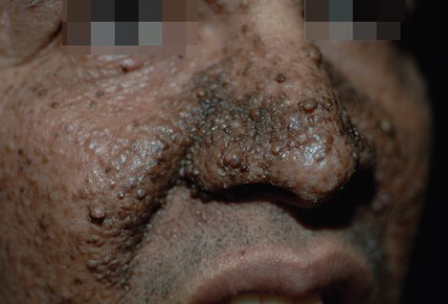
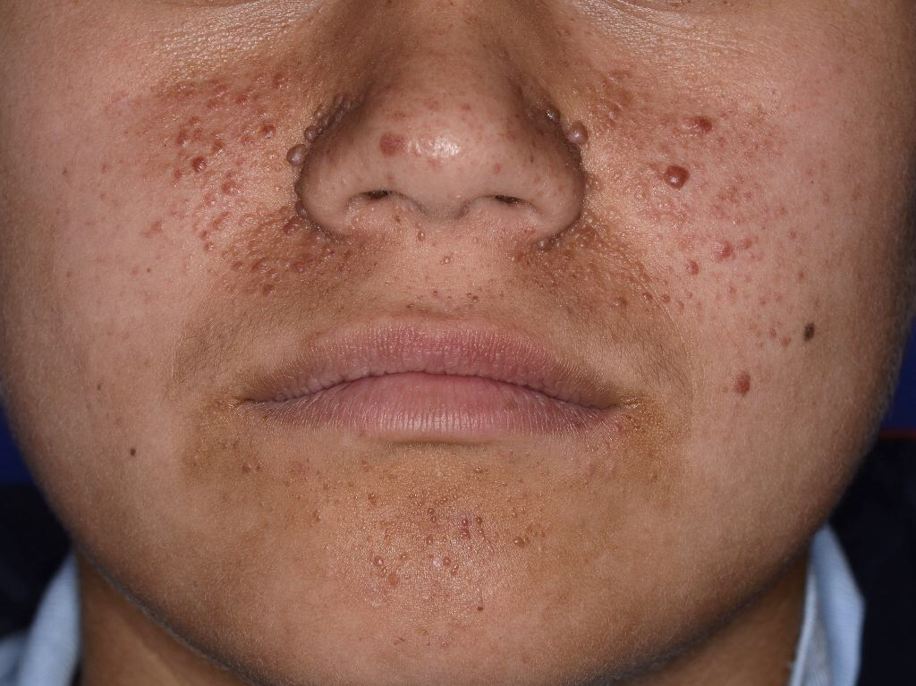
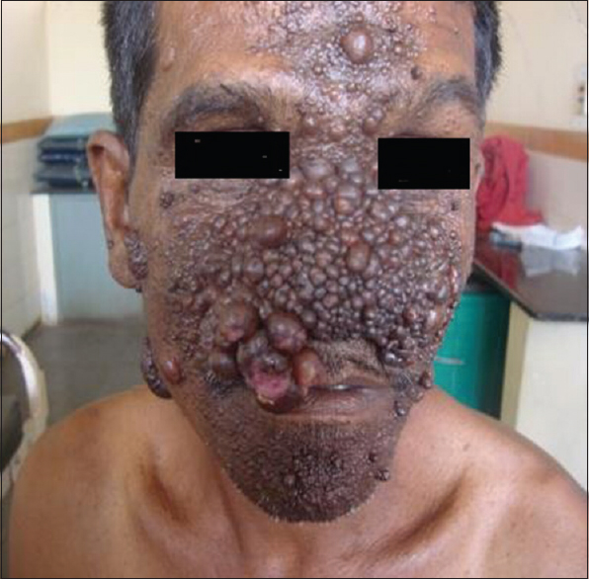
Facial angiofibromas

Slide 19
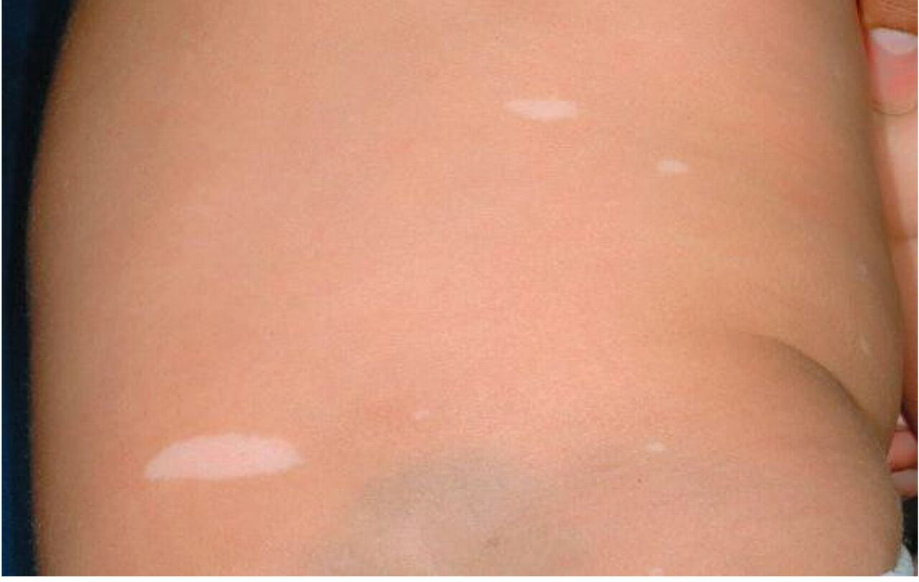
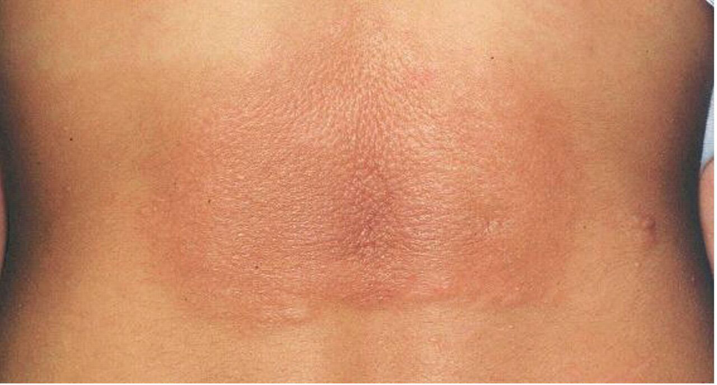
Subungual fibroma
Ash leaf
Shagreen patch

Slide 21
VON HIPPEL LINDAU DISEASE
Autosomal dominant.
Chromosome 3p25.
Loss of normal pVHL → increased levels of vascular endothelial growth factor → excessive angiogenesis.
Sporadic hemangioblastomas tend to be solitary and to occur in older patients.
Hemangioblastomas tend to be multiple and occur in young adults; mean age at presentation is 29 years.
They are well circumscribed, benign, vascular tumors usually found in the posterior fossa or spinal cord and frequently consist of a mural nodule with an adjacent cyst.
All patients with VHL disease must be screened regularly with surveillance MRIs of the brain and spinal cord.
Surgery for hemangioblastomas in VHL disease is indicated for symptomatic or rapidly growing lesions and is currently the standard of care.

Slide 22
Factors influencing the decision to proceed with surgery include
Neurological symptoms or signs,
Increasing size that might ultimately render the lesion more difficult to resect,
The presence of an enlarging brainstem cyst or an enlarging spinal cord syrinx.
All patients with VHL disease should undergo preoperative screening for pheochromocytoma (which may cause intraoperative hypertensive crisis).

