Slide 1
Meningeal Sarcomas and Hemangiopericytomas Youman chap.148

Slide 2
Meningeal Sarcomas
Locally aggressive central nervous system (CNS) lesions with true metastatic potential that are best treated by gross total resection followed by additional therapies
Three distinct entities:
Fibrous sarcoma. Median survival (6 years)
Spindle cell sarcoma. Median survival (2 years)
Polymorphocellular sarcoma. Median survival (1 year)
Progenitors cells are derived from mesenchymal tissue.
Mesenchymal tissues that may serve as the origin for sarcomas:
Dura
Pia-arachnoid
Stroma of the choroid plexus
Adventitial fibroblasts associated with blood vessels
Tela choroidea

Slide 3
Intracranial sarcomas may arise in continuity with the meninges or as intraparenchymal masses without a dural base when the origin is from blood vessels, the tela choroidea, or the choroid plexus stroma.
Intracranial sarcomatous lesions can be classified into 7 distinct groups
Primary sarcomas of the brain and meninges that arise de novo
Sarcoma arising in the context of meningioma
Sarcoma after treatment of the brain with radiotherapy
Gliosarcoma
Intracranial metastases from sarcomatous primary tumors outside the CNS
Sarcomas arising from the scalp and skull with intracranial extension
Nonmalignant tumors that may simulate sarcoma because of pleomorphism (pleomorphic xanthoastrocytoma, benign fibrous histiocytoma) or fascicular arrangement of the spindle cells with marked desmoplasia (superficial cerebral astrocytoma, desmoplastic infantile ganglioglioma)

Slide 4
Clinical Findings and Evaluation
Symptoms are due to mass effect from the tumor or peritumoral edema
Palpable mass If the tumor erodes through the skull into the soft tissues of the scalp.
Extension into the scalp is more common with sarcoma than with meningioma.
In contrast to most adult CNS sarcomas, which are extra-axial masses, sarcomas and meningiomas; in children more commonly arise as
Intra-axial or
Intraventricular masses.

Slide 5
Imaging
The presence of bone erosion overlying the mass suggests a more malignant tumor but this finding may also be seen with typical and atypical meningioma.
Extension into the scalp is more common with sarcoma than with meningioma.
Underlying edema is also nearly universal with sarcomas but may also be seen in up to 50% of typical meningiomas.
Invasion of the superficial venous structures may occur with both types of tumors.

Slide 6
MRI
T1 hypointense or isointense
T2 slightly hypointense, a finding that may reflect hypercellularity.
All tumors show some enhancement after the intravenous administration of gadolinium, similar to that seen on CT.
MRI is ideal to evaluate extension through the bone into the scalp, invasion of superficial venous structures, and extension into the soft tissues of the base of the skull.
CT is ideal to evaluate bone invasion
Angiography plays a limited role in the evaluation of these tumors show vessel encasement by tumor.
Plain radiographs do not play a role in the diagnosis of these tumors.
Hemorrhage, cysts, and necrosis can be seen within sarcomas.

Slide 7
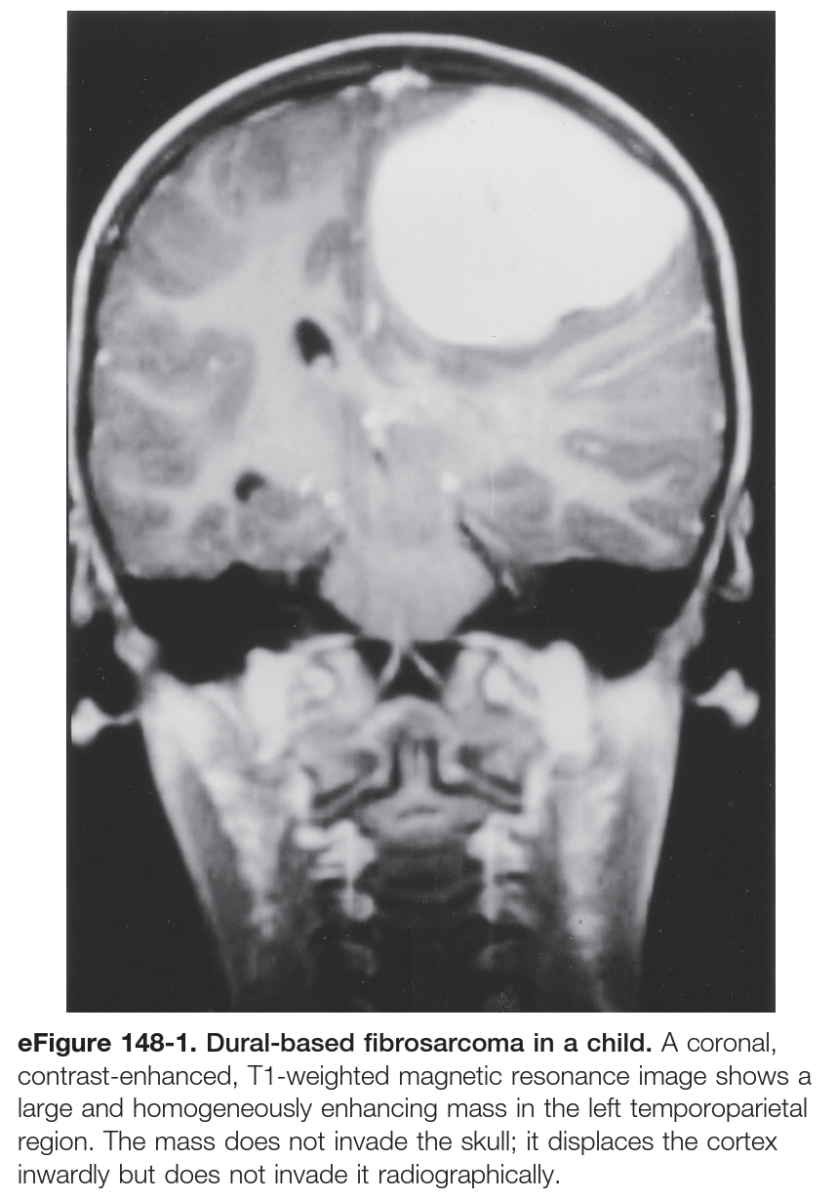

Slide 9
Angiosarcoma
Half of angiosarcomas occur in the head and neck, mainly in the subcutis
Because of the vascularity of these lesions, preoperative embolization has been used to decrease the blood supply before surgery.
Chondrosarcoma
Most commonly involves the skull base and rarely involves the choroid plexus, dura, or brain parenchyma.
Histopathologically, chondrosarcomas can be of the
Conventional, most common
Mesenchymal, more aggressive , higher tendency for metastasis
Clear cell or dedifferentiated type
Therapy includes a combination of surgical resection and adjuvant radiation therapy

Slide 10
Rhabdomyosarcoma
Most common soft tissue sarcoma in children.
When seen in the posterior fossa, rhabdomyosarcomas can be difficult to differentiate from medullomyoblastomas.
They can also be part of germ cell tumors in the pineal and suprasellar region.
Stain positive for desmin, MyoD1, and myogenin (the last being more specific and sensitive than the rest).
Malignant Fibrous Histiocytoma
These tumors can arise in the dura or, less commonly, intraparenchymally.
More common in adults.

Slide 11
Fibrosarcoma
Most common intracranial sarcoma in adults.
These tumors arise from the dura or leptomeningeal infolds and can extend along the VirchowRobin spaces.
Develop as a
component of gliosarcoma,
after radiotherapy (particularly treatment of the sella for pituitary adenoma)
primary intracranial sarcoma.
Differentiate between gliosarcoma and fibrosarcoma by
Gliosarcoma staining +ve with glial fibrillary acidic protein (GFAP)
Differentiate between a true fibrosarcoma and sarcomatous degeneration of a meningioma by :
1st the well-known herringbone appearance of fibrosarcoma is not usually seen after sarcomatous degeneration of a meningioma.
2nd meningioma stains for epithelial membrane antigen (EMA), whereas fibrosarcoma does not.
3rd a past history of meningioma aids in the diagnosis, as does the presence of whorls or psammoma bodies.

Slide 12
Treatment
Options include surgery, radiotherapy, and chemotherapy.
Brain invasion is common
The best outcome usually follows radical resection of a well-circumscribed tumor (fibrosarcoma or mesenchymal chondrosarcoma)
Reconstruction can be challenging because of loss of bone, dura, and scalp.
Radiation therapy following subtotal resection either in the form of conformal radiation therapy or stereotactic radiosurgery for residual or recurrent disease.

Slide 13
MENINGEAL HEMANGIOPERICYTOMA

Slide 14
MENINGEAL HEMANGIOPERICYTOMA
Highly cellular and vascularized mesenchymal tumor, nearly always attached to dura.
The originating cells are thought to be meningeal capillary pericytes, Zimmerman pericytes, or precursor cells with angioblastic tendencies.
WHO classification differentiates meningeal hemangiopericytoma from meningioma and groups hemangiopericytoma in the category of mesenchymal tumors.
Average age at diagnosis is in the 5th decade.
Hemangiopericytomas are located similar to meningiomas, with 15% in the posterior fossa and 15% in the spine ( 50% are in the cervical region ).

Slide 15
Pathology and Pathogenesis
Firm and lobulated and vary from pink-gray to red in color.
Characteristic
Extremely vascular
Often adherent to the dura
Do not usually invade the brain.
They do not spread en plaque
Rarely contain calcification.
Distinguish hemangiopericytomas from meningiomas
No Whorls and psammoma bodies are not seen.
No Mutation of the NF2 tumor suppressor gene.
Reticulin envelops individual cells not multiple as in meningioma.
Express factor XIIIa
They frequently metastasize outside the CNS, The most common sites of metastasis are bone, lung, and liver.

Slide 16
Clinical Findings and Evaluation

Slide 17
Imaging
CT typically shows :
Narrow or broad-based meningeal attachment.
Appear hyperdense with focal areas of hypodensity.
Heterogeneous enhancement.
They may have features suggesting malignancy, such as macroscopic brain invasion, or “mushrooming” inhomogeneous contrast enhancement and irregular borders.
Bone erosion is seen in more than 50% of hemangiopericytomas, and hyperostosis is not a feature of this tumor.
MRI
Isointense and display prominent vascular flow voids on T1 and T2.
Heterogeneous enhancement, and half the tumors have a dural tail sign.
Arteriographic features, including a corkscrew vascular configuration, shunting, and a long-lasting venous stain within the tumor
Hemangiopericytomas frequently have a dual blood supply from the internal carotid or vertebral arteries and external carotid arteries, but the dominant supply is from the internal carotid rather than a primarily external source in meningiomas.

Slide 18
Treatment
Multimodality approach, close follow-up, and aggressive treatment of recurrence
Surgery with the aim of gross total resection
Simpson grade I, is the primary modality for treatment of hemangiopericytoma.
If complete removal is not possible, adjuvant radiation therapy is recommended.
Adjuvant radiation does not improve overall survival but does improve local recurrence.
SRS for the treatment of recurrence or residual disease.
Chemotherapy ….. insignificant.
Meningeal hemangiopericytoma has a relentless tendency to recur, even after what is considered complete surgical resection.

Slide 21
