Slide 1
Medulloblastomas in children Youmans Chap. 213

Slide 2
Introduction
key clinical features of medulloblastoma included
Male gender predilection.
Young age at presentation.
Abrupt symptom onset.
Midline, vermian location.
The tendency for leptomeningeal spread and dissemination.
The favorable response of the tumor to radiation therapy.
Epidemiology
Most common malignant Solid pediatric brain tumor, 10% to 20% of brain tumors in children.
Medulloblastomas are related to primitive neuroectodermal tumors (PNETs)
1% of primary central nervous system (CNS) tumors in adults.
Peaks at 3 to 4 years and at 8 to 9 years.
Overall male-to-female ratio of 1.5 : 1.

Slide 3
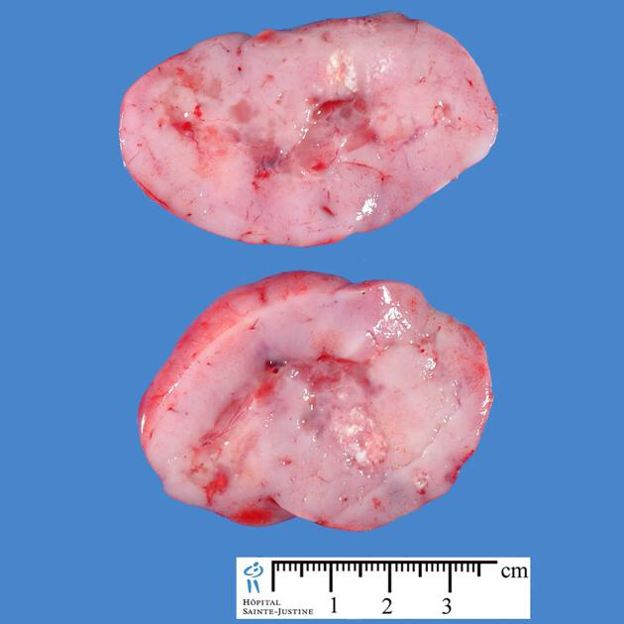
Gross pathology
On gross pathologic inspection, medulloblastoma appears as a pinkish gray to purple mass
Arising from the medullary velum and supplied from the posterior inferior cerebellar artery PICA.
Some lesions are firm, discrete masses, whereas others are soft and friable.
In a minority of cases, the tumor invades the floor of the fourth ventricle.
Occasionally, gross hemorrhage is seen.
CSF dissemination may result in a white “sugar-coated” appearance of the cerebellar surface. So called Zuckerguss.
Microscope feature :
High mitotic index
Neuroblastic (Homer-Wright) rosettes

Slide 4
Medulloblastoma : M relation
1st M mean Male predominance
2nd M flip to right to become 3 which mean peak age 3-4
3rd M fusion of 2 M to become 8 which mean peak age 8-9
4th M mean Midline location which is the most common
5th M mean Most common Malignant
6th M mean Medullary velum which is the origin

Slide 5
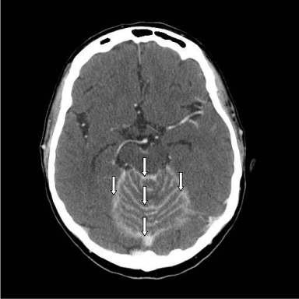
Axial image of the gadolinium-enhanced MRI showing enhancement throughout the leptomeningeal spaces of the posterior fossa, highlighting the Zuckerguss pattern around the cerebellum and brain stem (white arrows).

Slide 8
Histologic Subtypes:
All medulloblastomas are recognized as WHO grade IV tumors.
Five histologic subtypes of medulloblastoma are recognized in the 2007 WHO classification:
Classic
Anaplastic
Large cell
Extensive nodularity
Desmoplastic/nodular
WNT have classic histologic type
SHH have desmoplastic and extensive nodularity histologic type
Group 3 have anaplastic and large cell histologic type
Group 4 have classic and anaplastic and large cell histologic type

Slide 9
GENETICS AND MOLECULAR SUBGROUPS
Medulloblastoma, originally named for a presumed cell of origin, the “medulloblast,” but more recently commonly thought to take origin in cerebellar granule cells.
Now considered to originate from not only external granular layer precursors, but also ventricular zone and dorsal brainstem neuronal progenitors.
There are four subgroups:
The Wnt/Wingless (WNT)
Sonic hedgehog (SHH)
Group 3 medulloblastomas
Group 4 medulloblastomas
WNT arise from (dorsal brainstem or ventricular zone progenitors) early in embryonal development.
SHH arise from (cerebellar granule cells or from neural stem cells) early in embryonal development.
Group 3 and Group 4 arise from (cerebellar granule cell) later in embryonal development

Slide 10
WNT Medulloblastoma:
Arise from the dorsal brainstem or ventricular zone
Classic histologic type, M=F
Best prognosis among the four subgroups.
Occur in older children and less frequently in adults.
Infrequently metastatic at the time of presentation 9-18%.
Sonic Hedgehog Medulloblastoma:
Arise from cerebellar granule cells or from neural stem cells
Desmoplastic/nodular & Extensive nodularity hisology
Intermediate prognosis, M=F
Occur in infant < 4y and older children and adults.
Infants have a better prognosis than older children or adults.
Metastases are present at the time of diagnosis in 20%.

Slide 11
Group 3 Medulloblastoma:
Derive from cerebellar granule cell.
Classic but Anaplastic & large cell more than other group.
Worst prognosis among the four subgroups.
M:F = 2 : 1
Occur in infant and children but not in adults.
Metastases are present at the time of diagnosis in up to 50% of patients, higher rates of metastatic disease in infants compared to older children.
Group 4 Medulloblastoma:
Derive from cerebellar granule cell
Classic but show desmoplastic/ nodular and analplastic/large cell histology
Intermediate prognosis, adults faring worse than children.
Most common of medulloblastomas.
M:F = 3 : 1
Metastatic disease is found at presentation in approximately 31%.

Slide 13
CLINICAL PRESENTATION:
Clinical presentation is that of raised intracranial pressure: headaches, vomiting, and lethargy.
The most common objective signs include
Papilledema
Truncal ataxia
Nystagmus
Limb ataxia
Location/subgroup classification:
Cerebellopontine angle; specific to WNT subgroup tumors.
Cerebellar hemisphere location; specific for the SHH subgroup.
Group 3 and Group 4 tumors appear to be predominantly restricted to a midline location.

Slide 14
MRI findings are
MRI signal
hypointense on T1
hyperintense on T2
desmoplastic/nodular and MBEN variants which may appearing
isointense on T1
isointense on T2
Enhancement
Demonstrate a homogeneous or heterogeneous enhancement pattern.
Group 4 tumors demonstrate minimal to no enhancement (rarely observed in SHH and Group 3 tumors)
Diffusion weighted imaging
high signal due to high cellular (demonstrate diffusion restriction within the tumor itself).
CT Findings
Moderately hyperdense, relatively well-defined mass
Strong but heterogeneous enhancement

Slide 15
1/3 of patient have
Intratumoral cysts
Leptomeningeal spread (detected by MRI, cytology, or myelography).
½ of patients have
Peritumoral edema
¾ of patients have
Hydrocephalus
Calcifications or intratumoral hemorrhage is rarely detected.
Complete spinal MRI should be obtained preoperatively to assess for leptomeningeal dissemination, because postoperative changes may present difficulty in discriminating between true CSF dissemination and postsurgical artifact during the first 2 weeks following surgery.

Slide 21
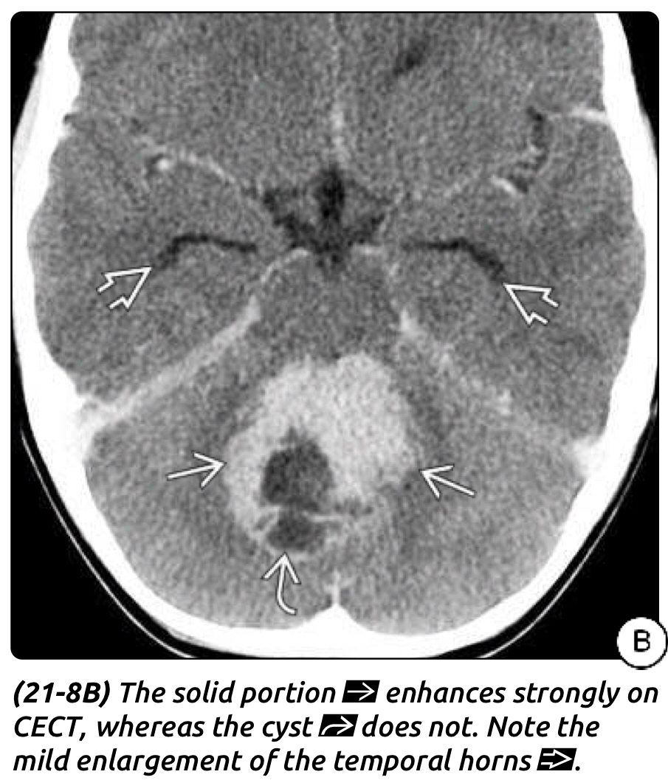

Slide 22
DIFFERENTIAL DIAGNOSIS
Atypical Teratoid/Rhabdoid Tumor (AT/RT)
Top differential diagnosis (indistinguishable by imaging)
Pilocytic Astrocytoma (PA)
Cerebellar hemisphere > 4th ventricle
Cyst with enhancing nodule
Ependymoma
Extrudes through 4th ventricle foramina/foramen magnum
Heterogeneous (Ca++, hemorrhage more common)
Higher ADC values (less cellular)– 90% hyperdense– Ca++ (up to 20%), hemorrhage rare
Choroid Plexus Papilloma (CPP)
4th ventricle less common, mostly adults

Slide 23
Treatment
Surgical goals:
Achievement of maximal safe.
ideally gross total or near-total resection.
obtaining tissue diagnosis.
relieving mass effect from the tumor.
relieving symptomatic hydrocephalus.
Management of Hydrocephalus:
Hydrocephalus is a very common presenting feature in children with medulloblastoma and at times may require emergent external ventricular drain (EVD).
It is not standard practice to perform a permanent CSF diversion procedure with placement of a ventriculoperitoneal shunt or endoscopic third ventriculostomy prior to tumor resection, because perhaps only one third of patients will require permanent CSF diversion.

Slide 24
Surgical Resection Technique:
A midline posterior fossa exposure from the inion to C2
A midline cerebellar trans vermian approach or an inferior telovelar tonsillar approach can be used for a midline tumor.
Bleeding from the circular venous sinus can be managed with Hemoclips which often can be removed at the end of the surgical procedure, thereby avoiding artifact on postoperative MRI.
CSF diversion with an EVD in the perioperative period is useful not only in managing hydrocephalus, but also in ensuring appropriate wound healing and avoiding occurrence of a symptomatic pseudomeningocele.

Slide 25
Postoperative Complications:
Worsening of preoperative deficits (cranial nerve palsies, ataxia, dysmetria, or bulbar symptoms).
Infection, aseptic meningitis, pseudomeningocele, and persistent hydrocephalus.
Cerebellar mutism can be observed in 10% to 25% of cases following resection of a posterior fossa tumor. This syndrome typically arises within 24 to 48 hours postoperatively and results in diminished speech progressing to mutism. The syndrome is also characterized by emotional lability, hypotonia, and ataxia.
Risk for peritoneal seeding after treating hydrocephalus with VP Shunt.

Slide 26
Adjuvant therapies:
Conventional radiation
The original radiation dose of 23 Gy to the neuroaxis and 55 Gy to the posterior fossa followed by 12 months of chemotherapy.
Primary treatment of medulloblastoma consisted of surgical resection followed by radiotherapy, chemotherapy.
Initial treatment strategies were aimed at limiting radiation doses or delaying radiation therapy.
Use of Conformal Boost Radiation and Proton Beam Radiation
Main advantage
Sparing of the cochlea
Preservation of hearing.
Limit dosing to the temporal lobes and hypothalamus.

Slide 27
Delayed Radiation Strategies in Young Patients
Children younger than age 3 the strategy are primary chemotherapy followed by delayed radiation to avoid serious side effect of radiation.
Side Effects and Late Toxicities of Radiation Therapy
Short-term side effects include hair loss, fatigue, nausea, and vomiting.
Late effects include neurocognitive effects, endocrine abnormalities, growth retardation, scoliosis, hearing loss, cardiac toxicity, and secondary cancers.
Secondary malignancies
Malignant glioma (most common)
Osteosarcoma
Myelodysplastic syndromes
Meningiomas

Slide 28
Chemotherapy
Average-Risk Children
Age > 3 years
Surgical resection (gross total or near-total) is followed by radiotherapy and adjuvant cisplatin and vincristine-based chemotherapy.
High-Risk Children
chemotherapy in additional to radiotherapy represents the optimal treatment in children with high-risk medulloblastoma.
Infants and Young Children
Better outcomes have been found in infants and young children with nonmetastatic medulloblastoma treated with chemotherapy.
Side effect
Myelosuppression can be a severe and dose-limiting complication.
Other side effects include fatigue, nausea, vomiting, anorexia, stomatitis, and infections

Slide 29
Adults medulloblastomas Youmans Chap. 142

Slide 30
Epidemiology
1% of primary central nervous system (CNS) tumors in adults.
age at presentation 28 years.
Overall long-term survival rates for adults with medulloblastoma appear to be worse with advanced age.
M:F = 1.35 : 1
All cases of adult medulloblastoma are accounted for by three molecular subgroups:
WNT.
sonic hedgehog (SHH).
group 4 medulloblastomas.
Group 3 medulloblastomas are rarely observed in adults.

Slide 31
WNT Medulloblastoma:
Minority of adult medulloblastomas 15%.
Relatively more female patients are affected.
Histologic pattern exclusively classic.
Best overall prognosis (in pediatric patients is significantly better than that of their adult counterparts).
Sonic Hedgehog Medulloblastoma:
More than half (as many as 84%) of medulloblastomas.
Male predominance
Adults have a better prognosis than do infants or children with SHH type.
Desmoplastic/nodular variants appear to be restricted to adults with SHH medulloblastomas.

Slide 32
Group 4 Medulloblastoma:
M:F = 2 : 1.
Classic Histological type
Desmoplastic/nodular histologic pattern has NOT been observed in adults.
Infrequently present with metastases at the time of diagnosis (but have highest proportion of metastases at diagnosis of all adults).
Have worst outcome.

Slide 33
CLINICAL PRESENTATION:
The most common presenting symptoms in adults :
Headache
Ataxia/gait disturbance
Nausea/vomiting
Dizziness/vertigo (vestibular symptoms)
Diplopia
Clinical presentation with obstructive hydrocephalus and macroscopic metastases are less than that of their pediatric counterparts.

Slide 35
Comparison between adult and pediatric radiological feature
Imaging | Pediatric | Adult
Location | Midline vermian | Lateral or hemispheric
Enhancement | Intense or homogenous | Less common
Tumor margin | More distinct | Less distinct
Cystic changes or, hemorrhage | Less common | More common
T1 | Hypointense | Hypointense
T2 | Hyperintense | Variable signal
The higher proportion of laterally located medulloblastomas in adults is related to the underlying desmoplastic/nodular histologic pattern.
SHH most common type in adult
Group 4 is the most common type in pediatric

Slide 37
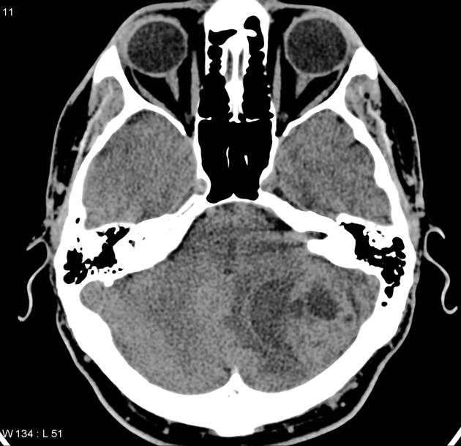
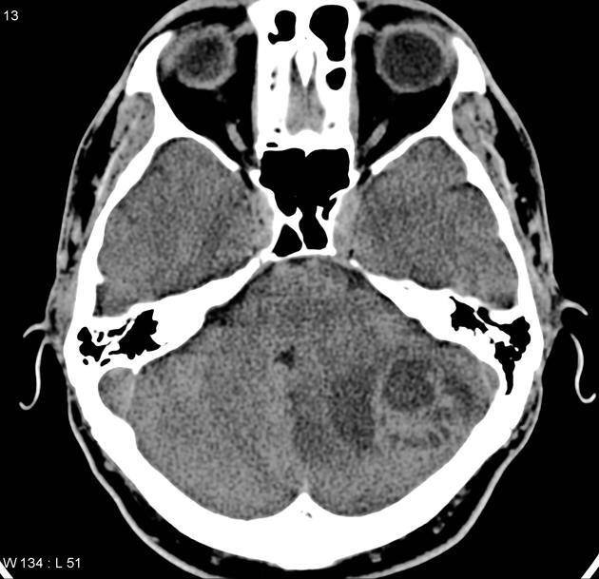
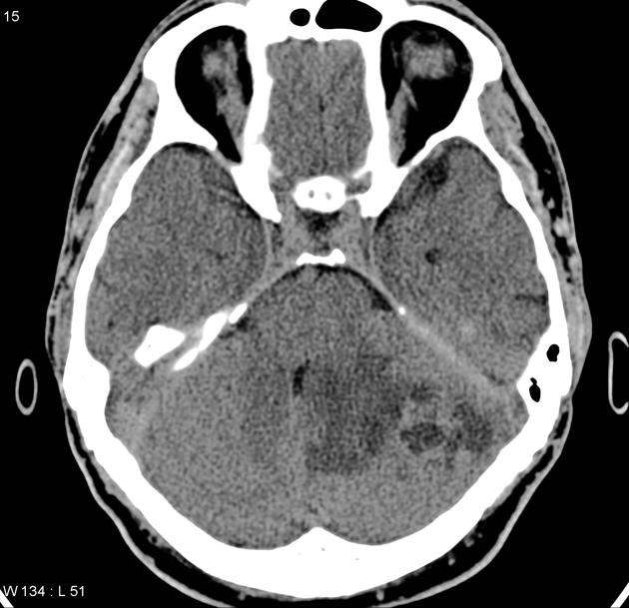

Slide 38
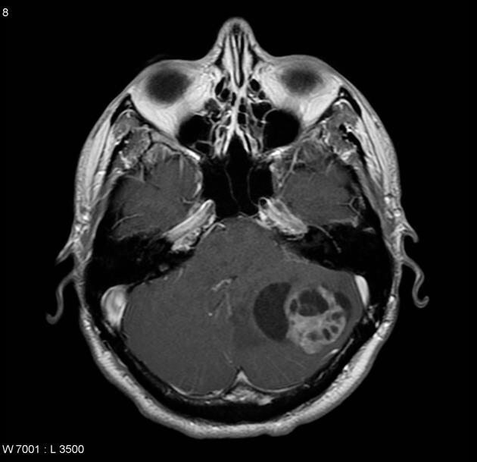
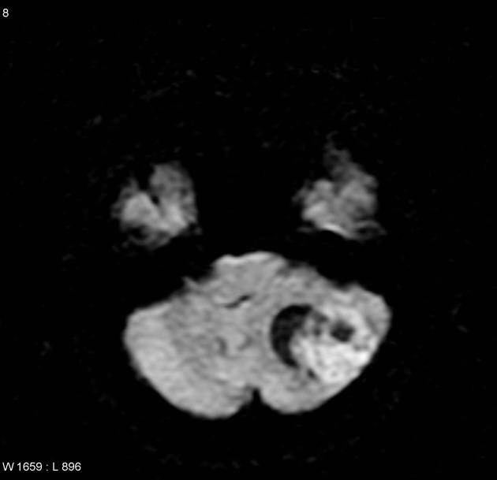
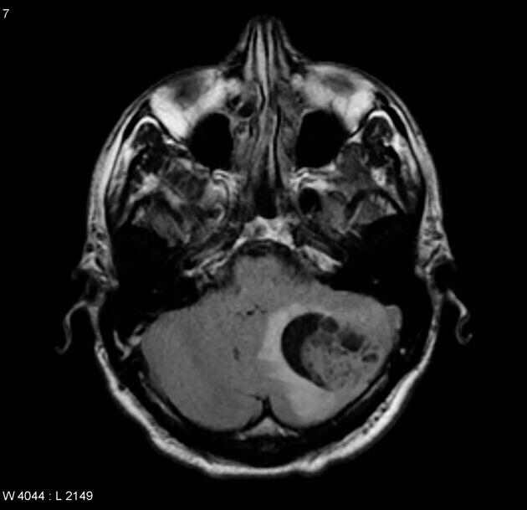
T1
T1 + C
Flair
DWI

Slide 39
Poor prognostic factor
Metastasis
Residual more than 1.5 c.m (sutotal resection)
Large cell/anaplastic histologic patterns
Group 4 tumors
CDK6 amplification, chromosome 17q gain, and chromosome 10q loss
Whereas those with SHH and WNT tumors have a better prognosis
Group 3 medulloblastomas are rarely observed in adults.
Recurrence of SHH tumors is usually local.
Recurrence of group 4 tumors is more often metastatic.
Treatment
Same as children which include
Surgery
Radiotherapy
Chemotherapy

