Slide 1
Spinal Cord Tumor IntraDural IntraMedullary Youmans Chap. 296

Slide 2
Epidemiology
Primary Intradural Intramedullary tumors account for 5% to 10% of spinal tumors in adults and about 35% in children.
Primary glial tumors account for at least 80% of intramedullary tumors and include astrocytomas, ependymomas, and less common neoplasms such as gangliogliomas, oligodendrogliomas, and subependymomas.
In adults, ependymomas are the most common glial neoplasm of the spinal cord, followed by astrocytomas.
In children, astrocytomas occur more frequently.
Other intradural intramedullary tumors include hemangioblastomas, which are histologically benign and account for 3% to 8% of all intramedullary spinal cord tumors.
Spinal cord lymphomas, are extremely rare.
90% of spinal cord gliomas are benign (WHO grade I or ll), 10% are malignant (WHO grade III or IV).

Slide 3
Spinal Cord Astrocytoma

Slide 4
Spinal Cord Astrocytoma
30% to 35% of all intramedullary spinal cord tumors in adults.
Most common intramedullary spinal cord tumor in the pediatric population, accounting for approximately 90% of intramedullary tumors in patients who are younger than 10 years old.
Intramedullary astrocytomas characteristically have an affinity for white matter tracts, causing asymmetrical enlargement of the spinal cord and infiltration into the surrounding parenchyma.
Cervical > thoracic
85 – 90 % are low grade (WHO grade I or II).
10 – 15 % are malignant (WHO grade III or IV).
Most of these are anaplastic astrocytomas (WHO grade III),
To less extend are glioblastoma multiforme (WHO grade IV).

Slide 5
Presentation
Back pain.
Progressive weakness.
Myelopathy.
The major difference in presentation between low-grade and high-grade astrocytomas are
High grade astrocytomas
High propensity to develop hydrocephalus.
More likely to disseminate by spreading in the subarachnoid space to involve the leptomeninges.
Have a shorter history and are typically diagnosed about 6 months after the onset of symptoms because of neurological deterioration.
Low grade tumors symptoms are present on average for 3.5 years before diagnosis.

Slide 6
MRI findings are
Appearance
Asymmetrical, fusiform expansions of the cord that usually involve fewer than 4 segments and occasionally contain a cystic component.
Pilocytic astrocytomas are often clearly delineated on MRI.
Malignant lesions may be infiltrative with poorly defined margins.
Associated edema or syringomyelia is often present.
MRI signal
Isointense to hypointense on T1
Hyperintense on T2
Enhancement
Most intramedullary astrocytomas show enhancement
Malignant astrocytomas often are characterized by heterogeneous enhancement and have areas of hemorrhage, necrosis, and edema, which are not usually seen in lower grade lesions.

Slide 11
Treatment
Astrocytomas are infiltrating neoplasms and total resection is not generally possible.
Surgical treatment, ranging from biopsy alone to partial or gross total resection
Perform a biopsy alone because :
Poor prognosis for patients with malignant astrocytomas.
Radical intramedullary tumor resection carries the risk of permanent neurological deficit.
Total resection of malignant astrocytoma is often not possible because the tumor–spinal cord interface is indistinct.
Cordectomy
for recurrent malignant astrocytomas with en bloc resection of the involved spinal cord segment is considered only in patients who already have a complete neurological deficit.

Slide 12
Radiation treatment :
After surgery, rates of local and distant recurrence are high, The majority of patients with malignant astrocytoma of the spinal cord undergo Radiation treatment.
Chemotherapy :
For patients with no other options in whom disease has progressed despite surgery and radiation therapy.
Intramedullary malignant astrocytomas carry
Median survival of only 13 months
Adults with median survival of 16 months
Children with median survival of 9 months

Slide 13
Ependymoma

Slide 14
Ependymoma
Are solitary tumors of the spinal cord that arise from the ependymal cells lining the central canal.
They cause diffuse enlargement of the cord over several segments and arise most commonly in the cervical spine.
They account for
40%-60% of intramedullary spinal cord tumors in adults
16%-35% of intramedullary spinal cord tumors in children.
Most commonly occur between the 4th and 5th decades of life.
Approximately 65% have associated cysts, particularly when cervical regions are involved.
There is an association between neurofibromatosis 2 and intramedullary ependymomas, and most sporadic ependymomas also feature mutations in the neurofibromatosis 2 gene.

Slide 15
Although unencapsulated, these glia-derived tumors are usually well circumscribed and do not usually infiltrate adjacent spinal cord tissue, which allows for total resection in 70% to 100% of cases.
WHO grade I (low grade)
Subependymoma
Myxopapillary ependymoma,
WHO grade II
Cellular, papillary, clear cell, tanycytic, or mixed.
WHO grade III (malignant anaplastic)
May infiltrate into the surrounding normal parenchyma, exhibit more aggressive behavior, and tend to recur.
Anaplastic ependymomas are rare.

Slide 16
Presentations
Back pain.
Dysesthesias without sensory loss because intramedullary ependymomas cause symmetrical expansion around the central canal, which results in interruption of the crossing fibers of the spinothalamic tract.
Imaging
MRI signals
Hypointense on T1
Hyperintense on T2 and FLAIR images
Enhance homogeneously with gadolinium contrast material.
Cap sign: Hemosiderin at cranial or caudal margin.

Slide 21
Treatment
Surgical Resection :
Intramedullary ependymomas, including anaplastic variants, are treated by gross total resection without major morbidity in the majority of cases.
Postoperative radiation therapy :
is recommended for patients including children with anaplastic ependymoma, regardless of whether gross total resection is achieved.
Chemotherapy is not routinely used.
For benign lesions, the recurrence rate after gross total resection is less than 10%.
Anaplastic ependymomas, in contrast, often require additional treatment and are more likely to recur.

Slide 22
Rare intramedullary tumors
A: Gangliogliomas :
Make up approximately 1% of intramedullary spinal cord tumors.
They are predominantly benign, indolent tumors but in rare cases transform to anaplastic ganglioglioma (WHO grade III).
They tend to occur in children.
In adults most cases of ganglioglioma present with
Paraparesis (50%)
Radicular pain (46%).
MRI signals
Mixed signal characteristics on T1 .
Hyperintense on T2 and FLAIR images.
with patchy contrast enhancement that often reaches the surface of the spinal cord.
Tumoral cysts seen with greater frequency, in up to 46% of cases.
Like astrocytomas, these tumors asymmetrically involve the spinal cord parenchyma but are larger; on average, spanning eight vertebral segments.

Slide 24
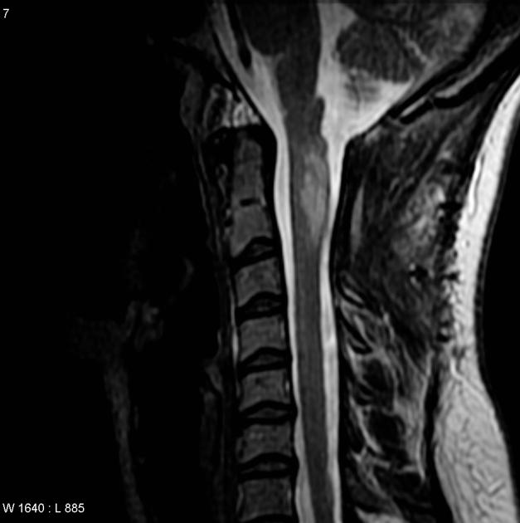

Slide 25
Treatment
Maximal surgical resection
which is associated with good survival rates (5-year survival rate, 88%-89%) and low rates of morbidity and mortality.
Recurrence
Intramedullary gangliogliomas have an increased tendency for recurrence in comparison with their supratentorial counterparts;
recurrence is documented in 30% to 47% of these patients.
Routine postoperative radiation therapy
is not recommended, and it has been suggested that radiation therapy may increase the risk of malignant transformation in supratentorial gangliogiomas.
Adjuvant radiation
may be considered, however, if the tumor recurs after radical resection or transforms to a higher grade lesion.

Slide 26
B: oligodendroglioma:
Have a tendency for leptomeningeal spread with elevated intracranial pressure.
Patients may experience fluctuating symptoms as a result of spontaneous intratumoral hemorrhage.
MRI signals
isointense on T1
hyperintense on T2
heterogeneous contrast enhancement.
Treatment
Complete resection of these tumors may be difficult because of infiltration into the surrounding spinal cord parenchyma.
Gross total resection is possible in only 16% of cases.
Prognosis for this lesion is extremely poor.

Slide 27
Primary Spinal Melanoma
Rare intramedullary tumor.
The majority of these lesions are intramedullary, they have also been found to have extramedullary extension, to be entirely located in the intradural extramedullary compartment, or even in some cases to be extradural.
Originate from leptomeningeal melanoblasts or neuroectodermal congenital rests.
More than half of these lesions are found in the thoracic spine.
On MRI
Hyperintense on T1
Isointense to hypointense on T2
Show mild enhancement

Slide 29
Treatment
Surgical resection
is the mainstay of treatment for primary spinal melanomas.
Adjuvant chemotherapy and radiation therapy
have been recommended by some authors, but there is no clear evidence that these strategies are beneficial.
Mean length of survival for patients with primary spinal melanomas is more than 6 years, whereas life expectancy for a patient with metastatic melanoma is much shorter: usually less than a year.

Slide 30
Intraspinal Tumors
in
Children
Youmans Chap 236

Slide 31
Intramedullary Spinal Cord Tumors in children
Intramedullary astrocytoma
The most common.
Tends to arise eccentrically.
The average length is usually (4 spinal segments).
MRI T1 the majority (≥80%) are hypointense
Gangliogliomas
The 2nd most common tumor of the spinal cord seen in children
Like astrocytoma, this tumor tends to arise eccentrically.
The average length is usually twice that of an astrocytoma (8 spinal segments).
MRI
T1 and T2 mixed intensity signals
Patchy or focal enhancement is the rule for gangliomas
15% showing no enhancement.
Tumor cysts are more common in gangliogliomas than in astrocytomas or ependymomas.
Their margins (astrocytoma and ganglioglioma) are also infiltrative and there is no “plane” between them and normal cord parenchyma.

Slide 32
Ependymoma
Hallmark for intramedullary ependymomas are
Central location.
Sharp demarcation from the surrounding parenchyma, tending to establish a plane between themselves and the surround spinal cord.

