Slide 1
Spinal Cord Tumor IntraDural ExtraMedullary Youmans Chap. 294

Slide 2
The most common IDEM tumors are :
Meningiomas (most common)
Nerve sheath tumors (2nd most common)
Schwannomas
Neurofibromas
At the filum terminale:
Myxopapillary ependymomas.

Slide 3
Meningioma :
Arise from dura surround spinal cord and nerve.
12% of all meningioma occur in spine.
Affect 6th & 8th decade of life.
M:F ratio 1:3
Most common intradural spinal tumor.
Most common site in the thoracic region followed by cervical then lumber.
Most common subtype (psammomatus variant).
Younger patients with spinal meningiomas typically are subject to a predisposing factor such as neurofibromatosis 2 (NF2) or prior radiation exposure.

Slide 10
Nerve Sheath Tumors
Can arise from the dorsal or ventral nerve rootlets, with a dorsal nerve root origin being more common.
Of the two benign NSTs, schwannomas are far more common
The Obersteiner Redlich zone, where the myelin-forming cells transition from oligodendrocytes to Schwann cells, is the place of origin of most intradural schwannomas, which tend to be well encapsulated lesions arising from a single nerve fascicle.
It can be
exclusively extradural or
exclusively intradural or
can involve both as extra-intradural (Dumbbell)
NSTs likely to be
Purely extradural in the cephalic spine
Purely intradural in the caudal spine
Cervical schwannoma tend to be extradural due to shorter intradural course of cervical nerve root.

Slide 11
Nerve Sheath Tumors
Schwannoma | Neurofibroma
NF 2 | NF 1 | Syndromic
No axons. | Presence of axons within the tumor. | Gross pathology
Single nerve fascicle. | Diffusely expansile lesion of the involved nerve (multiple fascicles are involved). | Involvement
Well capsulated | Less well encapsulated | Capsule
Stain well for S-100 and Leu-7, vimentin. | Stain less for S-100 and Leu-7, vimentin. | Histologic stains
Cellular Antoni A areas with Verocay bodies and less cellular Antoni B areas. | Lack of Antoni A | Histologic character

Slide 14
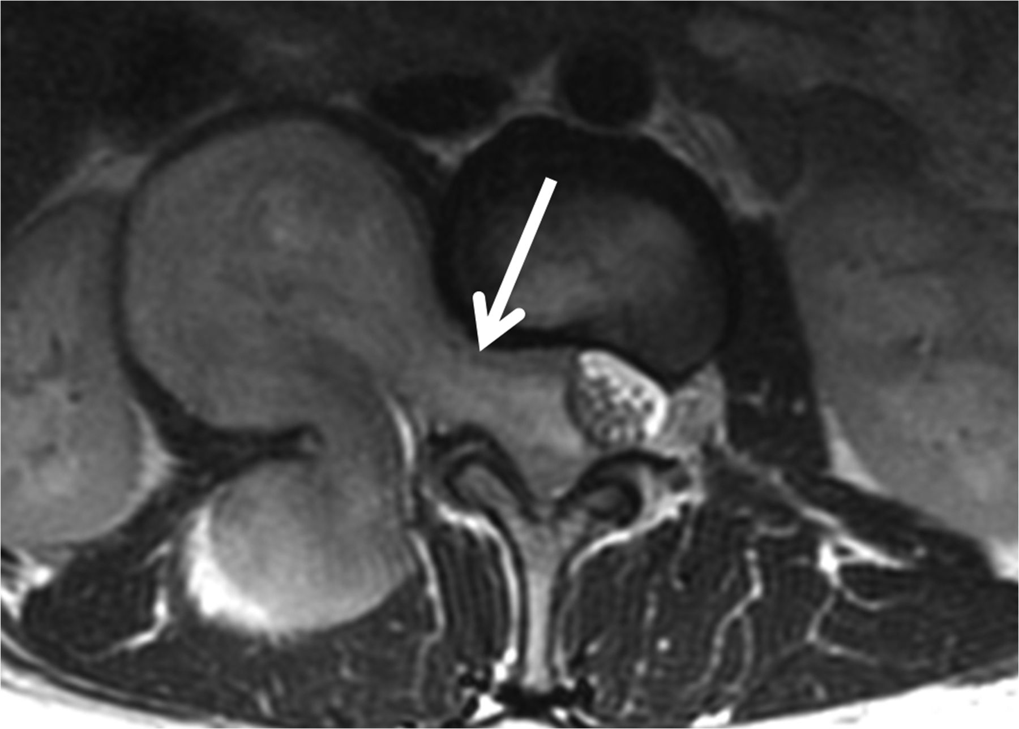

Slide 15
Myxopapillary Ependymoma
40% of spinal ependymoma occur in filum terminale.
Confined to the lumbosacral region.
Well encapsulated , lobulated mass adherent to filum terminale.
Affect 3rd decade of life.
M:F ratio 1.7 : 1
Diffusely Express GFAP and Vimentin.
Paragangliomas
Red fleshy tumors that demonstrate synaptophysin on immunohistochemistry
Show high levels of serotonin.

Slide 16
Syndromes associated with IDEM tumors
NF1 (chromosome 17) often resulting in multiple spinal neurofibromas.
NF2 (chromosome 22) lead to multiple spinal schwannomas, neurofibromas, and meningiomas.
Schwannomatosis, a syndrome characterized by multiple schwannomas without the defining features of NF1 or NF2.
Carney’s complex syndrome characterized by facial pigmentation, cardiac myxomas, endocrine problems, and melanotic schwannomas, 10% of which may be malignant.

Slide 21
Imaging
MRI is the modality of choice
to show relationship of pathology to spinal cord or nerve roots
sharp contrast enhancement
dural tail in case of meningioma
CT
used to evaluate bone anatomy
planning instrumentation
demonstrate tumor calcification
CT angio or Angiography
Useful in cervical region to show relationship to vertebral artery

Slide 22
Clinical presentation
Pain either
Radiculopathy or
Axial back pain
Neurological deficit
Myelopathy from cord compression
Cuada aquina from chronic compression
Spinal instability is less common, but patients presenting with multiple tumors or tumors at young age can present with spinal deformity.

Slide 23
Management
Indication for surgery
Symptomatic patient
Rapid growing tumor
Midline cuada equina lesion ( myxopapillary ependymoma )
When to use instrumentations
Large extradural components (whether dumbbell tumors or purely extradural tumors).
Multi compartment tumors (dumbbell tumors).
Anteriorly or ventrally situated tumors.
Malignant or adherent/invasive tumors.
Tumors which involve functional nerve root.
Electrophysiology
SSEP ( Somato Sensory Evoked Potential )
MEP ( Motor Evoked Potential )
EMG ( Electro Myo Graphy )

Slide 24
Cervical Approaches
The posterior approach
Avoids encounter with major vessels or visceral structures.
Even if the facet complex is not violated, multilevel laminectomies may predispose to cervical kyphosis and warrant spinal stabilization.
For high cervical lesions located anteriorly in relation to the spinal cord
Extreme lateral approach to the foramen magnum have been used for laterally or ventrally situated tumors.
For subaxial cervical lesions located ventral to the spinal cord
Anterior approaches have been described.
For low cervical lesions and lesions of the cervicothoracic junction
Modified anterior or trap-door exposure, utilizing an anterior approach, partial median sternotomy, and anterolateral thoracotomy, has been reported to allow bilateral or unilateral exposure of the spine as low as the third thoracic vertebra.

Slide 25
Lumbosacral Approaches
In the case of posterior approaches for myxopapillary ependymoma and paraganglioma
utmost care is taken in dissection of sacral nerve roots, and
in the case of an NST
sacral nerve root sacrifice may be necessary.
bladder and bowel function is preserved if S2-S4 are intact on at least one side.

Slide 26
Approach to intradural nerve sheath tumor
Completely intradural without extension
Posterior midline approach
Hemilaminectomy if no crossing the midline
Full laminectomy or laminoplasty if cross the midline
Facetectomy with instrumentation for lateral or ventrolateral lesion
Prior to initiating resection, it is important to identify afferent and efferent nerve origins. Though NSTs most often arise from dorsal nerve roots, this pattern is not always observed, and even when it is, the anatomy can be distorted and unclear.
For large tumors, the dorsal capsule is entered and internal decompression with an ultrasonic aspirator allows for delivery of nonvisualized tumor into the operative field.
Ventral nerve roots preservation is important in cervical and lumbosacral region while dorsal root can be sacrificed without deficit.
Care must be taken with upper cervical region to preserve spinal accessory rootlets which coursing superior and anterior to denticulate ligament

Slide 27
For schwannomas
it is usually possible to separate individual fascicles from the tumor, and smaller tumors may be excised in one piece, whereas larger tumors may require debulking.
Though the involved nerve root in schwannomas is often nonfunctional at the time of surgery.
Fascicle preservation is ideal, but only functional rootlets from important levels must be preserved.
For Neurofibromas
Usually lack a plane and are inseparable from their nerve root of origin.
In the cervical and lumbar spine, debulking with preservation of anterior rootlets may be best if the nerve root is found to be functional, whereas roots that are confirmed to be nonfunctional with intraoperative stimulation can be sacrificed.

Slide 28
SURGERY FOR DUMBBELL TUMORS AND EXTRADURAL NERVE SHEATH TUMORS
Several unique surgical considerations arise in these cases, including the additional bone removal necessary to expose the extradural component and management of resultant iatrogenic instability.
First intradural exposure, because resection of the intradural component will
Decompress the spinal cord
Release the neural elements from adhesions to the tumor capsule
Avoiding traction injury during manipulation of the extradural tumor component.
Extradural intraforaminal tumors can be accessed through a single posterior midline exposure with extended bone removal.
Extraforaminal tumors can grow to a strikingly large size in the free space of the retroperitoneum, extrapleural space, or neck soft tissue.
Its growth into these soft tissue spaces involves critical structures unique to the regional anatomy, such as the vertebral artery in the neck, the pleural cavity in the thorax, and the psoas and lumbosacral plexus in the retroperitoneum.

Slide 29
The intradural tumor component is transected at the distal dural root sleeve, then the dural edge is reflected medially to better visualize the epidural space and expose the extradural component of the tumor, which can be resected in one piece or internally debulked with an ultrasonic aspirator.
In the cervical spine, blind ventral dissection may endanger the vertebral artery, which is usually displaced by tumor, not engulfed.
Medial tumor should be freed of its medial dural root sleeve attachment, allowing for free rotation of a cored-out tumor capsule to deliver the lateral extradural component into the operative field for identification of its efferent attachment, which can then be transected.

Slide 30
Approach to Spinal Meningioma
Anteriorly located tumors are common; most of the time debulking and a gross total resection are feasible from a posterior standard laminectomy.
Usually meningiomas have an en plaque involvement of the dura, and the exact amount of dura that needs to be resected for a complete free margin is difficult to determine.
In the case of meningiomas, how to repair the dura ?
For dorsally situated lesions, excision of the dural base and reconstructive duraplasty are straightforward.
Lateral and anterior meningiomas have dural bases that cannot be resected or, if resection is feasible, dural reconstruction is not. In these cases dural coagulation is often performed.
It depend on
The lvl of tumor.
Location of tumor within spinal canal ( dorsal, ventral, lateral ).
Approach :
Posterior Approach used for lumber meningioma even if its ventrally.
Anterior approach used for ventrally located cervical tumor.
Parascapular extrapleural approach for upper thoracic.
Retropleural extracavitary approach for lower thoracic.

Slide 31
SURGERY FOR TUMORS OF THE FILUM TERMINALE
In the case of filum terminale tumors (myxopapillary ependymoma and paraganglioma), en bloc resection is often preferred and great care is taken to avoid piecemeal debulking of the lesion, because this has been associated with increased rates of
Local failure.
Upward seeding or CSF metastasis.
Myxopapillary ependymomas tend to be solid fleshy tumors amenable to en bloc resection.
Paragangliomas, however, can be very vascular and more adherent to surrounding nerves.
Unfortunately, en bloc resection may not always be possible. Sometimes, tumors are too friable and fall apart with even the most gentle manipulation.
Sometimes the tumor may be too large to deliver from the thecal sac without dangerous traction on the surrounding nerve roots, or functional roots ( In these cases subtotal resection is the only recourse ).

Slide 32
Adjuvant therapy and radiosurgery
Chemotherapy and conventional radiotherapy do not have significant role in Management of spinal NSTs
Radiotherapy for recurrent and meningioma with atypical or malignant histology
The usual dose is 50 – 54 Gy
Radiotherapy for spinal ependymoma following surgery associated with significant improvement of local control at 10 years survival.
Risk factors for recurrence include
invasion of the pia,
Simpson resection grade,
histologic grade.
Spinal meningiomas in patients under 50 years of age have been observed to recur at a higher rate and carry a worse prognosis, which may be attributable to the increased proportion of younger patients with tumors secondary to syndromes or radiation exposure.
Spinal NSTs in the setting of NF1 and NF2, significant risk factors associated with tumor recurrence include subtotal removal, surgery for a recurrent tumor, NF2, and old age.

