Slide 1
Evaluation and Treatment of C2 (Axis) Fracture Youmans chap. 305

Slide 2
Cervical Spine fractures are the most common spinal fractures
C2 fractures account for 10-20% of all Cervical Spine fractures
Most of these are fractures of the dens and 70% of them are type 2 fractures
C2 fractures are classified as
Odontoid fractures involving the dens (types I-III)
Hangman’s fractures (traumatic spondylolisthesis through the pars interarticularis)
Miscellaneous #s (facet #s, C2 body #s, or injury to the foramen tranversarium)
Patients with these injuries may present only with neck pain and without neurological deficits and thus these injuries may be missed clinically

Slide 3
The atlano-axial joint accounts for 50% of all the rotation of the entire spine It allows for
10 degrees of flexion rotation
50 degrees of axial rotation
The C1-2 joint complex
Does not have a true disk space.
The transition of the ligamentum flavum into a weaker atlantoaxial membrane.
Rich vascular supply from the carotid and vertebral arteries.
An increased spinal canal diameter.
The vertebral arteries travel within the ventral foramen transversarium from C6 to C2 and then course over the posterior-lateral arch of C1.

Slide 4
Odontoid Fractures
They account for 50% to 60% of all axis fractures.
Classification according to anatomic location:
Type I is an obliquely oriented fracture through the upper part of the odontoid process, likely representing an avulsion fracture.
Type II fractures occur at the junction of the odontoid process and the body of C2.
Type III fracture is one that extends downward into the body of the axis.
Type ll is by far the most common odontoid fracture. 70%

Slide 5
Classification for type II fractures according to treatment :
Type II subtype A is a transverse fracture without comminution and with less than 1 mm of displacement that is believed to be adequately treated with external immobilization.
Type II subtype B is a transverse fracture without comminution and with greater than 1 mm of displacement, which can be treated effectively by anterior screw fixation.
Type II subtype C is a fracture with significant comminution and is best treated with posterior atlantoaxial fixation.

Slide 6
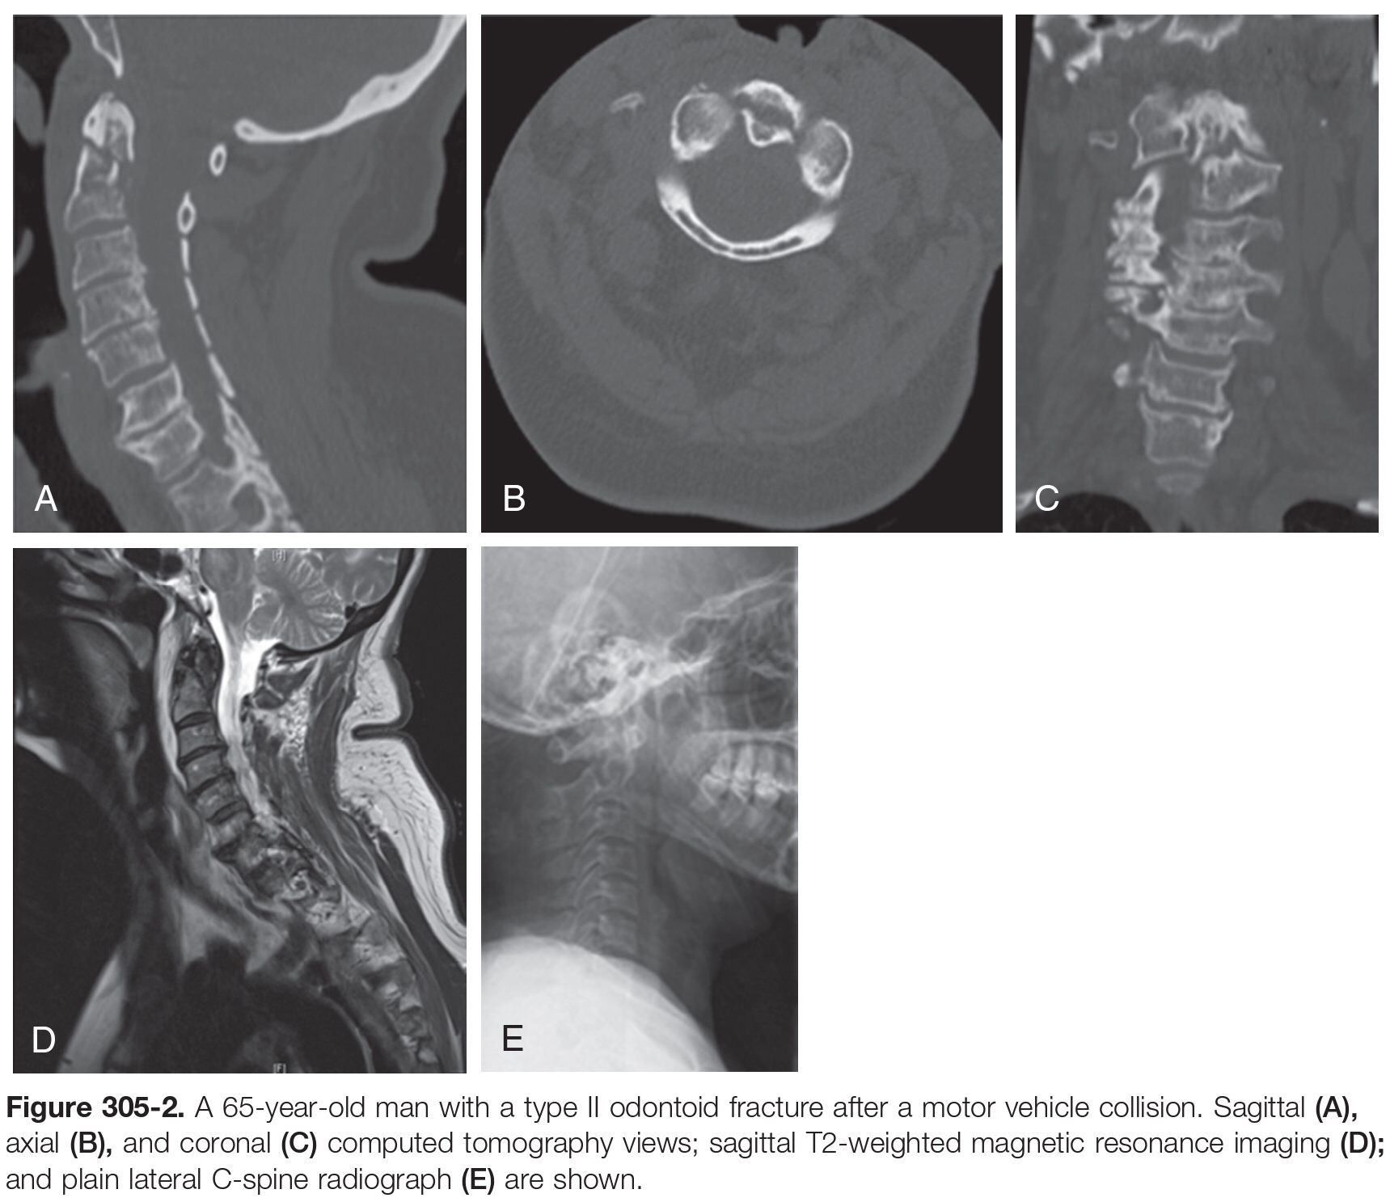

Slide 7
Type I Odontoid fractures
1% to 3% of all odontoid fractures.
Mechanism of injury is avulsion of one of the alar ligaments.
stable and able to be treated with external bracing.
Diagnosis
CT with sagittal and coronal reconstruction is the best method for evaluation.
MRI with or without flexion-extension radiographs is used for assessing ligamentous injury or instability.
Treatment
The rates of fractures healing by non-surgical methods are quite high.
Cervical collar is sufficient and is the treatment of choice.
Halo vest immobilization has been used with 100% successful union rates.
Complications of Halo vest Immobilization include
Pressure sores.
Pin site infection.
Pin loosening.
Breathing issues, and pneumonia.

Slide 8
Type II Odontoid fractures
Type II is the most common, 70% of all odontoid fractures.
These fractures are due to lateral bending and extension forces.
Considered unstable.
Diagnosis
CT scan with reconstruction is the best method for diagnosis.
MRI is helpful to evaluate the soft tissues.
Nonsurgical treatment ( cervical collar and halo vest ) frequently fails because there is a weak watershed zone with poor blood supply in the odontoid neck.
Surgical management of these fractures can be approached either anteriorly or posteriorly.
Most patients with acute type II odontoid # are considered good candidates
As the fracture is less than 6 months old.
The integrity of the transverse ligament must be intact.
90% fusion rates for type II odontoid # treated with anterior screw fixation.
Contraindications include osteopenia, body habits ( short neck , barrel chest ), and anterior obliquely sloping fractures.
The most common hardware failures include screw back-outs and screw pullout.

Slide 9
Type III Odontoid fractures
It is the 2nd most common fracture.
Caused by pure extension.
Most type III fractures can be successfully treated in external braces with expected healing rates of 87% to 100%.
A cervical collar is considered effective.
Halo Vest Immobilization is associated with several complications including noncompliance and pin site infection.
Dislocated or unstable fractures (i.e. shallow type III fractures) require surgical fixation.
A direct anterior screw can be placed when surgical treatment is necessary.
If the transvers ligament is disrupted, a posterior procedure is warranted.

Slide 10
Treatment of C2 fractures
Anterior Odontoid Screw Fixation
Patients with acute or subacute (less than 6 months old) type II B or high type III odontoid fractures
Contraindications include :
Disruption of the transverse ligaments
Fractures older than 6 months
Significant comminution of the C2 body
Inability to reduce the fracture
Osteopenia
Anterior obliquely sloping fractures (Type II C)
Technique
Same position and opening of ACDF.
Soft tissues are opened cephalad to the C2 region to allow access to the C2-3 disk space.
At this point, cannulation of the fracture can begin.
Two similar techniques have been used
The cannulated screw.
Standard lag screw techniques.

Slide 11
From Neurosurgery_Tricks_of_the_Trade
The optimal entry point is identified usually a few millimeters through the anterior aspect of the C2-C3 disk ( a few millimeters of bone in the midline of the upper vertebral body and endplate of C3 (anterior rim) and C2-C3 disk annulus can be drilled away).
This is performed to create space for the screw head and improve instrument inclination.
Depending on whether one or two screws are used, the starting point can be either in the midline or 3-5 mm lateral to the midline.
Using fluoroscopy, a K-wire aligned in a guide is introduced with a drill toward the midpoint of the odontoid tip
As the wire is advanced, the change in bone consistency is felt:
The cancellous bone of the vertebral body offers only mild resistance;
followed by a " give" when the fracture space is entered;
Mild resistance is felt when entering the cancellous bone of the odontoid;
then significant resistance is felt as the cortical shell of the odontoid tip is entered.
Stop at this point. It is very important not to overpenetrate the cortical bone to avoid immediate brainstem injury.

Slide 12
Screw length is carefully evaluated based on radiography or measured off the K-wire.
The screw must be the correct length to lag.
A partially threaded, cannulated, lag screw is inserted over the K-wire.
Great care must be taken to keep the K-wire from moving rostrally as the screw is placed or when a cannulated drill is used.
The partially threaded screw is advanced through the apical cortex of the odontoid to achieve further reduction and compression of the fracture site.
As it is advanced, a compressing force pulls the vertebral body closer to the distal fragment and compresses the fracture space or gap.
In certain fracture types (high type III fractures)
a lag screw will not provide sufficient support for the fracture.
A second fully threaded screw can then be placed in such cases after overdrilling the C2 body fragment with a drill bit of the same size as the screw diameter ( sasso technique ).

Slide 15
Transartuicular screw placement for C2 # (Magerl technique)
Is useful when anterior C2 fixation is not an option
Indications :
Poor bone quality (e.g. in older patients)
Fractures older than 6 months
Transverse ligament injury
Preoperatively, thin-cut CT should be carefully evaluated to determine
The fracture pattern
The course of the vertebral artery, which can be variable in up to 20% of the population. If the vertebral artery transverses aberrantly through the path that crosses the planned trajectory of a screw, screw placement should not be attempted on that side.
CT angio is advised to evaluate the course of Vertebral Artery.

Slide 16
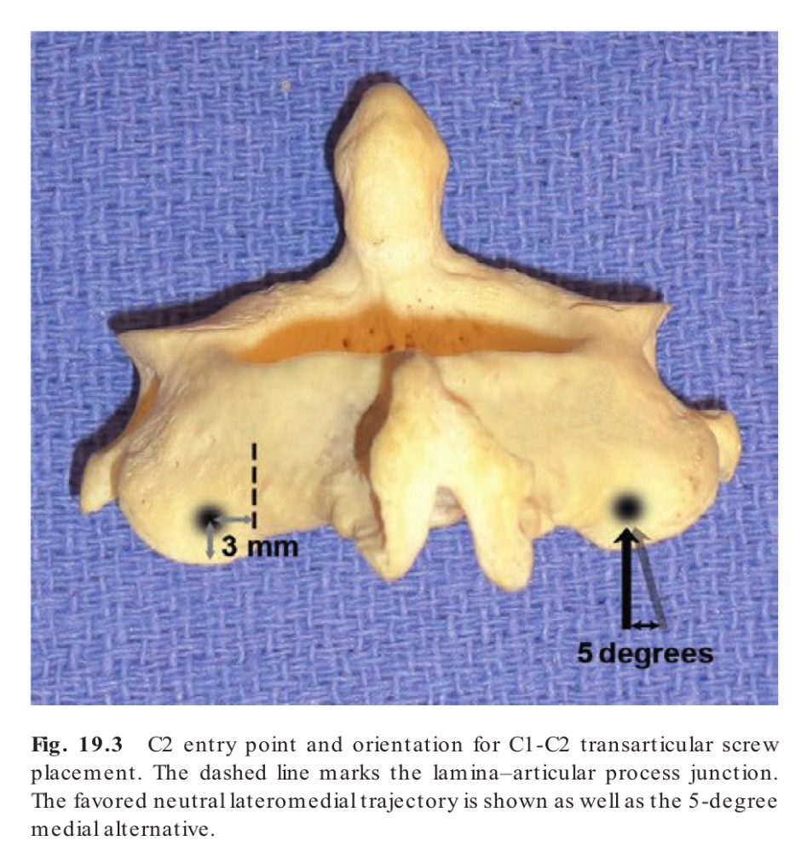
Technique
A midline incision is made to allow exposure from the occiput to C3.
Care must be taken to limit lateral dissection at C1 to avoid injury to the vertebral artery.
Attention is turned to the entry point of the screw at C2.
The screw entry point is 2-3 mm lateral from the medial edge of the facet and 3 mm superior to the caudal edge.

Slide 17
The entry point is marked and decorticated with a high-speed bur.
A drill is placed in neutral orientation and 25 to 30 degrees cranially, aiming at the anterior tubercle of the atlas.
A threaded screw is inserted along that trajectory.
After both screws have been placed, C1-2 interspinous wiring and bony fusion should be performed.
This can be done with the Brooks or Sonntag method and increases the stability of the construct so that bony fusion can take place.
Wire and bone techniques including
Gallie (midline graft with a single wire)
Brooks (bilateral sublaminar wires)
Sonntag (interspinous) methods.

Slide 19
Posterior C1-2 Screw-Rod Fixation (Harms technique)
This method of atlanoaxial fusion is the procedure of choice for (Indications)
Patients who can not undergo anterior odontoid screw placement.
Patients with a fixed unreducible subluxation.
C1 Lateral Mass Screw
The entry point for the C1 lateral mass screw is found at the midpoint of the inferior part of the C1 lateral mass (for both mediolateral and cranio-caudal directions).
This area is covered by paraganglious tissue, which can be removed with a straight curette.
The C2 dorsal root ganglion should be freed and gently retracted inferiorly.
A blunt dissector may be used laterally to protect the vertebral artery.
A high-speed 2-mm drill bit is used to mark the entry point to prevent slippage of the drill point.
Screw is placed into the atlas, directed at an angle of approximately 15 degrees medial to the sagittal plane and 15 degrees superior to the axial plane.

Slide 20
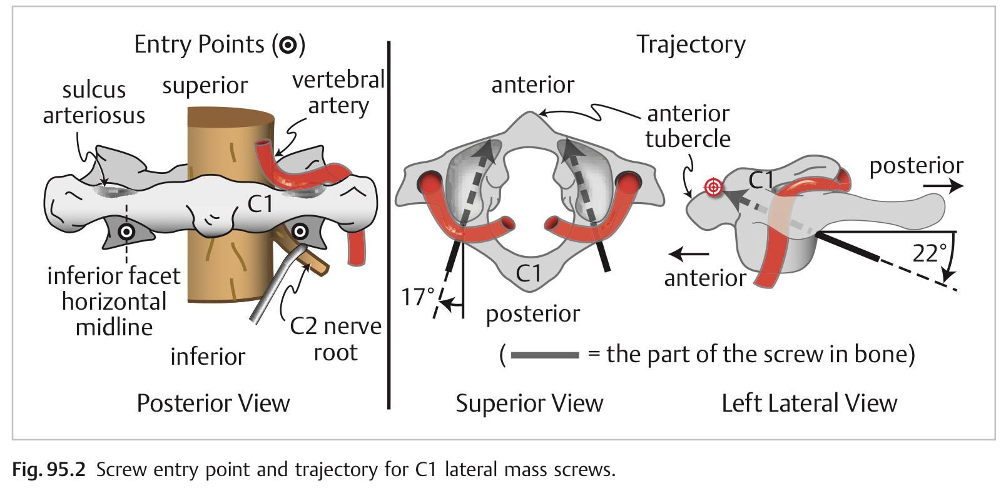
The screw entry point is the midpoint of the inferior part of the C1 lateral mass (for both mediolateral and cranio-caudal directions).
TARGET the superior aspect of the anterior tubercle of C1.
CAUTION: the thickness of the arch in the craniocaudal dimension varies widely, and the horizontal segment of the VA lies immediately above.
C1 SCREWS 3.5 or 4 mm diameter

Slide 21
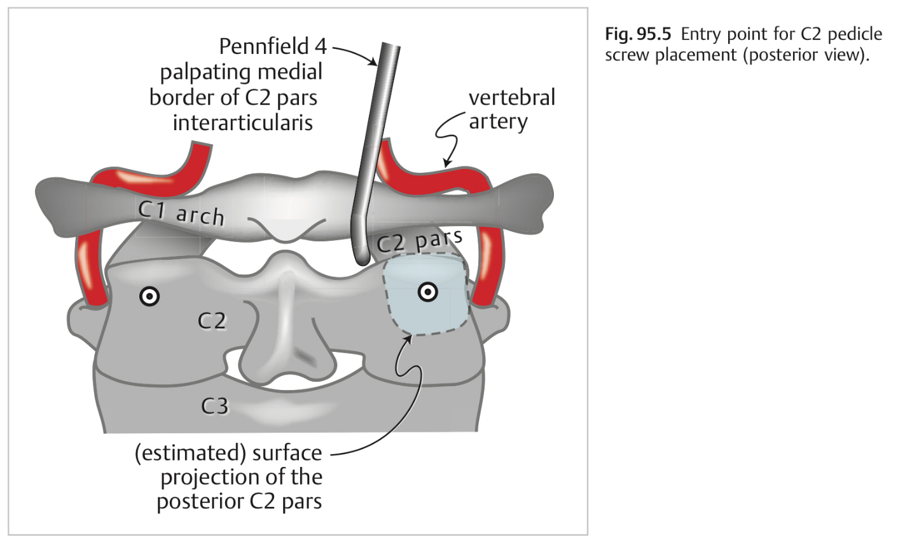
C2 Pedicle Screw
Entry point is medial and superior aspect of the pars
The trajectory of the drill path is directed
20-30 degrees medially and
20-30 degrees cephalad.
To prevent medial breach, the medial aspect of the pedicle can be exposed and palpated with a blunt dissector.
The heads of the C1 and C2 screws can be leveled by drilling off part of the lamina inferior to the C2 screw so that it can be advanced further. This simplifies rod placement.
SCREWS 3.5 mm dia.

Slide 23
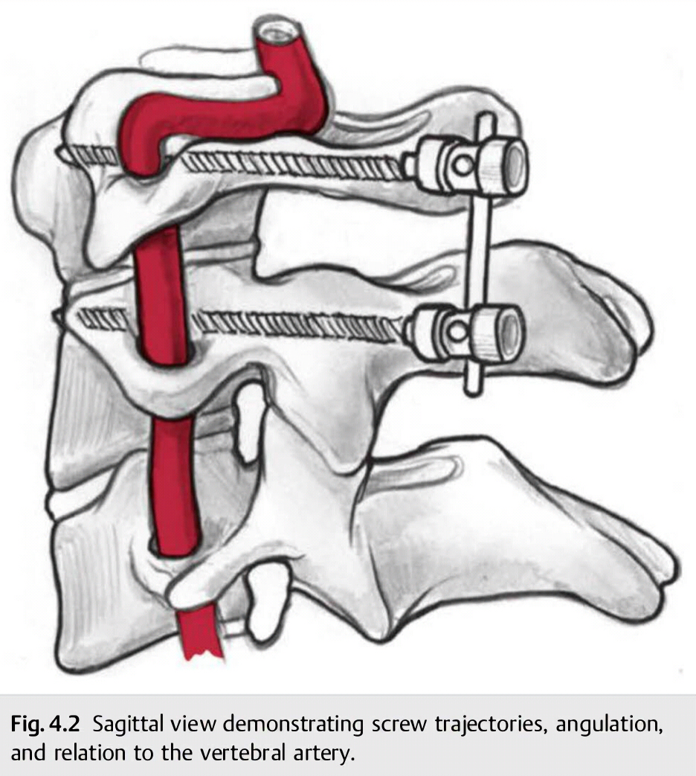

Slide 24
Complication of C2 fracture treatment
Vertebral artery injury
Spinal canal injury
Pseud-arthrosis
Wound infection
Nerve root injury
Persistent numbness or neuropathic pain
Screw breakage
Outcome and Prognosis
Type I fractures almost always heal with immobilization
Type III fractures usually heal with immobilization
Type II fractures have a lower fusion rates with immobilization than types I and III
Odontoid fractures are the most common form of cervical spine fractures in individual older than 70 years

Slide 25
Hangman’s Fractures (traumatic spondylolisthesis of the axis)
The 2nd most common fracture of the axis.
Involves bilateral fractures of the pars interarticularis.
Mechanism of injury is hyperextension and axial loading (the weight of the skull is transmitted through the occipital condyles and the C1-2 lateral masses, where it converges at the base of C2 passing through the weak pars).
Mechanism is different from execution hanging (hyperextension and distraction).
Most patients with this injury present with neck pain and are neurologically intact because the bilateral fracture tends to widen the spinal canal.
Evaluation includes XR, CT, and MRI to evaluate for ligamentous injury.
CT angiography should be obtained if the fracture extends into the foramen transversarium to exclude vertebral artery injury.

Slide 26
Levine Classification system for Hangman’s fractures
Type I
Bilateral pars interarticularis fractures with less than 3 mm of displacement of C2 on C3 and with no angulation (most common type)
Type Ia
Fracture lines are not parallel, and may go through the foramen transversarium.

Slide 27
Type II
More than 3 mm of displacement of C2 on C3 with or without angulation and with disruption of the C2-3 disk and posterior longitudinal ligament.
Type IIa
Have angulation (can be >15 degrees) and minimal subluxation (<3 mm), with the same associated disk and ligamentous injury of type II fractures

Slide 28
Type III
Have type II features with associated unilateral or bilateral facet dislocation, along with injury to anterior and posterior longitudinal ligaments.
Type IIa and III fractures are rare and are generally considered unstable.

Slide 29
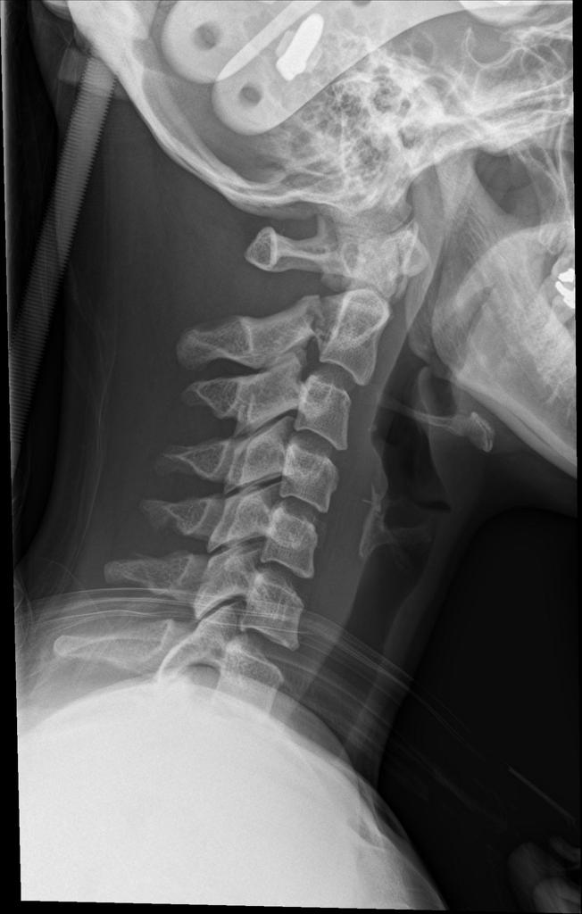
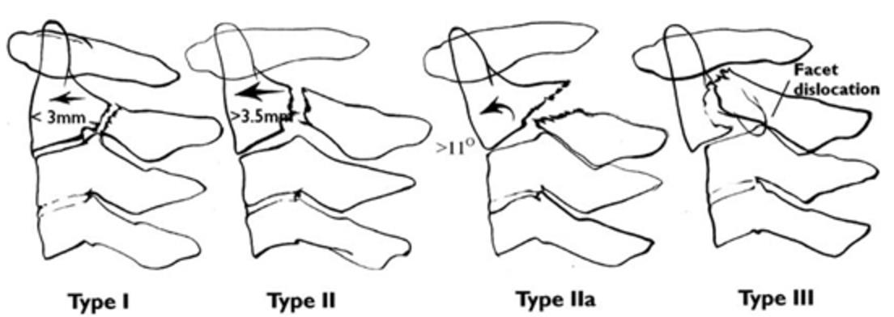
Classification system for Hangman’s fractures

Slide 30
Management of Hangman’s Fractures
Mostly not associated with neurological deficit and can be treated non surgically.
Type I or Ia can be treated with collar immobilization for 3 months.
Type II reduce with cervical traction. Patients with these fractures should be placed in a halo vest for 3 months
Indication for surgery
Fractures with more than 5 mm of subluxation.
At Least 30 degrees of angulation.
Type IIa fractures should be reduced immediately in a halo vest with extension and compression applied.
Type III fractures require surgery for stabilization and reduction.

Slide 31
Indication for Surgical fixation
fractures that cannot be reduced. (Type II, IIa Hangman)
patients who fail external immobilization.
traumatic C2-3 disk herniation with compromise of the spinal cord.
nonunion established on flexion-extension radiographs.
Surgical options include Posterior C2-3 fusion with either wire or screws and anterior C2-3 discectomy and fusion.
An anterior C2-3 discectomy and fusion can frequently treat these fractures.

Slide 32
Miscellaneous C2 Fractures
Includes fractures that are not odontoid or hangman’s fracture
Occur infrequently
Four basic types :
Vertebral body
Lamina
Spinous process
Lateral mass #s
Classification of vertebral body fractures into three types:
Type I fractures are vertically and coronally oriented.
Type II fractures are vertically and sagittally oriented.
Type III fractures are transverse (horizontally) oriented
External immobilization is the preferred initial treatment strategy
Fractures through the foramen transversarium can be evaluated with CT Angiography to exclude vertebral artery injury

