Slide 1
Evaluation
and
Treatment of Lumbar Disk Disease
Youmans Chap. 286

Slide 2
Clinical Evaluation
Pathophysiology
The proliferation of nerves in the anuli of diseased disks, particularly in the vascularized granulation tissue of annular tears, results in increased sensitivity to inflammatory mediators such as prostaglandin E2 and interleukin 6 & 8, and thus likely influences the severity of pain experienced by patients.
Symptoms
The most common complaint of patients with disk disease is low back pain, often radiating to the sacroiliac joints.
The pain is often vague, described as “deep” pain that is exacerbated by positions and activities that increase spinal axial loading and intradiscal pressure, such as spine flexion, standing, and sitting.
May develop symptoms of nerve root compression or, in rare cases, of neurogenic claudication.

Slide 3
Red flag symptoms in identifying back pain secondary to serious pathology
Advanced age,
Prolonged corticosteroid use,
History of severe trauma,
History of previous malignancy should increase suspicion of fracture or malignancy.
Symptoms indicative of emergent conditions such as cauda equina syndrome should be sought in these patients.

Slide 4
Physical Examination
The examination should include
Observation of patient’s gait, and posture.
Visual inspection of the back.
Palpation of the spinous processes and paraspinal musculature.
Spinal range of motion should be assessed.
Lower extremity strength, reflexes, and sensation.
Weakness of specific muscle groups may indicate the affected level.
Provocative testing for radicular symptoms related to nerve root compression caused by a herniated lumbar disk includes
Straight leg raise (SLR) or Lasègue test. With the patient supine, the affected leg is straightened and slowly passively elevated. If the patient’s sciatic pain is reproduced between 30 and 70 degrees of elevation, the test is considered positive.
Crossed straight leg raise or Fajersztajn’s crossed sciatic sign reproduction of symptoms with elevation of the contralateral leg.

Slide 9
From Handbook 8

Slide 10
Nerve root tension signs Includes :
Straight leg raising (SLR) test (Lasègue’s sign) Helps differentiate sciatica from pain due to hip pathology.
Test: with patient supine, raise afflicted limb by the ankle until pain is elicited (should occur at <60°, tension in nerve increases little above this angle).
A positive test consists of leg pain or paresthesias in the distribution of pain (back pain alone does not qualify).
Ankle dorsiflexion with SLR usually augments pain due to nerve root compression.
SLR primarily tenses L5 and S1, L4 less so, and more proximal roots very little.
Crossed straight leg-raising test AKA Fajersztajn’s sign: SLR on the painless leg causes contralateral limb pain (a greater degree of elevation is usually required than the painful side). May correlate with a more central disc herniation.
Cram test: with patient supine, raise the symptomatic leg with the knee slightly flexed. Then, extend the knee. Results similar to SLR.

Slide 11
Femoral stretch test, AKA reverse straight leg raising:
Patient prone, examiner’s palm at popliteal fossa, knee is maximally dorsiflexed.
Often positive with L2, L3, or L4 nerve root compression (e.g. in upper lumbar disc herniation), or with extreme lateral lumbar disc herniation (may also be positive in diabetic femoral neuropathy or psoas hematoma);
In these situations SLR (Lasègue’s sign) is frequently negative (since L5 & S1 not involved)
Bowstring sign : once pain occurs with SLR, lower the foot to the bed by flexing knee, keeping the hip flexed. Sciatic pain ceases with this maneuver, but hip pain persists
Sitting knee extension test : with patient seated and both hips and knees flexed 90°, slowly extend one knee. Stretches nerve roots as much as a moderate degree of SLR

Slide 12
Other signs useful in evaluation for lumbar radiculopathy
Faber or Patrick test
FABER = Flexion ABduction External-Rotation, A test of hip motion.
Often markedly positive in the presence of hip joint disease – e.g. trochanteric bursitis, sacroiliitis or mechanical low-back pain.
Trendelenburg sign:
Examiner observes pelvis from behind while patient raises one leg while standing.
Normally the pelvis remains horizontal.
A positive sign occurs when the pelvis tilts down toward the side of the lifted leg indicating weakness of the contralateral thigh adductors (primarily L5 innervated)

Slide 13
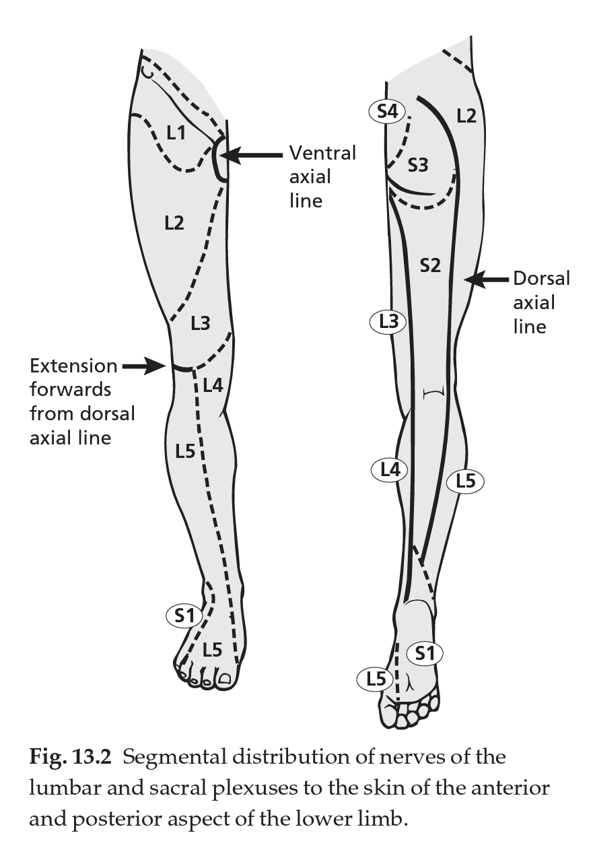
L3/4 prolapsed intervertebral disc
Pain in the anterior thigh
Wasting of the quadriceps muscle
Weakness of the quadriceps function and dorsiflexion of foot
Diminished sensation over anterior thigh, knee and medial aspect of lower leg
Reduced knee jerk
L4/5 prolapsed intervertebral disc
Pain along the posterior or posterolateral thigh with radiation to the dorsum of the foot and great toe
Weakness of dorsiflexion of the toe or foot
Paraesthesia and numbness of the dorsum of the foot and great toe
Reflex changes unlikely.
L5/S1 prolapsed intervertebral disc
Pain along the posterior thigh with radiation to the heel
Weakness of plantar flexion (on occasion)
Sensory loss in the lateral foot
Absent ankle jerk.

Slide 14
Surgical indications
Failure of non-surgical management to control pain after 5–8 weeks from the onset of radiculopathy before considering surgery.
EMERGENT SURGERY (i.e. before the 5–8 weeks of symptoms have lapsed). Indications:
Cauda equina syndrome (CES).
Progressive motor deficit (e.g. foot drop), the acute development or progression of motor weakness is considered an indication for rapid surgical decompression.
Urgent surgery may be indicated for patients whose pain remains intolerable in spite of adequate narcotic pain medication.
Patient preference patients who do not want to invest the time in a trial of non-surgical treatment if it is possible that they will still require surgery at the end of the trial.

Slide 15
Indications of Open Posterior Lumbar Approach
Lumbar decompression
Lumbar disk herniations
Lumbar stenosis
Facet synovial cysts
Lumbar spondylolisthesis
Lumbar infections
Intervertebral diskitis
Vertebral body osteomyelitis
Spinal epidural abscess
Lumbar trauma
Lumbar tumors
Extradural neoplasms
Intradural neoplasms
Spinal fusions
Correction of spinal deformity
Posterolateral intertransverse fusion
Pedicle screw fixation
Posterior lumbar interbody fusion
Other indications
Iliac crest bone graft harvest

Slide 16
Advantages
Common technique
No major visceral or vascular structures at risk during approach
Versatile for most pathology of the lumbar spine
Cauda equina allowing retraction with low risk of spinal cord injury
Easier localization of spinal level
Disadvantages
Extensive muscle dissection needed
Significant postoperative pain
Higher risk of iatrogenic spinal instability
Restricted access to anterior pathology

Slide 17
Cauda equina syndrome
The clinical condition arising from dysfunction of multiple lumbar and sacral nerve roots within the lumbar spinal canal.
Usually due to compression of the cauda equina (the bundle of nerve roots below the conus medullaris arising from the lumbar enlargement and conus for features to help differentiate CES from a conus lesion.
Patterns
Group I – sudden onset of symptoms with no previous low back symptoms
Group II – previous history of recurrent backache and sciatica, the latest episode combined with CES
Group III – presentation with backache & bilateral sciatica that later develop CES

Slide 18
Possible findings in CES:
Sphincter disturbance:
Urinary retention: the most consistent finding.
To evaluate acutely: have patient empty bladder and check post-void residual (by catheterization or with bladder ultrasound).
Cystometrogram shows a hypotonic bladder with decreased sensation and increased capacity.
Urinary and/or fecal incontinence: some patients with urinary retention will present with overflow incontinence.
Anal sphincter tone: diminished in 60–80%
“saddle anesthesia”: the most common sensory deficit. Distribution: region of the anus, lower genitals, perineum, over the buttocks, posterior-superior thighs. Once total perineal anesthesia develops, patients tend to have permanent bladder paralysis.
Significant motor weakness: usually involves more than a single nerve root (if untreated, may progress to paraplegia)
Low back pain and/or sciatica sciatica is usually bilateral, but may be unilateral or entirely absent, prognosis may be worse when absent or bilateral.
Bilateral absence of Achilles reflex has been noted
Sexual dysfunction (usually not detected until a later time)

Slide 19
Etiologies of CES includes:
Compression of cauda equina
Massive herniated lumbar disc
Tumor
metastatic disease to the spine with epidural extension
intravascular lymphomatosis
Free fat graft following discectomy
Trauma: fracture fragments compressing cauda equina
Spinal epidural hematoma
Infection: may cause neurologic deficit from
compression: typically from spinal epidural abscess complicating discitis or vertebral osteomyelitis
vascular compromise resulting from local septic thrombophlebitis.
Neuropathy: ischemic or inflammatory.
Ankylosing spondylitis.

Slide 20
Surgical option for lumber disc
Standard open lumbar laminectomy and discectomy :
65–85% reported no sciatica one year post-op.
Long-term results (>1 year) were similar.
10% of patients underwent further back surgery during the first year.
Microdiscectomy :
Smaller incision is utilized.
Advantages may be cosmetic, shortened hospital stay, lower blood loss.
May be more difficult to retrieve some fragments.
Overall efficacy is similar to standard discectomy.
Sequestrectomy :
removal of only the herniated portion of the disc without entering the disc space to remove disc material from there.

Slide 21
Common complications
Infection:
superficial wound infection: (risk is increased with age, long term steroids, obesity, DM): most are caused by S. aureus.
deep infection.
Increased motor deficit.
Unintended “incidental” durotomy ( dural tear):
CSF fistula (external CSF leak).
Pseudomeningocele: (may appear similar radiographically to spinal epidural abscess (SEA), but post-op SEA often enhances, is more irregular, and is associated with muscle edema)
Recurrent herniated lumbar disc.
Post-operative urinary retention (POUR): usually temporary, but may delay hospital discharge

Slide 22
Uncommon complications
Direct injury to neural structures.
Injury to structures anterior to the vertebral bodies :
Great vessels : risks include potentially fatal hemorrhage, and arteriovenous fistula which may present years later.
Most such injuries occur with L4–5 discectomies.
Only ≈ 50% bleed into the disc space intraoperatively, the rest bleed into the retroperitoneum.
Aorta: the aortic bifurcation is on the left side of the lower part of the L4 VB.
Common iliac arteries below L4
Veins (more common than arterial injuries): vena cava at and above L4, common iliac veins below L4
Ureters.
Bowel: at L5-S1 the ileum is the most likely viscus to be injured.
Sympathetic trunk.
Wrong site surgery.
Cauda equina syndrome.
Postoperative visual loss.

Slide 23
Post-op arachnoiditis : due epidural hematoma, post-op discitis, and intrathecal injection anesthetic agents or steroids.
Thrombophlebitis and deep-vein thrombosis with risk of pulmonary embolism (PE).
Complications of positioning:
compression neuropathies: ulnar, peroneal nerves. Use padding over elbows and avoid pressure on posterior popliteal fossa
anterior tibial compartment syndrome: due to pressure on anterior compartment of leg. An orthopedic emergency that may require emergent fasciotomy
pressure on the eye: corneal abrasions, damage to the anterior chamber.
cervical spine injuries during positioning due to relaxed muscles under anesthesia

Slide 24
Unintended durotomy
10% in first surgery
20% in redo surgery
Symptoms
A CSF leak may produce “spinal headache” with its associated symptoms and if it breaches the skin it may be a risk factor for meningitis.
Pain or sensory/motor deficits may be associated with injuries to nerve roots or delayed herniation of nerve roots through the dural opening.
Etiologies: Potential causes are many, and include :
Unanticipated anatomic variations.
Thinning of the dura in cases of longstanding stenosis.
Adhesion of the dura to removed bone.
Surgically created spicule of bone.
Slippage of an instrument.
An obscured fold of dura caught in a rongeur or curette.
The risk may be increased with anterior decompression for OPLL, with revision surgery, and with the use of high-speed drills.

Slide 25
Treatment:
If the opening is recognized at the time of surgery,
Watertight primary closure (with or without patch graft) should be attempted with nonabsorbable suture if at all possible to prevent pseudomeningocele and/or CSF fistula.
A cottonoid placed over the opening prevents aspiration of nerve roots.
Care must be taken to avoid incorporating a nerve root into the closure.
Most repairs will be accomplished with no complication or sequelae to the patient.
When the opening is in the far (anterior) side of the dura,
Consideration may be given to intradural repair accessed through a posterior durotomy which is subsequently closed (this may risk additional injury to the nerve roots).
Biocompatible fixatives (e.g. fibrin glue) may be used to supplement primary closure.

Slide 26
When the opening cannot be found or accessed, as is sometimes the case when it occurs on the nerve root sleeve
Primary repair may be impossible in some situation and alternatives here include
Placement of a fat or muscle graft over the suspected leak site.
Use of a the patient’s own blood for a “blood patch” by draw ≈ 5–10 ml of the patient’s blood from an arm vein, keeping it in the syringe for several minutes until it starts to coagulate, and then to have the anesthesiologist inject the blood onto the dura),
Use of gelfoam, fibrin glue.
The wound not be drained post-op, with a water-tight closure of fascia, fat, and skin to add to the barrier.
CSF diversionary procedures (e.g. through a drain inserted 1 or more levels away) may also be used.
Bed rest 4–7 days is often advocated to reduce symptoms and facilitate healing, when watertight closure has been achieved, normal post-op mobilization is not associated with a high failure rate (bed rest is recommended if symptoms develop).

Slide 27
Post-op care
Re-operation was avoided when treated by
Resuturing the skin under local anesthesia.
Bed rest in slight Trendelenburg position (to reduce pressure on the leakage site).
Broad spectrum antibiotics and antibiotic ointment over the skin incision, and daily puncture and drainage of the subcutaneous collection.
Vital signs
Meds
laxative of choice (LOC)
optional: prophylactic antibiotics
acetaminophen
narcotic analgesia
optional: steroids are used by some surgeons to reduce nerve-root irritation from surgical manipulation
Labs (if significant blood loss during surgery): CBC

Slide 28
Post-op check
Strength of lower extremities, especially muscles relevant to nerve root, e.g. gastrocnemius for L5-S1 surgery, EHL for L4–5 surgery
Appearance of dressing: look for signs of excessive bleeding, CSF leak
Signs of cauda equina syndrome e.g. by post-op spinal epidural hematoma
loss of perineal sensation (“saddle anesthesia”).
inability to void: may not be not unusual after lumbar laminectomy, more concerning if accompanied by loss of perineal sensation.
pain out of the ordinary for the post-op period.
weakness of multiple muscle groups.
Any new neurologic deficit should prompt rapid evaluation for spinal epidural hematoma (EDH).
Delayed deficits may be due to EDH or epidural abscess.
Post-op films in the recovery room can rule out graft or hardware malposition for fusions or instrumentation procedures, or changes in alignment.
The diagnostic test of choice is MRI. If contraindicated or not available, CT/myelography may be indicated.

Slide 29
Herniated upper lumbar discs
Presentation
Typically presents with LBP, onset following trauma or strain.
With progression, paresthesias and pain in the anterior thigh occur, with complaints of leg weakness (especially on ascending stairs).
Signs
Quadriceps femoris was the most common muscle involved, demonstrating weakness and sometimes atrophy.
Straight leg raising was positive in only 40%.
Femoral stretch test may be positive.
50% had reduced or absent knee jerk.
Reflex changes were more common with L3–4 HLD than L1–2 or L2–3.
NB : With quadriceps weakness, climbing stairs, getting out of a car or stepping up onto a curb may feel “spongy” or the knee will feel like it will want to “give out”. Falls can occur with quick motions.

Slide 30
Extreme lateral lumbar disc herniations
Herniation of a disc at the facet (foraminal disc herniation) or distal to the facet (extraforaminal disc herniation).
Occurs most commonly at L4–5 and next at L3–4, thus L4 is the most common nerve involved and L3 is next.
Differs from the more common central and subarticular HLD in that:
The nerve root involved is usually the one exiting at that level (c.f. the root exiting at the level below).
Straight leg raising (SLR) is negative.
Femoral stretch test may be positive .
Pain is reproduced by lateral bending to the side of herniation.
Pain tends to be more severe (may be due to fact that the dorsal root ganglion may be compressed directly) and often has more of a burning dysesthetic quality.
Presentation :
Quadriceps weakness.
Reduction of patellar reflex.
Diminished sensation in the L3 or L4 dermatome are the most common findings.

Slide 31
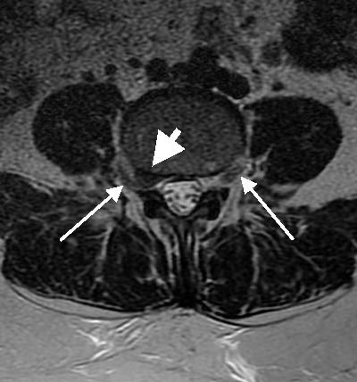
Radiographic diagnosis
MRI is the imaging of choice.
Myelography is not informative.
CT scan : reveals a mass displacing epidural fat and encroaching on the intervertebral foramen or lateral recess, compromising the emerging root. Or, may be lateral to foramen.
Large white arrow points to herniation.
Small white arrows point to normal and compressed nerves.

Slide 32
Treatment
Traditional midline hemilaminectomy:
The ipsilateral facet must be partially or completely removed.
The safest way to find the exiting nerve root is take the laminectomy of the inferior portion of the upper vertebral level (e.g. L4 for a L4–5 HLD) high enough to expose the nerve root axilla, and then follow the nerve laterally through the neural foramen by removing facet until the HLD is identified.
lateral approach (i.e. extra-canal) through a paramedian incision.
Advantages: the facet joint is preserved (facet removal combined with discectomy may lead to instability), muscle retraction is easier.
Disadvantages: unfamiliar approach for most surgeons and the nerve cannot be followed medial to lateral.

