Slide 1
Evaluation and Treatment
of
Degenerative Lumbar Spondylolisthesis
Youman Chap. 288, 329, 330
Handbook 8
Other

Slide 2
Its Anterior subluxation of one vertebral body (VB) on another, most commonly the upper VB is anterior to the inferior one.
Usually L5 on S1, the next most common is L4 on L5.
It is rare for a herniated lumbar disc to occur at the level of the listhesis, however the disc may “roll” out as it is uncovered and produce findings on MRI that may resemble a herniated disc which has been termed a “pseudodisc.”
It is more common to see a herniated disc at the level above the listhesis.
If the listhesis does cause nerve root compression, it tends to involve the nerve exiting below the pedicle of the anteriorly subluxed upper vertebra (e.g. if an L4–5 spondylolisthesis causes nerve root compression, it will generally involve the L4 root).
The compression is usually due to upward displacement of the superior articular facet of the level below together with disc material, and symptoms typically resemble neurogenic claudication, although true radiculopathy may sometimes occur.
Isthmic spondylolisthesis rarely produces central canal stenosis since only the anterior part of the vertebral body shifts forward.

Slide 3
Types of spondylolisthesis
Type 1: dysplastic: congenital.
Facet defects of Upper sacrum or lower L5 permits the spondylolisthesis.
No pars defect.
94% are associated with spinal bifida occulta.
Type 2: isthmic spondylolisthesis AKA spondylolysis:
Failure of the neural arch as a result of a defect in the pars interarticularis (identifiable as a discontinuity in the neck of the “Scotty dog” on oblique LS-spine x-ray).
Rarely produces central canal stenosis since only the anterior part of the vertebral body shifts forward.
May cause narrowing of the neural foramen.
Three subtypes:
Lytic: fatigue fracture or insufficiency fracture of pars (In the pediatric age group & may occur in athletes (especially gymnasts or football players)
Elongated but intact pars: possibly due to repetitive fractures and healing
Acute fracture of pars

Slide 4
Type 3: degenerative: due to long-standing intersegmental instability. Usually at L4–5. No break in the pars.
Type 4: traumatic: due to fractures usually in areas other than the pars
Type 5: pathologic: generalized or local bone disease, e.g. osteogenesis imperfecta
isthmic spondylolisthesis

Slide 5
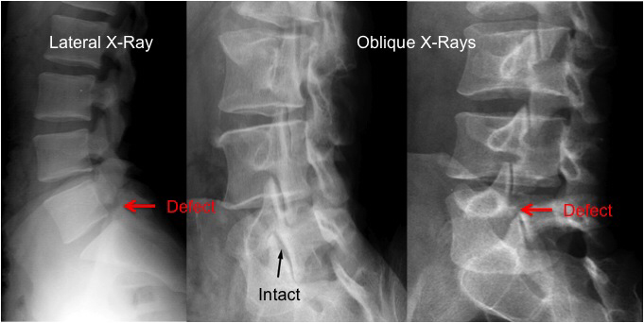

Slide 8
Degenerative spondylolisthesis DS
It is most common at the L4-L5 level, unlike other forms of spondylolisthesis, which are more common at L5-S1.
Among anatomic factors is the facet joint orientation. Sagittally oriented facets at L4-L5 have been associated with an increased risk of DS.
Facet with a greater than 45 degree sagittal orientation at this level had a 25 times higher risk of DS.
Risk Factors for DS
In men, only age was a risk factor.
In women,
Increased lordosis,
Body mass index (BMI),
Age
Black women also have an increased likelihood’s of experiencing DS.
Greater ligamentous laxity and hormonal effects in women (estrogen receptors were found to have increased expression in the facet joints of postmenopausal women with severe facet arthritis
Prior pregnancy has also been associated with DS.

Slide 9
Clinical Assessment
Low back pain with or without lower extremity pain.
Characteristics of the pain are similar to those of lumbar stenosis.
Pain is typically mechanical in nature, worsening with extension.
Leg pain can either be radicular or claudicatory.
Radicular pain can be caused by
Direct nerve root compression in the lateral recesses, with the L5 nerve root most commonly affected (shooting pain radiating to the posterolateral thigh to the lateral shin and to the dorsum of the foot & Weakness of the extensor hallucis longus is typical for a severe L5 radiculopathy).
Compression of the neural foramina, This may lead to L4 radiculopathy, because L4-L5 is the most frequently affected level (radiating down the anterolateral thigh, over the knee, and to the medial shin and medial malleolus & weakness in dorsiflexion for a severe L4 radiculopathy).
Neurogenic claudication
The pain and paresthesias are typically described as involving the anterior thighs, often bilaterally. This pain is usually present during walking. Flexion of the back during walking tends to ease symptoms.
Weakness in hip flexion can be suggestive of claudication.

Slide 10
TREATMENT
Conservative Treatment
Goals of conservative care should be to provide pain relief and maintain normal activities of daily living.
Initial management involves :
Bed rest, followed by a course of anti inflammatory medications
If pain is inadequately controlled, opiates or muscle relaxants are commonly employed.
If symptoms are persistent after a short trial of medications, a course of physical therapy can be useful.
Typical exercises include bicycling, swimming and walking.
Epidural steroid injections can potentially deliver short-term benefit.
Other options that can be considered for the management of DS include bracing, stabilization exercises, transcutaneous nerve stimulation, and ultrasound therapy.

Slide 11
Surgical Options
Decompression without Fusion
Simple laminectomy and/or foraminotomy to treat neural elements under compression in the setting of DS can be pursued.
Noninstrumented Fusion
Instrumented Fusion
Posterolateral fusion involves a purely posterior approach with placement of transpedicular screws connected with a rod system to achieve stability after facet and/ or transverse process arthrodesis, This technique, which may be performed along with decompressive procedures (laminectomy), carries the advantage of relative procedural simplicity.

Slide 14
Multiple approach options exist for lumbar interbody fusion, including
Posterior lumbar interbody fusion (PLIF)
Transforaminal lumbar interbody fusion (TLIF)
Lateral lumbar interbody fusion (LLIF)
Anterior lumbar interbody fusion (ALIF)
PLIF involved placement of bilateral interbody bone grafts via bilateral hemilaminotomies and medial facetectomies (The bilateral bone grafts were placed relatively medially, potentially exposing the dura and caudal exiting nerve root to traction injury).
TLIF involved a unilateral approach across the foramen, lateral to the dura and the exiting caudal nerve root, as an attempt to decrease the complication rate seen with PLIF.
Open PLIF and TLIF interbody fusion approaches have evolved with advances in instrumentation.
Pedicle screw fixation provides powerful internal fixation, obviating the need to preserve the facets and allowing PLIF spacers to be placed laterally away from the dura and caudal exiting nerve (which minimizes nerve root retraction).
Conversely, TLIF spacer placement has moved more medially away from the cephalad nerve root.

Slide 15
PATIENT SELECTION
The open PLIF & TLIF approaches are typically favored in patients with bilateral pathology with concomitant bilateral symptoms
Central or bilateral foraminal stenosis with neurogenic claudication or bilateral radicular pain.
Patients with poor sagittal balance and loss of lumbar lordosis.
Suited to multilevel pathology (three-level or more).
ALIF is also ideal for :
One and two-level disk pathology.
Access to intracanal pathology is relatively limited, but radicular symptoms can be addressed with indirect foraminal decompression.
Powerful correction of segmental lordosis and sagittal balance.
Minimally invasive TLIF is ideal for
Younger patients with unilateral radiculopathy with back pain, with one- or two-level.
Pt have near-normal lumbar lordosis because it is difficult to restore more than 5 degrees of lordosis with a minimally invasive TLIF.

Slide 16
Common indications for lumbar interbody fusion include
Spondylolisthesis, both lytic and degenerative;
Multiple recurrent disk rupture and failed fusion;
Treatment of coronal (scoliosis) and sagittal (kyphosis) deformity,
Discitis, and osteomyelitis
One or two-level degenerative disk disease with mechanical low back pain.
INTERBODY GRAFTS
Numerous grafting materials including structural and morselized iliac crest (A morselized graft involves cancellous bone or small bone fragments) and local autograft as well as various bone graft extenders.
Various eponymous cages popularized the use of synthetic interbody spacers. These spacers have been constructed from various biomaterials ( titanium, polyetheretherketone [PEEK], carbon fiber).
PEEK spacers have also come in various sizes and shapes, either solid or with graft chambers, allowing graft material to be packed in and around the spacers.
The most recent advance in interbody spacers involves expandable spacers that allow for maximal disk space distraction, facilitating maximal disk space height and indirect decompression while minimizing neural retraction

Slide 17
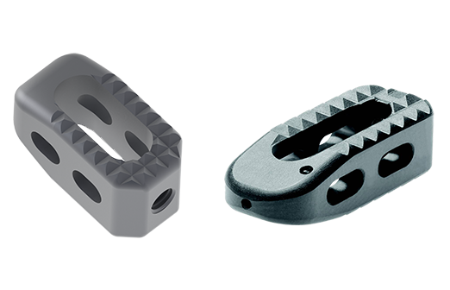
Titanium cage
PEEK cage

Slide 19
Posterior Lumbar Interbody Fusion PLIF ( Core )
INDICATIONS
Spondylolisthesis that is symptomatic, progressive, or requiring decompression that necessitates stabilization.
Degenerative disk disease with low back pain.
Pseudarthrosis of a previous intertransverse fusion that requires a fusion technique with higher success at achieving a solid arthrodesis.
Correction of degenerative scoliosis.
Recurrent disk herniation.
CONTRAINDICATIONS
Previous interbody graft placed at index level
Significant epidural scar at planned level or site of operation
Osteoporotic end plates that may not hold interbody graft, leading to subsidence
Disease at or above the conus medullaris
Active infection Arachnoiditis
Documented allergies to metals

Slide 20
TECHNIQUE of PLIF
Laminotomy and near-total facetectomy.
The thecal sac is decompressed through the lateral recess and foramen, directly freeing both the cephalad and caudal exiting nerve roots. The dura is gently retracted medially to expose the disk space.
Discectomy and disk space shavers, followed by end plate decortication.
The disk space is mobilized and disk height restored by employing progressively larger disk space trailers and distractors, generally to between 10 and 14 mm in height. Leaving the final distractor in place, the disk is packed with graft material from the contralateral side.
A funnel impactor may be utilized to facilitate dense packing of bone in the disk space. Expandable interbody spacers may be employed to maximize disk space height while minimizing neural retraction.
Spacers with graft chambers may be packed with additional graft material or extenders.
Monolithic spacers without graft chambers may be placed via the “insert and rotate” technique.
Supplemental fixation is obtained with pedicle screw fixation.
Placing screws under compression further facilitates lumbar lordosis.

Slide 21
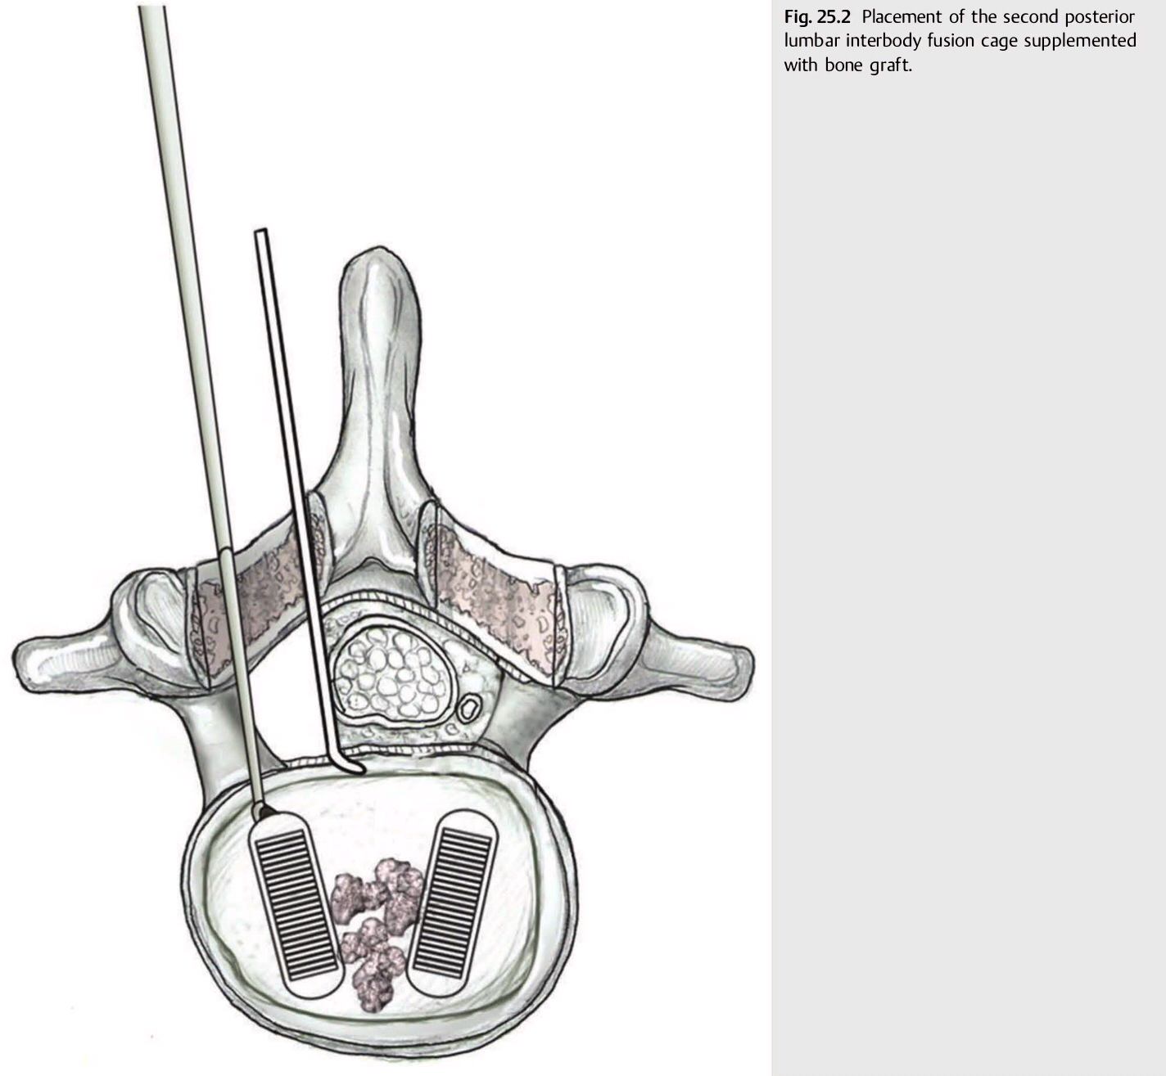
Placement of the second posterior lumbar interbody fusion cage supplemented with bone graft.

Slide 22
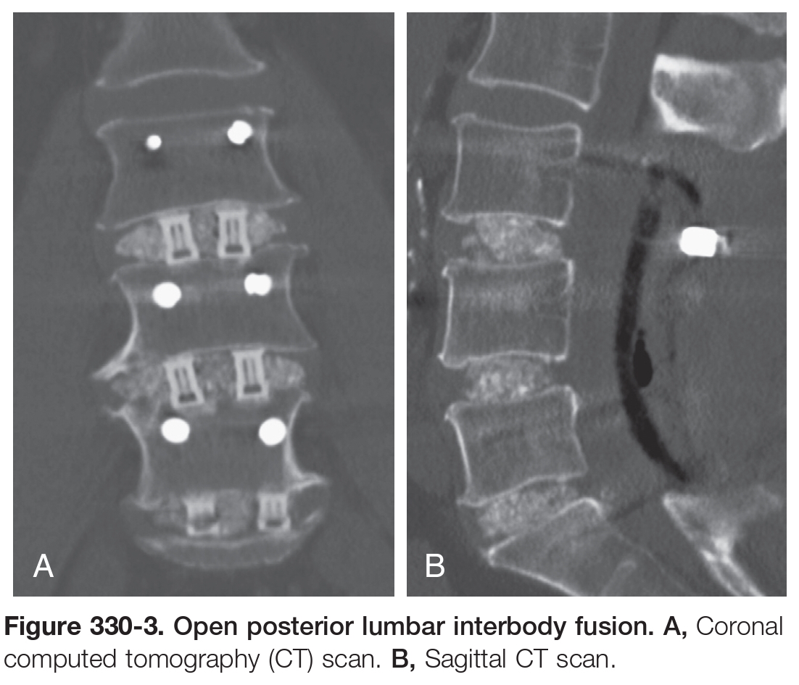

Slide 23
From ( Neurosurgery_Tricks_of_the_Trade)
Avoidances / Hazards / Risks
Dural laceration and neural injury should be avoided with careful dissection and release of adhesions.
Retraction of the thecal sac and roots should be minimized, and attention should be paid during graft insertion when these structures are more at risk.
Excessive bleeding should be avoided with meticulous hemostasis.
Anterior injury to major vessels (aorta, inferior vena cava) may occur with overaggressive diskectomy and breach of the anterior longitudinal ligament.
Salvage and rescue
Graft retropulsion and screw malposition should be sought with Xrays prior to closure and adjustments should be done accordingly.
On occasion, violation of the end plate may occur due to too aggressive bone scraping or poor bone density (as in osteoporosis). In these cases, placement of a structural cage or graft may not be optimal given the graft may migrate within the vertebral body. In these instances it is preferable to densely pack the interbody space with morselized bone (auto- and/or allograft) and supplement the arthrodesis with posterior instrumentation as pedicle screw fixation.

Slide 24
Complications
Spinal cord and nerve root injury with resultant deficits
Dural tear
Anterior vascular and/or visceral injury Hemorrhage
Wound or implant infection
Pseudoarthrosis
Symptomatic epidural fibrosis
Graft resorption or collapse
Graft retropulsion
Persistent pain
Instability
Adjacent level disease

Slide 26
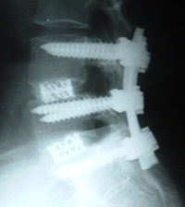

Slide 27
Transforaminal Lumbar lnterbody Fusion
Indications
Segmental instability requiring fusion for stabilization
Recurrent disk herniation
Symptomatic spinal stenosis with a significant back pain
Degenerative disk disease with a significant back pain component
Spondylolisthesis.
Correction of degenerative scoliosis.
Pseudarthrosis of a previous intertransverse fusion or arthroplasty

Slide 28
Procedure
Bone work
Decompression of the spinal canal is performed though a unilateral approach.
Care must be taken to get adequate decompression of the contralateral side if significant bilateral foramina( stenosis exists).
Facet joints can be removed to obtain appropriate lateral exposure to the disk space.
Removal of lateral mass bone, including the pars interarticularis as well as the medial facet, to reduce the amount of nerve retraction necessary.
Remove superior and inferior osteophytes to create a parallel and flat path for the interbody fusion cage or spacer.
Essentially all bone needs to be removed between the two pedicles on the approach side.
Placement of pedicle screws can help define the region of bone for removal.

Slide 29
Discectomy
unilateral or bilateral diskectomy is performed.
The end plates should be thoroughly prepared ensuring the removal of the cartilage.
The space may be prefilled with fusion product (bone or bone substitutes).
Device introduction
The interbody fusion device is then inserted.
It is crucial that the specialized graft (banana or boomerang cage) cross the midline.
The device can be inserted before or after the pedicle screws are placed according to the surgeon's preference and clinical needs.
The advantage of the latter approach is that the surgeon can use the pedicle screws to distract the interspace, possibly allowing the use of a larger interbody fusion device.
The pedicle screws are placed in the usual fashion.
The lateral bone (remaining facet joint and transverse process or sacral ala) is decorticated and bone is placed in laterally. The pedicle screws are attached to the rods and secured.

Slide 30
Fig. 1. Three types of TLIF cages were evaluated for their biomechanics including (a) banana shape (b) flat and straight shape (c) biconvex and straight shape.

Slide 31
Lumbar Pedicle Screw Placement
Indications
Lumbar spondylolisthesis (isthmic and degenerative).
lumbar burst and compression fractures.
Instability arising from primary or secondary neoplastic lumbar lesions.
Chronic low back pain due to degenerative disk disease in patients in whom conservative treatment fails (potential option of treatment).
Disk herniation with evidence of instability.
Lumbar stenosis with evidence of instability.
Correction of Scoliosis & Sagittal misbalance.
Contraindications
Vertebral body or pedicle destruction
Severe osteoporosis
Active infection

Slide 32
Positioning the hips in extension improves lumbar lordosis. Fusing multiple segments of the lumbar spine with the hips positioned in flexion may cause iatrogenic flatback deformity.
Screw angulation is " Medialized" an additional 5 degrees per level ( screws are aimed medially 5 degrees at L1 up to 25-30 degrees at LS.
In patients who are osteopenic, the entry point should be lateral to allow greatest medial angulation.
Typically, 6-mm-diameter and 40- to 45-mm-length screws are required in the lumbar spine.
Lateral entry points on the transverse process require greater medial angulation.
The sagittal plane angulation must also be accounted for in achieving the optimal trajectories of screw placement.
In a properly positioned patient, with the hips extended to maintain lumbar lordosis
At L4 pedicle the optimal sagittal angle is usually zero degrees.
The lordotic curve of the lumbar spine necessitates increasingly rostral angulation for the upper lumbar levels,
At L5 pedicle the optimal sagittal angle is 5 to 10 degrees caudal.

Slide 33
Key Procedural Steps
The ideal entry point for the pedicle is at the intersection of a vertical line tangential to the lateral border of the superior articular process and a horizontal line passing through the middle of the insertion of the transverse process, or 1 mm below the joint line.
The cortical bone overlying the entry point is removed with a bur, rongeur, or awl to expose the underlying cancellous bone, after which the pedicle is palpated with a probe.
A lateral entry usually requires more medial angulation, and a medial starting point may not require any angulation of the pedicle probe.
The typical lumbar pedicle is elliptical in cross section, with the larger diameter oriented vertically. This shape facilitates variable angular positioning of the probe in the sagittal plane.
Sudden loss of resistance during insertion almost certainly indicates that the probe has violated the pedicle wall. The instrument should be removed and the entry hole and tract felt with a semiflexible ball-tip feeler probe to determine whether penetration has been medial, lateral, superior, or inferior.
The isthmus of the hole should be tapped with a tap of slightly smaller diameter than the screw, to optimize screw purchase.

Slide 35
Fig. 39.3 After a blunt pedicle probe or curette is used to initiate the screw tract, the tract is tapped.

Slide 44
Salvage and Rescue
Misplaced screws are the most common complication of pedicle screw placement. In addition to poor screw purchase, breaches can compromise vital structures:
A rostral breach would lead to penetration of the intervertebral disk.
A caudal breach could lead to compromise of the neural foramen.
A medial breach would risk injury to the thecal sac.
A lateral breach would risk injury to segmental vessels.
An anterior breach could risk injury to the iliac vessels.
If the pedicle screw is deemed to be mal positioned by the above methods, it should be removed.
The thecal sac and nerve roots should be inspected for possible injury and cerebrospinal fluid (CSF) leaks should be addressed.
A pedicle probe should be used to probe the area of breach and a new path should be attempted. Depending on the degree of malposition, a new path could be reattempted by
Directing the curved pedicle probe Medially for a lateral breach.
Directing the curved pedicle probe Laterally for a medial breach.

Slide 45
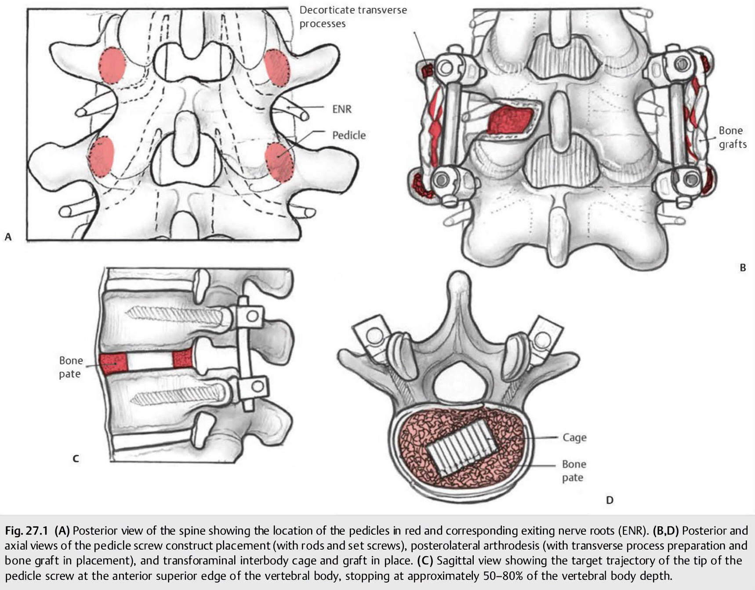
In cases of complete fracture of a pedicle during cannulation (as in osteoporotic patients with small pedicles), then the screw should not be placed or should be removed if misplaced. The construct may be extended one level above and/or below the fusion level of interest. Alternatively, one may choose to rely on a unilateral construct.

Slide 46
Pitfalls
Malpositioning of the screw may cause injury to surrounding structures.
Medial and inferior placement may injure the exiting nerve root
Excessive medial angulation can also cause a dural tear.
Overpenetration risks injury to the vascular and visceral structures anteriorly.
Pedicle fractures may occur with aggressive use of the pedicle probe or by placement of an oversized pedicle screw without proper tapping.
Complications
Nerve root injury
Conus injury
Pseudarthrosis (failure of fusion), instability
CSF leak
Infection
Vascular injury
Screw misplacement
Instrumentation failure
Vertebral fractures

