Slide 1
Evaluation & Classification and Treatment
of
Thoracolumbar Spine Injuries
Youmans Chap. 309

Slide 2
The thoracolumbar junction (T10-L2) is a biomechanical transition zone prone to injury because of an inherent susceptibility to the kinetic energy transfer from the stiff, rostral thoracic spine to the relatively more flexible, caudal lumbar spine.
The most common mechanisms of injury are those of a high-velocity pattern; these include motor vehicle collisions, falls, occupational injuries, and wartime-related injuries.
High-velocity bony injuries carry an additional 25% risk for accompanying spinal cord injury (SCI) and 30% risk for intra-abdominal injury.
Most thoracolumbar fractures are burst fractures.
The most common pathologies at the thoracolumbar junction are anterior and middle column
Posterior Ligamentous Complex include
Supraspinous ligament.
Interspinous ligament.
Ligamentum flavum.
Ventral facet joint capsules.

Slide 3
ANATOMY
Transitional zones of the spine, owing to a high degree of flexibility, are prone to injury.
The thoracic spine is rigid, resisting translational forces from the stability provided by
Coronally aligned facets.
The rib cage.
Coronal facet alignment adds further stability to the thoracic spine because it limits flexion, extension, translational, and rotational forces.
At the transitional point for the thoracic spine (T11 and T12), the ribs do not articulate with the sternum (they articulate with their contralateral rib by a more mobile fibrocartilaginous tissue, distinguishing them as “floating” ribs).
At the level of T11, the coronally aligned facets begin to orient more sagittally, which becomes the predominant facet orientation of the superior and inferior articular surfaces, forming the joint spaces of the lumbar spine.

Slide 5
Initial Clinical Evaluation and Secondary Survey
Motor and sensory examination to localize the level of SCI.
Palpation of the spine for spinal deformity and to determine any spinal tenderness.
Rectal examination to assess for tone, volition, and sensation.
Imaging
CT
MRI ( T2, STIR ) to evaluate ligamentous injury.

Slide 6
Score (≥4 is suggestive of a need for posterior column restoration)

Slide 9
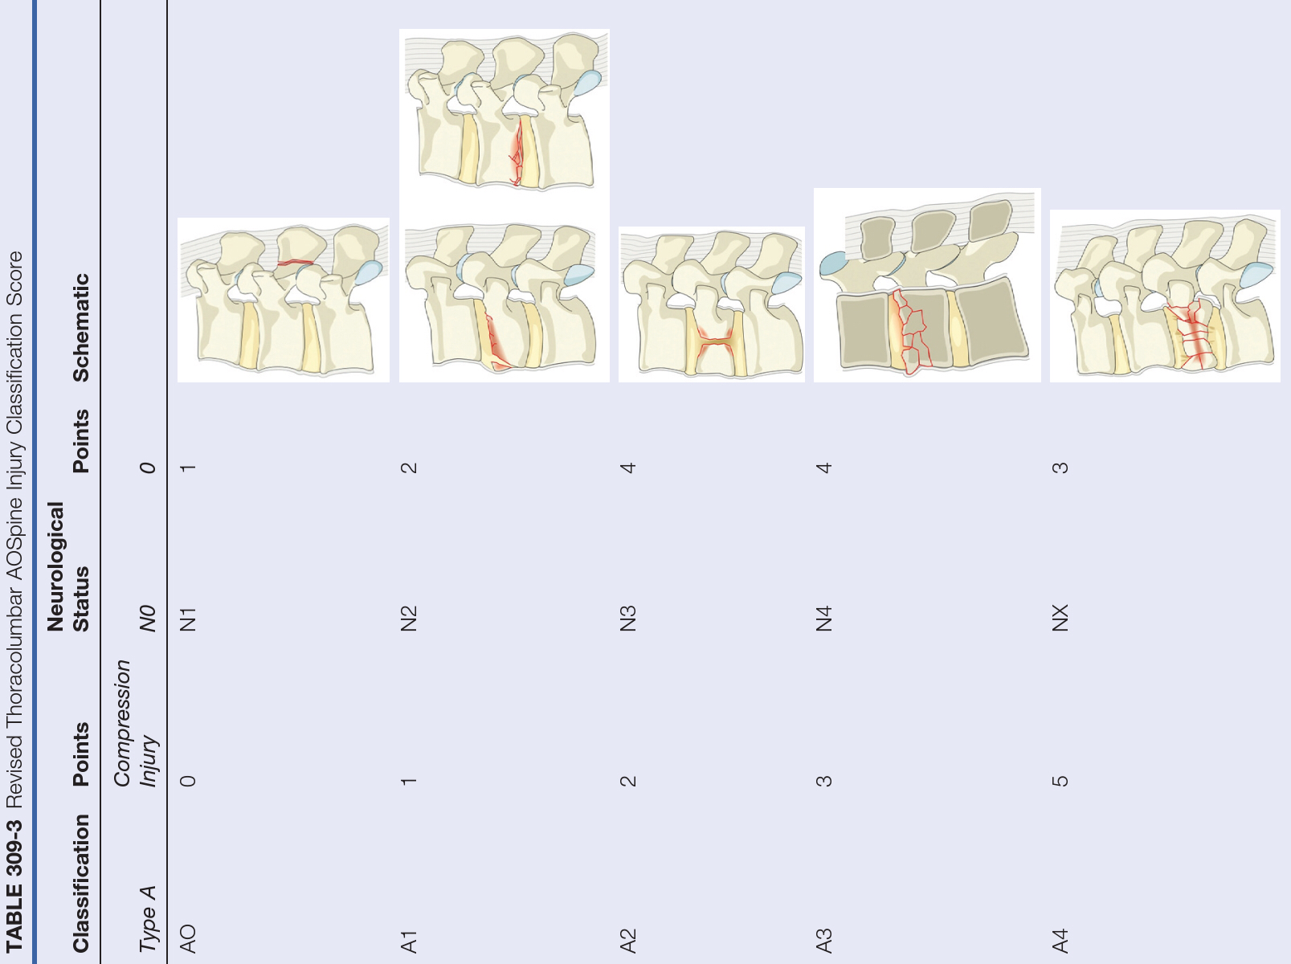

Slide 10
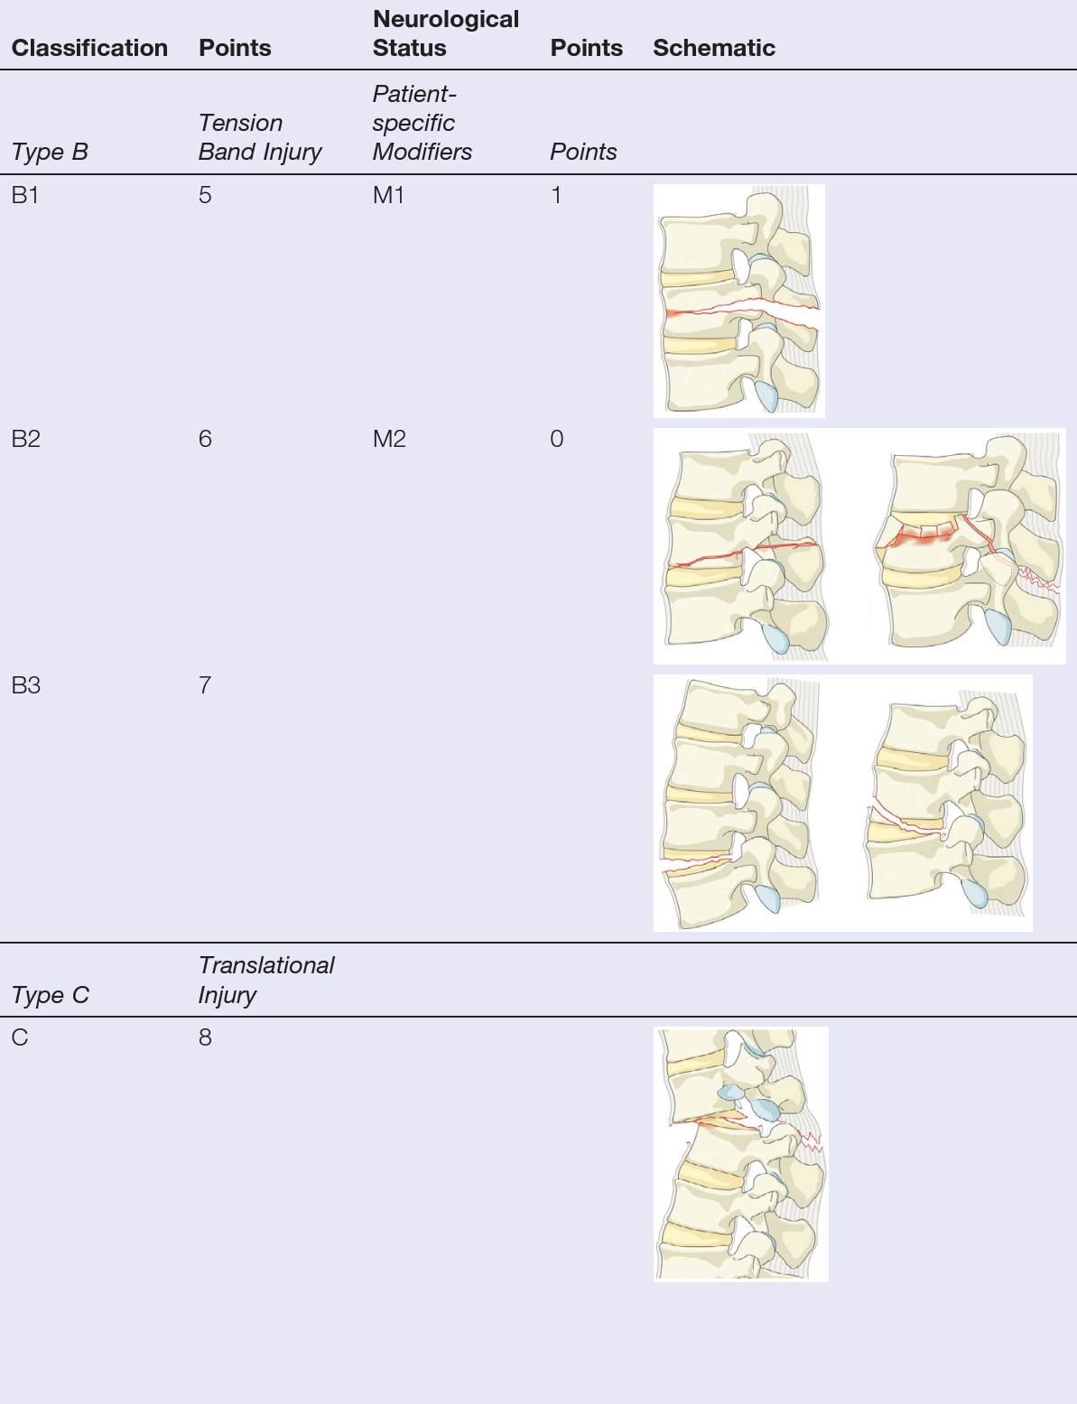
M1, indeterminate integrity of posterior ligamentous complex;
M2, patient-specific morbidities significantly influence treatment decision-making;

Slide 11
Treatment
The standard treatment is posterior instrumentation and fusion, modern techniques allow for all three columns to be addressed by the posterior approach.
For specific pathology, such as retropulsed fragments into the canal
Anterior, retroperitoneal approach allows for the greatest ease of neural decompression.
Posterolateral approach in the ability to access all three columns, decompress retropulsed anterior pathology, and provide three-column stabilization through an anteriorly placed graft as well as a pedicle screw-rod construct.

Slide 12
INDICATIONS FOR POSTERIOR THORACIC AND LUMBAR INSTRUMENTATION
Unstable Fractures Requiring Surgical Stabilization
Posterior complex ligament injuries, rotational fractures, and certain types of burst fractures: some AO classification type B, type C, and some type A4 fractures.
Degenerative Disk Disease
Patients with longlasting low back pain without stenosis or spondylolisthesis with radiologic evidence of disk degeneration at one or two levels in whom the best medical management had failed.
Deformities
Spondylolisthesis with Lumbar Stenosis
Lumbar Stenosis Following Decompression (Without Spondylolisthesis)
Spinal Instability Due to Tumors or Infections

