Slide 1
Discitis and Epidural Abscess Youmans chap 289, 290

Slide 2
Discitis
Is an infection affecting intervertebral disks.
Vertebral osteomyelitis or spondylitis
infection that invades the end plates or the vertebral body.
Spondylodiscitis ( SD )
the infection has already compromised these two structures.
Spinal epidural abscess (SEA)
Is the purulent fluid drained to the epidural space due to Spondylodiscitis.
Etiology
spine infections occur through three major agents, in the following order of frequency:
Bacteria, causing pyogenic infections.
Tuberculosis or fungi, responsible for granulomatous infections.
Parasites, which are the less common cause.

Slide 3
EPIDEMIOLOGY
SD has a bimodal distribution with peak
before 20 years of age
another between 50 and 70 years of age.
The M:F ratio 2 : 1 to 5 : 1 for pyogenic SD.
Discitis complication represents up to 30% of all cases of pyogenic SD after previous surgery.
SEA affects people at any age, but the highest prevalence is in the fifth to seventh decades of life.
Similar sex incidence or a slight male predominance has been described in SEA.

Slide 4
Risk factors for spinal infections are
Intravenous drug use.
Indwelling catheter.
Previous spinal procedure.
Epidural procedure.
Immunocompromised.
HIV
Alcohol abuse.
Distant site infection.
Diabetes mellitus, cancer, liver cirrhosis, renal failure.
Rheumatologic disease.

Slide 5
Pathogens Involved
Staphylococcus aureus
is the predominant pathogen, with an incidence between 30% and 80%.
Gram-negative bacteria such as Escherichia coli and Proteus, Klebsiella, and Enterobacter species
are responsible for up to 25% of spinal infections, mainly in older people and often secondary to urinary tract infections.
Pseudomonas aeruginosa
is more common in intravenous drug users.
Coagulase-negative staphylococci, such as Staphylococcus epidermidis, and methicillin-resistant S. aureus
are infections consequent to spinal procedures or catheter placement.
Anaerobic agents
are also a cause of infections, especially in penetrating spine trauma.

Slide 6
Routes of Pathogen Spread
The microorganisms often spread through three routes: (A) hematogenous, (B)contiguous, (C)iatrogenic inoculation.
In 30% to 40% of cases, the source of infection is not identified.
Hematogenous spread ( 50% )
The most frequent cause of infection.
Primary sources are skin, soft tissue, urinary tract, and respiratory tract.
In children, the infection is located within the disk because the intraosseous arteries have extensive anastomoses, with some vessels penetrating the intervertebral disk.
In adult intervertebral disk undergoes an involution of the intraosseous anastomosis, and the septic emboli lead to the formation of extensive vascular bone infarcts and spread of infection to the vertebral end plates.
Posterior vertebral body spread is very rare in pyogenic SD because of their deficient vascular supply and occurs more frequently in fungal and tuberculous infections.
Anterior portion of the vertebra has the principal vascular supply, and erosion of vertebral end plates, osteolytic lesions, compression fractures, and SEA formation are observed, which can lead to spine instability, deformity, and risk for spinal cord compression.

Slide 7
Contiguous Tissues (10% to 30% )
Contiguous tissue extension originates from vertebral osteomyelitis or psoas muscle abscess.
Direct Inoculation (15% )
Direct inoculation as a cause of SEA includes all kinds of invasive procedures, such as surgery, lumbar puncture, peridural anesthesia, epidural analgesia, and nerve blocks.

Slide 8
CLINICAL SIGNS AND SYMPTOMS
Spondylodiscitis (SD)
In children
Symptoms may include irritability; refusal to crawl, sit, or walk; abdominal pain; or incontinence.
The most frequent sign found on physical examination is the loss of lumbar lordosis.
The uncommon signs are neurological deficits and fever.
In adults
The first clinical findings are usually nonspecific back or neck pain and fever.
Radicular pain to the chest or abdomen, which becomes worse at night, is a consequence of the infection spreading into the epidural space.
Motor neurological deficits, such as leg weakness and incontinence, are present in about 1/3rd of patients and are usually associated with late diagnosis.

Slide 9
Spinal epidural abscess
The classical triad of SEA symptoms (back pain, fever and neurological deficit) is present in only 9% to 15% of patients.
Heusner stage system of clinical signs and symptoms of SEA
Stage I includes back pain, fever, and tenderness to palpation.
Stage II includes radicular pain and nuchal rigidity or neck stiffness.
Stage III the patient presents with neurological deficits and bowel and bladder dysfunction.
Stage IV includes paralysis.
Spinal kyphosis and tumefaction → tuberculous spondylitis.
Infarction of the skin of the forearms or hands and conjunctivae, as well as the presence of a heart murmur → infectious endocarditis, which is associated with pyogenic discitis.

Slide 10
DIAGNOSIS
SEA represents a spinal emergency condition and a potentially life-threatening disease that can cause severe neurological deficits by either
direct compression of an abscess onto the spinal cord or nerve roots
vascular compression and ischemia.
If spinal infection is suspected clinically, the diagnosis confirmed by
Blood Inflammatory Markers:-
CRP
Best marker for diagnosis and monitoring responses to treatment because it returns to normal after adequate treatment and faster than ESR.
CRP levels in the second week after admission can be a prognostic marker.
ESR
Sensitive marker of infection and therapeutic response, but low specificity.
The CRP level usually responds within weeks, but the ESR may take months to normalize.
WBC count
Patients with acute SEA commonly have more systemic illness than those with vertebral osteomyelitis; nevertheless, none of the laboratory findings is specific to the pathology.

Slide 11
Blood and Urine Cultures
The aerobic and anaerobic blood and urine cultures should be obtained before antibiotics are initiated to identify the causative microorganisms.
Positive blood cultures were observed in about 60% of cases.
Infected Tissue Biopsy
The infected tissue biopsy should be performed early because blood cultures remain negative in 40% of cases.
Histologic analysis of the biopsy material should be done to rule out malignancy.
The tissue material can be obtained by using computed tomography (CT)-guided needle, open, or endoscopic biopsy.

Slide 12
CT Guided Needle Biopsy
The diagnostic accuracy of CT-guided needle biopsy is as high as 70%.
Indications are:-
Patients with a posterior SEA.
No neurological deficit.
High surgical risk.
Those who do not respond satisfactorily to antimicrobial treatment.
Open or Endoscopic Biopsy
Indicated when
Negative culture results are observed after CT-guided needle biopsy.
In cases of surgical indication, such as intractable pain, instability, and progressive neurological deficit.

Slide 13
Radiologic Imaging
SEA is usually localized in the dorsal portion of the canal and mainly at the thoracic region because The diameter of the epidural space is greater at the dorsal portion of the vertebra canal and gradually expands from C7 along the thoracic region, with the greatest depths below L2.
Abscesses located anterior to the spinal cord are frequently but not exclusively associated with vertebral osteomyelitis.
The imaging study can be done by
Plain X-ray
CT
is superior for showing bony changes, including early changes of vertebral end plates, the presence of bone necrosis, and pathologic calcifications suggestive of tuberculosis.
Myelography followed by CT will show a block to contrast medium flow at the level of the SEA but cannot identify the cause of the thecal sac compression.
Radionuclide Imaging

Slide 14
Magnetic Resonance Imaging
MRI is the “gold standard”
T1
low signal in disc space (fluid) and in adjacent endplates (bone marrow edema)
T2: (fat sat. or STIR especially useful)
high signal in disc space (fluid) and in adjacent endplates (bone marrow edema)
T1 + contrast (Gd)
Peripheral enhancement around fluid collections , vertebral endplates.
Enhancement around low-density centre indicates abscess formation.
DWI
hyperintense in the acute stage
hypointense in the chronic stage
The key to identifying liquid abscess, which is usually sufficient cause for surgical drainage, is the presence of a region of high T2 signal, with low T1 signal and without enhancement (usually surrounded by a rim of enhancement).

Slide 17
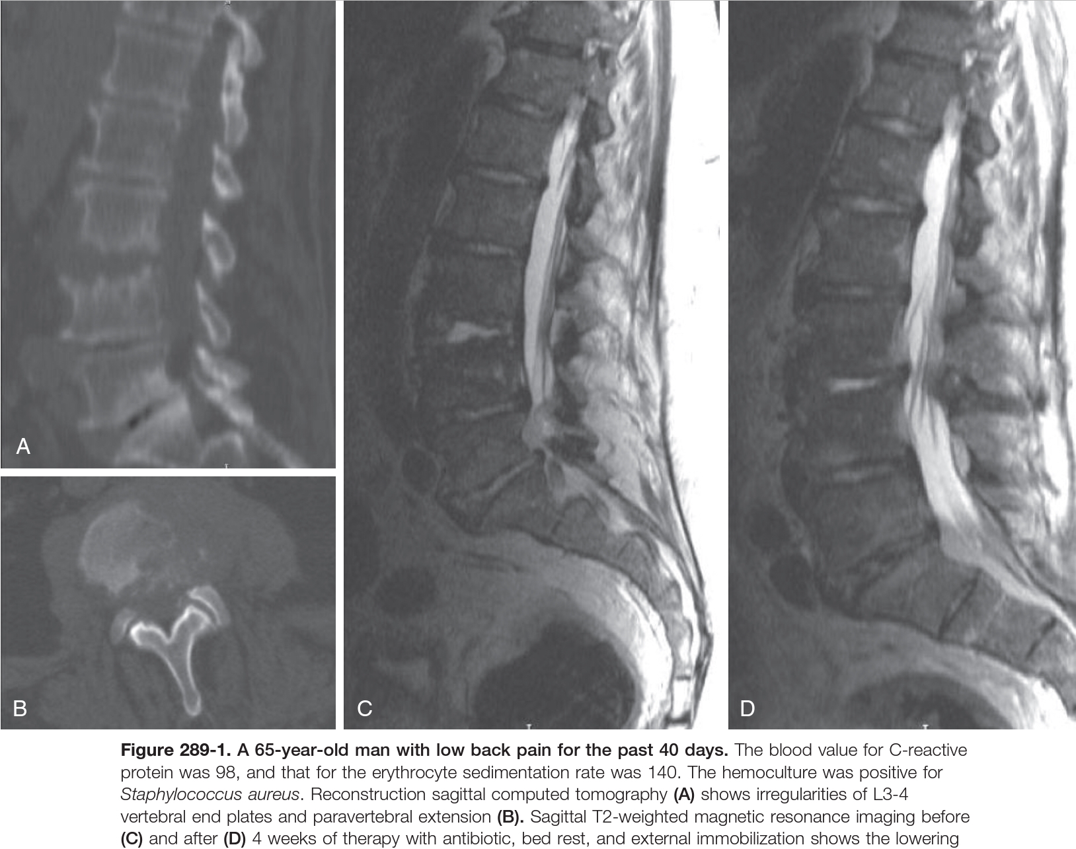

Slide 18
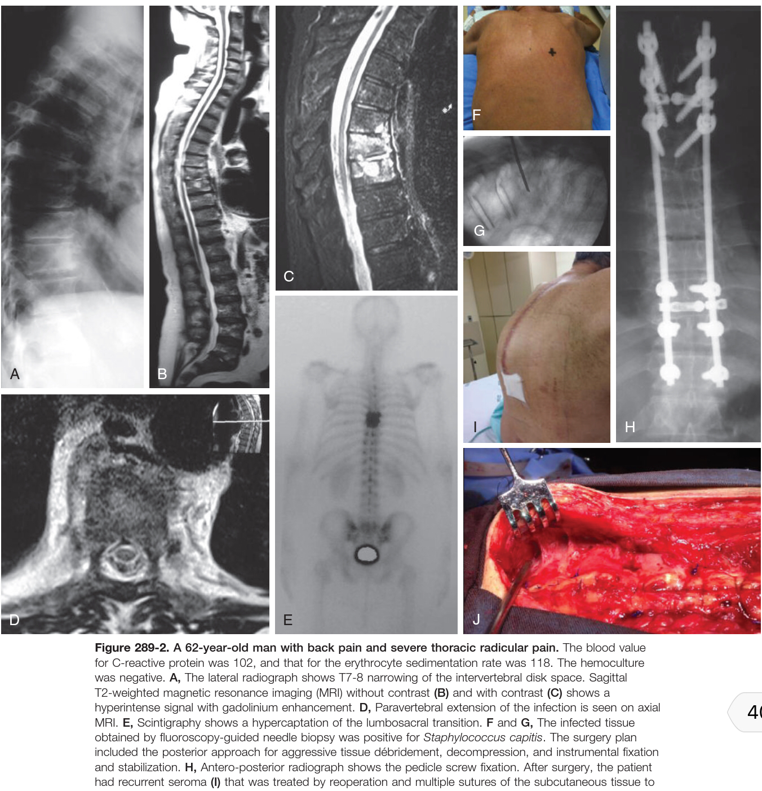

Slide 19
Differential Diagnosis: Pyogenic versus Tuberculosis Spondylodiscitis

Slide 20
TREATMENT
The goals of treatment are:-
Infection eradication.
Preservation of neurological status.
Pain relief.
Prevention of neurological deterioration.
Maintenance of vertebral column stability.
Antibiotics are the main therapy for eradication of the underlying infection and should always be prescribed.
Blood culture and CT-guided or open biopsy are the first line of investigation in suspected cases of SD and SEA
Treatment modalities are
( A ) Antibiotic Therapy.
( B ) External Immobilization.
( C ) Surgical Treatment.

Slide 21
Antibiotic Therapy
Indications
High surgical risk
Complete paresis for more than 3 days
In the presence of sepsis or with the impossibility of an etiologic diagnosis, empirical antibiotic therapy should be considered
Augmentin 2.2 g given intravenously 3 times daily
cefuroxime 1.5 g given intravenously 3 times daily
Definitive antibiotic treatment is predicated on culture and sensitivity results.
The duration of the intravenous treatment is
3 to 4 weeks in cases with only SEA
6 to 8 weeks in cases of concomitant vertebral osteomyelitis, followed by oral administration for an additional period of 6 to 12 weeks using (fluoroquinolones, clindamycin, rifampicin, and fusidic acid).
Antibiotic therapy efficacy is monitored by ESR or CRP
To monitor SEA size, MRI with contrast should be repeated after 2 to 4 weeks.

Slide 22
External Immobilization
The goals of external immobilization are :-
Reduce the pressure on the affected vertebra through a better load distribution to the normal joints.
Reduce the incidence of deformity.
Reduce the complications of prolonged bed rest.
Cervical spine immobilization can be achieved using a collar or a halo fixator, and a thoracolumbar brace is indicated for the thoracic or lumbar spine.

Slide 23
Surgical Treatment
Indications
Failure of conservative measures.
Compression of neural elements.
Spine instability or deformity.
Presence of epidural abscess, sepsis.
Intractable pain.
The surgical goals are
Debridement.
Tissue Sampling for microbiologic and histologic analyses.
Decompression of the spinal canal and drainage of paravertebral abscesses.
Restoration of spinal alignment and stabilization.

Slide 24
Surgical Approaches
Anterior Approach
Recommended in spinal osteomyelitis patients with a neurological deficit caused by progressive kyphosis.
Posterior Approach
is performed in the setting of posterior location spinal epidural abscesses associated with neurological deficit.
The facet joints are left intact to maintain spinal stability.
Large multilevel laminectomies without instrumentation are contraindicated.
Combined Approach
Extensive anterior bone destruction, collapse, and segmental kyphosis are better achieved by a combined approach to obtain better decompression, strong fixation, and better circumferential fusion.
When anterior radical debridement and reconstruction are anticipated, it is more convenient to start with posterior fixation and stabilization.

Slide 25
Decompression in Different Spinal Segments
Cervical Spine
Cervical spine infections usually occur at the anterior location of the spinal canal and are or are not associated with bone destruction.
Anterior approach is recommended for debridement, decompression, and fusion with bone graft and is associated with anterior plate stabilization.
In severe instability or when multilevel intervention is needed, a combined posterior approach for circumferential fixation is usually performed.
Posterior decompression alone can be performed in the presence of an epidural abscess located posterior to the spinal cord without bone destruction or instability.

Slide 26
Thoracic Spine
In cases with mono segmental and anterior lesions, the anterior approach for decompression and fusion is usually indicated.
In the presence of thoracic SEA without anterior disk or bony destruction, and when the procedure itself will not destabilize the spine, laminectomy over the affected levels may be indicated.
The combined approach is reserved for patients with kyphosis caused by multilevel anterior and posterior bone involvement or by anterior bone destruction and collapse.

Slide 27
Thoracolumbar Junction and Lumbar Spine
Posterior decompression is indicated
In patients with a neurological deficit associated with extensive epidural invasion.
Posterior decompression and stabilization is indicated
In patients with a neurological deficit associated with mono segmental spondylodiscitis associated with minimal kyphosis.
The combined approach is usually indicated
in cases of anterior destruction of the vertebra associated with kyphosis in order to perform an initial anterior decompression, with anterior reconstruction using a bone graft or a titanium cylinder with or without instrumented fixation, followed by a posterior stabilization procedure.

Slide 28
Minimally Invasive Approach
Indicated in old age or medical unfit for GA
The less invasive surgical procedure can be an option including
CT-guided percutaneous catheter drainage.
Percutaneous transpedicular discectomy and drainage.
The percutaneous endoscopic technique.
Poor outcome are
Older age
Cervical and thoracic spinal involvement
D.M & Chronic heart disease
Motor deficit or bowel or bladder dysfunction before treatment
Neurological deficits for longer than 36 hours
Delayed diagnosis
Infections caused by methicillin-resistant S. aureus MRSA
Among these, the major prognostic factors are the presence of a motor deficit or bowel or bladder dysfunction and delayed diagnosis.

Slide 29
Medical treatment for pyogenic SD
For sensitive staphylococcal strains
4 to 6 week intravenous (IV) course of a first-generation cephalosporin and rifampin.
For resistant strains
vancomycin is the preferred option.
Gram-negative bacterial infection
Third-generation cephalosporin is considered, as is ciprofloxacin or another alternative with good bone penetration.
Lower CRP level after 2 weeks of treatment represented an indication for switching to oral administration.

