Slide 1
Degenerative
spine
( thoracic )
Youmans chap 285, 327

Slide 2
Evaluation and Treatment of Thoracic Disk Herniation
Thoracic disk herniations are rare in comparison with cervical and lumbar herniations.
Equal numbers of men and women are affected.
The locations of most thoracic disk herniations are central or lateral central ;exclusively lateral ones are extremely rare.
The majority of herniations are found at levels T7 and lower.
Approximately 30% to 70% of thoracic disk herniations are calcified.
5% to 10% of them have intradural extension.

Slide 4
Anand and Regan classification
Lateral herniations can compress the nerve root, and radiculopathy can occur; this is characterized by pain and sensory alteration in the dermatome of the effected root. Radicular pain is frequent and worsens in a recumbent position. For that reason, night pain is a common complaint.

Slide 5
INDICATIONS FOR SURGICAL INTERVENTION
Progressive or severe uncontrollable radicular pain and myelopathy.
Surgical treatment should be considered in cases of grade 3A or worse herniation, according to the Anand and Regan classification.
The factors that most influence the choice of the surgical access are
The level and position of the herniation.
Penetration of the dura mater.
Disk consistency.
The need for fusion.
The physiologic age of the patient.
The familiarity of the surgeon with different approaches.

Slide 7
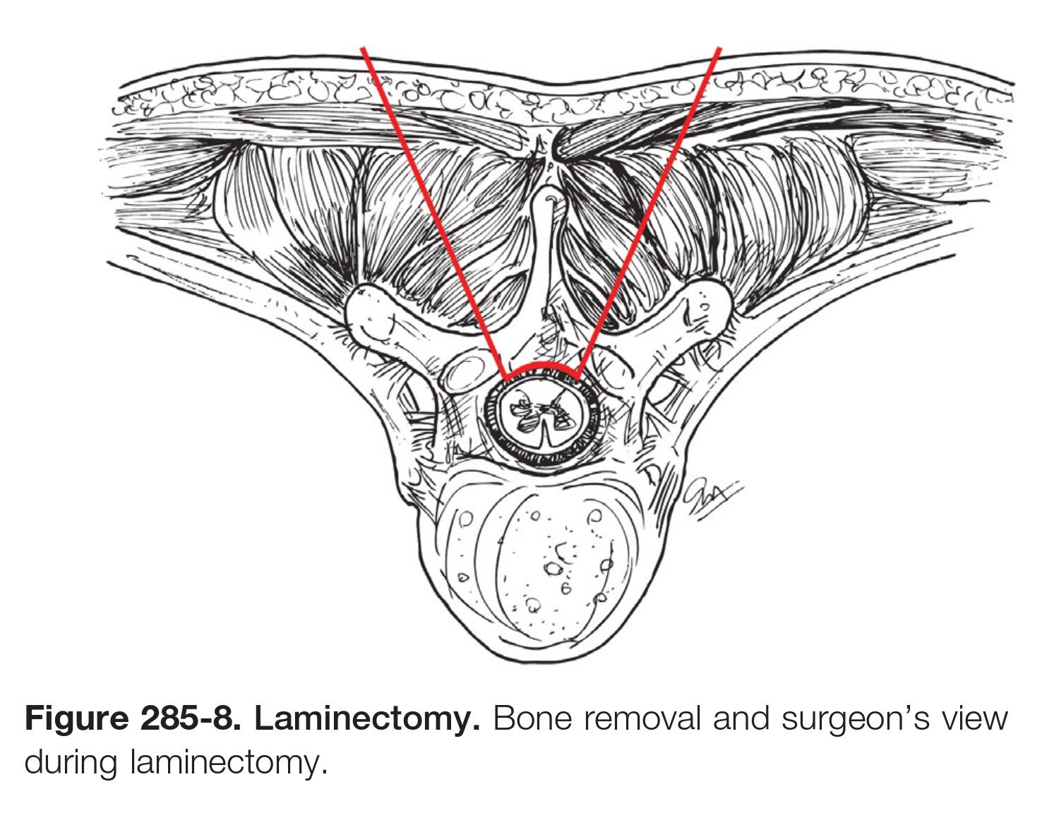
Dorsal Approaches
Laminectomy
The earliest options of treatment consisted of simple laminectomies, and the results were varied and frequently associated with spinal cord injuries.
Some surgeons would limit their operation to a simple decompression, without removing the disk, to avoid potentially harmful effects of manipulation of the spinal cord to reach the ventral positioned herniated disks.

Slide 8
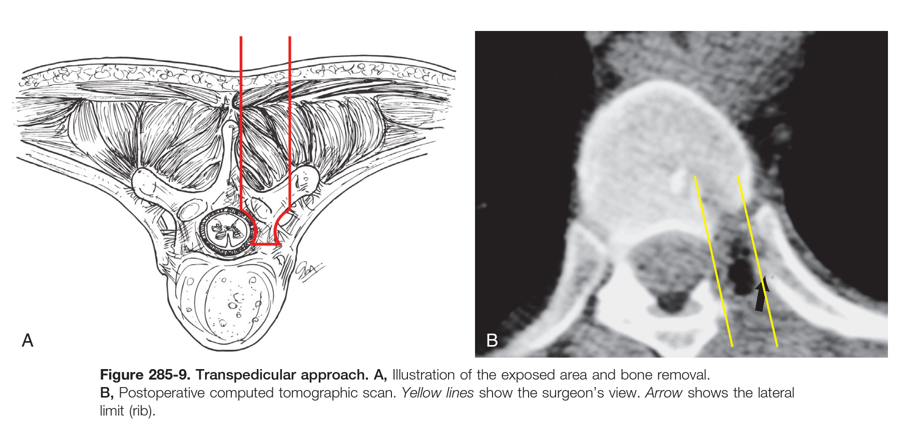
Transpedicular Approach
The transpedicular approach provides more direct access to the disk space ventrally and involves the removal of the whole pedicle and facet.
This approach is best used for lateral and mediolateral disk herniations.
The advantage
The possibility of preserving the radicular arteries and the lack of manipulation of the spinal cord.
The disadvantage
There is no or limited visualization of the spinal dura so that the procedure is done to a certain extent in a blinded fashion.

Slide 9
Posterolateral Access
Costotransversectomy
it involves resection of the medial aspect of the rib and the removal of the transverse process, allowing significantly better access ventrally compared with laminectomy.

Slide 10
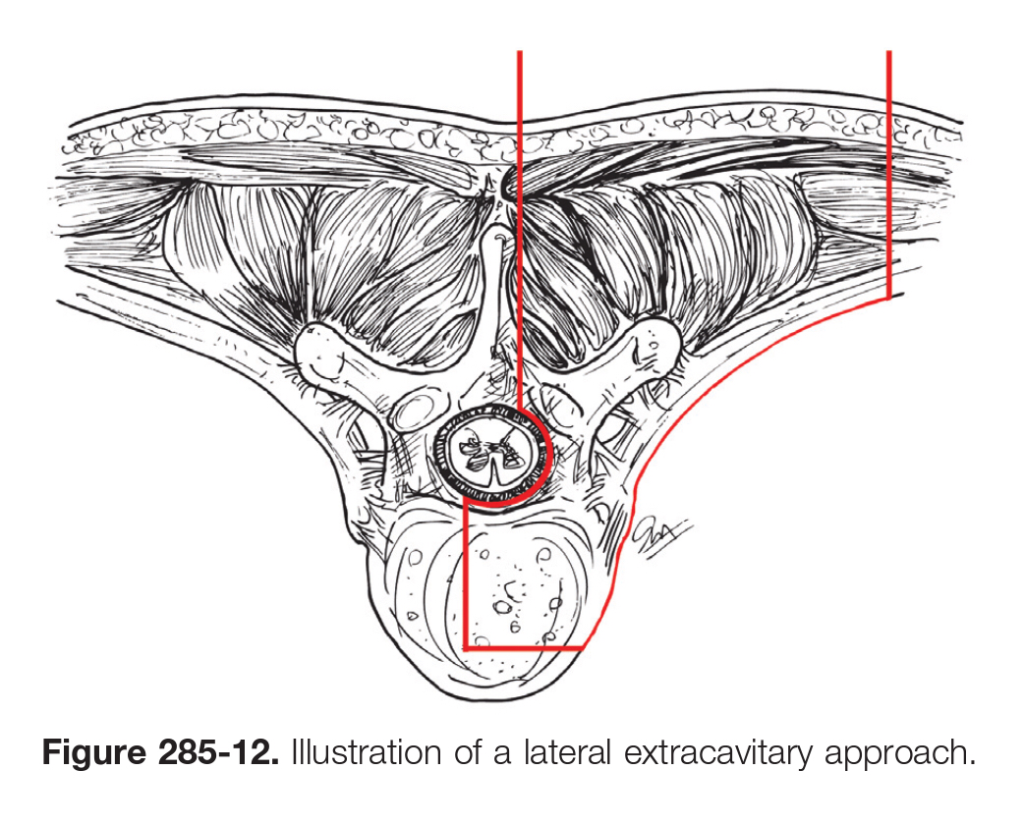
Lateral Extracavitary Approach
It provides excellent ventral exposure of the spine, and it is completely extrapleural.
It requires extended dissection and manipulation of soft parts, including the paravertebral muscles, which can be denervated and devascularized.
It is limited above T5 by the scapula.

Slide 11
The lateral extracavitary parascapular approach
It provides exposure of the superior thoracic spine above T5, which is comparable to the lateral extracavitary approach.
The additional risks of this approach relate to difficulties in mobilization of the scapula and associated postoperative dysfunction and pain.

Slide 12
Ventral Approaches
Advantages
Provide unparalleled exposure of the spinal cord, allowing a wide angle for the removal of intradural disks and for dural repair.
It also allows access to various levels of the thoracic spine.
Indication
Ventral access is considered the most appropriate way to treat a thoracic disk lesion Except in the case of a lateral disk herniation.
For calcified and medially located herniations.
Disadvantages
Lung morbidity and the risk of injuring large vessels and viscera.
The morbidity of a thoracotomy (e.g., long stay in the intensive care unit, postsurgical pain caused by the chest tube).

Slide 13
Complications
Neurological deterioration
Wrong surgical level
Incomplete resection of the disk
Postsurgical instability
CSF leak
Pulmonary complications
Infection
Intercostal neuralgia

Slide 15
INDICATIONS FOR ANTERIOR THORACIC SPINE SURGERY
Infection
Trauma
Tumor (metastatic spinal cord compression)
Degenerative disease (Medially located, calcified disks)
Deformity: The two most common deformities in this region are
Adolescent idiopathic scoliosis.
Scheuermann’s kyphosis.
Treatment of Pott’s disease.
TB spine usually affects the vertebral end plate and subsequently the intervertebral disks.
Surgery for tuberculous spinal infections is less common, and the mainstay of treatment is antituberculous chemotherapy.
The main indications for surgical intervention are
Progressive neurological deficit.
Mechanical instability with progressive deformity.
Unresponsiveness to conservative treatment.
Uncertain diagnosis.

Slide 16
Trauma
Indications
Compression # (burst fractures from retropulsed bony fragments).
Comminution with loss of anterior and middle column support.
Correction of kyphosis.
Contraindications
Traumatic injuries to the chest with pulmonary contusion, and abdominal injuries.
Marked osteoporosis.
Irreducible dislocation may be easier to reduce using a posterior approach.
Morbid obesity may limit exposure.

Slide 17
SURGICAL APPROACH
Split Manubrium Approach for C7 to T4
Open Thoracotomy for T2 to T8
The upper thoracic spine (T2 to T9) is best approached from the right side to avoid the heart and aortic arch.
The thoracolumbar spine (T10 to L2) can be approached from the left to avoid liver retraction.
Split Diaphragm Approach for Thoracolumbar Junction
Thoracoscopic Approach

