Slide 1
Degenerative disease of the spine Evaluation and Treatment of Cervical Disk Herniations Youmans Chap.283 Atlas_of_Neurosurgical_Techniques Operative Techniques-Spine Surgery 2018

Slide 2
ANATOMY AND PATHOPHYSIOLOGY
The cervical region of the spine consists of seven cervical vertebrae.
The cervical vertebrae have relatively small bodies with respect to the arch and transverse processes.
The transverse foramina perforate the transverse processes and contain the vertebral artery from C6 to the skull base.
The nerves lie posterior to the vertebral artery.
Articulations of the subaxial cervical spine include the intervertebral disk and facet joints posteriorly.
There are eight cervical nerve roots and seven cervical vertebral bodies; therefore the respective nerve exits above its named pedicle down through C7.
The C8 nerve root exits below the C7 pedicle.
Cervical nerve roots exit through a neural foramen in a shorter, more direct transverse trajectory and occupy most of the foramen, in contrast to lumbar nerve roots, which have a more oblique path and capacious foramina.

Slide 3
The cervical spine can be divided into functional groups:
Rotation
Approximately 40% of axial rotation occurring at C1-2.
The anatomic configuration of the atlantoaxial joint permits only rotation.
The remaining axial rotation is evenly distributed throughout the subaxial cervical spine, with the C4-7 levels providing the most motion.
Flexion / Extension
Nearly 50% of ﬂexion occurs in the occipital to C2 region, with the greatest contribution coming from the occipitocervical junction.
The remainder of flexion is spread throughout the subaxial cervical spine, with the lower cervical segments contributing most.

Slide 9
Cervical spondylosis is a progressive pathologic process that is secondary to biomechanical stress and strain. The process includes :
Disk degeneration.
Facet arthropathy.
Hypertrophy and ossification within both the posterior longitudinal ligament (PLL) and the ligamentum ﬂavum.
The C4-5 and C5-6 segments were shown to contribute most of the total angular mobility, but their contribution to total angular mobility decreased significantly after severe degeneration.
This degenerative cascade eventually leads to neuroforaminal or spinal canal stenosis, or both.

Slide 10
CLINICAL FINDINGS
Axial Neck Pain
In most cases is self-limited.
If due to disc
The anulus is innervated by recurrent branches of the gray rami communicantes, and acute tears are a potential source of axial neck pain.
A degenerative disk, in the absence of acute herniation or tear, can be the source of neck pain when under significant mechanical stress.
If due to Facet arthropathy
The cervical facet joint is likely also an important component of axial neck pain that is innervated by the dorsal rami of cervical nerve roots.
Patients may also have decreased range of motion secondary to pain, and muscle spasm.

Slide 11
Cervical Radiculopathy
Radiculopathy can have sensory or motor findings or both.
Acute radiculopathy
Often occurs in younger patients and is more likely to be caused by a herniated soft disk than by osteophytic spurs.
The inflammatory process leads to a decrease in the number of large-diameter myelinated axons.
Symptoms tend to manifest more rapidly and are more likely to have predominant motor findings.
Chronic radiculopathy
Usually presents with predominantly sensory findings and is more commonly seen in older patients.
Chronic radiculopathy often has both a component of disk pathology and larger contributions from facet arthropathy and most notably uncovertebral osteophytes.
The exact symptoms will depend on the laterality and level of nerve root compression.

Slide 12
Neurological examination
Motor
Sensory
Reﬂex changes
Provocative maneuvers
Spurling’s maneuver :
in which the neck is placed in slight extension with lateral bending toward the symptomatic side as the clinician applies manual axial compression, can re-create symptoms along the compromised nerve root.
It is important to consider C3 and C4 radiculopathy as a potential cause of trapezoidal and posterior scapular pain because it can be overlooked and grouped into chronic axial neck pain.
Shoulder abduction test

Slide 13
Myelopathy
The pathophysiology of myelopathy can resulting from three distinct components:
Static :
Most directly correlates with the degenerative changes associated with cervical spondylosis (Spinal cord compression can result from any of the diskogenic, ligamentous, or osteophytic degenerative processes).
The normal sagittal cervical canal diameter is 17 to 18 mm.
High risk for the development of myelopathic occur with a reduction in canal diameter to 13 mm.
Dynamic :
Secondary to repetitive movement of the compressed spinal cord leading to chronic injury.
Flexion of the cervical spine stretches the cord and can lead to injury in the presence of ventral osteophytes or in the setting of cervical kyphosis.
Cervical extension causes buckling of the ligamentum flavum posteriorly and can result in dynamic compression.
Ischemic :
Secondary to compression of the small pial and intramedullary arterioles or the larger anterior spinal artery, although venous congestion may also play a role.
The pathologic butterfly pattern of cord ischemia involving the gray and medial white matter seen in myelopathy further supports a vascular role.

Slide 14
Cervical myelopathy can be subdivided into :
The lower motoneuron component
2ry to alpha motoneuron injury or nerve root injury when there is concomitant nerve root compression.
Patients complain of dermatomal weakness, tingling, numbness, and decreased fine motor coordination.
Patients may have muscle atrophy, focal motor weakness attributable to the involved level, decreased pinprick sensation, and hypoactive reflexes.
The upper motoneuron injury
2ry to long-tract dysfunction.
The primary tracts responsible for symptoms in patients with cervical spondylotic myelopathy are
Corticospinal (motor).
Spinothalamic (pain and temperature).
Dorsal column (vibration and proprioception).
Spinocerebellar tracts (motor tone and coordination).
Patient may have
Increased leg rigidity and balance impairment.
Hyperreflexia below the level of compression with the possible presence of Babinski’s reflex or Hoffmann’s phenomenon and pathologic clonus.
Close inspection of the hands may demonstrate visible hand intrinsic atrophy and flattening of the thenar eminence.

Slide 15
May complain of decreased manual dexterity in the form of changes in handwriting, typing, buttoning shirts, or occupation related fine motor movements.
Altered sensation is a common complaint of patients and often involves the fingertips.
Balance impairment is an important part of the history in patients suspected of having cervical spondylotic myelopathy because it not only is a symptom but raises the risk of a fall with subsequent spinal cord injury.
Walking tests such as the 30-m walking test represent a reliable and quantifiable metric to assess functional impairment in ambulation in patients with cervical spondylotic myelopathy.
In more severe cases patients may become unable to ambulate without mechanical assistance, or at all.
Bowel and bladder dysfunction can also be seen late in the disease.

Slide 16
DIAGNOSTIC STUDIES
Plain Radiographs:
They can provide information regarding the extent of degenerative disease, such as disk space collapse, osteophyte formation, and spondylolisthesis.
Dynamic X-ray (Flexion and extension), they can be used to identify any area of segmental instability.
Computed Tomography:
Useful in patients who have undergone prior cervical spine surgery.
Important modality in the event that ossification of the PLL is suspected.
Assess the relative contribution of osteophytes to stenosis.
MRI:
Visualization of the spinal cord and nerve roots.
Neurophysiologic Studies:
Patients who do not present with a clear dermatomal pattern of symptoms and have inconclusive imaging findings.
Interventional Techniques: Diskography
Used to confirm or evaluate suspected one- or two-level disk disease, generally in patients with de novo axial neck pain that fails conservative treatment.

Slide 17
CONSERVATIVE MANAGEMENT
Axial Neck Pain
(NSAIDs)
Isometric exercises
Muscle relaxant or opioid pain medication.
Facet joint injection
Radiculopathy
NSAIDs
Short steroid taper targeting the inﬂammatory component of nerve root compression
Cervical collar
Isometric exercises
Cervical traction
Neuropathic medication such as Gabapentin

Slide 18
Anterior approach
Indications :
Radiculopathy/myelopathy from spondylosis or disk herniation
Degenerative instability
Kyphosis
Trauma
Tumor
Infection
Contraindications :
Prior anterior neck infection/scarring
Previous radiation to the anterior neck obscures dissection planes.
Aberrant vertebral artery anatomy is a relative contraindication.
Chin on chest deformity is best treated with cervicothoracic fusion and T1 osteotomy.
Severe ligamentum flavum hypertrophy
Anterior bony ankylosis secondary to degenerative or inflammatory disease.
Vocal cord dysfunction
Medically unfit to general anesthesia.

Slide 19
Advantages :
Familiar, reproducible approach
Successful outcomes in pain relief and resolution of neurologic symptoms
Applicable to a variety of pathological conditions
Disadvantages :
Adjacent segment disease
Neurologic/vascular injury
Dysphagia, dysphonia
Airway risks including reintubation
Inability to address posterior spinal pathology

Slide 20
SURGICAL ANATOMY
The anterior approach is performed through a plane between
the sternocleidomastoid muscle (SCM) and carotid sheath laterally.
the strap muscles and tracheoesophageal viscera medially.
At-risk structures during dissection of the platysma and opening of the cervical fascia include
The external jugular vein.
The 11th C.N is at risk during the retraction of the SCM.
Once the plane is established between the SCM laterally and the strap muscles medially, structures at risk include the larynx and trachea, esophagus and pharynx, laryngeal nerves, and the carotid sheath.
Notes
The right RLN makes a more oblique angle than the left RLN in the sagittal plane after looping around the subclavian artery traveling toward the midline, deflating endotracheal cuff pressure during retractor placement decreases damage to the RLN.
On the left sided opproach the thoracic duct can be injured in the lower cervical spine and may result in chylothorax and severe metabolic derangements.

Slide 21
Levels of pathology are as follows:
C1-3 → 1 cm below the angle of the jaw
C3-4 → hyoid bone
C4-5 → top of the thyroid cartilage
C5-6 → bottom of thyroid cartilage
C6-7 → top of cricoid cartilage
C7-T1→bottom of cricoid cartilage

Slide 23
OPERATIVE MANAGEMENT Planning for Surgical Treatment
Anterior Cervical Discectomy and Corpectomy
Arthroplasty
Fusion
Anterior cervical instrumentation
The core principles of spine surgery
Decompression of the neural elements
Restoration of normal alignment
Stabilization of pathologic segments
Prevention of further deformity

Slide 24
The decision to use an anterior approach versus a posterior approach depends on a multitude of factors.
An anterior approach for
Central and posterolateral disk herniation.
Cervical kyphosis is present, for restoration of lordosis and improved sagittal balance.
Posterior approaches rely on an indirect decompression with the spinal cord drifting away from anterior pathology.
Complication of Ant. Approach:
The most common complication was a transient dysphagia
Hoarseness, vocal cord paralysis
Anterior vascular injury
Injury to the trachea or esophagus
Horner syndrome due to sympathetic chain injury
Spinal cord injury
CSF leak
Wound infection
Hematoma
Injury to the vagal innervation of the larynx can result in silent aspiration (superior laryngeal branch)

Slide 25
Anterior Cervical Discectomy and Corpectomy
Anesthesia and Positioning
Ask the patient to flex and extend the neck voluntarily.
The patient is placed in the supine position.
Mechanical injury as a result of neck hyperextension during intubation must be avoided, especially in the setting of preexisting myelopathy.
In an unstable cervical spine, the neck is kept in a neutral position and may require fiberoptic intubation.
The head can be stabilized using a Mayfield horseshoe headrest.
A rolled towel is placed between the scapulae to increase accessibility to the anterior spine.
Gardner-Wells tongs may be utilized in situations where distraction is required (corpectomy).
After adequate padding, the arms are tucked to the sides.
The shoulders are then pulled caudally and secured to the operating table with broad cloth tape, which intraoperative lateral radiography of the cervical spine, especially at C6-C7 and C7-T1 levels.
Excessive shoulder traction may cause a C5 nerve root injury or brachial plexopathy.

Slide 26
Exposure
Transverse incision (from the medial border of the sternocleidomastoid muscle to midline along the path of a skin crease).
For simple one or two-level discectomies.
In some patients a three-level discectomy, corpectomies, and even four-level discectomy ,improving cosmesis.
For more than two levels, the incision can be extended past midline.
Oblique incision along the medial border of the sternocleidomastoid muscle can be utilized to have adequate surgical access.
The platysma muscle is then divided sharply either
Along the course of the fibers near the medial aspect of the sternocleidomastoid muscle
Or transversely along the course of the skin incision.
It is important to undermine the platysma muscle in order to reduce superficial tension and a restricted surgical field.
The outer cervical fascia is then incised sharply along the medial aspect of the sternocleidomastoid muscle and the lateral aspect of the laryngeal strap muscles.

Slide 27
Blunt dissection is utilized, and carotid pulsations can be palpated deep to the sternocleidomastoid muscle.
Using a Cloward handheld retractor,
the trachea and esophagus are retracted medially
the carotid sheath retracted laterally.
The prevertebral fascia, which directly lies over the cervical spine, can be bluntly stripped away to expose the medial edge of the longus colli muscles.
These muscles can then be resected laterally with electrocautery on the surface of the vertebral body, enabling subperiosteal placement of a self-retaining retractor beneath the longus colli.
Sharp dissection should halt when the vertebral body begins to slope downward to the edge of the transversarium foramen.
Straying lateral to the longus colli muscle places the sympathetic chain at risk, leading to a possible Horner’s syndrome, which is a neurologic condition characterized by ptosis, miosis, and anhidrosis.
Caspar distraction pins can be placed midline at the midpoint of the vertebral body to assist in exposure and help distract the intervertebral disk space.

Slide 28
Anterior Cervical Discectomy and Corpectomy
Retraction : Caspar pins are placed in the vertebral bodies cranial and caudal to the corresponding disk.
Disk removal :
The disk space is incised circumferentially from the lateral margins along both end plates.
A pituitary rongeur and curets are used to resect the superficial disk material.
Drilling :
utilized for significant osteophyte formation,
utilized right down onto the PLL with careful attention to respect the lateral margins of the disk space and not to exert any downward force.
The joints of Luschka are a good lateral landmark that helps the surgeon avoid extending the drilling too laterally and potentially injuring the vertebral artery.
Once the PLL is identified , any residual osteophytes are drilled away prior to resection.
Resection of PLL :
The PLL is then elevated laterally, where it is thinnest and weakest, with a blunt-tip nerve hook and resected with a small Kerrison punch.

Slide 29
Formainatomy :
If the patient has radicular symptoms, a wide foraminotomy is performed.
An adequate decompression is confirmed with the use of a small nerve hook.
Hemostasis is accomplished with the use bipolar electrocautery or other available hemostatic agents.

Slide 30
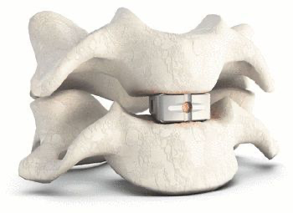
ACDF PEEK cage

Slide 31
Regarding Corpectomy
Indications
When the extent of epidural compression extends beyond the level of the disk space.
For significant retrovertebral compression that would not be decompressed through a standard discectomy.
Discectomy is performed above and below the involved vertebral body.
The PLL need not be resected during the initial discectomies.
Bone work by Leksell rongeur to remove the central portion of the vertebral body, and it is saved for local autograft.
A high-speed drill is then used to drill the remaining bone down onto the PLL.
The drilling trajectory must be kept perpendicular to the vertebral body to avoid skating obliquely and injuring the vertebral artery.
The width of the decompression need not extend more than 18 mm, because any radicular symptoms would be addressed at the level of the disk.

Slide 33
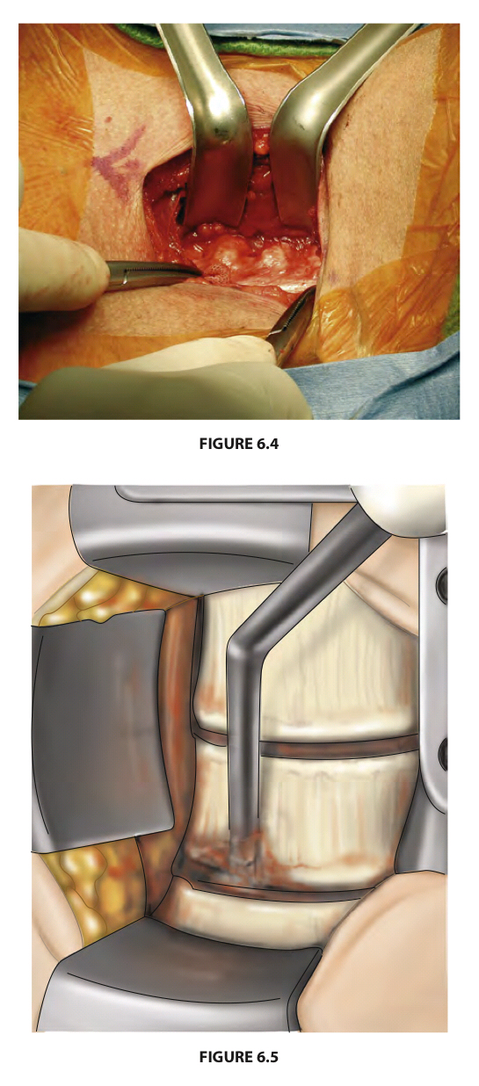

Slide 34
Fusions
The most commonly utilized techniques are a modification of the Smith-Robinson technique that seats the graft on the stronger subchondral bone, thereby limiting subsidence.
Available interbody materials include
Cadaveric allograft
Titanium
Polyetheretherketone (PEEK)
Hydroxyapatite
Tantalum
Iliac crest autograft associated with morbidity and has discouraged.
The use of allograft with an anterior plate demonstrated fusion rates comparable to those of iliac crest autograft without the associated morbidity.

Slide 38
Cervical arthroplasty
Indications :
Patient with one- or two-level symptomatic cervical disk protrusion between C3 and C7, causing radiculopathy or mild myelopathy refractory to medical management.
Patients who have radiculopathy due to herniated disk without facet joint arthropathy.
Contraindications :
Cervical spine kyphosis or deformity.
Severe spondylosis of the facet joints.
Trauma with ligamentous or facet injury.
Osteoporosis.
Cervical ankylosis due to spondyloarthropathy.
Recent history of infection or osteomyelitis.

Slide 43
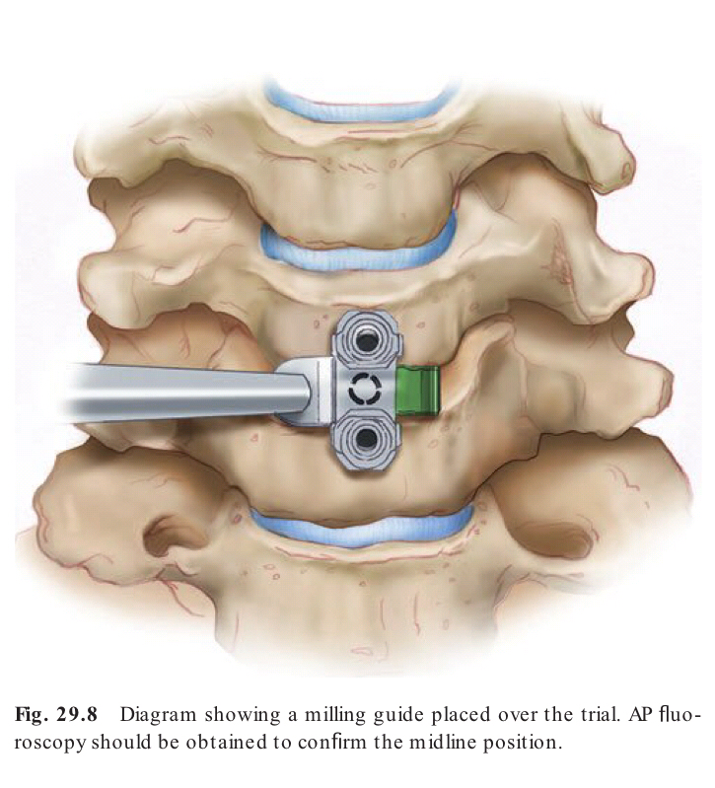

Slide 44
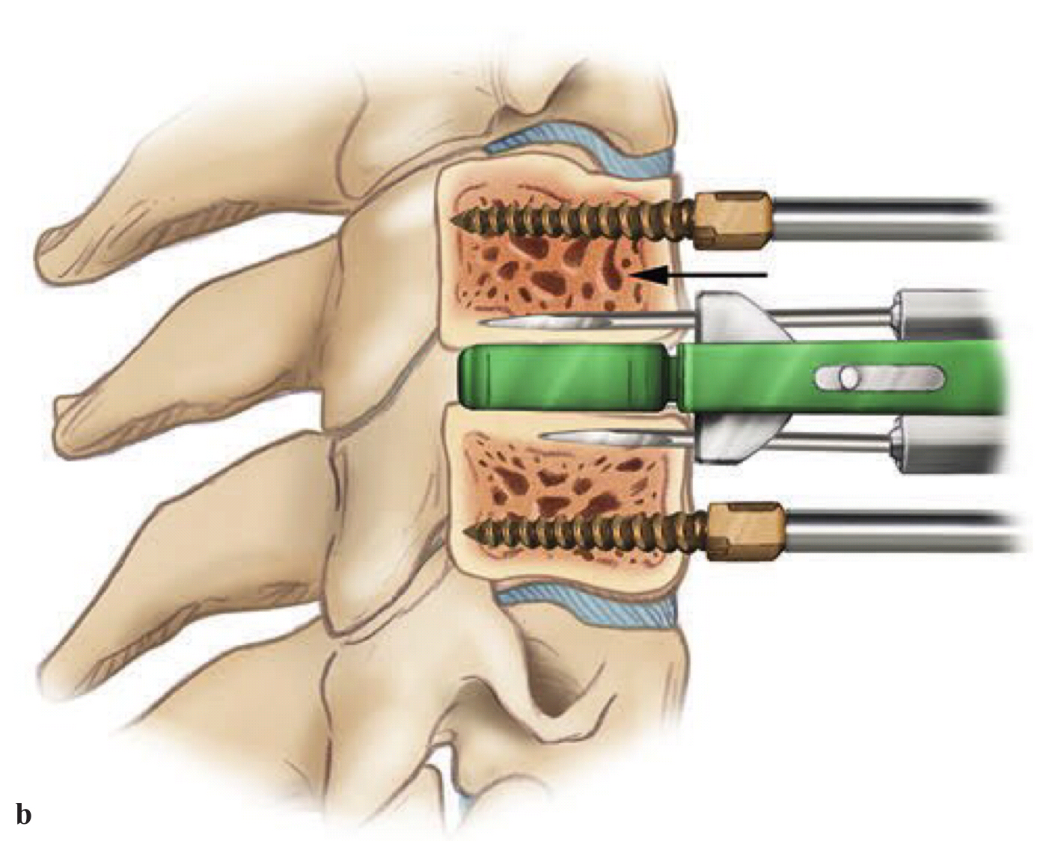
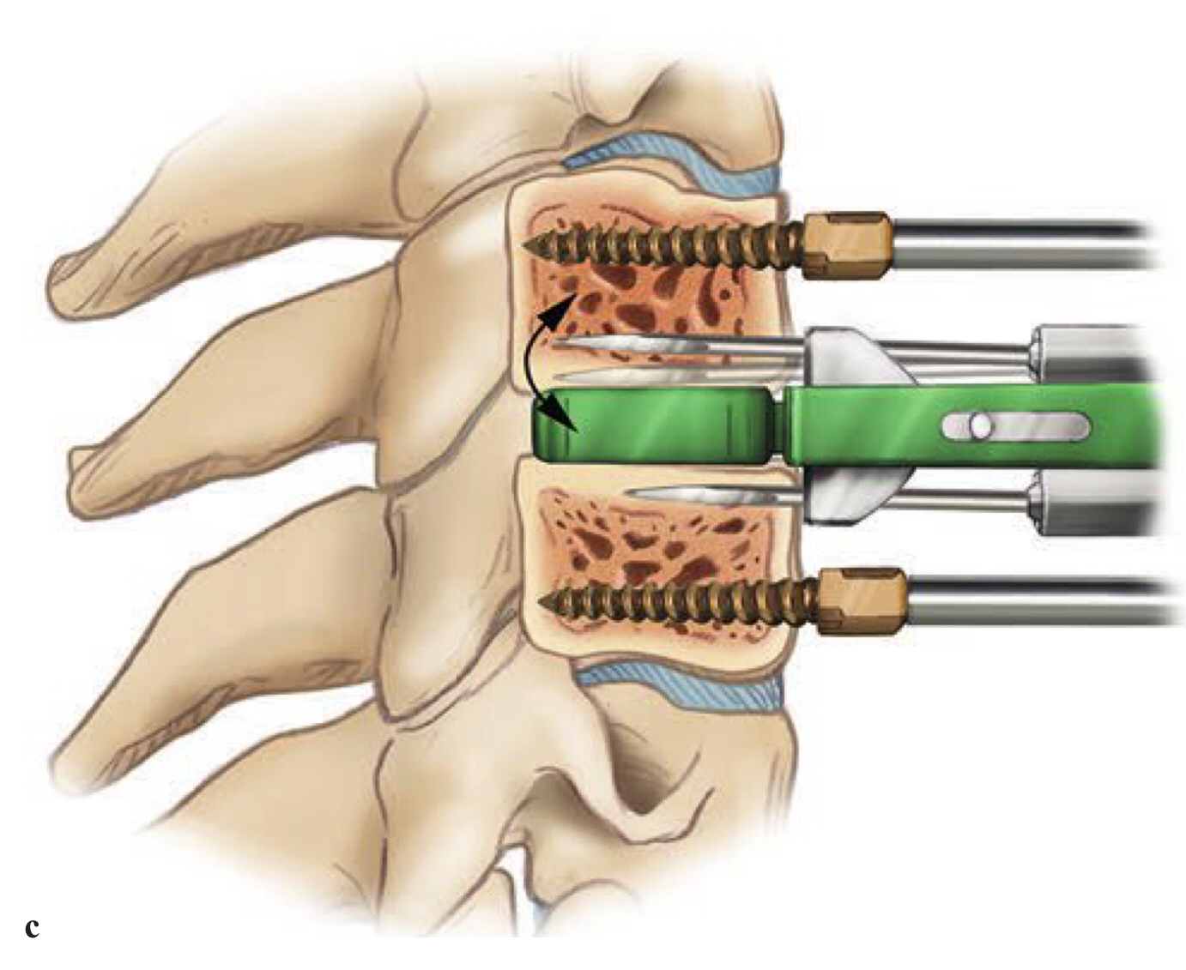
Fig. 29.9 Schematic diagram showing the milling process.
(a) A sharp temporary pin is placed through the inferior hole in the guide and manually driven into the bone.
(b) The milling device is inserted into the superior hole of the guide until the tip of the mill touches the anterior cortex, which should be confirmed by lateral fuoroscopy. The bit is advanced into the vertebral body under full power until it reaches the positive stop in the guide.
(c) The bit is then swept toward the trial implant and then away from the trial to the full outer limit.

Slide 45
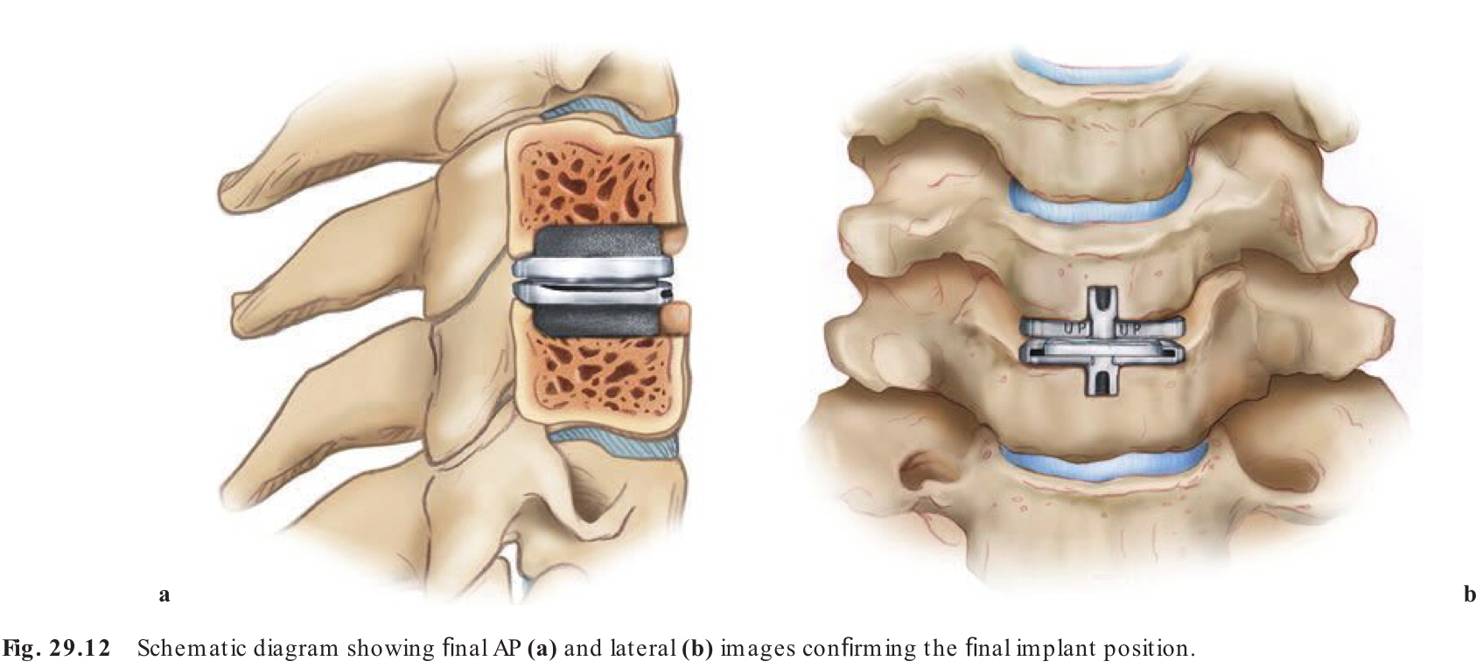

Slide 47
Anterior Cervical Instrumentation
Absolute criteria for cervical plate instrumentation include
Procedures that involve any extent of formal corpectomy
Patients with posttraumatic spinal instability
Agents should be stopped before surgery
Should be stopped 10 days before surgery
Anticoagulant agents can cause excessive intraoperative bleeding.
Preoperative dependence on narcotic analgesics → poor outcomes.
The use of estrogen replacements or oral contraceptives → DVT.
Corticosteroids or NSAID can be related to a lower fusion rate.
Stopped 2 month before surgery
Smoking inhibits the neovasculization necessary for incorporation of a bone graft.
Not begin smoking again for 3 to 6 months after surgery.

Slide 48
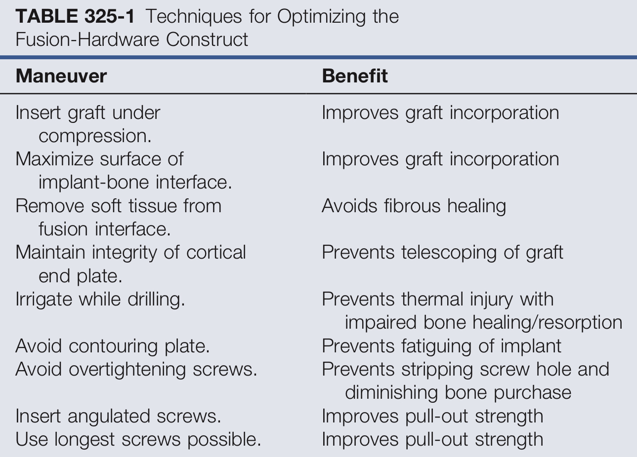
Advantages
Enhance the natural capacity for bone healing to occur.
Minimize the extent of iatrogenically induced impediments to bone graft incorporation.
Maximize the biomechanical advantage of the hardware construct.

Slide 49
A major concern for any spinal surgery (Late complications)
Pseudarthrosis.
Bony nonunion persisting more than 6 months after an anterior procedure that is accompanied by persistent axial neck pain.
Evidence of a radiographic lucency at the vertebral body–graft junction 6 or more months after surgery can be considered diagnostic.
When present, an anterior decompression using an ipsilateral or contralateral approach is indicated.
Subsidence of the bone graft
Which is diagnosed by a loss of graft height of 2 mm or more detected on radiographs taken 1 year postoperatively.
Loss of normal cervical curvature with development of a kyphotic deformity
Chronic infections such as discitis, and osteomyelitis
Adjacent segment disease
Occurs as disk degeneration at the levels immediately adjacent to the fused segments,
Usually rostral to the fused level

Slide 50
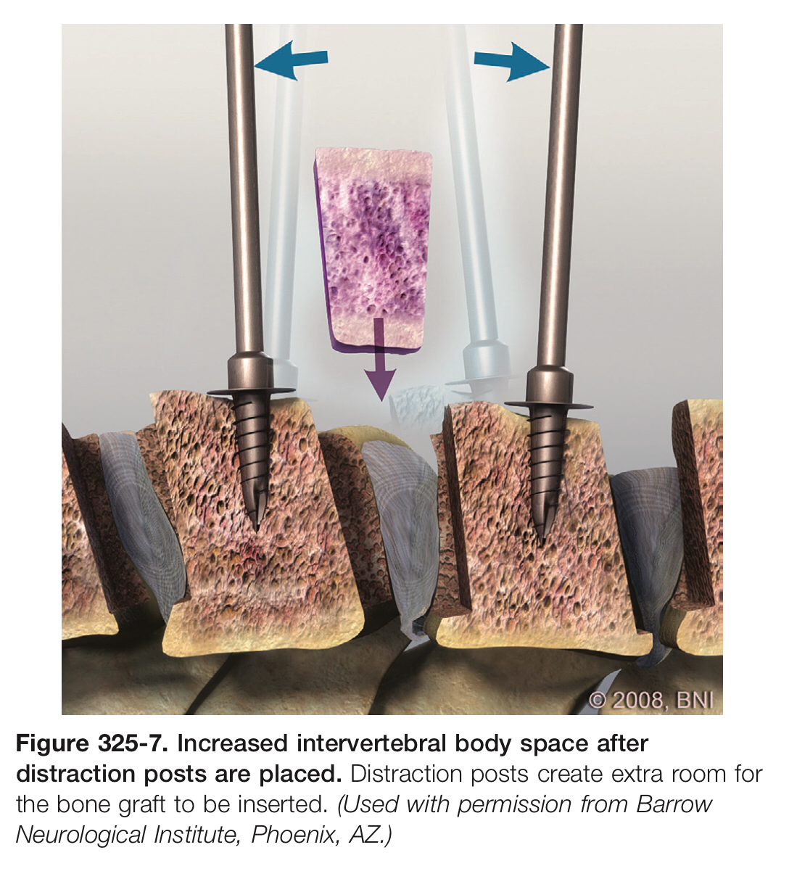

Slide 52
Posterior Approach for Cervical Degenerative Disease Indications for Surgical Treatment
Patients with multiple levels of cervical spinal cord compression (at least three levels)
Cervical lordosis is relatively well maintained
Patients with predominantly posterior compression
Ossification of the PLL
Contraindications to anterior surgery such as severe scarring from prior radiation.
In patients who have concurrent radiculopathy, unilateral or bilateral foraminotomies can be added to the central decompression.
In the presence of segmental kyphosis at the site of compression, the spinal cord is unlikely to drift away from ventral disease with a posterior laminectomy and an anterior approach should be considered.
In addition, a laminectomy without instrumentation in patients with kyphosis can make the compression worse by disrupting the posterior tension band and subsequently worsening the kyphosis.
Foraminotomy/Discectomy
Laminectomy/Laminaplasty
Cervical Posterior Segmental Instrumentation

Slide 54
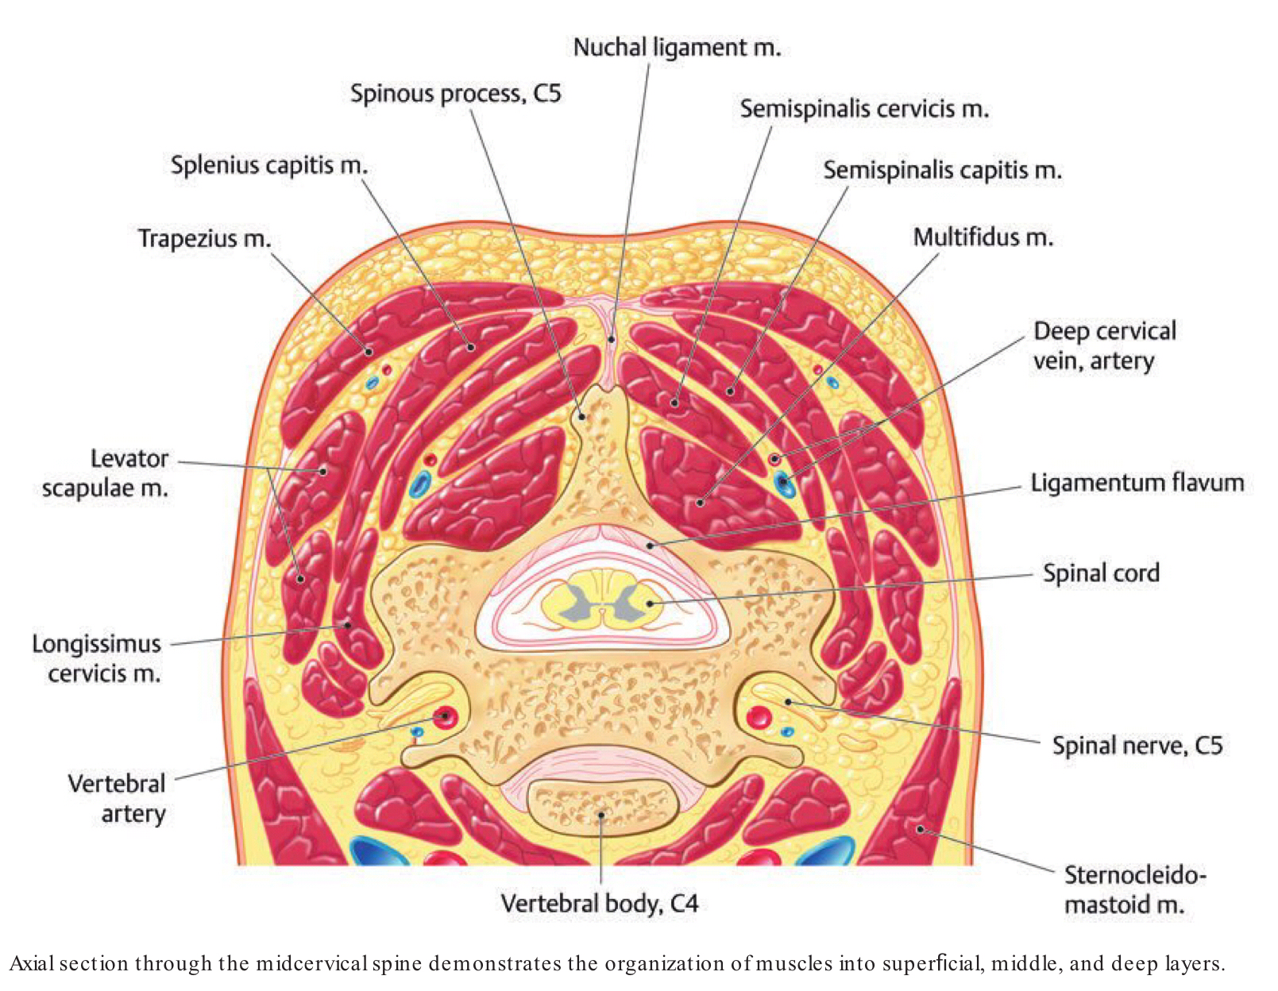
Foraminotomy / Discectomy
Indications
For unilateral radiculopathy with one- or two-level disk herniations.
Foraminal stenosis without myelopathy or cord compression.

Slide 55
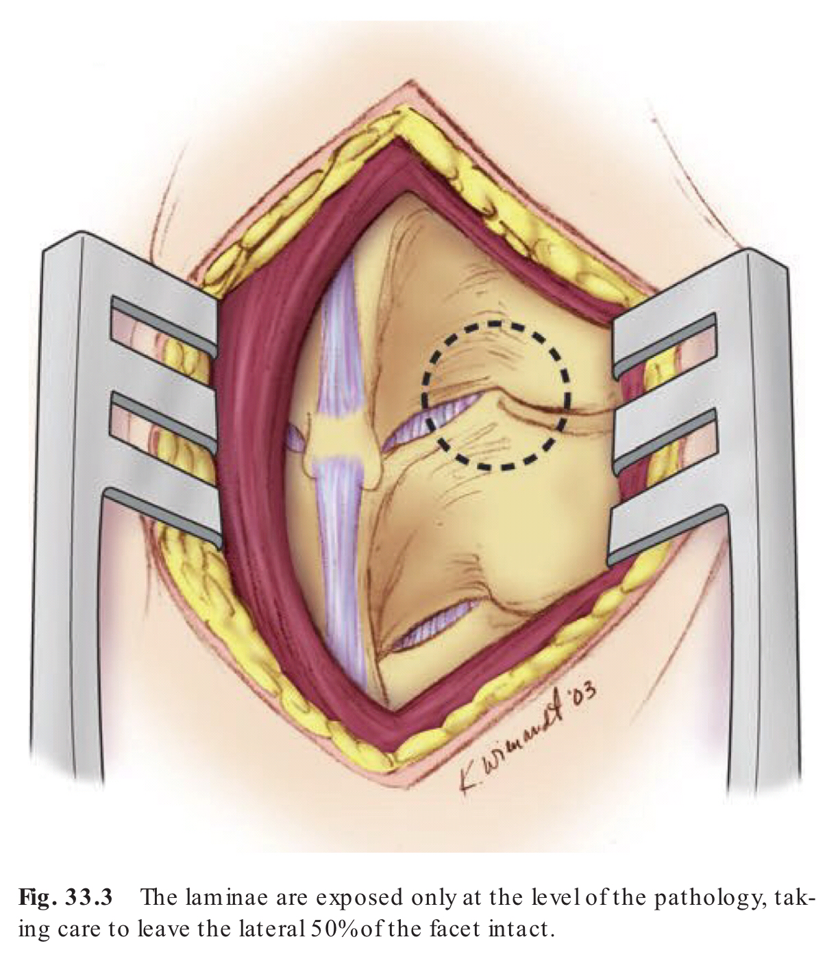
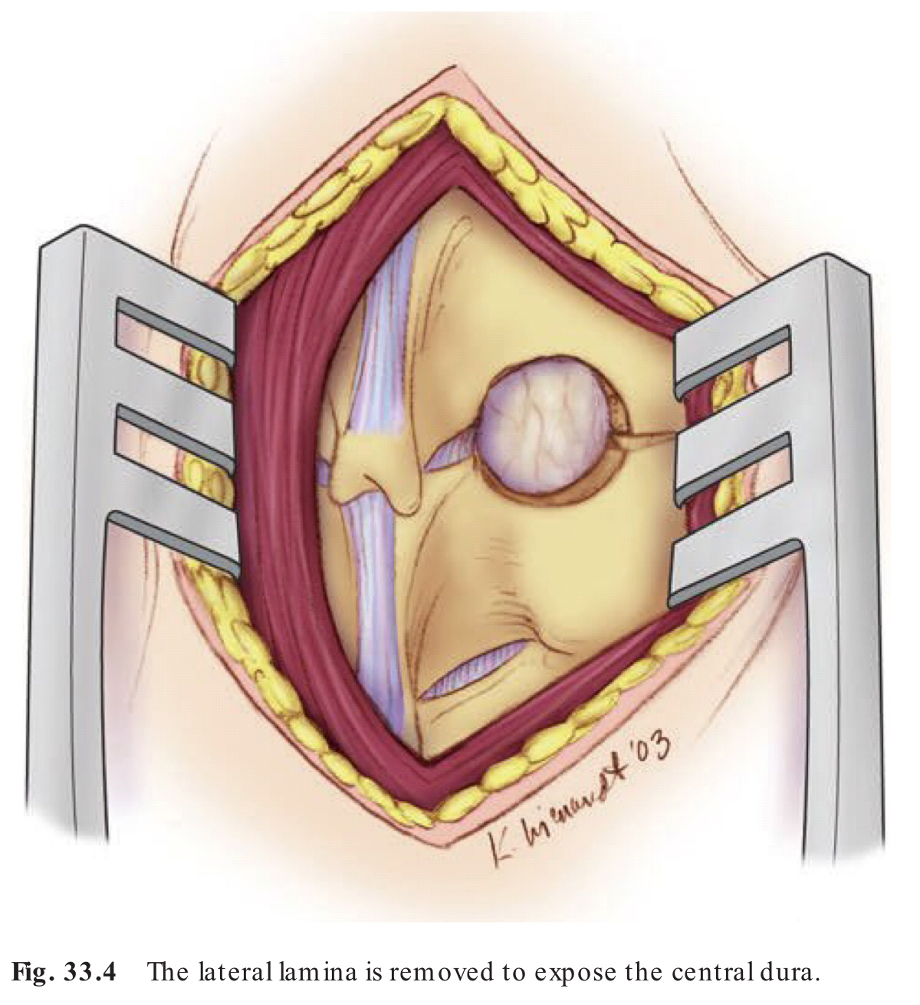

Slide 56
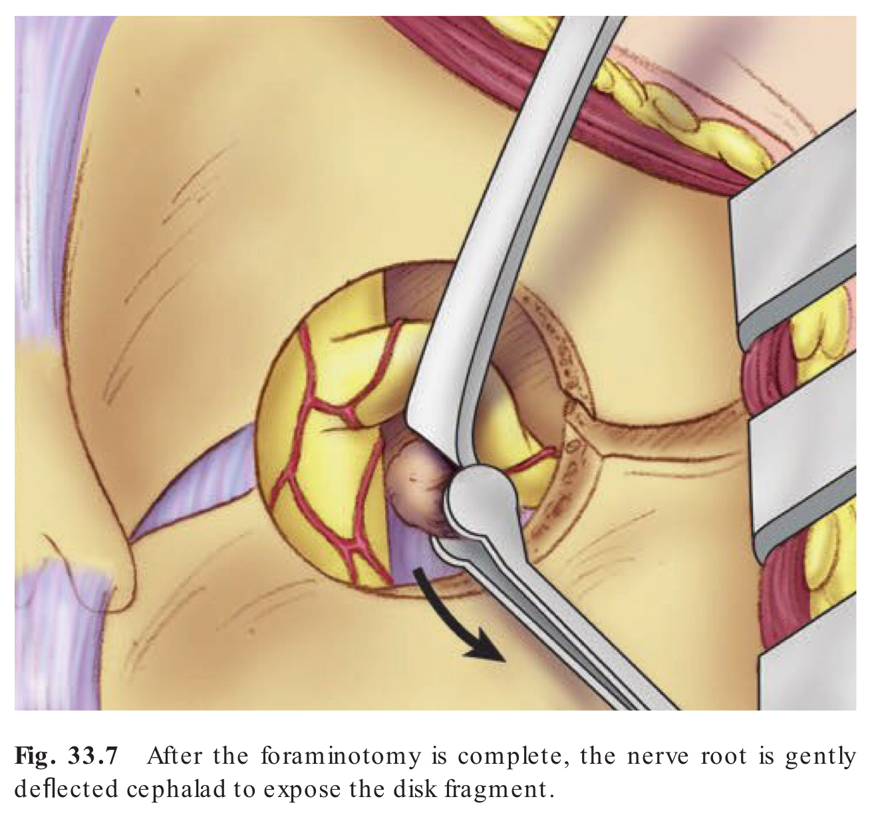

Slide 57
Laminoplasty
Indications
Compressive cervical myelopathy due to developmental canal stenosis.
Multilevel spondylosis.
Continuous or mixed-type ossification of the posterior longitudinal ligament (OPLL) requiring multilevel decompression is a reasonable treatment strategy.
Laminoplasty is an alternative to ACDF, especially in young patients with concomitant developmental canal stenosis, and can help avoid adjacent segment disease.
Advantages
Enables simultaneous decompression for multilevel spinal cord compression
Low incidence of serious complications as compared with ACDF
Low incidence of adjacent segment disease as compared with ACDF
Foraminotomy for radiculopathy can be performed if necessary.
Reduced incidence of postlaminectomy kyphosis.
Cervical range of motion can be preserved as compared with multilevel ACDF.

Slide 58
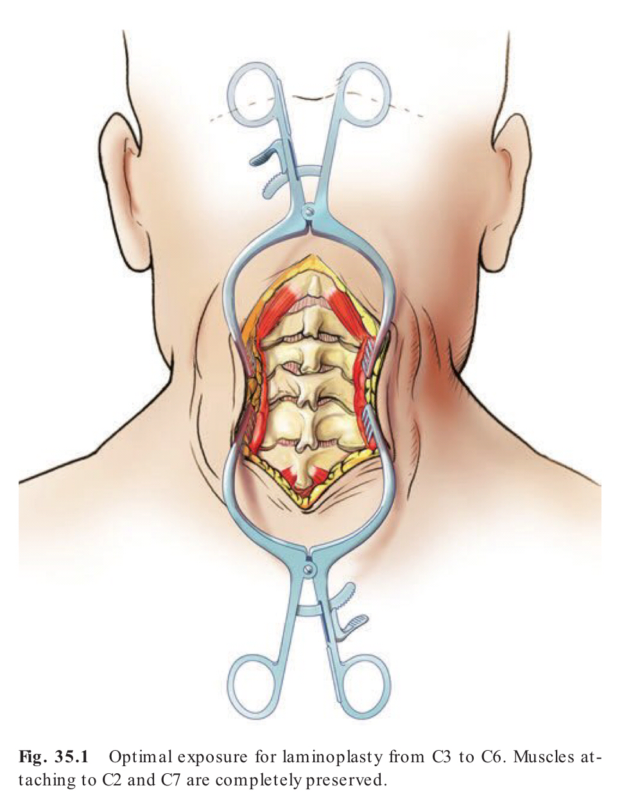
2 procedure
Open-Door Laminoplasty
Double Open-Door Laminoplasty

Slide 61
POSTOPERATIVE FOLLOW-UP
Postoperative immobilization is controversial
Some recommend no bracing after a single-level fixation
Some recommend a collar for 6 to 12 weeks.
Plain film radiography is repeated 4 to 6 weeks after surgery and include dynamic views (flexion and extension) if there is evidence of graft incorporation and stable hardware position.
When evidence of a fusion response (bridging trabeculated bone across the graft vertebral body interface)
Patients are instructed in neck-strengthening exercises.

