Slide 1
Craniopharyngiomas
Chapter 151-210

Slide 2
EPIDEMIOLOGY
Craniopharyngiomas are relatively rare tumors.
Most common Nonglial tumor of childhood.
Slightly more often in males
3% of all intracranial neoplasms.
6% to 9% of all pediatric brain tumors
A bimodal distribution by age :
  late adulthood (ages 65-74 years)
  larger peak in childhood (ages 5-14 years).
Their incidence is greatest at 6 to 10 years, followed by 11 to 15 years.
no racial or ethnic predilection for craniopharyngiomas.

Slide 3
PATHOLOGY
Origin develop from epithelial nests that are embryonic remnants of Rathke’s pouch.
Location along an axis extending from the sella turcica along the pituitary stalk to the hypothalamus and the floor of the third ventricle.
  They extend along the path of least resistance into the basal cisterns or invaginate into the third ventricle.
Gross Pathology gradually enlarge as partially calcified, heterogeneous solid and cystic masses predominantly in the supra sellar region.
Hydrocephalus can result from continued growth superiorly into the third ventricle.
Basic patterns of cellular growth:
  Adamantinomatous
  Squamous papillary
  Mixed tumors with both craniopharyngioma and Rathke’s cleft cyst

Slide 4
Adamantinomatous tumors
The more common variant.
They resemble tooth-forming tumors.
The cysts contain oily liquid composed of desquamated epithelium rich in (cholesterol, keratin, and occasionally calcium).
Microscopic islets or “fingers” of adamantinomatous tumor embedded in densely gliotic parenchyma are seen when tumor arises in the region of the tuber cinereum, hypothalamus, and floor of the third ventricle.
The presence of this gliotic tissue on surgical pathology is associated with a decreased risk of recurrence after gross total tumor resection.
Squamous papillary tumors
Exclusively in adults and often involve the 3rd ventricle.
They are predominantly solid and rarely undergo mineralization.
When cysts occur, the fluid is less oily and dark than in adamantinomatous.
As a result of the absence of calcification and minimal cyst formation, complete curative surgical resection may be obtained.

Slide 5
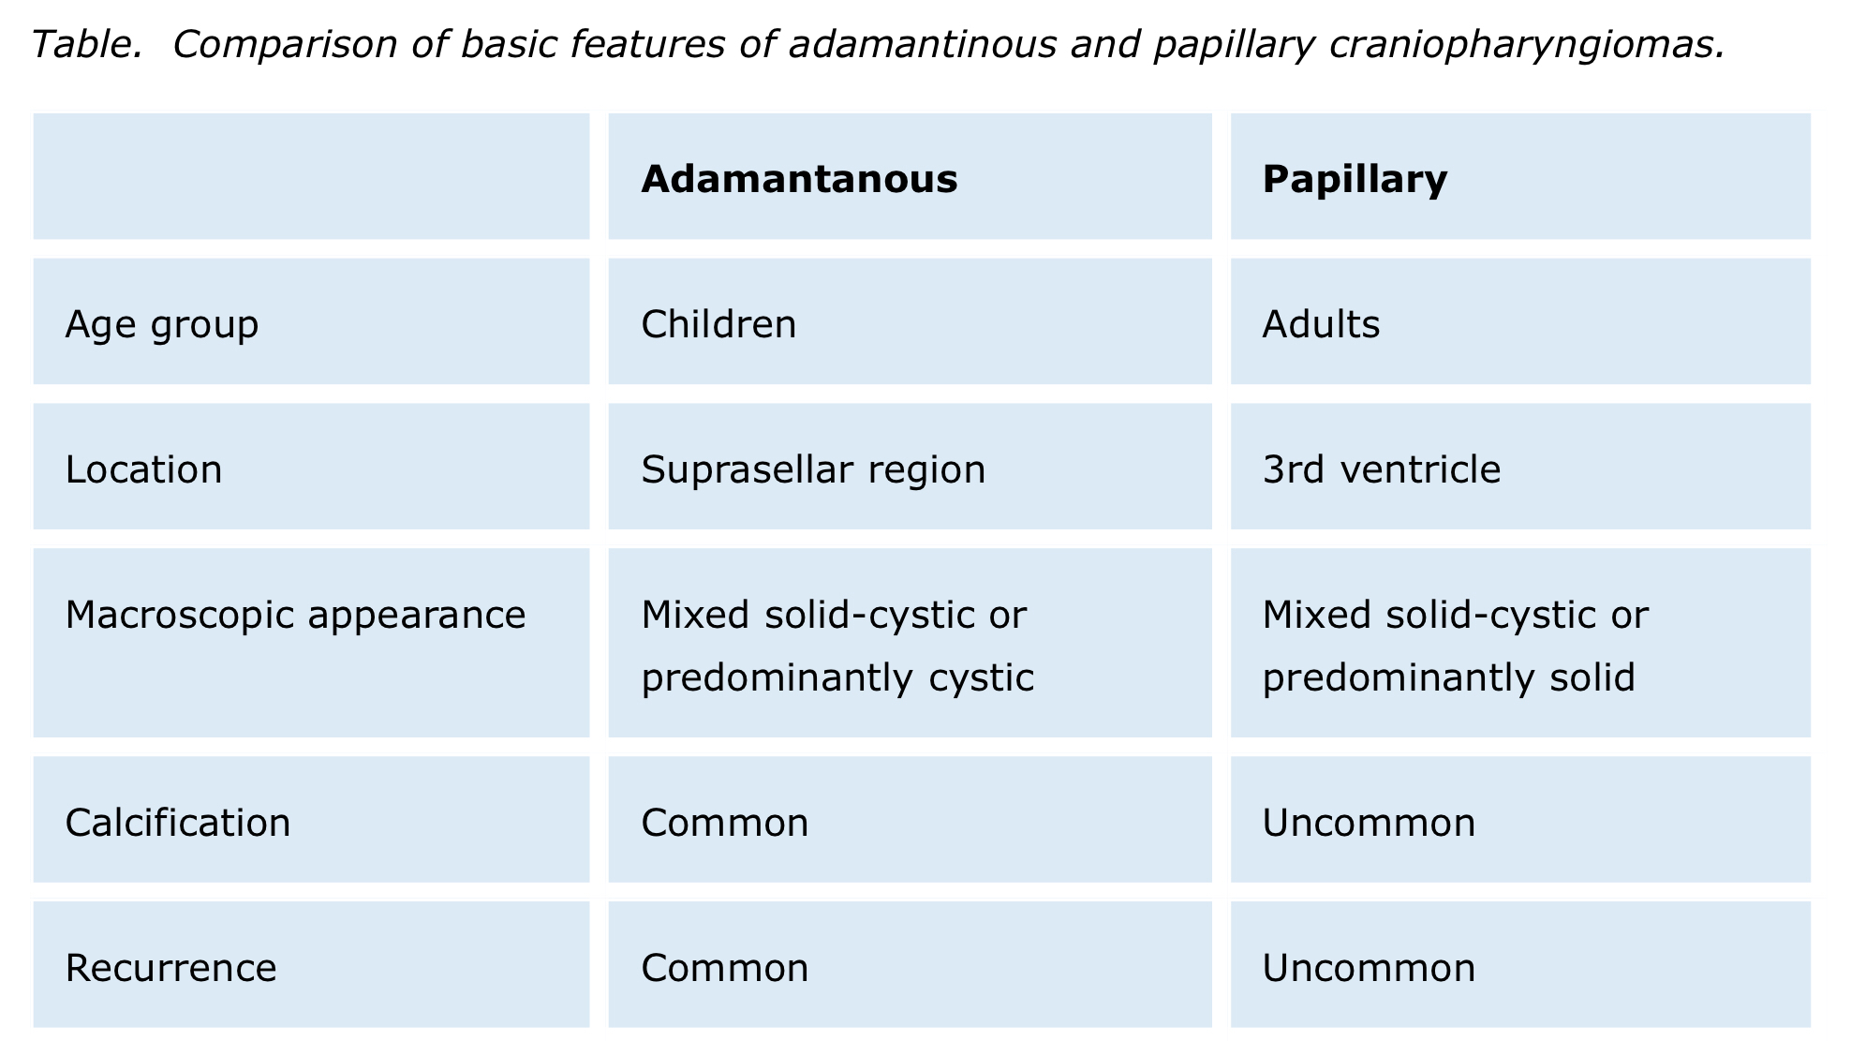

Slide 6
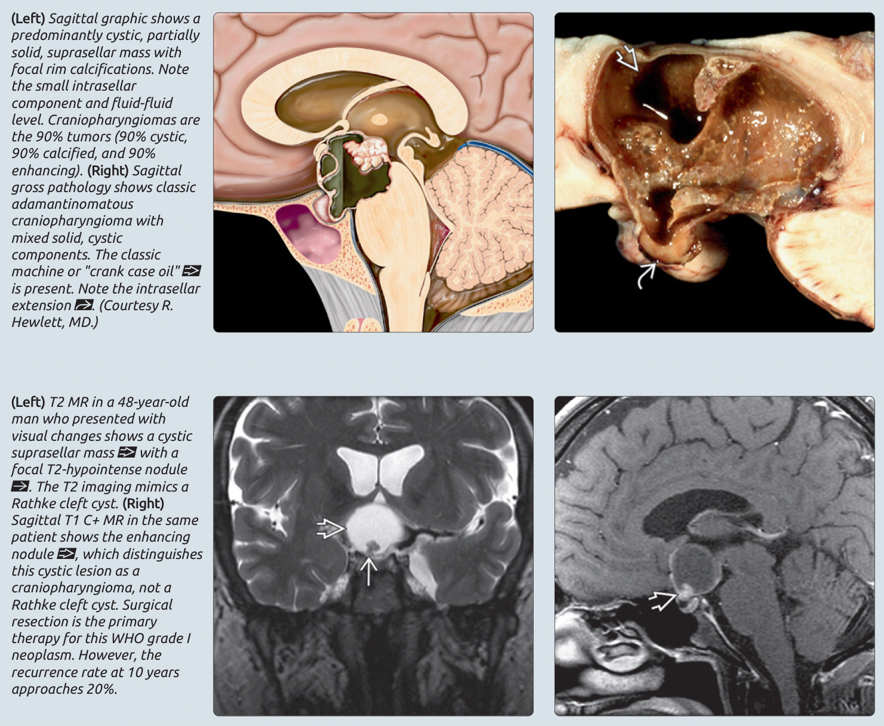

Slide 7
DIFFERENTIAL DIAGNOSIS
The differential diagnosis of suprasellar-sellar masses includes:
  Chiasmatic-hypothalamic glioma.
  Germinoma.
  Rathke’s cleft cyst.
  Hypothalamic hamartoma.
  Arachnoid cyst.
  Thrombosed Aneurysm
  Pituitary adenoma.
  Meningioma.
The last two (Pituitary & Meningioma) are rare in children.
The presence of calcification on CT eliminates all these diagnoses except meningioma.
The next most common tumor in this area is the chiasmatic-hypothalamic glioma, which does not have an intrasellar component and does not commonly calcify.

Slide 8
IMAGING
CT useful in detection
  Mass located within the suprasellar, less commonly, in an intrasellar or parasellar location.
  Calcifications, 90% of craniopharyngiomas in children.
  Secondary changes in the skull base, such as enlargement of the sella turcica and/or erosion of the dorsum sella.
  Contrast-enhanced CT is not necessary when MRI is available.
MRI
  Cyst capsule and solid tumor vividly enhance with gadolinium contrast .
  (MRS) Craniopharyngiomas show a dominant peak consistent with lactate or lipids.
Solid part | T1 | Iso or hypointense
 | T2 | Mixed
 | T1 + contrast | heterogeneous
Cystic part | T1 | Hypointense
 | T2 | Hyperintense
 | T1 + contrast | Cystic rim enhancement

Slide 9
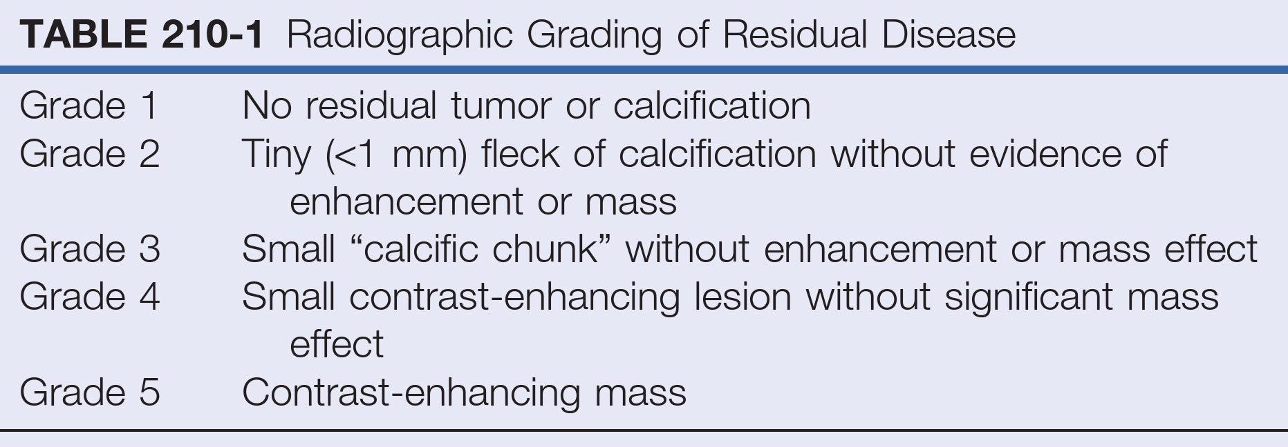
Neuroimaging is also important postoperatively to evaluate the extent of tumor resection and ideally should be performed within 48 hours after surgery to avoid the artifacts of surgical trauma.
Grade 1 or grade 2, flecks of residual calcification on CT without solid or enhancing tumor on postoperative MRI, do not carry an increased risk of tumor recurrence and should not be considered for adjuvant therapy or treated as residual tumor

Slide 10
CT shows calcification within the cyst wall.
T1- (MRI) shows a large cyst
T2-weighted MRI shows the dome of the cyst and acute hydrocephalus.

Slide 11
Sagittal T1- (MRI) without contrast.
Sagittal T1- MRI with gadolinium shows patchy enhancement with multiple small cysts
Axial T2- MRI demonstrates a solid tumor portion and a cyst.

Slide 12
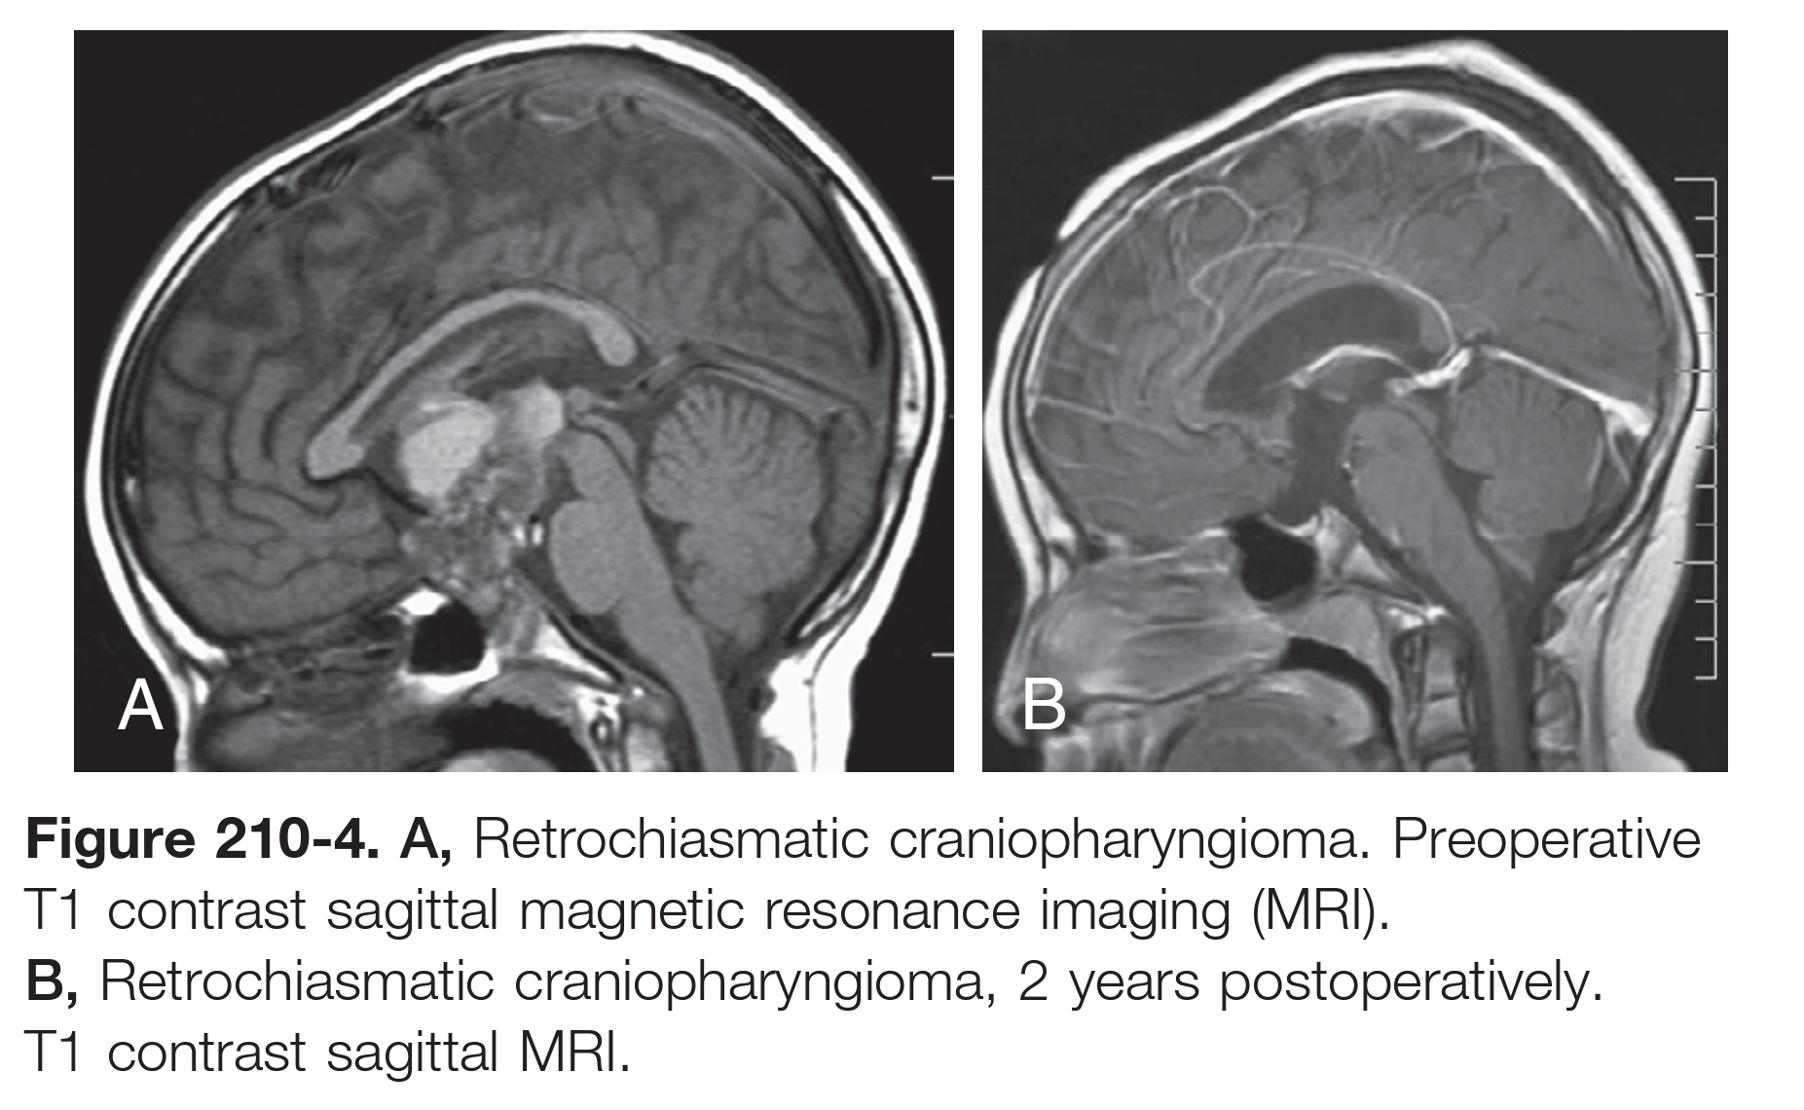

Slide 13
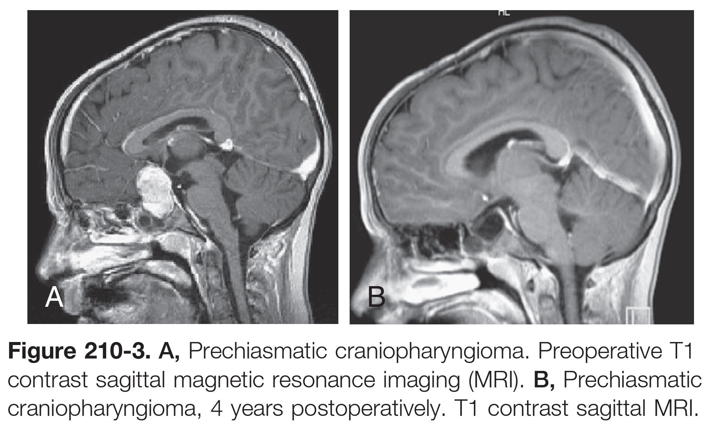

Slide 14
Samii Classification system of craniopharyngiomas based on their position along the vertical hypophyseal axis:
Grade I: Tumor isolated to intrasellar/ infradiaphragmatic region
Grade II: Tumor isolated in cistern with or without intrasellar extension
Grade III: Tumor reaches inferior third ventricle
Grade IV: Tumor reaches superior third ventricle
Grade V: Tumor extends to septum pellucidum or lateral ventricles

Slide 15
CLINICAL PRESENTATION
Raised intracranial pressure.
Visual disturbances.
Hypothalamic and endocrine dysfunction.
The slow growth of craniopharyngiomas often results in a delay between onset of symptoms and diagnosis.
The main presenting signs and symptoms of craniopharyngiomas are secondary to pressure on adjacent neural structures.
Preoperative neuro-ophthalmologic, endocrinologic, and neuropsychological evaluations are mandatory.

Slide 16
Raised intracranial pressure
  Headache from raised intracranial pressure is the most common complaint, occurring in 60% to 75% of patients.
Visual symptoms
  noted in approximately half of children
  70% - 80% of children have abnormal visual acuity or fields on preoperative.
  Frank papilledema is present in 20% of children .
  Adult patients present more commonly with visual disturbances, whereas pediatric patients present more with endocrine dysfunction.
  Prechiasmatic extension will compress optic nerves with loss of visual acuity.
  Postchiasmatic ( posterior tumors ) cause chiasmatic compression with complex visual field defects.

Slide 17
Hypothalamic and endocrine dysfunction
  <30% of children are endocrinologically normal at diagnosis.
  (GH) deficiency is the most common finding, up to75% of children,Gonadotropin ,thyroid or adrenal.
  DI is relatively uncommon preoperatively.
  Growth failure (short stature), delayed sexual maturation, excessive weight gain, and diabetes insipidus (DI) are present in 20% to 50% of the children at diagnosis.
  Failure to preoperatively recognize and correct adrenocorticotropic hormone or thyroid deficiency or appropriately manage DI can result in severe morbidity or death.

Slide 18
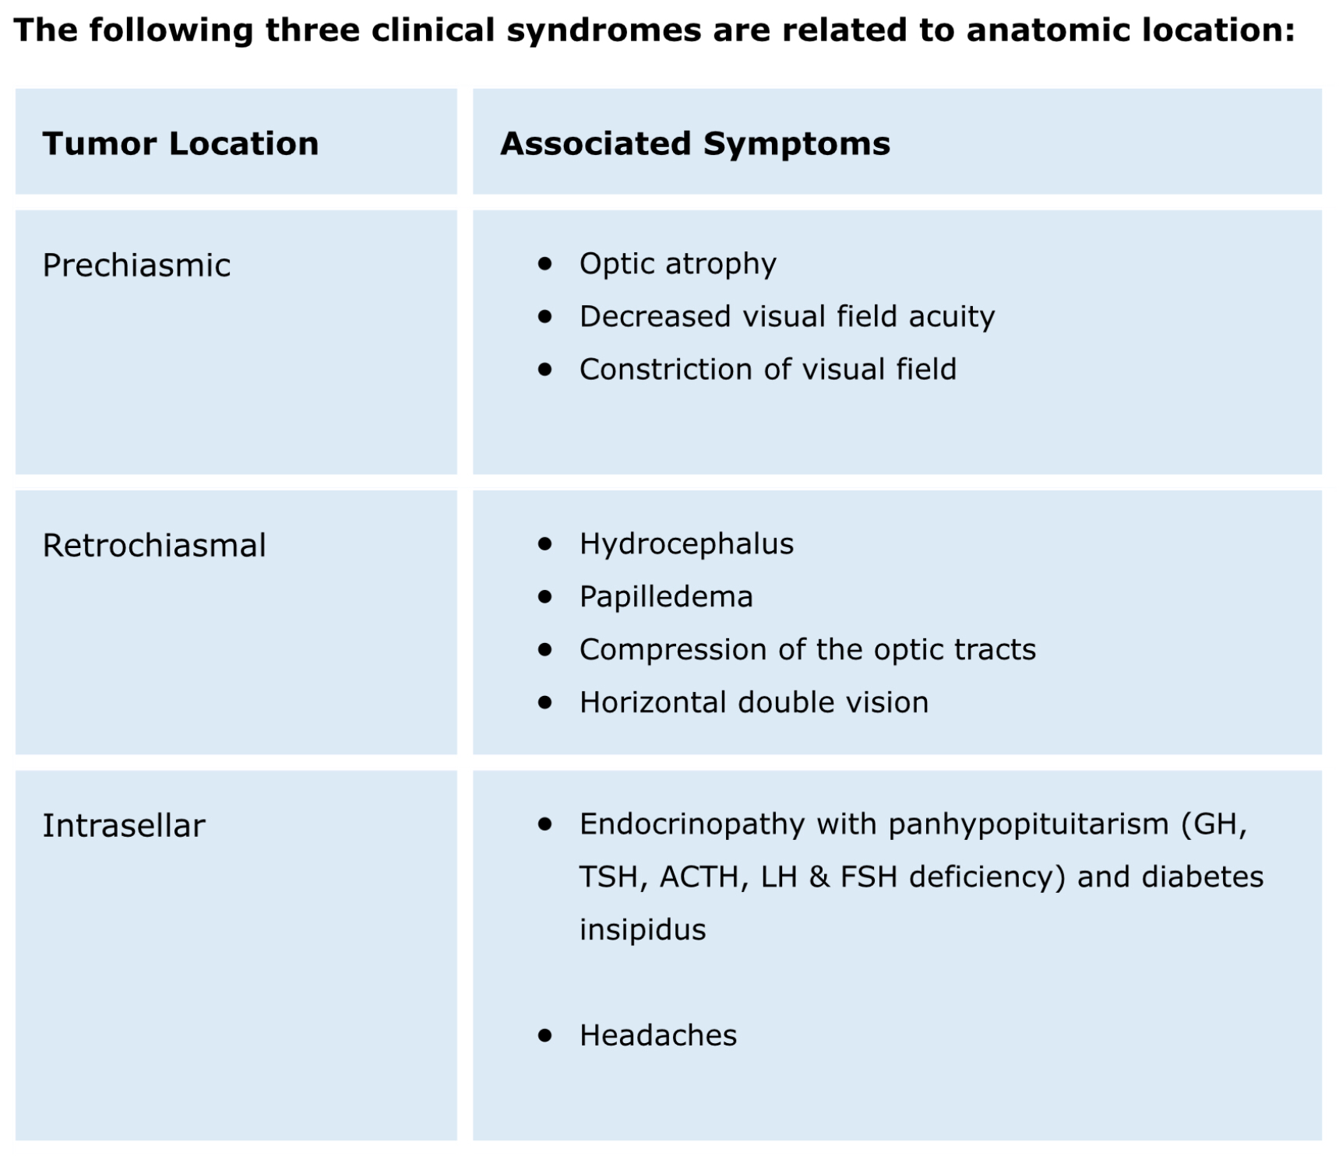

Slide 19
TREATMENT
Tumor size is graded as
  Small (2 cm)
  Medium (2-4 cm)
  Large (4-6 cm)
  Giant (>6 cm)
Giant tumors may extend into multiple or all compartments, extending from the medulla to the foramen of Monro.
Complete removal is desirable for a benign tumor.
To avoid perioperative hypothalamic damage, some surgeons prefer to perform a subtotal resection (STR) or limited surgery.
Surgery: success of such radical resection is dependent on:
The size and extent of the tumor
Whether the tumor is primary or recurrent
The availability of surgeons with expertise
Postoperative endocrinologic support

Slide 20
Disadvantages | Advantages | Approach
Poor visualization of tumor within third ventricle, Poor visualization of undersurface of optic chiasm | Good visualization of optic nerve and chiasm, Good visualization of ipsilateral carotid artery | Sub frontal
Unilateral approach, Poor visualization of undersurface of ventral ipsilateral optic nerve | Short distance to parasellar region | Pterional
Similar to subfrontal and pterional approaches, Additional surgical risks from more extensive exposure and areas of retraction | Combined advantages of subfrontal and pterional approaches ,Additional visualization and angles beyond those of either subfrontal or pterional approach alone | Orbito frontal
Difficulty locating lateral landmarks High risk of hypothalamic injury | Good visualization of retrosellar region, Good visualization of anterior third ventricle, Allows separation of tumor from choroid plexus and internal cerebral veins | Lamina terminalis
Difficulty identifying landmarks Divides anterior corpus callosum ,Risk of bilateral fornical damage, Poor visualization of undersurface of chiasm | Mostly extra-axial approach, Good visualization of third ventricular region | Trans callosal
Disrupts normal frontal cortex, Requires hydrocephalus, Poor visualization of undersurface of chiasm, Increased postoperative seizure disorder | Good visualization of ipsilateral foramen of Monro, Good visualization of anterior and contralateral third ventricle | Trans cortical

Slide 21
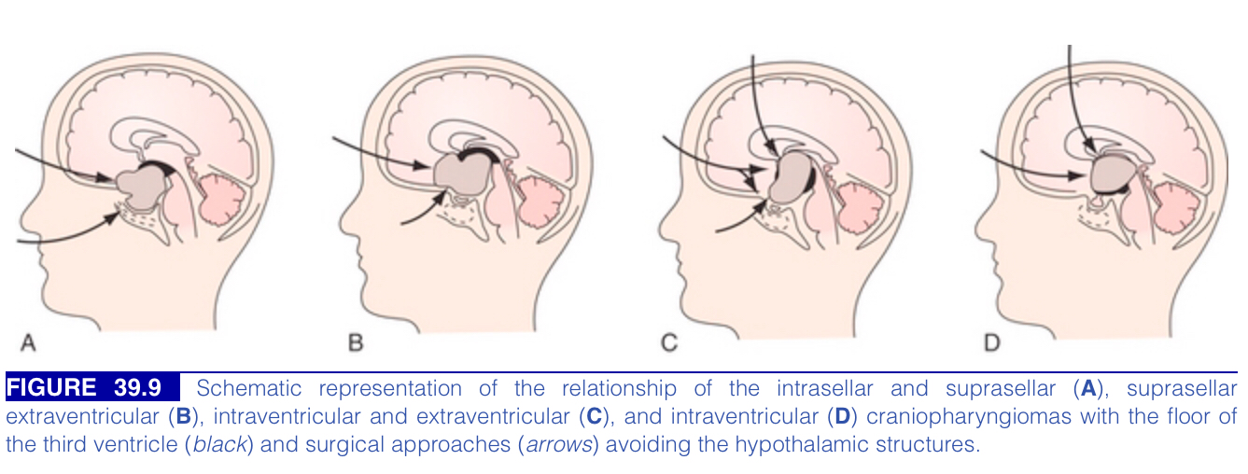
Surgical division of CPs into 3 groups
  Sellar
  Prechiasmatic
  Retrochiasmatic

Slide 22
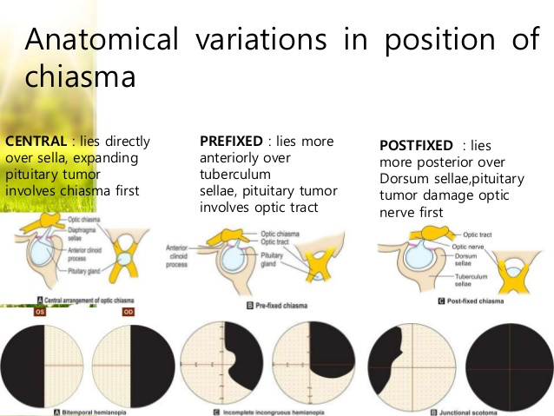
Transcranial Approaches
For a right-sided approach, the head is first rotated 60 to 75 degrees to the left (more rotation for anteriorly displaced “prefixed” optic chiasm with retrochiasmatic tumors and less rotation for posteriorly displaced “postfixed” optic chiasm as with prechiasmatic tumors), and then the vertex is extended toward the ground with slight forward flexion toward the chin.

Slide 23
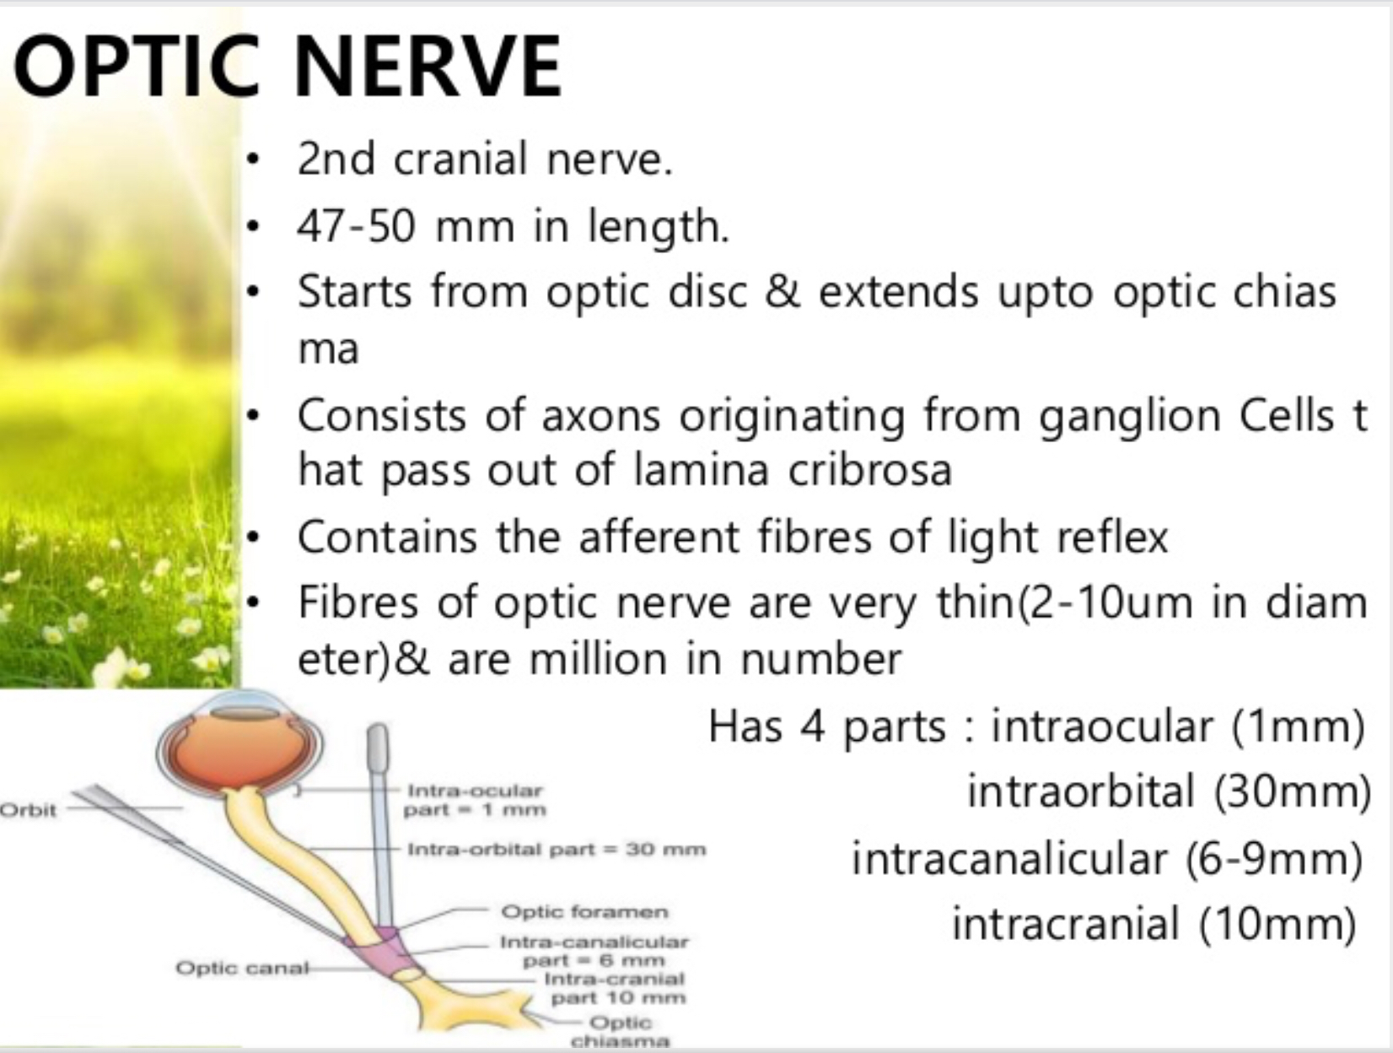
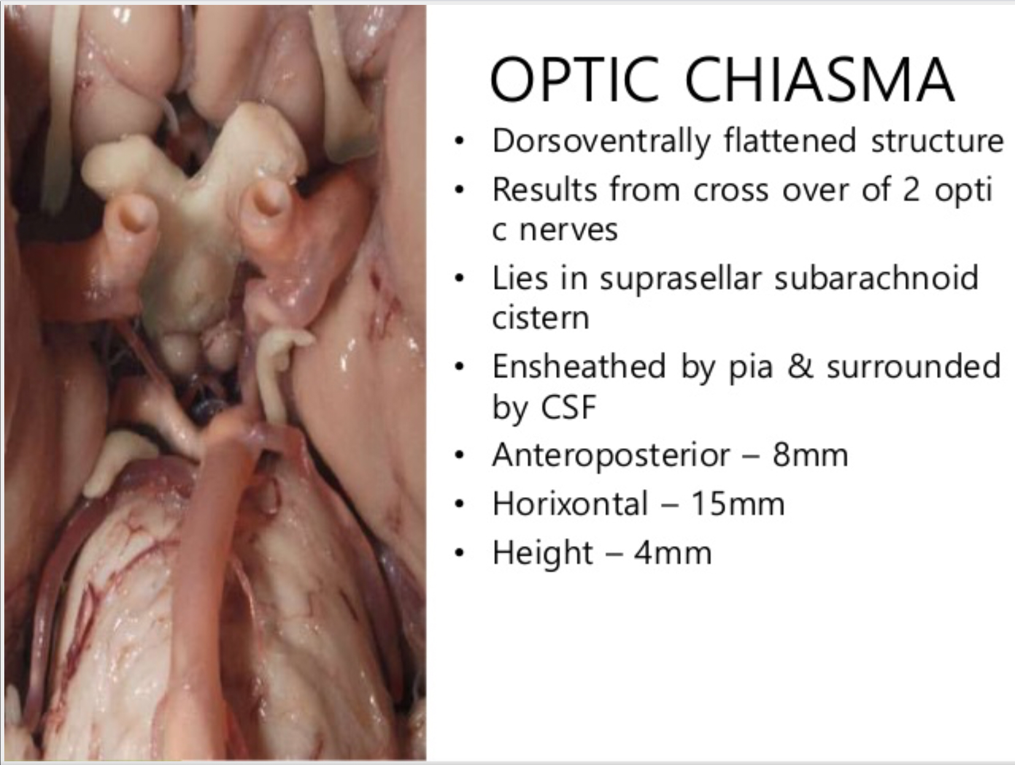
Optic Nerve
Intraocular (1mm)
Intraorbital (30mm)
Intracanalicular (6-9mm)
Intracranial (10mm)
OPTIC CHIASMA
Dorsoventrally flattened structure
Lies in suprasellar cistern
Anteroposterior - 8mm
Horizontal - 15mm
Height - 4mm

Slide 24
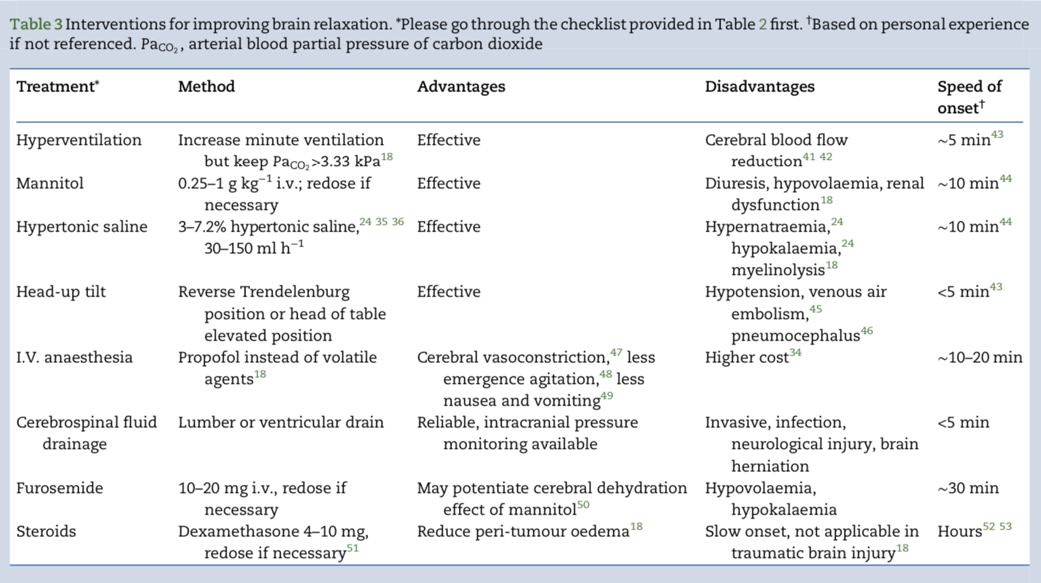
Measures to reduce ICP INTRAOPERATIVE

Slide 25
Anatomical Consederations
Because these tumors often extend diffusely throughout the suprasellar cisterns, displacing and distorting normal structures, identification of the vascular anatomy provides essential landmarks.
Starting laterally, the sylvian fissure is widely split and the distal branches of the middle cerebral artery are identified.
The dissection proceeds medially to the main trunk of the middle cerebral artery, which is followed proximally to the ipsilateral carotid bifurcation, anterior cerebral artery, and internal carotid artery.
As the carotid artery is followed proximally to the clinoid, the optic nerve, chiasm, and/or tracts are identified in relation to the tumor.
Premature decompression of tumors causes the tumor capsule and arachnoid to become redundant, obscuring the planes of dissection.
Working in the prechiasmatic, opticocarotid, and carotidotentorial triangles, an arachnoid plane is developed and maintained between the intact tumor and the branches of the ipsilateral carotid artery, till the basilar artery is identified.
In primary tumors, the membrane of Liliequist invariably separates the tumor from the basilar artery and serves as a posterior landmark.

Slide 26
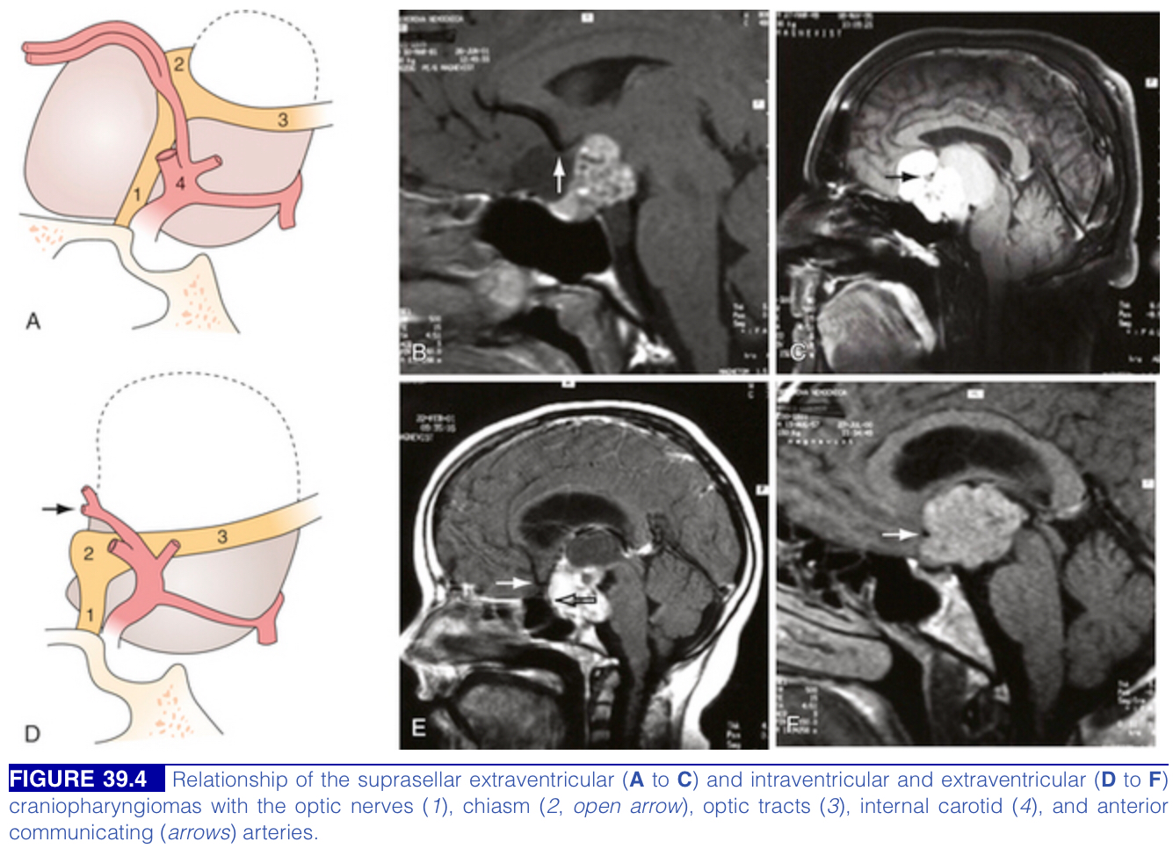

Slide 27
If the tumor extends into the 3rd ventricle or has a significant retrochiasmatic component.
Third ventricular tumor is simultaneously delivered through
  The lamina terminalis fenestration
  Placement of a neuroendoscope into the lateral or third ventricle.
The lamina terminalis is distinguished from the chiasm, appearing pale, avascular, and often distended by tumor.
After removal of retrochiasmatic part, the prechiasmatic space may widen allowing an additional avenue for dissection.
When the tumor extends into the sella turcica,
Removal of the posterior planum sphenoidale and tuberculum sellae may be required to gain adequate intrasellar exposure.
After removal of tumor, any defects communicating with the sphenoid sinus must be obliterated with fat and pericranial grafts.
For tumors with significant and tenacious intrasellar components, we have had success with staged transcranial approach followed by delayed trans sphenoidal surgery.

Slide 28
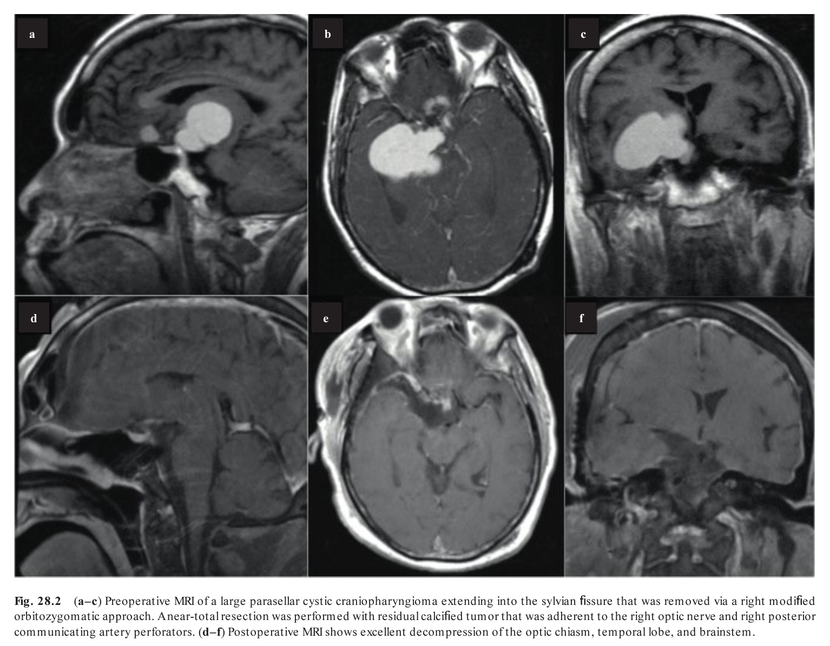

Slide 29
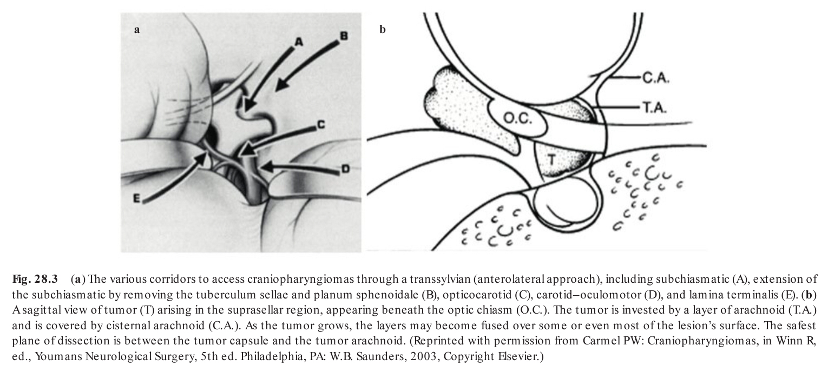

Slide 30
Surgical Outcomes
Total resection can be 60% to 100% of primary tumors in children and requires no adjuvant therapy.
Recurrence rates after total resection rare.
  Ectopic tumor recurrence distant from the primary site as a result of implantation at the time of initial resection was seen in 7% of recurrent tumors.
Endocrine morbidity may be more severe when tumor resection involves bilateral manipulation of the hypothalamus.
  Deaths: uncommon, if occur mostly due to pituitary insufficiency.
  Hormonal replacement therapy is required in 80% of the children. Thyroid and cortisol replacement therapy is administered as necessary.
  DI is universally present immediately after surgery.
  GH deficient.
Weight gain without overt hyperphagia may occur in half of all children.
  Bilateral hypothalamic damage.
Deterioration in visual function.
Fusiform dilation of the carotid artery (FDCA): different from that of radiation-induced aneurysms, which are usually saccular in morphology, not fusiform.

Slide 31
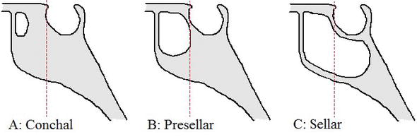
Trans sphenoidal Approach
Indication
  small, more often completely or predominantly intrasellar, and often cystic in nature.
Transsphenoidal or transnasal surgery in young children may present anatomic difficulties related to the small size of the bony structures and to the lack of a pneumatized sphenoid sinus.
With trans sphenoidal better visual, neurological, endocrinologic, and oncologic outcomes.
The presence of a conchal or prepneumatized sphenoid sinus is not a contraindication to transsphenoidal surgery.
Total resection can be accomplished in
  60% to 90% of primary tumors.
  10% to 60% for recurrent tumors.
Operative mortality is very rare.
Nonendocrine morbidity in low percentage.

Slide 32
Trans sphenoidal Approaches | Transcranial Approaches
Purely intrasellar tumors, Intrasellar and suprasellar subdiaphragmatic tumors, Predominantly cystic tumors | Large or giant tumors, Cystic or solid suprasellar tumors Tumor entirely within the third ventricle | Indications
Early decompression of tumor before optic apparatus manipulation , Shorter hospital stays, Less tissue trauma, and brain retraction, Less pain. | Excellent visualization and control of major arteries | Advantages
Tumors with extension lateral to the internal carotid artery Large or giant tumors Encasement of arteries of circle of Willis or optic apparatus, Suprasellar lesions with peripheral calcifications | Intrasellar tumors | Contraindication
Immature (conchal) sphenoid sinus Poor control of hemorrhage (arterial injury) Risk of cerebrospinal fluid leak | Brain retraction, Manipulation of optic apparatus before tumor removal | Disadvantages

Slide 33
Transnasal endoscopic stereotactic-guided resection of sellar and sphenoid sinus craniopharyngioma. Axial, coronal, and sagittal contrast T1 magnetic resonance imaging and endoscope image..

Slide 34
Radiation Therapy
Craniopharyngiomas are Radiosensitive tumors.
RT has been used as primary treatment after:
  Cyst aspiration
  Biopsy
Postoperative radiotherapy used in gross residual disease and recurrent disease.
Increased risks of optic neuropathy and necrosis with doses of 60 Gy or more, most radiation oncologists use 54 to 55 Gy.
Stereotactic Radiosurgery
Gamma Knife (GK) is the predominant form of SRS for craniopharyngiomas.
It is best suited for:
  Smaller tumors (<3 cm in diameter) with a predominant solid component .
  Few millimeters away from the optic apparatus.
  Smaller cystic or mixed tumors near the optic apparatus
The mean marginal dose 12 Gy
The most common morbidities from GK are secondary to visual deterioration and endocrine dysfunction, most commonly DI.

Slide 35
Intracavitary Therapy
Aspiration
Intracavitary Irradiation
Intracavitary Interferon
Intracavitary Bleomycin
Aspiration
  Simple stereotactic aspiration of tumor cysts or placement of an Ommaya reservoir into the cyst for serial aspirations is never indicated as primary therapy in children and should be reserved for palliation when all other treatment modalities have failed.
  Frequent aspirations tend to stimulate cyst fluid production, leading to progressively shorter symptom-free intervals.

Slide 36
Intracavitary Irradiation
  Using a fine needle to puncture the cyst or under stereotactic guidance.
  The amount of radionuclide based on the cyst volume .
  Most studies indicate that a minimum dose of 200 Gy to the inside of the cyst wall is necessary for effective treatment with intra cystic irradiation.
Intracavitary Interferon
  Interferon alpha has been used as both systemic and intracavitary therapy for primary craniopharyngiomas.
Intracavitary Bleomycin
  Bleomycin is an anti neoplastic antibiotic that interferes with DNA production and has demonstrated clinical efficacy in squamous cell carcinomas.
  An Ommaya catheter is placed into the cyst either stereotactically or at the time of craniotomy. total dose of 60 to 80 mg.
  The major risk is leakage of bleomycin which lead to ventriculitis, meningitis, or vasospasm.

Slide 37
RECURRENT CRANIOPHARYNGIOMAS
Tumor recurrence is the most common complication after treatment of craniopharyngiomas.
The presentation is most often visual deterioration in both acuity and field deficits. Other symptoms of recurrence include progressive headaches, development of hydrocephalus, hormonal disturbances, and seizures.
Median time to recurrence varies from 2 to 8 years.
STR without adjuvant radiation unequivocally results in recurrence.
Adjuvant irradiation markedly decreases the recurrence rate.
Clinical factors associated with increased recurrence rates appear to be:
  The single factor most closely associated with recurrence appears to be the extent of resection at initial surgery.
  Larger tumors (>5 cm)
  Highly calcified tumors
  Tumors that extend beyond the supra sellar space.

Slide 38
Reoperation, intra cystic therapy, adjuvant irradiation or re-irradiation, and SRS are all potential options.
All children with recurrence after previous radical surgery were able to be salvaged with reoperation and no significant new morbidity.
The possibility of reoperation is also dependent on
  The previous treatments for the tumor.
  Irradiation can cause significant arachnoidal fibrosis obliterating the normal planes between the optic nerves, vessels of the circle of Willis, and the tumor.
  The gliotic cleavage plane between the tumor and the hypothalamus that is usually present at an initial surgery may have been destroyed by previous radical resection, significantly increasing the potential for complications for a second radical removal.

Slide 39
Craniopharyngiomas in Adults
Many of the clinical features and surgical approaches are similar in both age.
in Adults (ages 65-74 years) , childhood (ages 5-14 years)
present more commonly with visual disturbances , pediatric more with endocrine dysfunction.
calcifications, less commonly in adult.
The squamous papillary type is observed almost exclusively in adults.
In older patients with symptomatic tumors, surgical resection may carry an unacceptable risk of postoperative morbidity, and treatment should be aimed at symptom management to improve quality of life rather than cure .
Trans ventricular neuroendoscopy for cyst aspiration/drainage.
Fractionated stereotactic radiotherapy after endoscopic cyst drainage.

Slide 40
Comparison between Pediatric and Adult Craniopharyngiomas
Adult | Pediatric |  | Characteristic
65-74 M = F | 5-14 M > F | Age Gender | Epidemiology
Visual dysfunction | Headaches due to ICP |  | Presentation
Less common ++ | More common ++++ |  | Endocrine abnormalities
Less common ++ Less common ++ | Common +++++ Common +++++ | Calcification Cysts | Radiology and imaging
Yes yes | Yes no | Adamantinomatous Squamous papillary | Pathology
Same as those for children | Surgical resection, radiation therapy, and intracavitary therapy |  | Treatment options
Radiation Better in adults | Surgery Better in children | Surgery Radiation | Toleration of treatment type

Slide 41
Rathke Cleft Cyst
From HB

Slide 42
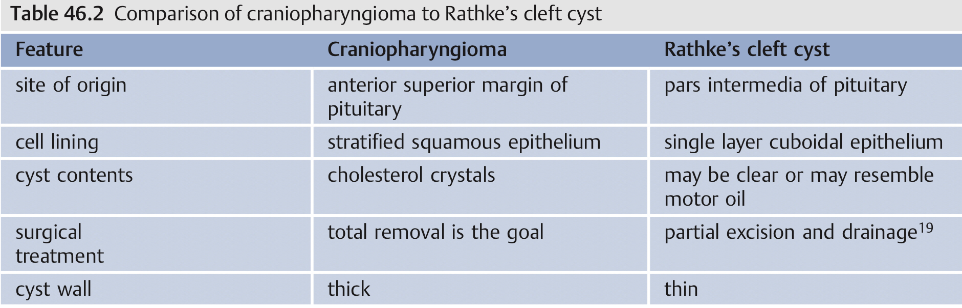
Rathke’s cleft cysts (RCC) AKA pars intermedia cysts.
Slow-growing nonneoplastic lesions that are thought to be remnants of Rathke’s pouch.
They are primarily intrasellar, suprasellar extension is common, purely suprasellar presentation is rare.
RCC are often discussed in contrast to craniopharyngiomas (CP)
Recurrence after treatment is common.

Slide 43
Clinical presentation
  May be asymptomatic
  Headache
  Endocrinopathy
  Visual defect
Natural History & Prognosis
  Most are stable, do not change in size/signal intensity
  Some cysts may shrink/disappear spontaneously
  Rathke cleft cysts do not undergo neoplastic degeneration
  Iso-/hyperintense cysts on T1WI more often cause symptoms
Treatment
  Conservative if asymptomatic
  Surgical aspiration/partial excision/resection if symptomatic
  Persistent/recurrent cyst formation occurs in approximately 15-18% of patients
  May occur many years after surgery
DDx
Craniopharngyoma
Cystic pituitary adenom
Arachnoid cyst
Epidermoid and dermoid cyst

Slide 44
Best diagnostic clue
  Nonenhancing, noncalcified, intrasellar &/or suprasellar cyst with intracystic nodule
  Uncommon but pathognomonic = posterior ledge sign: Upward extension through diaphragma sellae Ledge of tissue overlies posterior lobe.
CT Findings
  Well-delineated, round, intra or suprasellar mass
  Hypodense (75%)
  Ca++ (10-15%)
  Does not enhance
  Occasionally see Claw sign with normal pituitary gland surrounding the cyst.
MRI
  T1 hypointense
  T2 hyperintense
  No internal enhancement
  Claw sign = enhancing rim of compressed pituitary surrounding nonenhancing cyst

Slide 45
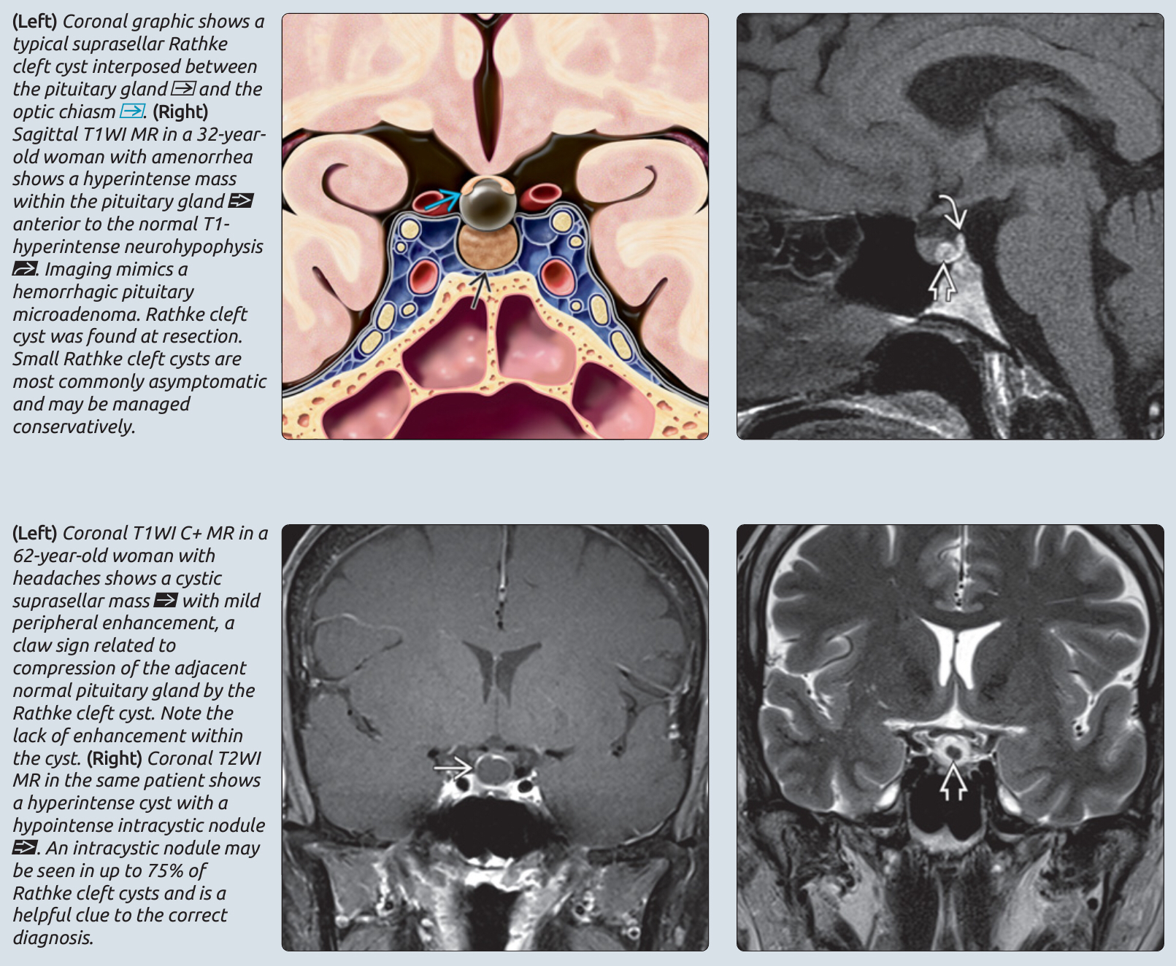

Slide 46
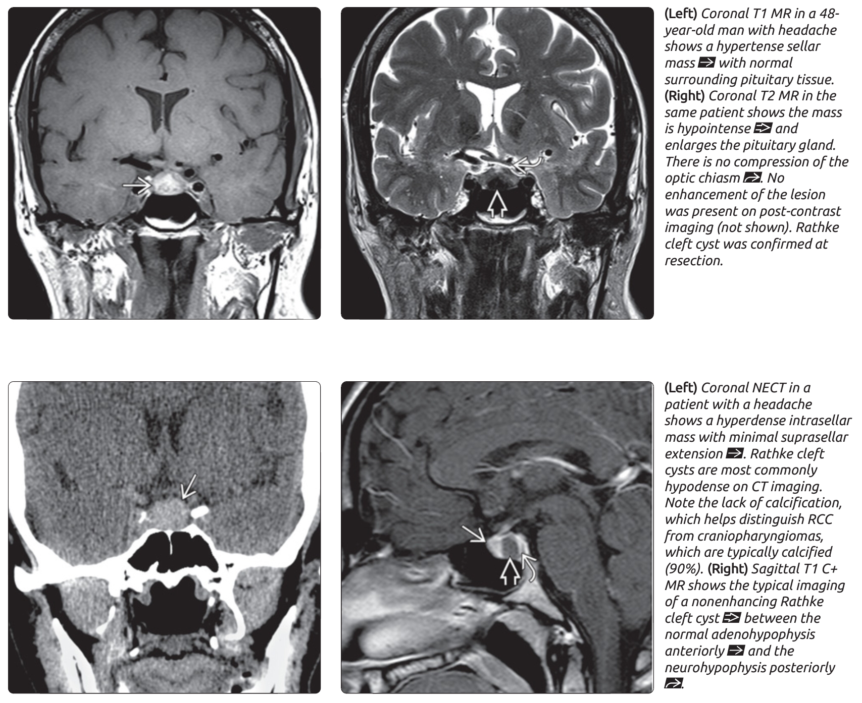

Slide 47
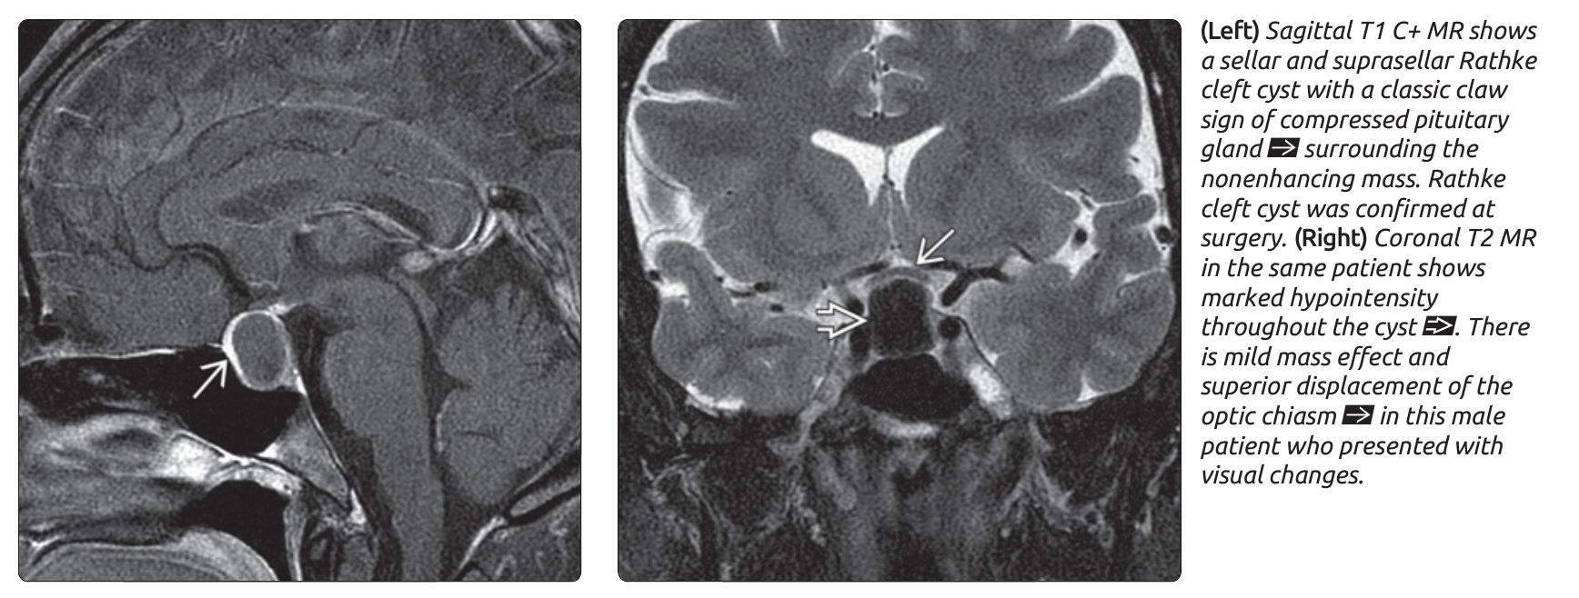

Slide 48
