Slide 1
Classification
and
Treatment of
O-C1
Craniocervical Injuries Youmans chap. 304

Slide 2
The craniovertebral junction (CVJ)
The most mobile portion of the spinal axis.
Formed by three main bony structures: the occiput, C1 & C2 vertebrae, and multiple ligaments and membranes to protect the upper spinal cord, medulla, and bilateral vertebral arteries.
ISOLATED LIGAMENT INJURIES
Occipitoatlantal Dislocation
Transverse Ligament Injuries
ISOLATED OSSEOUS INJURIES
Occipital Condyle Fractures
Isolated Atlas Fractures

Slide 3
Occipitoatlantal Dislocation
(OAD)

Slide 4
Complete or nearly complete disruption of the ligamentous structures between the occiput and upper cervical spine.
The occipitoatlantal joint is the strongest joint of the body.
The incidence is significantly higher in children because:
Large head-to-body ratio.
Underdeveloped supporting neck musculature.
The ligaments are more elastic and the bone more cartilaginous.
Immature, shallow, less stable, and horizontally oriented articulation surfaces of the occiput and C1.
The most common cervical spine injury (motor vehicle crash).
The most important structures for cervical spine stability are (mnemonic TOOL)
Tectorial membrane
Occiput-C1 joint
Odontoid process
Ligaments
Disruption of any of these elements may lead to instability requiring treatment, and may lead to sudden death or permanent neurological damage.

Slide 5
Anatomy and Biomechanics
The CVJ ligamentous anatomy is composed of intrinsic and extrinsic ligaments.
Intrinsic ligaments provide most of the stability of this region.
They are located anterior to the dura, within the canal. From posterior to anterior, they include the following structures:
Tectorial membrane.
Cruciate ligament.
Odontoid ligaments.
Anterior atlanto-occipital membrane.
The tectorial membrane is an upward extension of the posterior longitudinal ligament from C2 to the anterior aspect of the foramen magnum. It is one of the major stabilizing structures of the CVJ for flexion and axial distraction.
The cruciate ligament is a cross-like structure behind the dens.
Transverse part is inserted bilaterally on the medial portion of C1 lateral masses, ensuring axial rotation and lateral bending of C1-2 joints. This portion prevents the odontoid process from translating posteriorly.
Vertical part attaches the C2 body to the anterior portion of the foramen magnum, rostral to the tectorial membrane and caudal to the apical ligament.

Slide 7
The odontoid ligaments consist of the alar ligaments and the apical ligament.
The apical ligament attaches the tip of the dens to the anterior portion of the foramen magnum, rostral to the tectorial membrane, increasing the resistance to distraction.
The paired alar ligaments run from the posterior upper third of the odontoid process to the lateral masses of C1 and the medial borders of the occipital condyles.
They are crucial for preventing excessive axial rotation of the upper cervical region and act together with the tectorial membrane to prevent flexion without affecting extension.
The anterior atlanto-occipital membrane prevents hyperextension of the head.
Extrinsic ligaments
include the ligamentum flavum, which is located between the atlas and axis; the ligamentum nuchae; and the fibroelastic membranes, which replace the anterior longitudinal ligament.
The cruciate ligament, paired alar ligaments, and tectorial membrane are the major stabilizing elements of the CVJ.
The anterior and posterior atlanto-occipital membranes and the bony articulations play a minor role.

Slide 9
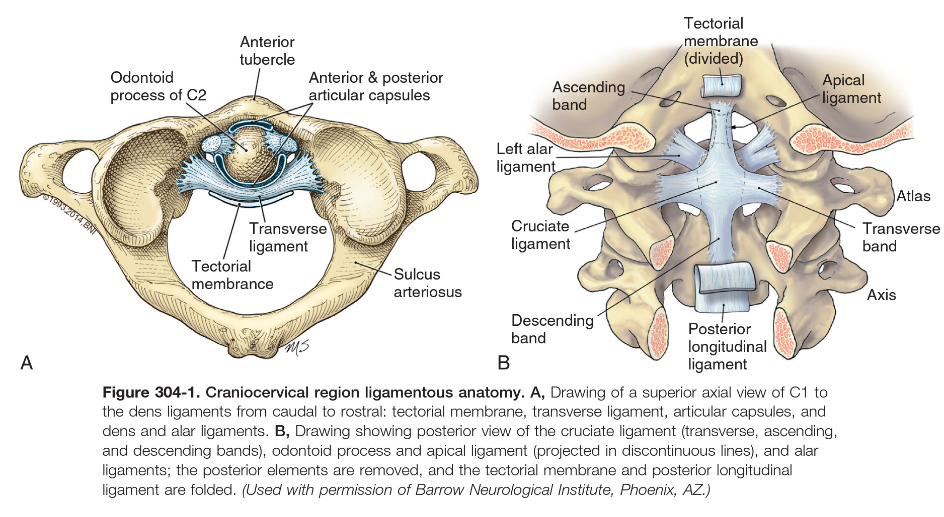

Slide 10
Mechanism of Lesion
High-speed motor vehicle crashes and the striking of pedestrians by motor vehicles are the two most common causes.
Primary mechanism in OADs are
Extreme hyperextension of the neck which leads to sectioning of the tectorial membrane.
Hyperflexion is the principal mechanism as indicated by injury to posterior elements.
Presented with:
Neurological abnormalities, including
Lower cranial nerve paresis (particularly cranial nerves VI, X, and XII),
Monoparesis, hemiparesis, quadriparesis,
Respiratory dysfunction including apnea,
Complete high cervical cord motor deficits.
Cruciate paralysis is weakness in the hands and arms with relative sparing of leg strength can be seen as a presenting feature in OAD. (Central cord syndrome)

Slide 11
Diagnosis and Classification
The diagnostic methods most commonly used now include the following:
Wholey’s method
Powers’ ratio: sensitivity 60%
Dublin method: a distance of more than 13 mm between the posterior mandible and anterior atlas, or 20 mm between the posterior mandible and dens, is considered abnormal.
X lines method: sensitivity 20%
Sun’s method: a ratio between the interspinous distance of C1-2 and C2-3 that is greater than 2.5 is considered abnormal.
Harris’ lines: sensitivity 100%, the most reliable method to diagnose OAD.
Condyle-C1 interval (CCI) “coronal and parasagittal CT”
Most sensitive diagnostic measurement.
Normal if less than 2 mm in adults & less than 4 mm in children.
Sensitivity and specificity of 100%.
MRI “unnecessary unless neurological deficit”

Slide 12
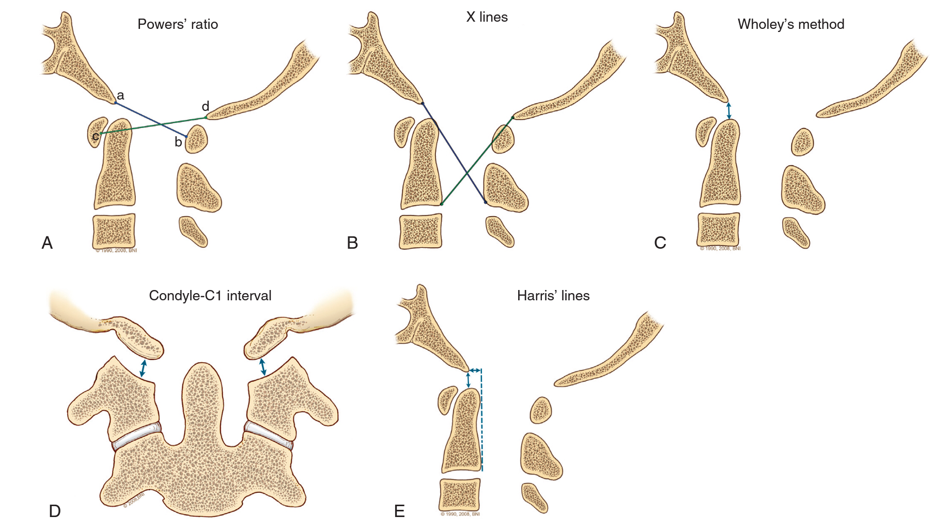
Abnormal if > 1
Sensitivity 60%
Failure of intersections
Sensitivity 20%
Abnormal if >10 mm displacement
Figure304-2. Radiographic criteria for occipitoatlantal dislocation showing the most frequently used radiographic measurements for a positive diagnosis.
A Powers’ ratio: that is, the basion–posterior arch of C1 distance (a to b) divided by the opisthion−anterior arch of C1 distance (d to c), is considered abnormal if greater than 1.
The X lines method: abnormal as a failure of a line from the basion to the axis spinolaminar junction to intersect C2, or a failure of a line from the opisthion to the posterior inferior corner of the body of the axis to intersect C1.
Wholey’s method considers a displacement of more than 10 mm between the basion and dens to be abnormal.

Slide 13
>4 mm in children
>2 mm in adults
The condyle-C1 interval method: defines an abnormality as the distance between the occipital condyle and C1 >4 mm in children and >2 mm in adults, measured on coronal and parasagittal CT imaging.
Harris’ lines: are used to define abnormal as a displacement of more than 12 mm posterior, or less than 4 mm anterior in the basion and posterior C2 interval (BAI), or a displacement of more than 12 mm in the basion to dens interval (BDI).

Slide 14
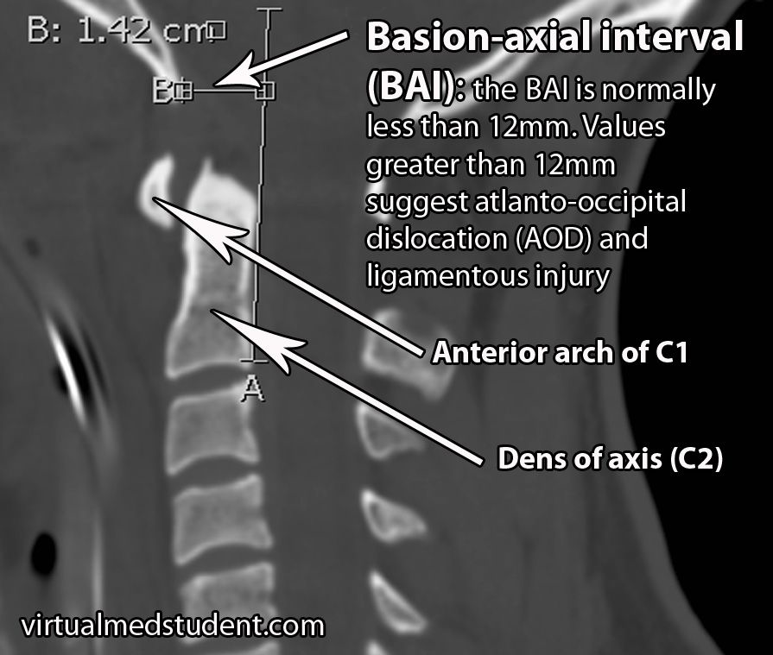
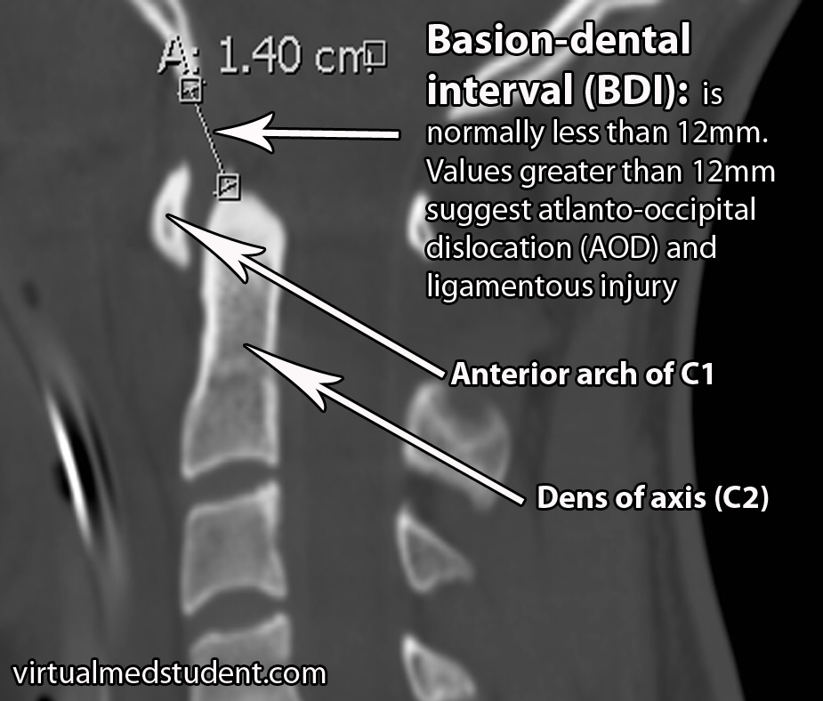
←← displacement of > 12 mm posterior in the basion and posterior C2 interval (BAI)
Displacement of more than 12 mm in the basion to dens interval (BDI)→→

Slide 15
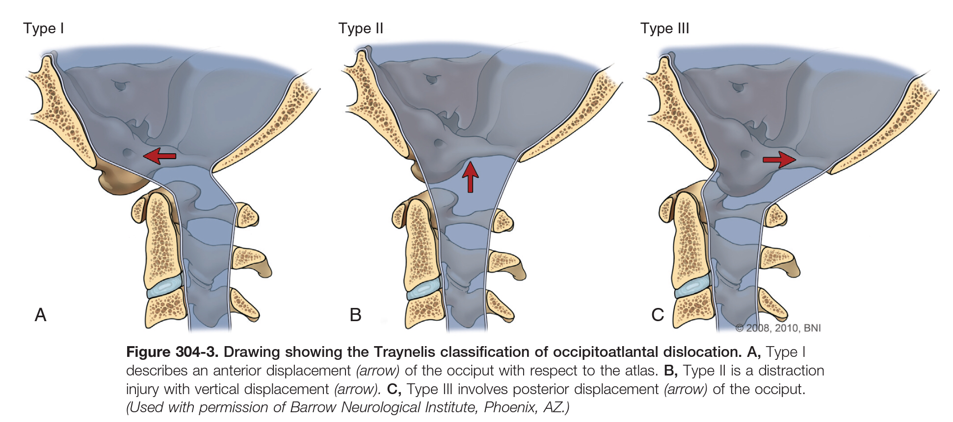
Diagnosis and Classification
The presence of prevertebral soft tissue swelling on plain radiographs and SAH on CT at the CVJ should prompt consideration of the diagnosis of OAD.
Normal cervical radiograph is not a reason to discard the diagnosis of OAD.
Traynelis classification “3 types”
Type I: an anterior displacement of the occiput with respect to the atlas.
Type II: vertical displacement.
Type III: posterior displacement of the occiput.

Slide 16
Treatment
All patients with OAD should be treated because ligamentous injuries may not heal and surgery is required to recover spinal stability.
Early diagnosis, prompt intubation, and early immobilization of the neck and head to improve survival in young patients.
Delay in the diagnosis is associated with an increased likelihood of neurological deterioration.
The use of traction is now not recommended in OAD because deteriorated neurologically or failed to achieve craniocervical stability.
Dorsal fusion with rigid internal fixation
Is recommended (the occiput to C2) with the aid of screw instrumentation and wired structural rib autografts or fibular allografts.
High mortality rate, mostly related to associated brainstem or upper cervical spinal cord injury.

Slide 17
Techniques
The use of occipital screws requires careful assessment of the thickness of the occipital bone and the location of the dural venous sinuses.
Screws up to 8 mm long can be inserted in the region of the superior nuchal line up to 2 cm laterally from the center of the external occipital protuberance
1 cm from the midline at a level 1 cm inferior to the external occipital protuberance,
0.5 cm from the midline at a level 2 cm below the external occipital protuberance.
Outcome
Patients surviving the first 48 hours after trauma may have a good outcome.
Up to 1/4th of the surviving population may be neurologically intact.
Another 1/4th may have mild to moderate neurological deficits.

Slide 18
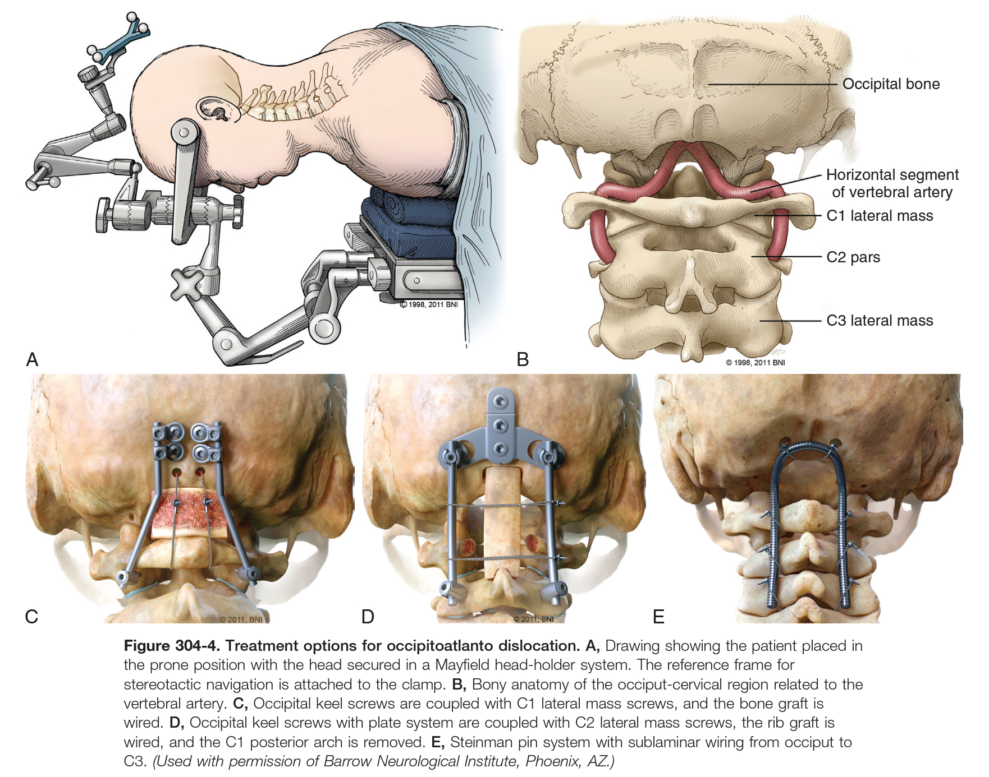

Slide 19
Transverse Ligament Injuries

Slide 20
The transverse ligament prevents the odontoid process from posterior translation.
Extreme hyperextension of the neck can lead to its disruption that results in an anterior C1-2 dislocation with an increase of the atlantodental interval, which can be seen on lateral cervical radiographs when the neck is flexed.
A distance from the posterior wall of the anterior arch of C1 to the anterior wall of the dens of
More than 3 mm in adult or
More than 5 mm in pediatric patients
with or without a lateral mass displacement of C1 and the dens of more than 7 mm (rule of Spence) on an open-mouth cervical radiograph, is suspicious for a transverse ligament injury
MRI with a gradient echo (transverse ligament is shown as a continuous low-intensity signal band)
CT (bony pathology)

Slide 21
Dickman classification (useful for determining treatments):
Type I: disruptions of the transverse atlantal ligament.
Type II: fractures or avulsions that detach the bony tubercle that is the insertion point of the transverse ligament at the C1 lateral mass.
Treatment
Type l: C1-C2 fixation
Type ll: chance of healing satisfactorily with external orthosis (halo vest). Surgery can be reserved for nonunion injuries after 3 to 4 months of attempted immobilization.

Slide 22
In acute atlantoaxial dislocation, the most important clinical indication of instability is
Local neck pain and spasm or stiffness of the neck muscles.
Degree of cord compression with associated neurological deficits.
Longstanding or chronic instability is associated with
Shortening of the neck size
Torticollis
Restricted neck movements with the neck favoring hyperextension and restricting flexion movements
Range of other local neck and generalized spinal deformities.
The neck size reduction is facilitated by and associated with
Reduction in the disk space height
Secondary osteophyte formation
Bone fusions leading to Klippel–Feil abnormalities
Platybasia

Slide 23
ISOLATED OSSEOUS INJURIES
Occipital Condyle Fractures
Isolated Atlas Fractures
Anatomy and Mechanism of Lesions
Occiput-C1 articulation is the most important segment involved in flexion-extension of the cervical spine.
The occipital condyles articulate with the lateral masses of C1 in a cup-shaped joint that facilitates flexion and extension, with limited axial rotation or lateral bending.
Similar to isolated ligamentous injuries, the most common fractures of the occipital condyles and the atlas are related to blunt trauma or motor vehicle crashes in which high energy craniocervical injuries are sustained.

Slide 24
Occipital Condyle Fractures

Slide 25
Infrequent.
Blunt craniocervical trauma.
Diagnosis
Rarely made using plain radiographs.
CT: sensitivity is 100%. (thus recommended)
MRI is not recommended.
Classification :
Type I: comminuted fracture of the condyle.
Type II: extension of a linear skull base fracture involving the occipital condyle.
Type III:avulsion of a fragment of the condyle.
Types I and II are considered stable fractures (require external immobilization of the head and cervical region alone).
Type III are considered unstable (requiring internal fixation of the injury because of its ligamentous nature).

Slide 26
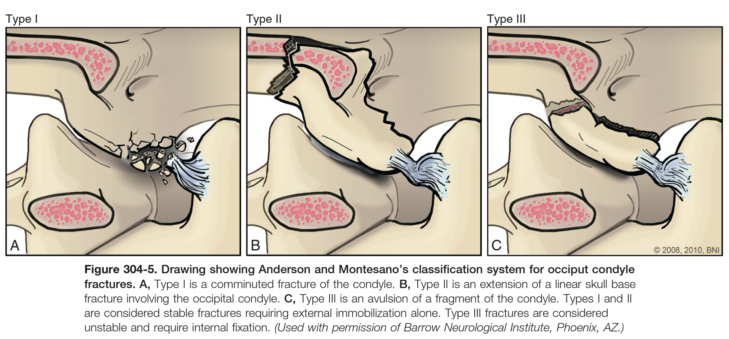

Slide 27
Treatment
Unilateral OCF: External cervical immobilization is almost always sufficient.
Bilateral OCF: more rigid external immobilization (halo vest).
Type III OCF, with associated ligament injury (OAD), requires surgical stabilization with posterior instrumentation depending on the extent of the injury.
Presence of OCF should raise the suspicion for the potential of an associated OAD
Note
Approximately 40% of patients with OCFs have lower cranial nerve injuries (primarily cranial nerve XII), some of which can develop in a delayed fashion.

Slide 28
Isolated Atlas Fractures
(Jefferson fracture)

Slide 29
Isolated fracture of the atlas (C1), or Jefferson fracture (indicate a burst fracture injury of the atlas ring).
Rarely associated with neurological deficits.
The central concern in the management of Jefferson fractures is the integrity of the transverse ligament and joint capsules.
Classification
Type I (anterior or posterior arch fracture) is confined to a single arch and does not cross the equator of the atlas; however, each arch can be involved.
Type II (burst fracture) involves both arches and crosses the equator of the atlas; two or more fragments may be present.
Type III (lateral mass fracture) has a fracture line extending from the lateral mass into one arch only.

Slide 30
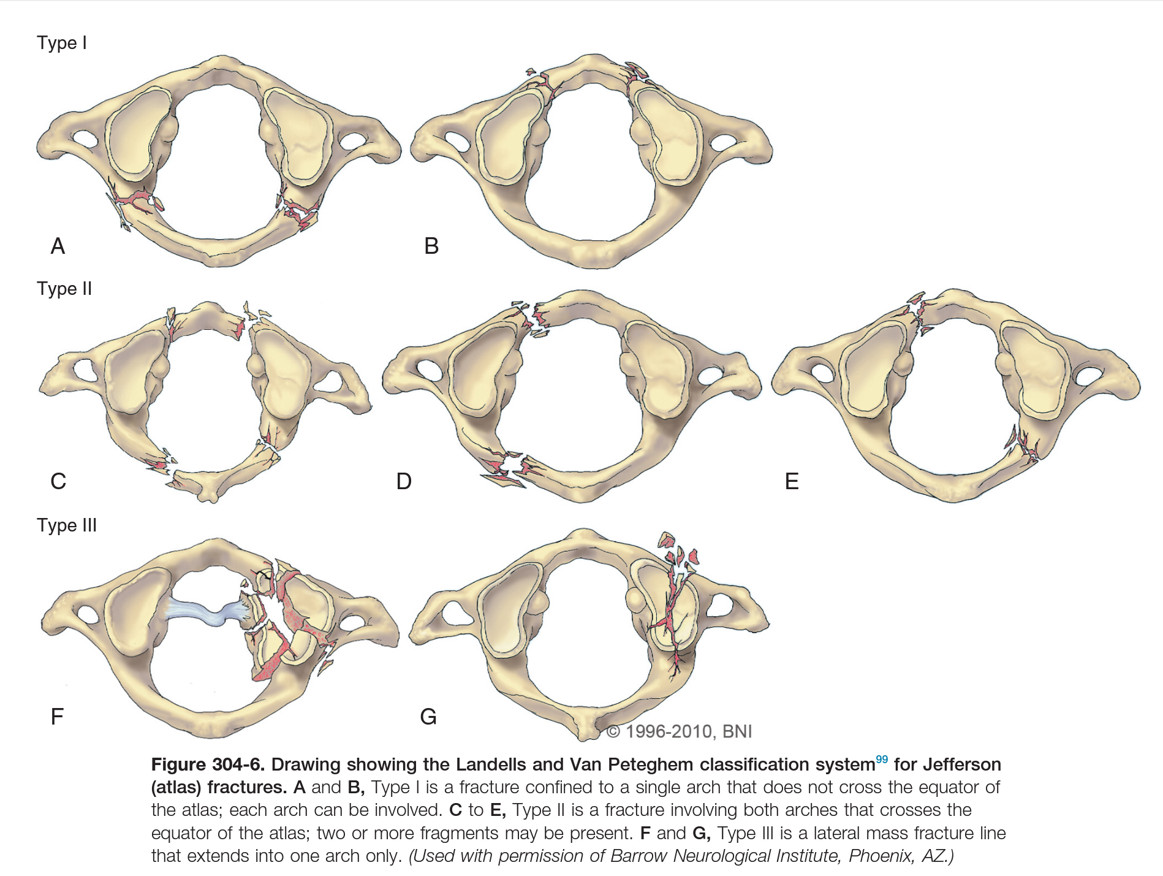

Slide 31
Diagnosis
The clinical relevance of C1 fractures resides on the integrity of the transverse ligament.
By using the Rule of Spence by which a more than 7 mm lateral mass displacement of C1 over C2 on the open-mouth radiograph suggests a transverse ligament disruption.
MRI (more sensitive indicator): loss of integrity of the transverse ligament (high signal intensity within the ligament, loss of anatomic continuity, and blood at the insertion site of the ligament).
Criteria to determine transverse ligament injury with associated C1-2 instability.
The sum of the displacement of the lateral masses of C1 on C2 on a plain open-mouth radiograph.
Predental space of more than 5 mm in adults.
Evidence of transverse ligament disruption or avulsion on MRI.

Slide 32
Treatment
Nondisplaced, isolated type I and III fractures:
Effectively treated with external cervical immobilization devices (rigid collars, suboccipital mandibular immobilizer braces, and halo vest orthoses) for 8 to 12 weeks.
Type II (burst) fractures with an intact transverse ligament
Stable fractures.
Patients can be effectively managed with the use of any rigid external immobilization for 10 to 12 weeks.
Type II (burst) fractures with Combined anterior and posterior arch fractures of the atlas with evidence of transverse ligament disruption
Unstable fractures.
Some patients can be effectively treated with:
Either rigid immobilization alone (halo vest orthosis) for 12 weeks.
Or posterior surgical stabilization.

Slide 33
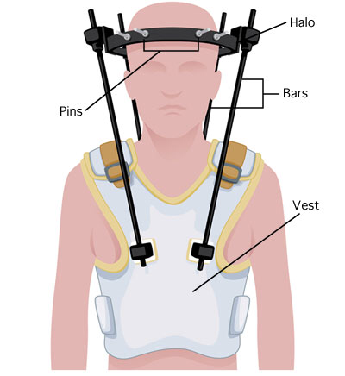
suboccipital mandibular immobilizer braces
Halo Vest

