Slide 1
Choroid Plexus Tumors YOUMANS CHAP. 209

Slide 2
Choroid plexus tumors are benign or malignant neoplasms that arise from the ventricular ependymal cells.
The majority of choroid plexus tumors are benign & rarely convert to malignant.
Malignant tumors arise de novo.
Majority occur in children.
Slightly male predominance.
Supratentorial tumors (Lat. V. & 3rd V.)
Mostly in infants; the median age at diagnosis was 1.5 years
Infratentorial tumors (4th V. & CPA)
Median ages at diagnosis of tumors were 2nd and 3rd decades.
50% of tumors were situated in the lateral ventricles mainly the atrium.
37% in the fourth ventricle,
9% in the third ventricle, and the remainder in other locations.

Slide 3
PATHOLOGY
Gross Appearance
CPPs (choroid plexus papilloma)
Similar to the soft fronds of choroid plexus, and the overall shape is approximately globular.
The well-differentiated 2ry structures result in a cauliflower-like appearance.
Tend to expand the ventricle rather than invade adjacent brain tissue.
Surgical resection is more difficult because of the proximity of these tumors to deep-seated structures, such as the internal cerebral veins and limbic structures.
CPCs (choroid plexus carcinoma)
The boundary between CPCs and the surrounding brain parenchyma is not as well developed, and brain invasion is frequently observed.
The tumor itself appears less differentiated and is often very vascular.

Slide 4
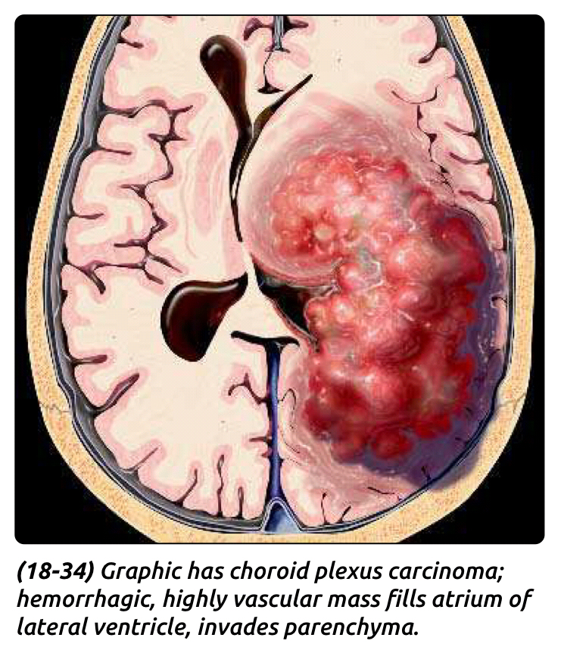
Classification and Histopathology
Choroid plexus tumors were separated into
CPPs WHO grade I
Atypical CPP WHO grade II
CPCs WHO grade III
Defnitive diagnosis of a CPC is usually based upon three major histopathologic features :
Cytologic criteria of malignancy (nuclear atypia, increased nucleus to cytoplasm ratio, and prominent mitotic figures).
Loss of the normal papillary architecture.
Brain invasion with extension of the tumor through the ependymal lining of the ventricle.

Slide 6
Clinical Features
The most common presentation related to increased ICP secondary to obstructive hydrocephalus, CSF over production, or both.
Infants and young children, the characteristic symptoms of increased ICP are nausea/vomiting, irritability, headache, visual diffculty, and seizure
Most common signs:
Macrocephaly
Papilledema.
Decreased level of consciousness.
The duration of symptoms 2 months in patients younger than 2 years to 6 months on average in patients older than 2 years.
Acute deterioration caused by
Massive hydrocephalus
Tumoral hemorrhage

Slide 7
Neuroimaging
CPPs reveals typical features that strongly suggest the diagnosis.
Clearly located within the ventricle.
Well demarcated from the brain.
Lobulated.
Punctate calcification.
T1 isointense
T2 hyperintense
Enhances brightly although this can be patchy, reflecting areas of high flow.
CPCs, the border between tumor and normal brain tissue appears diffuse, which may reflect areas of brain invasion.
MRS characterized by
Prominent choline peak
Absence of N-acetyl aspartate.

Slide 8
Deferential Diagnosis
Cerebellar astrocytomas tend to stain less homogeneously and often have cystic areas.
Medulloblastomas are characterized by a more heterogeneous appearance, although they also stain vividly with contrast material, and they may be confused with fourth ventricular CPPs.
Ependymomas arise physically in similar locations but tend to enhance inhomogeneously.
Meningiomas can occur in an intraventricular location but are rare in children.

Slide 9
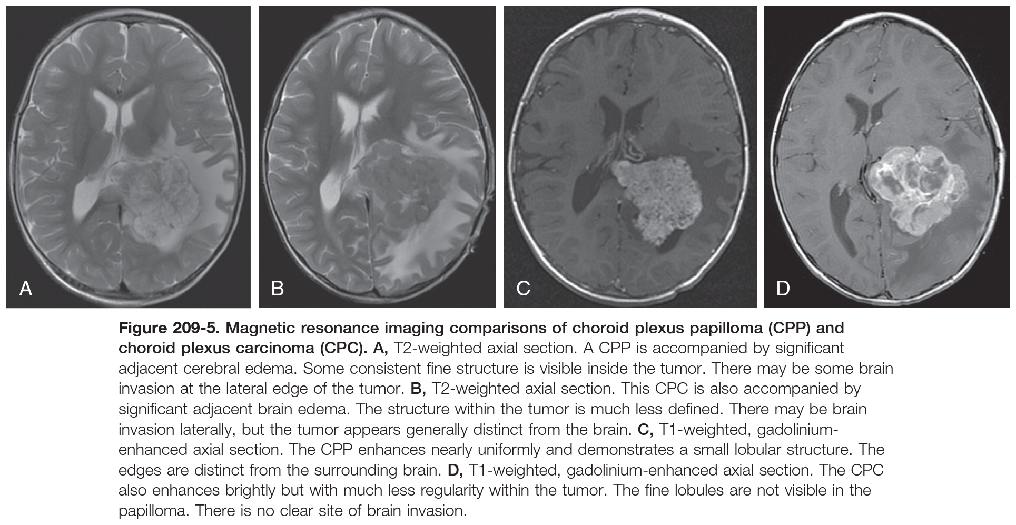

Slide 12
TREATMENT
Management of Hydrocephalus
In infants younger than 8 to 10 months, treatment of hydrocephalus can often wait until the planned surgical date.
In the presence of a decline in neurologic function, however, an EVD should be inserted immediately, before definitive tumor management.
VP shunt disadvantages
Not allow external CSF drainage and ICP monitoring in the intraoperative and postoperative setting.
The presence of intraventricular blood and debris after tumor resection may lead to blockage of the shunt.
For 3rd & 4th V. tumors its recommended immediate shunt placement, followed by a delay of 7 to 14 days before surgery.
Tumors of the Lat. V. or 3rd V. are generally supplied by branches of the anterior or posterior choroidal arteries.
4th V. tumor receives its blood supply from medullary or vermian branches of the posterior inferior cerebellar artery.

Slide 13
Operative Treatment
Steps are part of most surgical plans.
Temporary or permanent resolution of hydrocephalus,
Identification of the arterial supply,
Planning the surgical approach to allow access to the vascular supply and maximal exposure of the tumor
Avoiding eloquent tissue and anticipating the particular surgical features of the tumor.
The two features of choroid plexus tumors that can make resection exceedingly difficult are vascularity and large size.
Piecemeal resection is usually associated with increased blood loss.
The most effective strategy is early identification and ligation of the feeding artery.
En bloc excision is recommended.

Slide 14
For CPPs of the lateral ventricle, a direct cerebrotomy posterior to the angular gyrus allows access to the entire trigone and enables the surgeon to identify the pedicle of the tumor and allow coagulation.
Tumors located within the temporal horn are easily approached through the middle or inferior temporal gyri.
Tumors in the third ventricle are rare and are best approached through a midline, transcallosal route. The depth of the tumor’s location and its proximity to important structures surrounding the third ventricle mandate early control of the blood supply.
Fourth ventricular tumors almost always produce triventricular obstructive hydrocephalus and may necessitate preoperative CSF drainage.
Tumors in this location arise from the caudal part of the roof of the 4th ventricle
The approach is through a standard midline posterior fossa craniotomy that exposes the vermis and tonsils.
The blood supply from branches of the PICA are visualized from a medial vantage point.

Slide 15
Special Considerations in the Pediatric Population
The primary operative concerns in small children are related to blood loss, resuscitation, and anesthesia.
A child who weighs 10 kg has a circulating blood volume of 800 to 1000 mL. The entire blood volume can easily be lost during the resection of a particularly vascular tumor.
Complication after resection of choroid plexus tumors
Development of large subdural fluid collections.
Ventriculo-subdural fistula (If a transcortical approach was used).
Disproportionate space between the brain and calvaria caused by removal of a choroid plexus tumor and decompression of the ventricular system (In small children with macrocephaly caused by hydrocephalus).
This may necessitate treatment with the placement of a subdural-peritoneal shunt.

Slide 16
CHOROID PLEXUS CARCINOMA AND ATYPICAL CHOROID PLEXUS PAPILLOMAS
Surgical Considerations
Technical considerations with CPC include
The increased vascularity of the tumor.
The lack of a well-developed plane between the brain and tumor.
Excessive friability of the tumor tissue.
CPCs are more common in younger children,
Excessive bleeding is an important consideration in deciding the optimal operative strategy.
Embolization, early control of feeding arteries, and rapidity of dissection are important steps to reduce blood loss.
Use of preoperative chemotherapy → reduces vascularity and improves the likelihood of success with GTR.
Use of combination chemotherapy after an initial surgical procedure → reduce tumor volume and enable a more complete resection during the second-stage operation.

Slide 17
Adjuvant Therapy
Patients with CPC and atypical CPP were treated with etoposide , vincristine carboplatin, cyclophosphamide was shown to have the highest response rate.
Postoperative radiation is usually recommended for
Children older than 3 years.
The presence of leptomeningeal dissemination.
Subtotal resection.
Drop metastases.
Surgery alone is not sufficient for CPC. Disease relapse confers a poor prognosis.
For atypical CPPs
GTR can result in good outcomes, but the disease can recur, sometimes years after the initial diagnosis.
It is not clear whether chemotherapy for atypical CPPs after GTR will reduce the likelihood of recurrence.
More aggressive treatment for CPPs is indicated if features such as metastasis are present at the time of diagnosis.

