Slide 1
Cervicothoracic
Junction
Injuries
Youmans chap. 307

Slide 2
BIOMECHANICS OF THE CERVICOTHORACIC JUNCTION
The cervicothoracic junction, is a transitional region both from lordosis to kyphosis and from mobile to rigid, is subject to unique forces acting in many directions.
The normal alignment of the subaxial cervical spine is
  Straight to lordotic.
  Axial loading is resisted primarily by the vertebral bodies, aided by the lateral masses, particularly in the condition of extension.
  The obliquely oriented facets allow for a significant degree of laxity in rotation, lateral bending, and flexion.
The normal alignment of the upper thoracic spine
  Is kyphotic.
  The rib cage resists forces of flexion, extension, lateral bending, and axial rotation.

Slide 3
When the thoracic kyphosis is exaggerated or when the overall sagittal balance of the spine is positive, the C7-T1 disk space can be oriented more steeply.
  This causes axial loading forces to be transmitted across the disk space as anterior translating forces (a shear force across the disk space).
  If orientation is very steep, or if there is disruption in the posterior ligamentous complex, the obliquely oriented facet joints may be of little to no help in resisting these forces.
INJURIES
Cervicothoracic junction fractures are relatively rare.
Fractures at the C7-T1 level may not be detected by plain films,
Especially in patients with a large body habitus or muscular build, and computed tomography (CT) is recommended if injury is suspected at this level.

Slide 5
Types of Injuries
Injuries to the cervicothoracic junction need to be judged on
  the presence of instability.
  the presence of neurological compression.
  the need for stabilization.
Instability in the acute setting may be judged by
  the integrity of the anterior, middle, and posterior columns.
Allen classification system described injuries based on mechanism:
  Compressive flexion
  Compressive extension
  Distractive flexion
  Distractive extension
  Lateral flexion
  Vertical compression
The Harris classification included rotational vectors in flexion-extension rather than compressive-distractive vectors included by Allen.
The Subaxial Cervical Spine Injury Classification (SLIC) system:
based largely on three characteristics: morphology of the fracture, integrity of the DLC, and neurological status of the patient.

Slide 6
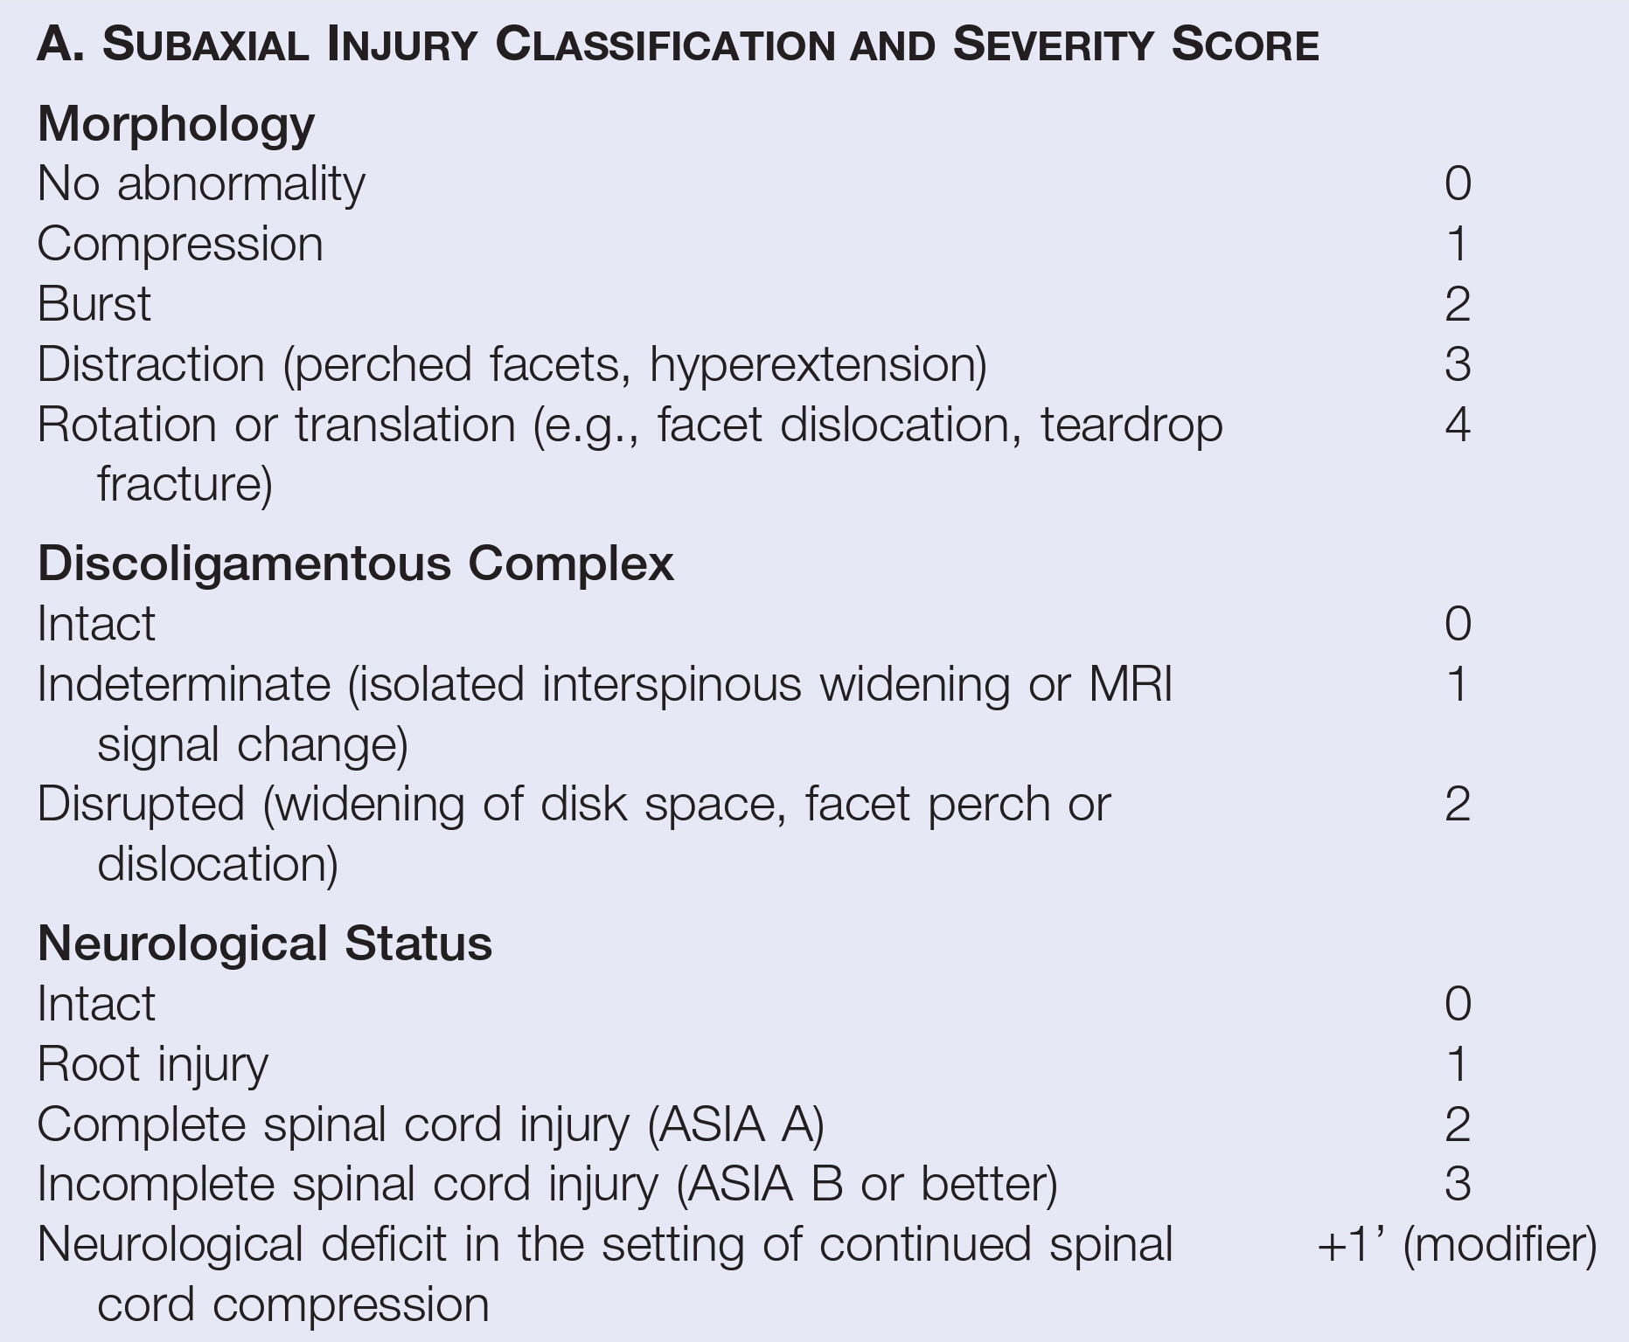

Slide 7
Types of Injuries
Compression Injury :
Compression injuries are due to axial loading and result in loss of height of the vertebrae which include:
Flexion compression fractures, which cause loss of height of the anterior column (a flexion tear drop fracture).
Minimally displaced lateral mass fractures resulting from lateral compression.
Very high energy axial loading can lead to a burst fracture, the most severe form of compression fracture, resulting in comminution of the vertebral body, often with retropulsion into the spinal canal (associated with the worst outcomes among compression fractures).

Slide 8
Distraction injury
Distraction injuries are characterized by anatomic dissociation in the vertical axis.
They are typically secondary to forces that cause tensile failure of a ligament or ligamentous complex.
Hyperextension injuries are one example of this because distraction forces result in compromise of the anterior longitudinal ligament (ALL), leading to a widened intervertebral space seen on imaging.
Alternatively, if the ALL does not fail, an extension teardrop fracture may occur if the ALL avulses the anterior-inferior corner of the vertebral body.
Powerful hyperextension forces can result in simultaneous compression of the posterior elements, leading to posterior element fractures.
Extreme examples of this can result in buckling of the ligamentum flavum and posterior compression of the spinal cord.

Slide 9
Rotational-Translational Injury
Rotational-translational injuries are characterized by horizontal rotation of one vertebral body with respect to another.
Typically, angulation greater than 11 degrees or translation greater than 3.5 mm has been considered pathologic.
Unilateral and bilateral facet dislocations, floating lateral masses, and bilateral pedicle fractures are representative of this type of injury.
Both anterior and posterior structures are compromised in rotational translational injuries.
Clay Shoveler’s Fracture
Is an avulsion of the spinous process, most commonly at the C7 level.
It is a hyperflexion injury seen now most commonly as a result of whiplash type injuries in automobile collisions.
It can be associated with facet fractures or unilateral jumped facets; however, after these are ruled out, the fracture is considered stable.

Slide 10
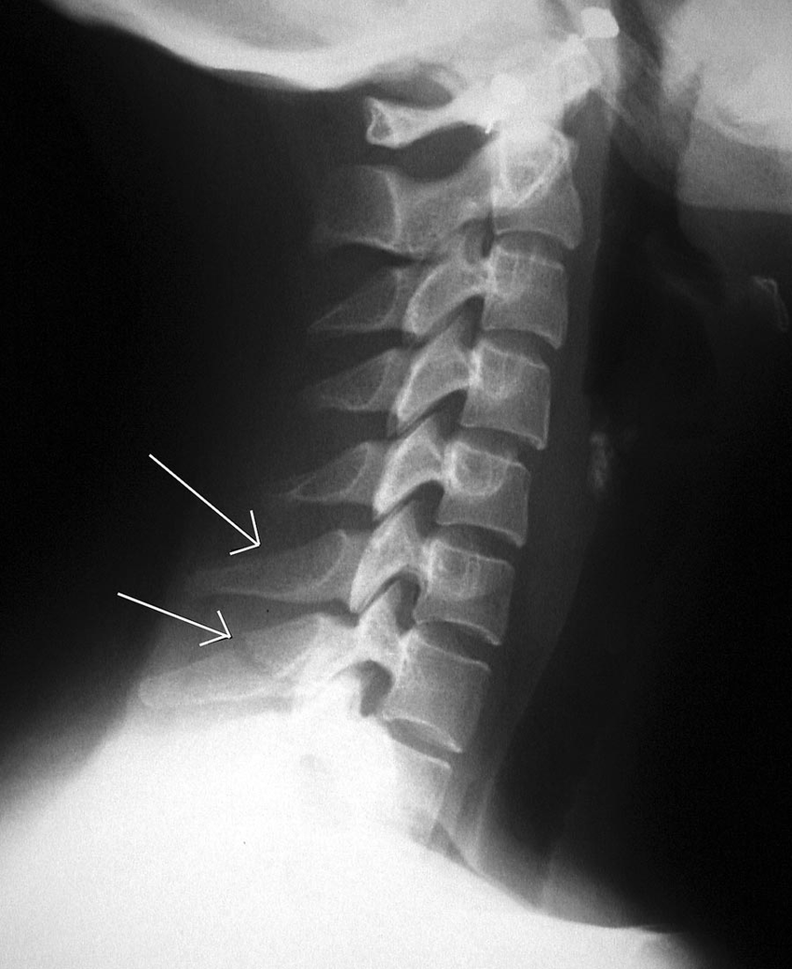
Clay Shoveler’s Fracture

Slide 11
Discoligamentous Complex Injury
The DLC is made up of the intervertebral disk, ALL, posterior longitudinal ligament (PLL), ligamentum flavum, interspinous ligament, supraspinous ligament, and facet joint capsule.
Together, these structures allow flexibility of the spine while providing resistance against supraphysiologic motion.
When assessing the severity of injury in the SLIC system, the complex is classified as intact, indeterminate, or disrupted.
It is important to assess these structures because soft tissue healing is typically slower than bony healing, and injured ligaments may never regain their prior tensile strength.
Abnormal facet alignment, defined as
articular apposition of less than 50% or diastasis of more than 2 mm,
widening of the anterior disk space,
most distracting and translation injuries imply DLC incompetence of some sort.

Slide 12
Treatment
Depending on SLIC system:
score of 1 to 3 treated conservatively.
4 can be treated conservatively or operatively.
5 or more treated operatively.
Fractures should be surgically fixed:
When there is overt instability,
When there is risk for neurological injury over time because of glacial instability,
When reduction of a dislocation is needed to facilitate physiologic load bearing and early mobilization but cannot be achieved nonoperatively.

Slide 13
Compression injuries in which the PLL is intact and there is no neurological deficit can be treated conservatively with a cervicothoracic orthosis.
Displacement of the vertebral body into the spinal canal or a three-column injury, the patient should most often undergo surgical fixation.
Most distracting injuries and nearly all rotational-translational type fractures should strongly be considered for operative management.
Ankylosing spondylitis are at higher risk for secondary neurological injury with conservative treatment. Surgical treatment is usually indicated, most often in the form combined anterior and posterior fixation.

Slide 14
Surgical Approaches
The choice of surgical approach should be dictated by
The degree and direction of neural compromise,
Extent of instability,
Patient anatomy,
Construct design necessary to provide stability,
Surgeon experience.
Anterior approaches to the cervicothoracic junction are limited by bony, vascular, visceral, and neural structures.
Posterior approaches provide easier access to the cervicothoracic spine.

Slide 15
Anterior Approaches
Key landmarks in anterior exposure of the cervicothoracic junction are the sternum and the great vessels.
The bony exposure can be expanded caudally and laterally, but the great vessels present a less malleable obstacle.
  Supramanubrial approach can access down to about T2.
  Transmanubrial approach can access down to about T3.
  Transthoracic approach can access below about T3.
The manubrial window is a common extension of the low anterior cervical approach and controversy exists regarding the side of approach.
A left-sided approach often is preferred. The primary advantage of the left sided approach is less consistent involvement of the recurrent laryngeal nerve, which runs quite vertical in the tracheoesophageal groove on this side.
The thoracic duct is encountered during a left-sided approach, but this can be ligated carefully and divided.
A right-sided approach will encounter the recurrent laryngeal nerve running obliquely across the surgical field, necessitating dissection and mobilization.

Slide 16
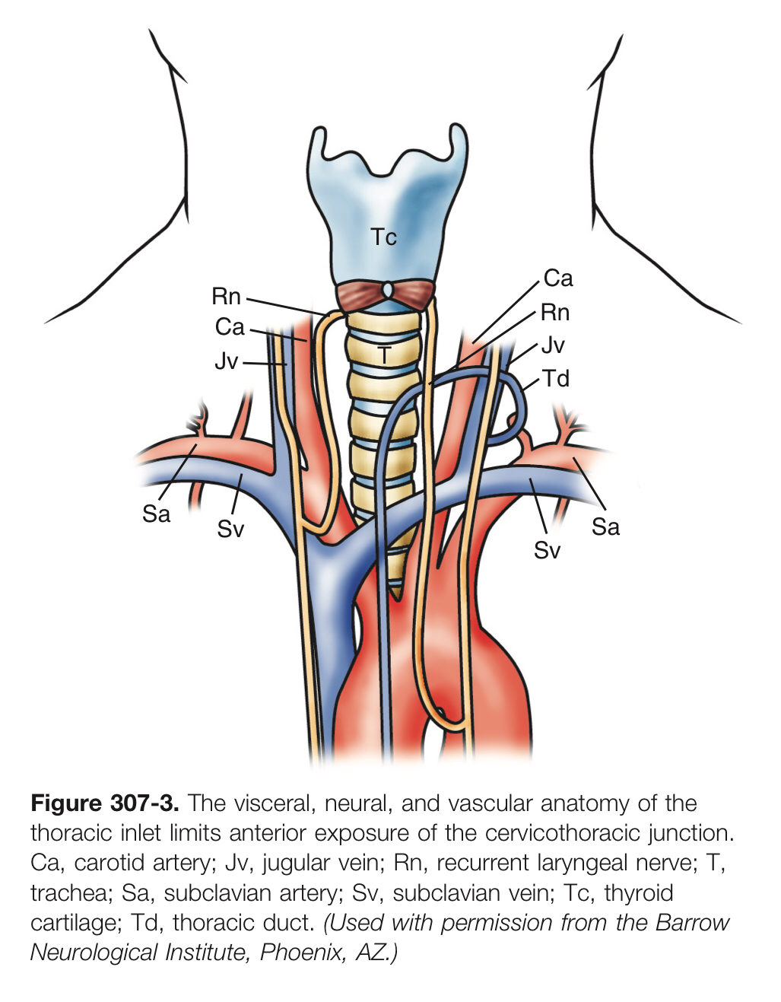

Slide 17
Resection of the medial clavicle
Is used in both a unilateral and bilateral procedure.
The surgical corridor is narrowed primarily by the great vessels rather than the medial clavicle; this limits the exposure gained by clavicular head resection.
The clavicular head may be used as a locally harvested autograft following corpectomy.
There is a risk for shoulder girdle destabilization, which can cause postoperative functional impairment.
Inferior extension of transmanubrial surgery (sternotomy)
Incurs the additional morbidity of an extensive mediastinal dissection.
Useful in the treatment of tumor and infection.
Thoracotomy
Provide access to the anterior aspect of the lower cervicothoracic junction.

Slide 18
Posterior approaches
Posterior approaches are much more straightforward at the cervicothoracic junction than anterior or lateral approaches.
A midline incision can provide access for a laminectomy, a posterolateral transfacet or transpedicular approach, or a costotransversectomy.
Lateral Approach
A lateral parascapular approach.
This approach can allow for ventral decompression and strut placement, but fixation is generally from a posterior approach.

Slide 19
Cadaveric Studies
Posterior-only and anterior-only constructs seem to be adequate in two-column injuries but may be inadequate in three-column injuries. Combined anterior-posterior constructs are significantly more rigid in three-column injuries.
Excluding screw fixation, C7 is of little biomechanical consequence as long as the construct spans the cervicothoracic junction and there is adequate fixation rostrally and caudally.
The thoracic extension of a construct to T2 adds significant rigidity to the construct in axial rotation, lateral bending, and combined flexion and extension.

Slide 20
Segmental Instrumentation
Lateral mass screw fixation is common in the subaxial cervical spine,
Whereas pedicle screw fixation is common in the thoracic spine.
Construct failure:
Can be due to
Patient characteristics such as osteoporosis or smoking;
Surgical site infection can also cause construct failure.
An inadequate surgical plan to deal with the forces acting on the cervicothoracic junction.

