Slide 1
Cervical, Thoracic, and
Lumbar Stenosis
Youmans Chap.287

Slide 2
CERVICAL SPINAL STENOSIS
May be congenital or, more commonly, acquired.
It is a multifactorial process involving :
Reactive hypertrophy of the osseous, uncal, and end plate osteophytes.
Hypertrophy and infolding of the ligamentum flavum.
This process results in a restriction of the anteroposterior (AP) dimension of the spinal canal and compression of the cervical spinal cord.
Normal adult AP diameter of the bony spinal canal is 17 to 18 mm.
Average AP diameter of the adult spinal cord is 5 to 6 mm.
The intracanalicular soft tissue components, such as the posterior longitudinal ligament, dura, and ligamentum flavum, occupy 2 mm of spinal canal.
Thus the minimal spinal canal space required for a noncompressed spinal cord is 10 mm, which has been set as the threshold value for absolute cervical spinal stenosis.
In extension, the spinal canal AP diameter reduces by 2 to 3 mm; therefore, 12 to 13 mm is a threshold value for relative stenosis.

Slide 3
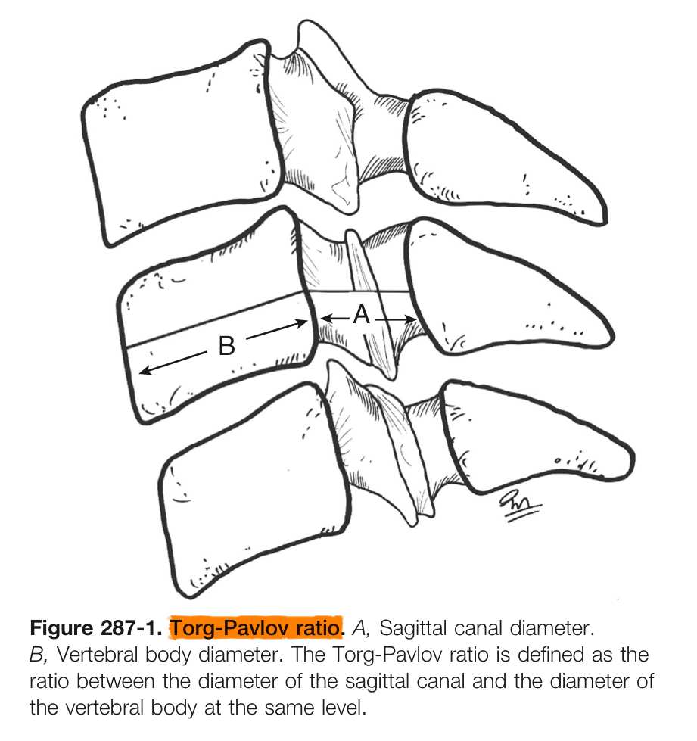
The Torg-Pavlov ratio (spinal canal–vertebral body ratio)
is the distance from the midpoint of the posterior aspect of the vertebral body to the nearest point on the corresponding spinolaminar line divided by the AP width of the vertebral body.
The normal Torg-Pavlov ratio is 1
In congenital cervical stenosis, it is 0.8 or less.
Used to identify football players at risk for acute spinal cord injury.
but it inconsistent predictor of symptomatic compressive myelopathy.
Not effective when spondylotic changes commonly occur in the vicinity of the intervertebral disk, and because the canal narrowing caused by soft tissue.

Slide 12
THORACIC SPINAL STENOSIS
Isolated symptomatic stenosis of the thoracic spine is rare.
Congenital narrow thoracic spinal canal may predispose affected patients to symptomatic stenosis with progressive degeneration.
Degenerative changes such as hypertrophy of the facet joints are most common in the lower third of the thoracic spine.
Other causes of thoracic spinal stenosis include dislocation of fracture fragments, disk herniations, and ossification of the posterior longitudinal ligament.
Biomechanical studies suggest that laminectomy or unilateral facetectomy at the level of the true ribs (upper and middle thoracic spine) does not compromise spinal stability and may not necessitate additional instrumentation.
In severely stenotic segments, a 1-mm Kerrison rongeur should be used to avoid neural damage from the footplate of too large an instrument.
The main goal of thoracic decompressive surgery is to prevent symptoms from progressing.
Late deterioration can result from postoperative deformity or recurrent stenosis.

Slide 13
LUMBAR SPINAL STENOSIS
Stenotic changes are most prevalent at the L4-5 level, followed by the L3-4 and L5-S1 levels.
The clinical course of LSS symptoms is characterized by gradual onset and slow progression.
Patients usually present with intermittent neurogenic claudication or a more well-defined radicular pain.
Patients with single-level LSS with or without degenerative spondylolisthesis were more likely to have a dermatomal pain pattern,
Patients with multilevel stenosis frequently complained of intermittent neurogenic claudication.
Typical intermittent neurogenic claudication consists of
Pain, numbness, or tingling sensation in the buttocks or lower extremities when walking or standing;
Symptom relief is experienced with sitting or bending forward.
The most informative clinical signs of symptomatic LSS
bilateral buttock or leg pain.
absence of pain when sitting.
improvement of symptoms with bending forward.

Slide 15
Differential diagnosis should rely on the patient’s history rather than on physical examination findings.
Symptoms above the knees, aggravated by standing and relieved by sitting, are suggestive of neurogenic claudication,
Symptoms below the knees that are alleviated by standing still indicate a vascular cause.
Vascular claudication can be ruled out with reasonable reliability if leg pain is not triggered by walking.

Slide 16
Stenosis Associated with Synovial Cysts
Intraspinal synovial cysts usually arise from facet joints, but they may also develop from the ligamentum flavum or the posterior longitudinal ligament
Synovial cysts are most frequent at the L4-5 level.
50% will have concomitant degenerative spondylolisthesis at the same level.
2% will have neurological symptoms.
Rapid cyst expansion → acute cauda equina syndrome.
Management
No role for conservative treatment (Spontaneous resolution of a synovial facet joint cyst is rare).
Steroid injections → symptom resolution in 75% of patients.
The synovial cysts are often adherent to the adjacent dura, which increases the risk of an incidental dural tear with surgery.

Slide 17
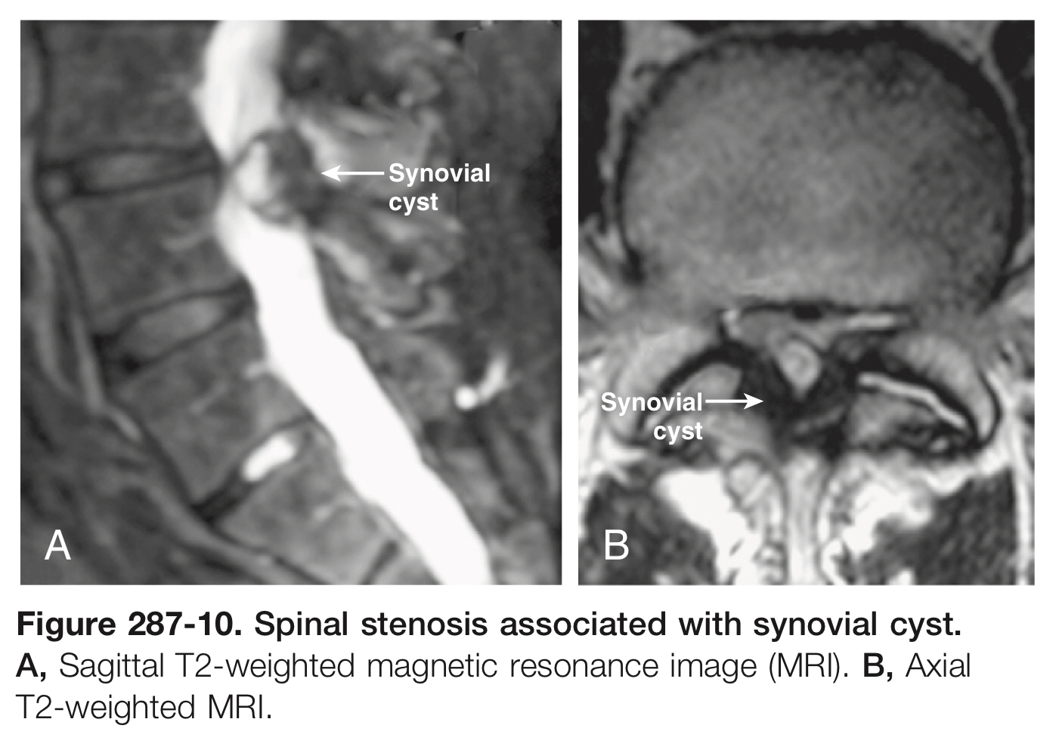
Indication for fusion
younger patients
cases of mobile degenerative spondylolisthesis
minor degenerative changes at the affected level.
If complete facetectomy is required for safe excision of a large cyst, additional stabilization may be necessary.
After decompression alone
6% of patients require reoperation within 25 months (usually a fusion procedure for mechanical back pain)
1% experience same-level recurrence of a synovial cyst.

Slide 18
TANDEM STENOSIS
Describe symptomatic spinal canal narrowing at multiple locations in the vertebral column.
MRI evidence of concurrent cervical and lumbar stenosis in 4% of an asymptomatic population.
Concurrent stenotic findings in the cervical and thoracic spine or in the lumbar and thoracic spine were seen in approximately 1%
About 9% of patients with symptomatic LSS have been reported to have cervical spondylotic myelopathy.
Tandem stenosis may occur more frequently than is clinically recognized: the prevalence of asymptomatic cervical stenosis

