Slide 1
Cerebellar Astrocytomas Youmans Chap. 214

Slide 2
20% of CNS tumors in children are astrocytomas, nearly half of which are infratentorial.
Predominant number occur within the cerebellum and are sporadic.
Within the cerebellum, the most common childhood tumor is (WHO) grade I pilocytic astrocytoma.
In contrast to the childhood astrocytomas at other sites, cerebellar astrocytomas are associated with neurofibromatosis 1 in fewer than 1% of cases.
Pilocytic astrocytomas WHO grade I lesions, have
Eosinophilic granular bodies
Rosenthal fibers.
Pilomyxoid astrocytomas, WHO grade II fibrillary (diffuse) astrocytomas have
Cellular atypia.
No Rosenthal fibers
No eosinophilic granular bodies.

Slide 3
Epidemiology :
Most common primary brain tumor in children
70% occur in children
Mean age at diagnosis of 7 years.
M=F
They can occur in any location of the neuraxis, but the cerebellar hemispheres (50%), optic pathways, thalamus, and hypothalamus are the most common sites.
Pilocytic tumors typically arise from the vermis and the cerebellar hemispheres but can extend into the ventricular system.

Slide 5
Clinical Findings :
Headache
Vomiting
Macrocephaly
Visual deficits
Coma
Cerebellar astrocytomas rarely manifest with emergency findings, such as
Acute decompensated hydrocephalus.
Intratumoral hemorrhage.

Slide 6
Tumor location contributes to the acuity and timing of symptom onset.
Vermian tumors cause early and significant headache and vomiting.
More lateral tumors manifest later with appendicular ataxia, intention tremor, and dysmetria.
More aggressive lesions invading the brainstem or cerebellar peduncles may manifest with cranial nerve palsies and other focal deficits.
Headache associated with posterior fossa lesions is
Progressive.
Begins in a frontal location, later localizing to the suboccipital region with associated nuchal rigidity.
Worse in the morning → hypoventilation and elevated ICP while the patient is lying flat during sleep.
Any type of Valsalva maneuver typically exacerbates headache symptoms.

Slide 7
IMAGING FEATURES :
CT scans
Isodense or hypodense
Calcification & hemorrhage is rare.
May have little or no surrounding edema
Cerebellar astrocytomas enhance with intravenous contrast.
The classic appearance of a mural nodule surrounded by a cyst is seen in fewer than half of these tumors.
Other appearances include
Solid mass
Complete cyst
Mixed features
MRI
T1 hypointensity
T2 hyperintensity
MRS
↑ choline, ↓ NAA, ↑ lactate (abnormal glucose utilization, rather than necrosis)
Differential diagnosis
Medullablastoma
Ependymoma
Hemangioblastoma
Pilomyxoid astrocytoma

Slide 8
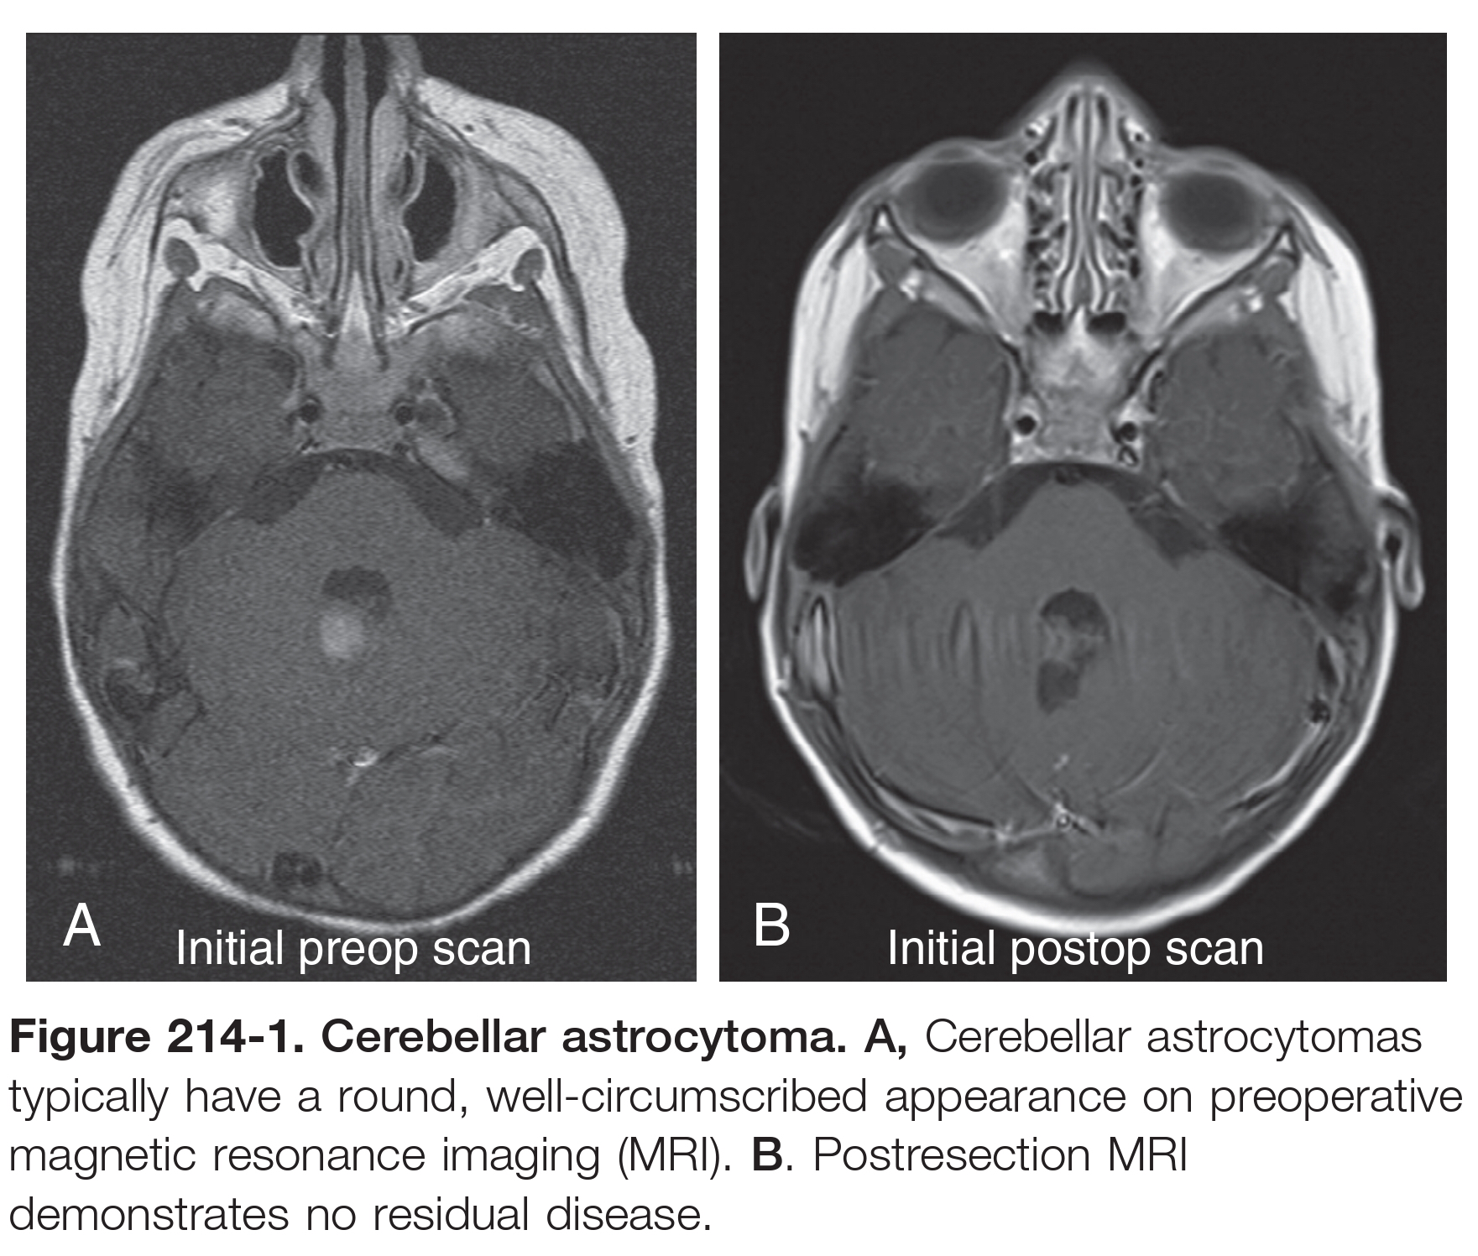

Slide 11
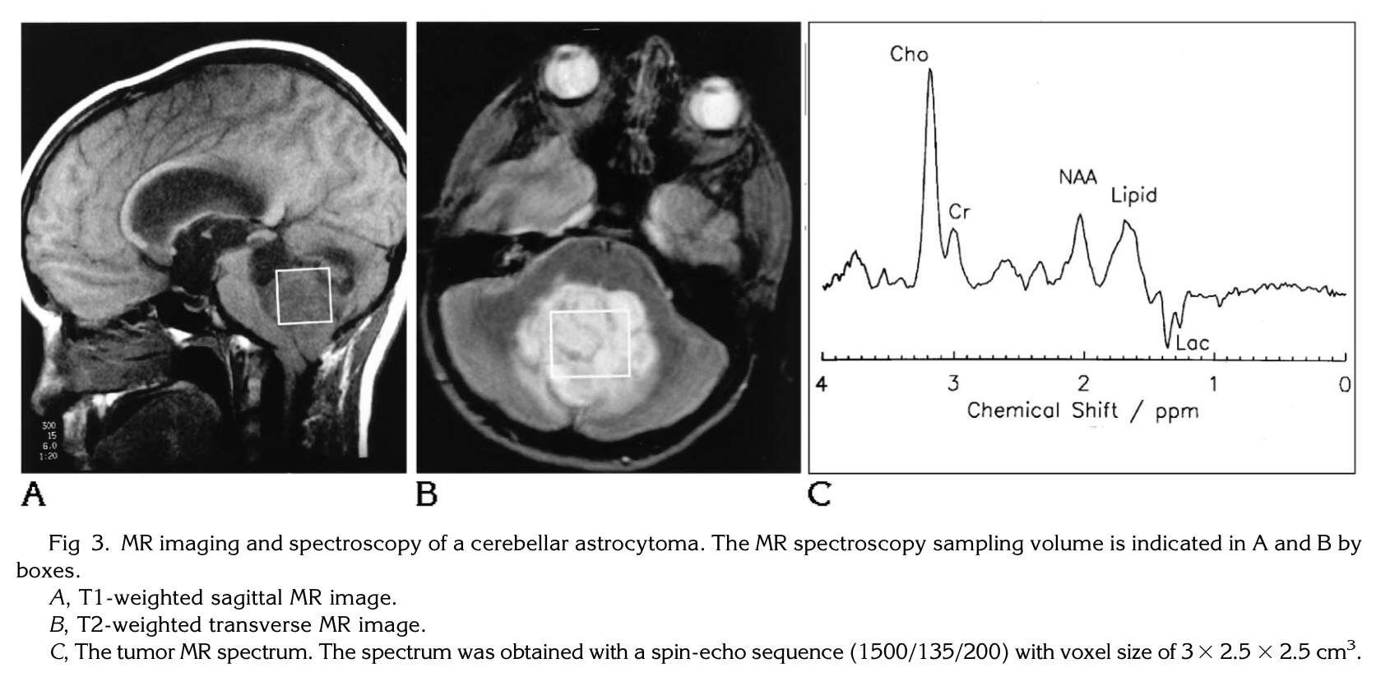

Slide 12
SURGICAL AND PERIOPERATIVE MANAGEMENT :
Surgery is always the first-line therapy because gross total resection is the most important determinant of outcome for low-grade gliomas.
Regarding Cysts
Thin rim of enhancement can often be safely left behind during surgical resection.
Thicker and more irregular cyst wall enhancement necessitates complete resection.
The incidence of dissemination outside the brain is 4% → MRI of the brain and entire spine before surgery because postoperative blood products may confound the interpretation of enhancing lesions.
Mx of hydrocephalus
VP shunt
ETV
EVD more preferable

Slide 13
Score > or = 5 suggest high risk of developing hydrocephalus
This help surgeon to decide whether or not to do ETV

Slide 14
Adjuvant Therapy:
If gross total resection is not achieved (brainstem or cerebellar peduncle invasion) → repeat surgery at the time of recurrence → approximately 70% of cases show spontaneous regression.
Radiation therapy or chemotherapy is not indicated because it has not been shown to delay progression or improve survival, even with WHO grade II tumors.
Chemotherapy is typically used to delay or avoid radiotherapy.
Recurrent disease or leptomeningeal spread → aggressive chemotherapy, followed by radiation.
The use of radiation in the treatment of cerebellar astrocytomas is generally limited to older children with recurrent or refractory tumors in whom chemotherapy has had no benefit.

Slide 15
COMPLICATIONS :
Cerebellar injury
Right-sided injury → long-term language difficulties
Patients may suffer loss of IQ and may demonstrate neuropsychological impairment if the right side of the cerebellum, dentate nucleus, or vermis is injured.
Left-sided injury → spatial and executive function deficits.
Aseptic meningitis
Although this type of meningitis is not infectious, it does manifest in febrile children with a similar symptom triad:
Photophobia, nuchal rigidity, and headache.
CSF studies typically demonstrate pleocytosis and increased protein levels.
Cultures of CSF and peripheral blood demonstrate no growth of organisms.
Develops approximately 5 to 7 days after surgery and can coincide with the onset of steroid tapering.
Typical treatment regimen for aseptic meningitis includes moderate- to high-dose corticosteroids with a prolonged taper.

Slide 16
Cerebellar Mutism, or Posterior Fossa syndrome
Occurs in 10-30% , it is defined by ataxia, hypotonia, cranial nerve palsies, hemiparesis, and emotional lability.
Delayed onset (1-6 day post op), last for 4 months or less and recovery of speech associated with significant dysarthria which may be permanent.
Acute-onset cerebellar mutism or bulbar dysfunction should be evaluated for brainstem injury or hematoma formation.
The prognosis for a patient with speech deficits 1 year postoperatively.
Caused secondary to damage to the dentatothalamocortical pathway
Afferent signal comes from the supplementary motor area through the pons & lateral cerebellum.
Efferent signals travel via the superior cerebellar peduncle and, to a lesser extent, the middle cerebellar peduncle → contralateral ventrolateral thalamus → primary and premotor cortices.
The two dentate nuclei have connectivity via the Guillain-Mollaret triangle and the inferior olivary nucleus.
These connections are key in regard to initiation of movement and cortical processing.
Injury to either dentate nucleus or to any portion of this pathway, especially the superior cerebellar peduncle → cerebellar mutism

Slide 17
Pseudomeningocele
as a result of inadequate dural closure.
Spinal instability
Care must also be taken to avoid disrupting the facets or condylar joints.
Cervical syrinx
Arachnoid adhesions and gliosis within and surrounding the resection cavity can lead to CSF outflow obstruction

Slide 18
Brainstem Gliomas Youmans Chap. 215

Slide 19
Brainstem gliomas (BSGs) are a histologically heterogeneous group of tumors defined primarily by their location.
BSGs can be categorized as
Tectal 5%
Focal pontine and midbrain
DIPG ( diffuse intrinsic pontine glioma ). 80%
Cervicomedullary junction
Dorsally exophytic tumors
EPIDEMIOLOGY :
Reflect approximately 25% of tumors arising in the posterior fossa.
The median age at presentation for pediatric BSGs is 6 to 7 years.
M=F
Patients with neurofibromatosis 1 (NF1) have a tendency for the formation of BSGs, although their clinical course tends to be more benign in comparison with non-NF1 BSGs.

Slide 20
Diffuse Intrinsic Pontine Glioma
Rapid onset and progression
Patients with DIPGs typically present with the classic triad of
Cerebellar dysfunction
Involvement of the cerebellar peduncles can result in either truncal or appendicular ataxia and incoordination
Long tract signs
Involvement of the crus cerebri or long tracts can result in hemiparesis.
Cranial neuropathy (typically bilateral)
The lower cranial nerves (V, VI, VII, IX, and X) are most frequently affected.
6th & 7th C.N are the most conspicuously involved, and most affected children have diplopia.
DIPGs often result in diffuse enlargement of the pons and, although large, often do not obstruct the fourth ventricle at the time of diagnosis.
Engulfment of the basilar artery can occur and is considered an imaging hallmark of this tumor.
With tumor progression, hydrocephalus can develop in up to 15% of affected patients

Slide 21
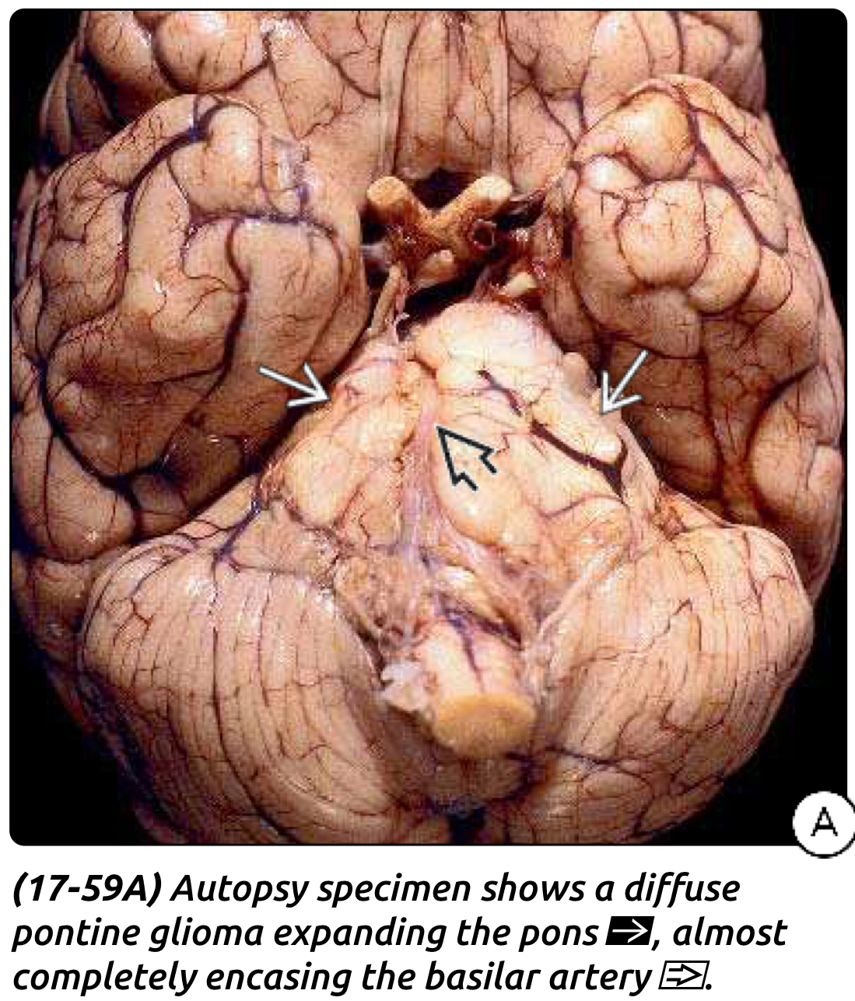

Slide 22
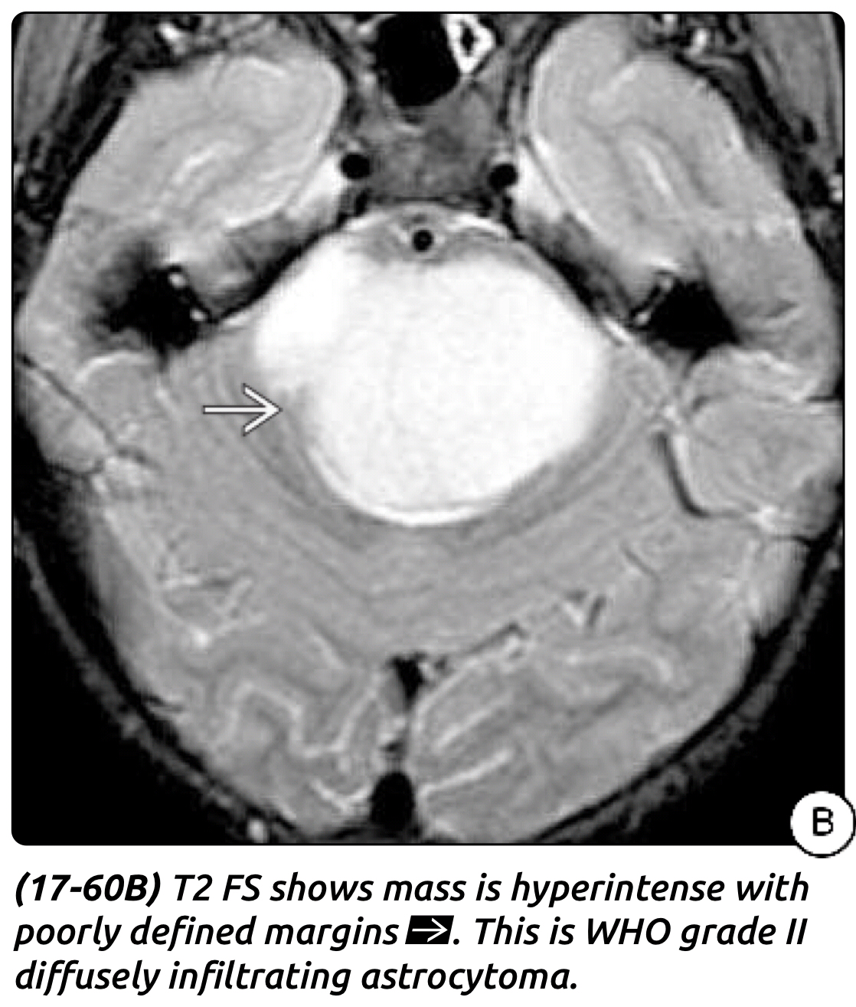

Slide 24
Tectal Glioma
5% of BSGs.
Most tectal gliomas are pilocytic astrocytomas grade I
Because of their close proximity to the aqueduct of Sylvius and slow growth, they most commonly manifest with obstructive hydrocephalus.
Parinaud’s syndrome is rare despite involvement of the tectal plate.
Rapidly progressive symptoms and evidence of a tectal plate lesion should raise concern for other lesions :
Medulloepithelioma, which tends to occur in younger patients
Primitive neuroectodermal tumor (PNET)
Other atypical pineal area tumors.

Slide 26
Focal Tumors :
Called Focal cause they occupy less than 50% of the brainstem.
Slow growing, and patients have a long history of complaints.
More common in the midbrain & medulla and least common in the pons
Midbrain tumors
Tegmentum can result in oculomotor nerve paresis or long tract signs, or both, reflecting selective involvement of cranial nerve nuclei,
Tectum manifest only with signs and symptoms of elevated ICP.
Lesions of the pons
Result in lower C.N dysfunction (hearing loss, facial paresis, and double vision, in addition to long tract signs).
Medullary lesions
Manifest with recurrent aspiration pneumonia and with choking and swallowing difficulty as a result of lower cranial nerve involvement.
Changes in voice and atrophy of the tongue may occur as well.
Failure to thrive may be the initial symptoms for infants

Slide 28
Exophytic Tumors :
Arise from the subependymal glia in the floor of the fourth ventricle and grow posteriorly, often extending into the fourth ventricle, where the bulk of tumor growth occurs.
Younger patients typically have a long history of failure to thrive and vomiting.
Older patients, signs and symptoms of elevated ICP.
Torticollis is also frequently present in affected older children as a result of chronic tonsillar herniation.

Slide 29
Cervicomedullary Tumors :
Arise within the intramedullary cervical spinal cord and grow dorsally towards the obex of the 4th ventricle.
Similar to that of spinal cord astrocytomas, with displacement rather than infiltration of the surrounding tissue.
Two distinct clinical syndromes
Cervical spinal cord compression
Results in neck pain and torticollis, slowly progressive myelopathy with sensory dysethesias, hyperreflexia, and motor weakness.
Medullary dysfunction
Obstructive Hydrocephalus.
Lower cranial nerve palsy such as choking and dysphagia, which result in upper respiratory tract infections and pneumonia.
Central apnea due to involvement of Respiratory center.

Slide 30
DIAGNOSIS
CT scan
DIPG: diffuse enlargement of the pons and posterior displacement of the 4th V. but rarely with hydrocephalus.
Contrast show heterogeneous enhancement and occasionally ring enhancement.
Calcifications in the brainstem usually implies an atypical BSG rather than a DIPG.
MRI
DIPG appear
T1 Hypointense
T2 Hyperintense
Typically engulf the basilar artery ventrally.
Contrast enhancement is usually variable and heterogeneous.
15% of these tumors have metastasized via the CSF at the time of presentation.
MRS : low NAA, high choline, presence of lactate mean poor prognosis.
PET : differentiate between low-grade and high-grade lesions and also to evaluate response to treatment.

Slide 31
MRI
Focal lesions appear circumscribed and are generally isointense on T1, with bright enhancement patterns .
Tectal tumors are poorly delineated and rarely enhance.
T1 hypointense ; T2 hyperintense
Size > 2 cm and enhancement are features associated with a worse prognosis and suggest an atypical tectal tumor.
Dorsal exophytic tumors are usually not well delineated from the underlying brainstem and frequently extend into the fourth ventricle.
Cervicomedullary junction tumors
Similar to those of infiltrating gliomas, with growth into the medulla and cervical spinal cord.
The epicenter is usually at the foramen magnum area with large exophytic component that is either obstructing the outlet of 4th V. or located in CPA and causing compression and distortion of the lower medulla.

Slide 33
Biopsy
Diagnostic biopsy of intrinsic brainstem lesions is considered for special circumstances.
When the clinical history or imaging studies reveal atypical features, such as ( mentioned below ) so diagnostic biopsy is indicated.
Focal areas of enhancement or calcifications or
Extension beyond the pons.
Techniques for biopsy include both open and stereotactic approaches.
Differential diagnosis
Fibrillary astrocytoma
Pilocytic astrocytoma
Ganglioglioma (WHO grade I)
Hemangioblastoma
Cavernoma and arteriovenous malformation.
Demyelinating disease, focal brainstem encephalitis, and infectious causes such as tuberculoma and abscess

Slide 34
TREATMENT
Options usually include some form of surgical biopsy or resection, chemotherapy, radiation, observation, or a combination.
Surgical resection plays a larger role in the management of focal tumors, dorsal exophytic tumors, and cervicomedullary tumors.
Surgery
Goals of surgery include establishing a diagnosis or maximally debulking the tumor in selected cases without incurring significant neurological deficits, or both.
Focal tectal tumors, which often
Do not necessitate direct surgical intervention.
Require surgery for secondary obstructive hydrocephalus.
ETV is the preferred first-line therapy, followed by the traditional VP shunt.

Slide 35
Focal Tumors
Typically low grade (WHO grade I or II), and commonly < 2 cm in diameter.
Pontine or midbrain surgery carries the risk for impairment of extraocular movements and resultant diplopia because of internuclear ophthalmoplegia or sixth nerve damage.
Surgical risks also depend on the type of tumor.
Fibrillary astrocytomas are more difficult to operate on than pilocytic astrocystomas, which are more often cystic in nature.
Solid tumors are generally more challenging than cystic ones because they are not as easily entered and because normal surrounding tissue must be manipulated in order to establish a surgical plane.
Resection is the primary treatment for these lesions.

Slide 36
Approaches to brain stem tumors
Midbrain
The dorsal midbrain can be accessed via the infratentorial-supracerebellar approach.
The ventral medial midbrain can be accessed via a standard pterional craniotomy.
The ventral lateral midbrain by subtemporal approach.
Pons
Dorsally located by suboccipital craniotomy
Ventral lateral tumors extending into the CPA by retromastoid approach.
Medulla
Intrinsic tumors of the medulla can also be accessed via a suboccipital craniotomy with or without cervical laminectomy, depending on the inferior extent of the tumor.

Slide 37
Dorsal Exophytic Tumors
Dorsal exophytic tumors are the first brainstem tumors for which aggressive tumor removal was advocated.
Cerebellar mutism and pseudobulbar palsy are surgical risks associated with larger tumors that necessitate splitting the cerebellar vermis.
A midline posterior fossa craniotomy with a telovelar approach often provides adequate access to the tumor.
These tumors can be divided into true exophytic tumors and focal tumors with an exophytic component.
True exophytic tumors often fill the fourth ventricle and are predominantly outside, and with minimal penetration of the brainstem.
Focal tumors with dorsal exophytic extension have the majority of their bulk within the brainstem.

Slide 38
Surgical anatomical notes
The bulk of the dissection occurs outside the brainstem.
It is important to first identify the floor of the fourth ventricle and maintain its view while the lesion is progressively debulked.
Risks of damage to the tract of 6th & 7th C.N are significant, as these structures are close to the floor of the ventricle (facial colliculus)
During caudal dissection, care must be taken to avoid damaging the nuclei of cranial nerves 10th and 12th by keeping away from the obex and calamus scriptorius.
Calamus scriptorius (inferior fovea): forming the inferior 1/3 of the floor of the 4th ventricle, just above the obex.
It is so named for its similarity to a "nib of a fountain pen."
The medial structures of the nib are the hypoglossal nucleus and the lateral structures the vagal nucleus.
Inferior to the calamus lies the area postrema and the sensory nuclei of CN X.

Slide 41
Cervicomedullary Tumors
Cervicomedullary tumors are often benign, and aggressive surgical removal is advocated when safe.
Early detection and surgical intervention are optimal because the later development of neurological deficits is often irreversible.
Ultrasonography can be helpful in identifying the extent of the tumor and the location of any associated cysts.
Intraoperative hypotension and bradycardia may occur from manipulation of the nucleus tractus solitarius and reticular formation in the caudal dorsal medulla.
Postoperatively, the patient may be left intubated for 2 to 3 days if a significant amount of tumor involved the medulla and if there is a concern for lower cranial nerve dysfunction.

Slide 42
Radiation Therapy
Radiation therapy is the mainstay of treatment for DIPG.
The standard treatment regimen is a dose of 54 to 60 Gy over 6 weeks with conventional external beam, local-field radiotherapy.
SRS has some benefit in focal BSGs and avoids the long-term effects of conventional fractionated radiation therapy in children.
Chemotherapy
Adjuvant and neoadjuvant chemotherapy as single agents and in combination have been used in treating DIPG.
The goal is to stabilize the tumor until children reach the late teens or early adulthood, at which point these tumors stop growing and do not necessitate further treatment.
Combination Therapy
In several trials incorporating the use of concomitant systemic chemotherapy or radiation sensitizers, no significant improvements in survival have been found.

