Slide 1
Evaluation of C3-C7 Injuries
Youmans chap. 306

Slide 2
The subaxial cervical spine includes the C3 through C7 segments
These injuries are frequently caused by high-energy mechanisms such as
  motor vehicle crashes,
  sports and extreme sports,
  falls from heights.
Other conditions such as osteoporosis or spondyloarthropathies predispose patients to injuries from relatively lower energy mechanisms, but these injuries have the potential to be unstable.
Subaxial cervical spine injuries account for approximately : Two thirds of all cervical fractures and 75% of all dislocations

Slide 3
Anatomy And Biomechanics
The subaxial cervical spine has been described anatomically in terms of columns by 2 classifications :
( 1st ) divided the cervical spine into : allen
  Ventral column, consisting of the posterior longitudinal ligament (PLL) and ventral structures,
  Posterior column, which included all structures dorsal to the PLL
( 2nd ) divided the cervical spine into : dennis
  Anterior column includes the anterior longitudinal ligament and anterior vertebral body;
  Middle column includes the dorsal vertebral body, PLL, and dorsal annulus fibrosus
  Posterior column includes structures dorsal to the PLL

Slide 4
Posterior Ligamentous Complex ( PLC ) and Facet Anatomy
The facet joint complex provides stability to the subaxial cervical spine
Along with the annulus fibrosus, nucleus pulposus, and ligamentum flavum, injury to the facet capsule can result in decreased biomechanical stability.
The posterior ligamentous complex (PLC) is an important stabilizer for flexion-extension, and the facet complex for axial rotation.
The percentage of the lateral mass fractured is an important predictor of failure of nonoperative management

Slide 5
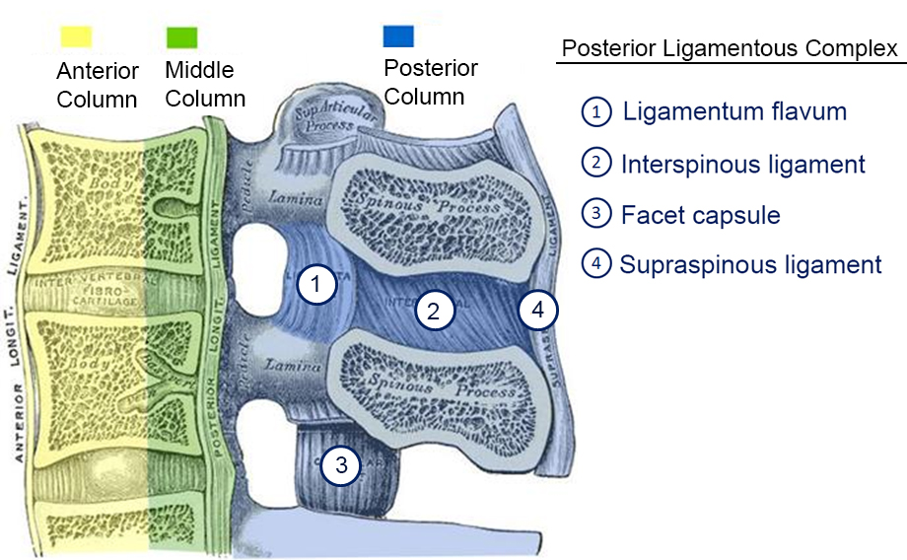

Slide 6
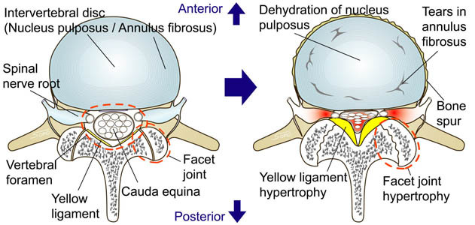

Slide 7
Evaluation
Evaluating the airway, breathing, and circulation.
Spinal precautions should be maintained with Immobilization In A Cervical Collar, assuming that all patients have an injury until proven otherwise.
A Flexion or extension of the spine should be avoided,
A jaw thrust maneuver can be performed if the patient’s airway is compromised.
Poor immobilization techniques may cause a second neurological insult in up to 25% of patients
Remove the collar in awake, alert, oriented patients with no current or history of neurological deficit, no distracting injuries, no pain with range of motion, and no tenderness, without any further imaging (NEXUS CRITERIA)

Slide 8
Evaluation ( Cont. )
Physical examination begins with
Palpation of the entire spine, to evaluate for any gaps between spinous processes, as well as observation of any abrasions, ecchymosis, or hematomas that may signal injury.
A thorough neurological examination testing for :
  key motor groups, sensation, and reflexes.
In asymptomatic patients, range of motion is assessed with rotation as well as flexion and extension.
For high-risk patients requiring imaging to clear the cervical spine,
  CT has become the screening study of choice
  MRI is indicated in patients with a neurological deficit.
For patients with persistent pain despite no findings on physical examination and radiographs, lateral flexion-extension radiographs may be indicated in the subacute setting.

Slide 9
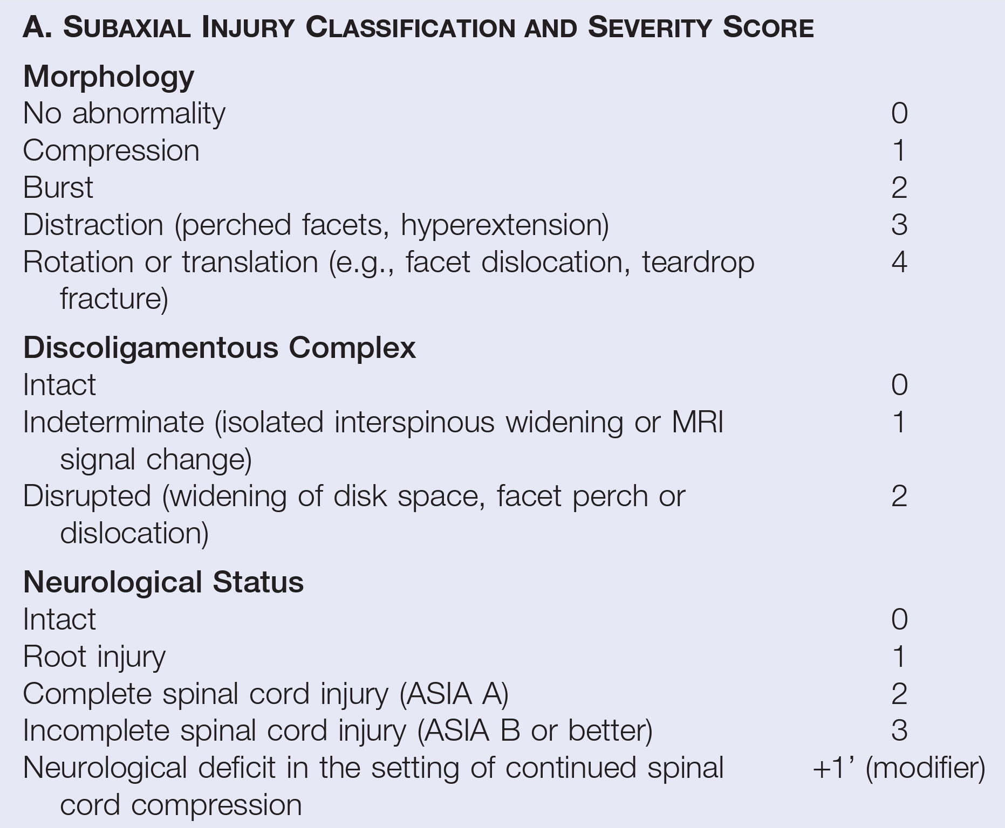

Slide 10
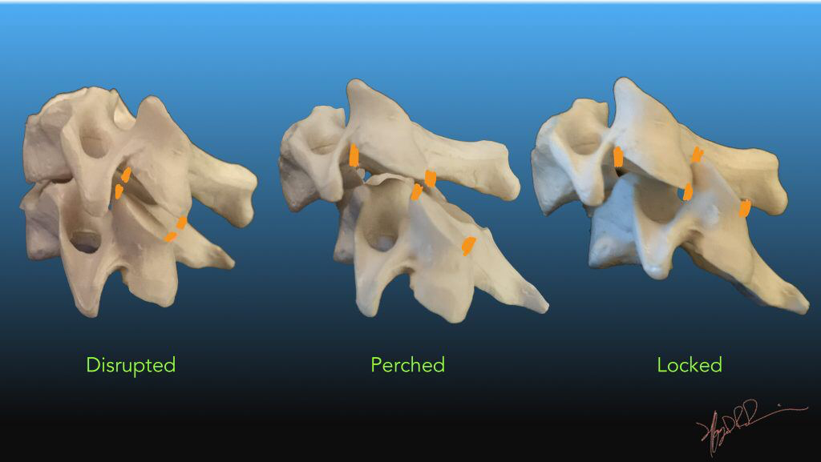

Slide 11
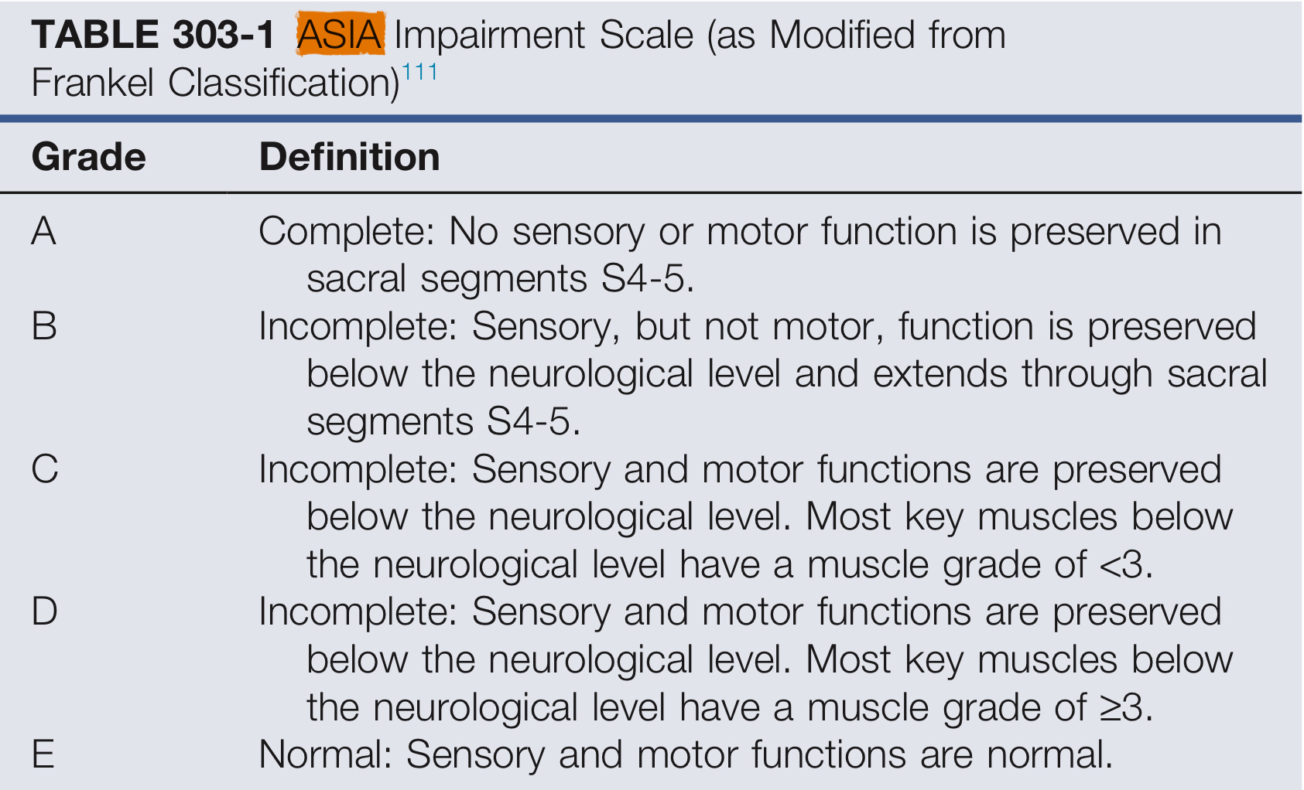

Slide 12
subaxial injury classification and severity score (SLICS)
Patients with scores of 3 or less are considered acutely stable and therefore candidates for nonoperative management with brace immobilization and rapid ambulation.
Patients with scores of 5 or greater are considered acutely unstable and thus recommended for operative intervention for acute spinal stabilization, deformity correction, and neurological decompression if necessary.
Patient with a score sum equal to 4 points can be considered for either operative or nonoperative treatment depending on the presence and relative effect of the various clinical qualifiers listed.

Slide 13
Spinal Cord Injury
In patients with spinal cord injury, the use of pharmacologic agents such as methylprednisolone is controversial.
  The loading dose of 30 mg/kg for the first hour for patients with an injury within 8 hrs.
  Followed by 5 mg /kg/ hr. for 23 or 48 hours depending on the acuity
AOSpine Subaxial Classification System
Type A. Compression Injuries
Type B.
    Distraction Injuries
    Bilateral Injuries
Type C. Translation Injuries
Type F. Facet Injuries

Slide 14
A. Compression Injury
Compression injuries of the subaxial cervical spine result in failure of the anterior structures (vertebral body) and/or the posterior structures (spinous processes, lamina), with varying degrees of severity
Grading
A0. Minor, nonstructural fractures Isolated lamina or spinous process fractures
A1. Wedge-compression Compression fractures do not extend into the posterior wall of the vertebral body, and may involve a single end plate
A2. Split Both end plates in a coronal split or pincer fracture pattern
A3. Incomplete burst Burst fractures extend into the posterior wall of the vertebral body and can involve one end plates
A4. Complete burst Both end plates with varying degrees of bony retropulsion into the spinal canal

Slide 15
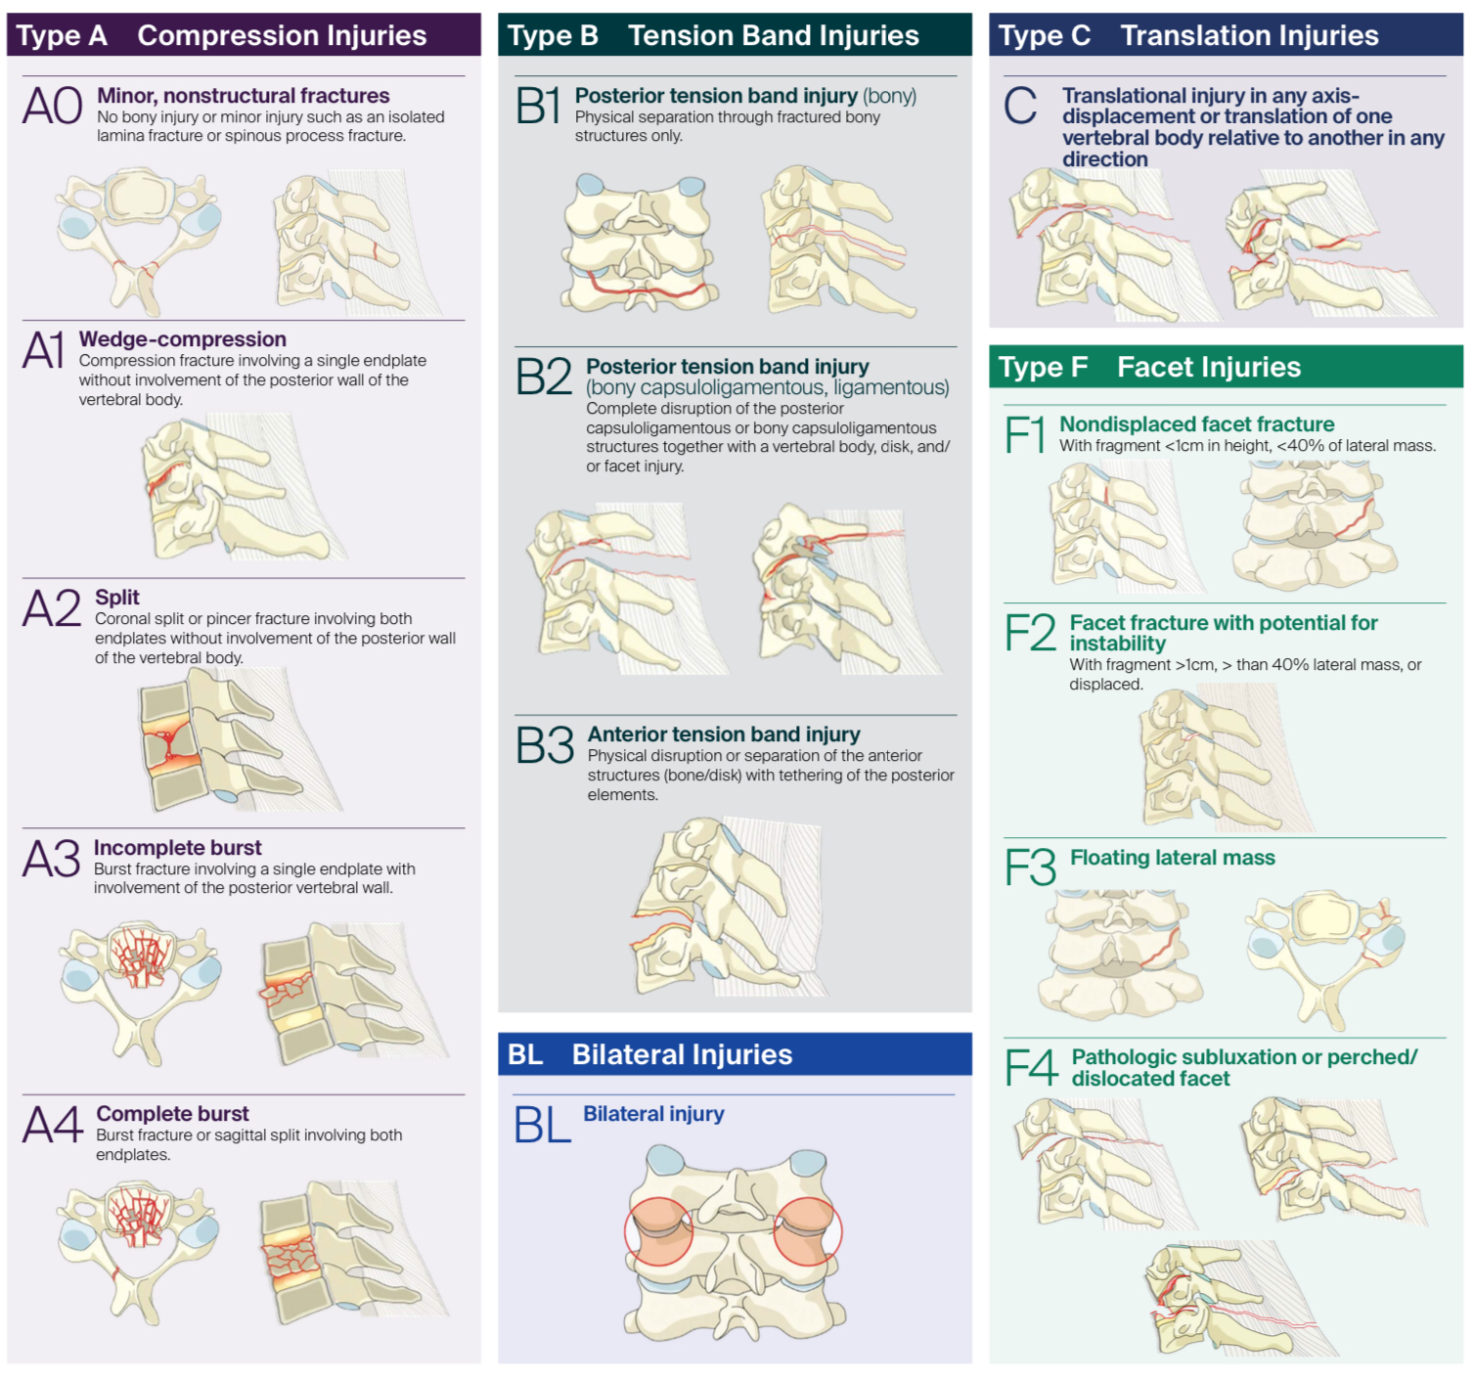

Slide 16
Subtype A0.
No bony or minor injury, such as an isolated lamina or spinous process fracture.
Subtype A1.
Compression fractures involving a single end plate without involvement of the posterior wall of the vertebral body.

Slide 17
Subtype A2.
Coronal split or pincer fractures involving both end plates without involvement of the posterior wall of the vertebral body.
Subtype A3.
Burst fractures involving a single end plate.

Slide 18
Subtype A4.
Burst fracture or sagittal split injury involving both end plates

Slide 19
Sagittal computed tomography scan of a compression type injury with a coronal split fracture of C6.

Slide 20
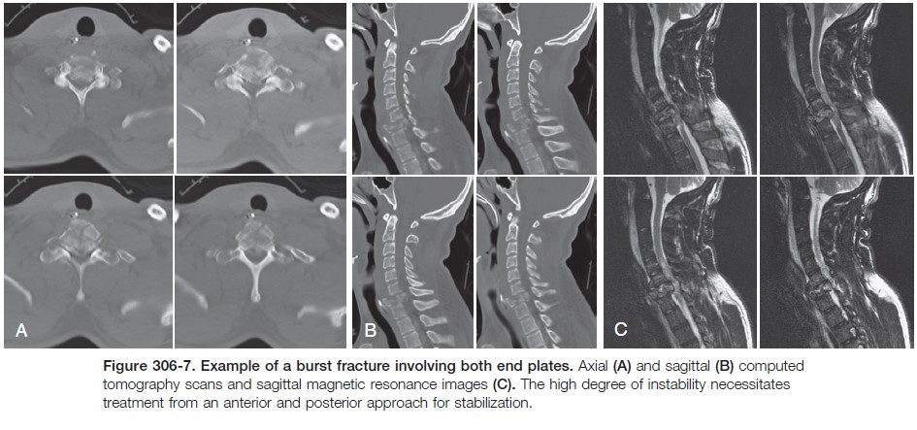

Slide 21
Treatment
A0 :
  Minor injuries such as isolated lamina fractures or spinous process fractures may be treated with a cervical orthosis.
A1 – A2 :
  Compression fractures of a single end plate typically are stable injuries that also may be treated in a rigid cervical orthosis.
  If there is an associated neurological injury, advanced imaging should be obtained to rule out a disk herniation.
  An anterior decompression and fusion procedure should be considered in the setting of a disk herniation with neurological deficit.
  Caution must be taken when placing an anterior graft after an end plate fracture, because subsidence can occur.
  If advanced imaging demonstrates disruption of the PLC, a posterior stabilization procedure may be indicated.

Slide 22
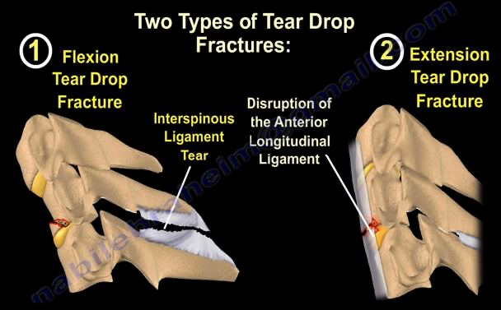
A3 – A4 :
  Burst fractures of a single or both end plates need to be treated with an Anterior Procedure to relieve pressure on the spinal cord.
  This may involve a corpectomy and graft placement with a plate, which may need to be supplemented with posterior fixation.
  Fractures of the vertebral body in the sagittal plane may also be unstable, and require operative treatment.
  These injuries are often found in conjunction with the teardrop or quadrangular fractures that may result in translation of the vertebral bodies; these are highly unstable injuries requiring stabilization.

Slide 23
B. Tension Band Injuries
Tension band injuries involve disruption of either the PLC, the intervertebral disc, or a combination of both, and may also involve an associated vertebral body or posterior elements fracture.
Distraction-extension injuries are more common in patients with ankylosing conditions (ankylosing spondylitis, Diffuse idiopathic skeletal hyperostosis {DISH} ) which are unstable injuries and requiring stabilization.
Grading
B1 Posterior tension band injury involve bony structures.
B2 Posterior tension band injury involve bony structures or capsular and ligamentous structures, or both , These injuries may also extend into the anterior structures such as the intervertebral disk.
B3 Anterior tension band injuries involve physical disruption of either the vertebral body or disk, with an intact posterior hinge that prevents complete displacement.
If there is displacement, these injuries would be classified as translational injuries.

Slide 24
Subtype B1.
Bony posterior tension band injury.
Subtype B2.
Complete disruption or separation of the posterior capsuloligamentous or bony capsuloligamentous structures.

Slide 25
Subtype B3.
Anterior tension band injury. Physical disruption or separation of the anterior structures (bone/disk) with tethering of the posterior elements.

Slide 26
F. Facet Injuries
In unilateral facet fractures, stability can be predicted based on the percentage of lateral mass involved as measured on CT scan
Increased risk of failure of nonoperative treatment if
  the fracture involved greater than 40% of the height of the intact lateral mass.
  or an absolute height greater than 1 cm.
The PLC is commonly injured to varying degrees with distractive-type injuries. This includes injury to the supraspinous and interspinous ligaments, as well as the facet capsules.
Grading
F1 Nondisplaced facet fracture
F2 Facet fracture with potential for instability Displaced Fractures
F3 Floating lateral mass fracture
F4 Pathologic subluxation or perched/dislocated facet Varying Degrees Of Facet Subluxations Or Dislocations

Slide 27
Subtype F1.
Nondisplaced facet fracture (either superior or inferior facets). Fragment less than 1 cm, less than 40% lateral mass
Subtype F2.
Facet fracture with potential for instability (either superior or inferior facets). Fragment greater than 1 cm, greater than 40% lateral mass or displaced.

Slide 28
Subtype F3.
Floating lateral mass. Disruption of pedicle and lamina resulting in disconnection of superior and inferior articular processes at a given level or set of levels.
Subtype F4.
Pathologic subluxation or perched/dislocated facet.

Slide 29
Treatment
Disruption of the posterior tension band of the cervical spine and Facet injury
  Disruption will result in various degrees of injury to the facet joint complex, such as ligamentous sprain, facet subluxation, perched facets, and dislocation, as well as fracture.
  Isolated facet capsular disruption may be treated in a Rigid Cervical Orthosis if no instability is suspected.
  Injuries of facet subluxation, perched facets, and dislocation will require operative reduction and stabilization.
  A Combined Anterior-posterior Approach
  is often needed when a discectomy is required to decompress the spinal cord, but added stability is considered necessary because of the amount of instability present.
  A Posterior-only Approach
  Indicated
  If no disk herniation present.
  In cases of a fractured end plate or vertebral body.

Slide 30
Injuries to the anterior tension band of the cervical spine
  Most Common in elderly patients with spondylosis, or younger patients with ankylosing conditions.
  Radiographic findings may include a small avulsion fracture off of the anterior vertebral body, or high signal intensity on MRI in the structures anterior to the spine and within the disk space.
  Edema may also be seen in the posterior soft tissue structures,
  In patients with ankylosing conditions, These injuries can be highly unstable, and are usually best treated with multilevel posterior stabilization

Slide 31
C. Translational Injuries
Translational injuries result from displacement of one vertebral body relative to another (These are highly unstable injuries).
This can occur in any direction (anterior, posterior, lateral, vertical), and frequently can have an associated vertebral body or posterior element #.
Result of torsional and shear forces and represent failure of all anterior column components (suggested by relative sagittal plane rotation of more than 11 degrees or horizontal translation of 20% (or 3.5 mm) in the cervical spine).
Treatment
These injuries can result from facet dislocation or facet fractures, extension-type injuries, or severe compressive injures.
In patients with severe compressive injuries and translation, positioning the patient supine with neck extension may reduce the spine.
  Gardner-Wells tongs and traction may be helpful to assist in the reduction, but caution should be maintained to avoid overdistraction.
  Anterior-only decompression and fusion can be attempted
  Combined anterior-posterior procedure is our preferred treatment for these highly unstable injuries.

Slide 32
Type C.
Translational injury in any axis.

Slide 33
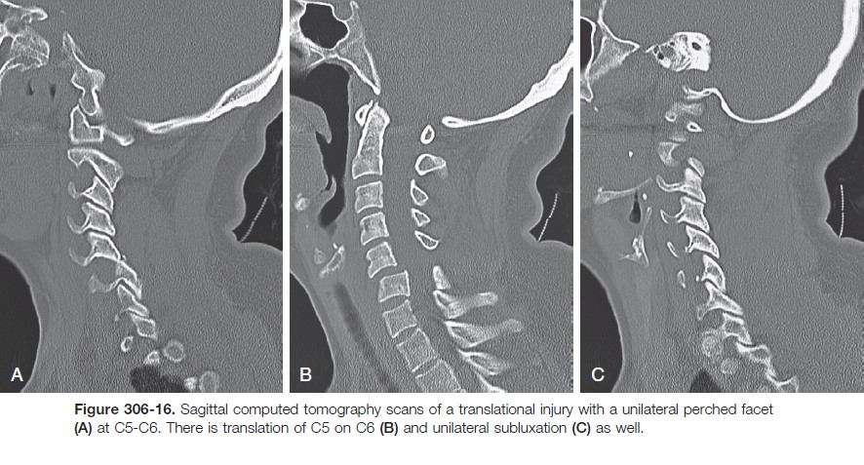

Slide 34
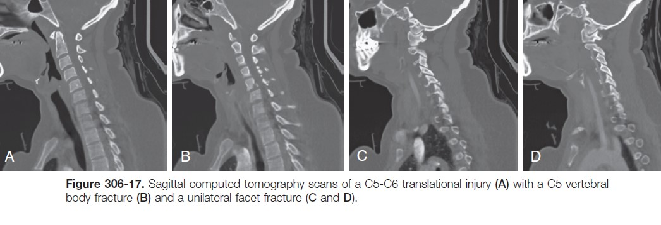

Slide 35
Vascular Injuries
The vertebral arteries should be evaluated in all subaxial cervical trauma injuries, especially when fractures extend into the transverse foramen.
Angiography may be useful to evaluate the vertebral arteries in cases with high clinical suspicion.
(15%) vertebral artery injury, associated with injuries to C1-C3

Slide 36
treatment in general
Surgical Indications :
  Decompress the spinal canal and neural elements if necessary.
  Provide stability in order to facilitate early mobilization.
  Prevent late displacement and deformity.
Nonoperative Treatment
In patients with stable injuries without neurological compression, nonoperative treatment is indicated.
Minor injuries such as spinous process fractures without significant discoligamentous injury can be treated in a cervical orthosis, which will assist the patient in proprioception and help prevent excessive flexion or extension.
  These orthoses range from soft collars to the more rigid Aspen collar or Philadelphia and Miami J collars CA)
Cervicothoracic orthosis are effective for limiting motion in the sagittal plane by extending into the rigid thoracic spine.
The halo vest is the most restrictive cervicothoracic

Slide 37
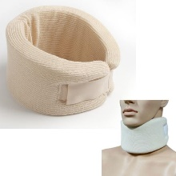
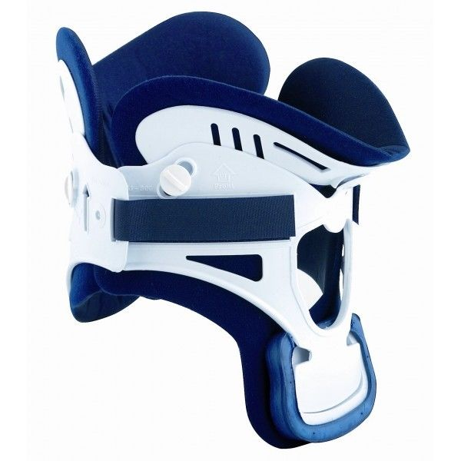
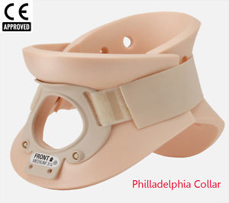
Soft collar
Miami J collars

Slide 38
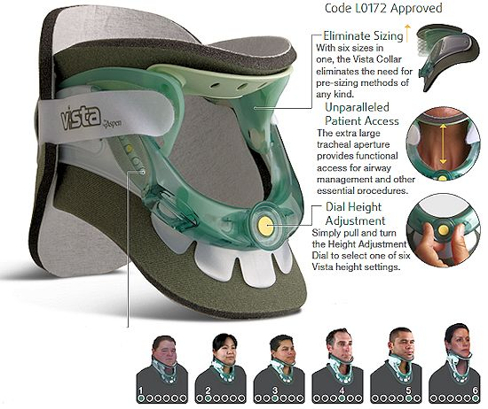

Slide 39
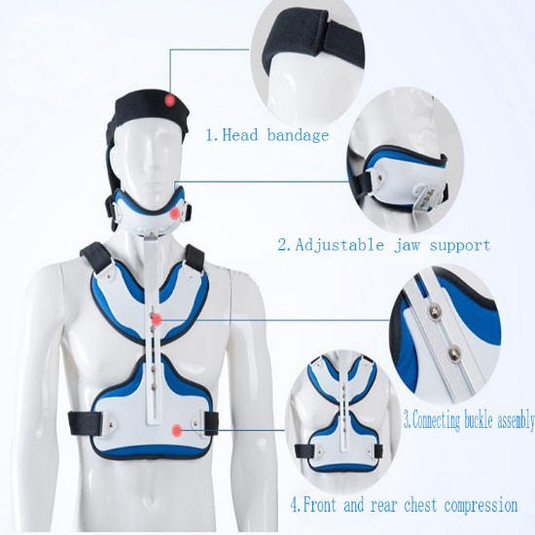
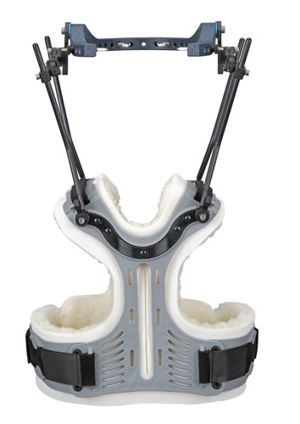
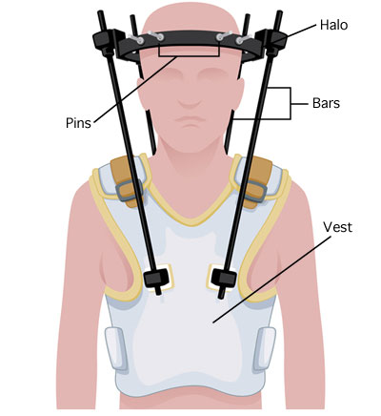
Cervicothoracic orthosis
The halo vest

