Slide 1
Atlantoaxial Facetal Dislocation
Youmans Chap. 324

Slide 2
The atlantoaxial dislocation can be a
mobile and reducible type
“fixed” or irreducible type.
Types
Anterior atlantoaxial facetal dislocation (type A).
Posterior atlantoaxial facetal dislocation (type B).
Central atlantoaxial facetal dislocation (type C).
Lateral atlantoaxial facetal dislocation.
Rotatory atlantoaxial dislocation.
Vertical Atlantoaxial Dislocation.
Anterior atlantoaxial facetal dislocation (type A)
Dislocation of the facet of atlas anterior to the facet of axis.
Characterized by
Posterior positioning of odontoid process into the spinal canal, and it results in compression of critical neural structures.
The atlantodental interval is increased
Usually acute in nature and identified relatively early.

Slide 3
Posterior atlantoaxial facetal dislocation (type B)
The facet of the atlas is located posterior to the facet of axis.
The posterior dislocation grading
Grade 1 less than 25%
Grade 2 between 25% and 50%
Grade 3 greater than 50%
Central atlantoaxial facetal dislocation (type C)
Occurs when the facetal surfaces of atlas and axis are in alignment and other clinical parameters suggest instability.
In types B and C atlantoaxial facetal dislocations,
The atlantodental interval may be normal or relatively unaffected.
The odontoid process does not displace into the spinal canal and cause neural deficit.
Neural compression is not early.
Syringomyelia and Chiari malformations, are predominant.
Basilar invagination (group B) is more often associated with types B and C.

Slide 4
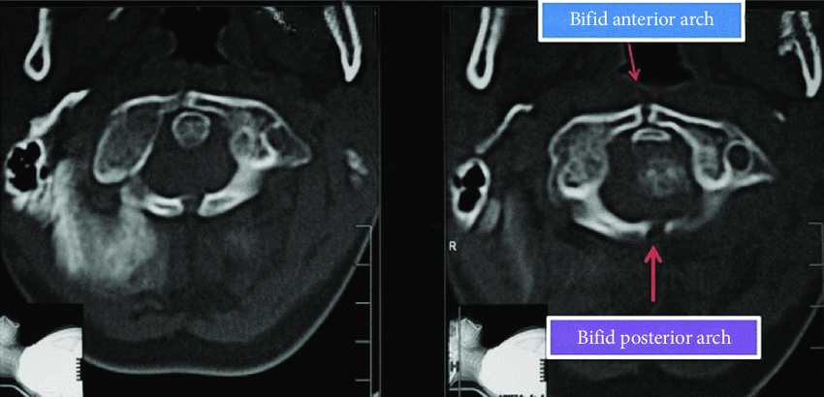
Lateral atlantoaxial facetal dislocation
Occurs when the facets of atlas are dislocated lateral to the facets of axis.
Caused by Fracture of anterior and posterior arches of the atlas because of
Trauma
Infection
Bifid or trifid constitution of the arches
Bifid anterior and posterior arches of atlas are associated with atlantoaxial dislocation and basilar invagination.

Slide 5
Rotatory atlantoaxial dislocation
occurs when the facet of atlas is dislocated posterior in relation to the facet of axis on one side and anterior in its relationship on the contralateral side.
Such a dislocation results in painless torticollis; it is usually identified in young children. The head is in a “cock robin” position.
There is no pain or neural deficit or symptom and the only problem is of an abnormal neck posture.
Vertical Atlantoaxial Dislocation
Occurs when the odontoid process moves up or rostrally in relationship to the anterior arch of atlas on flexion of the head results in basilar invagination.
In cases of mobile and reducible vertical atlantoaxial dislocation, on extension of the head, the odontoid process returns to its normal position.

Slide 6
Treatment
Lateral mass methods of fixation provide a zero-movement situation that is ideal for bone fusion.
Bony fusion requires approximately 3 months.
The techniques of fixation for atlantoaxial dislocation can be divided into
Midline procedures that involve the fixation of arch of the atlas with the lamina of axis.
Lateral mass fixation procedures.
C1-C2 segmental fixation is the procedure of choice for atlantoaxial instability, but occipitocervical fixation can be an alternative.

Slide 7
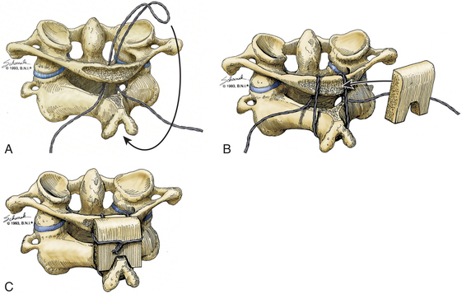
Midline method procedure
C1-C2 Wiring Techniques
Gallie Fusion: sublaminar wire that was placed around the posterior arch of C1 and then looped around the spinous process of C2 & held piece of bone autograft, which was notched to sit firmly over the spinous process of C2.

Slide 8
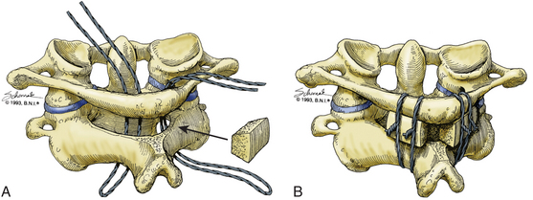
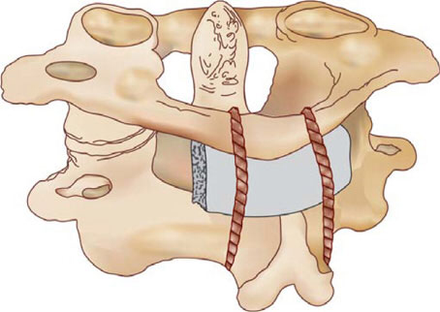
Brooks–Jenkins Fusion:
Doubled wires are passed bilaterally under the laminae of the atlas and axis.
Two pieces of beveled bone graft are placed posterolaterally in the interlaminar space bilaterally and held in place with the overlying wire.
Sonntag’s Modification of Gallie Fusion
Interspinous graft

Slide 9
Other procedure for fixation
Occipitocervical Fixation
Harms method
Magerl’s Technique
Double Insurance Fixation

Slide 10
Basilar invagination and basilar impression (BI)
AKA cranial settling: denoted upward indentation of the skull base, usually due to acquired softening of bone, often associated with atlantooccipital fusion.
Common feature: upward displacement of the upper cervical spine (including odontoid process, AKA cranial migration of the odontoid) through the foramen magnum into the p-fossa.
Chiari malformation and syringomelia are common associates of basilar invagination.

Slide 11
Classified into to group
Group I included
Invagination of the odontoid process into the foramen magnum that indented into the brainstem.
The tip of the odontoid process distanced itself from the anterior arch of the atlas or the inferior aspect of the clivus.
The angle of the clivus and the posterior cranial fossa volume were unaffected.
Group II included
Odontoid process, anterior arch of the atlas, and the clivus migrated superiorly in unison, resulting in reduction of the posterior cranial fossa volume, which was the primary pathology in these cases.
The Chiari malformation or herniation of the cerebellar tonsil was considered a result of reduction in the posterior cranial fossa volume.

Slide 12
Goel classifications of BI
 | Group A | Group B
The atlantoaxial joint | unstable and not “fixed” | stable and “fixed”
Chiari malformation | Present | Absent
Tip of the odontoid process invagination | Above (Chamberlain line, McRae’s line of foramen magnum, Wackenheim’s clival line). | Above Chamberlain’s line below McRae’s and Wackenheim’s lines.
Pathogenesis | Mechanical instability | Congenital dysgenesis

Slide 13
Hallmarks of basilar invagination
Short neck.
Low hairline.
Web-shaped neck muscles.
Torticollis.
Reduction in the range of neck movements.
In acute form of basilar invagination, the facetal dislocation is usually of type A (Anterior)
In chronic form of basilar invagination, the facetal dislocation is usually of type B, C (Posterior, Central)

Slide 14
Clinical Features
In Type A (Anterior) atlantoaxial Facetal dislocation
History of minor to major head injury preceding the onset of the symptoms.
The pyramidal symptoms formed a dominant component.
Kinesthetic sensations.
Spinothalamic dysfunction was less frequent.
Neck pain as a major presenting symptom
Torticollis.
Types B and C atlantoaxial facetal dislocation
The atlantodental interval may not be increased and the neural compromise is not early in clinical course.
The longstanding nature of instability results in marked structural alterations in the bone and soft tissue structures.
Chiari malformation and syringomyelia are a component of 2ry alterations.
Chiari malformation described as nature’s “airbag”
Short neck and torticollis were more frequently in types B and C dislocation.

Slide 15
Goel’s Clinical Grading System
Depending on the extent of neurological disability, the patients were divided into 5 grades:
Grade 1: Independent and normally functioning
Grade 2: Walks on own, but needs minimal support or help to perform routine household activities
Grade 3: Walks with minimal support and requires help to perform household activities
Grade 4: Walks with heavy support and unable to perform household activities
Grade 5: Unable to walk and dependent for all activities

Slide 16
Radiologic Criteria
Chamberlain’s Line:
From posterior hard palate to posterior margin of foramen magnum (opisthion).
When the tip of the odontoid process was at least 2 mm above Chamberlain’s line → Basilar invagination was diagnosed.
BI is much more severe in cases with types B and C atlantoaxial dislocation than in type A atlantoaxial dislocation.
Distance between Odontoid Tip to the Pontomedullary Junction
Useful index to define the reduction of the posterior cranial fossa bone size.
The distance was markedly reduced in cases with types B and C atlantoaxial dislocation, but it was relatively large in patients with type A atlantoaxial dislocation.
Wackenheim’s Clival Line
Drawn to connect the basion to the base of the posterior clinoids on the clivus
The tip of the odontoid process
Superior in type A atlantoaxial dislocation.
Remained relatively normal in type B, C atlantoaxial dislocation.

Slide 17
Platybasia is characterized by abnormal flattening of the skull base as defined as a base of skull angle over 143º.
Brainstem Girth
Type A atlantoaxial dislocation girth was markedly reduced.
Type B, C Only marginally affected or unaffected → no direct brainstem compression.
Occipitalization of the Atlas
Associated with basilar invagination.
Neck Size
The cervical height was measured from the tip of the odontoid process to the midpoint of the base of the C7 vertebral body.
McRae’s line:
From tip of clivus (basion) to opisthion.
The mean position of the odontoid tip below the line is 5 mm on CT.
No part of odontoid should be above this line (the most accurate measure for BI).

Slide 19
Surgical Technique of Atlantoaxial Fixation and Craniovertebral Realignment
The procedure of stabilization result in craniovertebral realignment, more particularly in patients with type A atlantoaxial dislocation.
In types B and C atlantoaxial dislocation, the aim of surgery is only fixation with no attempts at reducing the basilar invagination.
Procedure
The atlantoaxial facet joints are widely exposed on both sides after sectioning of the large C2 ganglion.
The joint capsule is excised, and the articular cartilage is widely removed
Distraction by osteotome
Titanium spacers are impacted into the joints to provide distraction and stability.
Interarticular fixation (The inclusion of the occipital bone and the subaxial spinal vertebrae in the fixation construct is not necessary).
Chiari malformation and syringomyelia are reversible after surgical procedures.

