Slide 1
Assessment and Treatment
of Benign Tumors of the Axial Skeleton
Youmans Chap.292

Slide 2
Clinical feature
Primary spinal tumors are typically diagnosed in younger patients than metastatic spinal tumors.
Primary vertebral tumors also occur in adults.
The most common benign vertebral column tumor in adults is vertebral hemangioma.
The most frequent initial symptom in patients with primary spinal tumors is pain.
Axial or mechanical pain.
Radicular pain.
Progressive neurological deficits can be associated with either benign or malignant primary spinal neoplasms.
Spinal deformity can occur in patients with primary spinal tumors, but it is rare.
Classic finding in patients with osteoid osteoma is painful scoliosis.

Slide 4
Aneurysmal Bone Cyst
ABCs are cystic and osteolytic lesions that typically affect patients younger than 20 years, with a slight female preponderance.
Usually arise from long bones, but about 12% to 30% of cases involve the spine.
These tumors typically involve the posterior elements, and the thoracic spine is the most common site of involvement.
The majority of ABCs are primary lesions.
They can be secondary lesions associated with other spinal tumors, including GCT, osteoblastoma, chondroblastoma, and osteogenic sarcoma.
Imaging
CT and MRI are most useful for the assessment of ABCs.
Expansile, osteolytic, and cystic lesions surrounded by thin layers of reactive cortical bone (“eggshells”) are seen on CT.
Fluid-fluid level demonstrating the layering of blood products from previous hemorrhages within the cystic lesions.
ABCs have a heterogeneous appearance on both T1- and T2-weighted MRI.

Slide 5
Treatment
Patients with symptomatic ABCs are treated with embolization or surgery.
Embolization
Used as first line and the sole therapy for ABCs.
Used preoperatively to decrease intraoperative blood loss and morbidity.
Surgery
Complete excision of the tumor is the goal but may be difficult.
Incomplete tumor excision may be associated with significant rates of tumor recurrence.
Radiotherapy
In patients with residual or recurrent tumor (ABCs are sensitive to radiation).
Curopsy
Is a percutaneous-limited curettage at the time of biopsy, obtaining the lining membrane from various quadrants of the cyst leading to consolidation (curopsy = biopsy with intention to cure).
Simple procedure that offers diagnostic and therapeutic benefit.

Slide 8
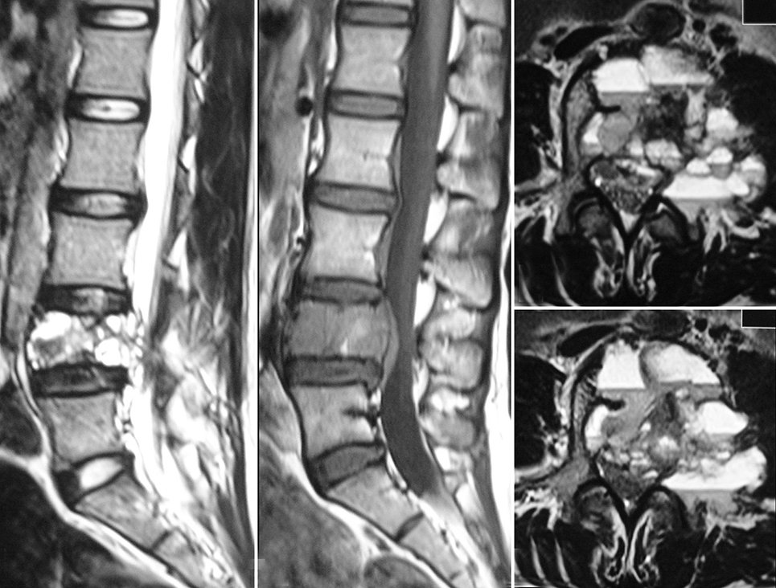

Slide 9
Hemangiomas
The most commonly occurring benign primary spinal lesion.
They are often incidental findings in the thoracolumbar spine.
The lower thoracic spine is the most frequent site of symptomatic vertebral hemangiomas.
Vertebral hemangiomas are considered nonneoplastic.
There appears to be an association between pregnancy and the development of symptomatic vertebral hemangiomas.
Aggressive hemangiomas can cause
Local pain from involvement of the vertebral body.
Radiculopathy from nerve root compression or myelopathy with epidural disease and spinal cord compression
Pathologic fractures can also occur with vertebral hemangiomas.
CT, vertebral hemangiomas display patterns of coarse vertical striations or bony trabeculation that are often referred to as “honeycomb” or “polka dot” signs, respectively.
MRI of these lesions demonstrates hyperintense signals on both T1- and T2-weighted sequences.

Slide 10
Treatment
The majority of vertebral hemangiomas are managed conservatively.
Painful hemangiomas can be treated by vertebroplasty or kyphoplasty.
In the symptomatic patient with spinal cord compression or neurological symptoms, surgical excision of the tumor plus spinal cord decompression is the treatment of choice.
Postoperative radiotherapy for vertebral hemangiomas is controversial but can be considered in patients with significant residual or recurrent tumors.
The use of Propranolol (20-40 mg per day) to treat painful vertebral hemangiomas in children, for whom other treatment modalities are unsuitable ( which will lead to pain free after 2 month ).

Slide 13
Osteoid Osteoma and Osteoblastoma
Arise from cancellous bone throughout the musculoskeletal system.
Less than 10% of these lesions originate from the spine.
Osteomas are smaller than 2 cm.
Osteoblastoma are Lesions larger than 2 cm.
Occur in teenage years with slight male preponderance.
Most patients have pain that is typically worse at night and relieved with salicylates (may have painful scoliosis, a classic manifestation of this tumor).
Affect most commonly the posterior elements of the spine, with the lumbar spine being the most frequently involved site.
Imaging
Plain X-ray: A round or oval lesion with a radiolucent center and peripheral sclerosis is the radiographic hallmark of osteoma.
CT, the imaging modality of choice, can determine the extent of vertebral involvement.

Slide 14
Treatment
Conservative management with salicylates is the initial treatment.
Surgical excision. Curettage or intralesional excision is acceptable, but the goal of surgery is complete removal to prevent recurrence.
There is evidence that alcohol, laser, or radiofrequency ablation is an effective alternative treatment for these tumors.
 | Osteoid Osteoma | Osteoblastoma
Age | Teenage years | 2nd -3rd decades
Size | Less than 2 cm | More than 2 cm
Histology | The same | The same
Radiology | The same | The same
Neurological deficit | Less | higher rate of neurological compromise
Primary Treatment | Relief by salicylates Then excision | Surgical excision
Recurrence | Low | High

Slide 17
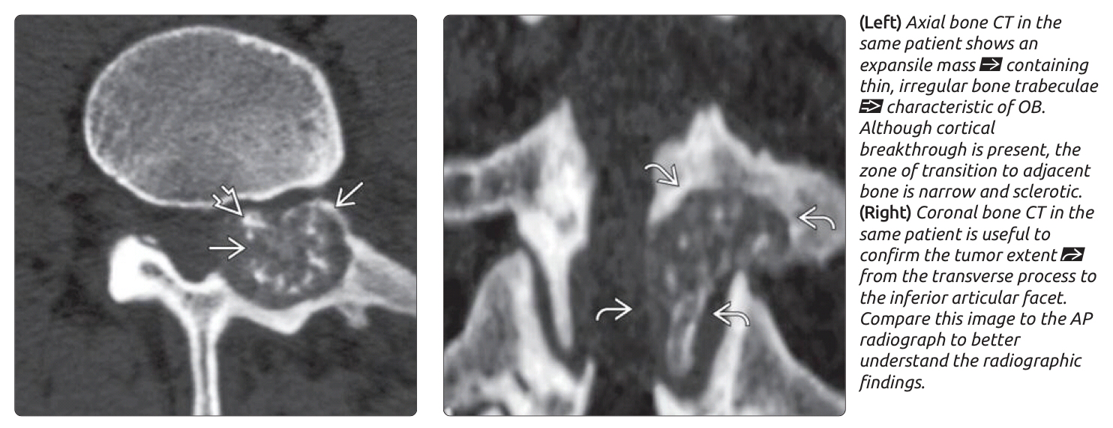
Ostoid osteoma
Osteoblastom

Slide 18
Giant Cell Tumor
GCTs are most often seen initially in the third or fourth decade.
The sacrum is the most common site.
Slight female preponderance
Common symptoms include pain, weakness, sensory deficit, and bladder or bowel dysfunction.
Patients with sacral GCTs often have large tumors as a result of significant tumor growth before the development of neurological symptoms.
Radiographically
This tumor appears as an expansile mass with destruction of the vertebral bodies.
GCT generally involves the vertebral body but can extend to involve the posterior elements
In the sacrum, GCT can involve the vertebral body bilaterally and can extend across the sacroiliac joints.

Slide 19
Mx
Complete surgical tumor excision is the treatment of choice for patients with GCTs.
Before surgery, it is advisable to perform tumor embolization.
because these tumors are vascular and associated with significant intraoperative blood loss.
Radiation therapy can be used as adjuvant treatment after incomplete resection or tumor recurrence.

Slide 21
Osteochondroma
Occur in the third or fourth decade, with male preponderance.
Most patients have a solitary lesion, except in cases associated with hereditary multiple exostoses.
Osteochondromas have a predilection for the cervical spine, with the axis being the most common site of involvement.
Patients may complain of pain or myelopathy.
Osteochondroma most commonly affects the posterior elements, and the patient can have a palpable mass.
CT
The pathognomonic finding of the exostotic lesion in continuity with the cortex and bone marrow of the underlying bone.
Sessile or pedunculated osseous "cauliflower" lesion
MRI
Help in evaluating the relationship of the lesion with its surrounding soft tissues and examining the cartilaginous end cap.
Thickening of the cartilaginous cap of more than 1 to 2 cm is suggestive of malignant transformation to chondrosarcoma.

Slide 22
Mx
Medical observation is indicated for incidental or dormant lesions that are stable in size.
Surgical excision is the treatment of choice for symptomatic lesions.
Radiation therapy is ineffective.
Radiation-induced transformation of this benign tumor to chondrosarcoma.

