Slide 1
Epidemiology of Traumatic Brain Injury Youmans Chap.336

Slide 4
Traumatic brain injury (TBI) is the leading cause of mortality and disability among young individuals mainly due to RTA.
Falls are a main cause of TBI in elderly people.
TBI has been defined as “brain damage resulting from external forces, as a consequence of direct impact, rapid acceleration or deceleration, a penetrating object (e.g., gunshot) or blast waves from an explosion.
TBI accounts for 9% of deaths around the world.
Brain trauma accounts for approximately one third of all deaths from TBI and for the majority of permanent disability.
TBI is common in young adults, particularly men.
Children (aged 0-4 years) and elderly patients are at particular risk for TBI.

Slide 5
CLASSIFICATION OF TRAUMATIC BRAIN INJURY
Clinical severity of intracranial injuries is commonly assessed according to the Glasgow Coma Scale (GCS).
The motor component provides more discrimination in patients with severe injuries.
The eye and verbal scales are more discriminative in patients with moderate and mild injuries.
Assessment may be confounded by prior alcohol or substance use, prehospital sedation, paralysis, and intubation.
TBI is associated with extracranial injuries in about 35% of cases.
Extracranial injuries increase the risk of secondary damage from hypoxia, hypotension, pyrexia, and coagulopathy.

Slide 6
Marshall CT classification
DIFFUSE INJURY I
No visible pathologic condition
DIFFUSE INJURY II
Cisterns present; MLS, 0-5 mm; and/or:
Lesion densities present
No mass lesion >25 mL
DIFFUSE INJURY III (SWELLING)
Cisterns compressed/absent
MLS, 0-5 mm
No mass lesion >25 mL
DIFFUSE INJURY IV (SHIFT)
MLS >5 mm
No mass lesion >25 mL
EVACUATED MASS LESION
Any lesion surgically evacuated
NONEVACUATED MASS LESION
High- or mixed-density lesion>25 mL, not surgically evacuated

Slide 7
Biomechanical Basis of Traumatic Brain Injury
Youmans Chap. 337

Slide 8
CLINICAL CLASSIFICATION OF BRAIN INJURIES
Clinically, brain injuries can be classified into three distinct categories:
Skull fracture.
Focal injury.
Diffuse brain injury.
Skull fracture
May or may not involve damage to the underlying brain.
The fracture is often not a direct cause of neurological disability.
Focal injuries
Defined as visible damage to the parenchyma that is generally limited to a well-circumscribed region; examples include contusions to the cortex and subdural, epidural, and intracerebral hematomas.
Focal injuries occur in nearly half of all patients with severe brain injuries and are responsible for approximately two thirds of brain injury related deaths.

Slide 9
Diffuse brain injuries
Occur without producing macroscopic structural damage, and associated with widespread brain dysfunction.
contribute to nearly one third of deaths from brain injury.
In mildest form (concussion) diffuse brain damage may not necessarily be structural and may involve only alterations in neural excitability, neurotransmission, or long-term changes in receptor dysfunction.
In more severe cases, diffuse brain injury manifests as prolonged coma without mass lesion and involves some degree of structural derangement at the microscopic level.
Diffuse brain injury includes damage from both brain swelling and ischemic injury.
Most commonly injured substrate in diffuse brain injury is the axons within the white matter; for this reason, the prominent form of diffuse brain injury is termed diffuse axonal injury.

Slide 11
Types of Biomechanical Loading
Static or quasi-static loading is used to describe force applied to the head very slowly.
Squeezing or crushing of the skull commonly occurs as a result of static or loading and probably involves fractures at the vault or basilar skull region.
Consciousness is commonly preserved.
Severe compression of the brain can lead to herniation of the brain contents and, fatal brain damage.
Dynamic loading is the more common type of mechanical loading to the head, especially in traumatic injury, is applied rapidly.
Dynamic loading can be of three types:
Impulsive loading.
Impact.
Blast overpressure.

Slide 12
Impulsive loading.
Occurs when the head is set into motion indirectly by a blow to another body region.
Lesser degrees of diffuse brain injury and cerebral concussion can be caused by impulsive loading.
Impact loading
Is the more frequent type of dynamic loading and commonly occurs as a result of motor vehicle accidents, falls, or sports collisions.
Results from a combination of contact forces and inertial (acceleration) forces.
For objects larger than 2 square inches, localized skull bending occurs immediately beneath the impact point, If the skull deformation exceeds the tolerance, skull fracture occurs.
For objects less than 2 square inches, Penetration, perforation, or localized depressed skull fracture is more likely.
Blast overpressure loading
Referred to as shock wave loading to the brain, this loading is the delivery of a rapid-onset, very short pressure wave to the brain that travels at the speed of sound within the tissue.

Slide 13
MECHANISTIC CAUSES OF HEAD INJURIES
Most head injuries are caused by one of two basic mechanisms:
Contact loading.
Inertial loading.
Although contact or inertial injuries may happen in isolation, it is most common for these injury mechanisms to occur in combination (e.g., contact loading that results in sudden head acceleration).
Shock wave propagation associated with blast-induced traumatic brain injury may represent a third basic mechanism of injury.

Slide 14
Contact Injuries
Caused by force during impact, result solely from contact phenomena and are not caused by head motion or acceleration.
Contact forces are of two types:
Local effects at or near the impact site.
Remote effects from the area of impact.
In both, contact forces cause only focal injuries; they do not cause diffuse brain injury.

Slide 15
Local Contact Effects
Examples of injuries from local contact effects include most
Most Linear and depressed skull fractures.
Some Basilar skull fractures.
Epidural hematomas.
Coup contusions.
Penetrating injuries by foreign objects, such as a bullet or shrapnel, also fit in this category.
Mechanistically, the local inward bending caused by the impact creates compressive strains in the outer skull surface and tensile strains on the inner surface.
Bone, naturally resistant to compressive forces and strains, is less resistant to the tensile forces on the inner skull surface (Thus the initial fracture begins at the inner table).
Depressed skull fractures occur when the striking or struck object is small enough to cause concentration of strain and stress immediately beneath the impacting object.

Slide 16
Impact to the skull base or nearby regions (occiput or mastoid) can occur and cause basilar skull fractures from local contact effects.
Vascular damage caused by local contact effects (e.g., epidural hematoma and coup contusions), is often intimately linked to skull fracture types.
The epidural hematoma results from a complicated form of skull bending, generally from a fracture in which:
Torn dural vessels by bone fragments.
Skull deformation and bending may be sufficient to cause vascular tears.
Coup contusions caused by
Direct injury to the brain and the surface vessels that lie beneath the area of skull deformation (highly focused compressive strains).
The high negative pressures that develop in the area where the skull rapidly snaps back into place (subjects the brain to very high tensile stresses).
In both case, the strains are sufficient to cause tissue failure of the pial and cortical vessels of the brain and form localized contusions.
Brain laceration is an extension of the same phenomenon but may also occur if inward bending of the skull is sufficient to actually perforate the pia.

Slide 17
Remote Contact Effects
Result from complex
Skull distortion
If the strain tolerance is exceeded, remote skull fracture occurs (inward-bending energy can travel away from the impact site to affect remote skull regions and undergo larger local bending because of their inherently weaker characteristics).
This raises the possibility that an impact at one site could lead to fracture distant from the impact site.
Once initiated, a fracture usually propagates along the lines of least resistance (Typically, regions such as the basilar skull area have thin skull sections that offer this path of least resistance.
Head contact is severe enough to cause global changes in skull shape (which are particularly apparent if the physical skull structure is compliant, as in infants and developing children.
This type of large skull deformation can cause rapid increases or decreases in intracranial volume.

Slide 18
These changes is sufficient to produce
levels of negative pressure at points where the skull has pulled away from the brain and caused contrecoup contusions.
the separation of the brain surface from the dura mater which lead to the rupture of surface vessels and subdural bleeding.
Sudden fluctuation or decrease in intracranial volume caused by global skull deformation can prompt herniation of the brain contents through the various foramina, primarily the foramen magnum.
Stress waves propagation
Originating at the point of impact and spread
Through the skull to cause local skull distortions that, if excessive, produce basilar and remote vault fractures.
Throughout the brain and, like waves in water, reflect from the opposite side of the head and reverberate within the brain.
Pressure waves used to explain the formation of
The intermediate coup contusions (hemorrhages on nonconvex surfaces).
Scattered deep intracranial hemorrhages.
Traumatic intracerebral hematomas.

Slide 19
Intermediate Coup Contusions
Are vascular disruptions of brain surfaces that are not adjacent to the skull.
It is likely that they are due to strain concentrations resulting from
Impact generated stress waves
Inertially generated brain movements (brain is strike or pulled away from the adjacent structures, which results in compressive or tensile strains).
Intermediate contusions of the cingulate gyrus can be caused by interactions with the falx.
Intermediate contusions of the inferomedial temporal lobe can result from involvement with the tentorium of the petrous ridge.

Slide 21
Head Motion (Inertial) Injuries
Inertial loading of the head, whether from impact or from impulsive loading, causes a broad variety of clinically relevant injuries.
These are commonly called acceleration and deceleration injuries because acceleration is an important physical measure for loading.
Head acceleration can produce strain within the brain parenchyma and can cause widespread disturbances to brain function or structures, manifest as:
Classic cerebral concussion.
Diffuse axonal injury.
Associated tissue tear hemorrhages.
Most intermediate coup contusions ( hrrg in non convex surface ).
Types of Head Acceleration
Three types of acceleration can occur:
Translational.
Rotational.
Angular.

Slide 22
Translational acceleration
Occurs when the center of gravity of the brain (which is approximately in the pineal region) moves in a straight line in any direction but the head is not able to rotate.
Concussive injuries do not occur when the head experiences a purely translational acceleration.
Translational acceleration does not cause diffuse brain injuries, but it can produce focal injuries, including
Contrecoup contusions.
Intracerebral and subdural hematomas.
Rotational acceleration
Occurs when there is rotation about the center of gravity of the brain, without the center of gravity itself moving.
Pure rotational acceleration is a virtual impossibility in nearly all clinical situations.

Slide 23
Angular accelerations
Occur when components of translational and rotational accelerations are combined.
The center of gravity moves in an angular manner. Because of the neck anatomy, angular acceleration is the most common head motion encountered clinically. Frequently, the center of rotation occurs in the lower cervical region.
Angular acceleration is the most damaging mechanism of brain injury because it combines the injurious mechanisms of both translational and rotational movements, especially the latter.
Every known type of head injury can be produced by angular acceleration, except for skull fracture and epidural hematoma.

Slide 26
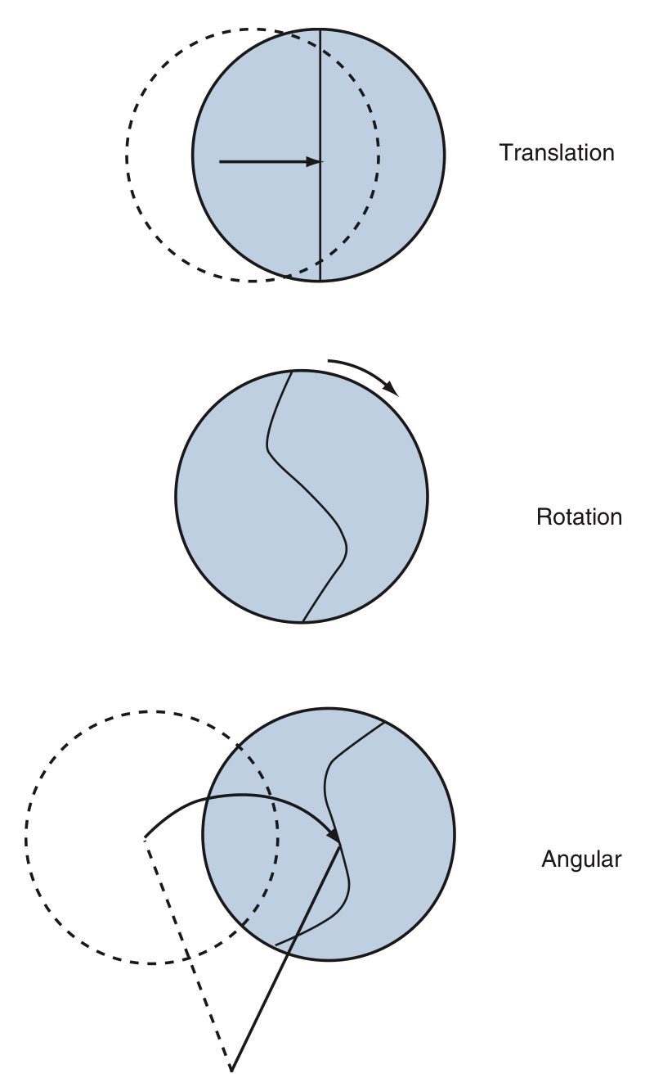
Figure 337-4. Types of head acceleration.
Translational acceleration moves the head in a linear path.
Rotational acceleration induces a rotation about the head’s center of mass, located approximately in the pineal region. Instances of pure translation or rotational accelerations are rare in real-world injury situations; rather, an angular motion is more common.
The angular motion leads to a combination of translational and rotational acceleration, thereby creating injury patterns that arise from both acceleration types. The dashed circles represent the original position of the head; the arrows indicate the direction of impact; and in bottom illustration, the angle of motion is represented by the solid and dashed lines.

Slide 27
Determinants of Acceleration Injury
Structural damage to superficial vascular tissue, especially to bridging veins and pial vessels, occurs in high-acceleration, short-duration conditions.
Damage to brain tissue occurs in circumstances of high accelerations with longer pulse durations and thus higher velocities.
Blast-Induced Brain Injuries
Blast-induced injuries as a group result from the different physical aspects of the blast phenomenon as:
Primary blast-induced injury is from the shock wave.
Secondary blast-induced injury is from shrapnel (focal).
Tertiary blast-induced injury is from the “blast wind” (head acceleration).
Quaternary blast-induced injury from any remaining mitigating factors (thermal, chemical).

Slide 28
Cavitation mechanism
Head impaction
—> Brain moves toward the impact site
—> Area of negative pressure develops directly opposite the point of loading
—> Cause damage by exceeding the tensile strength of neural tissue or, by causing small gas bubbles to appear within the parenchyma
—> The return to normal or positive pressures could then cause the small bubbles to collapse.
Contrecoup contusions
Are often not exactly opposite the point of impact. In fact, contusions of the temporal and frontal poles are contrecoup in almost every instance, regardless of the impact site.

Slide 29
Tissue Tear Hemorrhages
Are multiple areas of damage to blood vessels and axons occurring in combination with diffuse axonal injury.
Caused by inertial head motion effects and are not related to contact phenomena.
They are distinct from the intracerebral hematomas and are actually a part of the pathologic scenario of a severe form of diffuse axonal injury that results in immediate prolonged coma.
Are typically numerous, small, and located parasagittally and in the central portion of the brain.
Their locations are characteristically in
The superior medial frontoparietal white matter.
Corpus callosum.
Centrum semiovale.
Periventricular white and gray matter.
Internal capsule, and basal ganglia.
In the brainstem, they appear in the dorsal area of the midbrain in the upper pons.

Slide 30
Subdural Hematoma
Three varieties of acute subdural hematoma manifest clinically.
The first type
The most common form of vascular disruption.
Involves tearing of parasagittal bridging veins located along the superior margin of the brain.
Results entirely from inertial, not contact, forces.
The other two types
Associated with contusion and laceration and are called complicated subdural hematomas ( most common temporal pole causing burst lobe ).
Result from the contact or acceleration effects.
SDH may coexist with underlying hemispheric brain damage, usually diffuse axonal injury (which explains the frequency of cases in which the subdural hematoma is small but the underlying brain damage is greater than expected).

Slide 31
Diffuse Brain Injury
Cerebral Concussion
Is transient, generally reversible neurological dysfunction caused by trauma.
Caused by inertial loading and not from contact phenomena effects.
Concussion does not occur with purely translational motion of the head.
Can be observed in combination with injuries arising from contact phenomena because the contact loading produces both contact effects and angular rotational acceleration of the head.
Angular rotational head motion causes the deeper structures within the brain to deform and causes the classical widespread disruption of brain function that underlies concussion.
Most of the strain is insufficient to cause structural damage.

Slide 32
Diffuse Axonal Injury
Axonal damage appears to be an important pathologic condition that produces prolonged traumatic coma in cases without mass lesions.
Diffuse axonal injury is considered a more severe form of cerebral concussion
Caused only by angular rotational acceleration and not by contact phenomena.

Slide 33
Neuropathology of Traumatic Brain Injury Youmans Chap.338

Slide 34
INCREASED INTRACRANIAL PRESSURE AND HERNIATION
Any pathologic process that occupies space does so at the expense of the brain, CSF, or blood (verbal expression of the Monro-Kelly doctrine) that states:
Intracranial Volume = Volume of CNS + CSF + Blood + Lesion.
The immediate consequence of placing additional volume into the fixed space of the intracranial vault is an increase in intracranial pressure (ICP).
The normal mean ICP is less than 200 mm H2O or 15 mm Hg for a patient in the lateral decubitus position.
Consequence of increase ICP
The first line of physiologic compensation is reduction in CSF volume —> the ventricles and sulci are effaced
—> If the volume of the lesion exceeds compensatory CSF volume reduction, then blood volume reduction occurs.
—> reduction in cerebral blood flow can have immediate adverse consequences, because the brain is critically dependent on an uninterrupted supply of oxygen and nutrients.

Slide 35
Brain Herniation Syndromes
Subfalcine or cingulate herniations
Caused by one hemisphere is forced by mass lesions in the anterior or middle fossa under the free edge of the falx cerebri, the cingulate lobe is the first portion of that hemisphere to be displaced
Clinically
Often asymptomatic
Or becomes confused and drowsy.
Contralateral lower extremity weakness and urinary incontinence occur when pericallosal arteries compressed, resulting in unilateral or bilateral frontal infarcts within this vessel’s territory.

Slide 37
Uncal or transtentorial Herniation
Caused by mass lesions in the lateral middle fossa or temporal lobe that displace the medial edge of the uncus and hippocampal gyrus medially over the ipsilateral edge of the tentorium cerebelli.
Clinically
Ipsilateral 3rd C.N palsy (crushed by the displaced temporal lobe) results in the eye deviating laterally.
Contralateral hemiparesis (caused by midbrain shifting away from the descending hemisphere with the ipsilateral cerebral peduncle being driven into the unyielding tentorium).
Visual field disturbances due to occipital lobe infarction by compression of one or both posterior cerebral arteries by downward and medial displacement of the hemisphere through the tentorial opening.
Kernohan’s notch phenomenon (ipsilateral hemiparesis) caused by the herniation may cause stretching of the contralateral oculomotor nerve and compression of the contralateral cerebral peduncle against the tentorium.

Slide 40
Central or axial Herniation
Is a downward shift of the brainstem toward the foramen magnum, If both hemispheres herniate transtentorially.
Because of this downward progression,
The brainstem is elongated in its anteriorposterior diameter,
Central perforating branches of the basilar artery become stretched lead to brainstem ischemia and hemorrhage.
Clinically
Impaired consciousness
Cushing response to brainstem ischemia (arterial hypertension, bradycardia, and respiratory irregularity).
Upward cerebellar herniation
Occasionally seen with p-fossa masses, may be exacerbated by ventriculostomy.
Cerebellar vermis ascends above tentorium, compressing the midbrain, and possibly occluding SCAs → cerebellar infarction.
May compress Sylvian aqueduct → hydrocephalus.

Slide 43
Posterior (Tectal) Herniation
Posterior or tectal herniation occurs in patients with
Purely frontal or occipital lesions.
Bilateral lesions such as chronic SDH.
Rather than herniating transtentorially, medial temporal structures herniate posteriorly or bilaterally, compressing the quadrigeminal plate at the level of the superior colliculi.
Clinically
Findings resembling Parinaud’s syndrome: bilateral ptosis and upward gaze paresis in the presence of initially preserved pupillary responses.
Fungus Cerebri
A process in which brain extrude from the opening defect in the skull due to traumatic or surgical defect under increased pressure.

Slide 44
Fungus cerebri

Slide 45
Cerebellar Tonsillar Herniation or Coning
Prolapse of the cerebellar tonsils through the foramen magnum may occur with either supratentorial or infratentorial masses or in the context of generalized increased ICP.
The cerebellar tonsils and medulla are forced together at this opening with lethal compression of vital medullary centers.
Immediately before and after tonsillar herniation, the downward displacement of the brainstem can dislodge vessels from their parenchymal beds within the midbrain and pons, leading to multiple linear hemorrhages called Duret hemorrhages or secondary hemorrhages of herniation.
Clinically
Apnea due to compression of the medulla oblongata caused by obliteration of the cisterna magna.

Slide 47
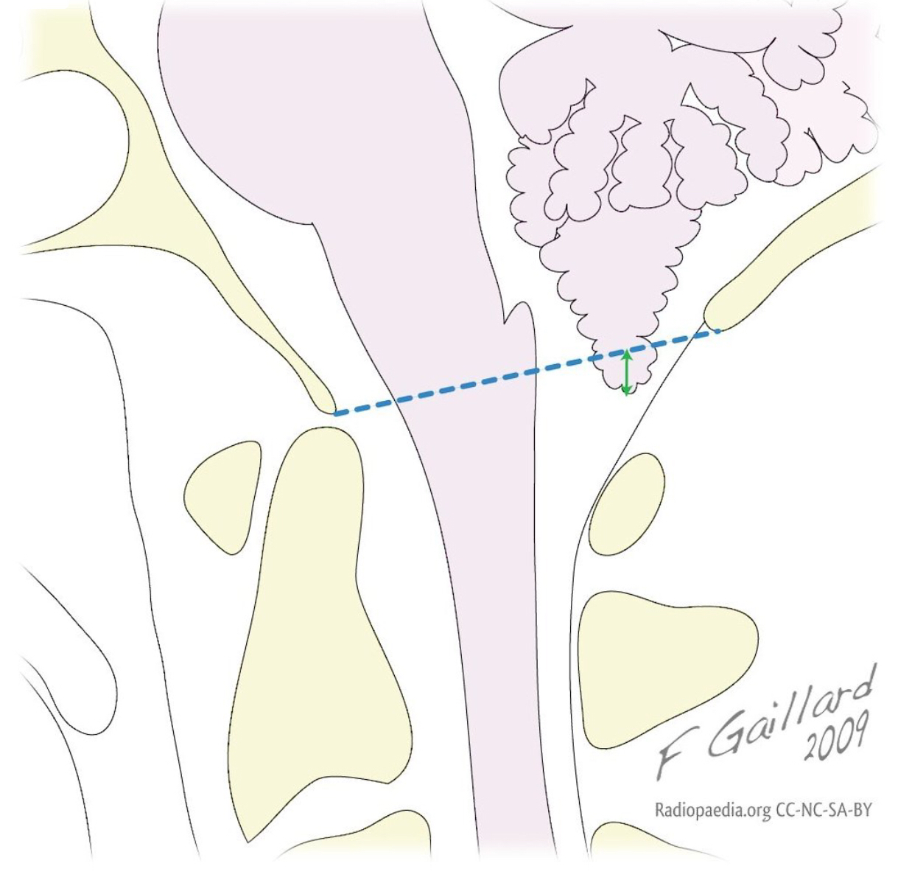
Cerebellar tonsillar position is the vertical distance (green arrows) from the tip of the cerebellar tonsils to a line drawn between the anterior and posterior rims of the foramen magnum (McRae line - dotted blue line).

Slide 49
Thank you

