Slide 1
Vagal Nerve Stimulation VNS

Slide 2
Efficacy of VNS
The device consists of coiled stimulation leads placed around the left vagus nerve.
The leads are subcutaneously connected to a generator placed below the clavicle.
The sensory afferents of the vagus nerve project to the tractus solitary nucleus in the medulla.
The NTS projects broadly, involving the thalamus, amygdala, anterior cingulate, and frontal and parietal cortex .
Release of norepinephrine into the hippocampus is a marker for effective stimulation in a limbic seizure Model.
Vagal Nerve Stimulator
Adjunctive therapy used with anti-epileptic drugs (AED’s)
Provides seizure control, but not relief from seizures.
Can take up to 2 years to have an effect.

Slide 3
Indications
Epilepsy:
The VNS Therapy System is indicated for use as an adjunctive therapy in reducing the frequency of seizures in adults over 12 years of age with partial onset seizures that are refractory to antiepileptic medications (>2) .
Resistant depressive disorder
Severe refractory headache , intractable chronic migraine and cluster headache.
Essential tremor.
Cognitive deficit in Alzheimer disease.
Memory and learning deficits.
Anxiety disorders.
Resistant obesity.
Sleep disorders.
Coma

Slide 4
Contraindications
One vagus nerve
Receiving other forms of brain stimulation
Heart arrhythmias
Abnormal functioning of the autonomic nervous system
Lung diseases
Ulcers
Hoarseness

Slide 6
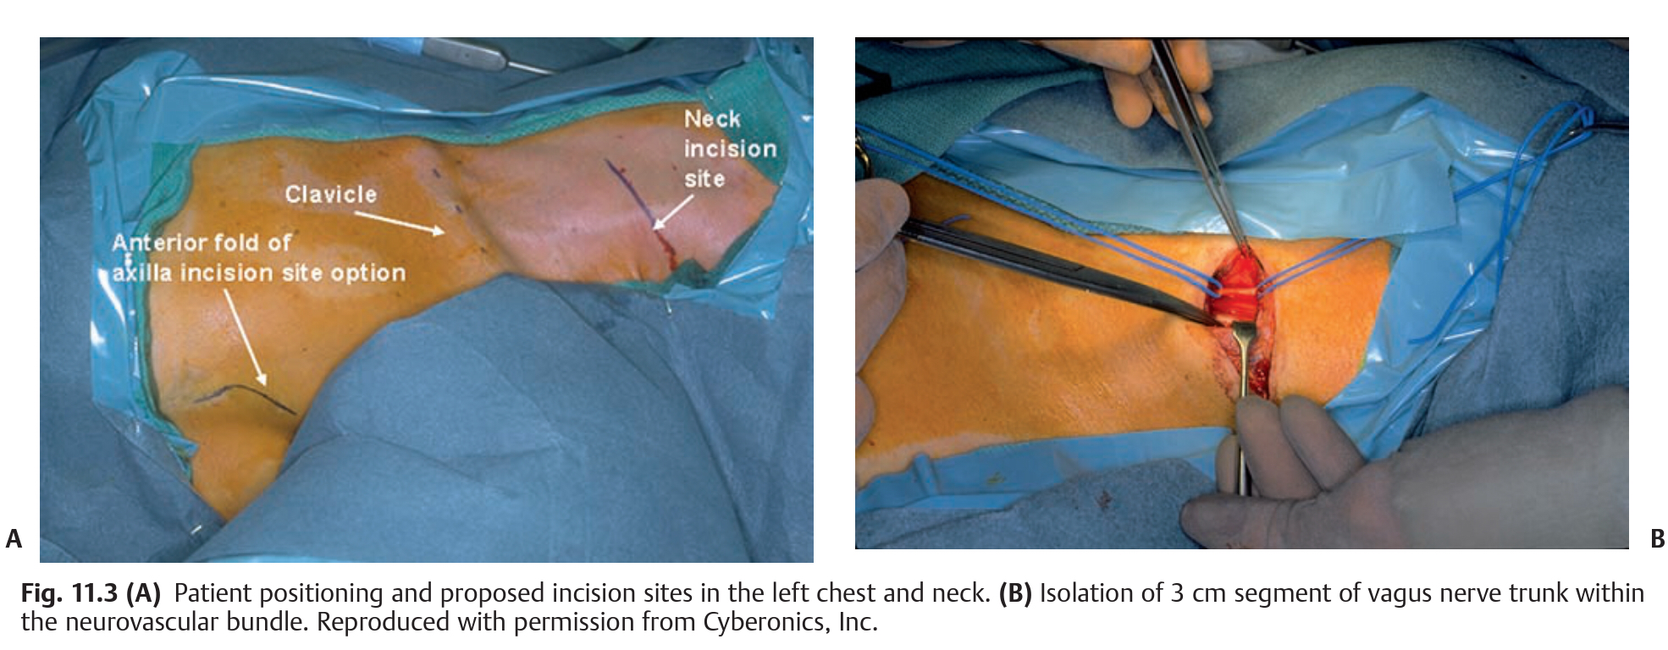
Operative procedure
The patient is positioned supine with mild neck extension to facilitate passage of the tunneling tool that connects the two incisions.
The head is rotated 30 to 45 degrees toward the right, bringing the left sternocleidomastoid muscle into prominence.
A 5-cm lateral incision is made along the anterior fold of the axilla, and the underlying fat is dissected to the level of the pectoralis fascia.
Next, a transverse 5-cm incision is made along a skin crease similar to that used for a C5–6 anterior cervical discectomy.
Alternatively, a longitudinal skin incision can be made along the anterior border of the sternocleidomastoid muscle centered on its midpoint.

Slide 7
The platysma muscle is divided vertically, and the investing layer of deep cervical fascia is opened along the anterior border of the sternocleidomastoid, allowing it to be mobilized laterally.
After the carotid pulse is palpated, the neurovascular bundle is identified and sharply incised to reveal its contents.
Self retaining retractors with blunt blades expedite this stage of the procedure.
Care is taken to limit the exposure between the omohyoid muscle and the common facial vein complex to minimize potential hazards to adjacent neurovascular structures.
Within the carotid sheath at the level of the thyroid cartilage, the vagus nerve is generally encountered deep and medial to the internal jugular vein, encased in firm areolar tissue lateral to the common carotid artery.

Slide 8
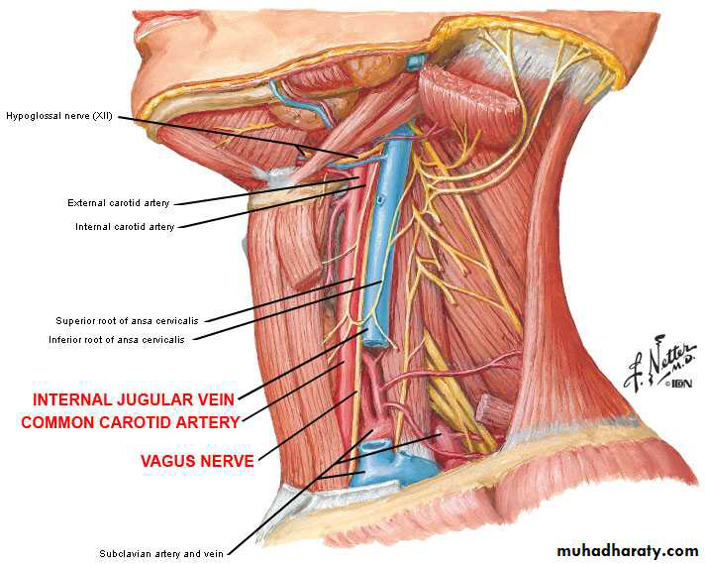

Slide 9
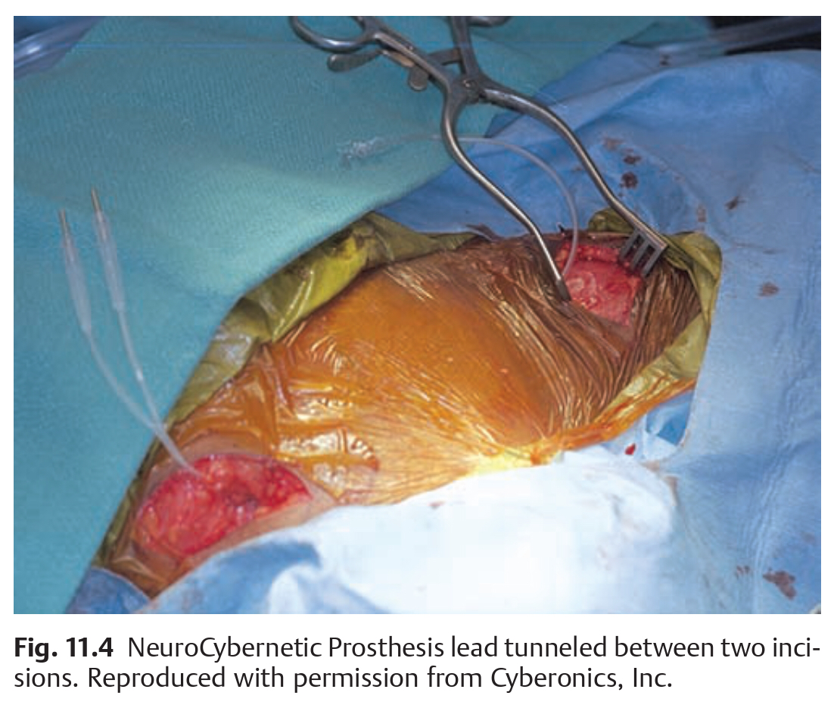
Next, the nerve trunk is identified and dissected with the aid of the operating microscope or surgical loupes.
Insertion of a blue background plastic sheet or vessel loops between the nerve and the underlying vessels greatly facilitates the subsequent steps of the procedure.
A tunneling tool is then used to create a subcutaneous tract between the two incisions.
The tool is directed from the cervical to pectoral sites to minimize potential injury to the vascular structures of the neck.

Slide 10
Electrodes must be placed only on the left vagus nerve (to avoid stimulation-related asystole or bradycardia).
Electrodes should be placed
Below the cardiac branches of the vagus nerve and
Above the left recurrent laryngeal nerves.
Excessive manipulation of the vagus nerve during placement of the lead can result in noticeable post-operative hoarseness.
Each coil is applied by grasping the suture tail at either end and stretching the coil until its convolutions are eliminated.
The lead connector pin is connected to the pulse generator and secured to their receptacles with set screws, using the hexagonal torque wrench.
After the test stimulation, the generator is restored to its inactive status until 1 to 2 weeks postoperatively. This waiting period allows postoperative edema to resolve and the electrode to fixate properly to the nerve.
Inserting the Generator in chest pocket.
programming wand by handheld computer.

Slide 13
Electrode Placement:

Slide 14
Complications:
Infection
Infection rate was low, but most were successfully treated with antibiotic therapy alone.
Vocal Cord Abnormalities
Transient vocal cord paralysis was very rare, most clinically significant cases are self-limited , patients with preexisting vocal cord abnormalities are at greater risk for long-term vocal cord paresis after VNS.
Bradycardia/Asystole
Ventricular asystole occurring intraoperatively during the lead test portion of VNS electrodiagnostic testing has been observed rarely in adult patients.
Sleep-Related Breathing Disorder
Some children evaluated after VNS implantation are found to have decreased respiratory airflow during sleep.

Slide 15
VNS – Side effects
Hoarseness
Increased coughing
Changes in voice/speech
General pain and Headache
Throat or neck pain
Laryngospasm
Insomnia
Nausea or vomiting
Impaired sense of touch

Slide 16
Magnetic Resonance Protocol for Patients with VNS Implants
Many clinicians to avoid magnetic resonance imaging (MRI) in patients with VNS implants .
Before MRI, The device is turned off, and imaging is performed on a 1.5-T MRI.
Indications for lead removal include
Patients who fail to achieve any therapeutic benefit
Suffer intolerable side effects,
Lead fracture or other equipment malfunction,
The need for (MRI) of the neck and body, which is otherwise contraindicated while the electrodes remain in situ.

Slide 17
Where on the vagal nerve should the lead wires be ideally placed, and is there any concern regarding VNS placement on the right side?
The right vagal nerve innervates the sinoatrial (SA) node more than 60%, whereas the left vagal nerve mostly innervates the atrioventricular (AV) node of the heart.
Placement of the leads on the right vagal nerve is contraindicated, as the stimulation will result in asystole.
The risk of bradycardia exists even when the electrodes are placed on the left vagal nerve.
The ideal place for implantation of leads on vagus is in the middle part of the neck proximal to the branches to the cardiac plexus.
The three lead wires are placed from proximal to distal along the nerve.

Slide 18
What are the usual initial VNS settings for use?
Although some centers initiate stimulation the day after implantation, usually the generator is kept turned off and an increase in output is advanced by the neurologists after a 2-week postoperative period.
This is not standard and multiple variations exist depending on the clinical situation.

