Slide 1
Tumors of the Orbit Youmans Chap.161

Slide 2
CLINICAL MANIFESTATIONS
Tumors that involve the orbit can be classified into two major groups:
Primary tumors of the orbit.
Tumors with other sites of origin that extend into the orbit.
The most frequent primary orbital tumors in:
Adults include cavernous hemangiomas, lymphoid tumors, and meningiomas.
Children include dermoid cysts, capillary hemangiomas, and rhabdomyosarcoma.
The most common tumors that extend into the orbit are meningiomas, followed by sinonasal carcinomas.
The most frequent initial symptom of an orbital mass is
Proptosis.
Diplopia is another common early complaint.
Change in visual acuity is often a late finding or indicates a tumor that is close to the orbital apex or optic nerve.

Slide 3
Orbital tumors can also be divided into three categories based on their location within the orbit:
Intraconal (within the extraocular muscle cone).
Intraconal tumors tend to cause
Early vision loss
Impairment of ocular motility (manifesting as double vision)
Axial proptosis.
These effects result from direct compression of the optic nerve and impingement on extraocular muscles.
Extraconal.
Early proptosis
Diplopia
Visual impairment occurs late because of tumor compression of the optic nerve and deformity of the globe itself.
Intracanalicular (within the optic canal).
Early vision loss, optic nerve head swelling, and the appearance of optociliary shunt vessels on the surface of the optic discs.
Minimal or no proptosis.

Slide 4
SURGICAL ANATOMY
The orbit is a cone-shaped structure with an approximate volume of 30 cm.
The base of the cone is quadrangular.
The apex is formed by
The optic canal (containing the optic nerve and ophthalmic artery).
Superior orbital fissure containing
3rd ,4th ,6th CN and V1 of 5th CN
Superior ophthalmic vein.
Sympathetic fibers from the cavernous sinus.
The orbit is composed of seven different bones.
Roof is part of the frontal bone.
Floor consists of parts of the maxilla and zygoma, with a small contribution from the palatine bone posteriorly.
Lateral wall the zygoma and greater sphenoid wing.
Medial wall the maxilla and lacrimal bone anteriorly, frontal bone superiorly, and ethmoid and sphenoid bones posteriorly.
Medially the sphenoid and ethmoid sinuses abut the apex of the cone and the optic canal.

Slide 6
The optic canal is approximately 4.5 mm wide and 5 to 10 mm long and has an average height of 5 mm.
Several anatomic landmarks should be noted
The optic strut is a bony ridge that runs between the anterior clinoid process (lesser wing of the sphenoid) and the sphenoid bone and sinus, it forms the inferiorlateral border of the optic canal and separates the optic canal from the superior orbital fissure.
Falciform ligament is a fold of dura in the proximal, dorsal opening.
The optic nerve travels approximately 15 mm in the subarachnoid space from the chiasm to the falciform ligament.

Slide 7
The intracranial dura enters the canal as a combined dural-periosteal layer before splitting into the dura of the optic nerve (optic nerve sheath) and the periorbita lining the orbital bone.
The intracranial arachnoid is separate through the optic canal, but fuses with the pia at the globe.
At the orbital portion of the optic canal, the pia and arachnoid are joined together dorsomedially and fuse to the dura and anulus of Zinn ventrally; this tethers the optic nerve and partially occludes the subarachnoid space.
The fibrous anulus of Zinn (common tendinous ring) is the origin of all four rectus muscles.
The levator palpebrae muscle originates from the posteromedial orbital roof.
The superior oblique muscle has its origin high on the medial wall of the orbit near the apex.
The inferior oblique originates from a position just lateral to the anterior lacrimal crest.

Slide 8
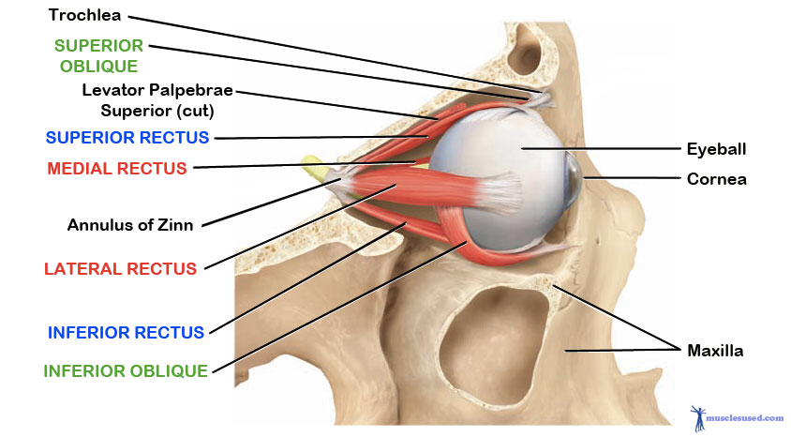
The Annulus of Zinn contains the
Optic nerve & Ophthalmic artery
Superior and inferior division of 3rd CN
nasociliary division of V1 of 5th CN
6th CN
Structures that pass above the tendinous ring
Lacrimal nerve
Frontal nerve
4th CN

Slide 10
Arterial supply
The ophthalmic artery, which provides the major blood supply to the optic nerve, arises from the supraclinoid internal carotid artery (ICA) and passes laterally and inferior to the optic nerve in the optic canal.
The central retinal artery (8 to 15 mm posterior to the globe), which penetrates the medial midportion of the nerve and provides the sole blood supply to the retina.
The ciliary arteries, which arise separately from the central retinal artery form a pial plexus supply the intraorbital optic nerve.
Fine perforators arising from the ICA and superior hypophyseal artery supply the intracranial and intracanalicular portions of the optic nerve.
Venous drainage
The superior ophthalmic vein passes over the lateral rectus muscle and through the superior orbital fissure before entering the cavernous sinus.
The inferior ophthalmic vein forms from venous channels in the floor and medial wall of the orbit before anastomosing with the superior ophthalmic vein and pterygoid plexus.

Slide 12
SURGICAL APPROACHES (“AROUND THE CLOCK”)
Orbital pathology lateral to the optic nerve is accessed via lateral orbitotomies, and medial pathology is accessed via medial orbitotomies.
These approaches vary depending on where the pathology is circumferentially around the orbit and whether it is anterior or posterior in the orbit.
External approaches to the orbit provide excellent access to tumors that are superior and lateral to the optic nerve and orbit.
Pterional or fronto-orbital temporal craniotomy with or without orbitozygomatic osteotomies for tumors with lateral intracranial extension.
Anteriormedial micro-orbitotomy or transconjunctival approach for
Tumors located anteriorly in the orbit.
Accessing the posterior intraconal space which involves detaching the medial rectus muscle and performing a lateral orbitotomy to allow mobilization of the cone.

Slide 14
LATERAL CORRIDORS
External Approaches
Fronto-orbital Temporal and Pterional Transcranial Approaches:
Standard pterional incision is to access the superolateral orbit posterior to the globe.
Modified bicoronal to access medially to the superior orbit, anteriorly as far as the globe or inferiorly or laterally (the incision extending from the tragus on the side ipsilateral to the pathology to the contralateral superior temporal line).
This approach is ideal for tumors such as meningiomas with both intracranial and orbital components.
If tumor is located in the medial or superior intraconal space or is affecting the optic nerve,
The anulus of Zinn should be opened medial to the levator and superior rectus muscles to prevent injury to the oculomotor nerve.
These muscles can be retracted laterally for improved exposure.
It can be difficult to preserve the trochlear nerve with this approach, but it should be attempted.

Slide 15
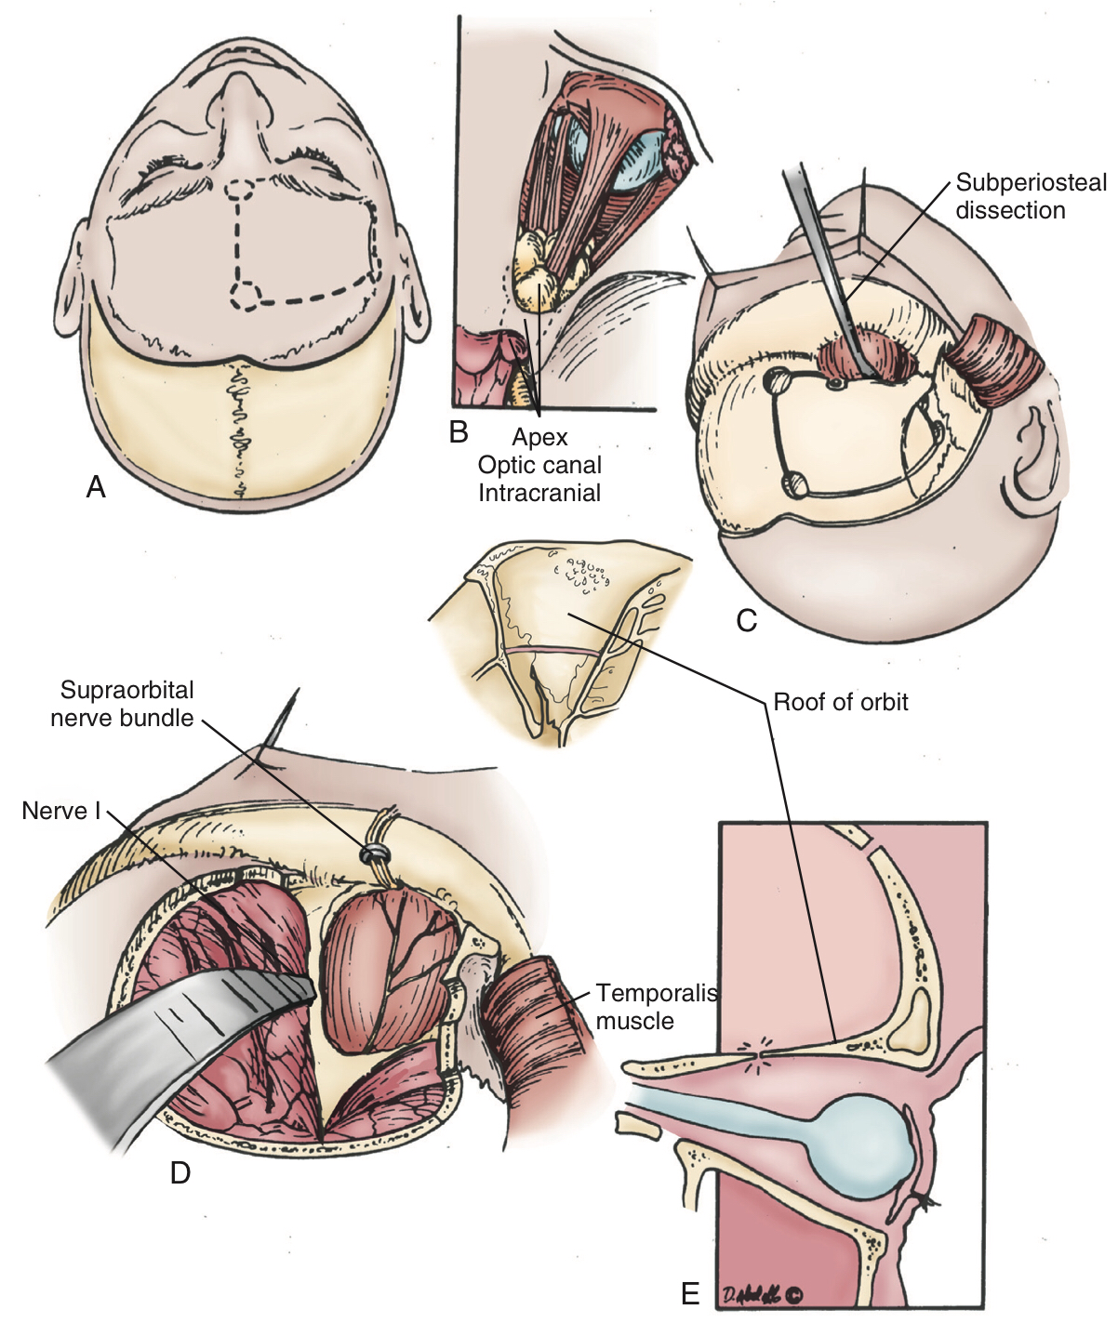
Figure 161-4. Partial bicoronal skin flap for the fronto-orbital temporal transcranial approach with unilateral orbitotomy.
Approximate skin incision overlying the craniotomy.
Superior view of the tumor accessed via this approach, with both intracranial and orbital components.
The subperiosteal dissection should be carried onto the orbit and around its rim to dissect the periorbita from the inner wall of the orbit.
Superolateral view showing access to the frontal and temporal dura, and the superolateral orbit, with the supraorbital neurovascular bundle freed and retracted with the orbit.
Orbitotomy cuts can be made with the craniotomy, but the posterior osteotomy can be performed in more controlled fashion if the two are done separately.

Slide 17
Eyebrow Fronto-orbital Approach and Lateral Supraorbital Approach
Formed via an incision in the eyebrow.
The incision is made from just lateral to the supraorbital notch to the lateral aspect of the brow.
Inferiorly based, U- shaped pericranial flap.
A small amount of temporalis muscle can be reflected laterally and posteriorly from the lateral orbit to provide access for a McCarty burr hole.
This approach provides a slightly more inferior corridor and is better suited for subfrontal tumors, as they may require more traction on the globe to access the posterior orbit.

Slide 18
Lateral Microsurgical Approach and Lateral Orbitotomy
Used for tumors located in the superolateral or inferolateral compartments of the orbit or the orbital apex.
This approach is generally restricted to lesions lacking intracranial extension.
The skin incision is 3 to 4 cm long, and it extends from the lateral canthal angle and curves posteriorly in a line in the temple that could be covered by eyeglasses.
The incision should be limited to 2 cm lateral to the bony lateral canthus to avoid damage to the frontal branch of the facial nerve.

Slide 19
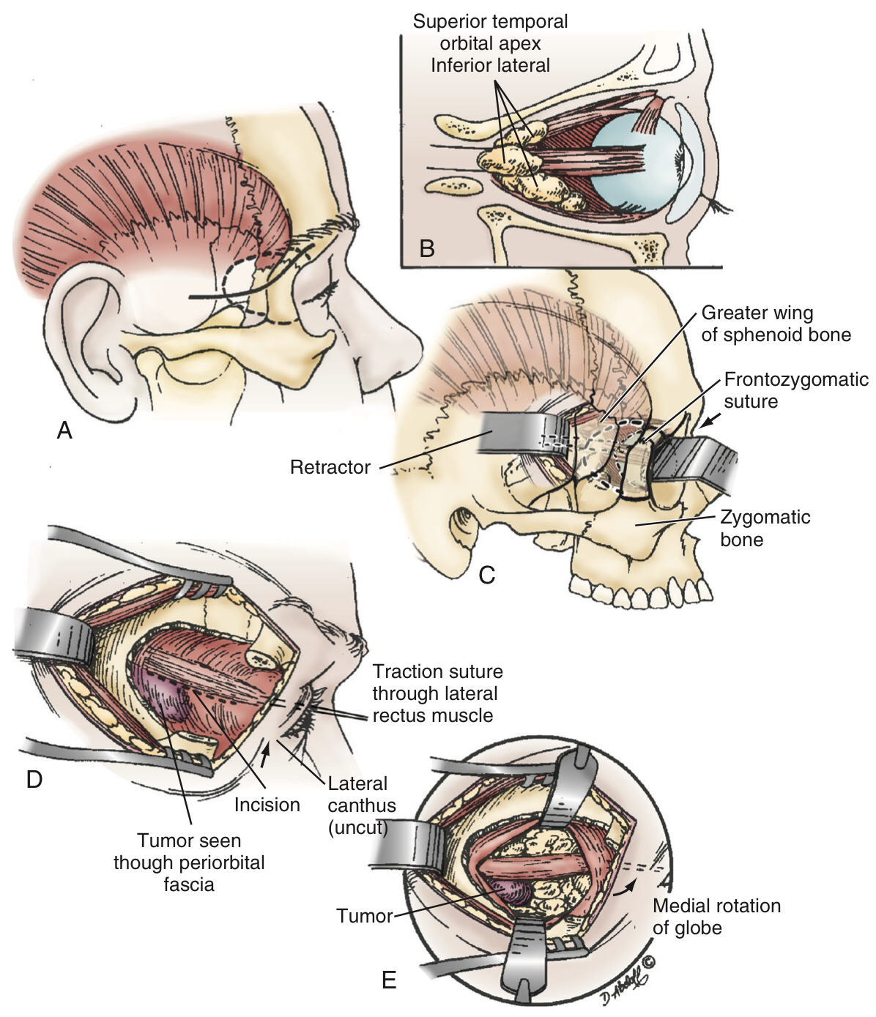
Figure 161-6.
The lateral microsurgical approach begins with a 3- to 4-cm incision that extends from the lateral part of the eyebrow or the lateral canthus and curves posteriorly in a line in the temple that could be covered by eyeglasses.
The approach provides access to tumors located in the superior temporal or inferior/lateral compartments of the orbit or the orbital apex.
The periorbita on the inside of the orbit and the temporalis muscle on the external orbit are dissected free before performing two horizontal osteotomies in the lateral periorbita.
Finally, the lateral rectus can be identified, controlled, and retracted to provide a lateral window into the orbit (E).

Slide 20
MEDIAL CORRIDORS
External Approaches: Anterior Medial MicroOrbitotomy and Transconjunctival Approach
Used for Tumors located anteriorly and medially in the orbit.
The morbidity associated with this approach is similar to that of extraocular muscle surgery.
This approach is useful for anterior lesions but becomes progressively restrictive when extended posteriorly.
For medial tumors posterior to the globe, it has become our practice to use an endonasal approach, which allows a more medial trajectory.
Endonasal Approaches
Medial-Inferior Extraconal Approach
Transmaxillary Extraconal Approach
Medial Intraconal Approach

Slide 21
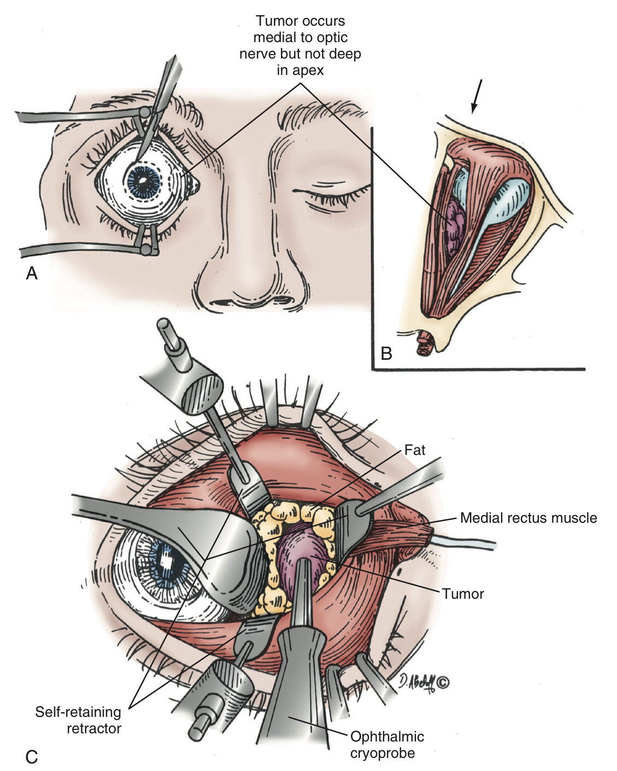
Figure 161-7.
The medial micro-orbitotomy approach begins with a conjunctival peritomy that is performed 90 degrees around the cornea.
Tumors located in the anterior and medial aspects of the orbit (arrow) can be accessed via this approach.
The self-retaining retractor has an enucleation spoon that is placed medially on the globe for medial-to-lateral retraction to provide access to the tumor.

Slide 22
COMPLICATIONS AND THEIR MANAGEMENT
Retro-orbital hematoma.
Loss of vision.
Postoperative meningitis.
Perioperative diplopia secondary to extraocular muscle and tissue edema.
CSF leak.
Mucocele.
Epistaxis.

Slide 23
Enucleation is the removal of the eye that leaves the eye muscles and remaining orbital contents intact.
Indications
Cancer of the eye, such as retinoblastoma and uveal melanoma.
Severe injury of the eye when the eye cannot be saved or attempts to save the eye have failed, such as after a globe rupture.
End stage glaucoma.
Painful, blind eye.
Sympathetic ophthalmia (inflammation of the eye) to prevent travel to the other eye, which if untreated can cause blindness.
Congenital cystic eye.
Constant infection in a blind or otherwise useless eye.

Slide 24
Exenteration is a surgical procedure involving removal of the entire globe and its surrounding structures including muscles, fat, nerves, and eyelids.
Indications
Orbital malignancies in an attempt to become cure of cancer with tumor free margins.
Painful or life-threatening orbital infections or inflammations.
Malignancies of the ocular adnexa are the most common causes of orbital exenteration include squamous cell carcinoma, basal cell carcinoma , and sebaceous cell carcinoma.
Other less common tumors include conjunctival malignant melanoma, adenoid cystic carcinoma of the lacrimal gland, and uveal melanoma with extrascleral extension

Slide 25
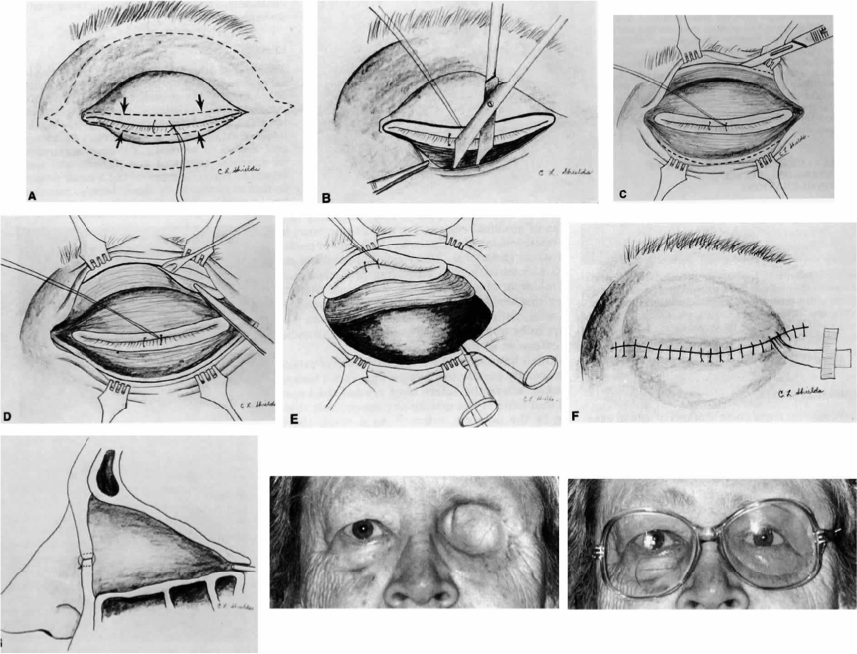
Fig. 8. Orbital exenteration by eyelid-sparing technique. A. The skin incision for the eyelid-sparing exenteration is made about 2 mm outside the cilia. B. Skin incision has been completed and the soft tissues are being dissected down to the bony rim for 360°. C. The periosteum has been exposed for 360° at the orbital rim, and the Bard-Parker knife is being used to cut through the periosteum down to the bone. D. The periosteal elevator is being used to separate the periosteum from the bone. The forceps are being used to put the periosteum on stretch during this procedure. E. Enucleation scissors have been inserted inferonasally and are prepared for cutting the optic nerve and other structures at the orbital apex. F. Frontal view of final closure with interrupted 5-0 silk sutures. G.Sagittal view of final closure. Note that the sutures have brought the upper and lower eyelids together and the orbital cavity is bare. H.Facial photograph of patient 4 weeks after eyelid-sparing orbital exenteration

