Slide 1
Thalamic Tumors Youmans chap.208

Slide 2
Deep location, complex neurocircuitry , dismal prognosis.
The mean age at diagnosis was 7 years.
Important points in SURGICAL ANATOMY
Thalamus is approximately 20 mm in height and width and 30 mm in the rostrocaudal direction.
Topographic organization of thalamic function is contralateral.
Arterial supply are end arteries and occlusions within typically result in thalamic strokes.
Arterial supply of thalamus
Anterolaterally : branches of the posterior communicating artery.
Laterally : from the anterior choroidal artery.
Posterolaterally : from the thalamogeniculate arteries.
Medially : via the thalamoperforating branches.
Dorsally : from the medial and lateral branches of the posterior choroidal arteries.

Slide 3
Venous supply of thalamus
The thalamostriate vein runs within the lateral ventricle floor, lateral to the choroid plexus, and defines the junction between the caudate nucleus anterosuperiorly and the thalamus posteroinferiorly.
Anteriorly it is joined by the descending septal vein near the foramen of Monro to form the internal cerebral vein.
This junction constitutes the anterior limit of the underlying thalamus.
The internal cerebral vein curves along the anterior border of the thalamus and runs posterior along the medial border of the thalamus in the roof of the third ventricle to join its contralateral branch posteriorly to feed into the great cerebral vein (of Galen).
This junction constitutes the scaffolding into which a number of smaller feeders drain.
Of particular importance among these is the superior choroidal vein, which runs along the superior surface of the thalamus deep to the choroid plexus of the lateral ventricle and joins the above complex near the transition of the thalamostriate to the internal cerebral vessels.

Slide 4
GROWTH PATTERN
Focal
Mass effect compressing the surrounding area rather than frank infiltration.
Represents the juvenile pilocytic astrocytoma (JPA).
Diffuse
Does not display a well-demarcated brain tumor interface and typically migrates beyond the confines of the thalamic boundaries.
Fibrillary type.
Bilateral
These tumors are presumed to have a de novo bilateral origin, though unilateral onset followed by migration across the interthalamic commissures (massa intermedia, habenular commissure, or posterior commissure) is possible.
Typically are bilaterally symmetric at the time of diagnosis.
Biopsies of these lesions have been associated with lower histologic grade, but prognosis is much worse ( infilative ), suggesting a malignant course despite the lower grade histology.
Bilateral lesions have a wider differential diagnosis, including encephalitis and mitochondrial and metabolic disorders.

Slide 5
features | Pattern 1 solid | 2 Solid With or no cyst | 3 Solid With or no cyst | 4 Solid
CT | Hypodense | Hypodense | Hypodense | Hyperdense
MRI T1 | Hypo to iso | Hypo | Hypo | Hypo to iso
MRI T2 | Hyper | Hyper | Hyper | Hypo to iso
Contrast | No | Yes | Yes | Yes
Calcification | No | no | Yes | No
Pattern 1 Diffuse, nonanaplastic astrocytoma
Pattern 2
Well defined and the contrast area is homogeneous…pilo­cytic astrocytoma or, more rarely, ganglioglioma.
Ill defined with nonhomogeneous con­trast enhancement, a high-grade astrocytoma
Extensive edema, necrosis, or hemorrhage suggest glioblastoma or an atypical teratoid rhabdoid tumor
Pattern 3 Oligodendrogliomas
Pattern 4 Germ cell tumor even if the pineal gland is not involved. Lymphoma is another possibility

Slide 6
HISTOPATHOLOGY
Neoplasms that harbor mutations in the histone variant H3.3, also found in diffuse intrinsic pontine gliomas (DIPGs), will be expected to have a malignant course ( poor prognosis );
Tumors that have BRAF fusions are almost invariably low grade.
CLASSIFICATION SYSTEMS
Unilateral thalamic tumors, arising from one thalamus with possible extension into surrounding structures.
Thalamopeduncular tumors, arising at the junction of these two structures with symmetrical supratentorial and infratentorial extension.
Bilateral thalamic tumors, originating from both thalami.

Slide 7
CLINICAL PRESENTATION
Thalamic tumors between 8 and 10 years.
No sex predilection.
The symptoms can be classified into
Those caused by increased (ICP) secondary to obstruction of (CSF) pathways, typically the posterior third ventricle, or to enlarging tumor mass.
Those caused by focal involvement of specific thalamic nuclei.
Those caused by infiltration of surrounding structures.
The most common symptoms are those of raised ICP, headaches, lethargy, nausea and vomiting, and, if left untreated, stupor and coma. Treatment of ICP with CSF diversion (Third ventriculostomy is feasible if the anterior third ventricle is open and also affords an opportunity for biopsy).
Lesions in the dorsomedial thalamus are more likely to occlude one or both of the foramina of Monro and cause hydrocephalus.
Lesions in the ventrolateral thalamus typically manifest as ( motor deficits more commonly , and sensory disturbances less frequent) due to their close proximity to the internal capsule and caused either by compression or frank tumor infiltration of the internal capsule.
A classic thalamic syndrome, characterized by contralateral anesthesia (or hypesthesia), contralateral weakness, ataxia, and, often, persistent spontaneous pain, is rare.

Slide 8
Visual symptoms
Are present in as many as 50% of children with thalamic tumors.
They may consist of hemianopia, a myopic poorly reactive pupil due to involvement of the optic tracts and the geniculate ganglia.
Ipsilateral oculomotor palsy as a result of involvement of the retrolenticular segment of the internal capsule or the midbrain tegmentum.
Movement disorders
Are not very common in patients with thalamic tumor; when they do occur, tremor followed by dystonia is the typical course.
Holmes’s tremor, a resting nonrhythmic tremor aggravated by movement, can occur. (Involvement of midbrainand superior cerebellar peduncle)
Focal lesions of the thalamus and/or the subthalamic region can lead to the development of dyskinesia and bilateral blepharospasm.
Involvement of the hypothalamus results in endocrinopathies.
Involvement of the mammillothalamic tracts or the fornices can lead to cognitive dysfunction and memory problems.
Bilateral thalamic tumor consists of personality changes, memory loss, confusion, hallucinations, hyperphagia, and bradyphrenia (slowness of thought ).

Slide 9
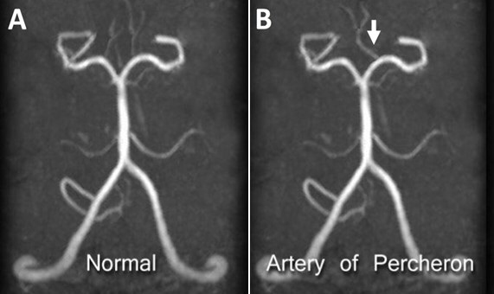
DDx of bilateral thalamic lesions
Thalamic glioma
Vascular : venous thrombosis ,Artery of Percheron occlusion.
Wilson disease.
Wernicke’s encephalopathy.
Infection : Creutzfeldt jacob disease.
Fahr disease.
MS.
The artery of Percheron (AOP) is a rare anatomic variation in the brain vascularization in which a single arterial trunk arises from the posterior cerebral artery (PCA) to supply both sides of brain structures; the thalamus and midbrain.

Slide 10
SURGICAL APPROACH
Transcortical transventricular
Interhemispheric transcallosal transventricular
Posterior interhemispheric parasplenial
Infratentorial supracerebellar
Transsylvian transinsular
Stereotactic
Endoscopic

Slide 11
Transcortical transventricular approach:
Advantage: Transfrontally, from a coronal or precoronal trajectory easier access to the lesion with a lower chance of disruption of the parasagittal veins.
Disadvantage is a disruption of normal cortex.
Indications
for larger lesions that come up toward the cortex
for lesions in patients with large lateral ventricles.
Inter-hemispheric approach:
Advantage no need for cortical or white matter disruption.
Disadvantage owing to the presence of draining veins at the superior sagittal sinus.
Indications For lesions that primarily protrude into the ventricular space.
Posterior interhemispheric parasplenial approach:
Lesions within the pulvinar.
Particular attention should be paid while retracting the occipital lobes, because damage to the internal occipital vein, or overzealous retraction, can result in an occipital infarct and a resulting visual field defect.

Slide 12
Supracerebellar infratentorial approach
Tumors involving the posteroinferior thalamus or pulvinar.
In particular, a contralateral approach may allow a clear view of the medial aspect of the opposite pulvinar.
Transsylvian, transinsular approach
Lesion is pushing the posterior limb of the internal capsule and the basal ganglia anteriorly.
via the postcentral insular sulcus of the insular cortex should not damage these structures.
Stereotactic or an endoscopic biopsy
Indications
A tissue diagnosis may be required, or appropriate, such as for bilateral thalamic tumors.
In unilateral lesions in which diagnosis is not clear.

Slide 13
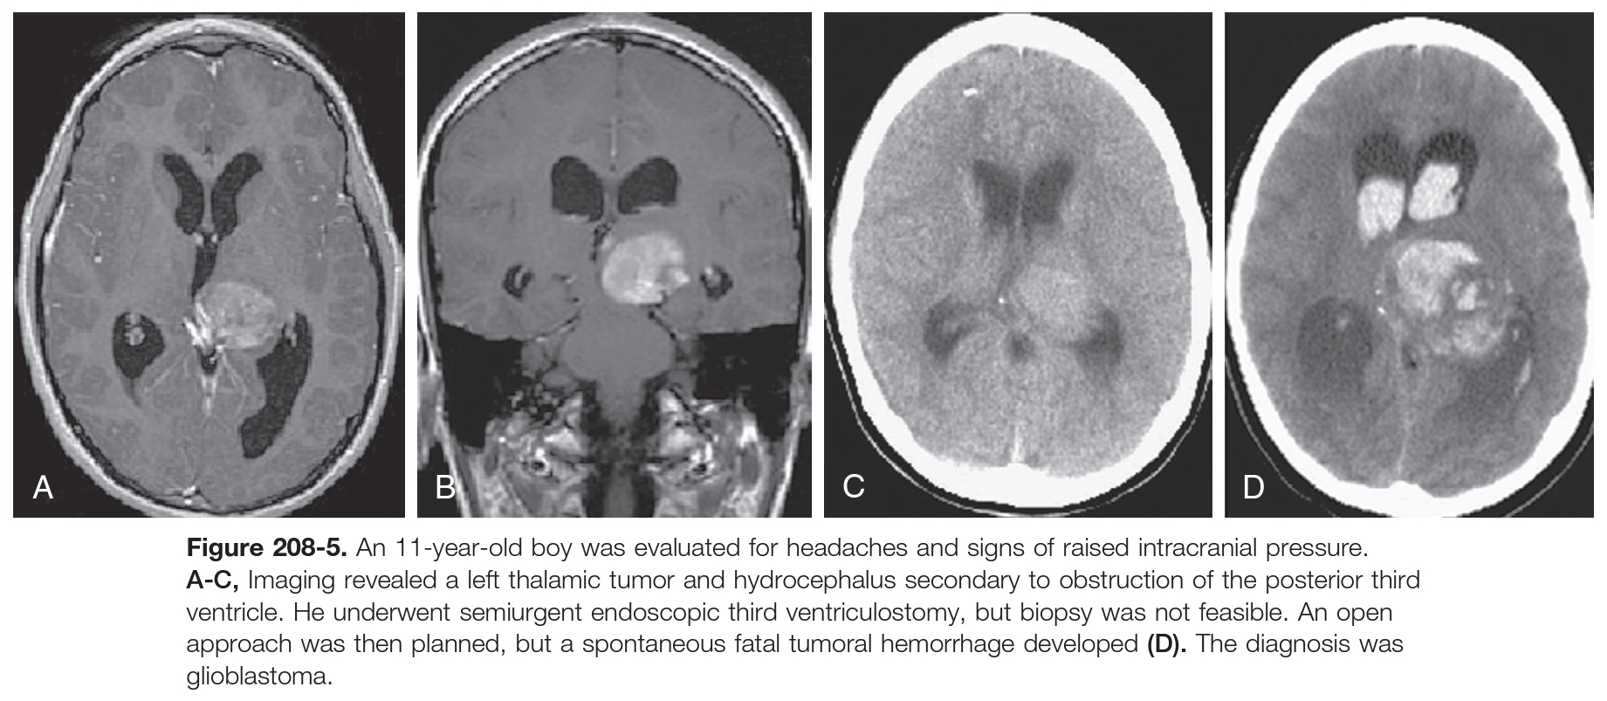

Slide 14
Complications
Mechanical Injury
Contralateral motor and sensory deficits.
Contralateral neuropathic pain syndrome (Dejerine-Roussy syndrome, which is more commonly described with ischemic damage).
Venous Infarcts
Interhemispheric approaches
A major cause of venous injury remains intraoperative retraction.
Diencephalic venous infarcts due to obstruction of the internal cerebral venous system, symptoms can range from hemiplegia and mutism to coma.
Diencephalic Amnesia
The anterior thalamic nuclei play an important role in neural pathways for memory processing and affect.
Bilateral surgical lesions within this structure have been utilized to treat a wide range of behavioral and pain problems.
Dorsomedial nuclei and the nearby mamillothalamic tracts , unilateral dorsomedial thalamic lesion can result in memory problems.
Korsakoff psychosis, typically seen with chronic alcohol consumption, is believed to be due to damage to the dorsomedial nuclei.

Slide 15
Forniceal Damage
forniceal damage in the anterior location appears to be less problematic than posterior damage near the hippocampal commissure.
Corpus Callosotomy
word-paired associate learning tasks in the Wechsler memory scale and left-sided motor apraxia for a right-handed person.
These deficits, which are typically associated with large callosal lesions
short (2.5 cm) anterior lesions of the corpus callosum, produce no clinically measurable deficits if no other lesions are present.
Aseptic Meningitis
Caused by blood and necrotic tissue are spilled in cerebrospinal fluid , treated with a short course of corticosteroids.

Slide 16
ADJUNCT TREATMENTS
Surgery remains the mainstay of treatment for low-grade gliomas of the cerebral hemispheres
Radiotherapy and chemotherapy being reserved for recurrent or progressive inoperable disease.
Moving to primary chemotherapy to avoid the late effects of irradiation, such as endocrinopathies, vasculopathies, optic nerve damage, and loss of intellectual function.
For growth of a residual pilocytic tumor, chemotherapy has become the preferred treatment, although repeat resection is also a consideration.
vincristine and carboplatin and vinblastine alone

Slide 17
PROGNOSTIC FACTORS AND OUTCOMES
worse prognosis
Younger than 5 years.
Thalamic and hypothalamic lesions.
Bilateral tumors.
Molecular identification of H3.3 mutations.

