Slide 1
Tethered Cord Syndrome
Youmans Chap. 232,300

Slide 2
Spectrum of congenital conditions that result in progressive neurological deterioration due to tension on the spinal cord.
Comprises progressive neurological deterioration, including
Bowel and bladder dysfunction.
Musculoskeletal abnormalities, such as scoliosis and extremity anomalies.
Cutaneous stigmata.
Dysraphic spinal elements.
Occult spinal dysraphism (OSD) refers to a collection of congenital anomalies of the lumbosacral spine due to malformation of midline dorsal neural, mesenchymal, and cutaneous ectodermal structures during early embryogenesis.
The position of the conus medullaris ranges from the midlevel of T12 to the lower portion of L3.
The majority of normal coni are found between L1 and the L1-L2 interspace.
The coni of term infants lie at L2-L3 but continue to ascend to the average adult level, L1-L2, by 3 months of age

Slide 3
PATHOPHYSIOLOGY OF TETHERED CORD SYNDROME
The filum terminale is a fibroelastic structure that extends from the conus to the sacrum; its role is to secure and to stabilize the conus medullaris during movement of the spinal column.
The length of the spinal canal has been shown to change by as much as 7% during flexion.
Failure of the filum terminale to alleviate spinal cord stretch during flexion-related changes in spinal canal length is the pathologic mechanism.
Pathologic stretching of the spinal cord has been shown to be associated with metabolic derangements similar to those seen under ischemic conditions.
These changes may be mediated by physical neuronal damage due to tethering, impairment of oxidative metabolism, and reduction in blood flow to the spinal cord during flexion movements.
Damage due to
Severe stretch may be irreversible,
Mild or moderate damage may be reversed by cessation of the pathological spinal cord stretch following spinal cord detethering procedures.

Slide 4
Progressive fibrosis of the filum with resultant
loss of elasticity, growth spurts in adolescence and early adulthood, and
degenerative spinal stenosis and associated restriction of movement of the spinal cord and filum may worsen spinal cord tension.
OSD and TCS are often associated with syringohydromyelia.
Neurological deterioration in a patient with TCS may thus be exacerbated by cystic dilation of the spinal cord.
Development of the syrinx may be related to
myelomalacia and ischemia secondary to tethering or
may be independent of the OSD and instead related to the same embryologic error that resulted in the formation of the OSD.
TCS caused
Dorsally by a meningocele manqué or a dermal sinus tract
Ventrally by a ventral band or diastematomyelia

Slide 5
SYMPTOMATOLOGY AND CLINICAL PRESENTATION
Presenting symptoms included
Pain
Sensory disturbances
Weakness
Urinary dysfunction
Perineal and gluteal pain is the most frequently described distribution, but many patients also complain of nondermatomal leg pain.
Sensory disturbances tend to be greatest in the saddle region and distal lower extremities and tend to have a patchy distribution.
Weakness, when present, generally affects distal lower extremity motor groups disproportionately and is often accompanied by spasticity and hyperreflexia.
Urinary complaints have traditionally been believed to be less commonly encountered in adult TCS than in pediatric TCS.
Urgency and stress incontinence being more common in adulthood and insufficient stream and enuresis being more common in childhood.

Slide 6
Patients may experience chronic urinary tract infections.
These symptoms are due most commonly to detrusor hyperreflexia but can also be due to poor bladder compliance, dyssynergia, and decreased sensation.
Neurological symptoms and pain are often precipitated by prolonged or sudden flexion of the spine.
Precipitating factors:
heavy lifting
traumatic injury
prolonged sitting
childbirth in the lithotomy position
OSD are associated with
Cutaneous abnormalities include hypertrichosis, pigmented nevi, subcutaneous lipomas, dermal dimples, and dermal sinuses
Musculoskeletal abnormalities include scoliosis, vertebral body abnormalities, and lower extremity deformities.

Slide 7
Etiology
Several etiologies have been associated with adult TCS, including the following:
Thickened or fatty filum terminale
Intradural or extradural lipoma
Lipomyelomeningocele and lipomeningocele
Fibrous adhesions around the conus or filum/meningocele manqué
Split cord malformation
Previous myelomeningocele repair
Mass lesions (neuroenteric cyst, dermoid and epidermoid cyst, hamartoma).
Arachnoid cyst
Cyst, lipid, adhesion, surgery

Slide 9
Fatty and Thickened Filum Terminale
The filum terminale is a viscoelastic band that is believed to enable the spinal cord to accommodate changes in spinal canal length without pathologic degrees of neural tissue stretch.
Changes in the structural elements of the filum terminale may result in an inappropriately tense filum terminale that prevents normal stretching with flexion and extension of the spinal column.
The diagnosis of TCS due to
low-lying conus and/or
fatty infiltration or thickening of the filum terminale ( 2 mm as the threshold value for determining that the filum is thickened).
The presence of adipose tissue or filum thickening may provide diagnostic clues in a patient with high clinical suspicion of TCS.

Slide 10
Symptoms
Common clinical findings are
The presence of cutaneous signs associated with OSD.
Neurogenic bladder with the development of primary or secondary incontinence or urinary tract infection.
Leg or foot weakness, numbness or spasticity (or both).
Leg or foot length discrepancy.
Foot deformity (pes cavus, claw toes).
Spinal deformities.
Nondermatomal back and leg pain.
Pain is a major initial symptom in adults with tethered spinal cord (irritability in pediatrics)
The neurological deficits may not be reversible with surgical intervention.
Commonly, the initial clinical symptom in patients with a tethered cord secondary to a fat-infiltrated filum is gradual and progressive loss of coordinated bladder activity.
Manifested as repeated bouts of UTI or primary or secondary urinary incontinence.

Slide 11
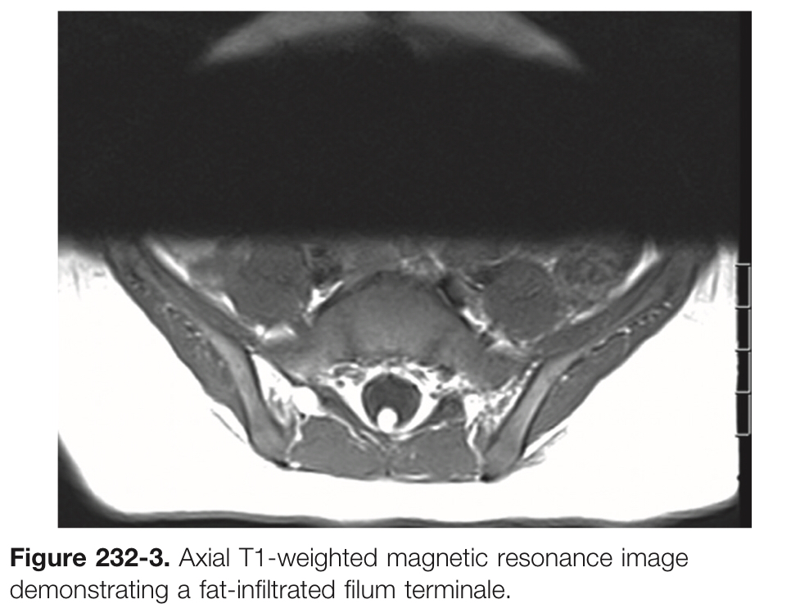
Imaging
Three criteria are necessary to confirm the clinical impression of a tethered spinal cord on imaging:
Caudal descent of the conus.
Fatty infiltration and thickening of the filum terminale.
Drawn-out appearance of the distal conus.
Imaging identifies a thickened (usually > 3 mm in diameter) filum, and if present, infiltration of the filum with adipose tissue is easily seen on T1-weighted MRI

Slide 12
Treatment
Detethering is performed through a single-level laminectomy (L5-S1 level is most commonly used, an approach at L3-L4 or L4-L5 may be preferable in some patients to decrease the risk of postoperative instability).
To begin the detethering procedure, a durotomy is made and the filum is identified by visual inspection and by nerve root mapping.
The filum terminale normally has a blue tinge with longitudinal blood vessels, which distinguishes it from the surrounding nerve roots; however, it may appear fatty, fibrous, or thickened in patients with TCS.
Once the filum terminale is identified, bipolar electrocautery is applied prior to sharp transection of the filum.
Options for monitoring include
Electromyographic (EMG) recording of activity of sphincter muscles.
Compound muscle action potentials (CMAPs) from sphincter and leg muscles.
Somatosensory evoked potentials (SSEPs) from roots to peripheral electrical stimulation.

Slide 13
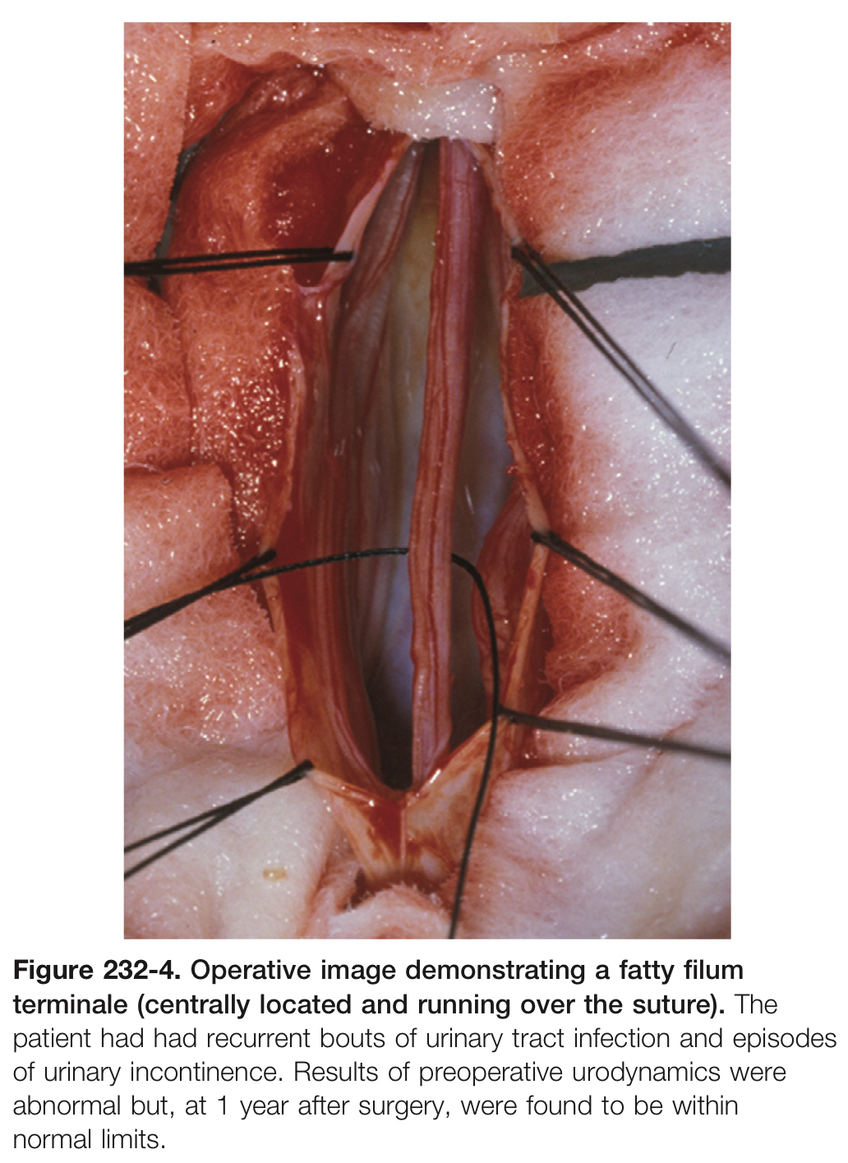

Slide 14
Meningocele Manqué (Missing)
Pathogenesis
Failure of a meningocele to develop, leaving only congenital bands in its place.
Congenital dorsal bands of fibrotic or atretic neural tissue extend from the dorsal aspect of the spinal cord or nerve roots to the dorsal dura and sometimes to the overlying lamina or laminar defect; they serve as a potential source of tethering on the spinal cord.
They are most frequently associated with split cord malformation.
The mean age at initial evaluation was 10 years.
Mostly occurred at two vertebral levels but may occupy single vertebra or up to 5 level.
The majority of bands are located in the lumbar and thoracolumbar regions, but approximately 15% may be located in the thoracic and cervical spine.

Slide 15
Presentation
The most common symptom was LMN Disturbance such as atrophy of the lower extremity muscles.
Followed by pain, UMN disturbances (e.g., hyperreflexia), bladder complaints, paresthesias, and finally, bowel complaints.
Imaging
CT myelography: thin linear filling defect extending from the spinal cord or hemicord (in cases of split cord deformity) to the dorsal dura.
Treatment of TCS due to meningocele manqué is surgical detethering by lysis of dorsal tethering bands and treatment of other dysraphic elements, as appropriate.

Slide 18
Dermal Sinus Tracts
An abnormal stratified squamous epithelium-lined tract that connects the skin and soft tissues of the back, the thecal sac, and neural elements.
Dermal sinus tracts are found anywhere from the nasion to the coccyx.
Most commonly in the lumbosacral area.
Patients often presented as
Chronic bouts of meningitis, meningitis caused by unusual organisms.
Later in life with either infection or neurological compromise.
Neurological deficits may arise from spinal cord tethering or from mass effect due to associated inclusion tumors.
Cutaneous findings include
sinus ostium with rostrally oriented tract if in the lumbosacral spine,
hypertrichosis, skin tags, subcutaneous lipomas,
capillary hemangiomas, erythema, induration,
signs of local infection, and drainage of debris from the surface of the tract.

Slide 19
A dermal sinus may be solitary or combined with other manifestations of dysraphism.
Inclusion tumors (dermoid, epidermoid, teratoma) may be found anywhere along the dermal sinus tract.
60% of all dermal sinuses enter the subarachnoid space, with approximately 25% being attached to neural elements.
Dermal sinus tracts occur almost exclusively along the dorsal midline and may be associated with midline bony defects in the skull or spine. If the spinal cord is involved, the attachment or infiltration is almost always dorsal.
Sacrococcygeal dimples
Innocuous, are found interior to the natal cleft
<5 mm in diameter, midline, within 2.5 cm of the anus, no other associated cutaneous stigmata.
Are sometimes confused with true dermal sinus tracts.
Intramedullary spinal cord abscesses probably represent the most serious complications of dermal sinus tracts.

Slide 21
Diagnosis
MRI with contrast
T1: the tract appears as a rostrally or caudally coursing linear, curvilinear, or cone-shaped area of hypointensity within the bright subcutaneous fat.
T2: Intradural portions of the dermal tract may be better visualized because of their greater contrast with cerebrospinal fluid.
Other findings that may suggest the presence of a dermal sinus tract are
Tenting of the posterior dura as the fistula enters the thecal sac.
Clumping of the nerve roots and create a ring-like configuration due to arachnoiditis.
Presence of an inclusion cyst.

Slide 25
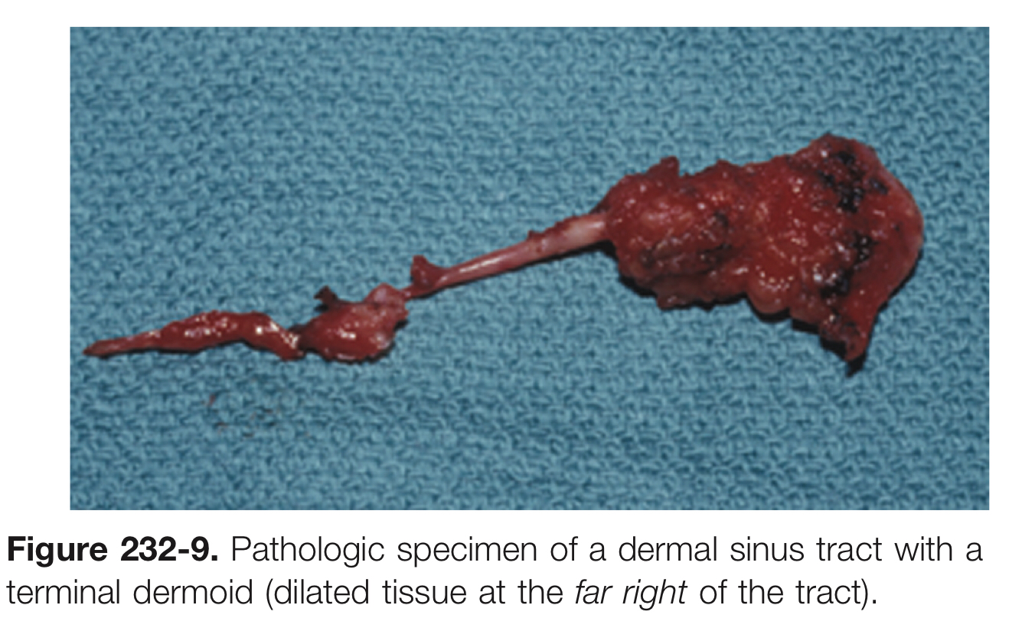
Treatment
Dermal sinus tract should be traced surgically from its origin to its termination, in as much as failure to completely follow these pathways may result in inadequate removal of epithelium producing cells and intradural dermoids.

Slide 26
Thank you

