Slide 1
Syringomyelia Youmans Chap. 301

Slide 2
Syringomyelia
Is a cystic cavitation of the spinal cord that contains fluid similar to cerebrospinal fluid (CSF) and is lined by gliotic tissue, or, in some circumstances, ependymal cells.
Syrinx = cavity of tubular shape
The lining of the cavity, whether by
Ependymal which mean hydromyelia.
Gliotic tissue which mean syringomyelia.
Associated conditions, include
Chiari type I malformation 50%.
Spinal cord trauma.
Inflammatory/ postinfectious conditions such as arachnoiditis.
Both spinal and posterior fossa neoplasms.
Degenerative diseases.
Spinal cord tethering.

Slide 4
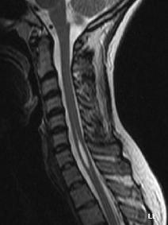

Slide 5
INCIDENCE AND EPIDEMIOLOGY
Syringomyelia largely affects children and young adults.
50% have Chiari I malformations.
Spinal cord trauma and arachnoiditis account for another quarter of adult patients with syringes
50% of patients with spinal cord trauma will develop a syrinx; 1-9% will be symptomatic.

Slide 6
PATHOPHYSIOLOGY
The hydrodynamic theory
suggested that Unbalanced CSF pulsations between the supratentorial and infratentorial spaces during development were theorized to result in :
Small posterior fossa.
Tonsillar ectopia.
Forced diversion of CSF from the 4th ventricle into the central canal as a result of blockage of 4th ventricular outflow tracts at the FM.
Transient elevations in intracranial pressure caused by epidural venous congestion as a result of Valsalva maneuvers resulted in bulk flow of CSF caudally.
Resistance to flow caudally as a result of adhesions or CSF outlet obstruction was theorized to result in differential pressure between cranial and spinal compartments and subsequent worsening syringomyelia.

Slide 7
Oldfield theory
Movement of the cerebellar tonsils caudally during systole generates a systolic pressure wave in spinal CSF that forces fluid into the spinal cord via perivascular and interstitial spaces rather than through the central canal at the obex,
Subarachnoid block caudal to the foramen magnum may produce similarly abnormal CSF pressure dynamics.
Subarachnoid block in the spinal cord shortens the length of the subarachnoid space of the spinal cord, reducing its compliance and impairing its ability to dampen the subarachnoid CSF pressure waves produced by brain expansion during systole.
This, in turn, results in an increased pulse pressure rostral to the site of subarachnoid space blockage and drives CSF into the spinal cord through perivascular and interstitial spaces as in syrinx formation among patients with arachnoiditis and with fourth ventricular outflow tract obstruction.

Slide 8
syringes that are isolated from the fourth ventricle has been explained by obstruction of the central canal at the rostral extent of the syrinx; however, because the central canal in adult humans normally has segmental occlusions by the third decade of life, and the central canal is often distinct from the syrinx in many cases of posttraumatic syrinx.
Ischemia Yet another theory implicates ischemia as the underlying pathologic mechanism, suggesting that syringomyelia results from the coalescence of microcysts that form secondary to ischemia caused by impaired CSF flow and cystic degeneration

Slide 9
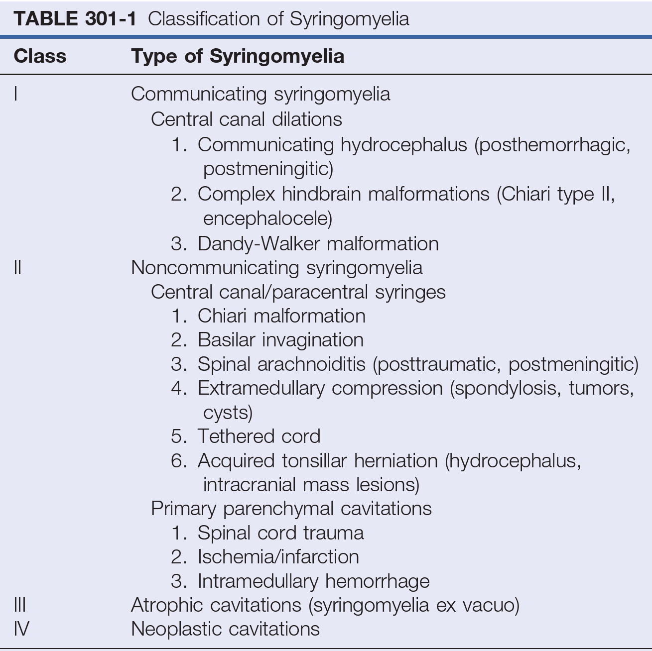

Slide 10
SYMPTOMATOLOGY AND CLINICAL PRESENTATION
Sensory deficit
Initial symptoms often include sensory loss and dull or burning pain attributable to spinothalamic tract involvement.
The sensory loss is often suspended and cape-like in distribution.
There is also characteristically a dissociated pattern of pain and temperature sensation loss with preservation of light touch and proprioception (Central cord compression).
Motor Deficit
Loss of motor function occurs following sensory loss with progression of the syrinx
weakness tends to be asymmetrical because of asymmetrical extension of the syrinx into the ventral horn of the spinal cord.
Autonomic deficit
Hyperhidrosis, autonomic dysreflexia, Horner’s syndrome, and asymmetrical reduction of reflexes may also occur with further progression.

Slide 11
Progression is generally slow, although sudden worsening has been reported in posttraumatic syringomyelia as a result of Hemorrhage into the syrinx cavity.
The clinical presentation is highly dependent on the location of the syrinx.
Patients with Arachnoiditis more commonly present with signs and symptoms of lower lumbar and sacral spinal segments, because arachnoiditis is more prevalent in the lumbar spine owing to its association with myelography.
Patients with Posttraumatic syrinx and Complete spinal cord injuries
May develop a gradual loss of function at progressively higher spinal levels.
When the syrinx is extensive or in the high cervical region, it may sometimes extend into the caudal brainstem and result in lower cranial neuropathies; this condition is best described as Syringobulbia.

Slide 12
RADIOLOGIC EVALUATION
MRI is the modality of choice for diagnostic work-up.
MRI of the entire neuraxis is indicated in order to rule out other associated conditions, such as foramen magnum pathology or spinal cord tethering.
Posttraumatic syringes should not enhance following the administration of gadolinium, and the signal characteristics of the syrinx fluid should be similar to those exhibited by CSF.
CT is not a reliable modality to evaluate for syringomyelia.
CT myelography does not detect up to 50% of syringes.

Slide 13
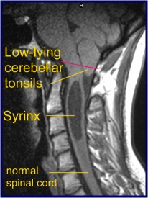
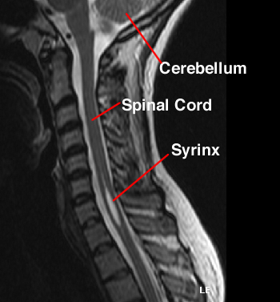

Slide 14
Posttraumatic Syringomyelia
Male predominance.
Nearly 50% develop spinal cystic change.
Pathological Principles that are specific to a posttraumatic syrinx :
1st
Inflammatory responses —> localized spinal cord edema —> cyst formation.
2nd
Intramedullary hematoma —> after absorption —> cystic cavity.
3rd
Subarachnoid adhesions, deformity, and spinal stenosis —> interruption of normal CSF flow in the subarachnoid space —> cystic formation.

Slide 15
Arachnoiditis
Spinal adhesive arachnoiditis (SAA) refers to scarring of pial and arachnoid membranes within the thecal sac and occurs as a sequela of chronic inflammation.
The severity of disease ranges from focal adhesions to dense scarring as seen in arachnoiditis ossificans.
Causes
Infection
History of myelography
Subarachnoid hemorrhage
Degenerative lumbar disease
Previous spine surgery
Intrathecal steroid injection

Slide 16
Symptoms
Onset of symptoms can be variable and ranges from only 14 days to up to 44 years following the initial insult.
Delayed onset is typical, with most symptoms developing years after the inciting event.
Many patients with SAA remain asymptomatic despite radiographic findings of SAA.
SAA has a predilection for the lumbar spine and Because of this predilection, patients often initially present with lumbar radiculopathy and back pain in addition to the signs and symptoms attributable to a syrinx.

Slide 17
Radiological finding
MRI is the imaging modality of choice.
CISS images may better visualize dural thickening, syringomyelia, and microcystic change than T2-weighted fast spin echo MRI
Arachnoiditis
Its diagnosed with axial T2 not sagittal
As nerve root black and CSF white
Pseudo cord sign
All nerve root become adhesive to each other and appear as a cord in the cauda equina level (after L1 – L2)
Empty thecal sac sign
Nerve root become attached to the edge of the thecal sac

Slide 20
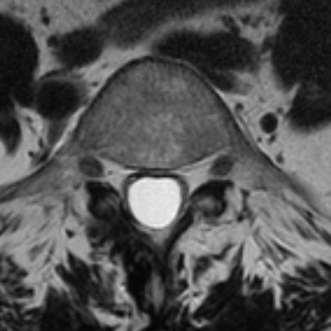
Pseudocord sign
Empty thecal sac sign

Slide 22
TREATMENT
Syringomyelia is often difficult to manage, because patients may remain asymptomatic for several years even with significant syringes.
Surgical treatment is generally deferred until the patient develops a progressive neurological decline or severe pain.
Surgical options for treatment of symptomatic syringomyelia include direct lysis of arachnoid adhesions with or without duraplasty and a variety of shunting procedures, including syringocavitary, syringosubarachnoid, and lumboperitoneal shunts.

Slide 23
Direct lysis of arachnoid adhesions with or without duraplasty
The primary goal of treatment is release of adhesions with duraplasty.
Better rates of reoperation and time to clinical recurrence compared to syrinx shunting
Because arachnoid lysis addresses the underlying disruption of CSF flow and expands the subarachnoid space rather than simply diverting CSF.
Caution should be used when undertaking lysis of arachnoid adhesions because overly aggressive arachnoid lysis in the setting of severe scarring may lead to neurological worsening.
Specially in patients with
post-infectious
post inflammatory arachnoiditis
in whom scarring tends to be sever, these may be best treated with CSF diversion procedures rather than arachnoid lysis.

Slide 24
CSF Diversion
A variety of CSF diversion procedures have been utilized in the treatment of syringomyelia, including syringocavitary, syringosubarachnoid, and lumboperitoneal shunts.
Syringocavitary
Higher rate of failure and recurrent symptoms.
Good short-term results following syringopleural shunting.
Complications
Neurological deterioration secondary to myelotomy.
Spinal cord tethering related to the shunt.
CSF over drainage.
Meningitis.
Pneumothorax.
Brachial plexus palsy.
Syringo-subarachnoid :
Advantage : suitable for patients not candidates for other surgical procedures.
Disadvantage : raised concerns of flow reversal in which pressure gradients may encourage flow of CSF from the subarachnoid space into the syrinx.

Slide 25
In posttraumatic syringomyelia, additional options include
Correction of deformity,
Spinal cord decompression,
In some cases, spinal cord transection.
The 1st 2 options are preferred over the 3rd because its :
Avoid intradural exposure
Avoid Postoperative arachnoid scarring
Often effective at minimizing the syrinx size.
In cases of foramen magnum obstruction or of spinal tethering as a result of a fatty filum
suboccipital decompression or filum terminale sectioning should be considered prior to consideration of any syrinx shunting procedure.

Slide 26
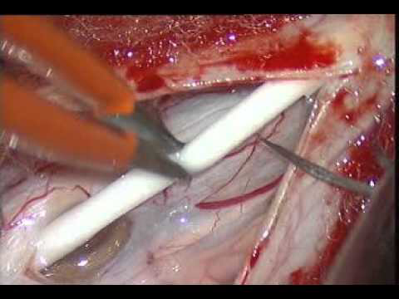

Slide 27
(A) Technique for placement of syringosubarachnoid shunt. A laminectomy is performed to allow access to the dura, which is opened in the midline.
(B) The pia is opened next, and pial sutures are placed and a midline myelotomy is performed to allow access to the syrinx.

Slide 28
(C) The shunt is then inserted in a caudal to cranial direction into the syrinx. The distal end is placed in the adjacent subarachnoid space.
(D) Following satisfactory placement and decompression of the syrinx, the dura is closed in a watertight fashion. For a syringopleural or syringoperitoneal shunt (not shown), the distal end is subcutaneously tunneled and placed in the pleural space or peritoneum, respectively.

Slide 30
Thank You

