Slide 1
Split Spinal Cord Youmans Chap. 231

Slide 2
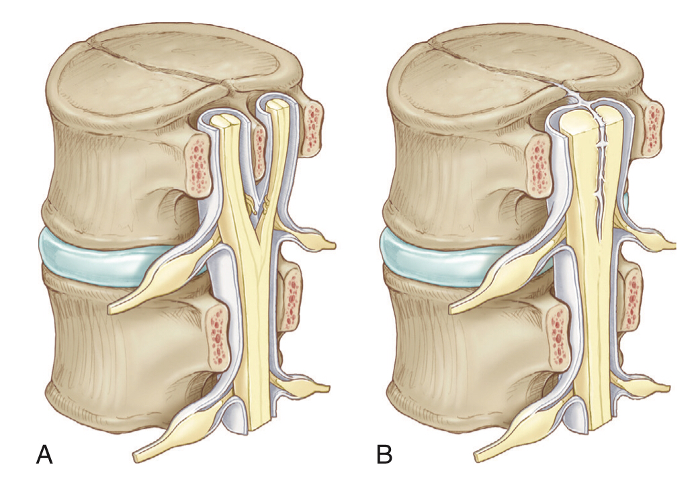
Type I malformations (Diastematomyelia) are characterized by a bony septum that cleaves the spinal canal in the sagittal plane and a duplicated thecal sac.
Type II malformations (Diplomyelia) are characterized by a cleft cord within a single dural sac, often tethered by a fibrous midline septum to the adjacent dura
Pathogenesis: adhesion between the ectoderm and endoderm leading to a persistent neurenteric canal.

Slide 3
EPIDEMIOLOGY OF SPLIT CORD MALFORMATIONS
Exceedingly rare, representing 3-5% of all congenital spinal anomalies.
Slight female preponderance.
The peak age at initial medical evaluation is 4 to 7 years, although there is a second peak between 12 and 16 years of age coinciding with the postpubescent growth spurt.
A delay in diagnosis until adulthood may be seen, with back pain being the sole complaint.
Type I occur more frequently than type II lesions.
SCMs rarely occur in the absence of associated anomalies.
The most common associations (in descending order) are
Tethered/low-lying cord >50%.
Kyphoscoliosis 50%.
Syringomyelia 50%
Other forms of spinal dysraphism such as thickened or fatty filum, dermoid cyst, dermal sinus tract, neurenteric cyst, and spinal lipoma

Slide 4
SCMs may occur in
5% of patients with congenital scoliosis.
15% of patients with myelomeningocele.
When SCM is association with myelomeningocele, it is three to four times more likely to be a type I malformation and tends to occur at or just rostral to the level of the myelomeningocele defect.
Diastematomyelia is most commonly encountered in the lumbar region, followed by thoracolumbar, thoracic, and cervical regions, and occurs over an average of six vertebral levels.

Slide 5
Embryogenesis
SCMs are thought to occur during the third week of embryogenesis.
Most theories posit two common prerequisites for the development of SCM:
1st is persistent adhesion of the ectoderm and endoderm (accessory neurenteric canal).
2nd is a cleft notochord, with subsequent induction of a cleft spinal cord.

Slide 6
Features of Split Cord Malformations
SCM Type | Anatomic Features | Radiographic Features | Location
I | Two hemicords in two dural sleeves separated by a midline bony spur. Hypertrophic laminae are often fused to adjacent levels. | Bony spur seen on CT. CT features of intersegmental fusion and adjacent spina bifida are virtually pathognomonic. MRI shows two hemicords in separate subarachnoid spaces. | Typically lumber
II | Two hemicords in a single dural sleeve. Hemicords are separated and tethered by a fibrous band attached to the dura. | Two hemicords seen within a single subarachnoid space on T2 MRI. High-resolution T2 MR or CT myelography may show fibrous septum attached to the dura. | May occur anywhere along the spinal axis

Slide 7
SIGNS AND SYMPTOMS
Patients with split cord may be asymptomatic, with only cutaneous marks (stigmata) of their spinal dysraphism.
Cutaneous markers are found caudal to the level of the neural defect.
The presence of hypertrichosis, is highly specific for SCM.
One characteristic variation of hypertrichosis, the “faun’s tail,” consists of a patch of unusually coarse, raised hair that is strongly associated with type I SCM.
There is typically a capillary hemangioma underlying these hairy patches.
Hemangiomas alone, without overlying hypertrichosis, may indicate the presence of an SCM in 7%.
True sacral dimples that are suggestive of underlying dysraphism should be distinguished from shallow, symmetric dimples over the coccygeal midline which is common in the general population and does not indicate the presence of distal tethering pathologic disease.

Slide 9
Majority of patients with SCM have one or more signs and symptoms of neurological deterioration.
Axial back pain is common and is typically focal and intense around the levels of the split cord.
Radicular component may be present in 10% of both adult and pediatric pts.
Progressive sensory or motor dysfunction (or both) is seen in 2/3 of patients.
50% of patients have gross (structural) asymmetry of the lower extremities (neuro-orthopedic syndrome) that is characterized by a triad of
Limb length discrepancy.
Muscular atrophy (resulting in secondary weakness).
Clubfoot deformity (talipes equinovarus).
The smaller limb is often ipsilateral to a smaller hemicord.
20% have an asymmetric neurological deficit despite structural symmetry of the limbs (which is highly associated with hydromyelia of one hemicord).
Autonomic dysfunction typically manifests as urologic signs and symptoms.
Associated Anomalies (present in approximately half of all patients)
scoliosis, tethered cord secondary to a thickened filum or terminal lipoma, myelomeningocele (with associated Chiari II malformation), and syringomyelia.

Slide 10
IMAGING
Screening antenatal ultrasonography can show extra echogenic foci in the spinal canal indicative of SCM as early as 14 weeks but may be affected by bony structures, fetal position, or amniotic fluid volume.
MRI
T1
The presence of two hemicords.
The cleft typically begins below T11, and the hemicords most often reunite after two to three vertebral segments.
Demonstrating the presence of an associated fatty filum, which may affect one or both hemicords, a dermal sinus tract, or a terminal lipoma.
T2
Discriminates between the presence of one or two subdural and subarachnoid spaces, allowing proper categorization of the malformation as type I (with an associated “owl sign”) or type II.
Demonstrate a hypointense fibrous band in type II SCM.
50% of patients demonstrate syringomyelia proximal to the cleft, which may extend into one or both hemicords.

Slide 15
CT
Best delineates the configuration of the osseous spur in type I.
Most spurs occur as a midline bony outgrowth of the posterior aspect of the vertebral body, although spurs with oblique orientation and spurs arising from the neural arch.
SCM is associated with bony anomalies in more than 85% of patients.
The more common bony segmentation defects include
Bifid vertebrae.
Bifid laminae.
Klippel-Feil malformation.
Butterfly vertebrae.
Hemivertebrae.
SCM is associated with scoliosis in 50% to 60% of patients.
Both tethering and congenital vertebral anomalies contribute to the formation and progression of scoliosis.

Slide 17
CT myelography
Superior to MRI in detecting the bony septum of type I SCM, bifid vertebrae, and hypertrophic neural arches.
Complex, hypertrophic neural arches are seen with type I malformations, presumably because of the presence of additional osteogenic meninx primitiva during development.
Hypertrophic arches are often fused to the lamina of an adjacent segment, a condition referred to as intersegmental laminar fusion.

Slide 18
SURGICAL MANAGEMENT
Surgical repair of SCM is often performed in conjunction with intraoperative electrophysiology.
Intraoperative fluoroscopy can be helpful in localizing the level of the SCM and defining any associated abnormal bony anatomy, especially because cutaneous stigmata may lie caudal to the actual level of the SCM.
The operation begins with bilateral paraspinous muscle exposure generally extending one to two levels above and below the SCM to allow dissection to extend from normal to abnormal anatomy.

Slide 19
For type I SCM
Bone work
The initial laminectomies should be limited to adjacent levels.
Perform bilateral paramedian laminectomies while preserving the midline lamina and spinous process and thus prevent disrupting the bony spur prematurely because the traversing midline septum is often fused with the undersurface of the lamina and the base of the spinous process.
Once the spur is isolated and exposed, blunt subperiosteal dissection may be performed to separate the dural sleeves from the spur bilaterally.
Dissection typically occurs in a rostral to caudal fashion (from the least adherent to the most adherent dura).
Once freed, the spur may be resected carefully.
All bone work should be completed before the dura is opened.

Slide 20
Detethering work
The dura is opened sharply in the midline above and below the lesion and on either side of the split at the level of the duplicated dural sleeves.
Sharp dissection can be used to free the hemicords from their medial attachments to the dural sleeves.
Once freed, the central dura can be sharply resected to the level of the posterior longitudinal ligament ventrally to restore the normal configuration of a single thecal sac.

Slide 21
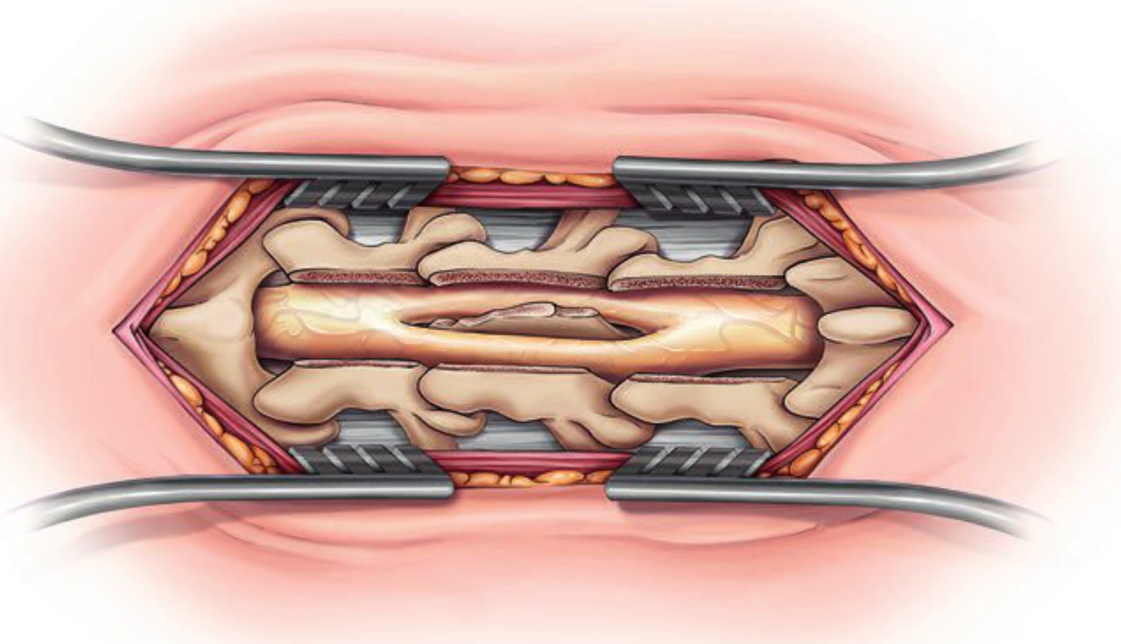
Laminectomy exposure demonstrates a bony spur splitting the spinal cord and its dural sleeves. The bony spur extends to the ventral surface of the canal.
Following laminectomies, the bony spur is left in place after its attachment to the posterior elements. Fibrous dural attachments to the bony spur are freed in a circumferential fashion.

Slide 22
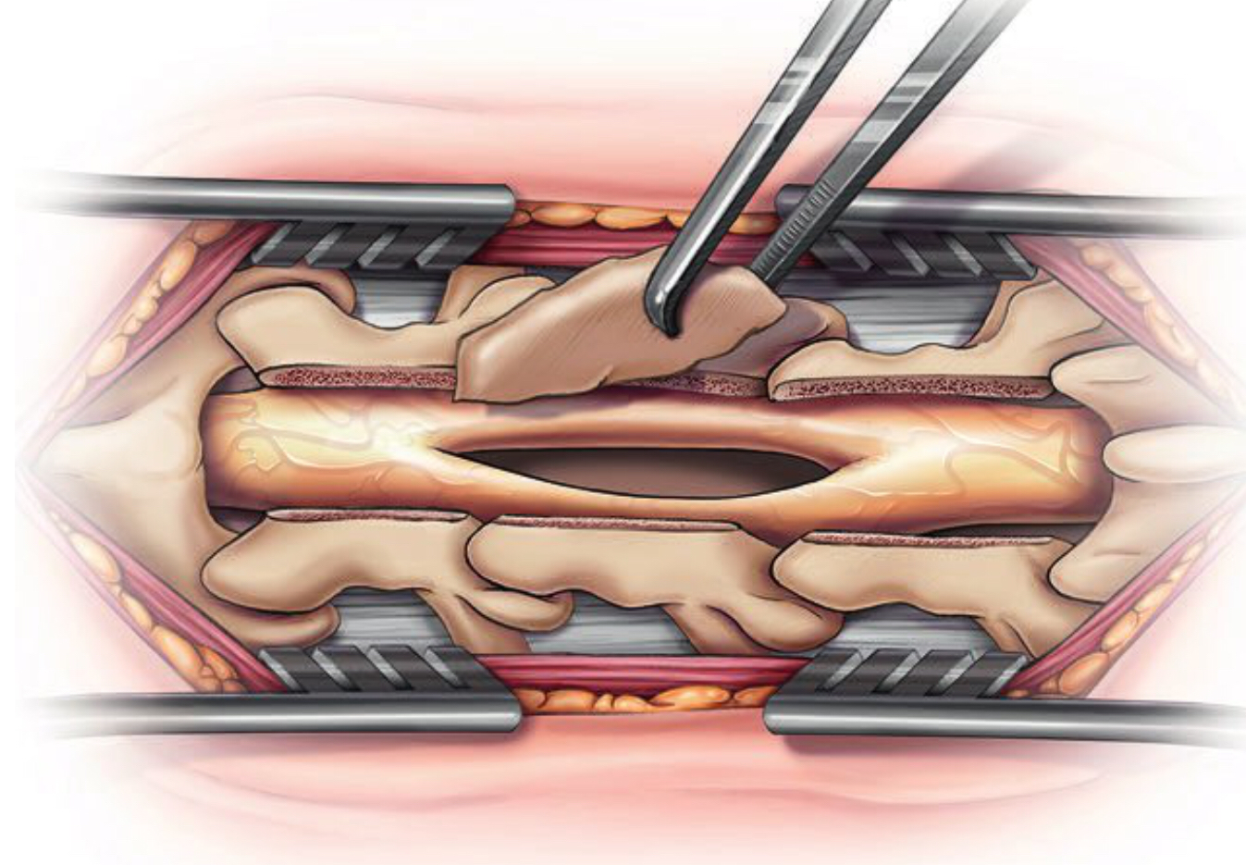
bony spur splits the dural sac in two. Blunt dissectors are used to carefully free the surrounding dural sac from the bony spur prior to its removal.
The bony spur may be removed by fracturing its base and removing it as a single unit.

Slide 23
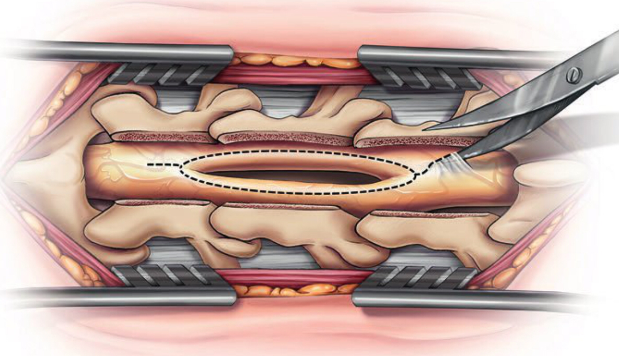
When the attachment is too wide and unable to be removed in a single piece, the bony spur may be removed using micro-drills and pituitary rongeurs to reach its ventral surface.
Following resection of the bony spur, the dural opening is performed.

Slide 24
After the dural sac has been completely opened, the medial dural sleeves need to be resected Flush with the ventral surface with the spinal canal. Often it is not necessary to repair the dural defect of the ventral surface because abundant adhesions to the bony elements preclude cerebrospinal Fluid leaks.

Slide 25
For type II SCM
Care should also be taken during removal of lamina at the level of the SCM in type II malformations because of the frequent presence of transdural adhesions.
A single midline dural opening traversing the fibrous bands at the level of the SCM should be made sharply.
These bands are most commonly attached to the dura dorsally but may also attach ventrally.
All nonneural and nonfunctional adhesive bands should be transected, beginning dorsally, and then with gentle rolling of the hemicords to one side to transect any ventral attachments.
The hemicords are typically closely approximated with no clear intervening plane.
Any associated tethering lesion (sinus tract, fatty filum, or terminal lipoma) should also be addressed.

Slide 26
Any additional tethering bands should also be transected so that both hemicords and the conus can move freely within the spinal canal.
Successful untethering often indirectly treats syringomyelia effectively.
Large, progressive, or recurrent syringes, however, may require direct surgical management.
One potential advantage of expansion duraplasty is that it discourages retethering.
Its prefered to keep patients in the prone position during this initial recovery to discourage adhesion of the spinal cord to the dural closure site.

Slide 27
Outcome
Axial back pain is improved in the majority of patients
Progressive sensory and motor deficits show the most pronounced improvement after surgical intervention.
Outcomes are most favorable in asymptomatic patients identified by cutaneous stigmata.
Complication
Transient urinary retention.
Cerebrospinal fluid leak.
Wound infection.
New sensory/motor deficit (Transient or Permanent).

Slide 28
Thank you

