Slide 1
Spinal cord stimulation Youmans Chap. 178

Slide 2
INDICATIONS
Failed back surgery syndrome
In whom the radicular leg symptoms are more severe than the component of axial back pain.
SCS proved more effective than repeat spine surgery.
Complex Regional Pain Syndrome (reflex sympathetic dystrophy).
Pain, dysfunction, and trophic changes occurring in an affected limb after trauma or surgery to that limb.
Ischemic Pain
May alter vascular tone and improve tissue perfusion.
MODERN-DAY LEAD TYPES
The contacts are composed of a nonferromagnetic alloy such as platinumiridium.
the insulating material is Silastic based in order to maintain flexibility and durability.

Slide 4
LAMINECTOMY VERSUS PERCUTANEOUS PLACEMENT
Better ratings of paresthesia coverage of pain as well as improved low back coverage with laminectomy-placed electrodes.
SURGICAL TECHNIQUE
Electrode Placement
Placement of epidural stimulation electrodes may be accomplished in a number of ways.
the electrode may be placed percutaneously through a Tuohy needle, with the leads connected to external generator that may be either external (temporary) or implanted.
a single-level laminectomy may be performed for placement of a paddle-style electrode.
A trial of stimulation prior to permanent implantation is usually performed to ensure that the effects of spinal cord stimulation are therapeutic. This trial involves an initial lead placement with connection to an external generator, allowing for evaluation of the treatment for several days. The electrodes may then be used permanently or changed at that time.

Slide 5
Determination of the spinal level for electrode insertion and placement is key to successful stimulation.
A practical rule of thumb is to insert the electrode at
T2-T3 or T3-T4 for upper extremity pathology.
L1-L2 or L2-L3 for lower extremity targets.
Needle-type electrodes have more flexibility, in that they may be advanced a number of levels cranially through the epidural space to ensure the best stimulation coverage.
Paddle-type electrodes may generally be placed only one to two levels cranial to the location of the laminectomy.
Common target levels for lower extremity coverage range from T8 through T12, spanning the lumbar enlargement of the cord.
Common levels for upper extremity symptoms range from C3 to C6, covering the cervical enlargement.
Posterior column stimulation evokes tingling paresthesias targeted to overlay the area of pain.

Slide 6
Generator Placement
Two common locations are the lower quadrant of the abdomen and the buttock.
Its advocate to place a generator in the region of the buttock, because it is more convenient surgically and is cosmetically acceptable to most patients, but the disadvantage :
Increases the strain on the leads,
Raising the propensity for lead migration or fracture.
Complications
May be divided into two categories: technical and biologic.
Technical complications relate to both the implantation technique and long-term durability of the hardware.
Electrode migration (Percutaneously placed electrodes are more susceptible to migration than paddle electrodes).
Paralysis has been reported rarely, usually in relation to the development of epidural abscess.

Slide 7
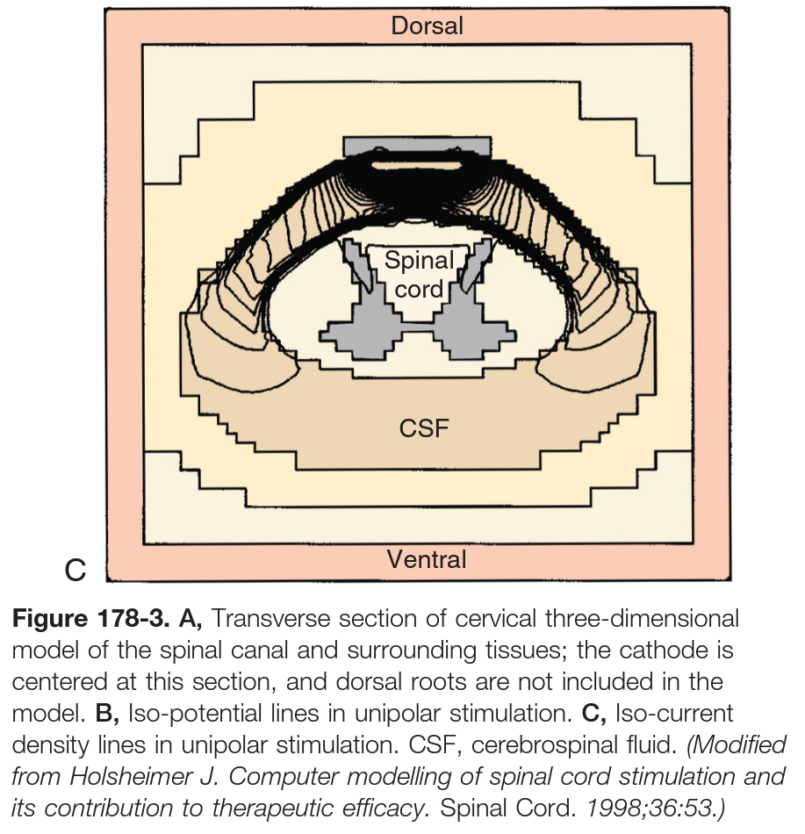

Slide 8
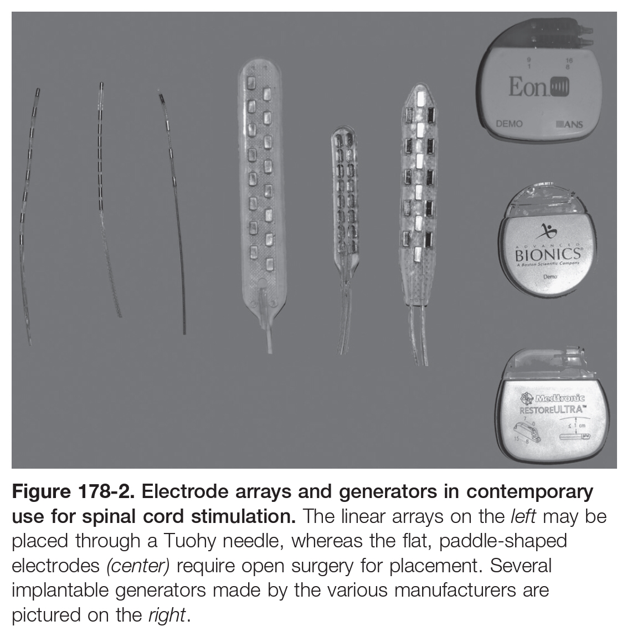
Compatibility with Magnetic Resonance Imaging
A new generation of radiofrequency shielded stimulator leads has been introduced, promising to allow whole-body MRI.

Slide 9
Handbook 9
Complications
Lead migration: More common in percutaneous and cervical stimulators.
Lead breakage.
Infection.
Hardware malfunction.
Unwanted stimulation.
Less common complications: CSF leak, radicular pain, intermittent interference with cardiac pacemaker, and neurologic deficit.

