Slide 1
Skull Lesions in Children
Dermoids
Langerhans Cell Histiocytosis
Fibrous Dysplasia
Lipomas
Youman Chap. 219

Slide 2
INCLUSION CYSTS
Immobile and rubbery lesions.
50% to 60% of all scalp and skull lesions found in pediatric patients .
Classified as either dermoid or epidermoid
Involve the calvarial bone especially the outer table and some cases the inner table is eroded and the outer leaf of the dura is involved.
Dermoid lesions are more common than epidermoid lesions.
Dermoid mostly midline covered by the anterior and posterior fontanelles.
Epidermoid more laterally at suture sites between the pterion and the asterion, along the squamosal suture.
Epidermoid composed of only keratin producing epithelial cells and are characterized by cystic contents with white, cheesy keratin debris.
Surgical management
  the cyst should be excised without being ruptured.
  Sharp and scalloped bony margins should be smoothed with a drill, curette.
  Incomplete removal of these lesions may result in recurrence.

Slide 3
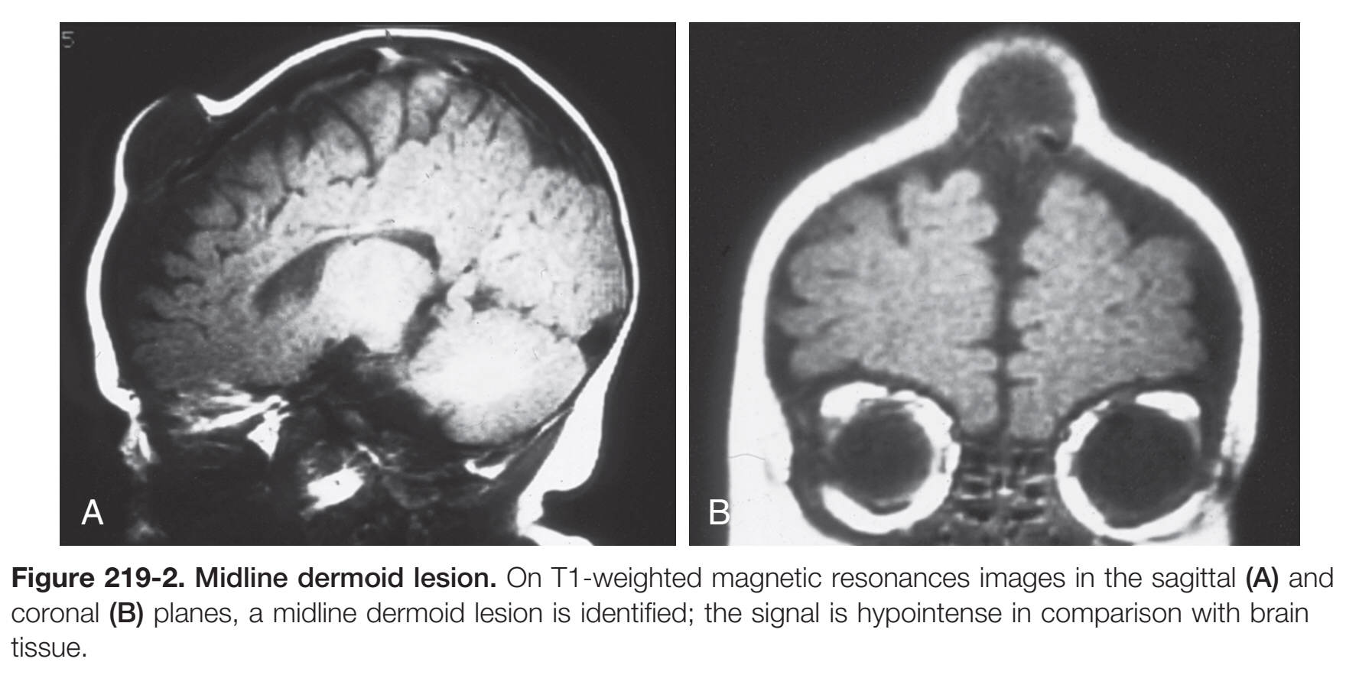

Slide 4
LANGERHANS CELL HISTIOCYTOSIS
Known as eosinophilic granuloma or histocytosis X, Hand-Schüller-Christian disease
7% to 10% of all skull lesions.
May be a solitary lesion classically referred to as an eosinophilic granuloma, or multiple lesions, especially in children younger than 2 years.
Systemic manifestations
  skin lesions, pulmonary infiltrates,
  hepatosplenomegaly, pancytopenia, and lymphadenopathy.
In an intermediate chronic form
  Calvarial: Pain, scalp mass, bony defect
  Mastoid destruction: Pain, chronic otitis externa, retroauricular scalp mass.
  Retroorbital mass: Exophthalmos, ± painful ophthalmoplegia
  Pituitary infundibular involvement: Central DI, ± visual disturbance, ± hypothalamic dysfunction
  Child < 2 years with diabetes insipidus, ± lytic calvarial lesion

Slide 5
Skull XR show an osteolytic, accompanied by a hyperostotic or sclerotic rim .
CT
  Lytic defect, "beveled" edge (inner table > outer table)
  It can have a hemorrhagic core that is hyperdense on noncontrast images.
Best diagnostic clue
  Calvaria: Sharply marginated lytic skull defect with beveled margins
  Skull base (mastoid most common): Geographic destruction ± soft tissue mass
  Brain: Thick enhancing infundibulum, absent posterior pituitary bright spot on T1WI.
  Despite occasional location over the venous sinuses, vascular invasion is not seen.
Management
  Wide surgical resection to normal bone margins .
  The skull lesions can usually be safely removed by curettage.
  Persistence or recurrence necessitate further treatment, chemo or radio therapy.

Slide 6
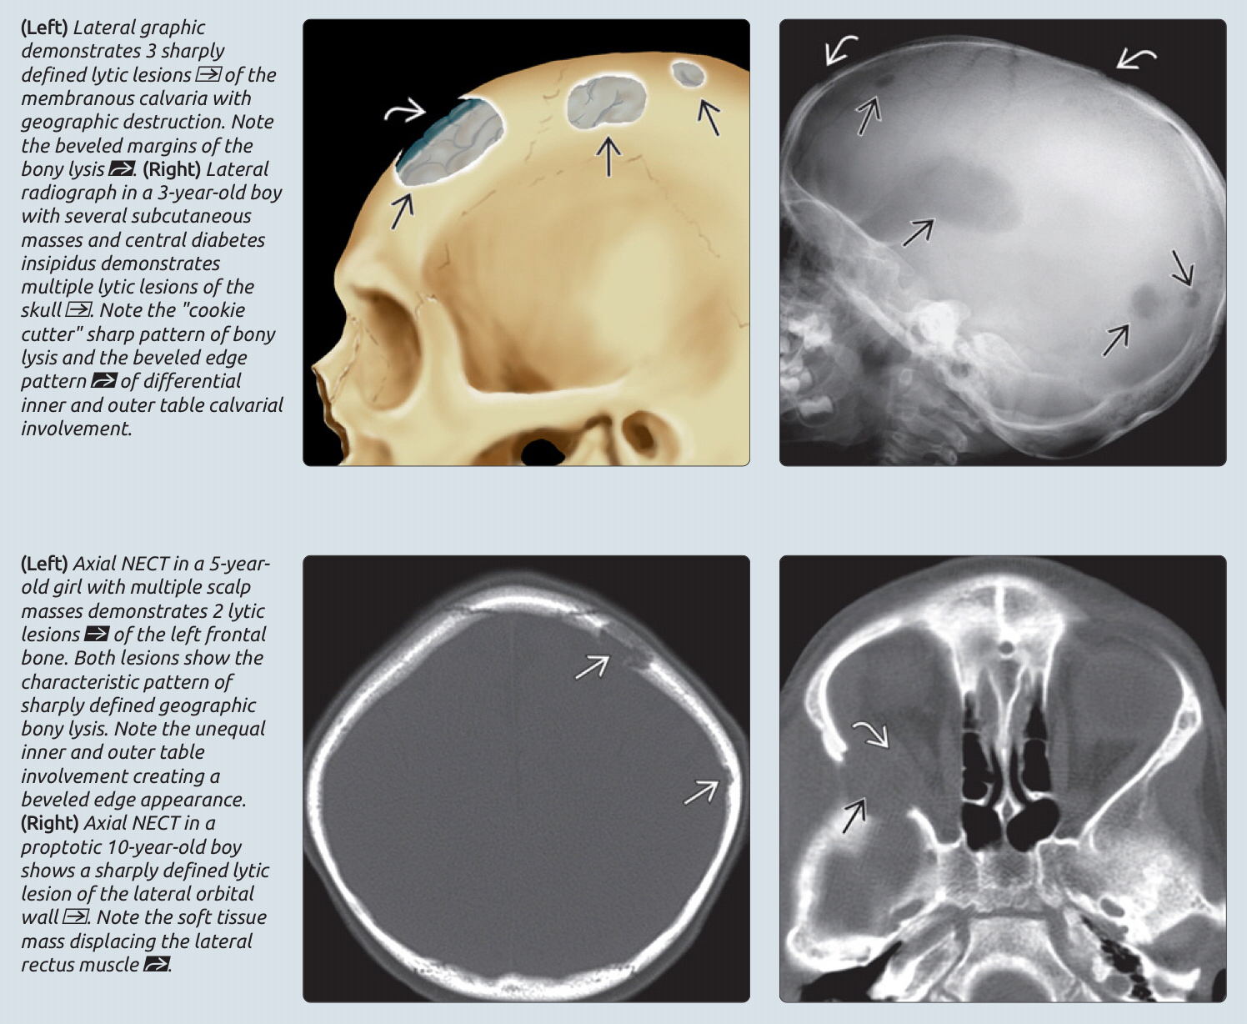

Slide 7
Langerhans cell histiocytosis.
Plain skull radiograph showing the punched-out appearance of Langerhans cell histiocytosis and the margins lacking in sclerosis.
This is further evident CT, greater involvement of the outer table than the inner table

Slide 8
FIBROUS DYSPLASIA
Benign skeletal lesion of immature mesenchymal cells, typically involves the long bones, ribs, and skull.
Clinically significant bone lesions are detectable by age 10 years.
Formed when cancellous bone is replaced with fibrous, cellular tissue and when collagen is deposited with immature woven bone
The genetic mutation on chromosome 20q.
Ethmoid bones most common involved, followed by the sphenoid, frontal bones ,maxilla ,temporal bones ,parietal bones ,and occipital bone.
Craniofacial standpoint, orbital apical involvement is not uncommon and most often consists of proptosis, dystonia, and distorted facies.
Optic nerve encasement is common, blindness is more infrequent.
It is generally agreed that optic nerves that demonstrate signs of compression should be decompressed circumferentially;
Growth hormone excess seems to be a risk factor for both nerve encasement and visual loss.

Slide 9
The presence of 2 of these 3 criteria confirms the clinical diagnosis McCune-Albright syndrome, is characterized by
Polyostotic fibrous dysplasia.
Endocrinopathy (particularly precocious puberty).
Café au lait spots.
Evident on thin-cut CT and displays a classic ground-glass appearance.
Management
  Goals of surgery include decompression of any neurological structures and cosmesis.
  optic nerve encasement is common.demonstrate signs of compression should be decompressed.

Slide 10
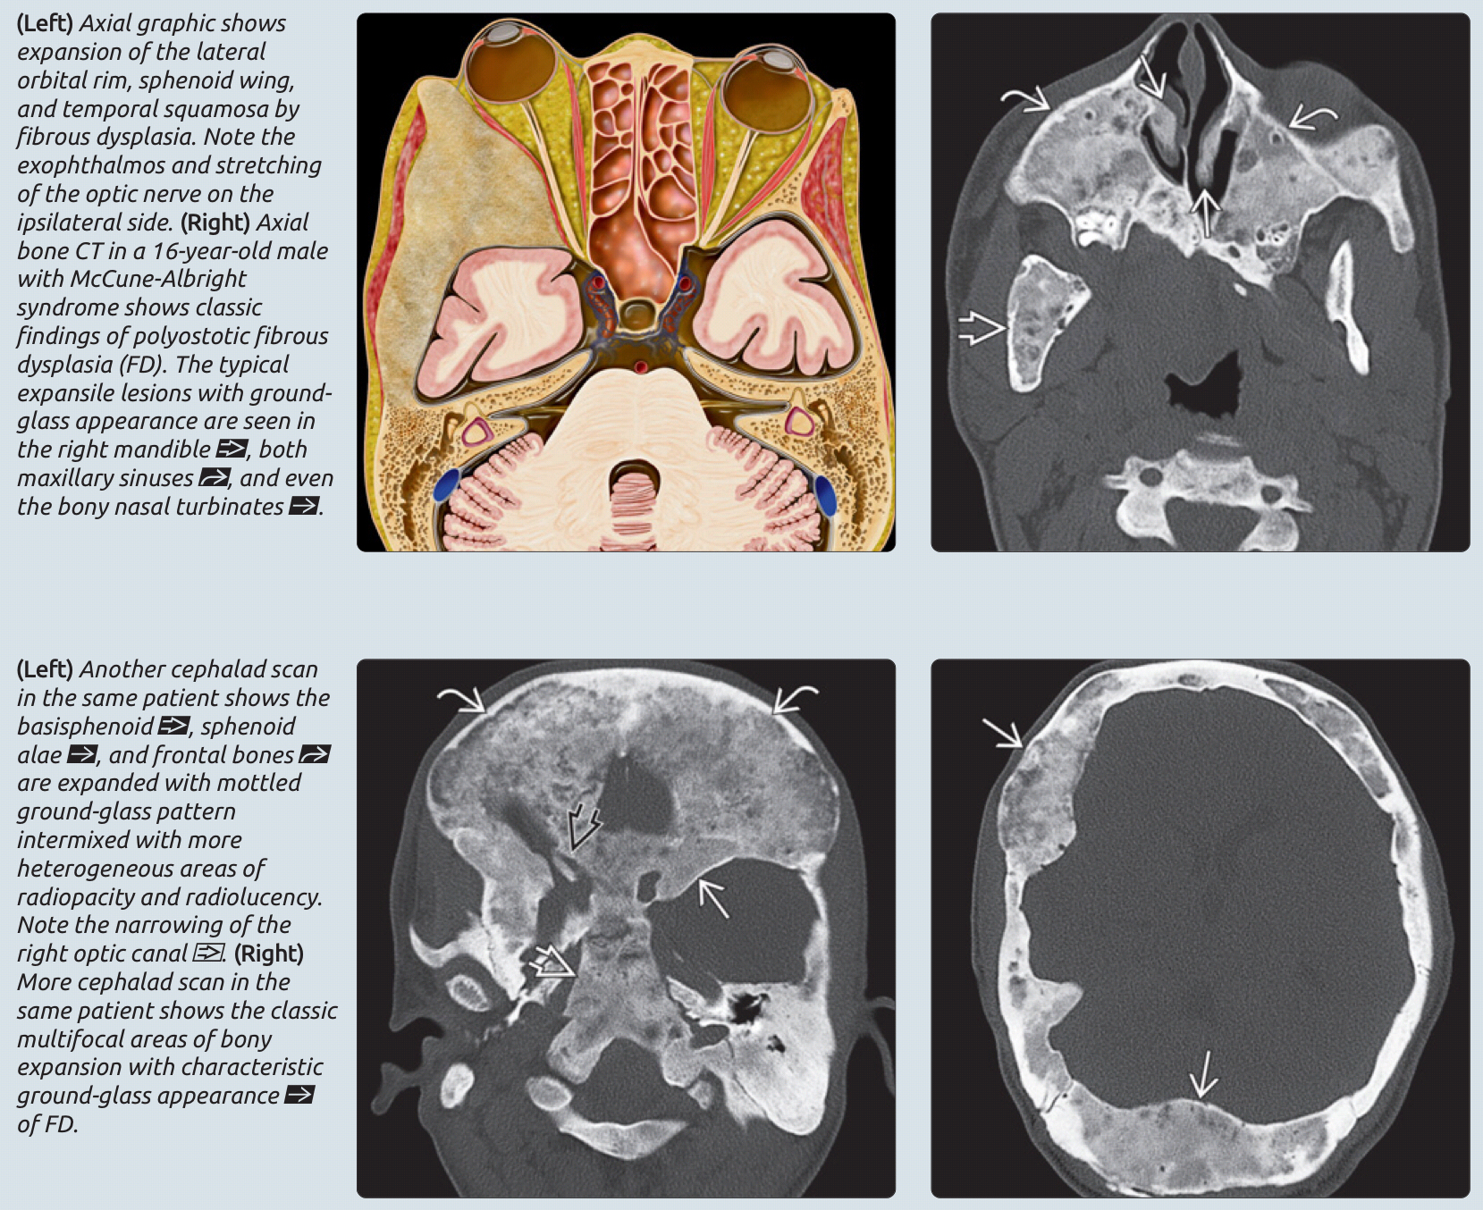

Slide 11
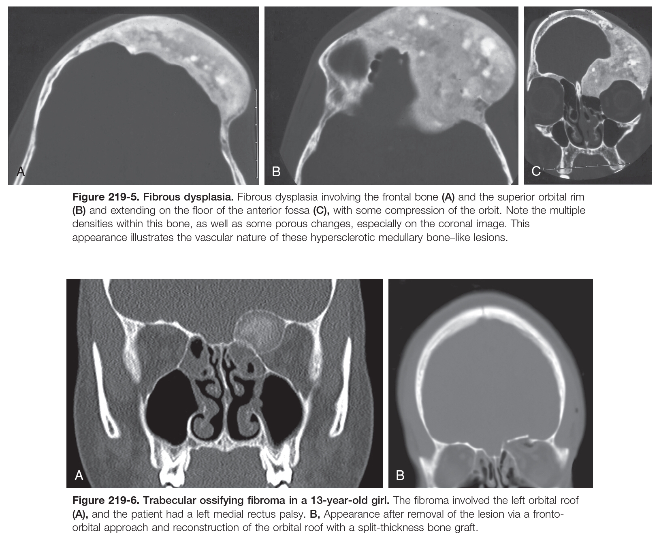

Slide 12
OSSIFYING FIBROMAS
Benign lesions ,usually occur in the first two decades of life.
Most commonly in the facial bones but can also occur in the cranium.
The tumors come in two varieties: trabecular and psammomatoid.
The psammomatoid variant can be aggressive.
Radiologically varied, from fluid-filled cysts to a ground-glass appearance that can be confused with fibrous dysplasia.
Ossifying fibromas appear more contained and surrounded by a fibrous capsule in comparison with fibrous dysplasia.
Should be removed surgically with curettage or drill.

Slide 13
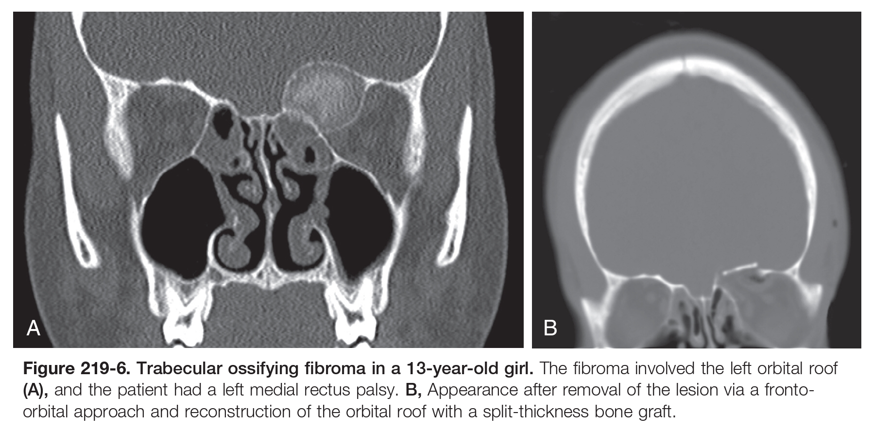
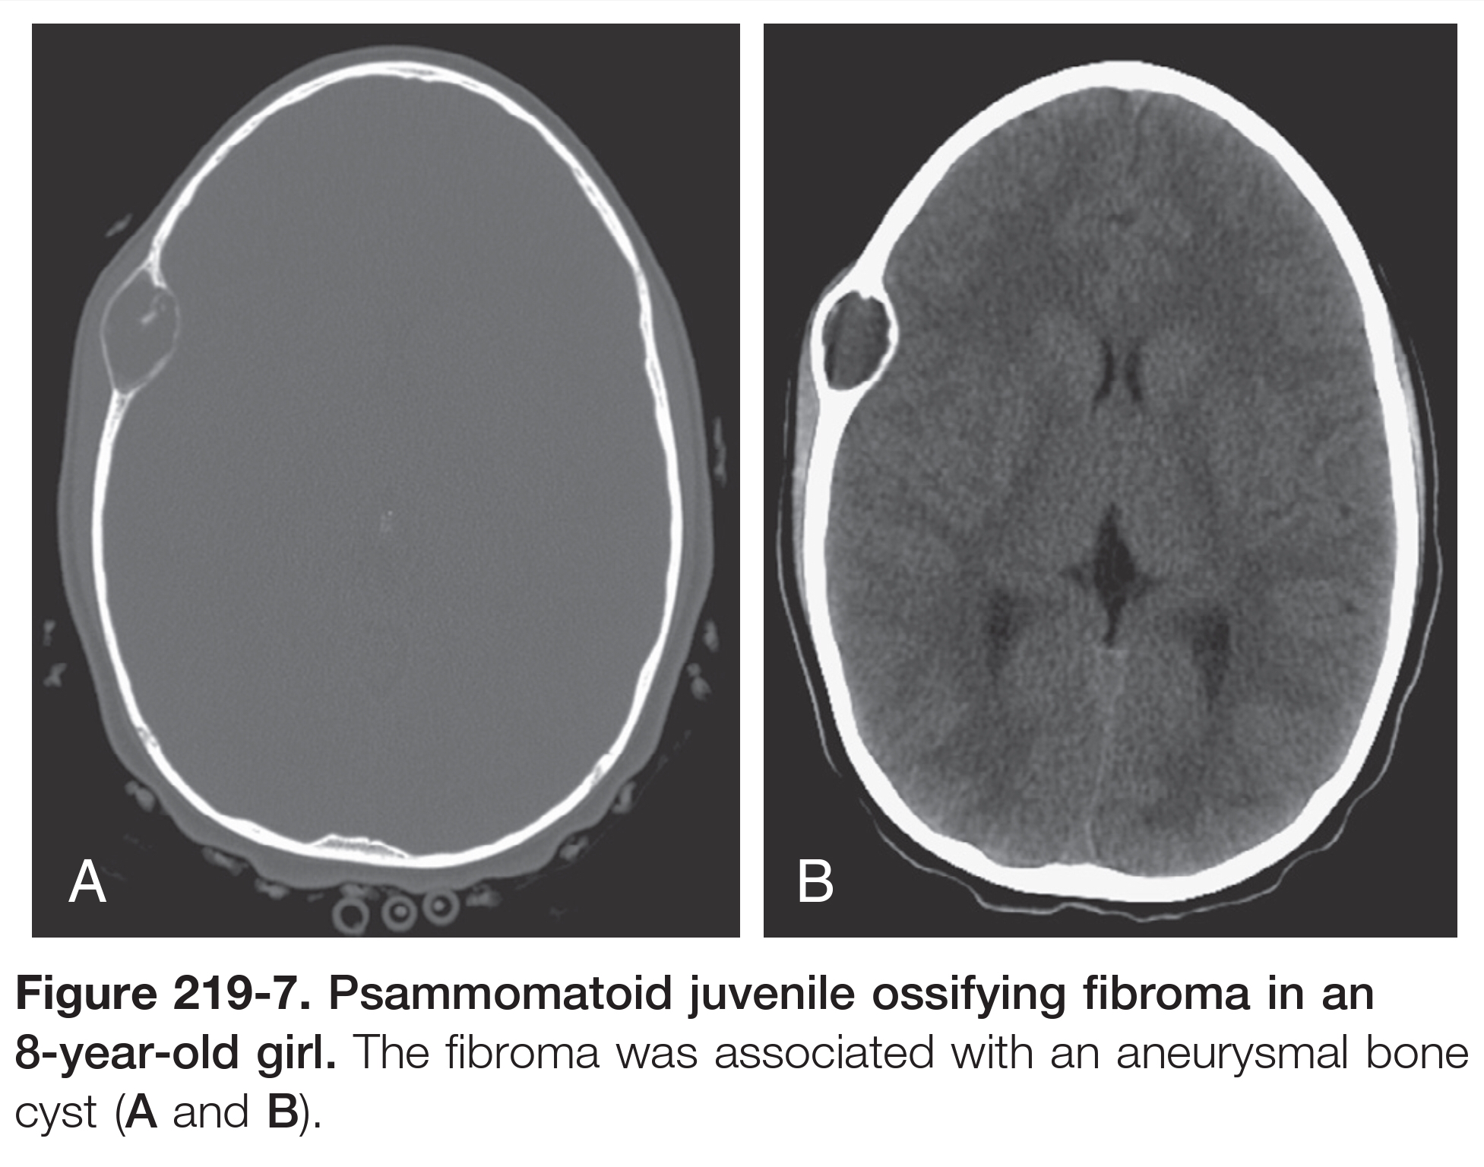

Slide 14
INTRAOSSEOUS LIPOMAS OF THE SKULL
Indolent, benign lesions of mesenchymal origin .
Rare bony tumors.
Predominantly to the frontoparietal region, the sphenoid, and the sphenoclival region.
CT demonstrates trabecular resorption with bony expansion, regions of fat attenuation, hyperdensity secondary to fat necrosis and calcification.
The MRI Low T1 and T2 signals correspond to peripheral sclerosis and central calcification.
Resection is not indicated if the purpose is not cosmesis.

Slide 15
