Slide 1
Sacral nerve stimulation

Slide 2
WHAT IS NEUROMODULATION?
Neuromodulation: Is the physiologic principle that activity in one neural pathway modulates the pre-existing activity in another through synaptic interaction.

Slide 3
Anatomy
During the micturition process, different neural pathways are involved to ensure correct interaction between muscle contraction and relaxation.
Micturition includes two phases: urinary Filling (storage) and Emptying phase.
Filling (storage) phase :
Automatic action: brain signal detrusor muscle to relax to allow urine to fill bladder . once bladder fills to capacity bladder nerves signal fullness back to brain.
Conscious action: as bladder fills you become aware of fullness. the response is to void or wait for a opportunity to void.
Emptying phase:
Automatic action: voiding reflex occurs, nerves in spinal cord signal detrusor muscles to contact and internal sphincter to relax to allow urine to flow from bladder in to urethra.
Conscious action: once urine enters urethra, you consciously relax to external sphincter to allow urine to pass through the urethra.

Slide 4
Where are the bladder control centres?
There are three main centres:
Frontal lobe: anteromedial frontal lobe and corpus callosum, which are involved in conscious inhibition.
Nucleus locus coeruleus of the pons: synchronizes the detrusor muscle contraction with relaxation of the urethral sphincter. It regulates both sympathetic and parasympathetic responses.
Sacral centre: the reflex centre.

Slide 5
Describe the physiology of bladder control?
The lower urinary tract is innervated by three principal sets of peripheral nerves involving the parasympathetic, sympathetic, and somatic nervous systems from three major nerves, namely the pelvic, hypogastric and pudendal nerves, respectively.
Motor control Autonomic (involuntary)
Parasympathetic control: pelvic splanchnic nerves S2-S4
  regulate the emptying of the urinary bladder,
  control opening and closing of the internal urethral sphincter.
Sympathetic control: inferior hypogastric plexus T12-L2
  causes the bladder to increase its capacity without increasing detrusor resting pressure (accommodation)
  stimulates the internal urinary sphincter to remain tightly closed.

Slide 6
Somatic control (voluntary) Control: Pudendal nerve S2_S4
  Originates from the frontal lobe and descends along the pyramidal tract into the pudendal nerve S2_S4 to innervate the external sphincters.
Sensory control:
  Bladder distension is detected by sensory stretch receptors on the muscle wall.
  An action potential is generated along the first order sensory neurons, which travel along the autonomic fibres (via pelvic, hypogastric and pudendal nerves) to the conus medullaris and then ascend primarily in the spinothalamic tract.

Slide 7
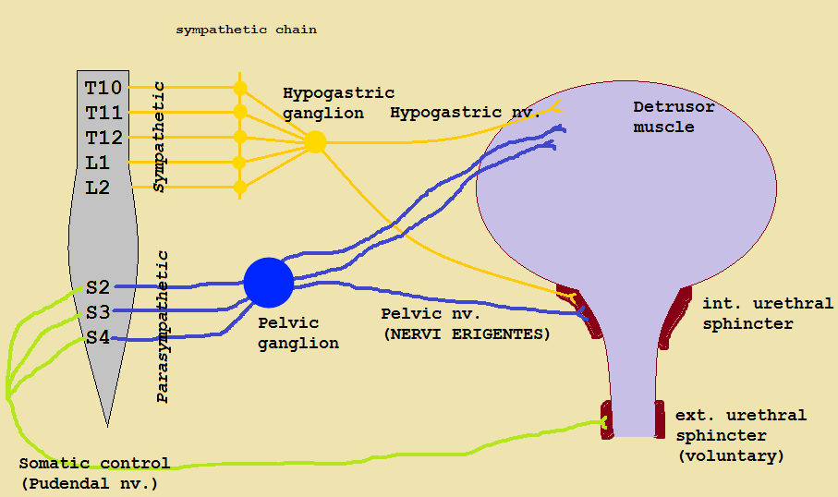

Slide 8
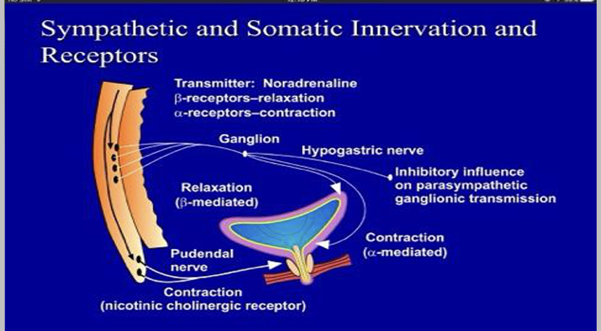

Slide 9
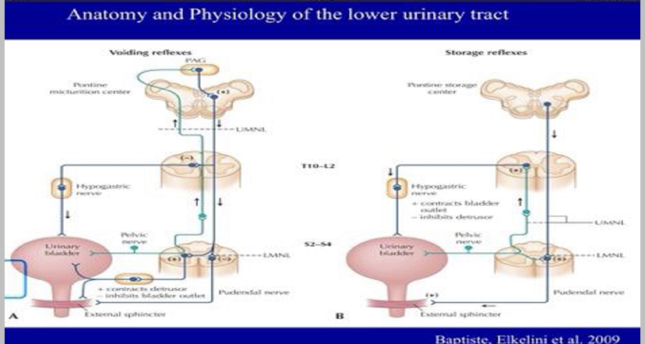

Slide 10
How does it work?
There are many theories about the mechanism of SNS:
Inhibits spinal tract neurons in the micturation reflex.
Inhibits interneurons involved in spinal segmental reflexes.
Inhibits postganglionic neurons directly.
Inhibits primary afferent pathway.
Indirectly suppresses guarding reflexes.

Slide 11
Indication of SNS include:
Overactive Bladder. (Frequent feeling of needing to void)
  Wet: Urgency urinary incontinence – is characterized by symptoms of frequency, urgency and urge incontinence (either alone or in combination)
  Dry: Urgency Frequency Syndrome - is characterized by symptoms of frequency and urgency without incontinence episode
Neuognic disorder e.g MS, SCI. (Incontinence)
Intestitial cystitis and pelvic pain.
Nonobstructive urinary retention – Inability to relax urethra/pelvic floor
  Pelvic floor muscle dysfunction.
Failed or intolerance to medical treatment.
  medications or biofeedback
  catheterization (retention)
  external electrical-stimulation

Slide 12
Patients selection:
Inclusion criteria for OAB:
Urodynamic study that manifest of lower urinary tract dysfunction.
Ultrasonography of lower urinary tract dysfunction.
Male or female and 18 years of age or older.
Failed in conservative treatment (e.g. pelvic floor training, biofeedback, behavioral modification).
Failed medical treatment to control symptoms.
Patients could not tolerate medication because the side effect.
On current regimen of medications, for at least 4 weeks prior to beginning the baseline voiding diary.

Slide 13
Contraindication:
Concomitant medical conditions.
Skin, orthopedic or neurologic anatomical limitations that could prevent successful placement of an electrode.
Neurological diseases such as multiple sclerosis, clinically significant peripheral neuropathy.
Knowledge of planned MRIs, diathermy, microwave exposure, high output ultrasonic exposure, or RF energy exposure.
Urinary tract mechanical obstruction such as benign prostatic hypertrophy, cancer, or urethral stricture.
Symptomatic urinary tract infection.
Implantable neurostimulators, pacemakers.

Slide 14
Surgical procedure
Stage I (placement of temporary device)
Under local anesthesia or with IV sedation according to the patient's condition.
The patient is placed in the prone position.
A surgical transparent film is used in addition to the standard surgical draping to reduce risk of bacterial contamination from the nearby anus, while providing vision to the motor responses of the anus.
The hallux is also positioned so that plantar flexion can be observed.
The coccyx is marked and using a ruler, a line is drawn 9 cm cephalad starting from the coccygeal tip. A horizontal line extends 2 cm on either side of the midline. This represents where the S3 foramina should be located.
A special needle is introduced into the S3 foramina bilaterally under fluoroscopy for assisting in localization the S3 foramina.
Each foramen needle is stimulated separately, noting which needle provides better response (contraction of the levator ani muscles and planter flexion)

Slide 15
Once appropriate placement of the foramen needle is confirmed
  A wire is fed through the needle.
  The foramen needle is removed
  the wires are carefully taped to the patient's back.
  The wires are connected to an external stimulator.
The patient is observed in the ward with systemic antibiotics (ceftriaxone vial 1gm IV bid) and pain medication.
The patient is discharged on the following day with antibiotics and pain medication.
First visit
Two weeks following Stage I procedure, the patients attended the Neuro-urology unit to assess their condition and results.
If the patient's symptoms improve by > 50%, we considered him a candidate to undergo Stage II (permanent device).
If the patient's symptoms fail to adequately improve, the temporary wires were removed and the treatment plan is reevaluated.

Slide 16
Stage II (permanent device)
After favorable patient response stage I, subcutaneous tunneling of the electrodes into the device for which a pocket was created above and posterior to the Iliac Crest.
Similar antibiotic and analgesia were given to the patient until removal of stiches.
For both stages Current applied was 0.5 to 5 mA at 15 pulse\sec.
Motor response during surgery had shown a better predictive value than sensory response.

Slide 17
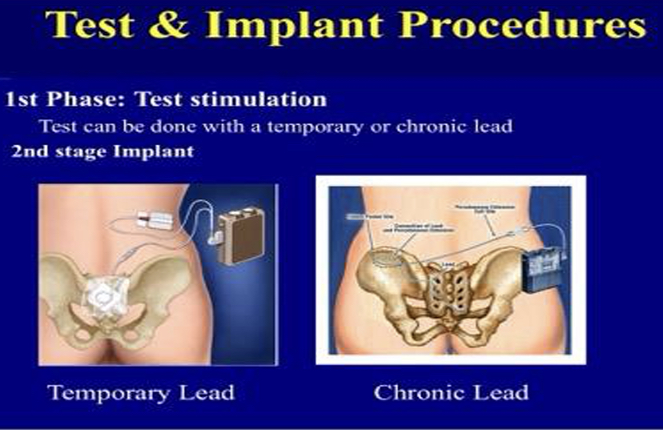

Slide 18
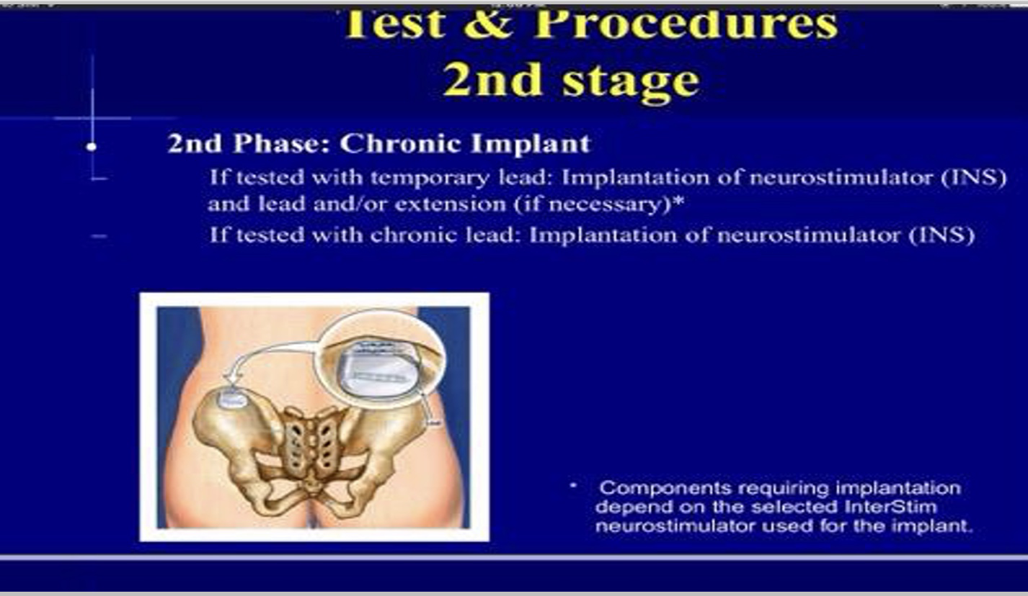

Slide 19
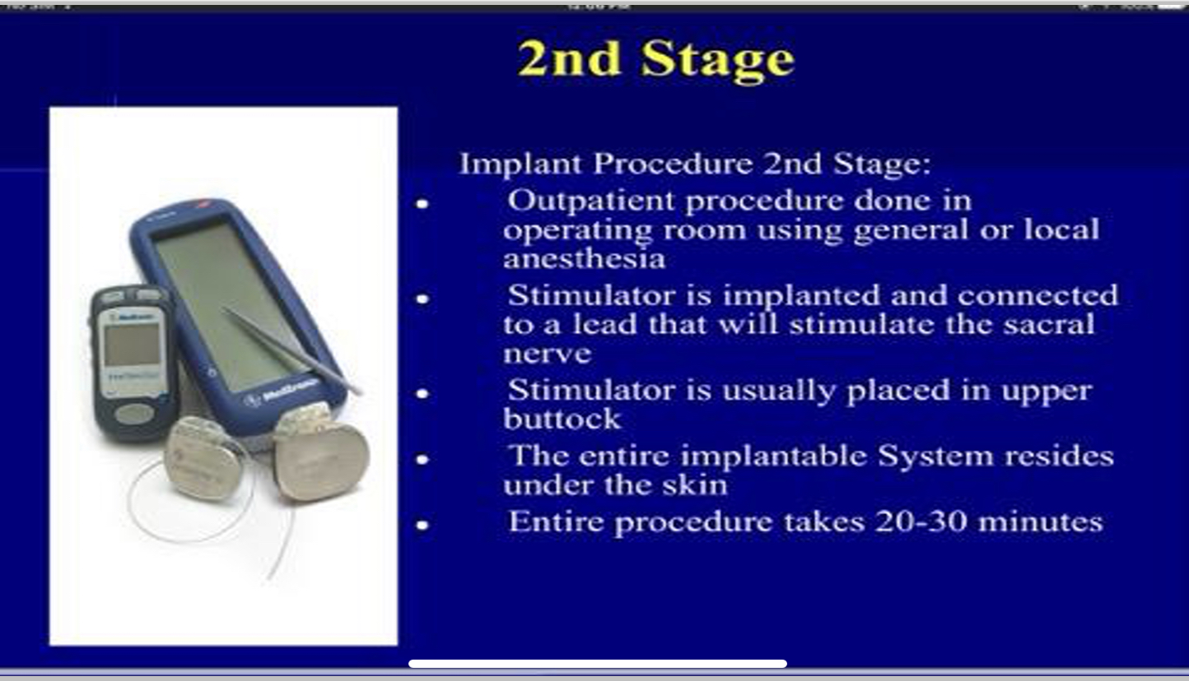

Slide 20
COMPLICATIONS:
Lead migration.
Pain at neurostimulator site and at lead site.
Infection in their implanted system.
Transient electric shock.
Adverse change in bowel function(3.0%).
Less frequent events like technical problems, device problems, change in menstrual cycle, and others.

