Slide 1
Pain management
Youmans Chap. 166

Slide 2
Definition | Term
An unpleasant sensory and emotional experience associated with actual or potential tissue damage, or described in terms of such damage | Pain
A high-threshold sensory receptor of the peripheral somatosensory nervous system that is capable of transducing and encoding noxious stimuli | Nociceptor
Increased pain from a stimulus that normally provokes pain | Hyperalgesia
Pain caused by a lesion or disease of the somatosensory nervous system | Neuropathic pain
Pain due to a stimulus that does not normally provoke pain | Allodynia
Increased responsiveness of nociceptive neurons to their normal input, and/or recruitment of a response to normally subthreshold inputs | Sensitization

Slide 3
Pain
Pain is the unpleasant physical and emotional experience associated with tissue damage, whether impending or actual and involves sensations transmitted from the periphery to the central nervous system for processing and perception.
Nociceptors :
Specialized sensory receptors responsible for the detection of noxious (unpleasant) stimuli, transforming the stimuli into electrical signals, which are then conducted to the central nervous system.
Distributed throughout the body (skin, viscera, muscles, joints, meninges) they can be stimulated by mechanical, thermal or chemical stimuli.
Inflammatory mediators (eg bradykinin, serotonin, prostaglandins, cytokines ,and H+) are released from damaged tissue and can stimulate nociceptors directly. This process is called primary sensitization.

Slide 4
Primary afferents neurons that respond to low intensity touch stimulation
C fiber | A delta fiber | A beta fiber
Smallest <2µm | Small 2-5µm | Large | Diameter
Unmyelinated | Thinly | Highly | Myelination
< 2ms | 5-15ms | > 40 ms | Conduction velocity
High | High and low | Low | Receptor activation thresholds
Slow, diffuse, dull pain | Rapid, sharp, localized pain | Light touch, non-noxious | Sensation on stimulation

Slide 5
Ascending tracts in the spinal cord
Primary afferent fibers In addition to the Aδ and C fibres that carry noxious sensory information, there are primary afferent Aβ fibres that carry non-noxious stimuli
Dorsal horn of the spinal cord Aδ and C fibres synapse with secondary afferent neurones in the dorsal horn of the spinal cord.
There are two main pathways that carry nociceptive signals to higher centres.
The spinothalamic tract: secondary afferent neurons decussate within a few segments of the level of entry into the spinal cord and ascend in the contralateral spinothalamic tract to nuclei within the thalamus. Third order neurons then ascend to terminate in the somatosensory cortex.
The spinoreticular tract: fibers also decussate and ascend the contralateral cord to reach the brainstem reticular formation, before projecting to the thalamus and hypothalamus. There are many further projections to the cortex. This pathway is involved in the emotional aspects of pain.

Slide 7
Classification of pain and characteristics
Nociceptive Pain is sharp (may be dull if not severe), correlated with injury, related to area injury or trauma, and varies widely between individuals.
Inflammatory Pain is aching, dull, stabbing, progressive (affected by activity), localized to the body part that inflamed or infected, variable and can affect functioning.
Neuropathic Pain is burning, shooting, squeezing, numb, insidious (usually progressive and possibly lasting for years), radiating both proximally and distally from the site of nerve damage, varies widely between individual.
Visceral pain is pain arising from the internal organs.
The viscera are largely innervated by C fibres. Visceral pain is typically diffuse and poorly localised,often described as deep, dull or dragging.
It can be associated with autonomic changes such as nausea, vomiting, and changes in heart rate or blood pressure.
It can also evoke strong emotional responses (usually intense and profound).

Slide 8
Approach to the patient with chronic pain
Obtaining a History
Physical and Neurological Examination
Pain History and Onset
Once an understanding of the current pain situation is established (including standard factors such as location, quality, radiation, duration, and exacerbating and alleviating factors) the pain may be analyzed in relation to the history.
Pain Characteristics
Pain Treatment History
Medical and Surgical History
Family History

Slide 9
Pharmacologic treatment of Pain
The main classes of treatment currently include:
Nonsteroidal anti-inflammatory drugs (NSAIDs)
Antidepressants
Ion channel blockers
Opioids

Slide 10
Nonsteroidal Anti-inflammatory Drugs
NSAIDs are a large group of medication that have antipyretic, analgesic, and anti-inflammatory effects.
They are divided into
Selective cyclooxygenase-2 (COX-2) inhibitors (diclofenac and ketorolac).
Nonselective cyclooxygenase (COX) inhibitors (aspirin, ibuprofen, and naproxen).
NSAIDS interfere with the inflammatory response to tissue damage and thus are best used for acute nociceptive, neuropathic, or inflammatory pain.
Nonselective COX inhibitors have more pronounced gastrointestinal side effects than do selective COX-2 inhibitors.
Some manufacturers have started combining NSAIDs with proton pump inhibitors or histamine blockers in an aim to offset these side effects.

Slide 11
Antidepressants
Three main classes:
Tricyclic antidepressants (TCAs).
Serotonin-norepinephrine reuptake inhibitors (SNRIs).
Selective serotonin reuptake inhibitors (SSRIs).
The analgesic effect has been found to be independent of the antidepressant effect and typically occurs at lower dosages than those required for antidepressant effect.
SSRIs (floxitine)
SSRIs are superior to placebo in the treatment of neuropathic pain and fibromyalgia, they are less effective than TCAs.
Side effects include nausea, vomiting, anorexia.
Unlike TCAs and SNRIs, SSRIs are not effective in the treatment of headache, low back pain, or rheumatoid arthritis.

Slide 12
TCAs
such as amitriptyline and nortriptyline have become the gold standard for treating
Neuropathic pain
Post herpetic neuralgia
Polyneuropathy
Central neuropathic pain caused by stroke
Spinal cord injury
Multiple sclerosis
Side effects to watch for include :
Sedation
Dry mouth
Blurred vision
Weight gain.

Slide 13
SNRI
Venlafaxine (an SNRI) is effective in treating neuropathic pain.
It is more tolerable and has fewer side effects.
Venlafaxine and other SNRIs have been found to be effective in:
Fibromyalgia
Poor sleep
Fatigue associated with fibromyalgia
There are no studies to support the use of SNRIs in low back pain.
The most common side effects experienced with SNRIs including nausea, vomiting.

Slide 14
Antiepileptics
Antiepileptics with varying mechanisms of action are commonly used for the treatment of neuropathic pain, work by blocking Calcium channel include
Levetiracetam
Gabapentin
Pregabalin
Zonisamide
Ziconotide
Levetiracetam
Effective in the treatment of neoplastic plexopathies, peripheral neuropathy, and postherpetic neuralgia and to be useful in migraine prophylaxis.
Most common side effects are fatigue, dry eyes, and dizziness.

Slide 15
Gabapentin and pregabalin.
Both medications are useful in the treatment of diabetic neuropathy, peripheral neuropathy after spinal cord injury, and postherpetic neuralgia.
Gabapentin has also been shown effective in the treatment of trigeminal neuralgia, HIV neuropathy, cancer-related neuropathy, multiple sclerosis, complex regional pain syndrome, Eagle’s syndrome, and glossopharyngeal neuralgia.
Pregabalin
tends to have a quicker onset of action,
patient may experience pain relief from the first doses.
It has been shown to be effective in treatment of
fibromyalgia,
facial neuropathic pain,
neuropathic pain refractory to gabapentin.

Slide 16
Antiepileptics that treat pain by sodium channel blockade include:
Lamotrigine.
Carbamazepine.
Oxcarbazepine.
Topiramate.
Lamotrigine works by blocking voltage-gated sodium channels, as well as suppressing calcium influx to the nerve terminal and therefore decreasing excitatory neurotransmitter release.
Used in the treatment of trigeminal neuralgia, peripheral nerve or spinal cord injury and HIV neuropathy.
Side effects, such as rash and Stevens-Johnson syndrome.

Slide 17
Opioids
The most well-known and controversial class of analgesic medications
They activate u receptors on the primary afferent nerves, dorsal horn neurons, and supra spinal pain centers.
U receptors are located on both sides of a synapse.
The most common opioids are :
Morphine
Codeine
Oxycodone
Hydrocodone
Fentanyl
Side effects include : Nausea and vomiting, Constipation , Sedation.

Slide 19
Types of pain procedures
Electrical stimulation: DBS, spinal cord stimulation.
Direct drug administration into the CNS:
Different routes: spinal, epidural or intrathecal, intraventricular.
Different agents: local anesthetics, narcotics.
Intracranial ablative procedures:
Cingulotomy.
Medial thalamotomy.
Stereotactic mesencephalotomy.
Spinal ablative surgical procedures
Cordotomy.
Cordectomy.
Commissural myelotomy.
Dorsal root entry zone lesion.
Dorsal rhizotomy.
Dorsal root ganglionectomy.
Sacral cordotomy.
Sympathectomy
Peripheral nerve procedure

Slide 21
Commissural myelotomy (Mediolongitudinal myelotomy)
Mechanism: Interrupts pain fibers crossing in the anterior commissure on their way to the lateral spinothalamic tract.
Indications
Bilateral or midline pain, primarily below the thoracic levels (including abdomen, pelvis, perineum and lower extremities).
Technique
Laminectomy must extend at least 3 levels above the highest dermatome involved in pain.
The dura is opened longitudinally to identify the midline sulcus.
The blade is inserted in the midline at the upper end of the desired incision and is then passed caudally for the length of the planned incision (3–4 cm).
Complications
Weakness in the lower extremities
Dysesthesias
Bladder dysfunction.
Sexual dysfunction may also occur.
Risk of injury to the anterior spinal artery (rare).

Slide 23
Open cervical cordotomy (Schwartz technique)
Indication
Both cancerous and noncancerous pain.
The ideal candidate is a cancer patient with unilateral somatic pain.
Extreme cases of frail patients with intractable noncancerous pain.
Contra indications
Bilateral pain
Axial pain
Pain above the dermatome of C5
Poor Pulmonary function test
Complications
Painful sensory loss (dysthesia)
Sleep apnea (Ondine’s curse): loss of automaticity of breathing due to Bilateral cervical cordotomies.
Worsening of bladder dysfunction
Mirror pain due either to a bilateral pain syndrome that is masked by marked severity on one side or to bilateral projection of dorsal roots in the both spinothalamic tracts.
CSF leak

Slide 24
Technique
Skin incision: midline from occiput to C3. Working only on the side contralateral to the pain.
To increase exposure, the inferior half of C1 and superior half of C2 lamina are removed with a punch.
Dural incision: open the dura in a linear incision from the lamina of C1 to C2 placed in the lateral third of the exposure.
A cordotomy knife placed at 5 mm, is inserted into the cord in an avascular area just anterior to the dentate ligament, sharp side down.
The anterolateral quadrant of the cord is cut with the following caveats:
do not go posterior to the dentate ligament (to avoid corticospinal tract)
do not cross the midline of the spinal cord
do not injure the anterior spinal artery
for patients with lower extremity pain, be sure to start exactly at the dentate ligament (to avoid missing lumbar and sacral fibers).

Slide 25
Percutaneous cervical cordotomy

Slide 27
Dorsal root entry zone (DREZ) lesions
Indications
Deaﬀerentation pain resulting from nerve root avulsion.
Spinal cord injuries (SCI).
Postherpetic neuralgia.
Postamputation phantom limb pain.

Slide 28
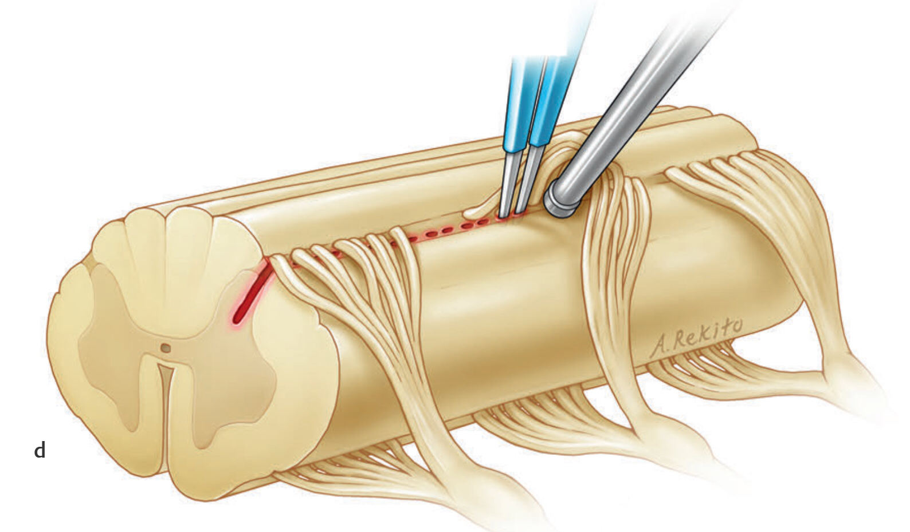
Operative procedure at the cervical level, on right side through right hemilaminectomy. Exposure for incision in dorsolateral (DL) sulcus.
Drawing at cervical level. displace the dorsal rootlets dorsally and medially. The rootlets are held with a specially designed ball-tip microsucker used as a hook to access the ventrolateral part of the DREZ and make incision with a micro knife.
Lesioning is performed by doing microcoagulations under direct magnified vision.

Slide 29
Sympathectomy
Indications
Cardiac sympathectomy (angina pectoris) Mx: removal T7 ganglia
Upper extremity sympathectomy
Upper thoracic sympathectomy
Lumbar sympathectomy
Indications for UE sympathectomy
Essential hyperhidrosis
Primary Raynaud’s disease
Shoulder-hand syndrome
complex regional pain syndrome consisting essentially of a painful 'frozen shoulder' with disability, swelling, vasomotor or dystrophic changes in the ipsilateral hand.
Intractable angina
Causalgia major
Procedure include Removal of only the 2nd thoracic ganglion to avoid Horner syndrome.
Removal of the L2 and L3 sympathetic ganglion is usually adequate to remove sympathetic tone from the lower extremities (occasionally L1 and sometimes T12 are also removed for causalgia of the thigh)

Slide 30
Thank you

