Slide 1
Myelomeningocele And Myelocystocele Youmans Chap. 229

Slide 2
Spinal dysraphism (spina bifida)
Spina bifida occulta: Congenital absence of a spinous process and variable amounts of lamina. No visible exposure of meninges or neural tissue.
Spina bifida cystica (Meningocele): Congenital defect in vertebral arches with cystic distension of meninges, but no abnormality of neural tissue. One third have some neurologic deficit.
Spina bifida aperta (Myelomeningocele): Congenital defect in vertebral arches with cystic dilatation of meninges and structural or functional abnormality of spinal cord or cauda equina.

Slide 3
Myelomeningoceles
are open neural tube defects, a consequence of incomplete closure of the neural tube during primary neurulation, resulting in a persistent neural placode with poor structural organization and resultant neurological impairment which need urgent repair.
Myelocystoceles
are closed neural tube defects resulting from errors in cellular differentiation during secondary neurulation.
Its composed of
a cystic trumpet-like dilation of the caudal central canal.
a surrounding meningocel , and a lipoma.
Not need urgent repair like Myelomeningocele .

Slide 4
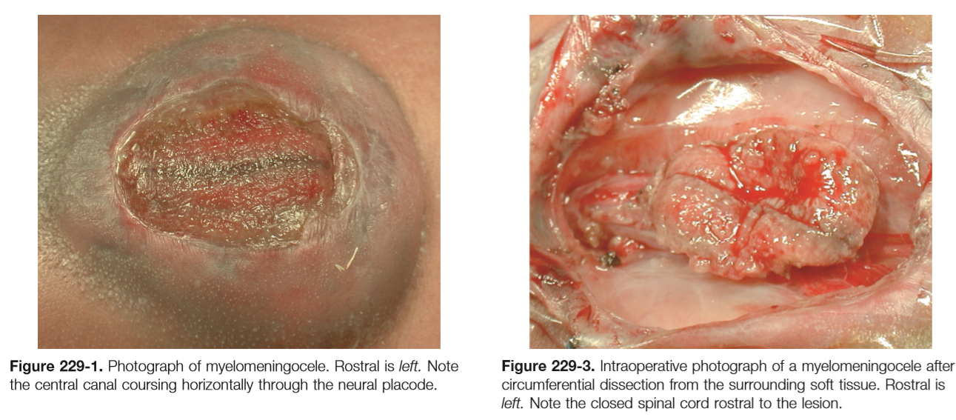

Slide 5
Myelomeningocele
Anatomy, Embryology, and Pathogenesis:
During normal neural development, primary neurulation occurs between days 18 and 27 of gestation. (First month)
Notocord —> spinal cord induced by infolding of the neural plate to form the neural tube.
Disruptions in this process result in a persistent neural plate, known as the neural placode.
The overlying mesodermal and ectodermal elements fail to form —> open spinal defect with poor structural organization —> neurological impairment of the lower extremities & bowel and bladder dysfunction.
The open neural placode has a groove in the center, which is the remnant of the central canal.
The spinal roots exit from the anterior surface of the placode, with the ventral roots lying medially and the dorsal roots laterally.
The dura fuses with the defect in the fascia laterally, The nerve roots exiting from the placode or caudal to the placode may include functional neural tissue.

Slide 6
MMC is almost uniformly associated with Chiari II malformation (95%) and other neurological abnormalities.
Brainstem abnormalities include
Medullary kinking.
Tectal beaking.
Intrinsic nuclei abnormalities.
Supratentorial abnormalities include
Partial or complete dysgenesis of the corpus callosum.
Polymicrogyria.
Large massa intermedia.
Gray matter heterotopia.
Associated skull defects seen include
Small posterior fossa.
Short clivus.
Low-lying tentorium and torcular Herophili.
Wide incisura.
Enlarged foramen magnum.
Craniolacunia (scalloping of the skull bones).

Slide 7
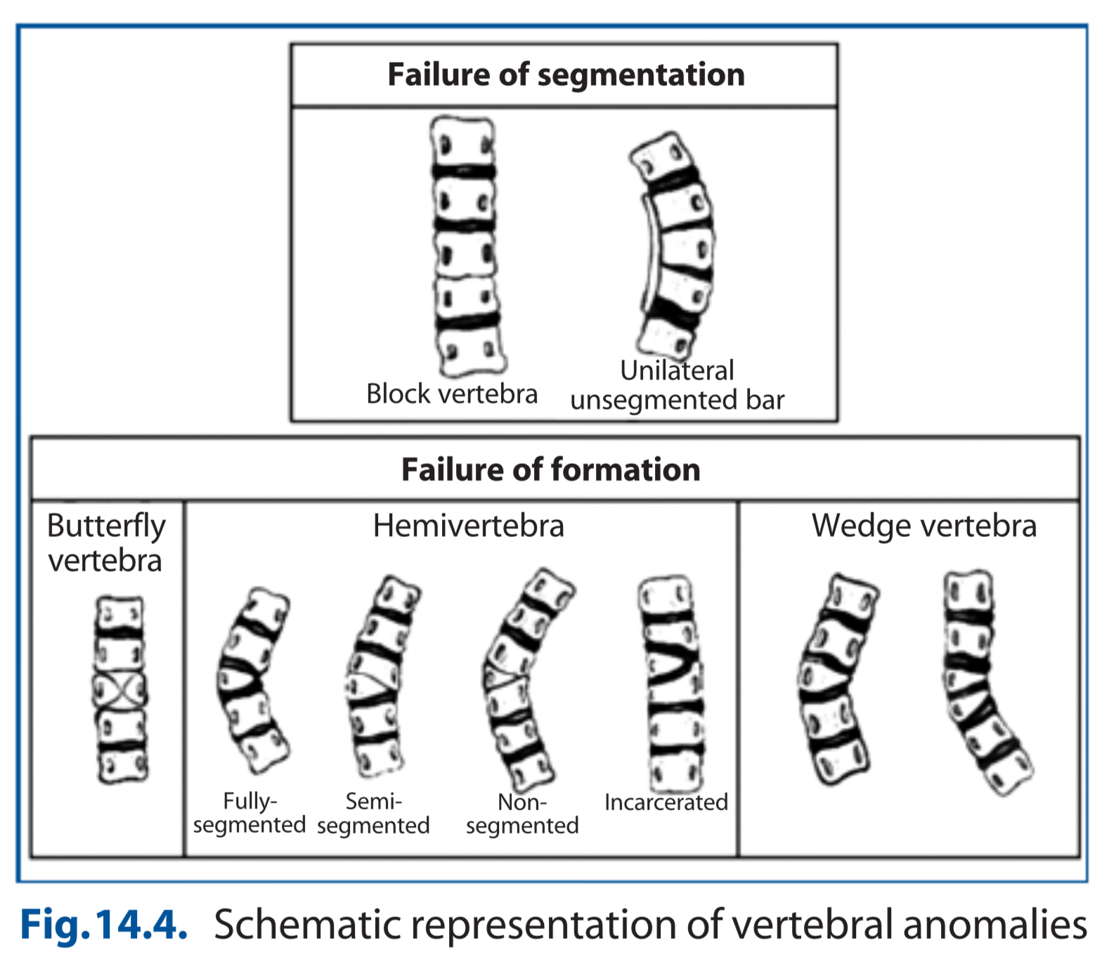
Congenital vertebral anomalies associated with MMC

Slide 8
80% to 90% of patients with MMC have hydrocephalus that requires treatment.
40% to 80% of patients with MMC have syrinx is usually non progressive.
95% of patients with MMC have chiari II Malformation.
Relation between MMC and CM ll is :
CSF is allowed to continually flow out of the defect.
A lack of distention of the developing cranium results in a small posterior fossa with both upward and downward herniation of the cerebellum and a resultant Chiari II malformation.

Slide 9
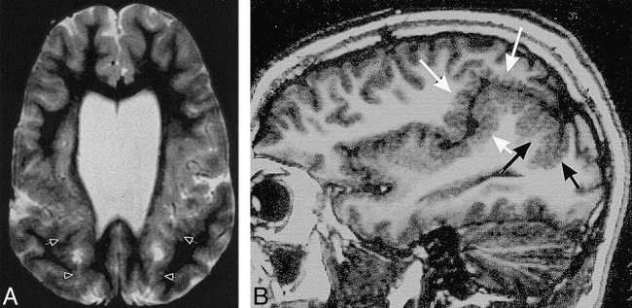
Polymicrogyria is a condition characterized by abnormal development of the brain before birth. The surface of the brain normally has many ridges or folds, called gyri. In people with polymicrogyria, the brain develops too many folds, and the folds are unusually small.

Slide 10
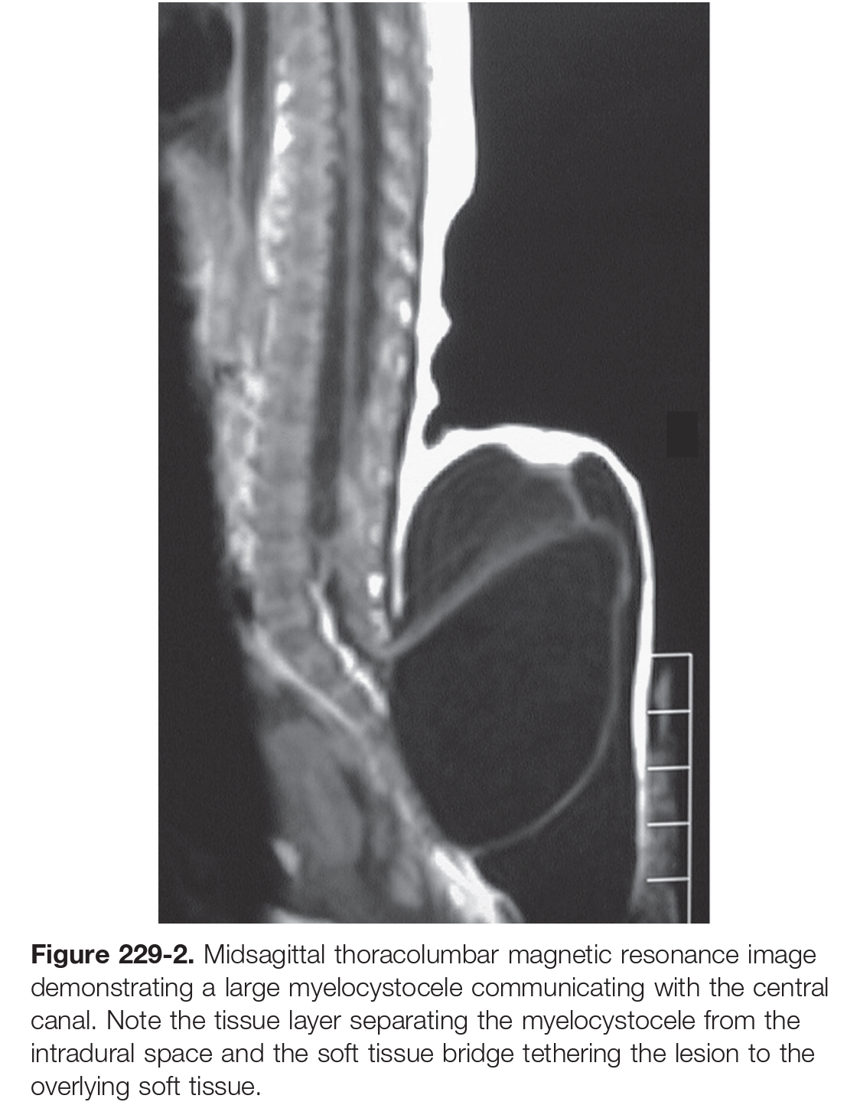

Slide 11
Cervical Myelomeningocele
Cervical myelomeningoceles are often associated with split cord malformations, with stalks of neural tissue arising from the medial aspects of both hemicords.
In children with cervical myelomeningoceles, once the hydrocephalus is treated, a significantly better prognosis can be expected than in patients with lumbosacral lesions.

Slide 12
 | Cervical MMC | Lumber MMC
 | Smaller anatomic defect | Large anatomic defect
 | Majority of patients having hydrocephalus but normal, or nearly normal, sensorimotor function below the level of the lesion and have better prognosis. | 80% to 90% have hydrocephalus With lower limb weakness and loss of sphincter control.
 | Closed lesions, covered with thick fibrous tissue, tough skin, or both. | Open lesion resulting in CSF leakage.
 | Contain only a small band of neural tissue that penetrates the small fascial defect as it passes from the dorsum of the spinal cord, ending along the inner surface of the sac. | Contain large band of neural tissue
 | Minimal or absent fascial defect | The large fascial defects and posterior bony malformations.

Slide 13
Epidemiology and Etiology
Meningocele, and myelomeningocele, represents one of the most common birth defects.
Most common in female
More common in white
Most commonly lumbosacral
10% thoracic (longer and wider, and often flat or even sunken)
5% cervical
Carbamazepine and Valproic acid carry risk of spina bifida due to interaction with folic acid’s function.
Nutritional Deficiencies : Zinc & Folic acid (0.4 mg before and during pregnancy)
Associated Chromosomal Abnormalities (trisomy 13, trisomy 18)

Slide 15
Diagnosis
Maternal Serum α-Fetoprotein.
Measure in the early part of the 2nd trimester optimally between 16 and 18 weeks, result in High level in association with NTD.
High-Resolution Fetal Ultrasonography
Two characteristic cranial abnormalities associated with hydrocephalus and Chiari II malformations.
Lemon sign, consists of the scalloping of the frontal bones on a biparietal view, and is present in 80% of fetuses with MMC.
Banana sign, consists of an abnormally shaped midbrain, elongated cerebellum, and obliteration of the cisterna magna, in 93% of MMC.
Magnetic Resonance Imaging.
Amniocentesis
When MSAFP level and imaging studies suggest the presence of an NTD, levels of amniotic AFP and acetylcholinesterase (AChE) are used as a confirmatory test
amniotic fluid levels of AFP and AChE will not be elevated with skin-covered malformations.

Slide 16
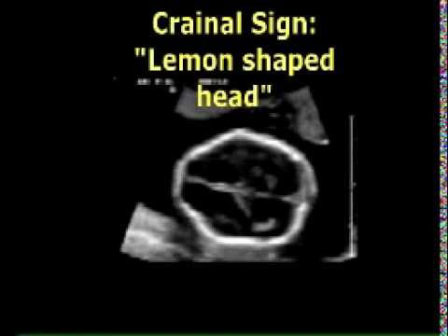
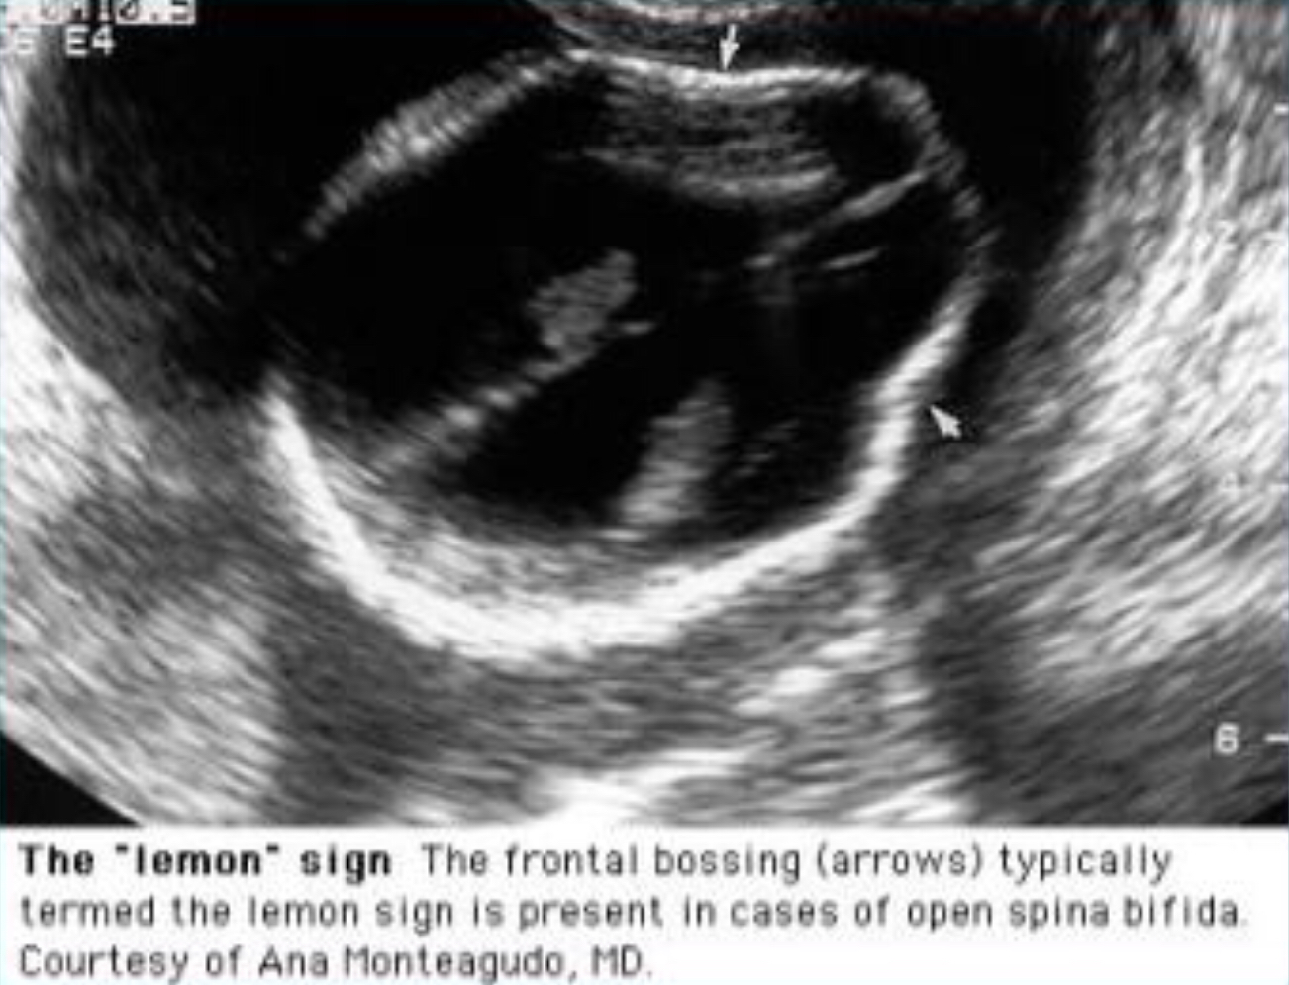

Slide 17
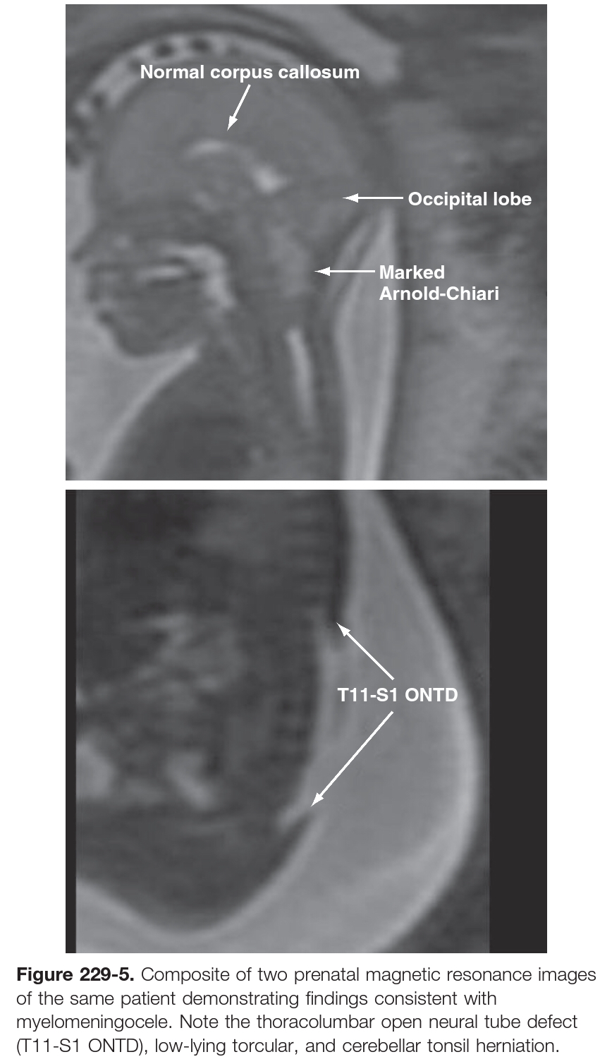

Slide 18
Examination
Examine the lesion includes noting its circumference, shape, the placode, skin integrity.
The spinal column is examined for
Early scoliosis, kyphosis.
Visible and palpable prominent laminae at the lateral margin of lesion.
Orthopedic deformities: club foot (talipes equinovarus)
Neurological examination include motor function, reflexes, bladder and bowel function.
The motor examination conducted with pinpricks over the baby’s torso
Lesion at T12 or above —> paraplegia.
Hip flexion —> L1 to L3 function.
knee extension —> L2 to L4 function.
Knee flexion —> L5-S1 function.
Plantar flexion —> S1-S2 function.
Spontaneous movements are best assessed by suspending the infant in the prone position and examining for spontaneous movements of the feet, legs, and hips.

Slide 19
Reflex testing include
Patellar tendon reflex (femoral nerve, L2-4)
Achilles tendon reflex (tibial nerve, S1-2)
Anal reflex (pudendal nerve, S3-4)
Sphincter function
Anal reflex or wink (anocutaneous reflex): is the reflexive contraction of the external anal sphincter upon stroking of the skin around the anus.
Infants with a positive anocutaneous reflex have a better prognosis for urinary continence.
Anal and urethral mucosae may prolapse in severely paralyzed cases.
Very early diaper dermatitis may also be a sign of incontinence.

Slide 20
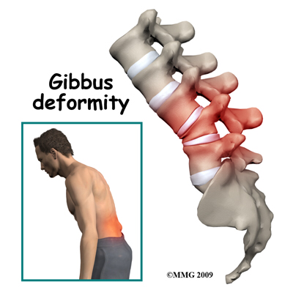
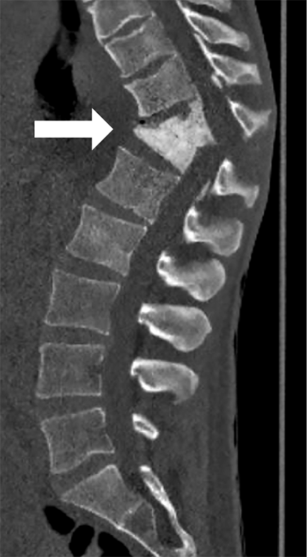
gibbus deformity
Approximately 15% of patients with spina bifida have kyphosis at birth.
They develop kyphosis because the muscles lateral to the spinous processes have not developed, leaving the longitudinal paravertebral muscles ventral to the lateral spinous processes without dorsal opposition.

Slide 21
Cutaneous Signs
Soft tissue mass
Skin dimple
Hemangioma
Hypertrichosis
Skin tag/tail-like appendage
Atretic or denuded skin patch
Dermal sinus hypopigmentation

Slide 22
Prognosis and Prenatal Counseling
95% of infants born with MMC survive to 2 years of age.
10% to 15% of children with spina bifida die before the age of 6y.
The most common causes of death in infancy include hindbrain dysfunction with stridor, apnea, and pneumonia.
The most common cause in older children is unrecognized shunt malfunction.
If they treated aggressively from hydro and infection.
75% - 80% can have normal intelligence.
Most children with spina bifida have bladder and bowel dysfunction.
A lesion with the upper border above T12 generally results in flaccid paraplegia.
L3 function allows one to stand upright.
L4 and L5 function are necessary for ambulation.

Slide 23
Management
Perinatal Management
In Utero Repair:
Prenatal surgery was shown to decrease the need for shunt placement by 50%, and improve a child’s motor function and cognitive development.
Prenatal surgery was associated with an increased risk of preterm delivery and uterine dehiscence at delivery.
Delivery
Elective cesarean section can be performed after lung maturity, but before the onset of labor.
C/S decrease the risk of trauma to the exposed neural placode.

Slide 24
Neurosurgical Evaluation
Normothermia and euvolemia should be maintained.
A sterile, saline-moistened gauze dressing should be used to cover the neural placode.
Prophylactic antibiotics are recommended.
Positioned prone or lateral in order to avoid pressure on the neural placode.
Cranial ultrasonography is performed to determine the size of the ventricles, which may be relatively small with relative microcephaly until after the spinal defect is closed.
Renal : The vast majority (90%) of children with spina bifida have a neurogenic bladder, with about a third having lower motor neuron dysfunction.
Direct visualization of the vocal cords by direct laryngoscopy is indicated in children with stridor because bilateral vocal cord paralysis is predictive of a poor outcome.

Slide 25
Surgery: Myelomeningocele Repair
Timing : repair should be performed within the first 72 hours.
If closure is delayed beyond 72 hours :
Ventricuitis increased by 5 folds which increase risk of shunt infection
Cultures should first be obtained from the neural placode and shown to have no growth.
If cultures are positive, an external ventricular drain should be placed and appropriate antibiotics administered until the infection clears.
Avoid hypothermia, hypovolemia, and hypoglycemia intraoperatively.
Contact between povidone-iodine solution and the neural placode should be avoided.
Children with severe hydrocephalus in conjunction with MMC repair in order to minimize pressure on the dural closure. This can be done either
Single-stage repair, with shunt insertion occurring at the beginning of the case, after intubation while the child is still positioned supine then MMC repair done .
Two-stage repair with shunt insertion first, followed by a second surgery for MMC repair.

Slide 26
The main goals of myelomeningocele repair are threefold:
Protect the functional spinal cord tissue.
Minimize loss of CSF.
Decrease the risk of meningitis
Free the neural placode from the surrounding junctional zone circumferentially, while preserving all functional neural tissue.
One must preserve the often-abnormal vascular supply to the neural placode to prevent ischemia.
Any residual epidermal or dermal elements are resected from the periphery of the neural placode in order to minimize the risk of later development of a dermoid tumor or lipoma.
Once the neural placode is fully freed from the surrounding tissue, a monofilament suture is used to close the pia, re-forming the neural placode into a tube.
the dura closure and re-formation of the thecal sac, using a nonabsorbable suture along the midline.
A vertical midline closure should always be the goal because this facilitates reexploration when necessary for retethering.

Slide 27
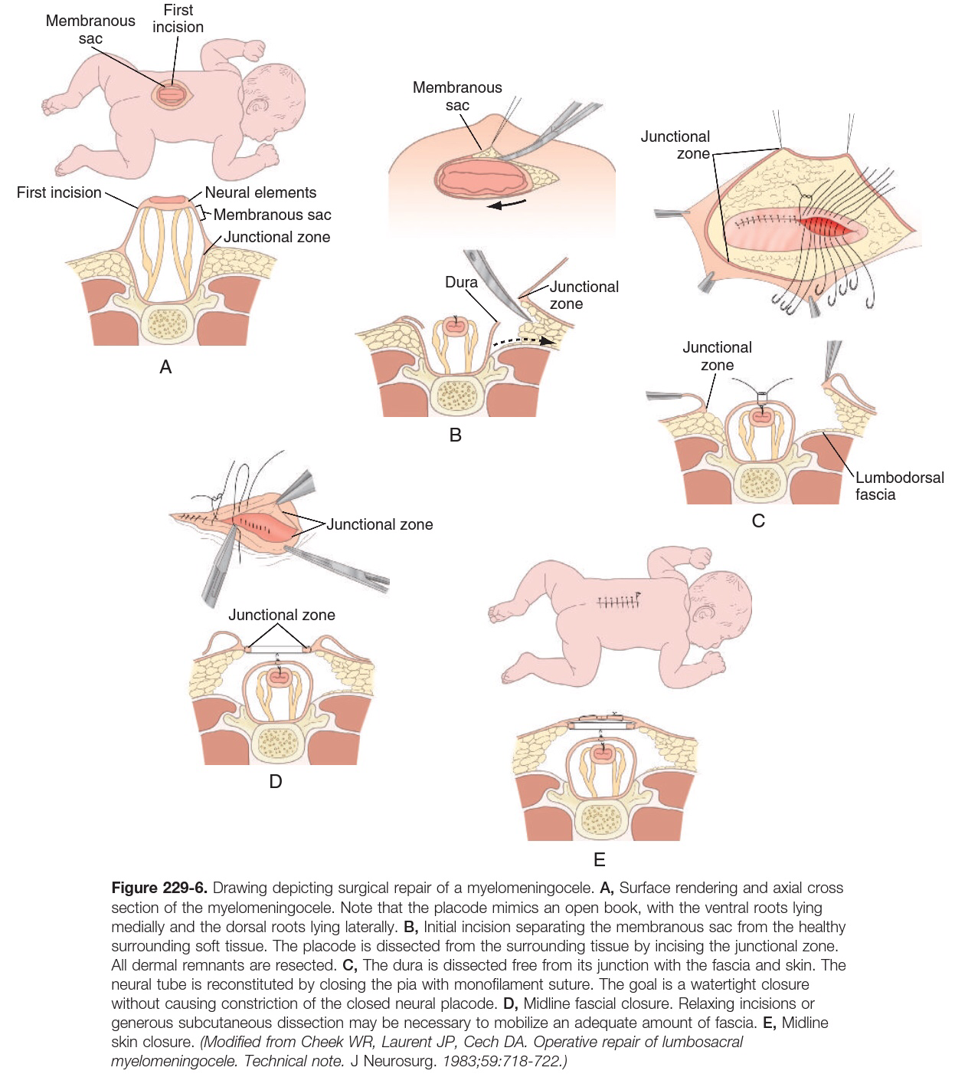

Slide 28
Flaps used in closure include bilateral bipedicle advancement flaps, double Z-rhomboid flaps, Limberg flaps, modified V-Y advancement flaps, and bilobed flaps
Limberg flaps

Slide 29
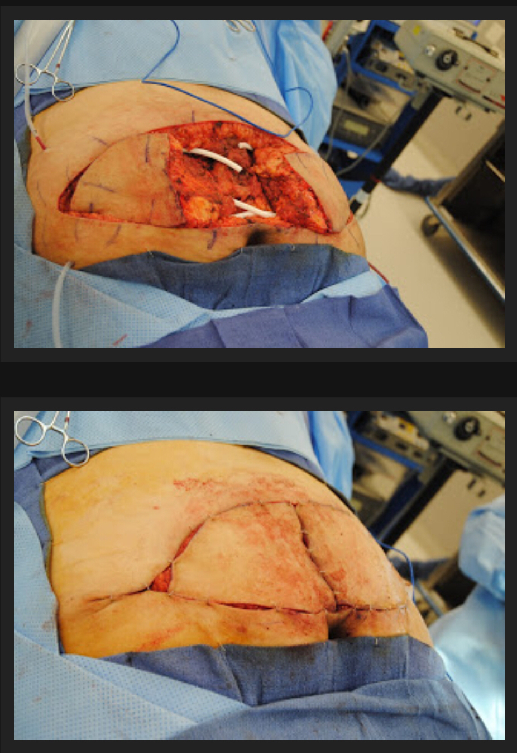
Modified V-Y advancement flap

Slide 30
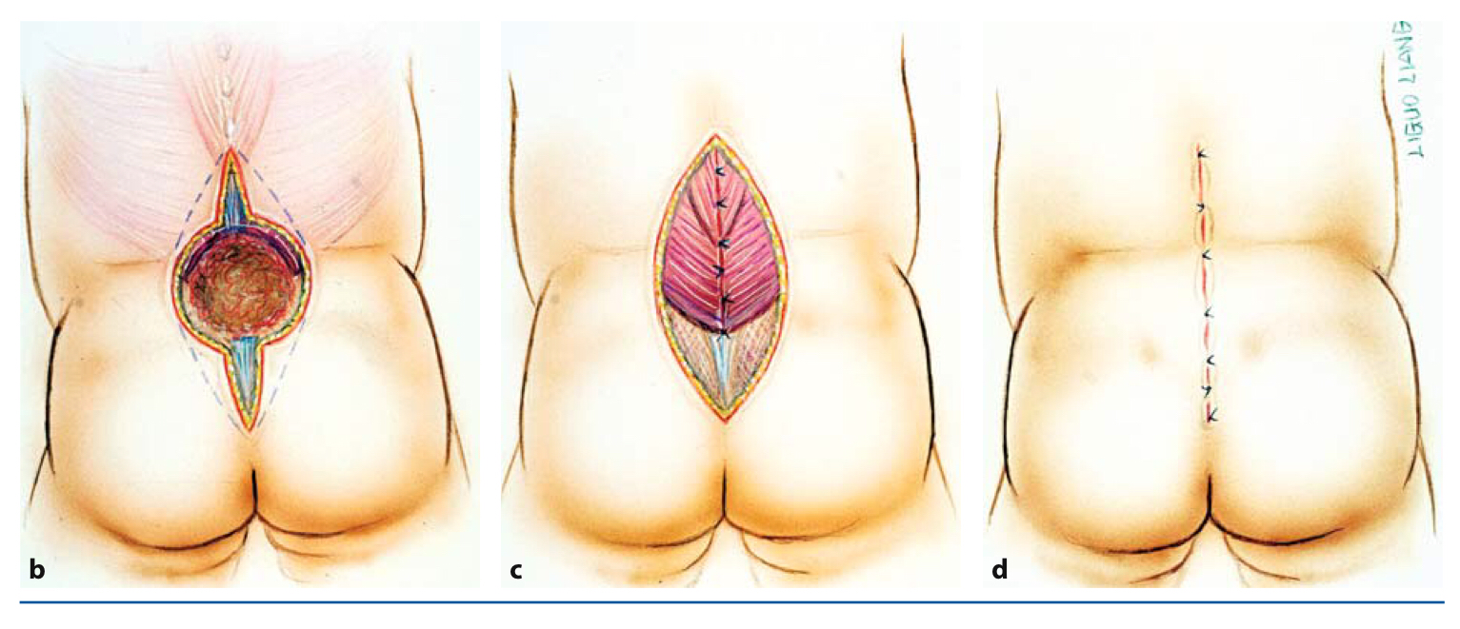

Slide 32
PostoperativeManagement
Prevention of infection risk by:
Perioperative antibiotics are continued for 24 hours postoperatively, and a plastic barrier drape is placed between the myelomeningocele wound and the anus.
Prevention of CSF leak by :
The child should remain prone, ideally with the lumbar area elevated above the level of the head.
Monitoring :
The child is closely monitored for signs of symptomatic Chiari II malformation, such as central apnea and other signs of brainstem dysfunction.

Slide 33
Complications
Wound dehiscence (most common complication)
Hydrocephalus
CSF leakage
Chiari II Malformation
Tethered Spinal Cord
Urinary incontinence and other renal problems
Hydrosyringomyelia
Bedridden and infection.
Latex antibodies can be detected in the serum in 20% to 60% of spina bifida patient

Slide 34
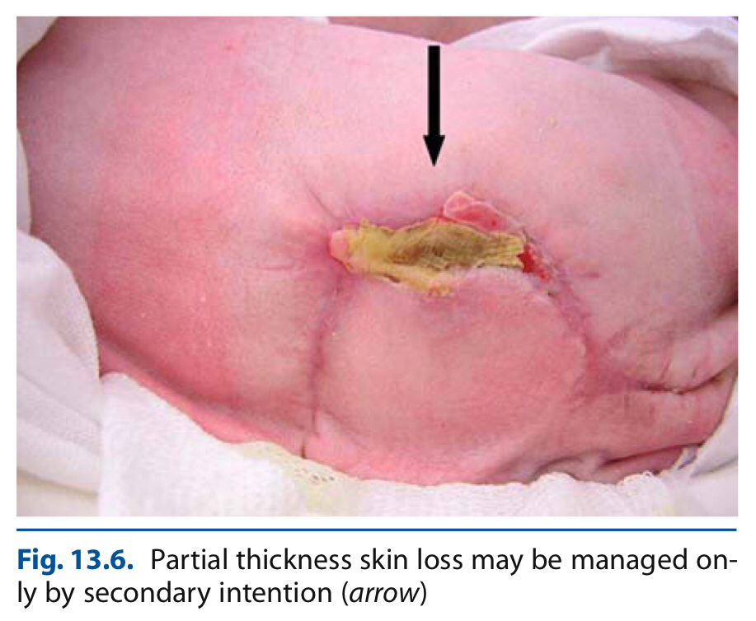
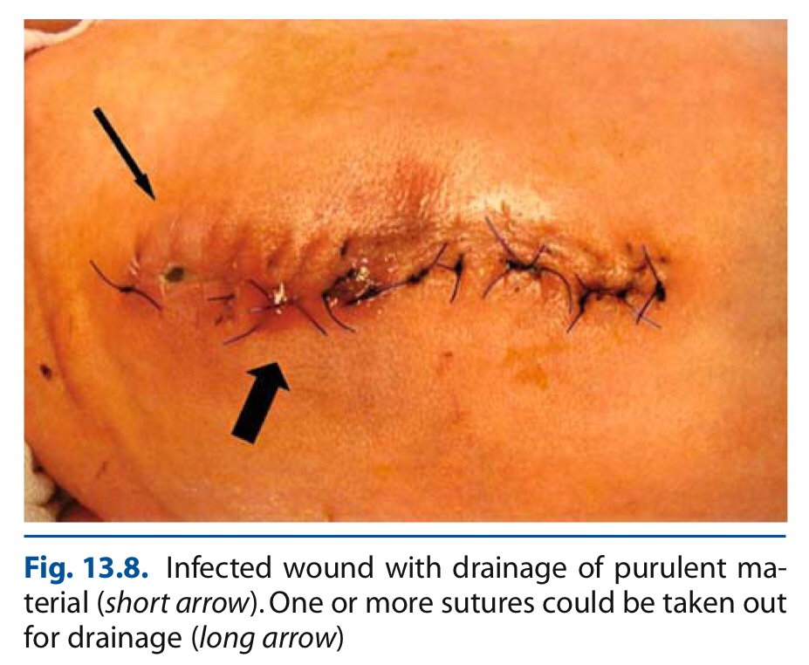

Slide 36
Notes about some complications
Regarding Hydrocephaly :
Children with MMC, shunt malfunctions often do not present with classic signs and symptoms such as headache, nausea/vomiting, poor feeding, increased fussiness, or decreased energy; nor may ventricles appear enlarged on CT or MRI.
Signs and symptoms of shunt malfunctions may be easily confused with signs and symptoms related to tethered cord, syringomyelia, or worsening Chiari II malformation, including:
Worsening motor function,
Worsening bowel or bladder control,
Worsening scoliosis or progressive lower extremity orthopedic deformities,
Pain around the suture site,
Worsening school performance or behavioral disturbances,
Increased seizure frequency,
Lower cranial nerve or brainstem dysfunction.

Slide 37
Regarding CM ll :
(>95%) of patients with myelomeningocele
In pts with CM ll The average age at decompression is 14 months.
1st start with shunt if no improvement within 48 hours, or if a child with life-threatening symptoms has a functioning shunt, decompression should be performed urgently.
Often cervical laminectomies are all that is required to decompress the malformation.
Narrow laminectomies at the levels overlying the compressed cerebellum may minimize the risk of future cervical kyphosis.
Regarding Syringohydromyelia :
Present in 50% to 80% of patients with myelomeningocele.
Hydrosyringomyelia may be the result of a shunt malfunction, and symptoms attributable to the fluid cavity will improve with shunt revision.

Slide 38
MYELOCYSTOCELE
Myelocystoceles, also known as syringoceles, syringomyeloceles, and lipomeningomyelocystoceles are skin-covered midline masses that occur in the lumbosacral area.
Failure of Secondary neurulation.
Resulting in an abnormally low-lying conus.
A terminal myelocystocele has distinct components, including:
Low-lying conus medullaris.
Cystic dilation of the caudal central canal.
Surrounding meningocele.
Lipoma that extends from the conus to a subcutaneous fat collection
The meningocele lie dorsal or ventral to or circumferentially around the terminal cyst, communicate with the subarachnoid space.
The overlying skin often has a cutaneous signature such as hemangioma, nevus, hypertrichosis, or dystrophic epithelium, suggestive of occult spina bifida

Slide 39
Myelocystoceles are rarely associated with hydrocephalus or a Chiari malformation, and most children have normal intelligence.
Myelocystoceles are often associated with cloacal exstrophy (or vesicointestinal fissure) or other severe genitourinary anomalies.
OEIS complex, consisting of an omphalocele, bladder exstrophy, imperforate anus, and spinal defect, as well as ambiguous genitalia and pelvic abnormalities, is often associated with myelocystoceles.
Myelocystoceles are very rare lesions, and appear to occur sporadically
Male > female.
Diagnosis
AFP level is not usually elevated unless there is a concurrent omphalocele.
Visualized on high-resolution fetal ultrasonography or prenatal MRI
The differential diagnosis
Sacrococcygeal teratoma characterized by the presence of polyhydramnios and intact vertebrae.
Associated with other congenital abnormalities: sacral agenesis, a small pelvic cavity, a flared iliac bone, and an absent bladder which are visualized first.

Slide 40
Management:
Repair Timing :
There is not the same urgency to repair a myelocystocele as there is with a myelomeningocele.
Priority should be given to the genitourinary anomalies if present, and adequate time should be allowed to ensure that the neonate has sufficient nutrition and is infection free.
With small, isolated myelocystoceles, the defect may not be detected until a few months of life, when underlying orthopedic abnormalities become apparent.
Its recommended that myelocystocele repair be carried out within the first 6 months of life in order to minimize neurological losses from spinal cord tethering.

Slide 41
Operative Technique
Midline incision is made. The most caudal intact lamina is identified and then removed in order to localize the normal thecal sac.
The myelocystocele sac and dura are circumferentially dissected away from the surrounding soft tissue
At the most cranial end of the lesion, usually requires release of the dorsal fibrous band connecting the bifid lamina across the midline.
Dura and arachnoid are opened, and the incision is extended caudally over the myelocystocele sac.
Adequate exposure should allow for visualization of the dilated spinal cord, terminal lipoma, and associated nerve roots that traverse the meningocele and re-enter the spinal canal.
The fat caudal to the meningocele is dissected, with careful attention paid to the emerging nerve roots
Tethered elements are released dorsally and caudally, and the wall of the cyst and associated lipoma can be resected distal to the caudal arachnoid reflection.
the free edges of the remaining sac are approximated and the residual dura is closed primarily to reestablish the thecal sac.

Slide 42
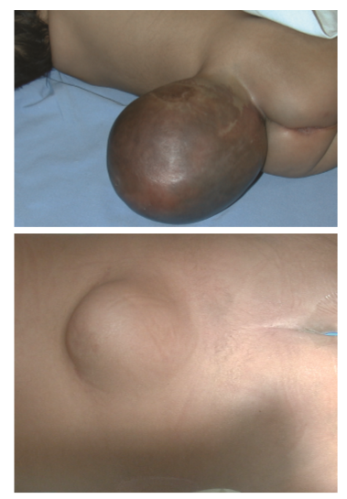
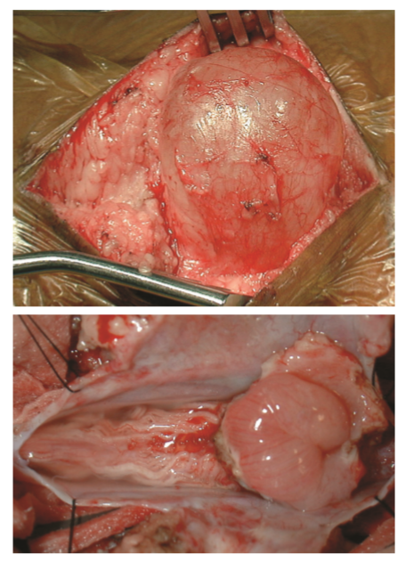

Slide 43
Thank you

