Slide 1
Metastatic Brain Tumors Youmans chap. 146

Slide 2
Epidemiology
In adults, cerebral metastases are by far the most common intracranial tumors, the highest incidence is observed in the 5th to 7th decades .
Occur more frequently in adults than in children.
The most common sources of brain metastases
In adults
Lung
Breast
Melanoma
In children
Leukemia
Lymphoma
Solid brain metastases among children
Younger than 15 years old ( Osteogenic sarcoma and rhabdomyosarcoma ).
15 to 21 years old ( Germ cell tumors ).

Slide 3
Lung cancer is the most common source of brain metastasis in men, whereas breast cancer is the most common source in women.
The overall incidence of brain metastases is not affected by patient sex, the only apparent exception to this is for melanoma, which is more likely to occur in men than in women.
The affinity of a primary tumor to spread to the brain
Malignant melanoma
Lung cancer
Breast cancer
Malignant melanoma has the highest propensity tumors to metastasize to the brain.

Slide 4
TREATMENT MODALITIES
High-dose corticosteroids are used for the initial treatment of patients with symptomatic brain metastases in order to decrease the edema that typically surrounds these tumors and to help restore neurological function.
Systemic chemotherapy is not very effective against the most common types of primary tumors metastasizing to the brain, which tend to be chemoresistant ; however its useful as an adjunct to other therapies against metastases from SCLC and germ cell tumors.

Slide 5
Radiation Therapy
The advantage of WBRT is that it is a simple, noninvasive method of treating the entire brain.
Headaches, seizures, or symptoms of increased ICP show a complete response to WBRT in more than 50% of cases.
Cranial nerve deficits have also been reported to improve.
Prognostic Factors
Age
Performance status
Presence of extracranial metastases
Status of the primary tumor
The RTOG (Radiation Therapy Oncology Group ) identify 4 factors associated with improved survival:
Age less than 60 years.
KPS score 70 or higher.
Metastatic spread limited to the brain.
An unknown or controlled primary.

Slide 6
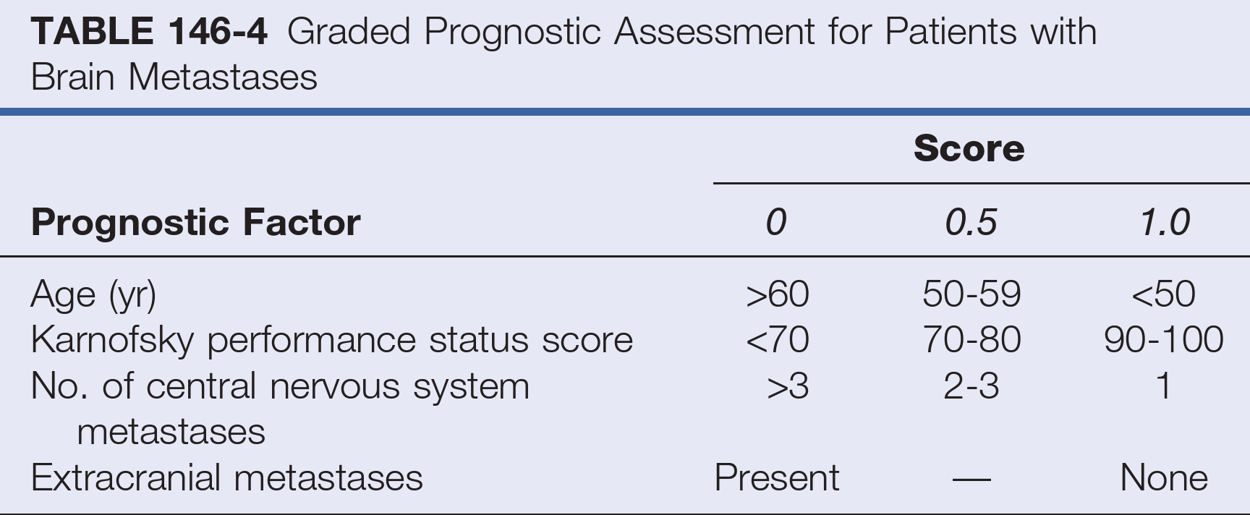

Slide 7
Prophylactic Cranial Irradiation for Small Cell Lung Cancer
Patients with SCLC may be considered for prophylactic cranial irradiation (PCI) because of the high likelihood of the development of brain metastases and consequent neurological deficits.
There is debate regarding use of PCI because of concerns that it may contribute to neurological deficits.
To minimize neurological toxicity, PCI should not be given concurrently with chemotherapy
Complications of Whole-Brain Radiotherapy
Acute effects of WBRT include mild fatigue, reversible hair loss, mild scalp erythema, and hyperpigmentation.
Somnolence syndrome: persistent fatigue, anorexia, and irritability (especially in children), may occur 3 to 10 weeks after WBRT but may resolve within 6 weeks.
Progressive dementia, ataxia, and urinary incontinence NPH developed within 5 to 36 months of treatment with WBRT, causing severe disability and leading to the deaths , (CT) scans showed cortical atrophy and hypodense white matter.

Slide 8
Surgical Resection:
Often considered the primary and optimal treatment for brain metastases.
Advantages
Immediately eliminating the effects of increased (ICP) and the direct irritation that metastases cause in surrounding brain tissue,
These effects may be greater for metastases than for primary intraparenchymal tumors because
Metastases grow by expansion and compression rather than by infiltration.
Metastases often produce a large amount of edema.
Provides tissue for confirming the diagnosis of metastasis. 10% 15% of patients with a clinical diagnosis of metastasis may have non metastatic lesions such as abscesses and primary tumors.
Provide local cure if all the tumor cells are removed.

Slide 9
Surgical Resection (selection &prognostic factors):
Its depends on
The radiographic imaging features MRI including the number, size, and locations of the tumors.
The histology of the metastasis.
The clinical status of the patient.
Radiographically Determined Features:
Tumor Number:
Patients with single brain metastases are the most appropriate surgical candidates, included patients who had limited systemic disease and those with a KPS score of more than 70.
Patients with multiple metastases, the role of surgery is more controversial . although, removal of multiple (typically 2-4) brain metastases is as effective as resection of single brain metastases as long as all the lesions are resected, followed by WBRT.

Slide 10
Tumor size:
More than 3 cm in maximum diameter ;surgical resection is the primary and best option as such lesions are too large for SRS.
Very small tumors (> 5 mm in maximum diameter); SRS is probably most appropriate, particularly if they are located deep within the brain.
Intermediate-sized metastases 1-3 cm in greatest diameter;The decision to operate on these lesions is particularly challenging because in many cases treatment with surgery may be considered by some to be as appropriate as treatment with SRS.
Tumor location :
Lesions that are deeply located or within eloquent areas are associated with higher surgical morbidity than those within neurologically silent superficial regions.
Thus patients with metastases to the brainstem, thalamus, and basal ganglia are generally are considered not good surgical candidates.

Slide 11
Histologic Features :
NSCLC and breast cancer are intermediately sensitive to fractionated radiation therapy, and surgery should be considered as one part of a multidisciplinary treatment scheme for patients with them.
The type of primary tumor is an important indicator of survival.
Melanoma is consistently poorer after surgery
RCC prognosis is relatively good after surgical excision
RADIOSENSITIVE (SMGLL)
SCLC
MM
GERM CELL
LEUKEMIA
LYMPHOMA
RADIORESISTANT (SMART)
SARCOMA
MELANOMA
ADENOCARCINOMA
RCC
THYROID

Slide 12
Clinical Assessment:
The most significant determinant of a patient’s outcome is the “status of the systemic disease,” which is defined as the activity and extent of the primary tumor and systemic (non cerebral) metastases.
70% of patients undergoing surgery for single brain metastases died from progression of systemic disease rather than from neurological causes.
Surgery is most beneficial to
Patients with absence of, controlled, or limited systemic disease.
Patients whose neurological functioning improves with corticosteroids are more likely to recover after surgery.
Patients with brain metastases from melanoma often have the shortest median survival time after surgery.

Slide 13
Metastasis Anatomy :
Microscopically :
Brain metastasis is composed of a solid tumor mass without intervening brain tissue.
Some degree of brain infiltration may be present but typically does not extend beyond a radius of 5 mm from the solid tumor.
There may be a central area of necrosis in larger lesions.
Macroscopically :
Typical cerebral metastases are round and well demarcated from the surrounding edematous brain.
Tumor cysts may also be present, particularly in metastases from bronchogenic carcinoma.
CT or MRI: region of contrast enhancement seen.
Surgery:
A gliotic pseudocapsule is often identifiable surrounding the metastasis.
Dissection in this gliotic plane generally ensures en bloc resection because there are typically no tumor cells in this zone.

Slide 14
Metastatic tumors may arise in any part of the brain.
Most metastatic tumors arise near the temporoparieto-occipital junction, in the distribution of the middle cerebral artery, usually within or near eloquent cortex.
Midline metastases, such as those in the cingulate gyrus, should be viewed in relation to the interhemispheric fissure.
Metastatic tumors occasionally arise within the ventricles.
The less common, cerebellar metastases can be divided into deep and hemispheric locations.
Metastases may occur
Subcortical: superficially just below the cortex, filling a gyrus
Subgyral: deep within a sulcus, either at the side of the sulcus
Subsulcal: deep within a sulcus at its base
Lobar: deep within the white matter, independent of a single sulcus or gyrus

Slide 15
Indications favoring surgical excision of a single lesion:
Primary disease controlled.
Accessible.
Symptomatic or life-threatening.
Relatively radio-resistant.
Recurrent SCLC following XRT.
Diagnosis unknown: alternatively consider biopsy, e.g. stereotactic biopsy.
Indicated of surgery for multiple mets
One particular and accessible lesion is clearly symptomatic and/or life threatening (life-threatening lesions include p-fossa and large temporal lobe lesions).
Multiple lesions that can all be completely removed.
No diagnosis (e.g. no identifiable primary): consider stereotactic biopsy.

Slide 16
Surgical Approaches
The surgical approach is based on the anatomic location of the brain metastasis.
Supratentorial subcortical lesions
Best resected by an incision in the apex of the sulcus and circumferential dissection of the tumor (transcortical approach).
Removal of a cortical plug above the lesion improves exposure.
Lesion arises within eloquent cortex: injury to the surrounding brain may be minimized with the use of a longitudinal incision dictated by local mapping with direct brain stimulation.
Large metastases: performing an “inside-out” piecemeal (rather than en bloc) resection.
Lesions in the subgyral or subsulcal location
Best approached by splitting of the sulcus leading to the lesion.
Subgyral tumors are removed by means of an incision in the side of the split sulcus.
Subsulcal lesions are entered at the sulcal base (transsulcal approach).

Slide 17
Metastases located deep within the white matter, independent of a single sulcus or gyrus (lobar), may be approached either transcortically or transsulcally.
Tumors in the subinsular cortex may be approached through splitting of the sylvian fissure.
Midline metastases are best approached through splitting of the interhemispheric fissure. Tumors may then be resected by further splitting of or entry into a deep gyrus.
Intraventricular lesions may be approached transcallosally or transcortically.
Cerebellar tumors
Superior hemispheric lesions are approached via the supracerebellar cistern and by incision of the cerebellum at the closest point to the tumor. This approach requires a high suboccipital craniotomy with exposure of the transverse sinus.
Lateral hemispheric lesions are approached directly from a posterior trajectory. Entry of the paracerebellar cisterns is generally not necessary, so exposure of the cranial nerves is avoided.
Inferior cerebellar tumors require opening of the foramen magnum.
Midline tumors can be resected after splitting of the vermis.

Slide 18
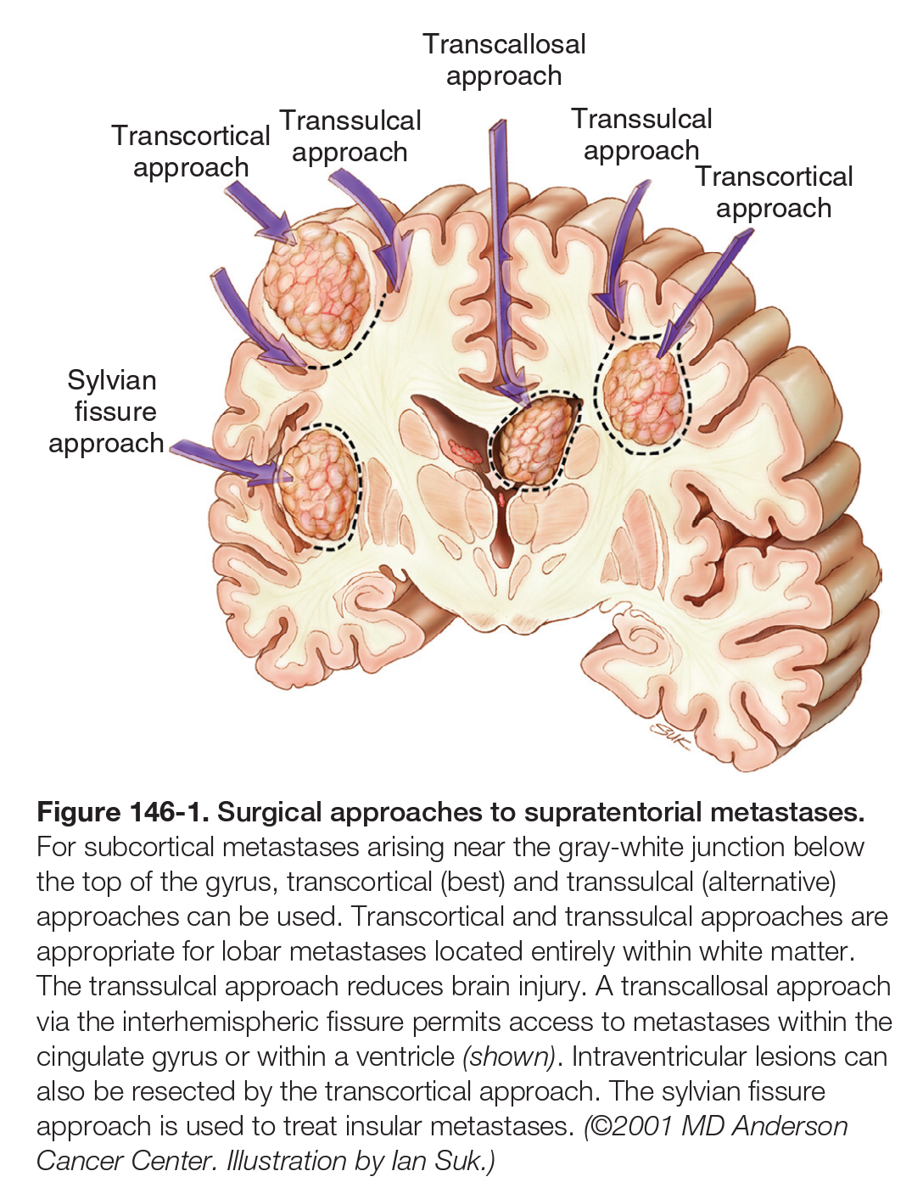
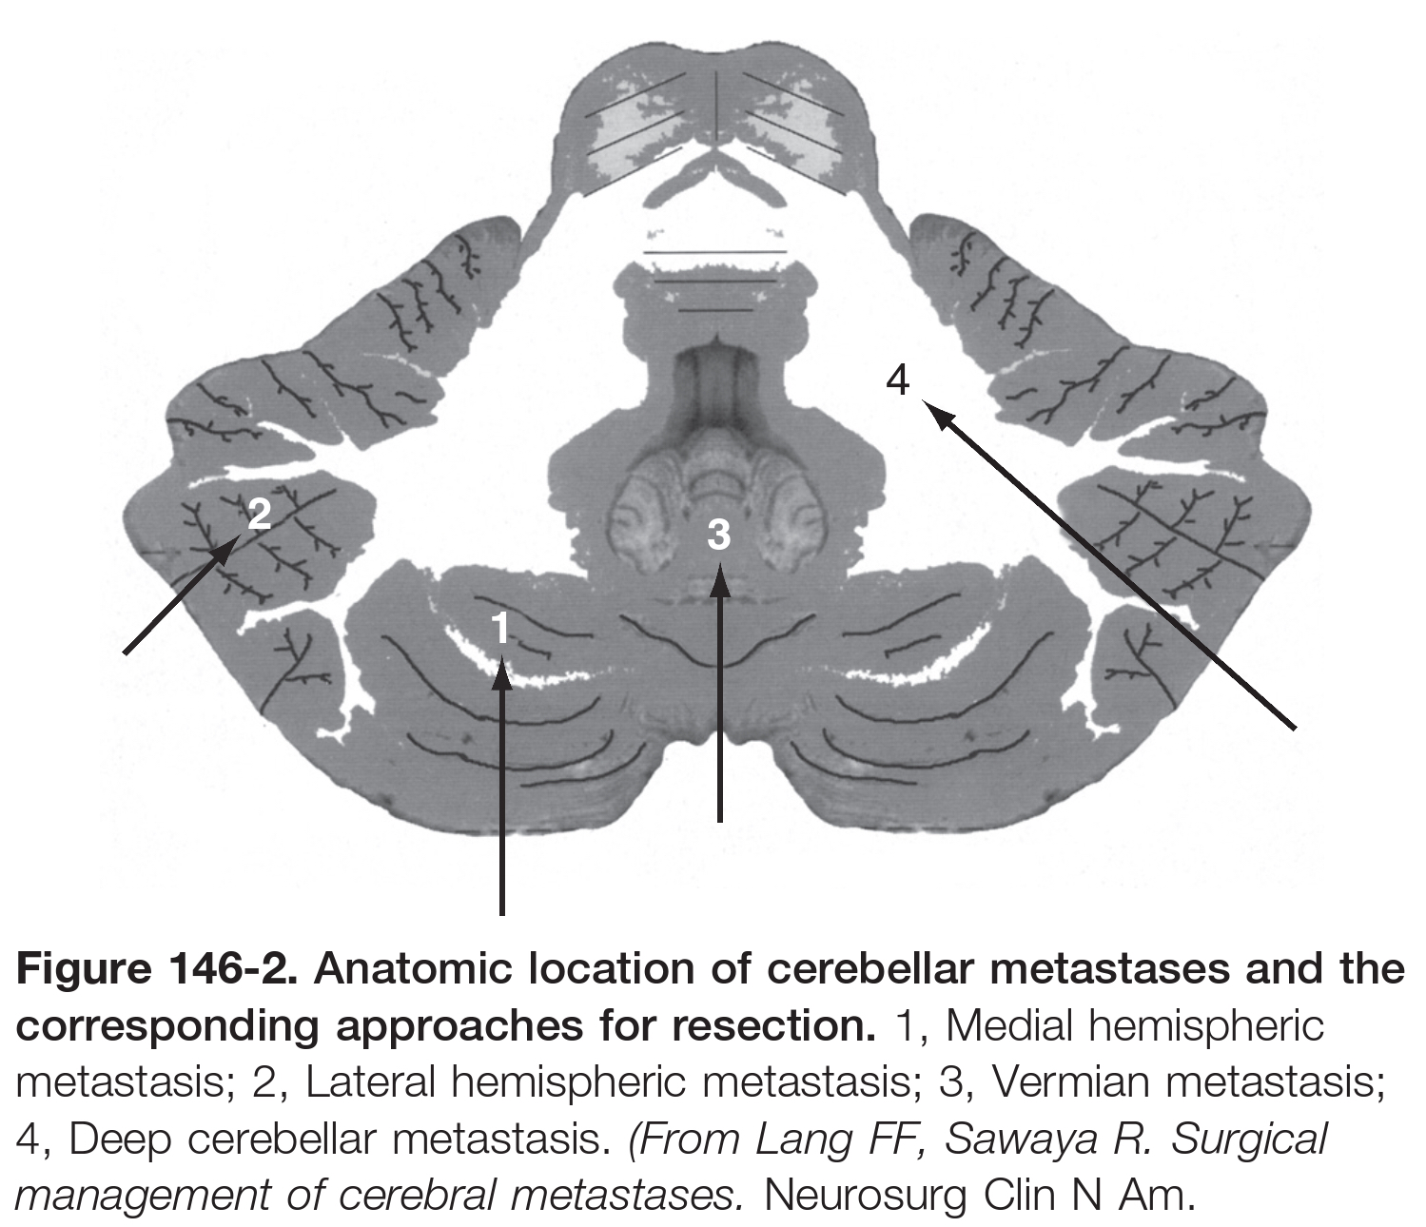
Solitary tumor: is 2ry tumor with unknown primary.
Single met.: is 2ry tumor with known primary.

Slide 21
Stereotactic Radiosurgery versus Conventional Surgery:
SRS Advantages
Decreased risk of hemorrhage and infection and no risk of tumor seeding.
Less invasive.
Less costly.
Requires shorter hospital stays than standard craniotomy.
Ameliorate symptoms even with tumors resistant to conventional radiation therapy, such as melanoma.
SRS Disadvantages
Potential exacerbation of peritumoral edema which require long-term steroid administration.
Radiation necrosis.
SRS is ineffective for lesions > 3 c.m because the radiation dose must be decreased as tumor size increases in order to avoid injury to the surrounding brain. As the dose is decreased, tumor control rates become unfavorable.

Slide 22
Patients with tumors more than 3 cm in maximum diameter are almost always treated with surgery.
Those with small lesions (<1 to 2 cm in maximum diameter) that are deeply located are treated with SRS.
The treatment for lesions amenable to either therapy is determined by the patient’s symptoms.
Patients who are asymptomatic can be treated with SRS.
Those with lesions that are causing symptoms are more frequently treated surgically.
Patients with conditions that increase surgical risk may undergo SRS, or patients who are to receive chemotherapeutic agents for systemic disease that are likely to cause a bleeding diathesis may be treated surgically in order to remove the lesion prior to commencement of such therapies and to thereby decrease the risk of tumoral hemorrhage.
SRS can be effective in treating “radio-resistant” solitary brain metastases for patients with malignant melanoma or RCC.

Slide 23
Indications of SRS
Lesions less than 3 c.m. ( single or multiple ).
Small lesions and deeply located (<1 to 2 cm).
Asymptomatic patient.
Radio-resistant” solitary brain metastases (malignant melanoma or RCC).
Recurrent brain metastases.
Residual remanent of tumor bed.
Patients unfit for GA.
Patient preference.

Slide 24
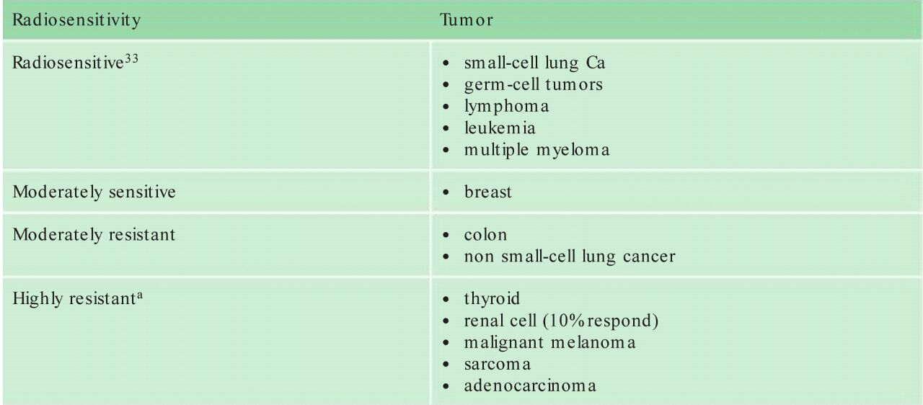
Metastases from Renal Cell Carcinoma and Melanoma
The cause of death was neurological in 76% of patients, whereas 16% died from systemic cancer.
Mx: including surgery and SRS.

Slide 25
Tendency to Hemorrhage.
Melanoma
RCC
Thyroid
Choriocarcinoma
Recurrent Metastases:
Brain metastases may recur locally if not all neoplastic cells are removed from the tumor bed at surgery.
New metastases arising at sites other than the original location are termed distant recurrences.
Recurrent tumors are found in up to 40% of patients with brain metastasis.

Slide 26
Leptomeningeal Carcinomatosis:
Leptomeningeal disease (LMD) is a relatively rare but devastating complication of metastatic brain cancer occur in 5% of patients with cancer.
Although any cancer can metastasize to the leptomeninges, breast and lung cancers are the most common causes of solid tumor–related LMD.
Typically, patients present with meningeal symptoms, including headaches, nausea, vomiting, gait impairment, and sensory abnormalities.
A diagnosis can usually be made radiographically with the finding of leptomeningeal enhancement, or “sugar coating.”
A cytologic diagnosis of LMD based on CSF samples from lumbar puncture, samples remains the “gold standard.”
A negative initial lumbar puncture analysis mandates an additional two attempts to rule out the LMD diagnosis.

Slide 27
Although LMD is incurable, treatment is advisable as a means to improve or stabilize the patient’s neurological status and prolong meaningful survival.
WBRT can provide pain relief and stabilization of symptoms; however, neurological recovery is rarely seen.
Symptom control is of paramount importance :
Pain from LMD often responds to antiepileptic drugs or tricyclic antidepressants.
Steroid administration can also be helpful in treating radiculopathy.
Patients in whom hydrocephalus develops can benefit from a cerebrospinal fluid shunting procedure.
Intrathecal chemotherapy is a mainstay of treatment for LMD, because most systemic therapies have poor CNS penetration (Methotrexate and cytarabine are the most commonly used intrathecal agents).
Intrathecal treatment can be delivered by
Repeated lumbar punctures or,
Ommaya reservoir which is more comfortable for the patient.

Slide 28
LMD is thought to occur through :
hematogenous spread.
contiguous spread from a solid mass.
direct seeding during surgical treatment of a solid metastatic.
No significant difference in the risk for LMD between patients undergoing en bloc tumor resection and those undergoing SRS.
En bloc resection is associated with a lower risk of leptomeningeal dissemination and local recurrence than piecemeal resection

Slide 29
Chemotherapy:
Unlike surgery or SRS, which provide only localized treatment, systemic chemotherapy permits treatment of the entire brain and allows concurrent treatment of extracranial sites of cancer.
Explanations offered for the limited effectiveness of chemotherapy for brain metastases include:
The presence of the blood-brain barrier (BBB).
The relatively drug-resistant nature of cancers that metastasize to the brain.
The frequent observation of brain metastases in patients in whom chemotherapy fails.
The use of suboptimal chemotherapeutic agents in past trials.
Drug delivery into CNS tumors may be further limited by the routine use of corticosteroids for symptomatic brain metastasis which may facilitate reestablishment of disrupted BBB function, thereby providing a protective effect against cytotoxic agents.
Chemo-resistant NSCLC and malignant melanoma.
Chemo-sensitive SCLC, breast cancer, germ cell tumors, and lymphoma.

Slide 30
Imaging
T1 isointense or hypointense.
Melanoma (due to the ferromagnetic melanin within the tumor), can appear hyperintense.
T2 hyperintense, but can be variable.
FLAIR is generally hyperintense.
DWI not restricted.
The differential diagnosis
Abscess
Encephalitis
Malignant glioma
Radiation necrosis
Thromboembolic stroke
Demyelinating disease
Resolving hematoma

Slide 31
Melanoma
The 5th most common cancer in men, 7th in women.
Hemorrhagic involvement is common.
CT: lesions may be slightly hyperdense to brain on unenhanced CT due to melanin. Enhancement is less constant than for other mets (e.g. bronchogenic Ca).
MRI: decreased signal on T2WI surrounded by intense halo of edema. Enhancing T1WI lesions in a patient with melanoma is highly suggestive of melanoma metastases.

Slide 32
Treatment
Surgical indications
Patients with 1-4 CNS metastases that can be completely resected when systemic disease is absent or slowly progressive.
Patients with intracranial mets that cannot be completely removed or with uncontrolled systemic disease may be surgical candidates for the following:
for symptomatic relief: e.g. lesion causing painful pressure.
life-threatening lesion: e.g. large p-fossa lesion with 4th ventricle compression.
for hemorrhagic lesion causing symptoms by mass effect from the clot.
Whole-brain radiation therapy (WBXRT).
Melanoma is typically radio-resistant , provides 2–3 months.
Stereotactic radiosurgery (SRS).
Considered for ≤4 lesions all ≤ 3cm diameter that are surgically inaccessible, with limited or quiescent systemic involvement.
Relative contraindications: hemorrhagic lesions, lesions with significant mass effect surrounding edema.

Slide 33
