Slide 1
Meningioma Youmans Chap. 147

Slide 2
Slow growing, extra-axial tumor, usually benign, arise from arachnoid (not dura)
Represents 20% of primary intracranial tumors.
Female : Male 2:1
Meningioma in children:
It represents 1-4% of brain tumors in children (younger than 18 years).
They are extremely uncommon in infancy.
The average age at presentation is 11 years
Equal M:F ratio, But male predominance 71% in infants age group.
Characteristic
Could be Intraventricular
They may be multiple
May have cystic component
May be associated with neurofibromatosis (NF 2)
May have no dural attachment

Slide 3
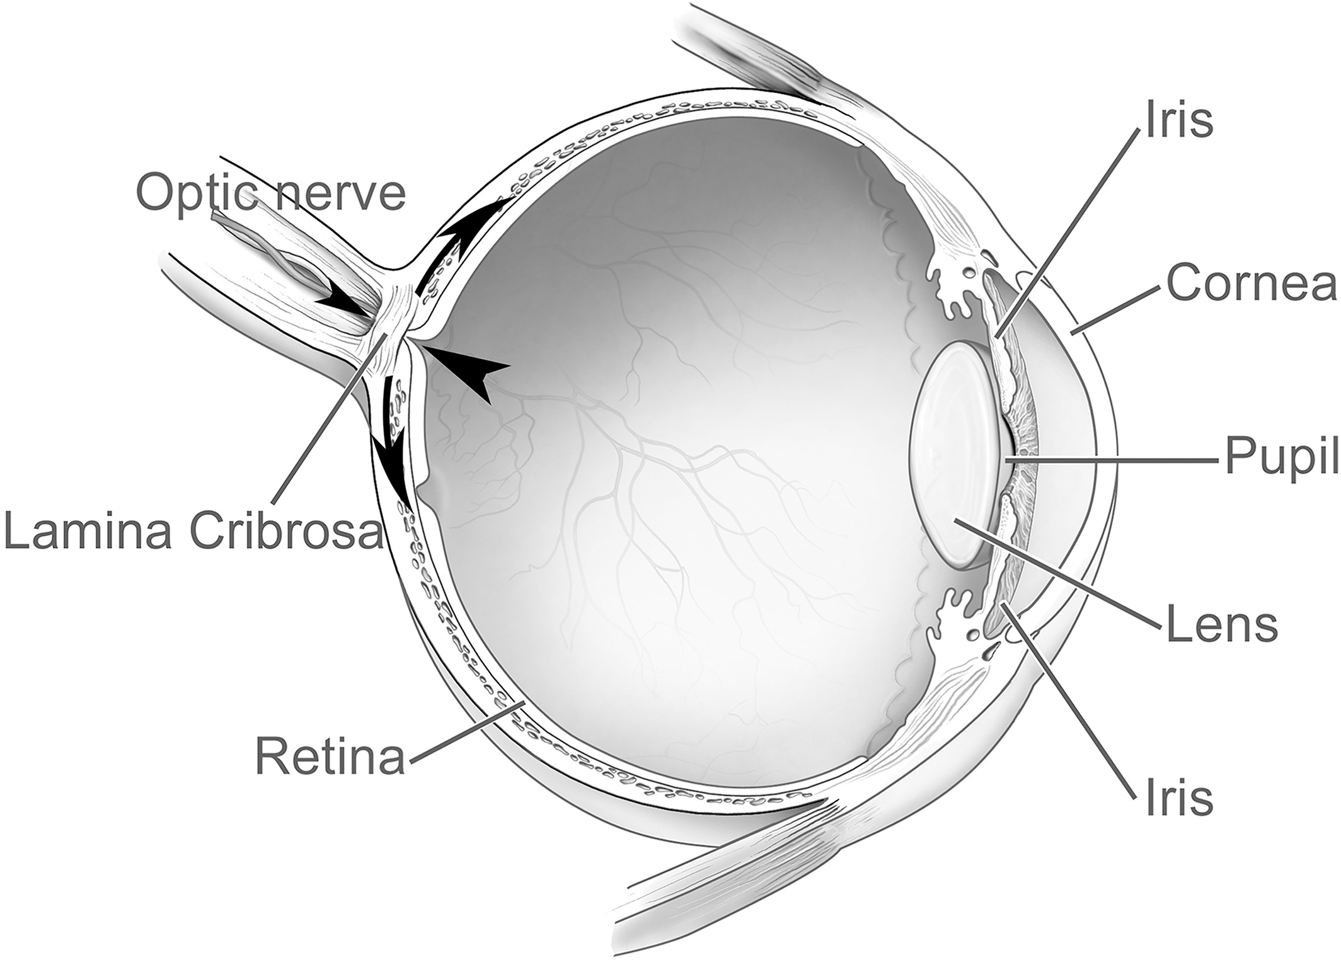
Pathology
Meningioma originate from the arachnoid cap cells.
It may occur as a flattened sheath of tumor, taking the shape of underlying bone (more common in sphenoid bone) and it called: meningioma en plaque.
Rarely occur in a location where dural attachment cannot be shown (intraventricular, intraparenchymal).
Intratumoral hemorrhage is rare, and necrosis is typically absent, abscess is possible.
Arachnoid villi are most numerous in the area of
Superior sagittal sinus, followed by
Cavernous sinus.
Tuberculum sellae.
Lamina cribrosa.
Foramen magnum
Torcular herophili.

Slide 4
Distribution of intracranial meningioma:
Convexity (35%)
Parasagittal (20%)
Sphenoid ridge (20%)
Infratentorial (13%)
Intraventricular (5%)
Tuberculum sellae (3%)
Others (4%).

Slide 5
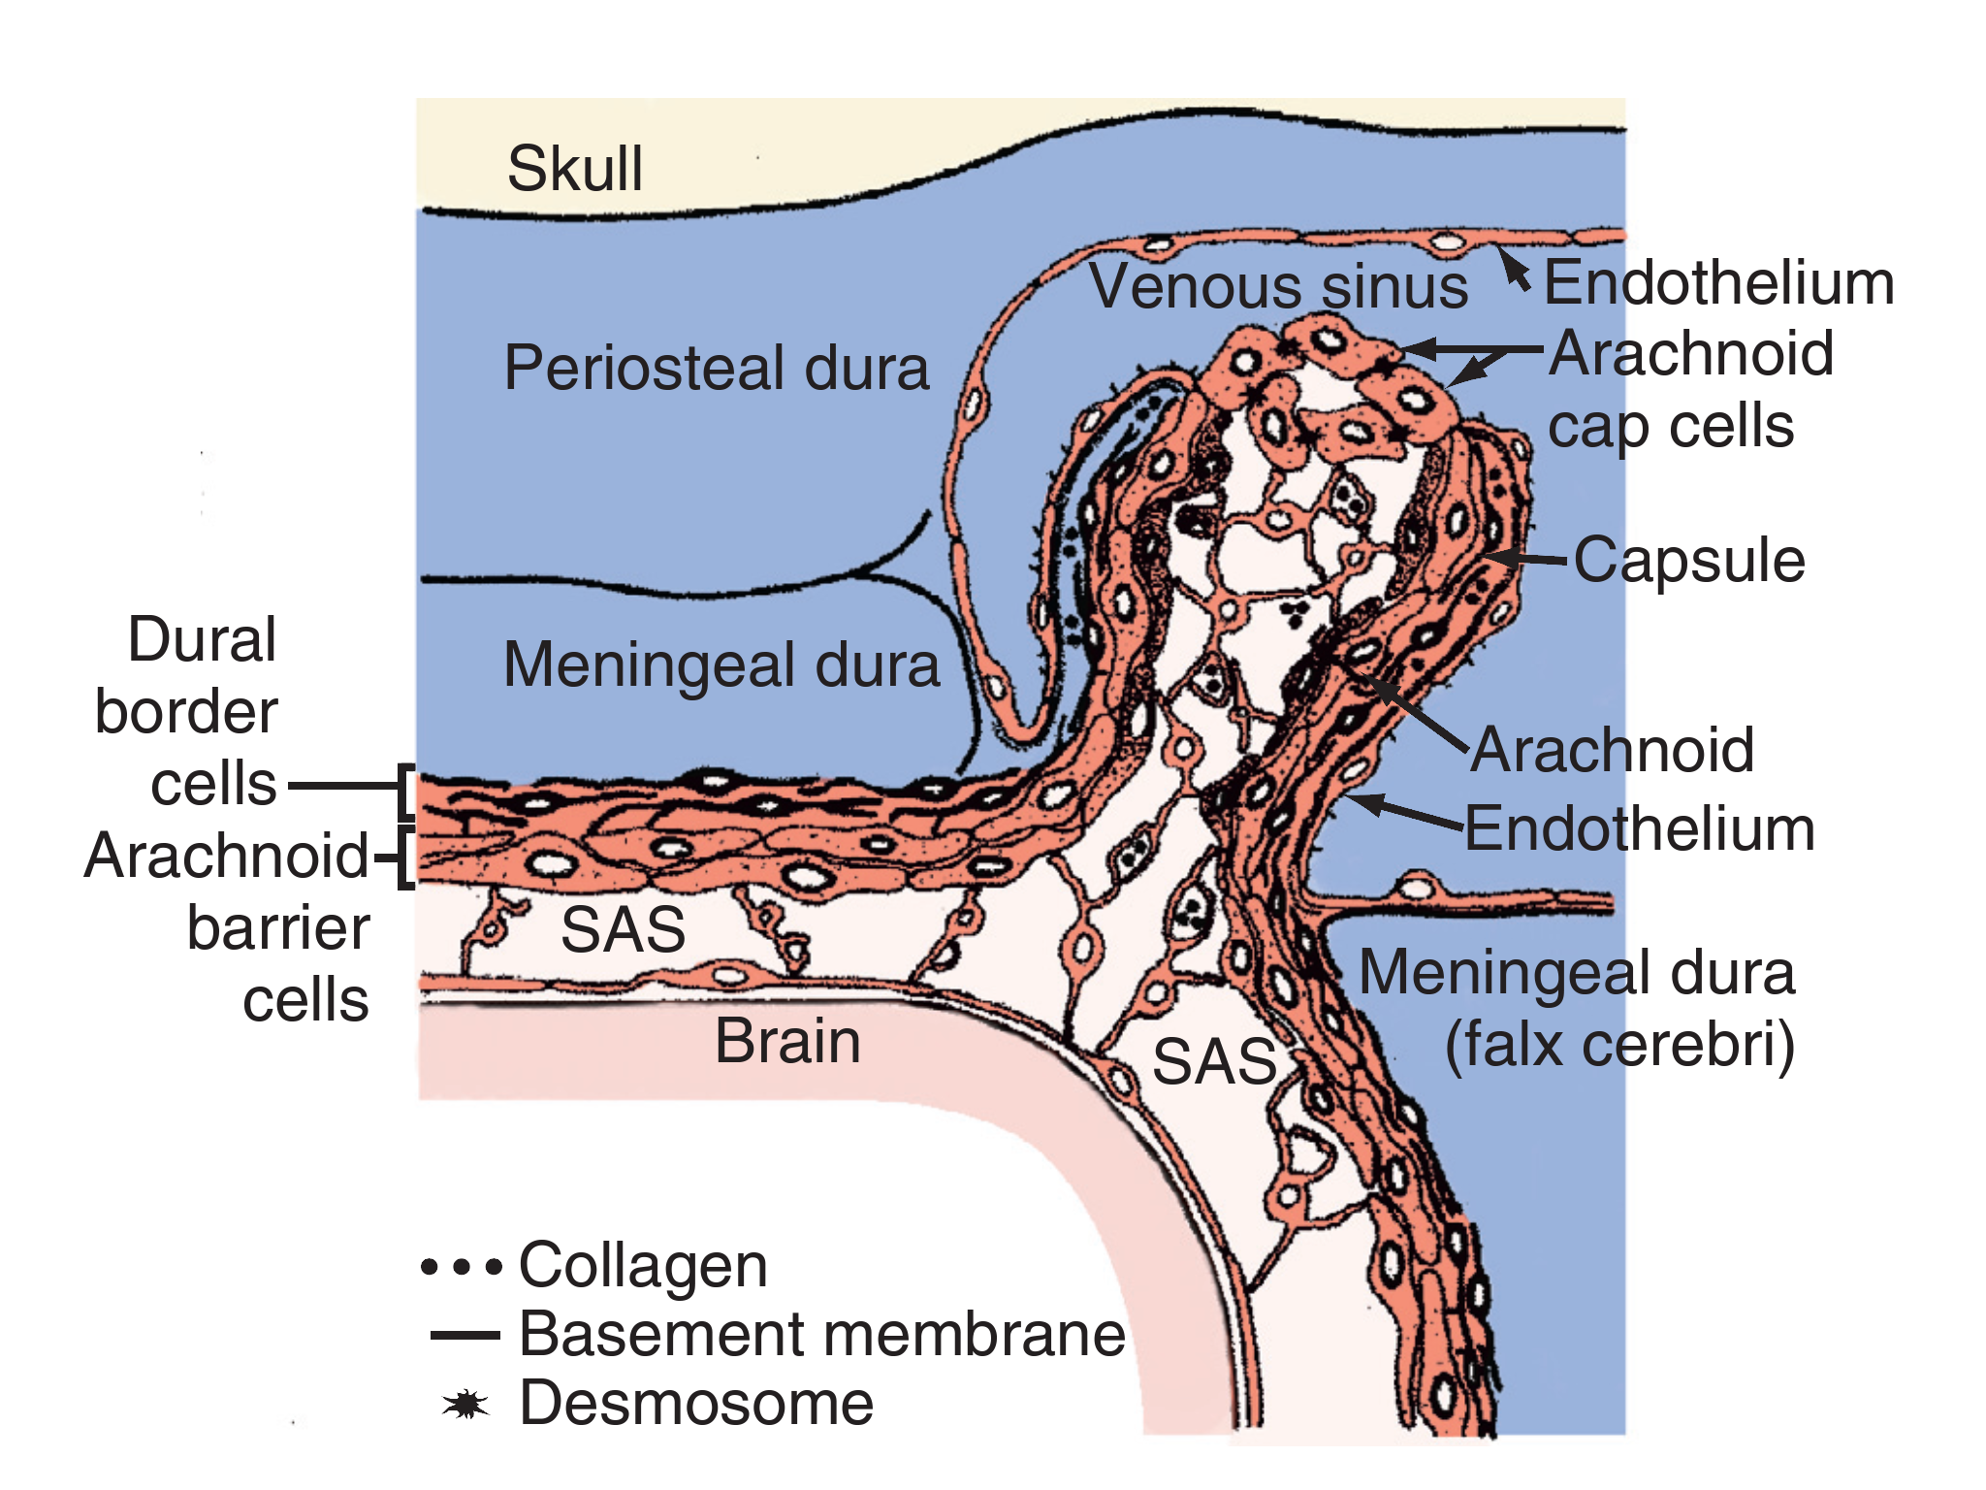
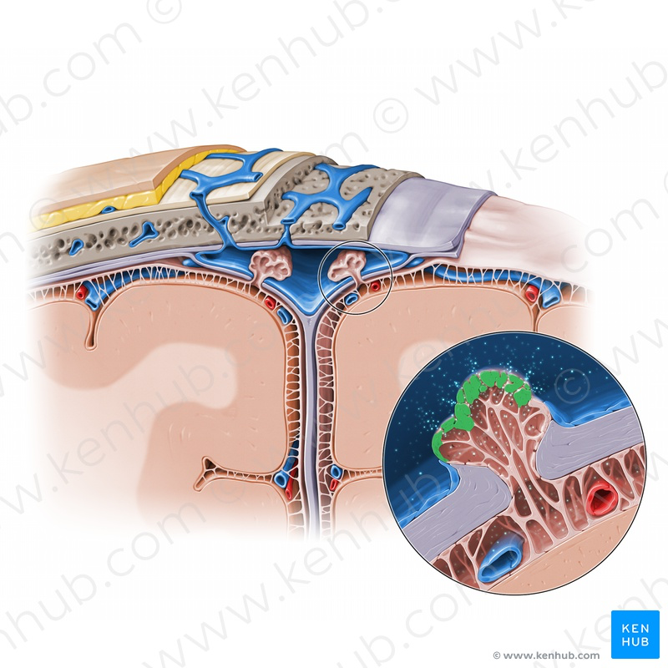
Arachnoid Cap Cell

Slide 6
Grading of meningioma
GRADE I
Meningothelial meningioma
Fibrous (fibroblastic) meningioma
Transitional (mixed) meningioma
Psammomatous meningioma
Angiomatous meningioma
Microcystic meningioma
Secretory meningioma
Lymphoplasmacyte-rich meningioma
Metaplastic meningioma
GRADE II (CAC)
Clear cell meningioma (intracranial)
Atypical meningioma
Chordoid meningioma
GRADE III (RAP)
Rhabdoid meningioma
Papillary meningioma
Anaplastic (malignant) meningioma

Slide 8
Notes:
Meningioma stained with (Hematoxylin-eosin staining)
Distinctive microscopic features of meningiomas include
Intranuclear cytoplasmic pseudo inclusions (invaginations of the cytoplasm into the nucleus).
Orphan Annie’s eye nuclei—target-like nuclei ( empty circular eye ).
Loss of heterozygosity on chromosome 22 is much more common in fibroblastic than in meningothelial variants.
It is important to note that hemangiopericytic meningiomas is of meningothelial origin, while true hemangiopericytoma is of mesenchymal origin.
Hyperostosis is a characteristic finding in meningiomas, especially in en plaque meningiomas.
Multiple meningioma: 60-90% of patients are women, mostly with NF2
Intraosseous meningiomas (in cranial bones)

Slide 9
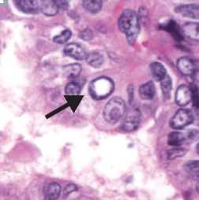
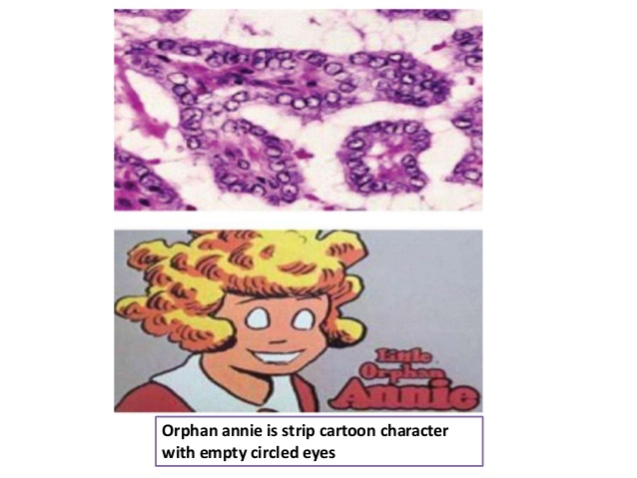

Slide 10
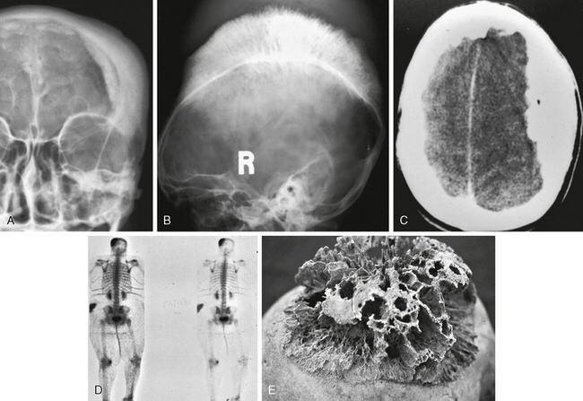
Osseous manifestations of meningiomas in different patients.
Frontal and lateral skull radiographs (A, B), and axial CT image (C) show prominent hyperostosis with typical hair-on-end appearance.
Postmortem skull (E) shows marked, coarse, hyperostotic changes.

Slide 11
IMMUNOHISTOCHEMISTRY AND MOLECULAR DIAGNOSTICS
Positive Marker for meningioma
Epithelial membrane antigen (EMA) is positive in 80% of meningiomas.
S-100 staining are quite variable.
Fibroblasts (vimentin) and epithelial cells (EMA and cytokeratins).
Negative Marker for meningioma
Anti-Leu 7 (positive in schwannomas)
Glial fibrillary acidic protein (GFAP) stains
Features of aggressive behavior include
Hypercellularity
Loss of architecture
Nuclear pleomorphism
Increased mitotic index
Focal necrosis
Hypervascularity
Hemosiderin deposition, and small cell formation.

Slide 12
Labeling method
Monoclonal antibody Ki-67 or MIB-1 have high labeling index —> more aggressive tumor.
Elevated Ki-67 labeling index seen in tumors that were previously irradiated.
E-cadherin expression is positive in only
Choroid plexus papillomas and meningiomas (transitional).
Negative in malignant recurrent tumor.
Extraneuraxial meningiomas can involve:
Orbit, paranasal sinuses, and nasopharynx.
Skin and subcutis.
Lungs, mediastinum, and adrenal gland.
Tumors of the central nervous system may metastasize to a primary intracranial tumor, 3/4th of these metastases target meningiomas

Slide 13
MENINGIOMAS AND RECEPTORS
Meningioma become symptomatic during pregnancy, and the symptoms decrease after delivery only to reappear with the next pregnancy.
Symptoms may also be exacerbated during the proliferative phase of the menstrual cycle.
PRs (progesterone receptors)
Identified much more consistently than ER (estrogen receptors) in meningioma.
Present in the cytoplasm of meningiomas, but not in the nucleus.
Expression of PRs alone is favorable clinical and biologic outcome.
Its absence carry poor prognosis.
Somatostatin receptors: meningioma exhibit a very high density of this receptor.
So we can give statin as it interfere with its proliferation.
Androgen, glucocorticoid, dopamine D1, and prostaglandin E2 receptors have been found in meningioma.
Epidermal, fibroblast, and platelet-derived growth factors PDGF shown to stimulate growth of meningioma.
Meningioma may interfere with glucose metabolism by increasing insulin levels.

Slide 14
Meningioma blood supply
Olfactory groove: feed from ethmoidal branches of the ophthalmic artery
Suprasellar meningiomas: may also be fed by large branches of the ophthalmic arteries
Parasellar meningiomas: tend to feed from the ICA. Secondary vascular supply may be derived from pial branches of the anterior, middle, and posterior cerebral arteries
Petroclival meningiomas: artery of Bernasconi & Cassinari (artery of tentorium a branch of the meningohypophyseal trunk)

Slide 15
RADIOLOGY:
Plain radiographs reveal three characteristic findings in meningioma:
Hyperostosis
Increased vascular markings
Calcification
CT Scan
Iso to hyperdense
Dural tail :The dura mater adjacent to the attachment of a meningioma may enhance.
MRI:
T1→ 60% isointense & 30% hypointense
T2→ 50% isointense & 40% hyperintense
Hyperintesity suggests higher water content as in (meningothelial meningioma, vascular meningioma, or aggressive meningioma which are easily aspirated during surgery )
15% of benign meningiomas have a n characteristic appearance, including
Presence of central lucency denoting necrosis
Presence of a cystic cavity (cystic meningioma).

Slide 17
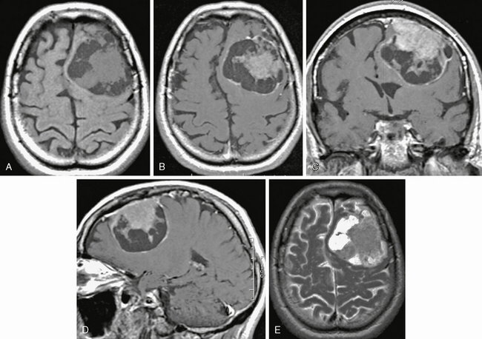
Cystic meningioma.
Axial T1W noncontrast (A) and axial (B), coronal (C), and sagittal (D) postgadolinium and axial T2W (E) MRI
show left frontal meningioma with prominent cystic regions typically located deep to the dural surface.

Slide 18
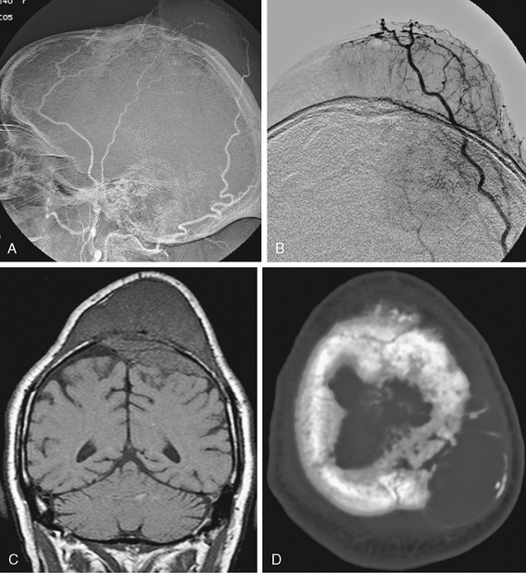
Angiographic images (A, B) show typical middle and posterior meningeal artery supply to this large transcalvarial meningioma.
Coronal T1W MR image (C) shows the substantial intracalvarial and extracalvarial soft tissue components of this mass
Axial CT scan (D) shows the intact but altered bony structure at the tumor site.

Slide 19
Typical Angiographic Features of Meningioma
Meningioma is supplied by the normal meningeal arterial supply to the meninges of the tumor site.
Prolonged homogeneous vascular blush is seen beginning in the late arterial phase and continuing into the late venous phase; this so-called mother-in-law blush comes early and leaves late.
Prolonged venous drainage is frequently seen.
After tumor penetration, the primary feeding vessels branch in a sunburst or radial pattern.
Partial tumor blush may arise from the injection of each major feeding vessel; overlapping the blush, images from selective injections often create a complete, homogeneous image of the tumor.
En plaque meningiomas, especially those associated with the planum sphenoidale, clinoids, and floor of the anterior cranial fossa, are generally poorly vascularized.

Slide 20
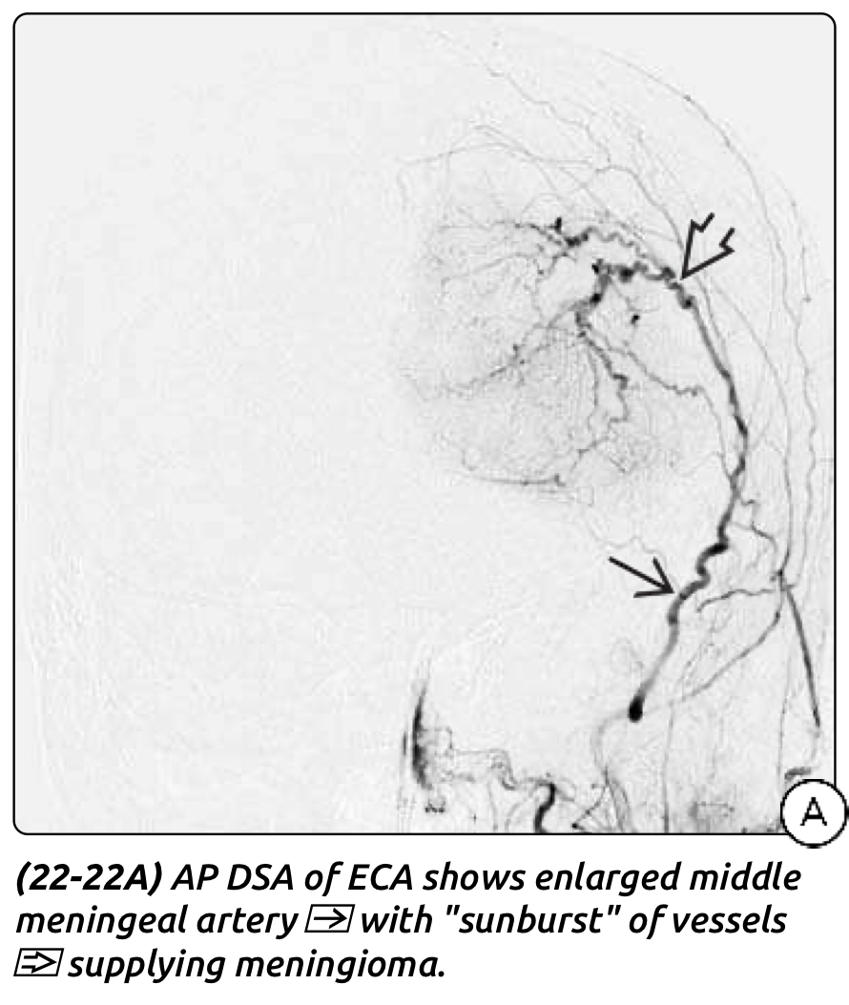
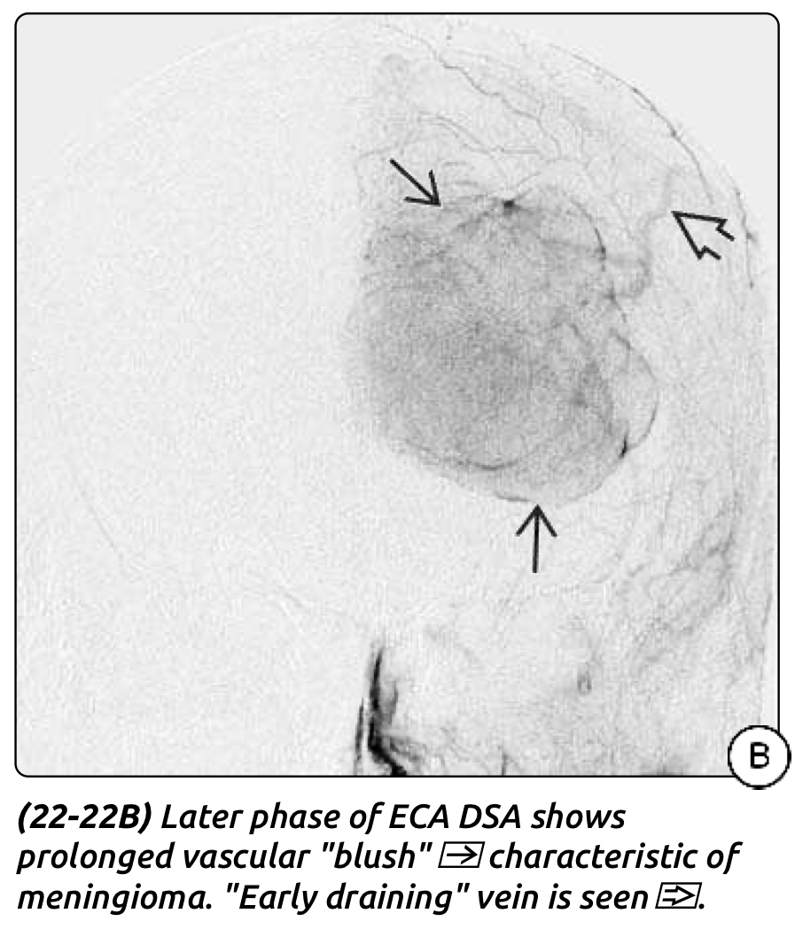

Slide 21
Top deferential diagnosis
Neurosarcoidosis
Pleomorphic xanthoastrocytoma (PXA)
Gliosarcomas
Solitary fibrous tumors
Of mesenchymal origin
Positive for CD34 and vimentin
Negative for EMA and S-100
OBSERVATION FOR MENINGIOMAS:
There are two exceptions needs surgery even if they were asymptomatic and incidentally diagnosed:
Tuberculum sellae meningiomas: because they can develop visual deterioration rapidly, even with small tumors.
Young patients: because meningiomas have been shown to grow more rapidly.
Observation strategy: 3months follow up to detect rapid growth, then 9months, then yearly for 5 years, after 5 years we can follow up biannually. Always compare with the old MRI.

Slide 22
Grade 0 The inclusion of an additional 2-cm dural margin.

Slide 24
SURGICAL THERAPY AND TUMOR RECURRENCE
Meningioma recurrence increased in:
Sphenoid wing M. 20%
Parasagittal M. (Invade sinus) 20%
Aggressive M. (invasion of the dura or brain infiltration, and papillary or hemangiopericytic pattern)
High level of vascular endothelial growth factor (VEGF)
High MIB-1 labeling index
Radiation therapy indicated in:
After surgery for a malignant meningioma.
Following incomplete resection of a meningioma.
Multiple recurrent tumors which is too risky for surgery.
Progressively symptomatic patient with inoperable meningioma.
Primary treatment for poorly accessible meningiomas (cavernous sinus or clival).

Slide 25
MEDICAL MANAGEMENT
The presence of hormonal receptors in meningiomas has prompted research into hormonal manipulation as treatment.
Tamoxifen (estrogen antagonist) reduce size of meningioma
Bromocriptine (dopamine antagonist) inhibits meningioma cells
Mifepristone (antiprogesterone agent) has progesterone and cortisol-blocking activities
Trapidil (antagonistic action against PDGF) inhibition of meningioma cell proliferation.
Inhibited the epidermal growth factor–stimulated proliferation of meningiomas as well as nontumorous fibroblasts.
Bevacizumab (VEGF inhibitor) used in the treatment of other malignancies

Slide 26
Types of meningioma by location
Convexity Meningiomas:
Characterized by
dural attachment
lie on the hemispheres without extension into the dura mater of the skull base
do not invade the dura of the venous sinus.
Sub classification: pre & post coronal, para central, parietal, occipital, temporal.
supplied centrally from the middle meningeal branches and peripherally from the intracranial vessels
Surgical principles:
Bur holes made around the tumor and far from the tumor margin to obtain healthy dura.
Dura opened circumferentially around the tumor 2cm from tumor margin.
Maintain the dissection in arachnoid plane to preserve the cortical layer.
Cortical vessels underneath the tumor should be preserved.
Remove tumor en bloc. (Simpson grade 0)
In large, adherent tumor, start with central enucleation.

Slide 27
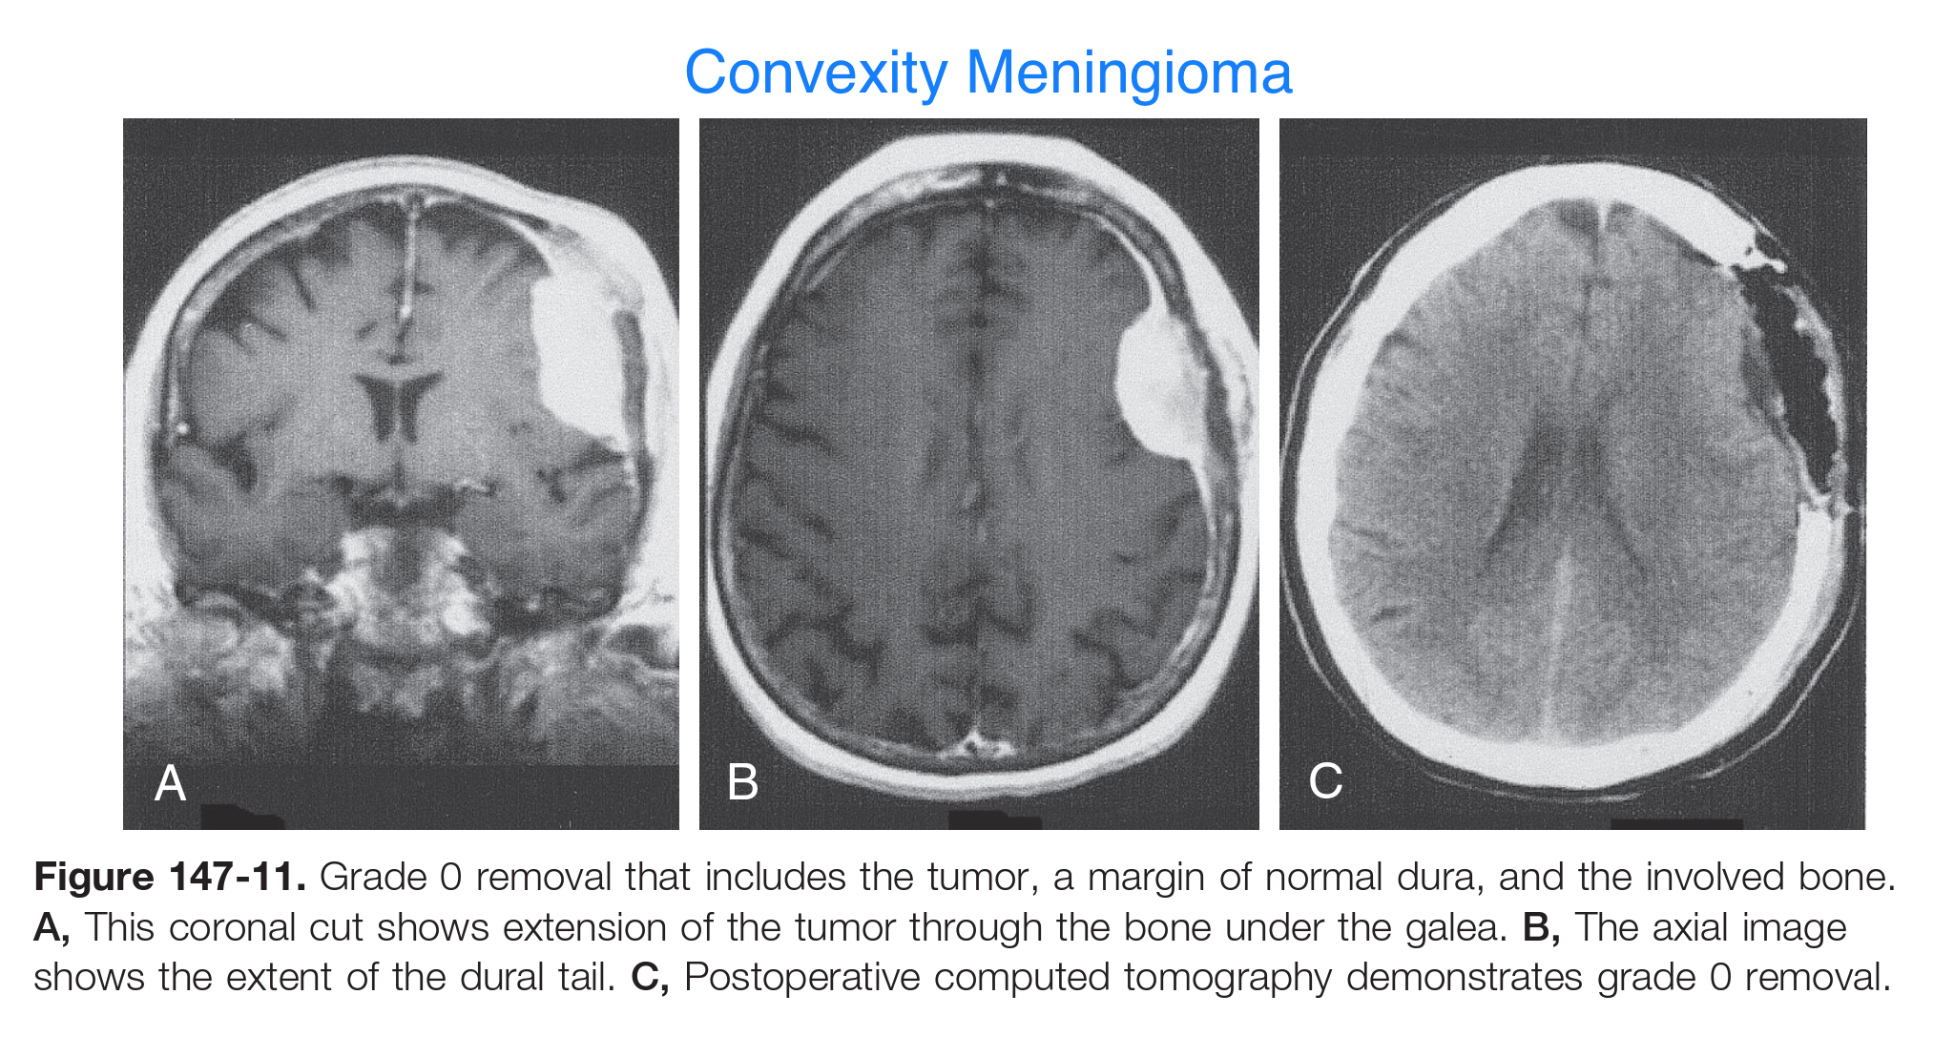

Slide 28
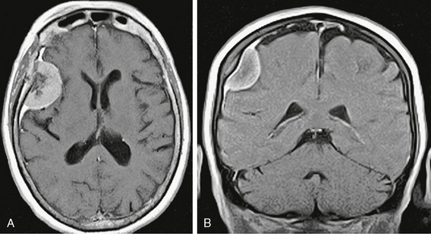
Axial (A) and coronal (B) postgadolinium T1W MR images show dense homogeneous enhancement and a “dural tail.” Some hyperostosis is also present. The dark signal intensity centrally is due to psammomatous or sand-like calcifications.

Slide 29
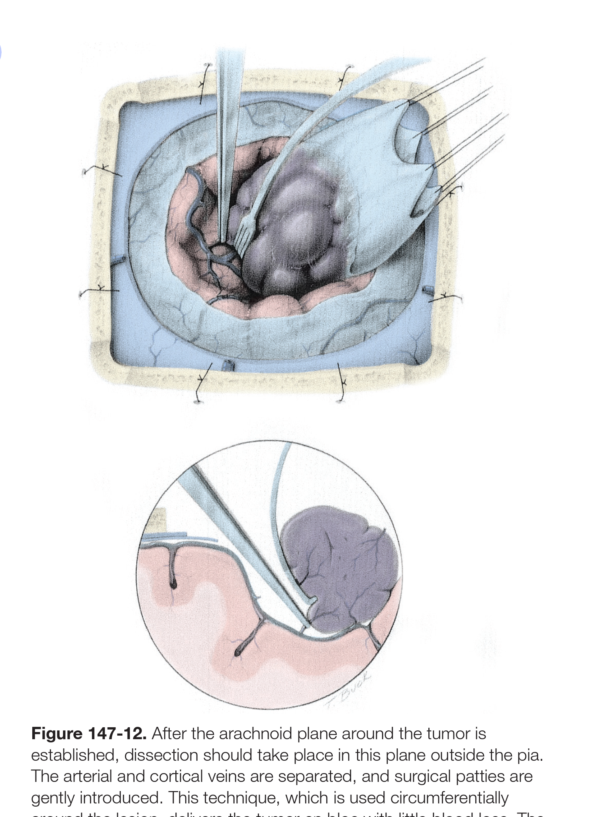
After the arachnoid plane around the tumor is established, dissection should take place in this plane outside the pia.
The arterial and cortical veins are separated, and surgical patties are gently introduced.
This technique, which is used circumferentially around the lesion, delivers the tumor en bloc with little blood loss.
The most important technical point is to preserve all cortical veins and arteries and avoid violating the pia.
The tumor is then lifted from its bed.

Slide 30
Parasagittal meningioma:
Fills the parasagittal angle, with no brain tissue between the tumor and the superior sagittal sinus.
Presentation: seizure, headach, unilateral weakness, mental symptoms.
Surgical principles:
Bicoronal incision.
Multiple Bur holes around the tumor, bur holes near the sinus allow safe separation of the dura from the bone.
separation of the tumor capsule from surrounding cortex is performed
If the tumor invade the sinus:
Totally occluded SSS can be excised at any point.
Partially occluded SSS, we have 3 choices:
Ligate the sinus ( only the anterior third of the sinus can be lighted ) , with risk of venous infarction
Leave the tumor part that attached to the sinus to be removed later after it slowly invade the sinus and making collaterals.
Resect the portion of the sinus involved and then repair the sinus primarily or with a patch.

Slide 31
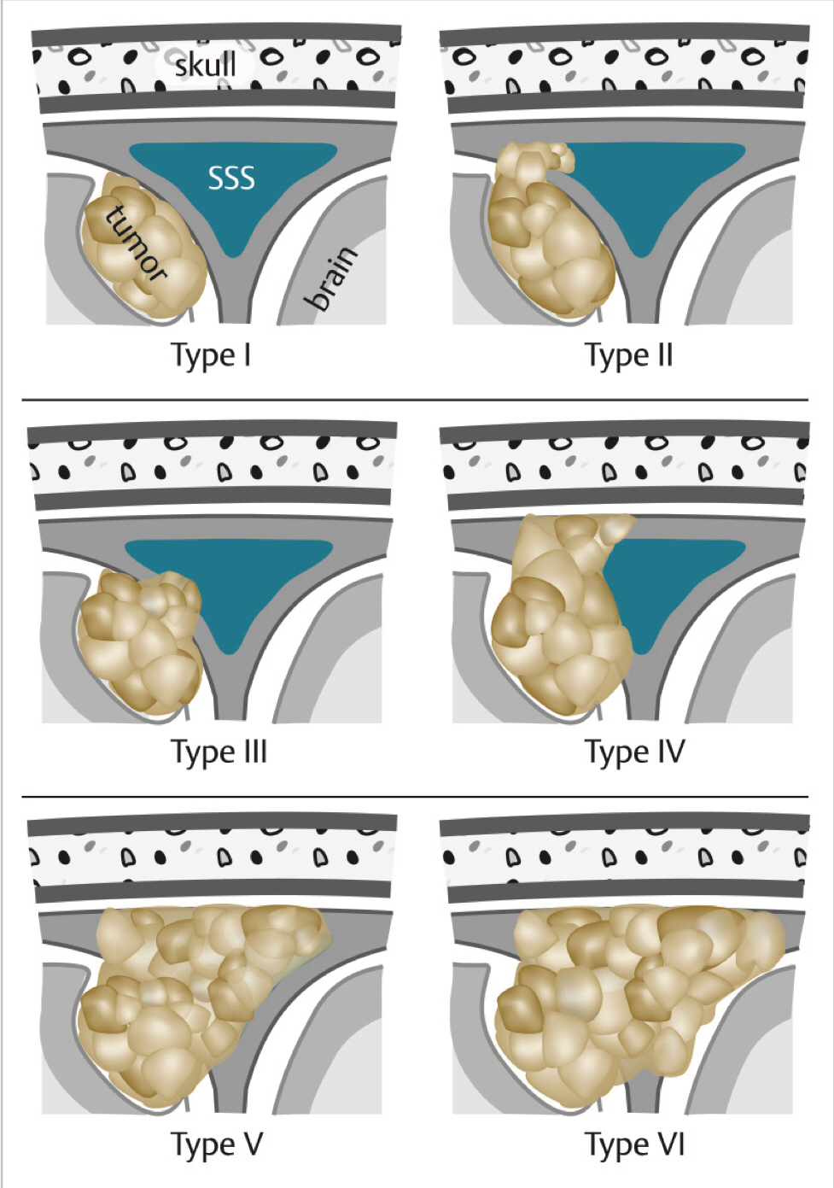
Sindou Grading for meningioma invasion of the superior sagittal sinus
Type I = attachment to lateral wall of sinus
Type II = invasion of lateral recess
Type III = invasion of lateral wall
Type IV = invasion of lateral wall and roof
Type V = total sinus occlusion, contralateral wall spared
Type VI = total sinus occlusion, invasion of all walls

Slide 32
Symptom and Presentation regarding SSS
Anterior third of SSS (ethmoidal plate to coronal suture)
Frontal lobe syndrome Slow progressive symptom short attention span, poor short-term memory, personality change, apathy and emotional instability
Sign of increase ICP headache, papilledema, or optic atrophy
Middle third of SSS (between coronal and lambdoidal sutures)
Spastic weakness and focal seizures that involve the contralateral foot and leg.
Posterior third of SSS (lambdoidal suture to torcular Herophili)
Persistent headache and hemianopsia
Visual hallucination
Large tumors homonymous hemianopsia with macular sparing

Slide 33
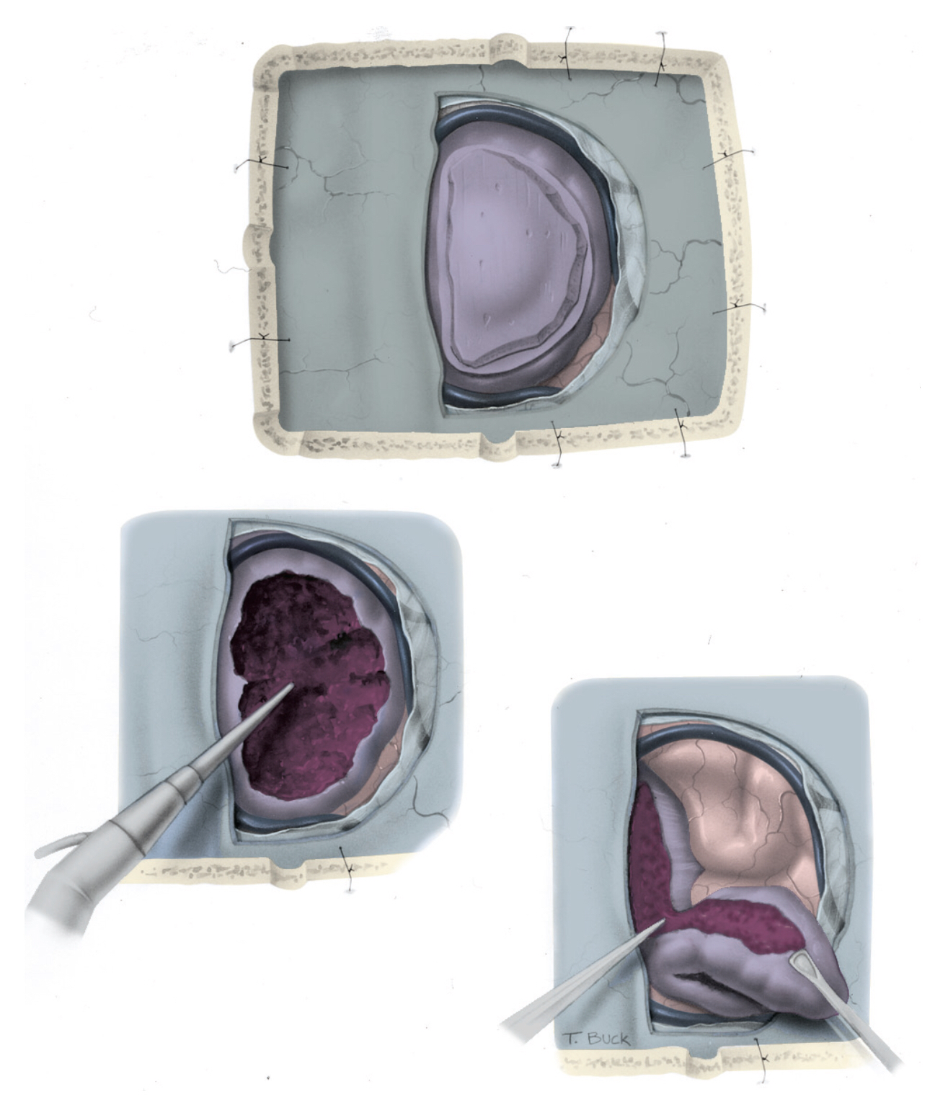
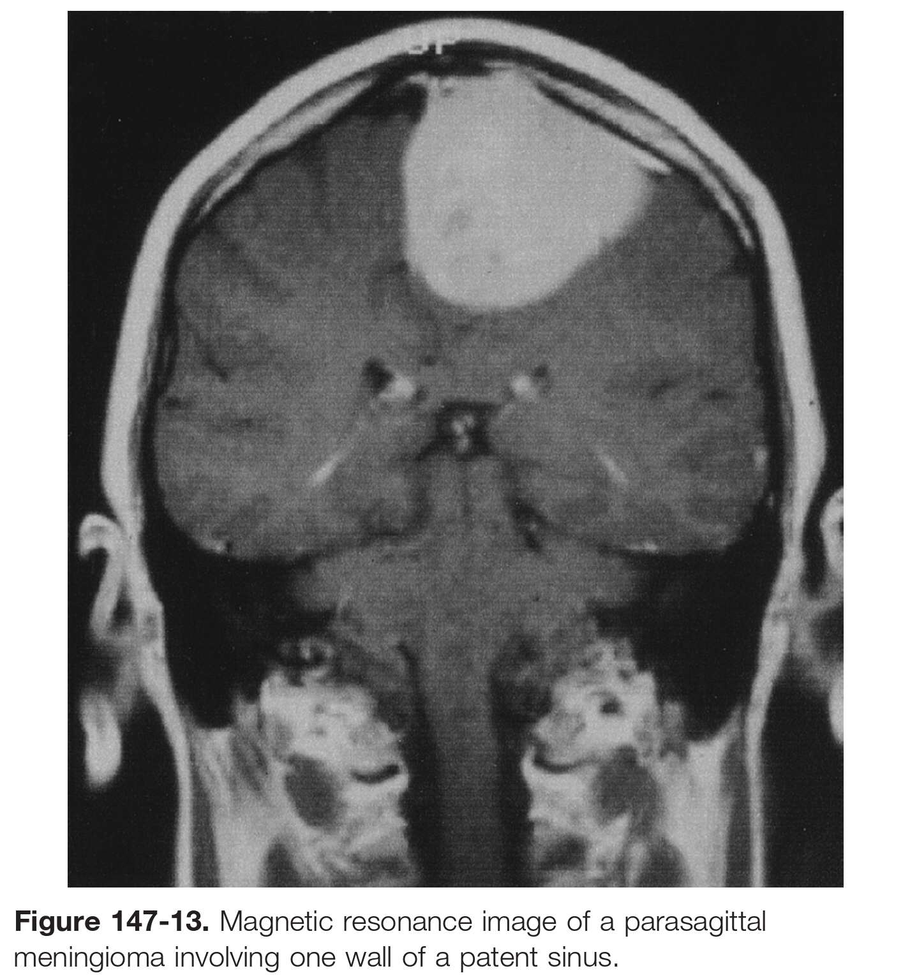
Parasagittal meningioma with a patent posterior third of the sagittal sinus and hyperostosis invading the skull. The hyperostotic, invaded bone is divided into pieces before it is removed. The tumor is debulked with an CUSA, and the capsule is separated from the cerebral cortex. The pial plane is maintained, and utmost attention is paid to preserving the cortical veins. The tumor capsule is then amputated along the sinus, and a piece of tumor invading the sinus is left.

Slide 34
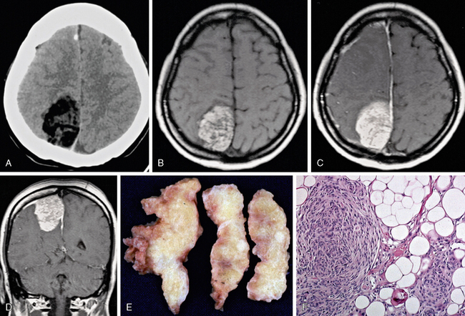
Lipomeningioma
considered a type metaplastic meningioma
Low density is seen on noncontrast CT (A). Fatty high T1 signal intensity is seen on a nonenhanced T1W image (B), which is somewhat less obvious on postgadolinium axial and coronal T1W MR images (C, D).
Gross pathologic specimen (E) shows typical yellow fatty tissue, and hematoxylin and eosin–stained (×100) microscopic specimen
(F) shows lipid globules.

Slide 35
Falcine meningioma:
It arises from the falx, completely concealed by cortex, and does not involve the SSS. In practice, many falcine meningiomas do involve the sagittal sinus.
Divided into:
Anterior: extends from the crista galli to the coronal suture
Middle: extend from the coronal suture to the lambdoid suture.
Posterior: extend from lambdoid suture to the torcula.
Yasargil classification:
Outer: arise from body of falx in the frontal (anterior or posterior), central parietal, or occipital regions.
Inner: arise from junction of falx with inferior SS.
Falcine meningiomas have tendency to progress to a higher grade.

Slide 36
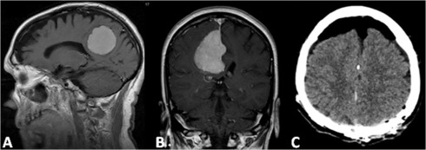
Surgical principles:
Interhemispheric exposure.
For a unilateral tumor, early devascularization along the falx is preferred.
For larger tumors, central enucleation allows subsequent microsurgical separation of the tumor capsule from surrounding arachnoidal areas.
The dissection plane helps avoid surrounding cerebral cortex injury and pial disruption and protects the pericallosal arteries in the inferior margin of the dissection.
A large margin of the falx is excised to remove the distant diffuse extension of the meningioma between the two falx leaflets.

Slide 37
Intraventricular meningioma:
Arise from arachnoid cells contained in the choroid plexus and tela choroidea,
90% of cases occur in the trigone of lateral ventricles (supplied by ant. Ch. Art.) , the post. Ch. Art. also contributes.
Post-op epilepsy is high in all procedure except callosotomy
Surgical principles: approaches to this meningioma could be:
Cortical incision in the middle temporal gyrus.
Incision in posterior paramedian parietal cortex.
Via the lateral temporoparietal lobe.
Temporal or occipital lobectomy could be a choice
Midline section of corpus callosum.
Contraindicated of corpus callosotomy
Patients with right homonymous hemianopia because complete splenial section in this circumstance results in alexia without agraphia
preoperative visual field defects are present in 40% to 70% of patients

Slide 38
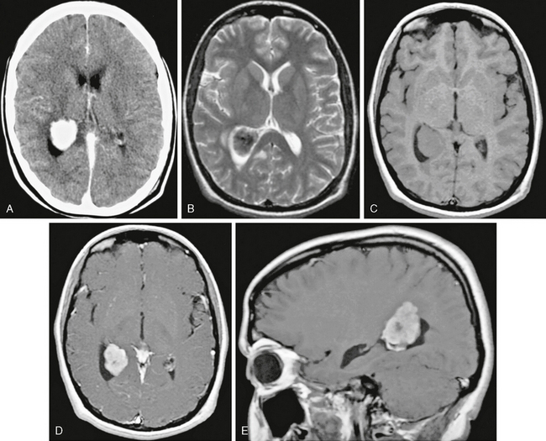
Intraventricular meningioma
Contrast-enhanced CT image (A) shows an ovoid, well-circumscribed, densely enhancing mass in the atrium of the right lateral ventricle.
Axial T1W (B), T2W (C), and axial and sagittal postgadolinium (D, E) MR images show a densely enhancing mass with some low signal intensity on T2 weighting, suggesting calcification. Pathologic examination revealed typical meningothelial meningioma.

Slide 39
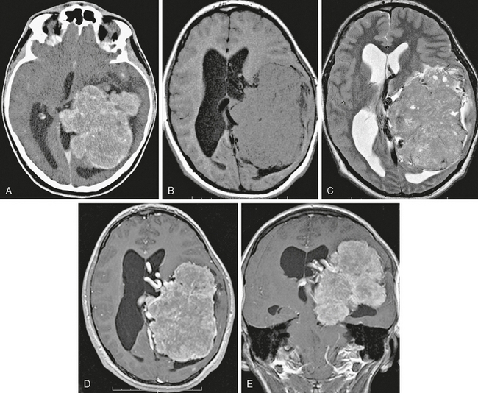
Intraventricular meningioma
Axial contrast-enhanced CT image (A) and axial T1W (B), T2W (C), and postgadolinium axial (D) and coronal (E) T1W MR images
show a large mass centered at the atrium of the left lateral ventricle with somewhat irregular margins and diffuse but slightly heterogeneous enhancement. Atypical imaging features correspond, in this case, but not always, with atypical histology.

Slide 40
Tentorial meningioma:
Divided into:
Inner: arise from tent. Inner edge.
Outer: arise along the transverse sinus.
Arise from tent. central leaflet.
Arise from falcotentorial junction.
Surgical principles:
Petroclival M. Arise medial to trigeminal nerve and have only one arachnoid layer separate it from the brainstem ( risky during surgery )
Tentorial M. Arise lateral to trigeminal nerve and push the cisterns during its growth so it have many arachnoid layers separate it from brainstem ( less risky during surgery )

Slide 41
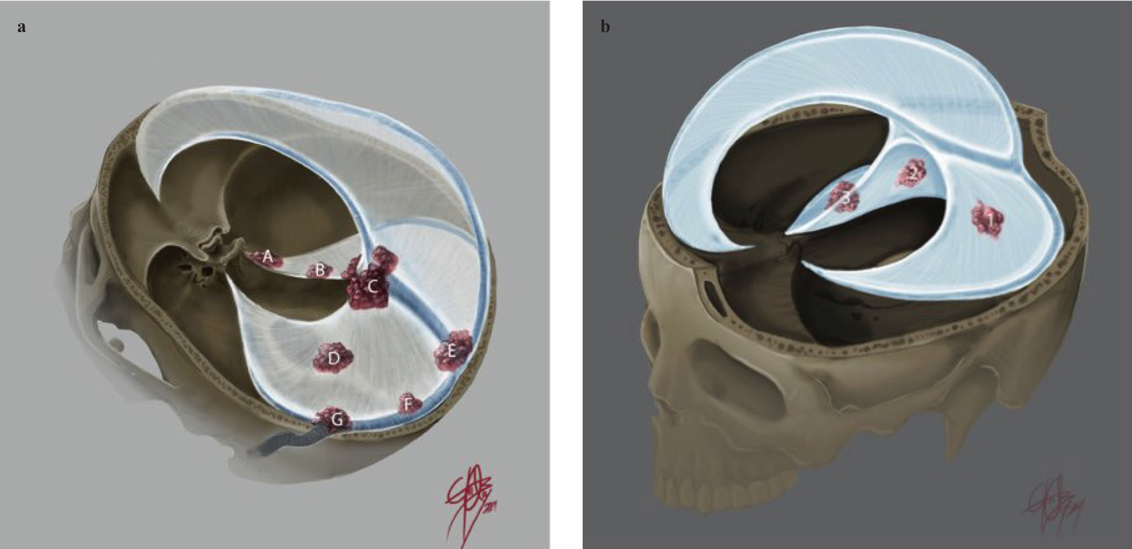
Approaches:
Standard subtemporal approach combined with Anterior petrosal app: for lesions extending posteriorly into the lateral pontine area.
Petrosal app: Lesions involving the middle to posterior part of the inner ring of the tentorium, with involvement of the petroclival area and extension into the perimesencephalic cistern
Posterior interhemispheric transtentorial app.: for falco-tentorial M.
Supracerebellar infratentorial app.: for falco-tentorial (goes infratentorially) M.
Supra-infratentorial app.: for large tentorial M. with supra-infratentorial extension.

Slide 42
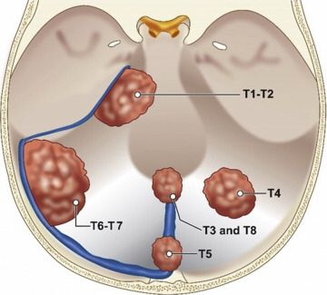
Yaşargil classification of tentorial meningioma
Meningiomas arising from the free tentorial notch (inner ring meningiomas, anterior T1, middle T2, and posterior T3)
Meningiomas originating from the intermediate tentorial surface (T4)
Meningiomas involving the torcular Herophili (T5)
Meningiomas arising from the lateral outer tentorial ring (posterior T6, anterior T7)
Falcotentorial meningiomas (T8)

Slide 43
Olfactory groove meningioma:
Originate from cribriform plate & extend to ethmoid, sphenoid, nasal cavities.
The tumor’s primary blood supply is from the anterior ethmoidal artery.
Late recurrence of olf. groove M. is significant and it caused by conservative handling of underlying invaded bone.
The pattern of recurrence is toward the ethmoid and nasal cavity.
Presentation (usually asymptomatic until they are large) may include
Foster Kennedy syndrome: anosmia (patient is usually unaware of this), ipsilateral optic atrophy, contralateral papilledema
Mental status changes: often with frontal lobe findings (apathy, abulia…)
Urinary incontinence
Visual impairment (bitemporal visual field defect) caused by posteriorly located lesions that compress the optic apparatus
Short-term memory loss by large lesions that compress the fornix
Seizure

Slide 44
Surgical approaches:
Unilateral pterional approach.
Bifrontal transbasal approach.
Supraorbital approach (the preferred approach).
It provides superb low basal exposure and lessens the need for retraction of the frontal lobe.
It allows a wider corridor to control tumor vascularity, enucleate the tumor, resect the basal dura, and repair the anterior cranial base
Note:
Olfactory groove meningioma→ early anosmia, late visual defects.
Tuberculum sellae (Suprasellar meningioma) → early visual defects, late anosmia.

Slide 48
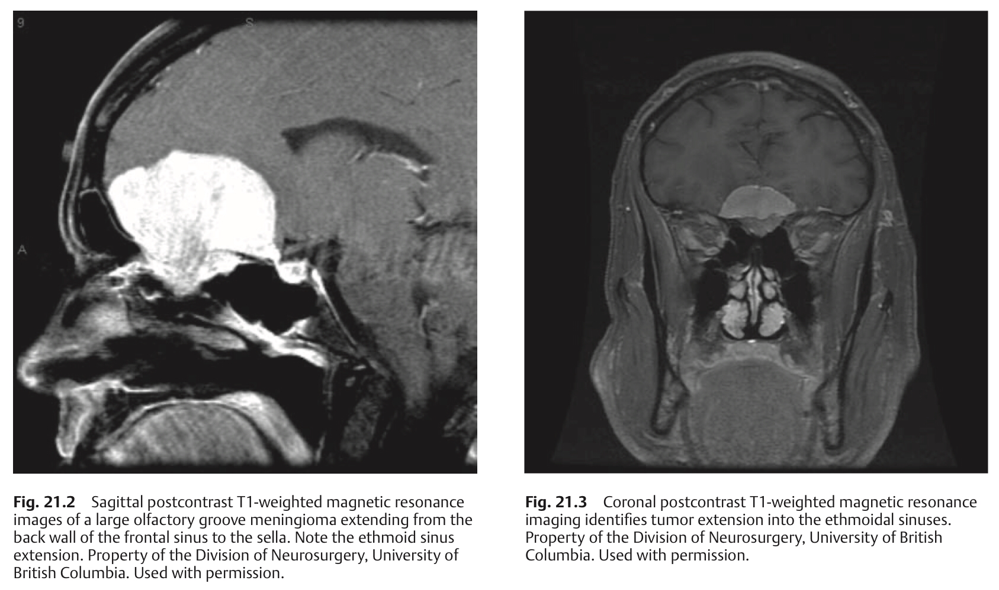

Slide 49
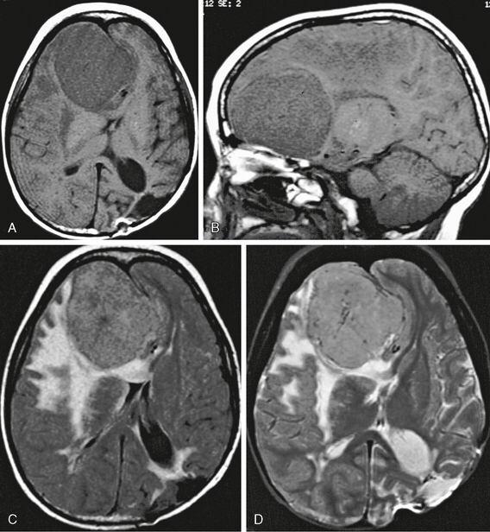
Olfactory groove meningioma.
Axial and sagittal T1W MR images (A, B) show a large extra-axial mass centered in the anteroinferior left frontal region with significant midline shift.
Axial FLAIR (C) and T2W MR (D) images show prominent perilesional edema as well as postsurgical encephalomalacia in the left parietal lobe.

Slide 50
Tuberculum sellae meningioma:
The mean age is in the 4th decade
M : F — 1 : 3
Present with Chiasmal syndrome (asymmetricle primary optic atrophy + asymmetrical bitemporal field defects).
Commonly extend to one or both optic canals.
Anosmia manifests late in suprasellar meningioma.
The optic nerves are displaced laterally and superiorly (lies above and lateral to the ICA).
The optic chiasm are displaced superiorly or posteriorly.
Diaphragma sellae meningioma:
usually grows retrochiasmatically and manifested with hypothalamic dysfunction.
It is Divided to:
Type A: originate from upper leaf of diaph. sellae anterior to pituitary stalk.
Type B: originate from upper leaf of diaph. sellae posterior to pituitary stalk.
Type C: originate from inferior leaf of diaph. sellae.

Slide 51
Surgical Notes
The preferred approach is the Supraorbital approach.
Diaphragma sellae meningiomas are technically more difficult to remove than tuberculum sellae meningiomas because of the deep location and the difficulty of dissecting them from the pituitary stalk.
The A1 segments in particular are usually severely stretched, adherent, or engulfed and can be the source of morbid injury.
When the tumor extends into the optic canal
The anterior clinoid process, optic canal, and roof of the superior orbital fissure are drilled away.
Tumor tissue around the optic nerve is removed by microdissection.
Preservation of the ophthalmic and central retinal arteries.

Slide 52
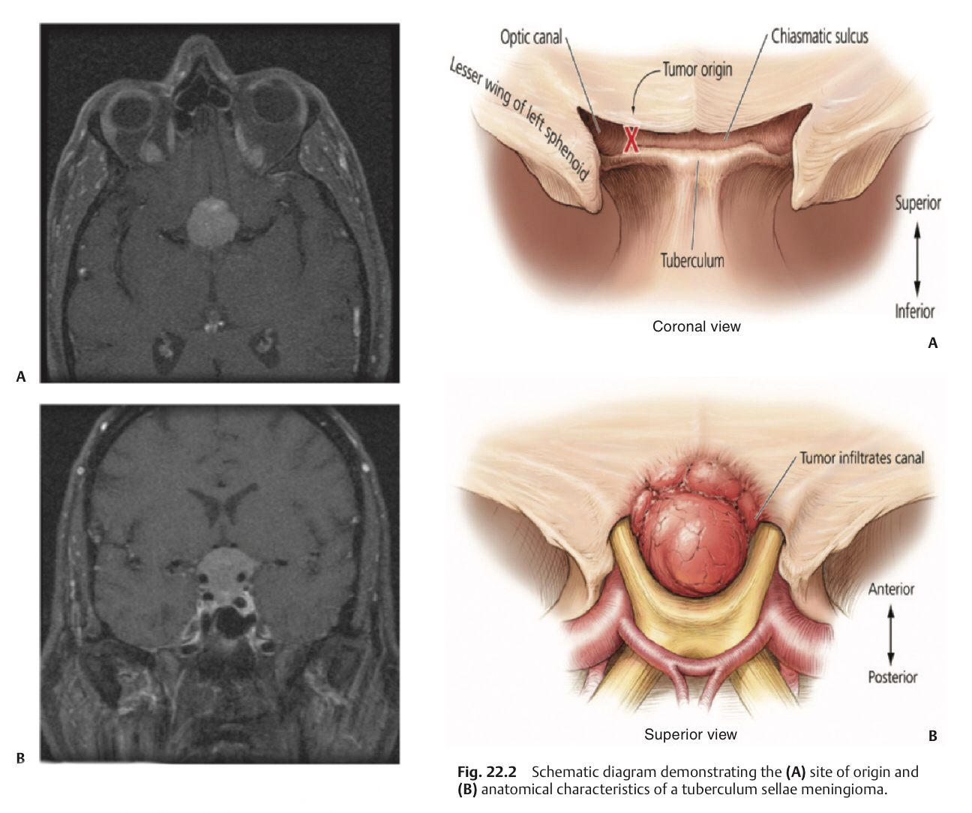

Slide 54
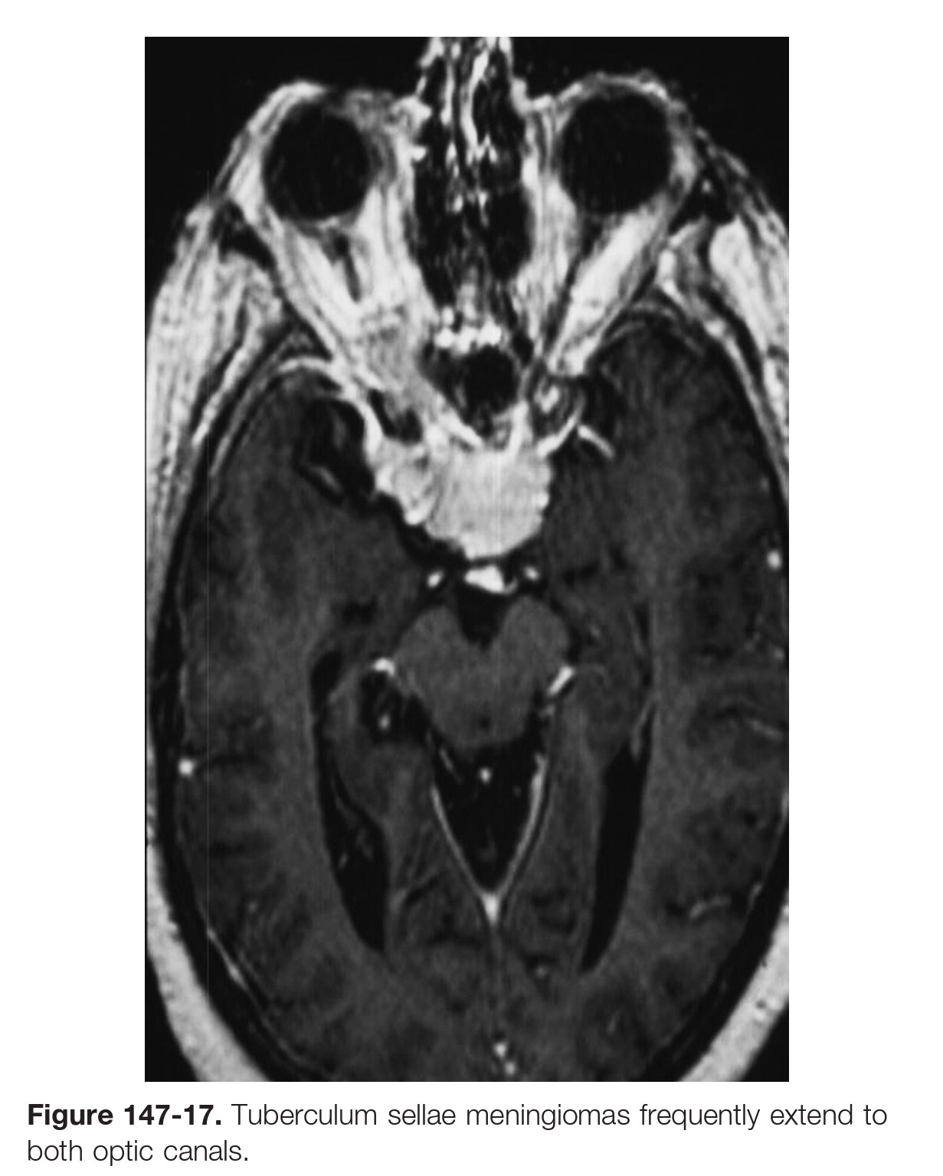
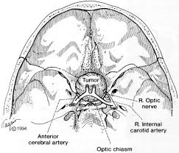
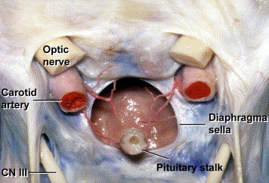

Slide 55
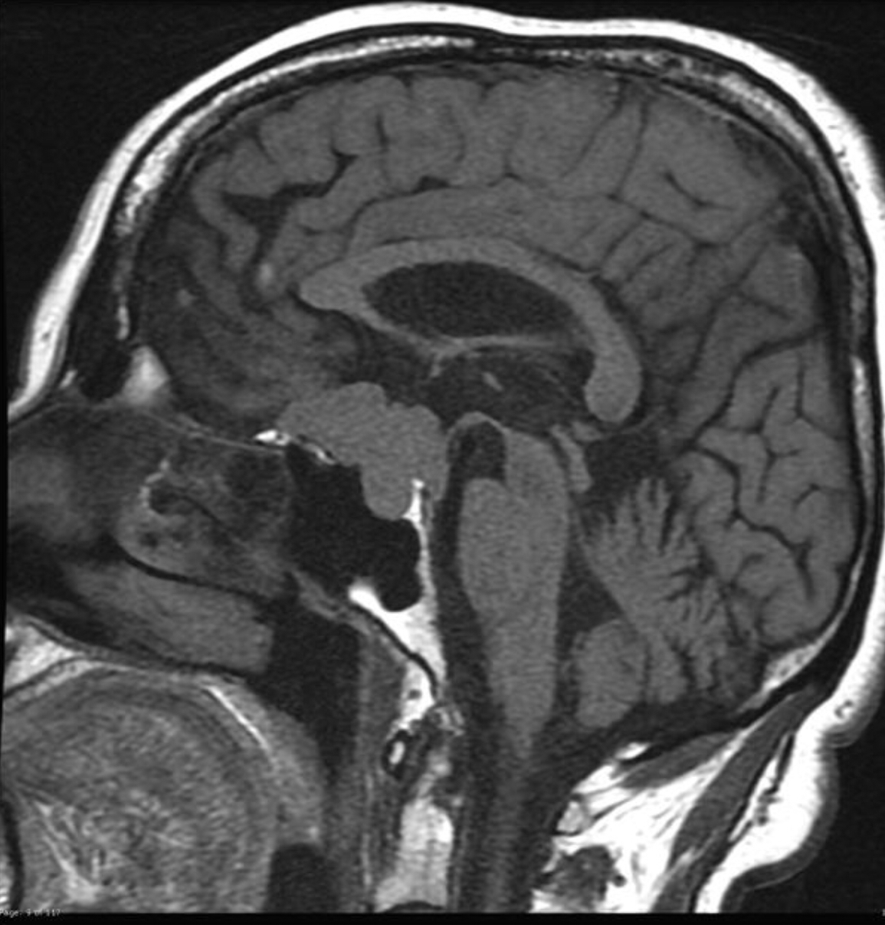
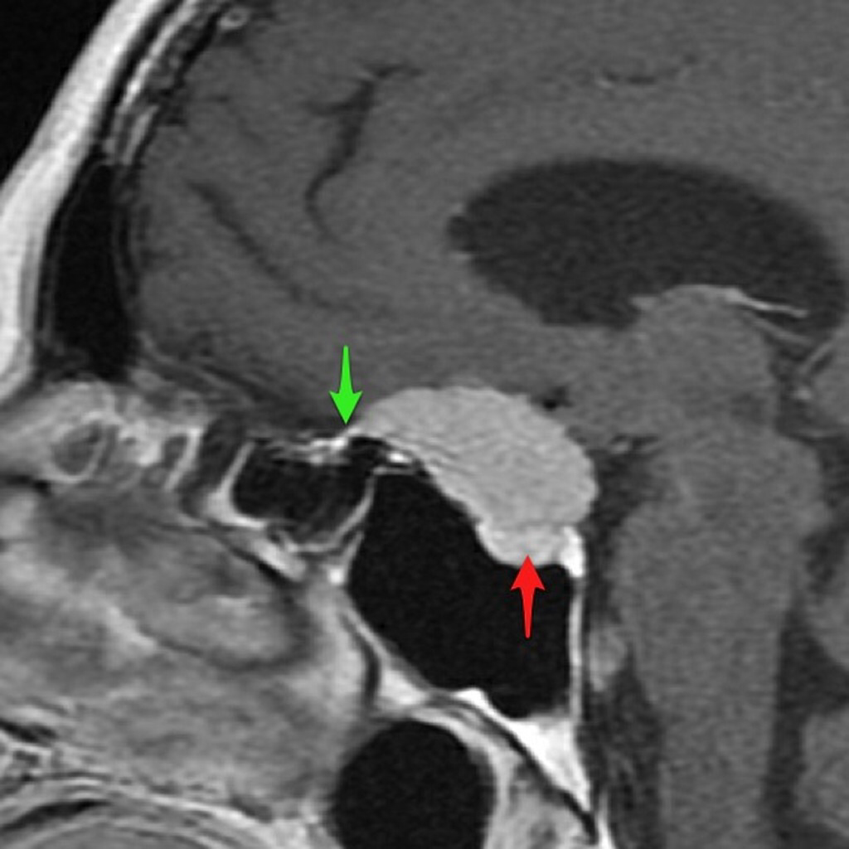

Slide 56
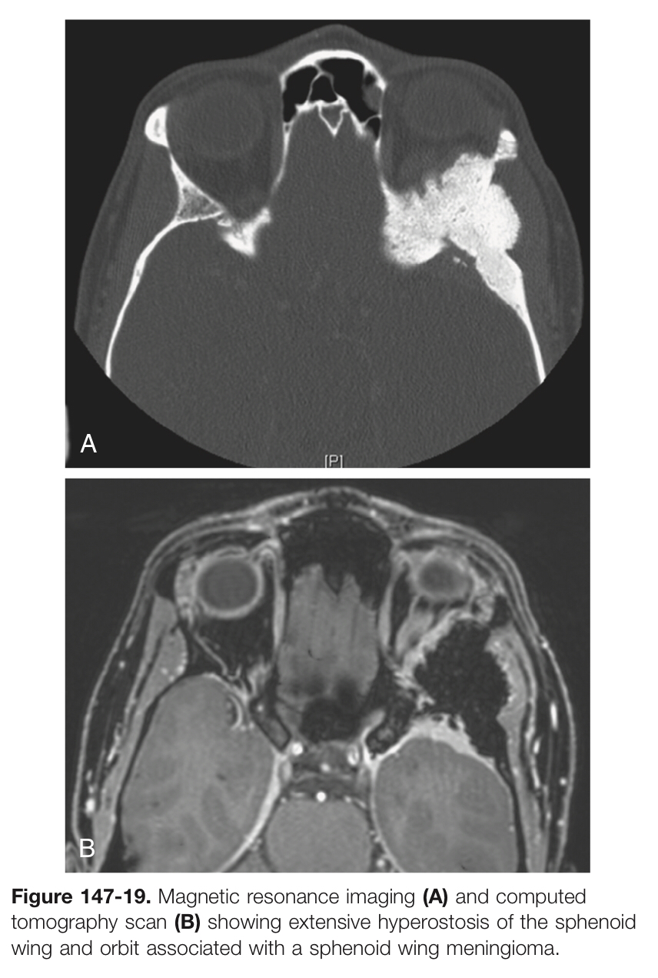
Sphenoid wing meningioma: divided into:
Lateral
Middle
Clinoidal
Meningiomas en plaque also occur in the area of the sphenoid wing and characterized by marked hyperostosis of the sphenoid bone and diffuse tumor invasion, leading to proptosis or cranial neuropathies caused by foraminal encroachment.
Lateral sphenoid wing meningiomas can be resected after extradural drilling of the sphenoid ridge, which also aids in devascularizing the tumor.
Meningiomas that arise from the middle third of the sphenoid wing are also resected after extradural drilling of the sphenoid wing.

Slide 57
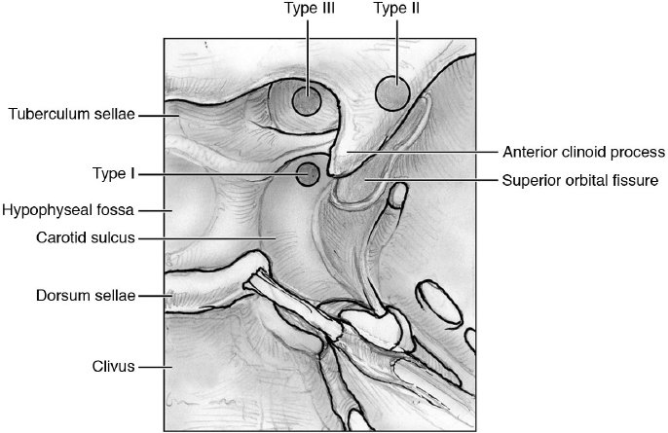
The Clinoidal meningioma is subdivided to:
Type I: originate from inferior aspect of clin. process, strong attachment to ICA
Type II: originate from anterior or lateral aspect of clin. process, arachnoid layers separate the ICA from the tumor.
Type III: originate from the optic canal, strongly attached to optic nerve and chiasm.

Slide 58
Surgical principles:
The surgical approach to this type of meningioma is complete removal of the greater sphenoid wing, anterior clinoid, and superior and lateral orbital walls, followed by generous removal of the affected dura.
Lateral sphenoid wing meningioma can be resected after extradural drilling of the sphenoid ridge.
Middle third meningioma are also resected after extradural drilling of the sphenoid wing.
Cranio-orbital zygomatic approach is recommended for the resection of clinoidal meningioma.

Slide 60
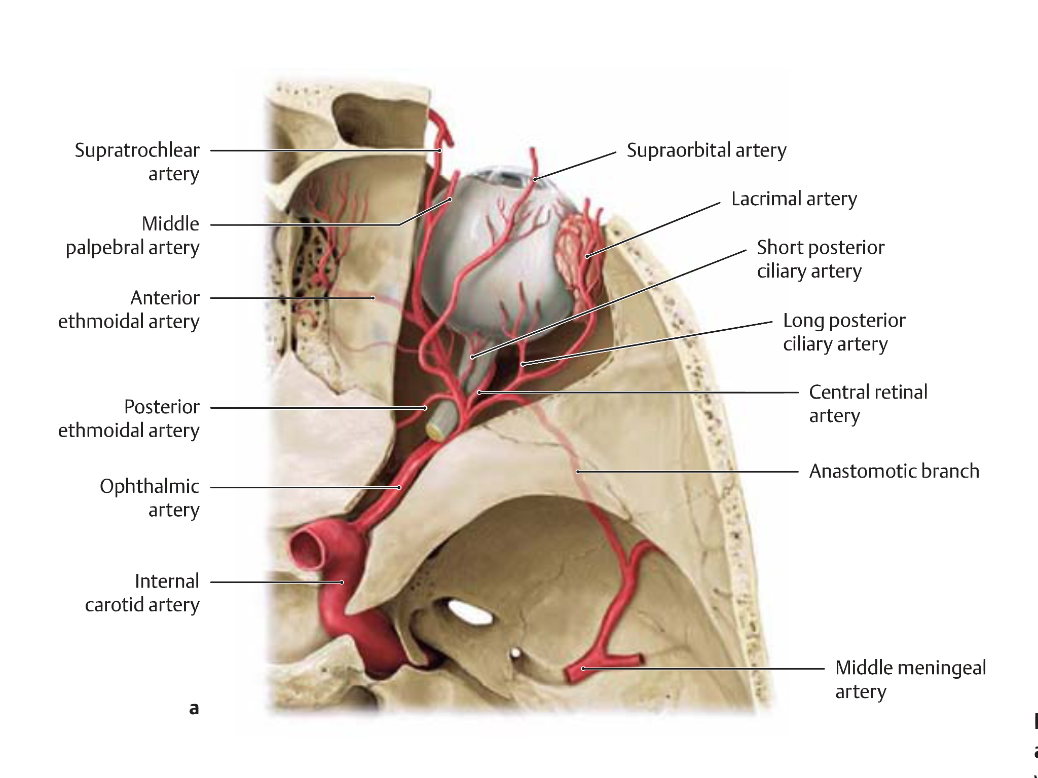
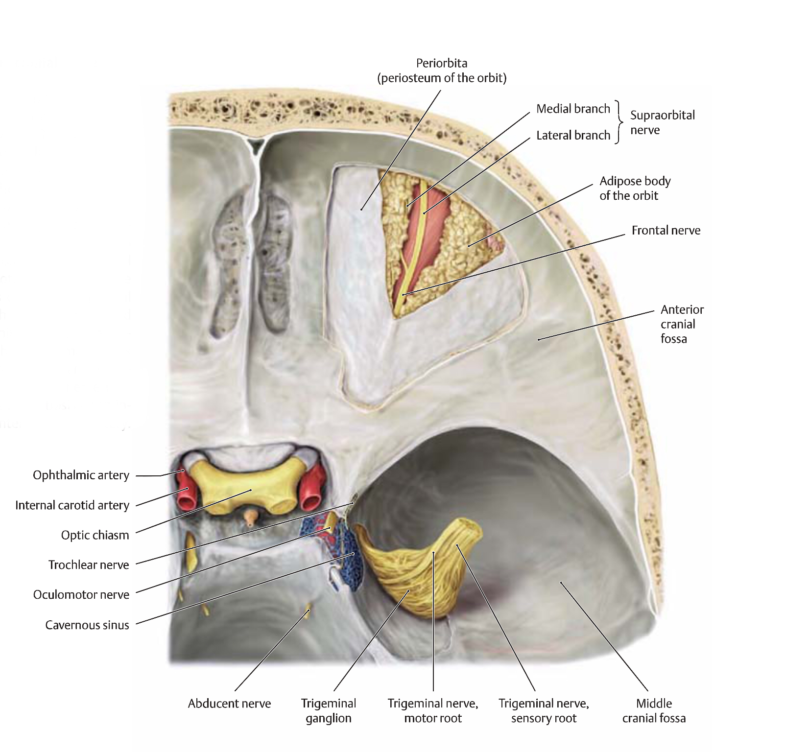

Slide 61
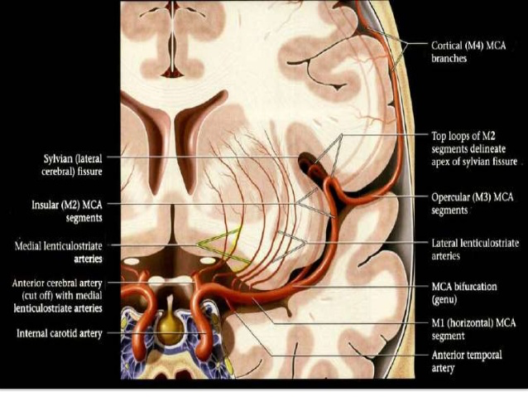

Slide 62
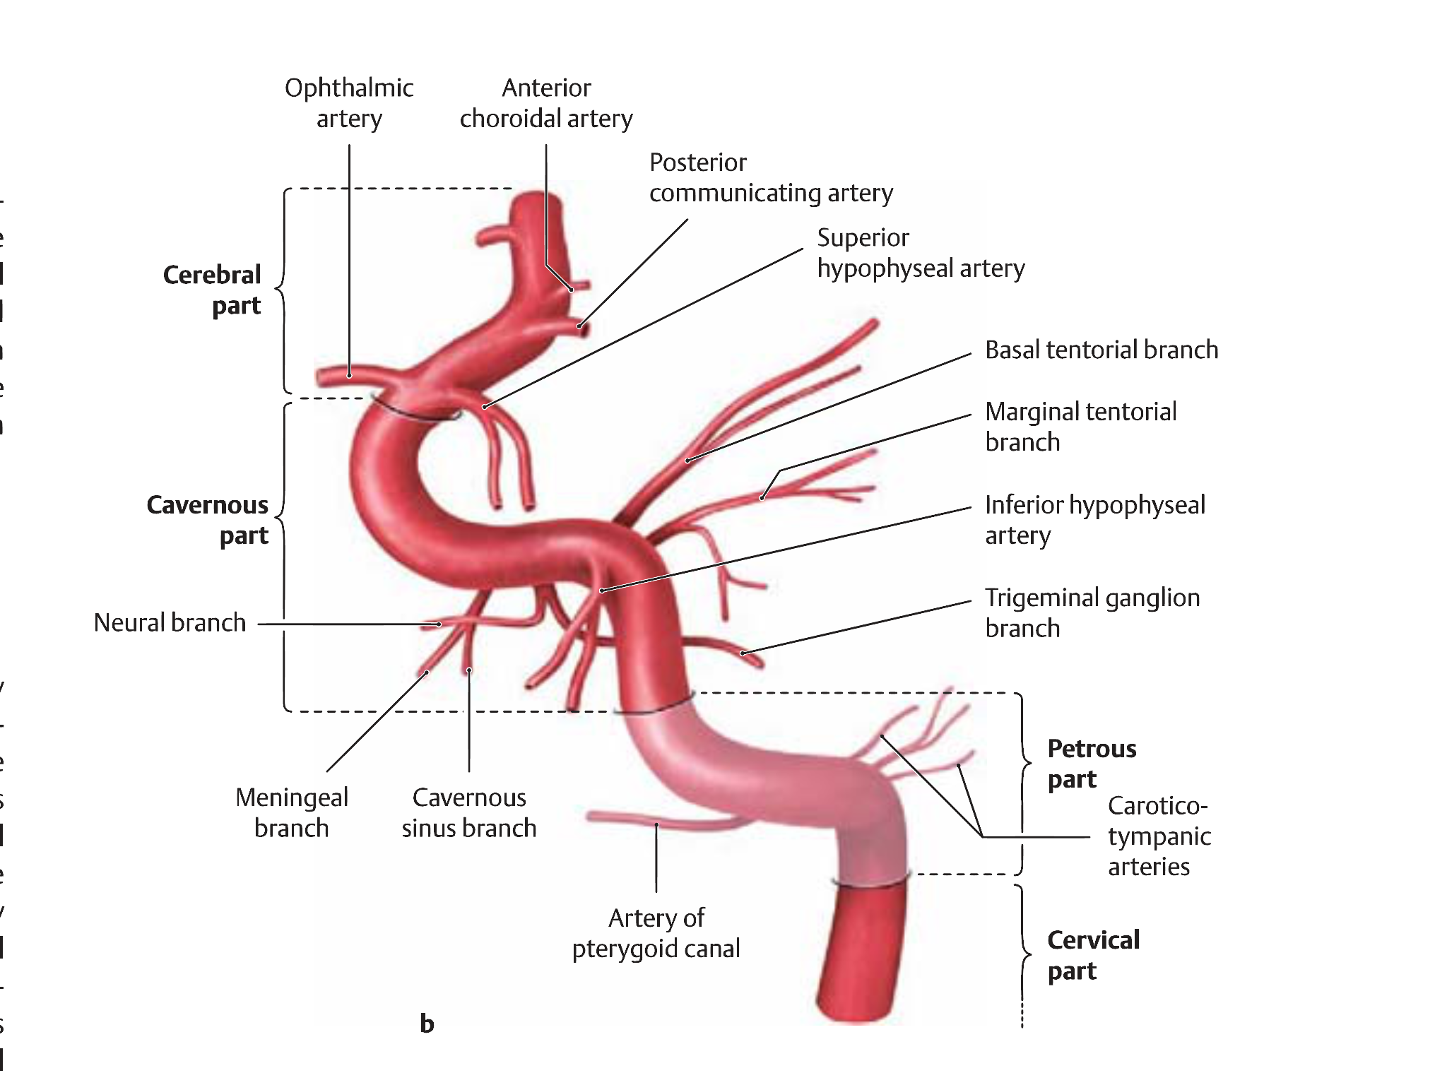

Slide 63
Cavernous sinus meningioma:
It could be:
Originate primarily within the cavernous sinus.
Involved by extension from a clinoidal, sphenoid wing, tuberculum sellae, or sphenopetroclival meningioma.
Surgical principles:
The surgical approach to the cavernous sinus is based on the cranio-orbital zygomatic approach.
Proximal and distal control of the internal carotid artery is required before dissection within the cavernous sinus.
Proximal control can be achieved by exposing the internal carotid artery within the petrous bone in the middle fossa or exposing the cervical internal carotid artery.

Slide 64
The internal carotid artery can be located by dissection between cranial nerves III and IV and V₁ of trigeminal nerve (Parkinson’s triangle).
Dissection of the tumor progresses in a stepwise fashion, beginning by opening the dura propria of the optic nerve sheath longitudinally along the length of the optic canal.
The distal dural ring is opened next, with the opening extending posteriorly to the oculomotor trigone, thereby also opening the proximal dural ring and allowing a wide entry into the anterior and superior cavernous sinus space.
The carotid artery can be mobilized laterally by releasing it from its proximal and distal dural rings, which allows dissection in the medial cavernous sinus space.
Lateral entry into the cavernous sinus is achieved by elevating the outer dural layer of the lateral wall of the cavernous sinus, which is peeled away.

Slide 65
Triangle | Anatomic limit | Target
Oculomotor (Hakuba’s) | Anterior clinoid process Posterior clinoid process Petrous apex | Horizontal portion of cavernous ICA Interpeduncular fossa
Clinoidal (anteromedial) | Optic nerve (CN II) Oculomotor nerve (CN III) Edge of the tentorium | Clinoidal segment of ICA Proximal and distal dural rings
Supratrochlear (paramedian) | Oculomotor nerve (CN III) Trochlear nerve (CN IV) Tentorial edge | Capsular artery of McConnell Horizontal segment of cavernous ICA Rarely, meningohypophysial trunk
Infratrochlear (Parkinson’s) | Trochlear nerve (CN IV) Ophthalmic nerve (V1) Petrous bone ridge | Abducens nerve (at Dorello’s canal) Sphenopetroclival venous gulf Gruber’s ligament Meningohypophysial trunk Inferolateral trunk

Slide 66
1 = superoposterior triangle ( oculomotor triangle ); 2 = superior triangle; 3 = middle triangle; 4 = inferior triangle; 5 = anteromedial triangle; 6 = anterolateral triangle; 7 = posterolateral triangle; 8 = posteromedial triangle; 9 = lateral triangle; 10 = medial triangle; II = optic nerve; III = oculomotor nerve; IV = abducens nerve; V1 = ophthalmic nerve; V2 = maxillary nerve; V3 = mandibular nerve; VI = abducens nerve; TG = trigeminal ganglion.

Slide 71
Meningioma of the Optic Nerve and Orbit:
Presents as progressive, painless vision loss & non pulsitile proptosis.
In cases of primary optic nerve sheath tumors, vision loss tends to be the predominant symptom.
Acute vision loss, although much less common, can occur.
Other signs associated with orbital meningioma include optic disc swelling, optic atrophy, and visual field defects.
These meningiomas could be :
Primary : arise from optic nerve sheath.
Secondary : arise from anterior clinoid type III , sphenoid, tuberculum sellae, or cavernous sinus.
The preferred surgical approach is the cranio-orbitozygomatic approach
most suitable for large lesions in the suprasellar, parasellar, and retrosellar areas and for those extending into the cavernous sinus or orbit and along the tentorial notch.
Radiotherapy

Slide 76
Cerebellopontine angle (CPA) meningioma
50% of posterior fossa meningioma. Lateral to 5th C.N
Common findings: hearing loss, facial pain or numbness, facial weakness or spasm, headache, cerebellar hemispheric signs.
The cranial nerves of the PFT relationships to CPA meningiomas
The trochlear nerve is usually displaced superiorly
The trigeminal nerve superiorly and medially,
The abducens nerve is found anteriorly,
The cranial nerves VII and VIII are anterior,
The cranial nerves IX through XI are inferior.
Commonly operated by retrosigmoid approach.
The capsule is carefully dissected from the surrounding cranial nerves, brainstem,
Superior cerebellar artery (superior and medial),
Anterior inferior cerebellar artery (medial),
Posterior inferior cerebellar artery (inferior and medial).

Slide 79
Petroclival Meningiomas
Clival meningioma: Tumors that arise from the superior 2/3rd of the clivus and displace the brainstem posteriorly.
Petroclival meningioma: originate from the upper 2/3rd of clivus at the petroclival junction and medial to 5th C.N. with bulk of tumor being laterally.
Sphenopetroclival meningioma: are more extensive, they involve the posterior cavernous sinus and extend to middle fossa.
Common symptoms: headache & ataxia, spastic paresis, and cranial neuropathies.
The principles of petroclival meningioma resection are based on using a lateral skull base approach while
avoiding brain retraction;
avoiding venous injury, especially the vein of Labbé;
connecting the middle and posterior fossa by drilling the petrous ridge and splitting the tentorium.
The main approaches considered for these lesions are
Posterior petrosal approach (presigmoid transtentorial).
Anterior petrosal approach to the middle fossa through petrosectomy, or a combination of both.
Total petrosectomy in the case of hearing loss.

Slide 82
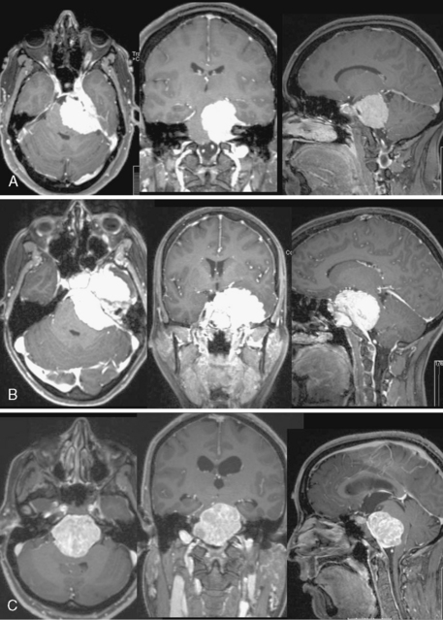
MRI example of the various types of petroclival meningiomas.
A, Petroclival (I) with small extension into the posterior cavernous sinus.
B, Sphenopetroclival (II) with invasion of the cavernous sinus and the clivus and petrous apex bone.
C, Midclival (III) with midline location and extension bilaterally.
D, Petrous apex (IV) small meningioma with petrous apex origin.
E, Meckel’s cave (V) with extension into the middle and posterior fossa between the leaves of the tentorium

Slide 83
Jugular foramen meningioma:
Arise from arachnoid cells lining the jugular bulb.
They may
Compress the lower cranial nerves.
Invade the temporal bone.
Invade, compress, narrow, or obstruct the jugular bulb.
Extend into the posterior cranial fossa or extracranially.
They manifest with lower cranial nerve deficits.
Two main DDX:
Glomus jugulare tumors.
Lower cranial nerves neuromas.
Approaches:
Transjugular approach by opening the jugular bulb itself.
Suprajugular or retrojugular approach by maintaining the integrity of venous flow through the jugular bulb.

Slide 84
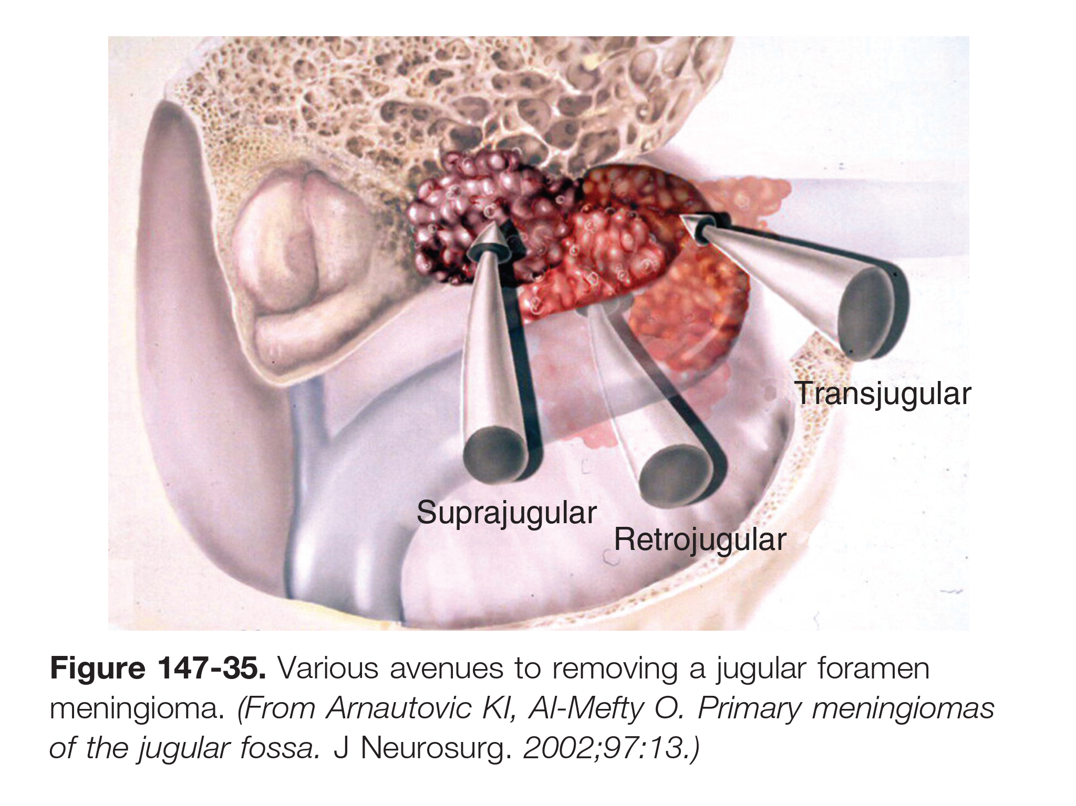

Slide 85
Foramen magnum meningioma
Originate at any location on the foramen perimeter. With 50% encases the intracranial vertebral artery. It divided into two main types:
Craniospinal (Ventral): originate from the basal groove at the lower third of the clivus, anterior to the medulla, and project inferiorly toward the foramen magnum.
Spinocranial: originating from the upper cervical canal usually posterior or posterolateral to the spinal cord, and extending intracranially in the cerebellomedullary cistern.
The clinical triad for diagnosis are:
Cervical pain, usually unilateral.
Motor and sensory deficits, especially involving the upper extremities and, in later stages, progressing to spastic quadriplegia. (Rotatory symptom)
Cold, clumsy hands with intrinsic hand atrophy.

Slide 86
In many instances, the tumor around the vertebral artery can be separated from the vessel because of an intervening arachnoid membrane.
If it located laterally, the vertebral artery is hidden beneath it.
If it located ventrally, the vertebral artery is at the lateral aspect of the tumor.
PICA usually displaced dorsally or medially; it may also be embedded in the tumor.
The anterior and posterior spinal arteries usually adhere to the tumor.
Intracranial segment of the vertebral artery displaced backward and laterally.
The brainstem and cervical spinal cord are displaced posteriorly and to the contralateral side by an anteriorly or anterolaterally located meningioma.
Approaches:
Inferior suboccipital approach for Lateral or posterior foramen magnum M.
Transcondylar approach for Ventral foramen magnum meningiomas.
The most common complication is deficits of cranial nerve IX & X & vertebral-basilar artery complex and significant brainstem compression.

Slide 91
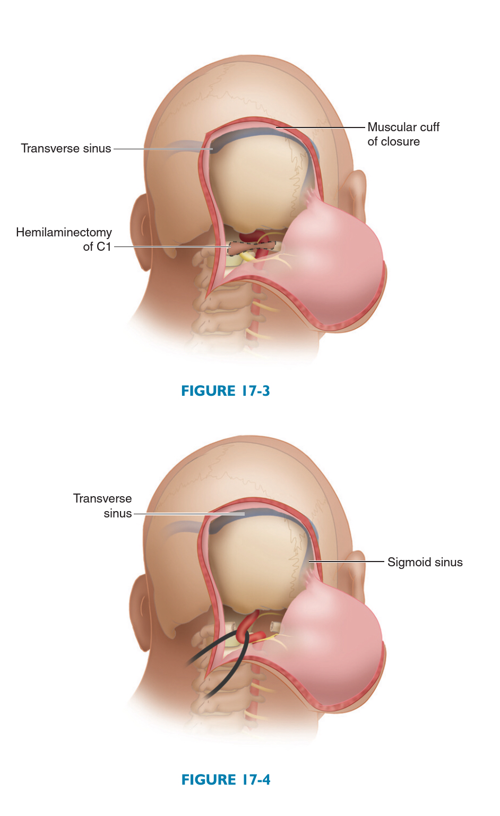

Slide 92
