Slide 1
Malformations of Cortical Development
Youmans Chap. 60

Slide 2
CLASSIFICATION OF MALFORMATIONS OF CORTICAL DEVELOPMENT
The development of the normal six layered human cortex results from a complex series of events, in large part controlled by known and yet unknown genes.
The formation of the normal cerebral cortex extends from weeks 8 to 26 of human gestation and is orchestrated by a complex array of genes that ultimately results in the correct cortical laminar organization.
The cortex forms from neuroglial progenitor (stem) cells born in the ventricular and subventricular zones that undergo successive rounds of mitosis, After exiting the cell cycle, neurons migrate.
The classification consist of
disorders of cellular proliferation.
disorders of neuronal migration.
disorders of cortical organization.
disorders with unknown mechanisms.

Slide 4
Disorders of Cellular Proliferation
Result in either increased or decreased growth or apoptosis.
These disorders often manifest themselves as
Abnormal brain size or
Localized areas of enlargement.
Abnormalities in brain size can manifest as
Microcephaly with a normal to thin cortex.
Microlissencephaly.
Microcephaly with polymicrogyria.
Macrocephaly.
Localized areas of enlargement [Focal cortical dysplasia (FCD)]
Low grade neoplastic lesions such as dysembryoplastic neuroepithelial tumors, gangliogliomas and gangliocytoma.

Slide 5
Microcephaly is defined as a patient having a head circumference that is greater than 2 standard deviations smaller than normal.
Brain may be up to 70% smaller than normal, but the brain has essentially normal cortical laminar architecture.
Microcephaly can result from a number of prenatal insults including
Hypoxia ischemia
Fetal alcohol exposure.
Genes Mutation [ The ASPM (abnormal spindlelike microcephaly associated) gene is the single most common genetic mutation associated with microcephaly].
When the gene is absent → resulting in reduction in the number of cells in the brain and consequently a smaller brain size.

Slide 6
Macrocephaly, defined as measureable (>2 standard deviations) enlargement of the head,
Occur in association with a large number of syndromes and conditions,
Hydrocephalus, autism.
Leukodystrophies.
Megalencephaly (ME) is when both brain and head size are increased.
Hemimegalencephaly (HME) is a malformation characterized by the abnormal enlargement of one entire hemisphere.
Seen in isolation or in the setting of known syndromes, such as tuberous sclerosis complex (TSC).
Highly associated with intractable seizures and, infantile spasms.

Slide 8
Focal Cortical Dysplasia:
The most common group of MCDs in patients presenting with intractable epilepsy.
The most common cause of epilepsy in children.
Imaging findings of FCDs can be subtle.
FCD type I | FCD type II
Cortical thickness is usually preserved. | Increased cortical thickness.
Mild blurring | Blurring of the gray and white matter junction
Most frequently located in the temporal lobe. | Extratemporal areas, with a predilection for the frontal lobe.

Slide 9
Disorders of Neuronal Migration
Characterized by altered gyral patterning and cortical laminar organization or the presence of ectopic neurons in the subcortical white matter or periventricular region.
These disorders include
Lissencephaly.
Heterotopia syndromes :Subependymal (periventricular), marginal glioneuronal, subcortical band [ X-linked ].
Lissencephaly (“smooth brain”) refers to a heterogeneous group of disorders characterized by the loss of the normal gyral pattern and significant disorganization of the cortical laminar cytoarchitecture.
Separated into two pathologic subtypes:
type 1, or classical.
type II, or cobble stone.
On MRI, the lissencaphalic brain appears agyric, and the sulci and sylvian fissures are shallow. The cortex is usually thickened (pachygyric).

Slide 10
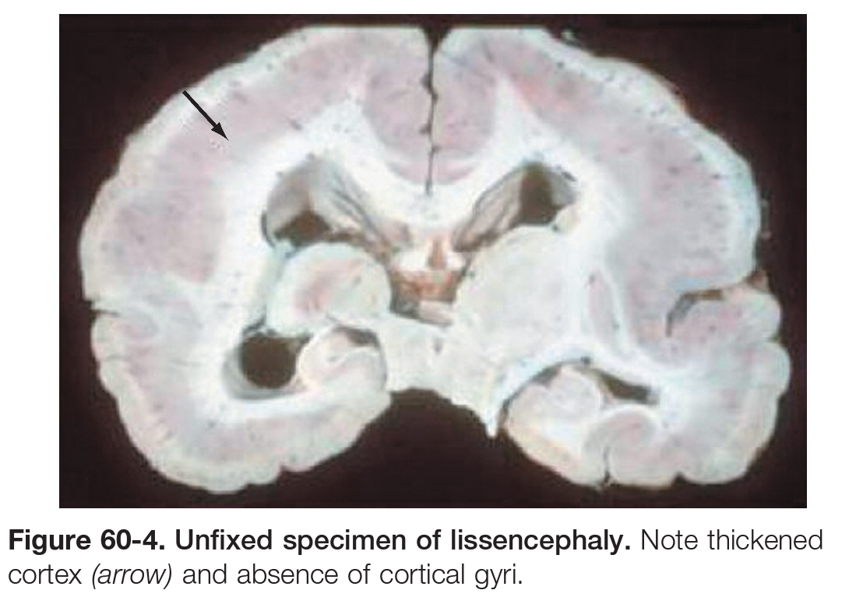
Type I classical
The gyral patterning is altered.
Neuronal progenitor cells fail to move to their correct laminar location,
The normal six layer cortex is reduced to a four layer pattern.
Type II or cobblestone
Associated with rare congenital forms of muscular dystrophy, muscle eye brain disease.
The altered gyral patterning is more heterogeneously distributed.

Slide 12
Heterotopia
Heterotopia is the presence of gray matter in abnormal sites and may be localized (nodular) or generalized (band).
Nodular heterotopias
Produce a signal that is isointense in relation to gray matter and should be distinguished from tubers that can be isointense or hypointense in relation to gray matter on T1 and hyperintense on T2.
Subependymal nodular heterotopias
commonly bilateral.
most frequently located in the occipital horn of the lateral ventricle.
predominantly in female patients.
The associated with partial seizures.
Generalized or band heterotopias
described as a double cortex.
They consist of a ribbon of gray matter within white matter, which runs parallel to the overlying cortex, which may be normal or macrogyric.

Slide 13
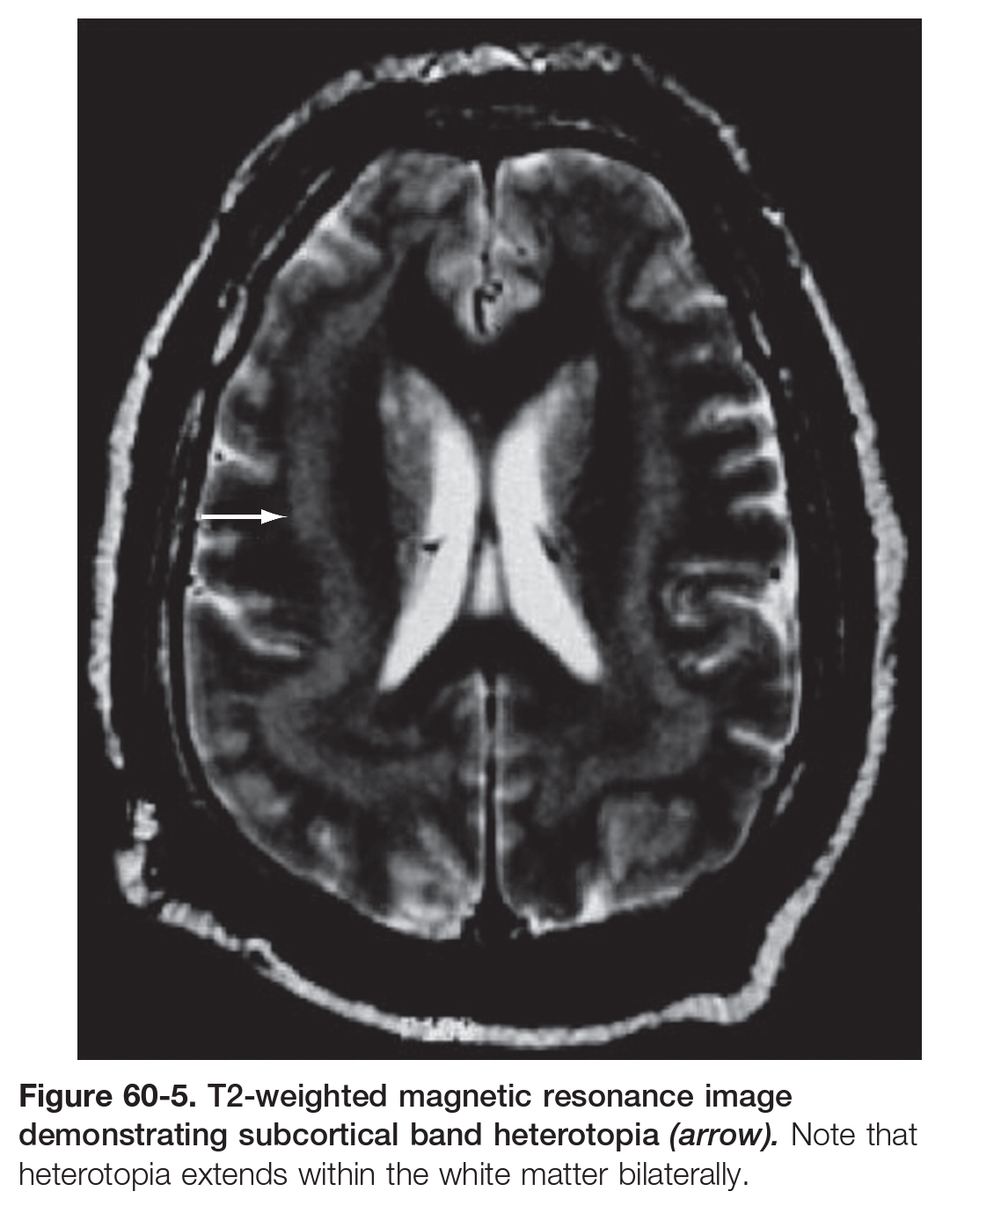

Slide 14
Disorders of Cortical Organization
Includes polymicrogyria, schizencephaly, and microdysgenesis.
Polymicrogyria
characterized by an excessive number of abnormally small gyri.
Bilateral perisylvian polymicrogyria (BPP) is the most common type.
Schizencephaly
Characterized by a cerebral cleft that, unlike a porencephalic cyst, is lined by gray matter.
The schizocephalic cleft extends from the surface of the cortex to the ventricle.
The cleft can be filled with
cerebrospinal fluid (the open lipped form), or
the two surfaces can be fused (the closed lipped form).
Schizencephaly is almost always associated with localized polymicrogyria around the cleft.

Slide 16
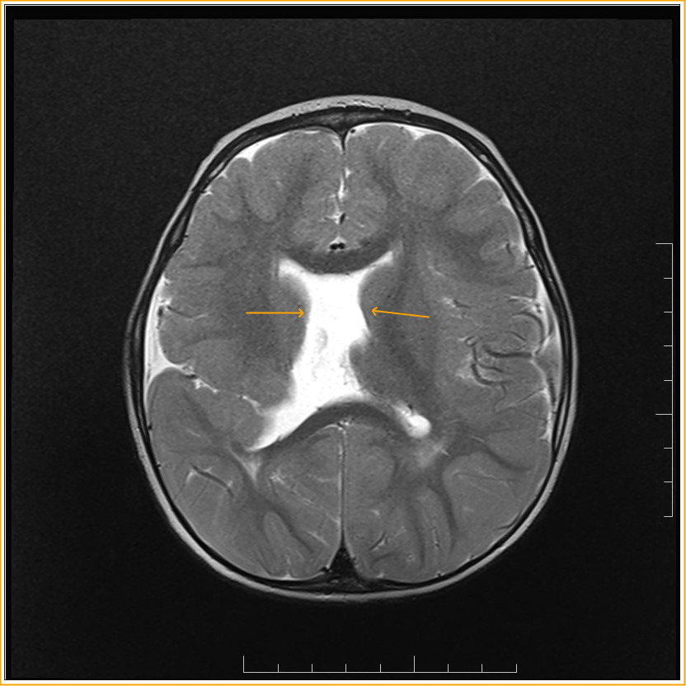
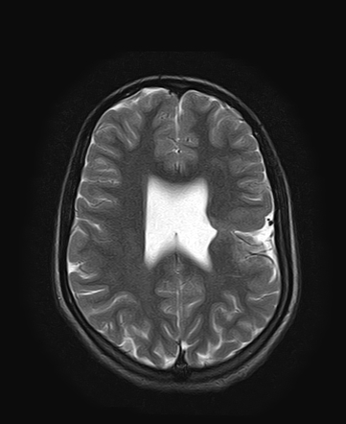

Slide 17
Sturge-Weber Syndrome (encephalotrigeminal angiomatosis)
SWS is a rare congenital disorder with a variable natural history.
Its characteristic feature is
Leptomeningeal angiomatosis.
Cutaneous angiomas (port-wine stain) involving the face in the distribution of the trigeminal nerve V1.
The clinical syndrome is progressive and characterized by
Epilepsy, if untreatable, frequently the development of mental retardation.
Cortical calcifications.
Cerebral atrophy.
Seizures usually develop by the end of the first year and may respond to medical treatment initially, but often become resistant to drugs.
By imaging show tram track calcification
The cerebral manifestations generally involve
the occipital or parietal cortex, or both, but the entire cortex or large parts of it may be involved.
the pathologic changes remain restricted to one hemisphere.

Slide 19
Thank you

