Slide 1
Lipomyelomeningocele Youmans Chap. 230

Slide 2
Lipomyelomeningocele
Subcutaneous lipomatous mass that protrudes through a midline bony defect, displaces the dura, and infiltrates and tethers the spinal cord while The neural elements remain within the spinal canal
F : M ratio 1.5 : 1
Embryology
The process of disjunction (closed neural tube detaches from the cutaneous ectoderm) occurs prematurely in patients with LMM —> dorsal cleft is maintained and paraxial mesenchyma has access to the prospective lumen of the neural tube, further preventing its closure.
The “luminal” surface of the ectoderm induces the mesenchymal cells to differentiate along a path, resulting in adipocyte formation, whereas the outer surface of the incompletely closed neural tube causes the mesenchyma to form the pia-arachnoid and dura. Other tissues have been found in the substance of an LMM, including striated muscle, cartilage, nerve cells, ependyma, and even cerebellum

Slide 4
LMM Risk Factors
Multiple maternal risk factors, such as
Diabetes.
Anticonvulsant use.
Obesity.
Genetical.
Socioeconomic/demographic.
Mother diet(folic acid).
Family history.

Slide 5
Classification
Chapman classified 4 anatomic variants of LMM according to the relationship of the lipoma–spinal cord interface:
Dorsal
Lipomas that insert onto the dorsal surface of the conus medullaris .
Subcutaneous fat component attached to the spinal cord via a fibrolipomatous stalk of varying thickness.
The posterior half of the lower spinal cord at the site of neural fold fusion is unfused (partial dorsal myeloschisis is present) and the stalk attaches directly to the exposed alar and basal cord regions, just posterior and medial to the posterior columns and dorsal to the central canal.
Location either in the midline (mostly) or eccentrically and can extend into the central canal and expand it for variable distances.
Along the lateral interface of the attachment of the lipoma to the spinal cord, the dura and pia are fused.
Sensory nerve roots emerge just anterior to this lateral line of fusion, which can be traced circumferentially.
There is often no evidence of leptomeninges posteriorly, and no sensory or motor roots are found within the actual substance of the lipoma.

Slide 6
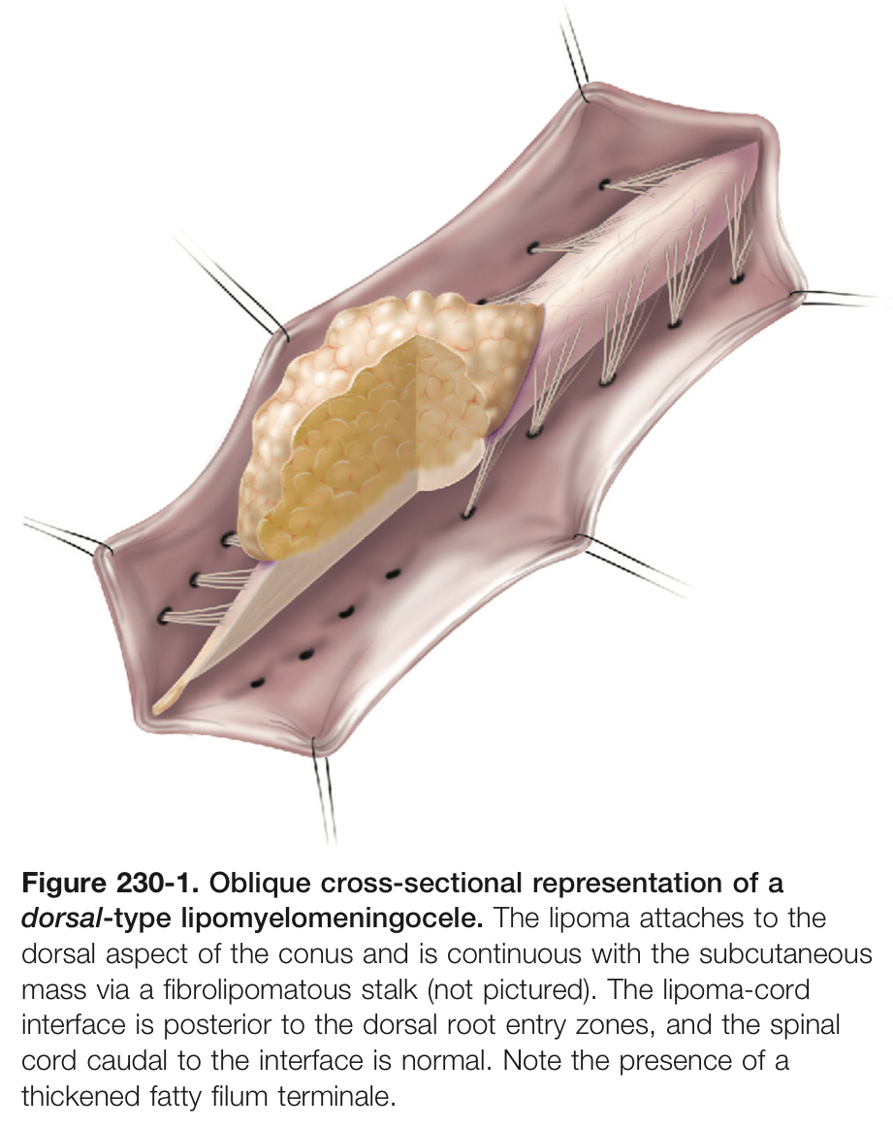

Slide 7
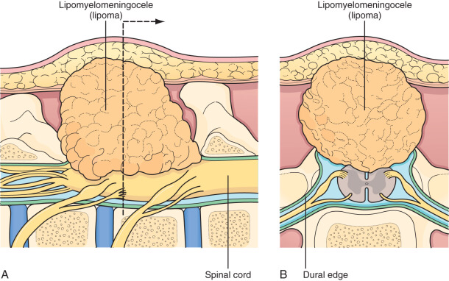
Dorsally inserting lipomyelomeningocele. The mass of the lipoma attaches broadly on the dorsal surface of the conus, extending through a dural and bony defect to be continuous with the subcutaneous mass. The nerve roots are ventral to the lipoma. (B) Cross-sectional view of a dorsal lipoma. The lateral lines of attachment are formed by the lipoma and the dural edge and must be divided to release the tether. Note that the nerve roots are ventral to this line.

Slide 8
caudal- or “terminal”-type LMM
Located at the caudal end of the conus, almost like a continuation of the spinal cord itself.
The remaining lipomatous mass may then lie entirely within the spinal canal or extend dorsally through a defect in the dura and bone into the subcutaneous space.
The fatty tumor may either
Replace the filum terminale or
Surround the filum, or
A separate filum may lie anteriorly.
The nerve roots may lie ventral to the lipoma or pass through the mass itself.
The caudal-type LMM is
often asymmetric, involving more of the cord and nerve roots on one side.
the lipoma-cord interface in caudal-type LMM is diffuse.

Slide 9
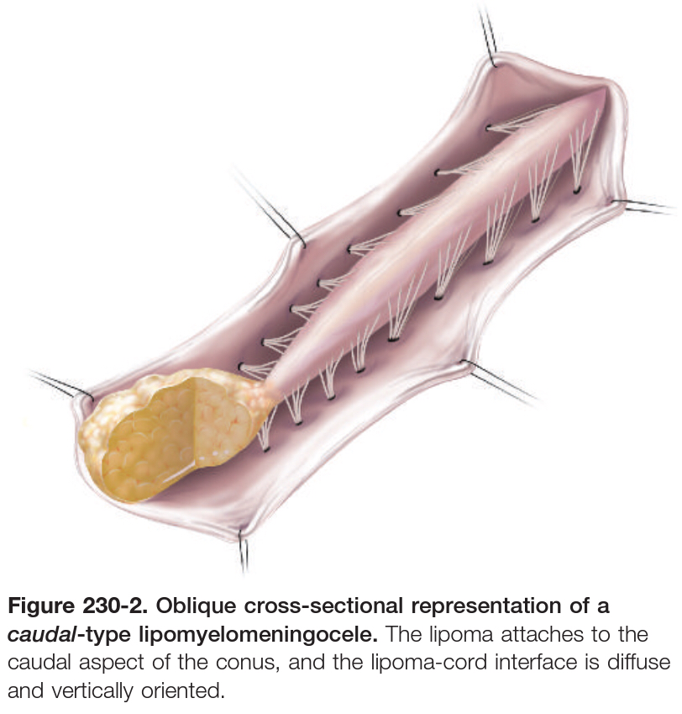

Slide 10
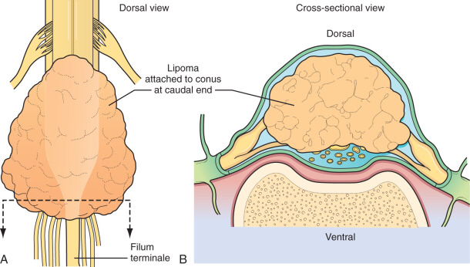
(A) and Cross-sectional view (B) of a caudal lipoma. The roots run anteriorly and may attach to the ventral wall of the lipoma.

Slide 11
transitional:
Type between the two variants may exist .
Often in these cases, the more cephalic portion is of the dorsal type, with posterior rootlets emerging from the cord just ventral to the line of fusion of the lipoma to the cord and leptomeninges.
Caudally, however, as the line of fusion is displaced ventrally, nerve roots emerge from the anterolateral portion of the lipoma mass

Slide 13
chaotic type:
This type of LMM begins dorsally in an orderly fashion, but its caudal portion is ventral to the neural placode, engulfing neural tissue and nerve roots.
The fusion line may be distinct rostrally but blurs distally, making the location of the dorsal root entry zone and nerve roots less predictable and surgical resection difficult.
Chaotic lipomas are uncommon but can be associated with sacral agenesis

Slide 14
Presentation
Infants typically present with cutaneous anomalies.
Older children with orthopedic, neurological, or urologic symptoms.
Adults often present with pain.
Typically cause tethering of the spinal cord via the associated fibrous, subcutaneous lipoma.
1/3rd of patients will demonstrate an asymmetric subcutaneous mass presenting with neurological deficits in the lower limb ipsilateral to the side of the mass.
Spinal cord tethering interferes with normal spinal cord energy metabolism, leading to ischemia and progressive neural damage.
In asymptomatic or slow progression of symptom, sudden and acute loss of function occur in:
Lithotomy position during pregnancy.
Hyper flexion injury from a RTA.
Muscle weakness and gait disturbance are often present by the time the patient starts ambulating.
Urinary or fecal incontinence or UTI is the presenting symptom.

Slide 15
Cutaneous Signs
Soft tissue mass
Skin dimple
Hemangioma
Hypertrichosis
Skin tag/tail-like appendage
Atretic or denuded skin patch
Dermal sinus hypopigmentation
Infants present most often (>90% of patients) with a cutaneous finding.
Covered with skin in lumbosacral region, non tender.
Superficial portion of the mass typically consists of lobulated and unencapsulated subcutaneous fat, which becomes more fibrous as the deeper structures are approached.
It is rare for patients with LMM to have intellectual impairment or associated hydrocephalus, Chiari malformations.

Slide 16
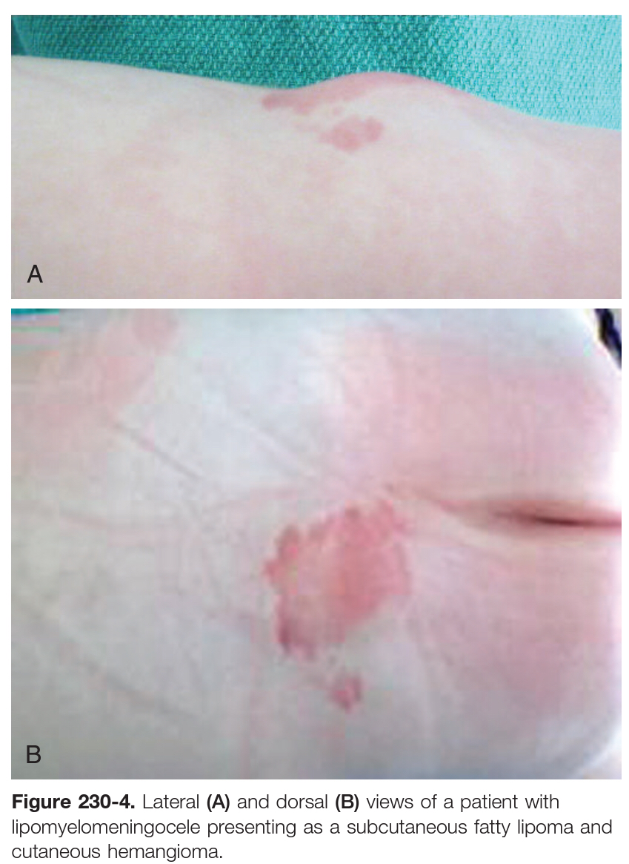

Slide 17
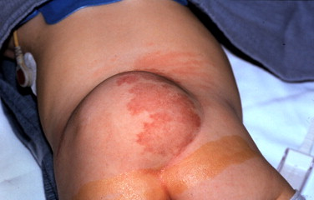
sizable lipomyelomeningocele is seen with cutaneous port-wine stains

Slide 18
Diagnosis
Prenatal Diagnosis
because these are closed defects with no communication between fetal spinal fluid and maternal amniotic fluid, amniotic fluid analysis for α-fetoprotein levels is not a reliable diagnostic measure.
US advantages
Differentiate between fat, spinal fluid, and spinal cord.
Defining the attachment of lipomas to the spinal cord because infants under the age of 6 months are skeletally immature with poorly calcified bone.
X-ray
It reveal a dorsal fusion defect (bony spina bifida) or widening of the spinal canal.
MRI the study of choice
T1 image visualization the level of conus; the absence, presence, and location of fat within the cord, spinal canal, or filum; & the size of filum.
T2 image allow the identification of spinal cord tumors, such as dermoids and epidermoids, & syringomyelia.
Spinal MRI in supine & prone help to determine adequate ventral movement of the cord and rule out dorsal tethering.

Slide 19
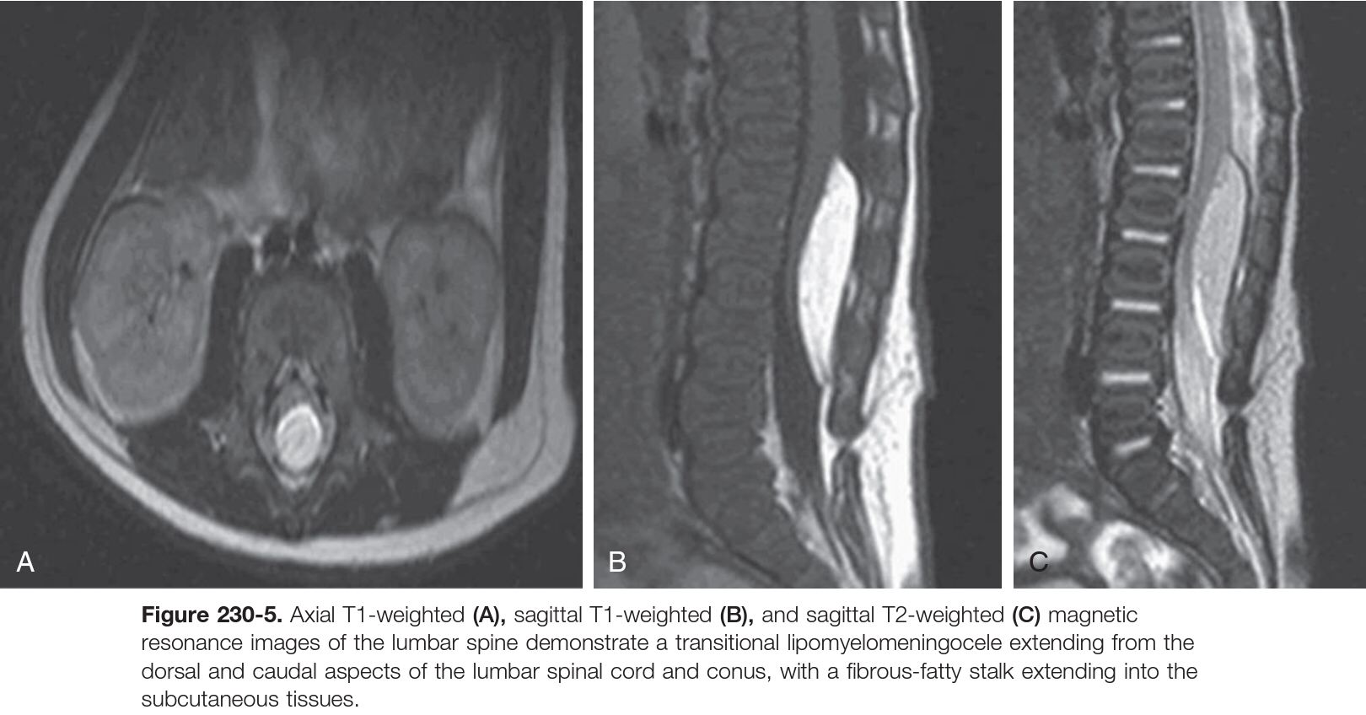
CT scan
for bone defect.
rarely used in children for either diagnostic or planning purposes.
Urodynamic testing

Slide 20
Surgical points
Goals of Surgery
Detethering.
Decompression.
Reconstruction.
Operative Technique
(an elliptical incision is occasionally needed to resect redundant skin).
Dissection is continued, undermining the subcutaneous tissues with the monopolar cautery to carefully identify the entry of the fibrolipomatous stalk through the medial fascial defect.
An adequate amount of fat is left under the skin to minimize devascularization and necrosis.
Large lipomatous masses are often amputated at the level of the stalk to help with spinal cord–lipoma visualization.

Slide 21
To prevent postlaminectomy scoliosis or kyphosis,
Perform an osteoplastic laminectomy in young children by cutting the lamina bilaterally; then the whole segment of posterior elements is reflected cranially and held out of the field with a stay suture (the interspinous ligament between the most cephalad segments is kept intact).
Careful inspection of the epidural space prior to lifting the bone will allow the identification of other tethering bands or structures that could be attached to the undersurface of the lamina.
The key to preventing neurological deficits
Extending the laminectomy one or two levels higher.
Careful dissection to identify the underlying neural structures (because nerve roots may enter the cord at the same point where the dura, lipoma, and spinal cord all join together).
The normal dura is opened till reaching the point where the lipoma penetrates the dura mater, the dura is opened on either side of the stalk circumferentially.
An incision too close to the point of dural penetration into the lipoma could result in transection of the dorsal nerve roots.

Slide 22
The circumferential dissection around the lipoma stalk is continued until the dura is separated completely from the cord.
The dural opening is then continued caudally below the dura-stalk cord junction until the filum is identified.
The fatty mass is debulked through a midline dorsal myelotomy until all visible fatty tissue is resected and the plane of gliotic tissue (white plane) between the lipoma and glial fibrous tissue is encountered.
Once all resectable intramedullary lipoma has been debulked, the filum terminale is identified and divided.
The midline myeloschisis defect is then closed dorsally with nonabsorbable suture to reconstruct the tubular configuration, thus minimizing exposed raw edges which may contribute to reduced future tethering from scar tissue.
Method of fat debulking iclude
CO2 laser.
yttrium-aluminum-garnet (YAG) laser.
Cavitron ultrasonic surgical aspirator (CUSA ).

Slide 23
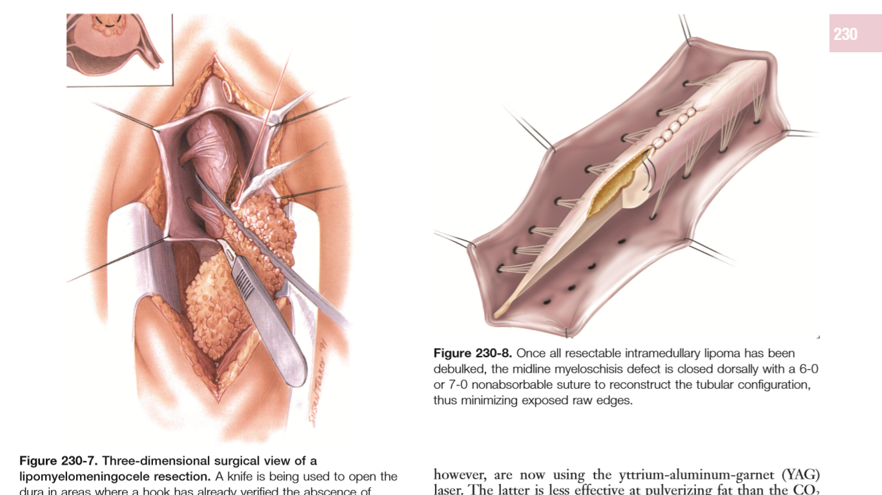

Slide 24
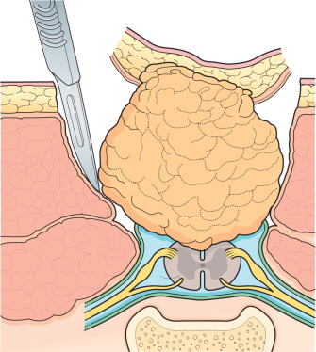
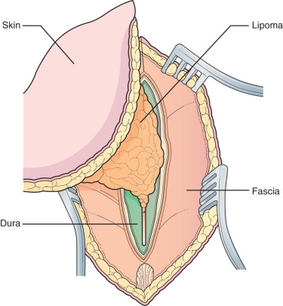
The skin has been elliptically incised around the subcutaneous mass and the incision has been carried to the lumbodorsal fascia. Dissection has proceeded medially, until the stalk of the lipoma is seen entering the spinal canal through the spinal bifida and the dural defect.
Surgery for spinal lipoma (continued). A laminectomy of the lowest intact neural arch has been performed and the dura has been opened at this level. The dural incision is extended caudally until the lipoma is encountered.

Slide 25
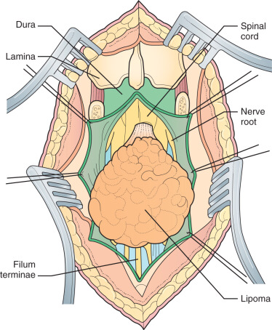
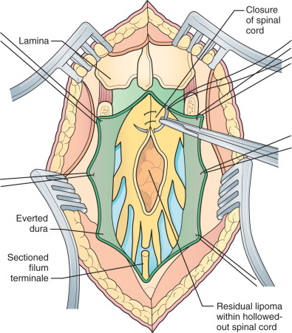
Reconstruction of the spinal cord. The lipoma has been largely removed with a CO2 laser, creating a cavity within the conus. This may be closed with interrupted sutures to prevent retethering.
Lateral dissection of the lines of fusion. The lateral lines of fusion are sharply incised on either side of the lipoma. A tunnel can usually be formed between the lateral lines of fusion and the nerve roots beneath.

Slide 26
Complications
CSF leak
Pseudomeningocele development
New neurological deficits (more commonly seen with transitional lipomas)
Meningitis
Intradural abscess
Wound infection
Wound breakdown
Scar retethering
Iatrogenic syringomyelia
Outcome
Patients younger than 18 months demonstrate a higher rate of urodynamic and urinary function improvement compared to older children and adults.
Symptoms that commonly improve following surgery include low back pain, buttock pain, and radiculopathy.

Slide 27
Thank you

