Slide 1
Intracranial Germ Cell Tumors Youmans Chap. 216

Slide 2
EPIDEMIOLOGY AND CLASSIFICATION
GCTs are more common in the pediatric population, mainly in children between 10 and 19 years of age.
M:F ratio 2:1
GCTs originate in the
Pineal (40%-60%)
Suprasellar (30%-40%)
Atypical intracranial locations, including the basal ganglia and posterior fossa.
Suprasellar tumors are only slightly more common in females than males
Pineal region tumors more common in males, M:F = 15 : 1
Suprasellar lesions often present earlier in childhood and more commonly contain nongerminomatous elements.
In up to 10% of patients, tumor is simultaneously detected in both the pineal and suprasellar regions.

Slide 3
Classification by age
Teratomas are most common in neonates
Most NGGCTs occur in younger children
Germinomas tend to occur in older children and adolescents.
Teratoma sub classified into :
Mature teratomas, which are benign lesions,
Immature teratomas, with an embryonal component which often behave malignantly and carry a poorer prognosis.

Slide 4
PRESENTATION
Pineal region
Typically present with symptoms of increased ICP (headache, nausea, and vomiting, which result from obstructive hydrocephalus).
Parinaud’s syndrome ( dorsal midbrain syndrome ) with
Impairment of upgaze,
Pupillary accommodative paresis with light-near dissociation,
Retraction nystagmus on attempted convergence.
Papilledema, somnolence, behavioral changes, and ataxia.
Suprasellar lesions
Hypothalamic pituitary axis dysfunction mainly diabetes insipidus.
Loss of visual acuity and field → compression of the optic apparatus.
Precocious puberty may be observed in patients with pineal as well as suprasellar lesions, secondary to secretion of β-human chorionic gonadotropin (β-HCG) by the tumor.
Small percentage of patients who radiologically appear to have purely pineal lesions can also present with diabetes insipidus, possibly reflecting microscopic tumor spread to the anterior third ventricular floor.

Slide 5
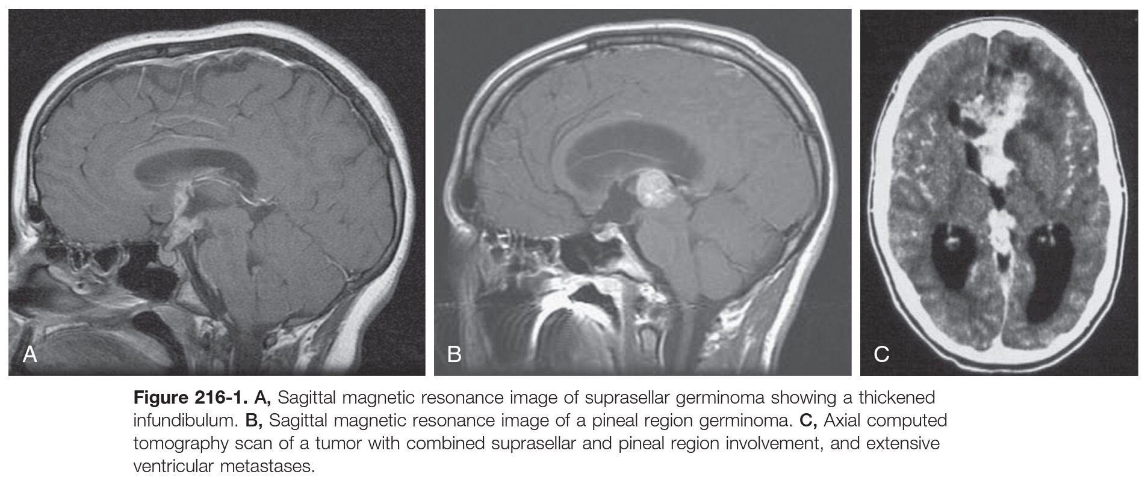

Slide 6
NGGCTs tend to be biologically more aggressive than germinomas.
Germinomas arising in the basal ganglia or thalamus
Seizures
Hemiparesis
Dementia
Choriocarcinomas have a particular propensity to enlarge rapidly and undergo hemorrhage, leading to precipitous symptom onset and clinical deterioration.
GCTs arising in infancy and early childhood :
The sole presenting symptom is increased intracranial pressure, manifested by macrocephaly, split sutures, and a bulging anterior fontanelle.
In some cases, presentation can be even more generalized, consisting of failure to thrive and loss of developmental milestones.

Slide 7
DIAGNOSTIC EVALUATION
This can be done with clinical symptom , Imaging , Tumor marker in the blood and CSF.
MRI
typically isointense to gray matter and show avid contrast enhancement, when in the basal ganglia, they are less likely to enhance.
Germinomas
tend to be symmetrical, sometimes with spread of the tumor from the pineal to the cerebral hemispheres.
bifocal lesions involving the pineal and suprasellar regions concomitantly without dissemination are most likely germinoma.
Choriocarcinomas often demonstrate intratumoral hemorrhage on imaging.
Teratomas can have a mixture of cystic and solid elements, often with fat and bone visible on imaging.
To differentiate Germinoma from other tumors ( pineal , glioma, metastases ):
“test dose” of radiation. If a complete response was achieved, the patient was presumed to have a germinoma and treated empirically with additional radiation therapy (RT), reserving biopsy for nonresponding lesions.

Slide 8
Tumor markers
The presence of germ cell markers in CSF ( which is more sensitive than serum ) is pathognomonic for malignant germ cell elements, while their absence not rule out malignancy.
Alpha Feto protien : is a marker for tumors with yolk sac components (endodermal sinus tumor, immature teratoma with endodermal sinus elements, and occasionally embryonal carcinoma)
High levels indicate endodermal sinus tumors.
Low levels indicate some embryonal cell carcinomas and immature teratomas.
β-HCG : is commonly expressed by choriocarcinomas, malignant teratomas, and embryonal carcinomas containing trophoblastic tissue.
High levels found with choriocarcinomas.
Low levels indicate some embryonal cell carcinomas and germinomas.
In NGGCT
High levels of β-HCG in the CSF (>100-200 IU) or
Detectable AFP (serum >5-10 ng/dL; CSF >2-5 ng/dL) is diagnostic and no need for histological confirmation.
In Germinomas with syncytiotrophoblastic cells
AFP is never elevated.
low-level expression of β-HCG (50-100 IU)

Slide 9
From Radiopedia
CT
Mature teratomas often demonstrate fat density
Germinomas are more homogeneous than non-germinoma germ cell tumors.
General features of intracranial germ cell tumors include:
Hyperdense with vivid contrast enhancement
Calcification: present in the majority of cases, representing engulfed normal pineal calcification, as well as sometimes tumor calcification.
MRI
T1: isointense
T2: isointense
T1 C+ vivid contrast enhancement
DWI: restriction is common especially for germinomas due to high cellularity
SWI: hemorrhage is common in non-germinomatous germ cell tumors

Slide 16
TOP DIFFERENTIAL DIAGNOSES
Germinoma
Other nongerminomatous germ cell tumor
PNET, AT/RT
Dermoid
Craniopharyngioma
Lipoma

Slide 18
Immature tertoma

Slide 19
Immature tertoma

Slide 20
SURGICAL MANAGEMENT
Surgical intervention is often necessary for diagnosis, cytoreduction, and/or treatment of hydrocephalus.
Germinomas are extremely responsive to radiation and chemotherapy, and there is usually no indication for surgical debulking.
1st neurosurgical issues is Treatment of Hydrocephalus which include :
VP shunt but there is risk for shunt-related metastases.
ETV ( Endoscopic 3rd ventriculostomy )
It allows biopsy in many cases, permits CSF sampling for markers and cytology, and achieves internal CSF diversion.
But its not suitable for patient with suprasellar tumor with significant tumor involvement of the third ventricular floor.
EVD ( External Ventricular Drain )
Useful for patients with germinomas, in whom the tumor can regress significantly within days of beginning radiation or chemotherapy
For those situations in which open surgical resection is being considered as an initial component of management.

Slide 21
2nd neurosurgical issues is confirmation Biopsy by :
stereotactic or endoscopic techniques which carry risk of hemorrhage.
open biopsy.
3rd neurosurgical issues is cytoreduction :
Germinomas are extremely responsive to radiation and chemotherapy, and there is usually no indication for surgical debulking.
Benign teratomas that lack elevations of AFP or β-HCG and do not contain malignant elements or evidence of metastatic spread respond poorly to either chemotherapy or irradiation and may require removal as definitive therapy, which can be curative.
For NGGCTs, which may contain treatment-resistant teratoma admixed with germinomatous and nongerminomatous elements
Neoadjuvant therapy in an effort to eradicate the malignant components of the tumor, with the remnant will remain and eventually require surgical intervention.
In this situation, a so-called second-look surgery is performed to biopsy and potentially resect residual tissue after initial chemotherapy, which spares children with treatment-responsive NGGCTs the risks of surgical intervention.

Slide 24
For pineal region lesions, multiple approaches are feasible :
The midline supracerebellar infratentorial approach is most common for tumors predominantly growing below the tentorium.
The occipital transtentorial approach which allows for a wide view but does place the splenium of the corpus callosum and the occipital visual cortex at risk.
The interhemispheric transventricular approach may each be appropriate, depending upon whether the tumor predominantly extends above or below the vein of Galen and the degree to which the lesion fills the posterior third ventricle.
For suprasellar lesions the approach including :
pterional, subfrontal, anterior interhemispheric, and transventricular routes, as well as endoscopic endonasal approaches.

Slide 25
ADJUVANT THERAPY
Germinomas
WVRT (for localized tumors) or craniospinal RT (for disseminated tumors) alone or pre-irradiation chemotherapy followed by reduced doses and volumes of RT
Nongerminomatous Germ Cell Tumors
surgery following neoadjuvant chemotherapy is often used in combination with irradiation.
RT is a critical component of NGGCT treatment but, unlike with germinomas, is not associated with tumor control when used alone.
Mature Teratoma
Resistant to RT and chemotherapy, but complete surgical resection is curative
SRS dose between 15-25 Gy
WVRT = whole ventricular radiotherapy

