Slide 1
Ventricular Shunting Procedures
Youmans Chap. 201

Slide 2
COMPONENTS OF SHUNT SYSTEMS
The three essential components of any CSF shunt system
Ventricular catheter
Valve
Distal catheter
Distal anatomic sites are : the peritoneum and, to a lesser degree, (right) cardiac atrium and pleura are currently the most commonly used.
In loculated hydrocephalus, multiple ventricular catheters may be necessary, one for each isolated CSF collection, joined in various combinations, for example, using straight, right-angled T, Y, or X connectors.
The Uni-Shunt ( Codman ): one-piece system
The advantage is to prevent shunt malfunction secondary to disconnection.
The disadvantage is some loss of freedom in customizing the shunt system by selecting individual components or using add-on devices.

Slide 3
Ventricular and Distal Catheter Choices
All modern CSF shunt catheters are made from silicone elastomer or polyurethane.
Most are impregnated with barium or tantalum to permit radiographic identification, barium overtime lead to
Local tissue reaction
Calcification
Loss of elasticity and strength of the distal catheter tubing
Increase the risk of focal tethering and catheter fracture
Catheters are available in a range of internal and external diameters; those with smaller internal diameters are used in neonates
The most frequent cause of mechanical shunt failure is proximal catheter obstruction secondary to ingrowth of choroid plexus and reactive (inflammatory) glial tissue.
Distal catheters may be open-ended or they may have a closed tip with distal slit valves that function by a differential pressure mechanism.
Catheters with an open distal end are associated with a lower rate of distal catheter occlusion

Slide 4
CSF Shunt Antibiotic Impregnation.
Codman and Medtronic, catheters are impregnated with rifampicin and clindamycin.
The Silverline shunt catheter system are impregnated with silver nanoparticles, which have antimicrobial properties.
Packaged catheters carry a static charge and, when opened, can attract airborne dust particles carrying microorganisms; accordingly, non–antibiotic-impregnated catheters should be soaked in sterile saline solution immediately on opening to reduce the risk of contamination.

Slide 5
Valve Choices
Shunt valves can be classified into three broad categories:
Fixed Differential Pressure Valves
Flow Regulating Valves
Programmable Differential Pressure Valves.
Fixed Differential pressure valves :
Mechanism
These valves close to prevent flow of CSF when the difference in pressure across the valve drops below a fixed threshold
Open when the pressure differential exceeds the opening pressure of the valve
Operate by one of four mechanisms:
Ball-in-cone and spring
Diaphragm
Slit
Miter
Fixed-pressure valves are available in low- medium-, and high-pressure settings.

Slide 6
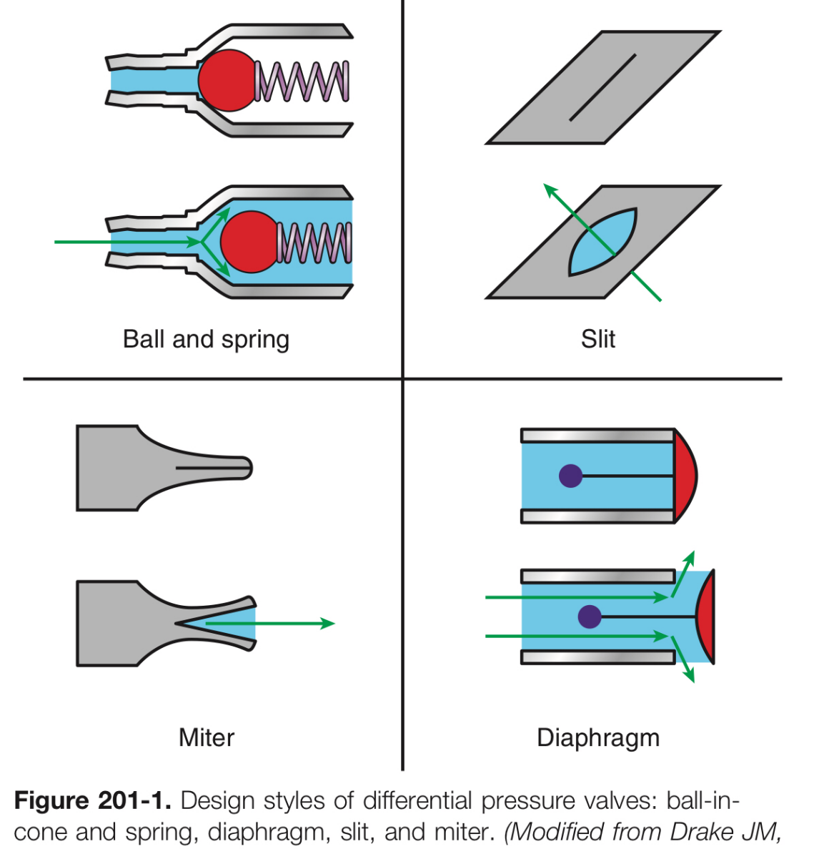
May cause over drainage secondary to siphoning , leading to
Low-pressure symptoms ( Headache, nausea, emesis, diplopia)
Tearing of bridging veins ( Subdural hematoma)
Premature closure of cranial sutures (Craniosynostosis)
Slit ventricle syndrome

Slide 8
The problem of shunt over drainage spurred the development of Anti-siphon Devices and Gravitational Devices.
Anti-siphon Devices
Depend on the pressure gradient between the internal lumen of the shunt and the surrounding atmosphere.
When the internal shunt pressure falls below the atmospheric pressure (negative pressure created by postural change to an upright position), the ASD membrane is drawn inward, which increases resistance and thus decreases flow through the shunt system.

Slide 9
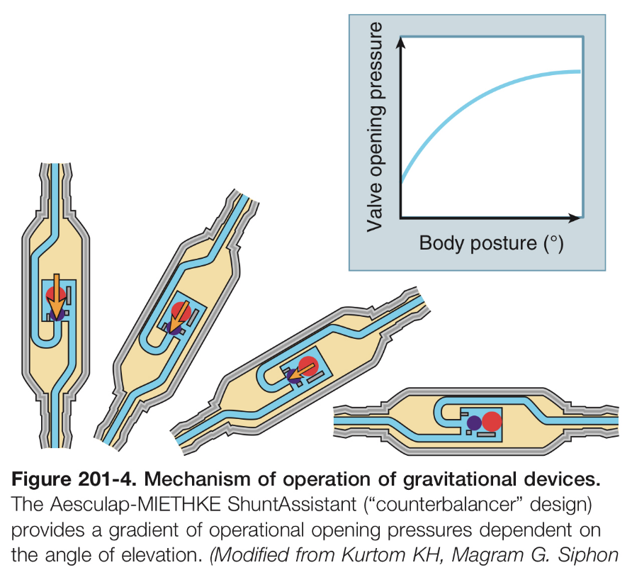
Gravitational Devices
Switcher designs
Gravity-dependent mechanism to change the shunt’s opening pressure based on body position, from recumbent to upright.
2 types
Dual-Switch valve (Aesculap)
Provide two operational opening pressures, one in the horizontal position and one in the vertical position.
Counter-balancer designs (Aesculap)
Offer a gradient of opening pressures dependent on angle of elevation

Slide 12
Flow-Regulating Valves
Flow-regulating valves have three stages of operation:
STAGE 1 at low pressures, they function like low-resistance differential pressure valves, and flow increases until a CSF flow rate of approximately 20 mL/hr is reached.
STAGE 2 as the pressure differential continues to increase ,the valve uses a variable resistance mechanism to maintain flow at a relatively constant rate
STAGE 3 pressure differential exceeds a set threshold (usually 300 mm H2O), the variable resistance mechanism is overcome and the valve again allows rapid flow of CSF against low resistance

Slide 14
Programmable Differential Pressure Valves
Identical in function to standard differential pressure valves, except that the opening pressure of the valve is not fixed but can be adjusted externally.
Operate by a ball-in-cone and spring mechanism
A transcutaneous electromagnetic programmer is used to actuate a magnetic rotor in order to adjust the tension on the spring, and thereby alter the opening pressure of the valve.
INDICATIONS
Patients prone to under- or over drainage
Patients with normal-pressure hydrocephalus
Gradually decreasing the size of arachnoid cysts
Drawbacks of programmable valves
Cost
Magnetic resonance compatibility, because large external magnetic fields may engage the valve and thereby alter the pressure setting.

Slide 16
Programming Hardware

Slide 17
Shunt Surgery

Slide 18
Infection Avoidance
A sign is placed on the OR door to restrict traffic.
Intravenous antibiotic prophylaxis is administered at most 30 minutes before the first incision is made, 30 mg/ kg of cefazolin, or 15 mg/kg of vancomycin in patients with cephalosporin allergy.
The hair is clipped, rather than shaved.
The hair is washed with chlorhexidine shampoo before the patient enters the or.
The skin is prepared with chlorhexidine solution, and left to dry for at least 3 minutes for maximal antimicrobial effect.
Gloves should be changed prior to handling shunt catheters.
All non–antibiotic-impregnated catheters should be soaked in bacitracin solution immediately on opening, because these carry a static electrical charge and may otherwise attract airborne dust particles carrying microorganisms, thereby increasing the risk of infection.
“No-touch” technique wherein all shunt equipment is handled using sterile instruments
A mixture of 1 ml (10 mg/ml) of vancomycin and 2 ml (2 mg/ml) of gentamicin, both preservative free, is injected into the shunt reservoir.

Slide 19
Indications
Acute hydrocephalus.
Intracranial hypertension:
Cerebrospinal fluid (CSF) drainage.
Direct measurement of intracranial pressure.
Subarachnoid/intraventricular hemorrhage.
Intraoperative brain relaxation.
CSF infection.
Paine’s Point
Entry point: Catheter entry point is inserted at the right angle formed by the intersection of the lines measuring 2.5 cm superior from the floor of the anterior cranial fossa (lateral orbital roof) and 2.5 cm anterior to the Sylvian fissure (marked by the Sylvian veins).
Direction: The stylet is directed perpendicular to the cortex.
Depth: The stylet must be advanced 4–5 cm.
Critical issues:
Proximity to the Broca's area in the dominant hemisphere.
Violation of the head of the caudate nucleus.

Slide 21
Ventricular Access:
Frontal (Kocher’s point):
From nasion 11 cm —> 2-3 c.m from midline —> 1 c.m anterior to the coronal suture (approximately along the midpupillary line)
The catheter is advanced 4 to 5 cm to a maximum depth of 6 cm.
Supraorbital (Kaufman’s Point)
4 cm above the orbital rim and 3 cm lateral to the midline.
Catheter advanced 6 c.m.
Transorbital (Tubbs piont)
Superior eyelid has to be retracted forward and upward.
Ocular globe is displaced downward.
Entry point: A 18-gauge spinal needle is placed 1 cm behind the supra-ciliar arch, just medial to the mid-pupillary line.
Direction: The stylet is directed 45° according to the axial plane (orbito-meatal line) and 15–20° medial to a vertical line (cranio-caudal line).
Depth: The stylet must be advanced from 3 to 8 cm, according to the ventricular size.

Slide 22
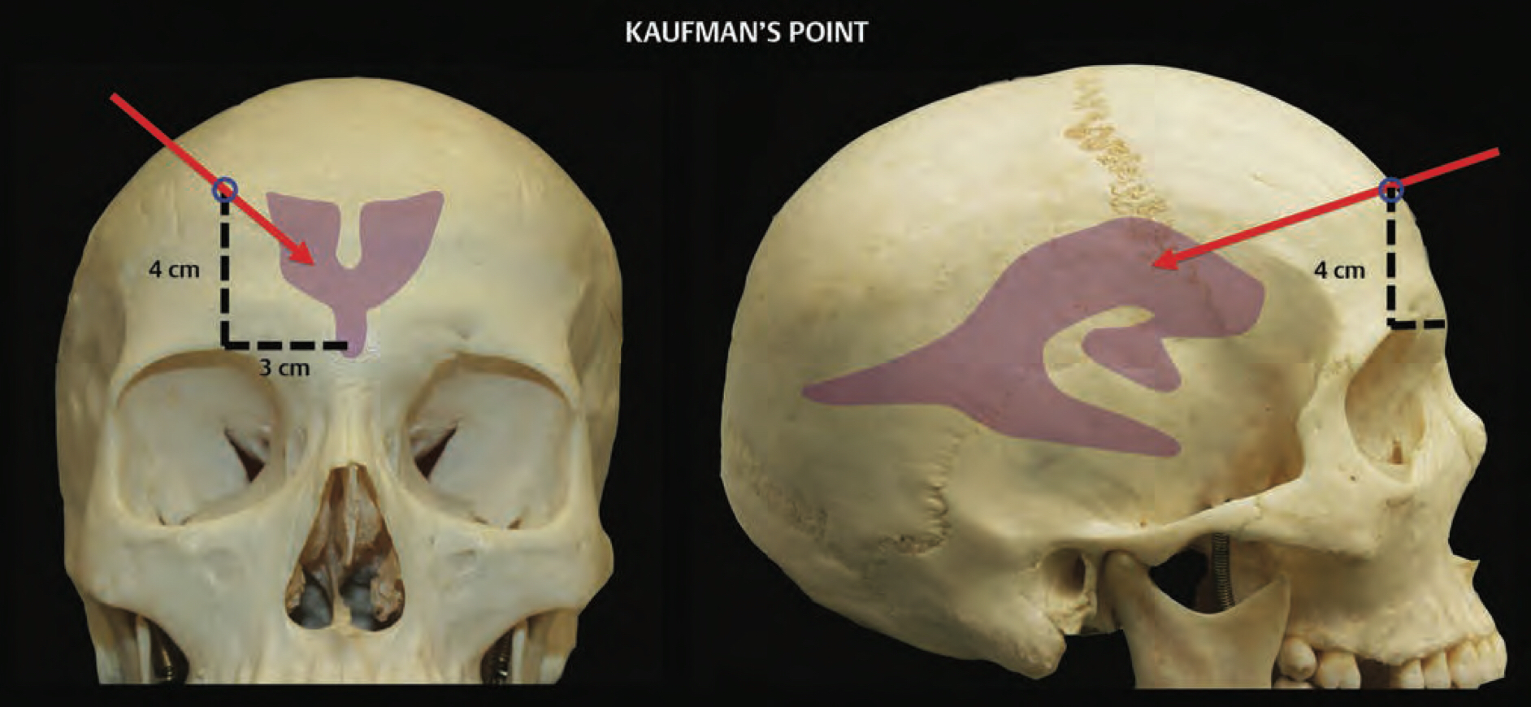

Slide 25
Occipitoparietal (Frazier’s point):
5 to 7 cm superior to the inion and 3 to 4 cm off the midline, the optimal catheter trajectory targets a point just above the nasion.
The catheter is advanced 4 to 5 cm.
Perpendicular to the cortex, toward the homolateral medial canthus.
Posterior parietal (Keen point ):
3 cm posterior and 3 cm superior to the top of the pinna.
Directed perpendicular to the cerebral cortex.
Advanced 4-5 c.m.
Occipital (Dandy’s point):
3 cm above the inion and 2 cm lateral to the midline (may be more prone to damage visual pathways than above)
Direction: The stylet is directed perpendicular to the cortex.
Depth: The stylet must be advanced 4-5 cm.

Slide 26
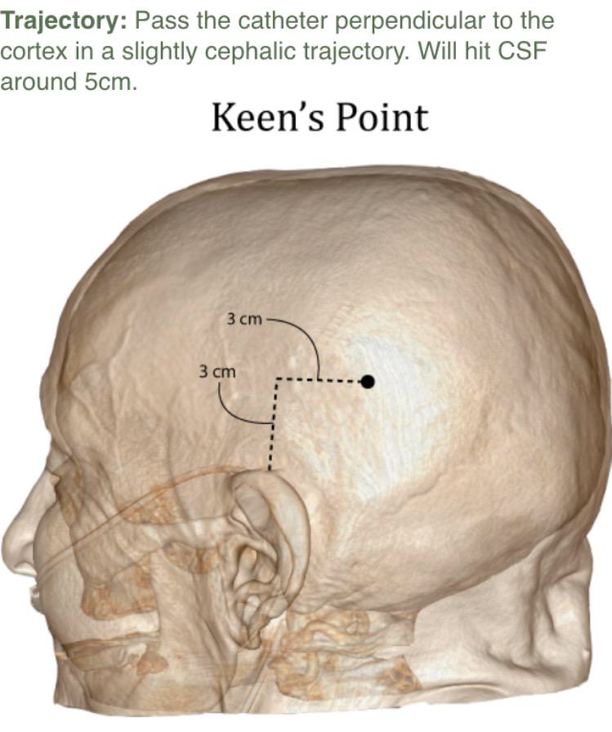
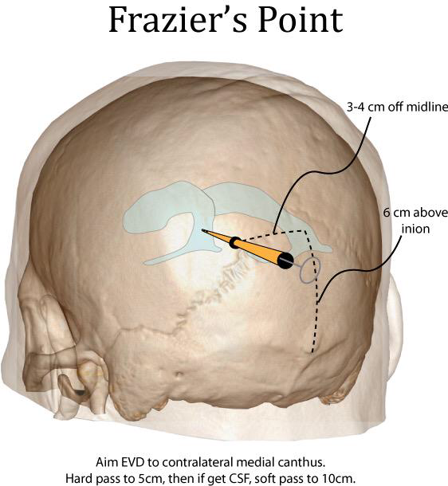

Slide 27
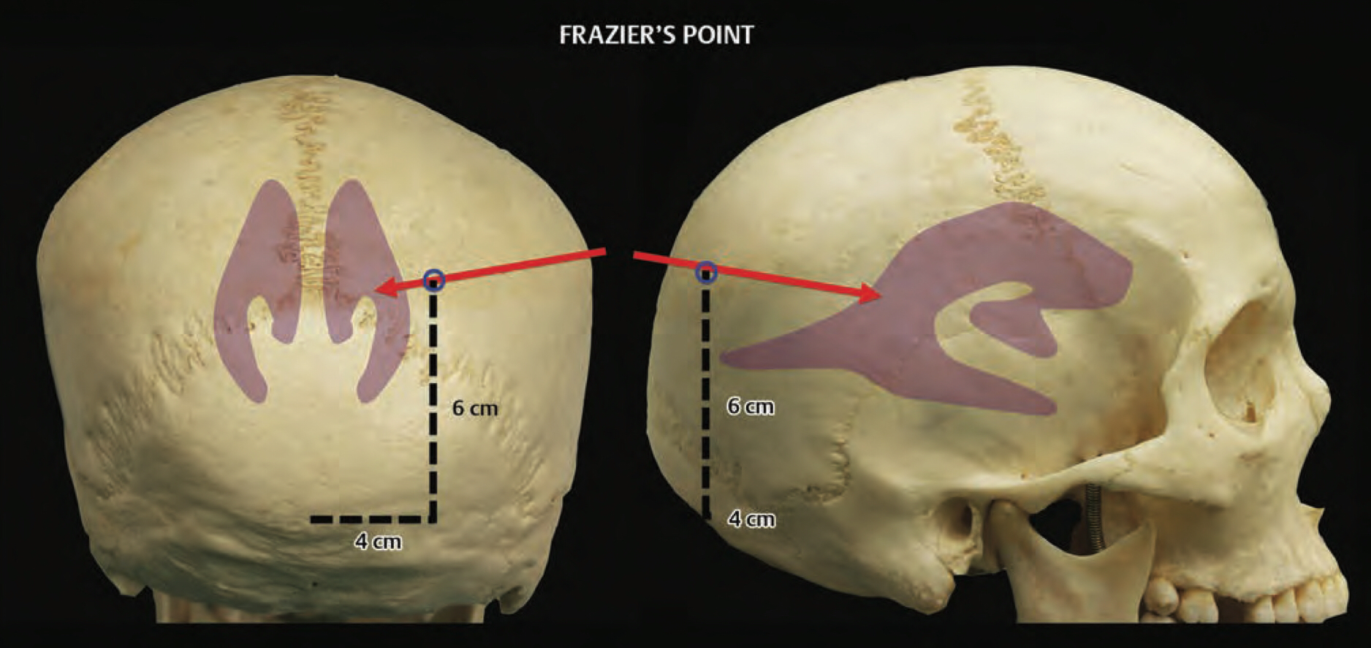

Slide 29
Distal catheter placement options
Peritoneal cavity
Pleural space: not for age ≤ 7 years
Right atrium or superior vena cava
Infrequently used distal shunt sites
Gallbladder
Internal jugular vein (with the catheter pointing “upstream”)
Superior sagittal sinus
Urinary bladder

Slide 30
Abdominal Access:
Minilaparotomy
For small children, use at least 30 cm length of intraperitoneal tubing to allow for continued growth
Layers of abdomen encountered:
Subcutaneous fat
Anterior rectus sheath
Abdominis rectus muscle fibers: should be split longitudinally
Posterior rectus sheath
Preperitoneal fat
Peritoneum (usually closely adherent to the posterior rectus sheath)
Laparoscopic assisted method :
2 small incision ( one for laparoscope , one for shunt insertion )
Small periumbilical incision for abdominal inflation with CO2 to pressure 12-15 mm Hg
Advantage
More safe than minilaparotomy
Reduce (operative time , hospital stay , blood loss)
Ensure optimal distal cath. Position within the periton , retrieve old cath. , confirm patency of shunt system

Slide 31
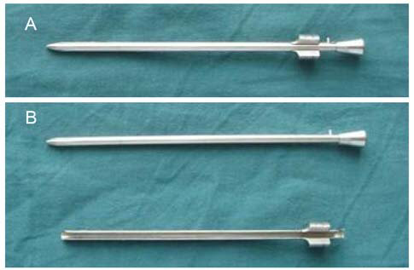
Trocar Method:
Trocar advanced parallel to floor toward the ipsilateral iliac crest
Two “pops” should be felt ( penetration of Anterior and Posterior Sheath )
Advantage :
Minimal invasive , low risk for incisional hernia
Disadvantage :
serious vascular or visceral injury

Slide 32
Ventriculoperitoneal Shunts
Indication
Hydrocephalus that is not amenable to endoscopic third ventriculostomy (ETV)
Specific Complications
Tract hematoma or IVH during ventricular catheterization
Placing the catheter in the preperitoneal fat rather than within the peritoneal space.
Vascular or visceral injury .
Over time the distal catheter may erode through any of the abdominal viscera migrating into the gallbladder, oral cavity, anus, scrotum, umbilicus, heart, thorax, pulmonary artery, and bladder .
Abdominal CSF pseudocyst formation, many factors predisposing to abdominal pseudocyst formation, the most important one being infection. Other risk factors include previous abdominal surgery (multiple shunt revisions) and allergic reaction to silicone.
Rarer abdominal complications include volvulus, CSF ascites, inguinal hernia, and hydrocele

Slide 33
Ventriculoatrial Shunts
Indication
Not candidates for ETV
Not candidates for a VP shunt because of peritoneal insufficiency.
Contraindications
Bacteremia or infection of the CSF.
Congestive heart failure and pulmonary hypertension.
Abnormal venous anatomy and previous jugular or subclavian vein thrombosis.
Specific Complications
The perioperative risks of VA shunt placement :pneumothorax, hemothorax, arterial puncture, hematoma, and catheter malposition.
Thromboembolism —> pulmonary hypertension —> cor pulmonale.
Shunt nephritis.
Endocarditis, myocardial injury, arrhythmia

Slide 34
Operative Technique
The right internal jugular vein (IJV) is the first choice for a cannulation site because it provides a more direct route to the superior vena cava.
Open method
A 2-cm transverse neck incision is made 2 to 3 cm below the ramus of the mandible in an adult (medial to the medial border of the sternocleidomastoid muscle).
The platysma is split in the direction of its fibers, then the common facial vein is identified.
The vein is isolated for about 1 cm of its length.
The vein is then ligated using the most cephalad tie.
A small venotomy is made in the common facial vein, and the atrial catheter is introduced through it into the jugular vein.
The catheter has been filled with an isotonic heparinized saline solution.
Catheter Position: verified by intraoperative fluoroscopy; the preferred position of the tip is midatrium (T6 to T8 vertebral level)

Slide 36
Ventriculopleural Shunts VP1
Do not Use under age ≤ 7 years due to reduced surface area for resorption of CSF which may result in high pleural fluid levels.
Indications
Not candidates for ETV
In whom the peritoneal cavity and heart are not suitable sites for CSF diversion.
Specific Complications : 10 - 20%
The most common complication is Pleural Effusion.
Pneumothorax.
Operative Technique :
A small (1.5 - 2-cm) transverse incision is made in the 3rd – 5th intercostal space in the anterior axillary or midaxillary line.
The catheter is introduced 20 to 40 cm of intrathoracic length.
The parietal pleura is visualized with the visceral pleura sliding underneath with each respiration.
Instruct the ansethiologist to do maximum expiration before introducing the catheter

Slide 37
Pleural access can be achieved by
Thoracotomy (open technique)
Thoracoscopic-assisted method
Trocar method.
After the anesthesiologist provides a maximal expiration, the trocar is advanced along a trajectory parallel to the floor through the intercostal muscles and parietal pleura. A “pop” may be felt as the trocar penetrates into the pleural space.

Slide 38
Ventriculosubgaleal Shunts
Reabsorption of CSF from the subgaleal pocket through the cervical lymphatics obviates the need for serial tapping.
A VSG shunt will ordinarily function for 2-3 months.
Indications
Preterm neonates with IVH and Post-Hemorrhagic Ventricular Dilation (PHVD).
Hydrocephalus in some of these infants will arrest while being temporized, subverting the need for permanent CSF diversion.
Abdominal pathologies ( Necrotizing enterocolitis, omphalocele) and intraperitoneal or systemic infection may further prevent distal catheter implantation into the peritoneal cavity in preterm infants with PHVD.

Slide 39
Ventricular Reservoirs
Indications
Prematurity-related IVH and PHVD, where hydrocephalus is temporarily controlled by serial reservoir tapping.
Malignancy :
ventricular reservoirs used for administration of Intrathecal chemotherapy either for
Treatment of leptomeningeal metastases or
Prophylactic therapy in patients at high risk for central nervous system relapse( acute lymphoblastic leukemia)

Slide 40
Shunt Failure

Slide 41
Management and Prevention of Shunt Infections

Slide 42
Management and Prevention of Shunt Infections
40% of shunts will undergo revision within the first 2 years of placement
The shunt infection rate ranges from 8% to 15%.
More than 90% of shunt infections occurred within the first 3 months of initial shunt placement.
Risk Factors
Age: neonates and very young children are at the highest risk for CSF shunt infection.
The number of revisions:
Children with single revision had 3-fold higher rate of infection.
Those who underwent two or more revisions had 13-fold.
Emergency abdominal surgery: such as appendectomies.
Placement of gastrostomy tubes
Others: timing of shunt placement, surgeon experience , length of surgery, use of preoperative antibiotics, surgical technique for shunt placement, method of distal catheter insertion, type of shunt used, and cause of hydrocephalus have been evaluated as risk factors.

Slide 43
The risk of infection increased in patients undergoing placement of CSF shunts for posthemorrhagic hydrocephalus and postinfectious.
Sources of shunt infection:
Colonization at the time of surgery
Wound breakdown over the shunt components.
Hematogenous spread from another source
Retrograde extension from a perforated viscus or peritoneal infection.
Shunt colonization from the patient’s skin at the time of surgery is the likely cause of most infections.

Slide 44
EVALUATING INFECTIONS
Signs and Symptoms
Very young children
fever, vomiting, and irritability, but symptoms can be as extreme as apnea and bradycardia.
Older children
Fevers, headache, nausea, localized pain, and gait disturbances.
Children of all ages may also present with seizures
Signs of ICP (blurry vision, diplopia, papilledema).
Signs of Meningitis (fevers, nuchal rigidity, and altered mental status).
Peritoneal infections often manifest with localized abdominal pain and shunt malfunction or abdominal pseudo cyst.
Superficial wound infections along the course of the shunt manifest as erythema, warmth, or tenderness over the shunt can lead to wound breakdown, cellulitis, and exposure of the shunt components.

Slide 45
Diagnosis
Imaging :
Plain radiographs can be used to assess the continuity of a shunt.
Brain (CT) & (MRI) : Dilated Ventricle , Ventriculitis , Abscess.
Ultrasonography or CT of the abdomen : patients may have abdominal pseudocysts
Laboratory :
CBC / CRP (first-line work-up)
CRP increase within 6 hrs. (acute phase) in response to inflammatory IL-6.
Avoiding a percutaneous shunt tap is justified if the serum CRP levels are less than 7 mg/L.
CSF Analysis
CSF from a percutaneous tap should be evaluated for cell count, protein and glucose levels, and Gram stain and culture.
Recent IVH or craniotomy may also increase CSF white blood cell counts, but the differential demonstrate a predominance of lymphocytes, which are suggestive not of an infection but of a more aseptic inflammatory process.
Eosinophil counts greater than 5% was highly predictive of shunt infection.

Slide 46
Causative Agents
Staphylococcus species are the predominant organisms isolated
S. epidermidis the most common pathogen 75%.
S. aureus is the second most common pathogen.
Gram-negative bacteria are the next most common pathogens
E. coli, Proteus species, and Klebsiella species
Skin-colonizing bacteria
Propionibacterium acnes difficult to isolate in cultures, and cultures may remain negative for more than a week , higher Eosinophilia.
Enterobacteriaceae and anaerobic organisms
Bacteroides fragilis consider an enteric source of VPS infection and thus the likelihood of perforated viscus.

Slide 48
TREATMENT
Three mainstay treatment options are described in the following discussion:
Medical management with antibiotics: (indications )
Patients who have had multiple prior surgeries.
Have complex shunts.
At significantly increased risk of surgical complications, such as those undergoing intensive chemotherapy.
Distal shunt catheter externalization (or removal of infected shunt and immediate replacement with a new shunt) with antibiotic treatment:
in patients with abdominal symptoms.
Externalization through a small incision along the course of the shunt tubing over the chest wall.
The distal catheter is connected to an external CSF collection system.
Removal of all shunt hardware, placement of a temporizing EVD with antibiotic treatment, and later new shunt placement:
Gives the best chance of eliminating the infection because all contaminated shunt components are removed.

Slide 49
The evaluation patient with shunt
By Hx and Examination
By checking the ability of shunt to pump and refill
Difficult to depress: suggests
Distal occlusion.
The composition of the reservoir are degraded and hardened over time.
Slow to refill (valve should refill in 15–30 secs): suggests
Proximal (ventricular) occlusion.
Slit ventricles.
Radiographic evaluation
Shunt series (X-ray , Brain CT & MRI, Abd. U/S & CT)
Shunt-o-gram: if it is still unclear if shunt is functioning

Slide 50
Shunt-o-gram
After tapping the shunt, drain 1 ml of CSF and send for C&S.
Inject either (iohexol or technetium) while occluding the distal flow (by compressing valve or occluding ports).
Immediately image the abdomen with the gamma camera to rule out direct injection into distal tubing.
Image the cranium to verify flow into ventricles (proximal patency) for diffusion of the isotope within the abdomen to rule out pseudocyst formation around catheter.
Interpretation:
If spontaneous flow into abdomen occurs within 20 minutes, the shunt is patent.
If there is no flow on delayed imaging, it is occluded.
The valve can be pumped to look for diffusion of isotope within the abdomen to rule out pseudocyst formation around the catheter tip.

Slide 51
Complication of shunt
Complication mainly in the cranial region
Tract hematoma or IVH
Obstruction
Disconnection at a junction, or break at any point
Infection
Hardware erosion through skin, usually only in debilitated patients
Seizures
Act as a conduit for extraneural metastases of tumors (medulloblastoma).
Silicone allergy

Slide 52
Complication of distal end
Inguinal hernia
Obstruction of peritoneal catheter
Peritonitis from shunt infection
Hydrocele
CSF ascites
Tip migration
Into scrotum
Perforation of a viscus
Through the diaphragm

Slide 53
Endoscopic Third Ventriculostomy ETV

Slide 54
ANATOMIC CONSIDERATIONS
The bur hole is placed just anterior to the coronal suture in the midpupillary line (Kocher’s point).
Within lateral ventricle
The foramen of Monro is usually identified first.
The choroid plexus arises posterior to the foramen of Monro, through which it passes before turning posteriorly to reside underneath the tela choroidea.
The anteromedial septal vein + posterolateral thalamostriate vein —> the internal cerebral vein (at the posterior margin of the foramen of Monro).
The internal cerebral vein: courses in the tela choroidea of the roof of the third ventricle.
The left foramen is defined by the choroid and the thalamostriate vein coursing toward the 8 o’clock position,
The right foramen these structures are oriented to the 4 o’clock position.
Boundaries of Foramen of Monro
Anterior and medial: The fornix as a curved white C-shaped structure.
Lateral: The head of the caudate.
Medial: the septum pellucidum.

Slide 55
Within the 3rd ventricle
After passing through the foramen of Monro, the floor of the third ventricle is visualized.
Two invaginations in the anterior portion of the floor represent the optic recess and the infundibular recess.
Posterior to them, a pair of whitish prominences, the mammillary bodies, appear in the middle of the floor.
Between the infundibular recess and mammillary bodies lies the tuber cinereum (Latin, gray potato).
In the setting of hydrocephalus, the tuber cinereum is often thin and translucent and can provide a glimpse of the basilar apex in the interpeduncular cistern below.
Structures of the posterior 3rd ventricle may be difficult to see because they are often
Hidden from the endoscope in a standard precoronal bur hole and transforaminal approach.
The massa intermedia may also obstruct the view of posterior structures.

Slide 58
INDICATIONS of ETV
Common indications for neuroendoscopy include:
Treatment of hydrocephalus
Cyst fenestration
Biopsy or resection of intraventricular and pineal region tumors
The spectrum of noncommunicating hydrocephalus can be managed with ETV:
Cyst fenestration
Septostomy
Foraminoplasty
Aqueductoplasty
The placement or removal of recalcitrant shunt catheters.

Slide 59
ETV for Noncommunicating Hydrocephalus
Used in symptomatic non-communicating HC manifesting with (headache, ataxia, nausea or emesis, and visual perturbation).
ETV candidates must have patent subarachnoid spaces and suitable anatomy to permit safe fenestration of the floor of the third ventricle without excessive risk to surrounding neurovascular structures (basilar artery complex).
Preoperative assessment by (MRI)
Size of the third ventricle
Thickness of its floor
Position of the basilar artery
The prepontine interval between the basilar artery and clivus
5mm interval is preferred
Prepontine interval of less than 1 mm, may still permit endoscopic fenestration of the floor of the third ventricle.

Slide 60
Fenestration techniques include
Passage of a Fogarty balloon catheter with repeated inflation and deflation until satisfactory creation of a stoma is achieved
Or blunt penetration of the floor with a Bugbee wire or rigid probe, laser coagulation, electrocoagulation, or water jet fenestration.
Both the ependyma and underlying arachnoid are opened.
Bleeding from the edges of the opening can be tamponaded by keeping the balloon inflated for a slightly longer period.
Fluctuation of the margins of the fenestration indicates CSF flow.
The basilar artery complex can be visualized through the fenestration without inserting the endoscope into the basal cisterns.

Slide 61
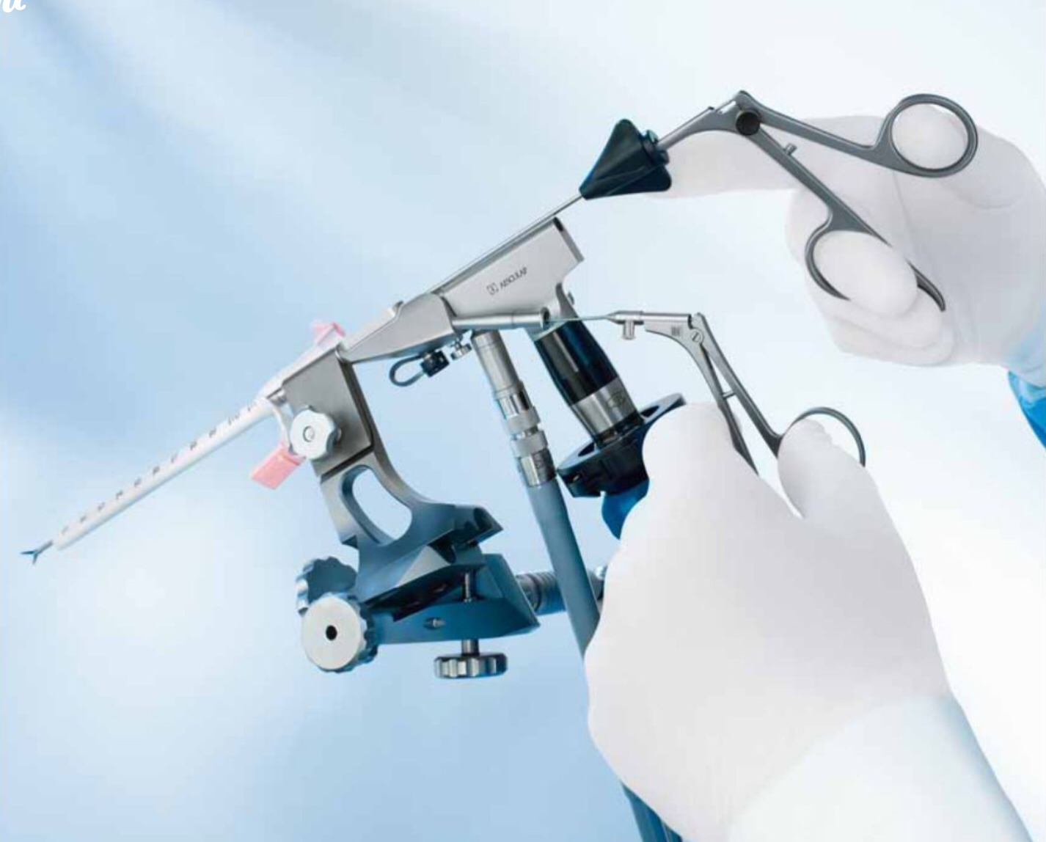

Slide 62
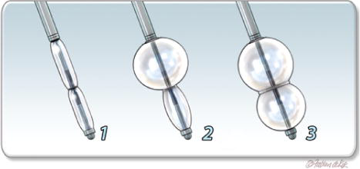

Slide 64
Infundibular Recess
Dorsum Sella
Ant. Septal V.
Thalamostriate V.
Basilar A.
Mamillary Body
Sup. Choroidal V.

Slide 65
Etiologies of obstructive HC for which ETV has been performed include
Aqueductal stenosis (most common cause)
Tumor
Infection
Intracerebral hemorrhage
Classical aqueductal stenosis resulting from a membranous strut produces triventricular hydrocephalus (lateral and third) on imaging.
Enlargement of the temporal horns may compress midline structures and mimic aqueductal stenosis.
Note: If the 3rd ventricular floor anatomy appears less favorable for safe ventriculostomy, fenestration of the lamina terminalis occasionally provides an alternative channel.

Slide 66
Complications
Intraoperative complications
Neurovascular injury and bradycardia with cardiac arrest.
Venous or arterial bleeding.
Massive SAH from perforation of the basilar artery or its branches.
Elevated ICP by aggressive irrigation and stimulation of the preoptic area or the posterior hypothalamus —> brady or tachycardia, respectively.
Early postoperative complications
Neurological and endocrinologic dysfunction
Subdural hematoma
CSF leak
Infection
Disturbance in short-term memory due to fornical injury
Transient 3rd and 6th nerve palsies
Late postoperative complications
Delayed failure

Slide 67
Multiple mechanisms contribute to late ETV failure, including
Inadequate size of the initial fenestration.
Underappreciated secondary membranes.
Reduced or absent CSF flow through the fenestration.
Narrowing or closure of the stoma as a result of hemorrhagic obstruction.
Elevated CSF protein and fibrinogen.
Inadequate CSF absorption by the arachnoid granulations.
Postoperative infection with CSF obstruction at the fenestration site.
Tumor progression resulting in blockage.

Slide 68
Endoscopic Aqueductoplasty
Used for CSF diversion in cases of hydrocephalus caused by membranous occlusion or short-segment stenosis of the aqueduct of Sylvius.
Advantages
Restores the physiologic CSF pathway
No risk for basilar artery injury
Avoids hypothalamic injury
Negates consideration of any arachnoidal adhesions
Disadvantages
Injury to the periaqueductal gray matter.
Injury to the floor of the fourth ventricle.
Stenting of the aqueduct is considered for
Patients at high risk for aqueductal restenosis.
Patients with a trapped fourth ventricle.

Slide 69
Shunted patients with a trapped 4th ventricle often have slit-like lateral ventricles and are poor candidates for the standard endoscopic aqueductoplasty.
For these patients, a suboccipital approach for retrograde aqueductoplasty and stenting.
Complications
Midbrain injury
Parinaud’s syndrome
Cranial nerve palsies.

Slide 70
Septostomy and Foraminoplasty
Indication of septostomy (fenestration of the septum pellucidum)
Isolated lateral ventricular hydrocephalus, resulting from compartmentalized CSF collections or loculated ventricular cysts.
Fenestration can be performed mechanically, through
Saline torch dissection
Laser coagulation
Sharp extirpation
Anatomic consideration
Large septal veins most frequently occur in the anterior septal region, whereas the middle septal region, at the level of the foramen of Monro, poses a relatively safe area for septostomy.
Indication of Endoscopic foraminoplasty
membranous obstructions of the foramen of Monro causing unilateral or bilateral hydrocephalus.

Slide 71
ETV Success Score
The overall success rate of ETV is between 50% and 90% at 1 year
Young age (less than 6 months) is associated with a lower success rate
The success rate for ETV is
High in patients older than 2 years with noncommunicating hydrocephalus caused by aqueductal stenosis, tectal glioma, and posterior fossa tumors.
Low in patients with hydrocephalus caused by intraventricular hemorrhage in association with prematurity or postinfectious hydrocephalus
The most important factor in selecting adult patients for ETV is the subtype of hydrocephalus itself. Treatment with ETV appears to offer the most benefit for
late-onset idiopathic aqueductal stenosis (LIAS),
secondary noncommunicating hydrocephalus,
NPH,
conversion of a shunt in a patient who was treated for hydrocephalus as a child

Slide 74
Late-Onset Idiopathic Aqueductal Stenosis ( LIAS )
“Delayed” or “Compensated” aqueductal stenosis.
Is a type of triventricular hydrocephalus with little or no flow through the aqueduct of Sylvius beside “normal to small” fourth ventricle.
Occurs in adult patients in the absence of space-occupying lesions or previous insults to the central nervous system (previous meningitis).
LIAS represents approximately 3% to 10% of all cases of hydrocephalus in adults.
Presentation :
Young (mean age of 33 years) : presenting primarily with headache and signs and symptoms of raised intracranial pressure
Old (mean age of 63 years) : with larger ventricles and NPH-like symptoms (cognitive impairment, urinary incontinence, and gait disturbance).
Respond to ETV 50% to 86.5%

Slide 75
Normal-Pressure Hydrocephalus
Triad of clinical signs and symptoms:
(1) Gait apraxia abnormalities such as a “magnetic” or “festinating” gait.
(2) Bladder incontinence.
(3) Cognitive impairments or dementia.
Findings on (MRI) include
Ventriculomegaly, focal subarachnoid space enlargements, brain atrophy.
An open aqueduct, without evidence of a macroscopic blockage of CSF flow
Diagnosis of NPH can be supported by results of
Formal neuropsychological testing, results of gait testing (only gait disturbance is currently considered useful in predicting treatment response).
Clinical improvement after a lumbar CSF tap test (miller fisher) or an external CSF lumbar drainage test.
CSF shunts have a high success rate.
The use of ETV is controversial for the management of NPH.
Potential predictors of success for ETV included a shorter duration of symptoms and milder symptoms, but neither patient age nor the size of the fourth ventricle was predictive of response.

Slide 76
Thank you

