Slide 1
Hemangioblastomas Youmans Chap. 144

Slide 2
Hemangioblastoma
WHO Grade I
Intra-axial tumor.
Originate nearly exclusively from CNS tissues and are rarely found in the peripheral nervous system.
Sporadic 60% to 75% of cases.
Autosomal dominant neoplasia syndrome, von Hippel-Lindau (VHL) disease (25% to 40%).
Most common primary posterior fossa tumor in adult

Slide 3
Epidemiology
More common in male.
Presentation
Earlier in VHL disease (30 to 40 years)
Late in sporadic tumors (40 to 50 years).
Locations
95% in the Infratentorial region (brainstem, spinal cord, and cerebellum)
5% in the supratentorial compartment (most frequently originate in the region of the pituitary stalk and tuber cinereum).
Represent about
2% of all intracranial neoplasms,
7% to 12% of posterior fossa tumors.
2% to 10% of all primary spinal cord tumors

Slide 4
Clinical findings
Cerebellar hemangioblastomas
Occur in the posterior, medial, or both portions
Headache (most common)
Gait ataxia
Dysmetria
Hydrocephalus
Nausea and vomiting
Spinal cord hemangioblastomas
Arise posterior to the dentate ligament at the dorsal root entry zone.
Hypesthesia (most common)
Weakness
Gait ataxia
Hyperreflexia
Pain

Slide 5
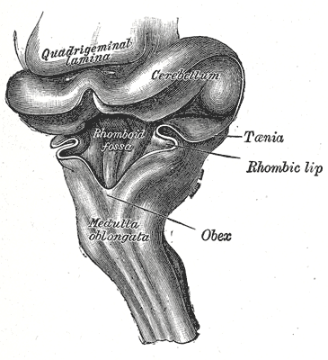
Brainstem hemangioblastomas
occur in the posterior medulla at the obex.
Hypesthesia (most common)
Gait ataxia
Dysphagia
Hyperreflexia
Headache
Disorders of appetite and feeding.
The obex (from the Latin for barrier) is the point at which the 4th ventricle narrows to become the central canal of the spinal cord.

Slide 6
PERITUMORAL CYST FORMATION
80% associated with a peritumoral cyst.
Neurological dysfunction is most frequently caused by the combined mass effect of the tumor and an associated peritumoral cyst.
It initiated by
Increased vascular permeability of the hemangioblastoma.
Extravasation of a plasma ultrafiltrate into the tumor interstitial spaces, and high interstitial tumor pressure then drives this fluid into the surrounding CNS parenchyma.
Because the hemangioblastoma is the source of extravasated plasma ultrafiltrate, peritumoral edema and cysts resolve after tumor removal, and treatment does not require cyst wall resection or fenestration.
In VHL disease: average cyst volume is
4 times larger than tumor volume in cerebellar hemangioblastomas.
12 times larger in brainstem hemangioblastomas.
Irradiation transiently increases vascular permeability, possibly leading to peritumoral edema and cyst formation
Anti–vascular endothelial growth factor (VEGF) tumor treatments have been associated with edema reduction and symptom improvement, despite having no effect on tumor size.

Slide 7
IMAGING
CT
The mural nodule is isodense without contrast but vividly enhanced with contrast.
The cyst walls do not usually enhance
MRI
T1
hypointense to isointense mural nodule
CSF signal cyst content
T1 Contrast
mural nodule vividly enhances
cyst wall does not enhance
T2
Hyperintense mural nodule
Flow voids due to enlarged vessels may be evident especially at the periphery of the cyst.
Angiography (DSA)
Enlarged feeding arteries and often dilated draining veins are demonstrated, with a dense tumor blush centrally .

Slide 10
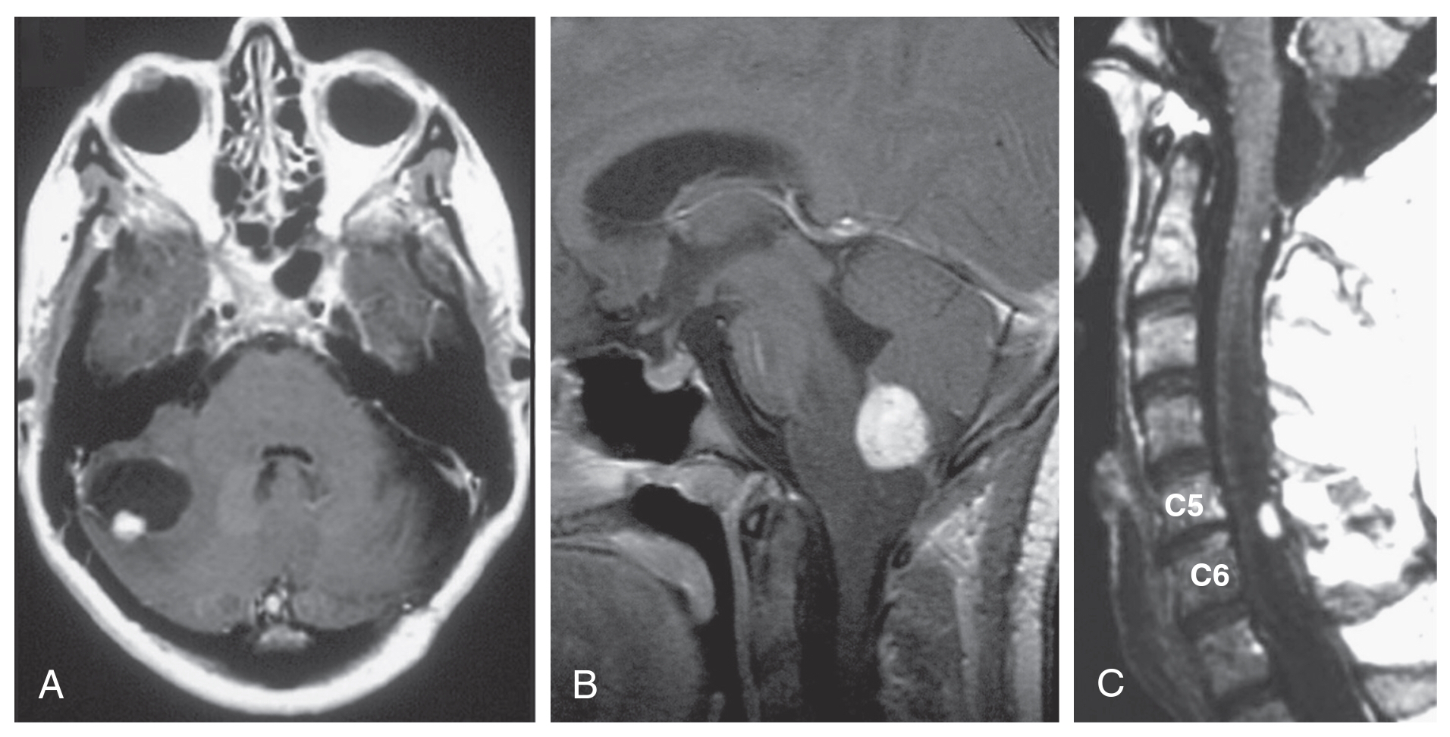
MRI of hemangioblastomas in the CNS of patients with von Hippel-Lindau (VHL) disease.
A, T1-weighted, contrast-enhanced axial image of a cerebellar hemangioblastoma (solidly enhancing area) with an associated cyst (homogenous associated dark region) in a 40-year-old woman with VHL disease.
B, Midsagittal T1-weighted postcontrast image of a medullary hemangioblastoma (solidly enhancing region) with associated brainstem edema (surrounding darker region) in a 12-year-old girl with VHL disease

Slide 11
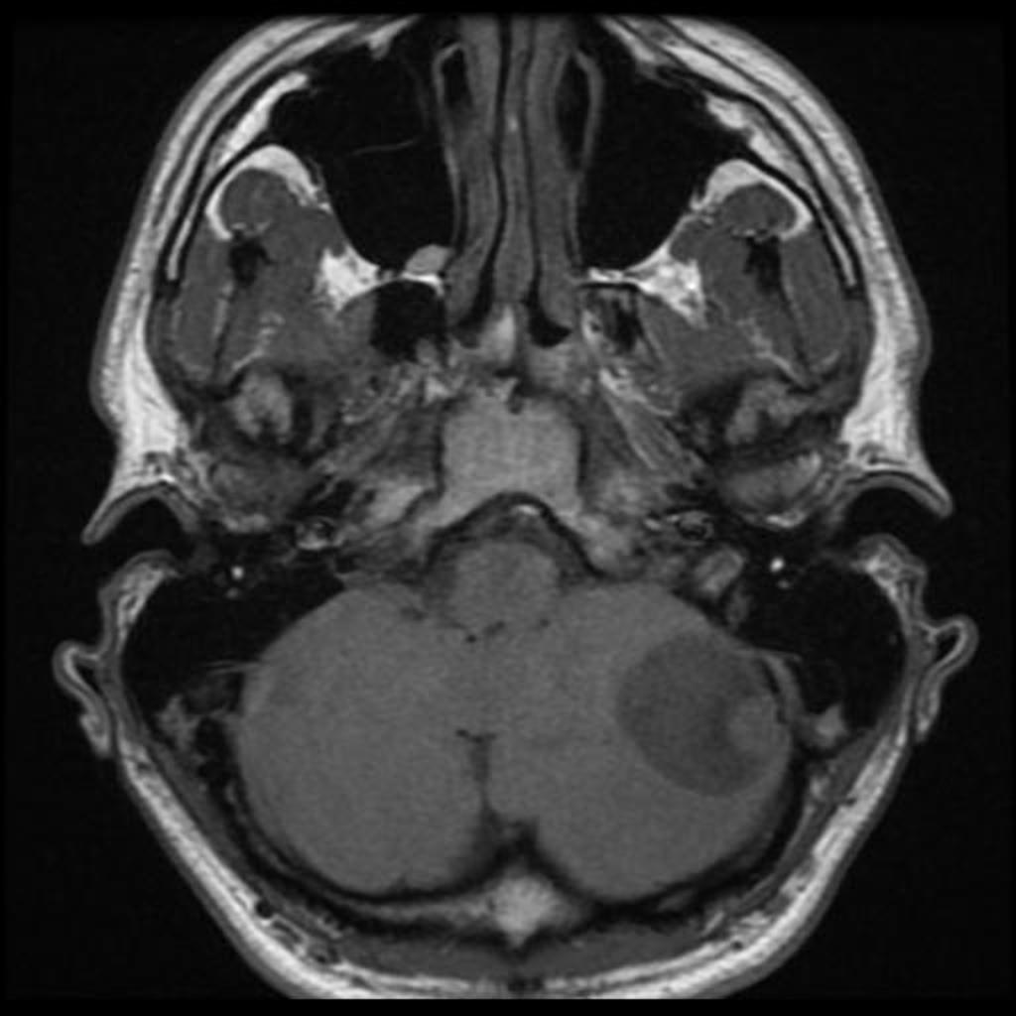
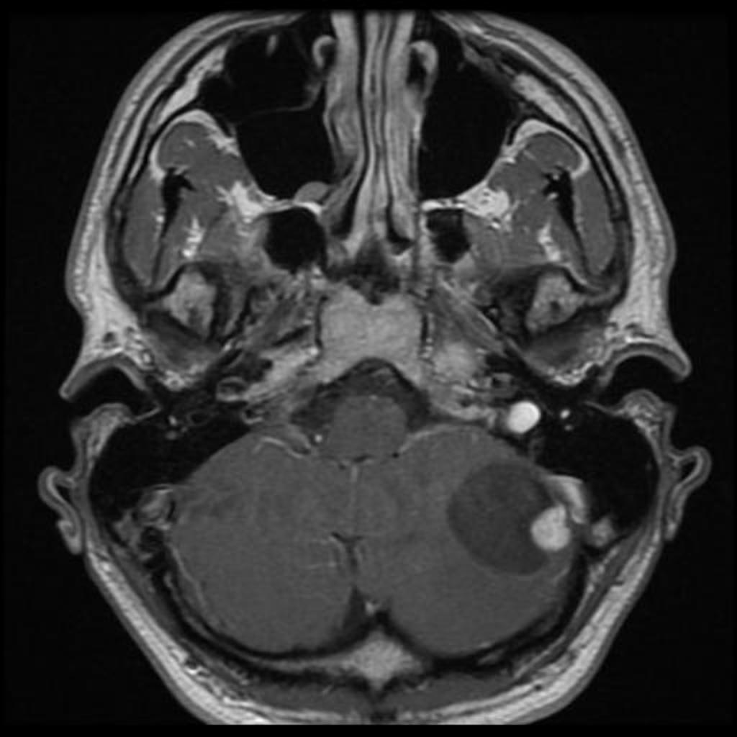
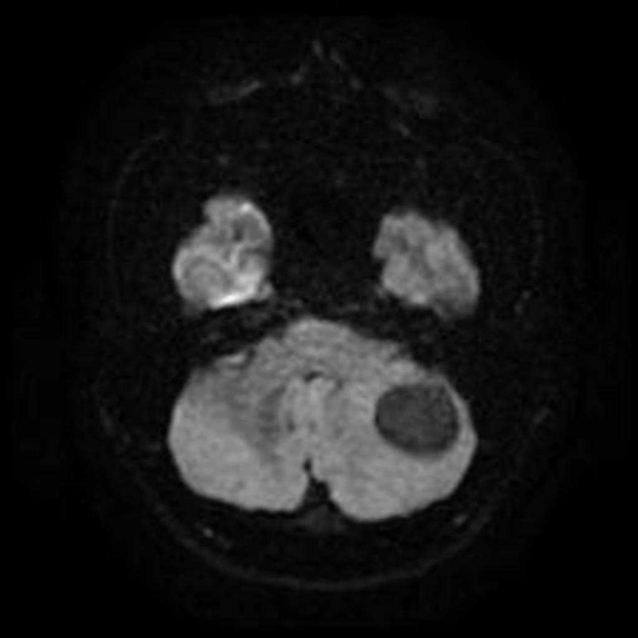
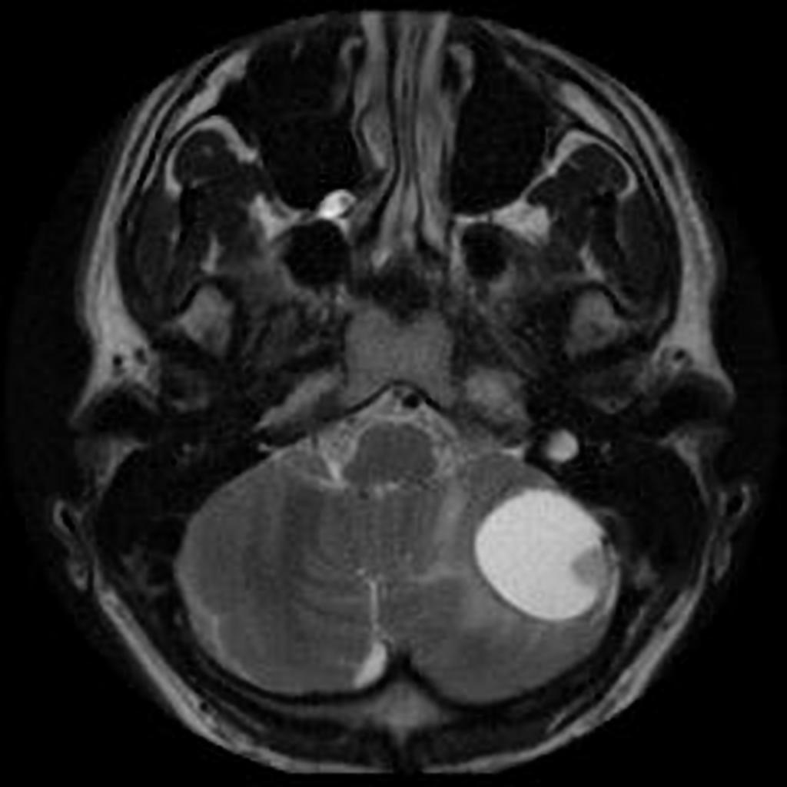
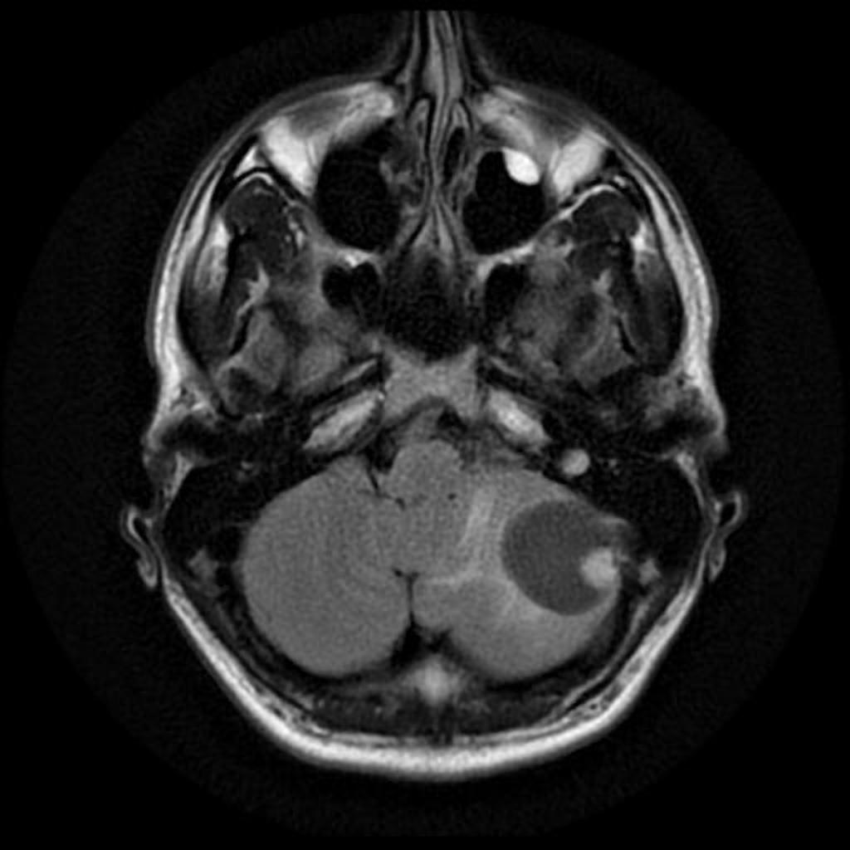
T1
T1 contrast
DWI
T2
Flair

Slide 12
Differential Diagnosis. From Osborne
Pilocytic Astrocytoma
Cyst and mural nodule
Imaging mimics HGBL
Child or young adult
Metastasis
Solitary posterior fossa metastasis uncommon, But most common parenchymal posterior fossa mass in> 40 year old is metastasis
May be very vascular
Solid > cystic
Multiple > single
Glioblastoma
Adults with irregular ring-enhancing mass
Posterior fossa uncommon location
Cavernous Malformation (CM)
Heterogeneous mass with blood products
Hemosiderin rim common
Enhancement uncommon
May acutely hemorrhage
Complete hemosiderin rim typical in CMs
Vascular Neurocutaneous Syndromes
Hereditary hemorrhagic telangiectasia (HHT)
Wyburn-Mason
Multiple intracranial AVMs may mimic HGBLs

Slide 13
VON HIPPEL-LINDAU DISEASE VHL
Patients with VHL disease are predisposed to development of disease-specific visceral and CNS lesions.
Hemangioblastomas is the most common manifestation of VHL disease.
The primary cause of VHL disease–related death is renal cell carcinoma or CNS hemangioblastoma.
Clinical criteria or genetic testing can be used to establish the diagnosis of VHL
Patients with a family history of the disease plus one of
CNS hemangioblastoma (including retinal hemangioblastoma),
Clear cell renal carcinoma
Pheochromocytoma
Endolymphatic sac tumors (ELSTs)
In the setting of VHL disease, it is probably best to reserve treatment of hemangioblastomas until they produce symptoms.
Pregnancy was not associated with hemangioblastoma and/or cyst development and progression.

Slide 15
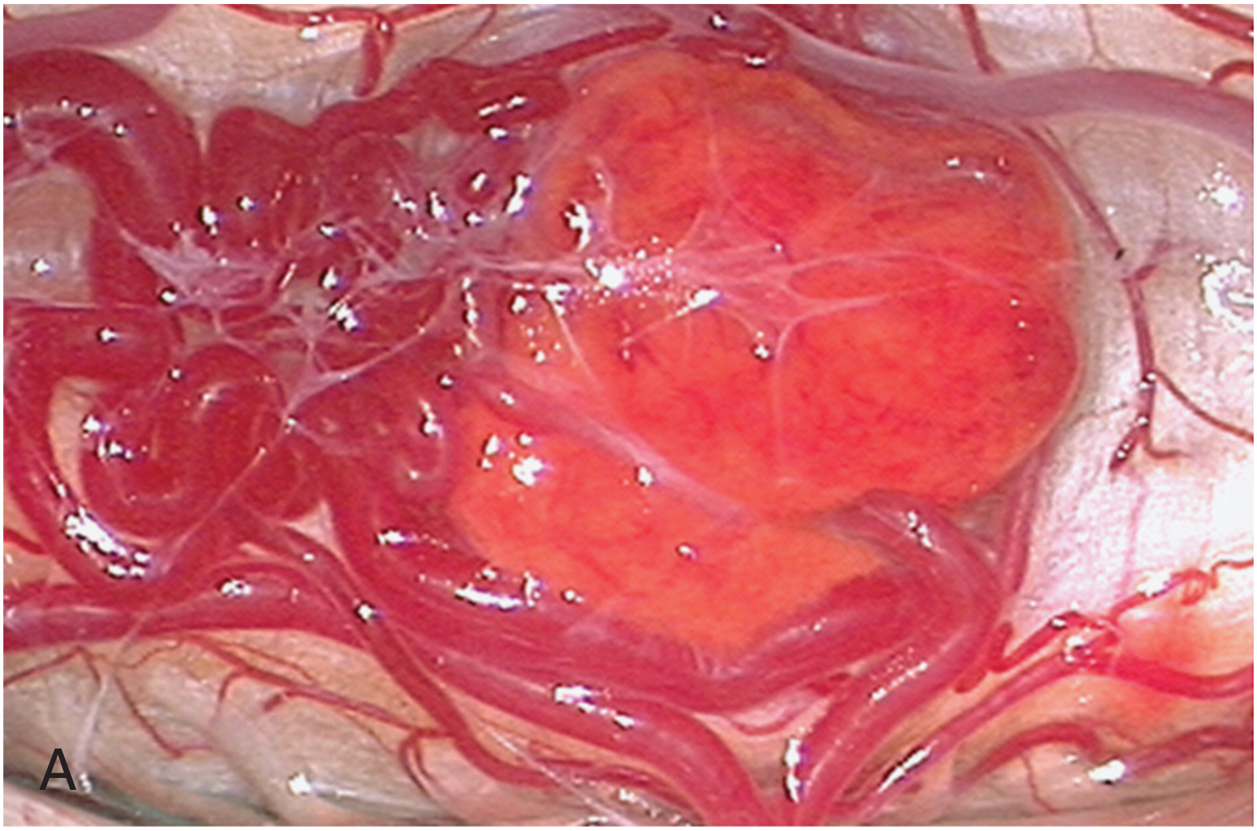
PATHOLOGIC FINDINGS
Hemangioblastomas are bright red or red-orange and are invariably associated with intense vascularity that abuts leptomeninges (pial).
Large abnormal veins are found at resection to be draining these tumors.
Hemangioblastomas are well-circumscribed, encapsulated tumors that occasionally have intratumoral cysts whose walls are composed of compressed brain tissue and reactive gliosis.

Slide 16
MANAGEMENT
(VHL Disease–Related versus Sporadic Hemangioblastomas)
Patients with VHL disease
Multiple CNS hemangioblastomas
Growth rate is unpredictable.
Treatment postponed until they become symptomatic.
Sporadic hemangioblastomas
Frequently investigated because they have symptoms.
Diagnosis cannot be confirmed until resection → to relieve symptoms and to provide a diagnosis in sporadic cases → surgery may be required.

Slide 17
Surgical Resection
When the tumor is associated with a cyst , the gliotic cyst walls are left undisturbed, because they are not neoplastic and simply removing the source of the cyst (the tumor) inactivates the cyst, which and will collapse.
When complete resection of the tumor is accomplished, recurrence is rare, and stabilization or improvement of symptoms occurs in majority (90%) of patients.
Radiation Therapy
Indication
Small tumors that are not associated with peritumoral cysts.
Caution is necessary in interpreting the results of radiotherapy because many of the treated tumors may have been in a quiescent phase and the absence of enlargement on serial MRI studies may not have been the result of treatment.

Slide 18
Notes about SURGICAL TECHNIQUE
Cerebellar Hemangioblastomas
Midline suboccipital approach for the posterior and/or medial cerebellar regions
Intraoperative ultrasonography, which is used to localize the hemangioblastoma (hyperechoic) and/or cyst (hypoechoic, if present).
Increased posterior fossa pressure can be reduced by :
Removal of CSF from the cisterna magna.
US guided spinal needle decompression of peritumoral or intratumoral cysts.
Mild hyperventilation, and/or diuresis (with intravenous furosemide and/or mannitol).
Tumor-associated vessels (those entering and leaving the tumor) are cauterized with self-irrigating bipolar cautery and sharply divided.

Slide 19
For large hemangioblastomas
Two operative maneuvers can be employed to reduce the tumor mass in order to diminish manipulation/retraction of the surrounding cerebellum.
First, the central component of the tumor can be coagulated with broad bipolar cautery tips and concurrent irrigation and then removed with microscissors or ultrasonic aspiration in piecemeal fashion.
Second, with the broad bipolar cautery tips and concurrent irrigation, the tumor can be shrunk by circumferential capsular coagulation.

Slide 20
Spinal cord hemangioblastoma
an uncommon vascular neoplasm of a benign nature.
3/4 of these tumors occur sporadically.
Locations :
50% are found in the thoracic.
1/3 are identified in the cervical.
Intramedullary location is the most common.
Differential diagnosis
spinal cord ependymoma.
vascular malformation.

Slide 21
Spinal Cord Hemangioblastomas surgical notes
Because most spinal cord hemangioblastomas are located posterior to the dentate ligament, a direct posterior approach is most often used to remove them.
Hemangioblastomas located in the anterior (anterior to the dentate ligament) or anterolateral region of the spinal cord may be accessed with an anterior or anterolateral approach which allow for minimal manipulation and rotation of the spinal cord during resection and can be associated with improved postoperative outcome.
Electrophysiologic monitoring is not routinely used
Except in ventral tumors close to a medullary artery or the anterior spinal artery, a circumstance that permits monitoring during test occlusion of the artery, if needed, with temporary clips, before its potential interruption.
Removal of the hemangioblastoma inactivates the syrinx, so syrinx drainage is not necessary

Slide 22
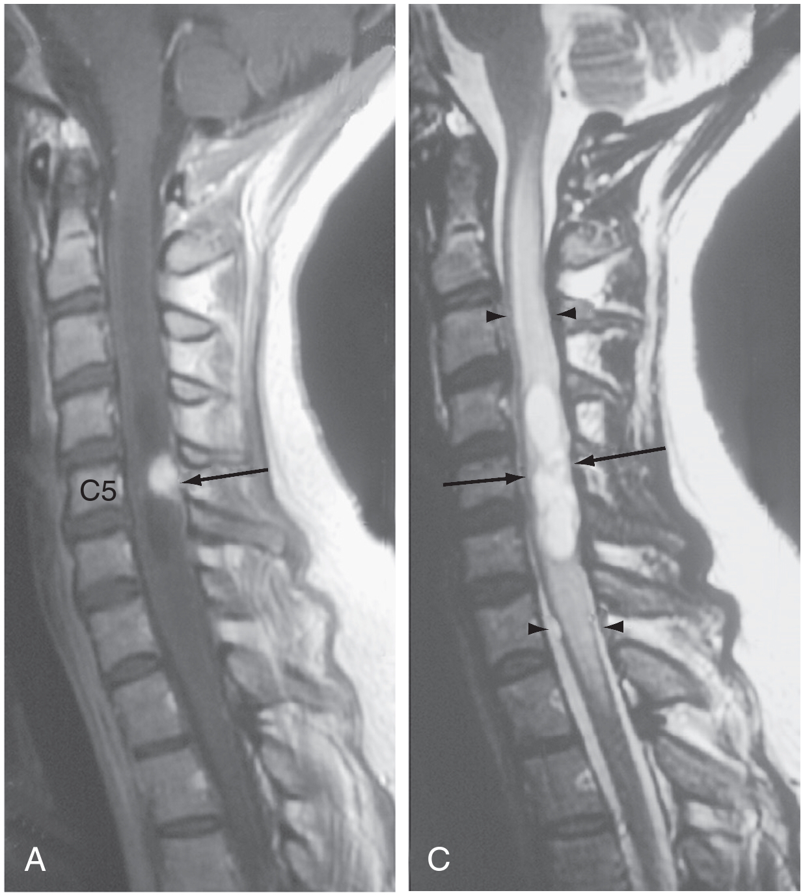
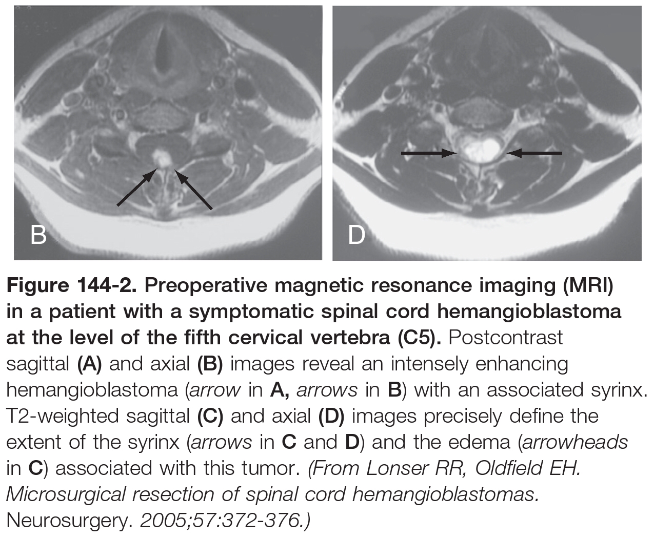
Preoperative magnetic resonance imaging (MRI) in a patient with a symptomatic spinal cord hemangioblastoma at the level of the fifth cervical vertebra (C5).
Postcontrast sagittal (A) and axial (B) images reveal an intensely enhancing hemangioblastoma (arrow in A, arrows in B) with an associated syrinx.
T2-weighted sagittal (C) and axial (D) images precisely define the extent of the syrinx (arrows in C and D) and the edema (arrowheads in C) associated with this tumor.

Slide 23
Microsurgical resection of spinal cord hemangioblastomas.
The intradural portion of the operation for resection of spinal cord hemangioblastomas is shown.
Using an operating microscope, the surgeon identifies associated vessels and tumor.
The surgeon exposes the tumor by reflecting the overlying vessels with gentle traction.
Vessels entering and leaving the tumor are coagulated with bipolar coagulation and sharply divided.
The junction between the pia and the tumor capsule is identified and incised with a diamond knife and microscissors. Dissection of the tumor is continued more deeply and circumferentially at the tumor capsule–spinal cord interface with bipolar microforceps.
After circumferential dissection of the tumor margin is complete, the surgeon reflects the inferior pole to the hemangioblastoma with gentle suction on a cottonoid to expose the underlying vessels.

Slide 24
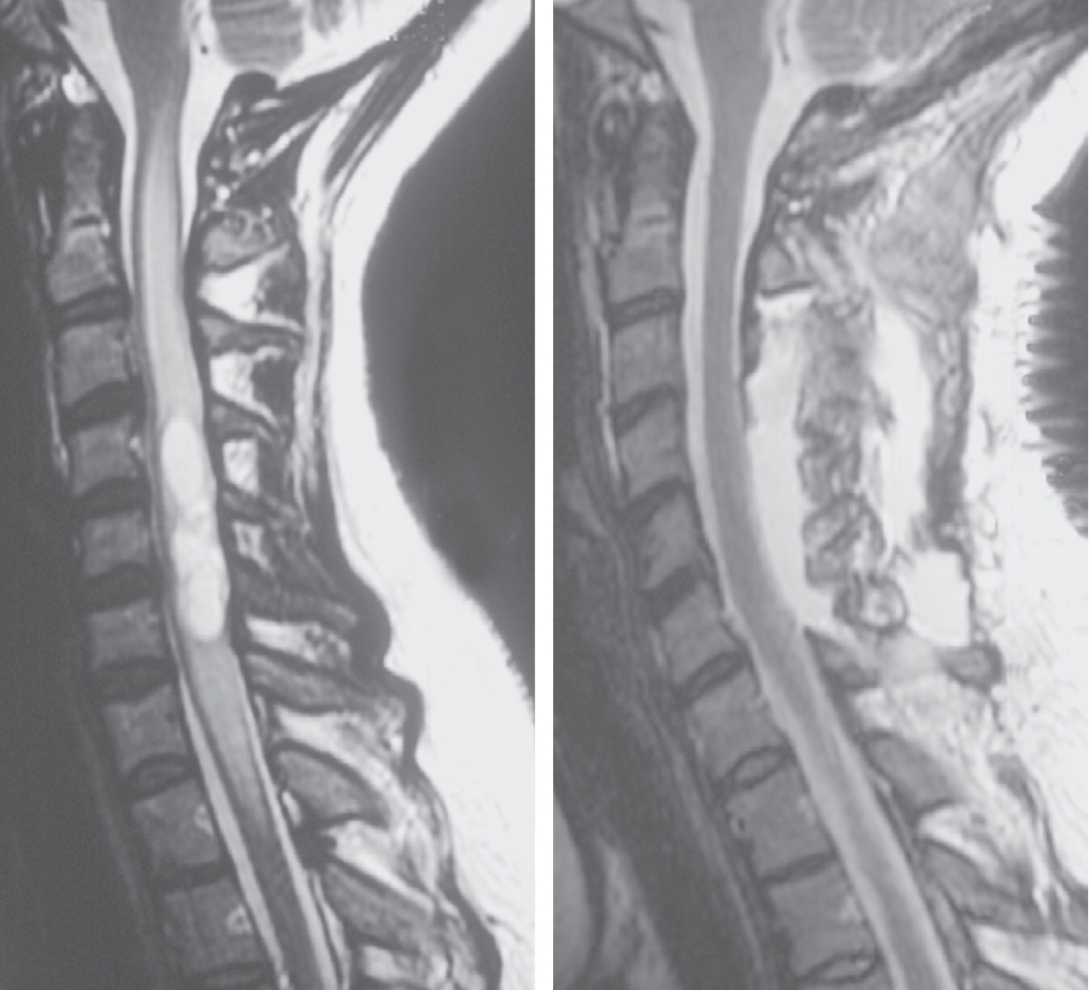
Preoperative (left) and postoperative (right) sagittal T2-weighted magnetic resonance images from a patient with von Hippel-Lindau disease and a hemangioblastoma in the cervical segment of the spinal cord and surrounding syrinx. After selective resection of the hemangioblastoma, complete resolution of the associated syrinx and surrounding edema has occurred.

