Slide 1
Head Injury Radiology and Management Youmans Chap. 344, 346, 348, 349 Handbook 9

Slide 2
Guidelines for Prehospital Management of Traumatic Brain Injury
Oxygenation and blood pressure
GCS score
Pupil examination
Treatment: airway, ventilation, and oxygenation
Establish airway
Avoid hypoxemia (SpO 2 < 90%)
Monitor blood pressure, oxygenation, and ETCO 2 while implementing ETT
Confirm position of endotracheal tube by auscultation
Avoid hyperventilation unless patient shows evidence of cerebral herniation.
Fluid resuscitation
Treatment of cerebral herniation
Avoid mild or prophylactic hyperventilation
Assess patient frequently for clinical signs of cerebral herniation,
In patients who are normoventilated, well oxygenated, and normotensive, hyperventilation can be used to keep ETCO 2 between 30 and 35 mm Hg
Administer hyperventilation as 20 breaths/min in adult, 25 in child, and 30 in infant
ETCO2 = end tidal co2

Slide 3
Pupillary examination in trauma
Unilateral
Unilateral dilated pupil that does not react to light —> uncal herniation.
Direct trauma to the eye can also cause unilateral pupillary dilation.
Nonreactive pupil in one eye with light response in the contralateral eye (an afferent pupillary defect or Marcus Gunn pupil) —> optic nerve injury.
Unilateral pupillary constriction is often accompanied by mild ptosis when Horner’s syndrome is present, suggesting carotid dissection.
Bilateral
Bilateral dilated pupils are not easy to interpret and may result from
Hypoxia.
Hypotension.
Mydriatic drugs.
Bilateral third nerve dysfunction.
Bilateral pupillary constriction is commonly a drug response (especially if narcotics were given) but can also represent a pontine lesion.

Slide 4
Both uncal and tonsillar herniation can result in brainstem hemorrhage that is located in the midline (Duret’s hemorrhage), which can be differentiated from the (punctate hemorrhage) seen in diffuse axonal injury, which is usually located dorsally in the corpora quadrigemina.
Evaluation of the oculocephalic reflex
by rapidly rotating the head in the horizontal plane, the eyes moving conjugately in the direction opposite to rotation of the head (doll’s eye or oculocephalic reflex) suggests intact tegmental structures in the pons and midbrain.
The cold caloric test
In a comatose patient, the head is placed at 30 degrees, and 30 mL of ice water is used to irrigate the ear canal.
Conjugate eye deviation toward the side being stimulated (vestibulo-ocular reflex) indicates an intact brainstem.
Cold opposite, warm same (COWS): which means that cold water pouring into the left ear leads to eye movement to the left and a direction of the nystagmus is on the right (opposite side). It is the same for the second side – pouring of warm water into the left ear leads to eye movement to the right and a direction of the nystagmus is on the left (same side).

Slide 5
Indications for intubation in trauma
GCS < 8
Need for hyperventilation (HPV)
Reserved as a temporizing measure for patients with signs of transtentorial herniation or progressive neurologic deterioration not attributable to extracranial causes.
Severe maxillofacial trauma
Need for pharmacologic paralysis for evaluation or management

Slide 6
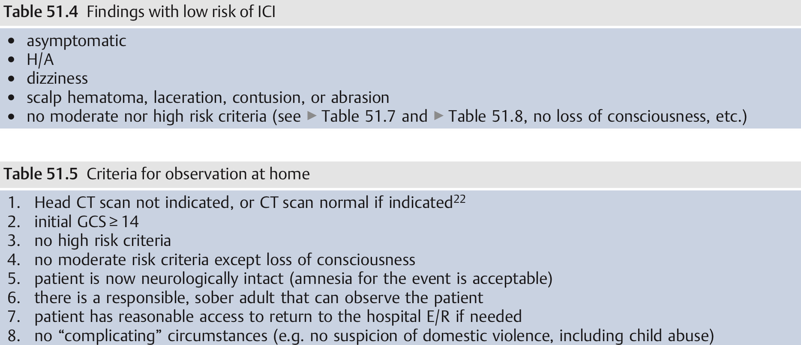
Admission criteria for TBI
Low risk for intracranial injury

Slide 7
High-Risk Factors
Failure to reach GCS score of 15 within 2 hours
Suspected open skull fracture
Any sign of basal skull fracture (e.g., Battle’s sign, periorbital ecchymosis, cranial nerve palsy, hemotympanum)
More than two episodes of vomiting
Age older than 65 years
Medium-Risk Factors
Amnesia after impact for longer than 30 minutes
Dangerous mechanism of injury

Slide 8
Radiological study
CT scan
Advantages
Acute hemorrhage and associated mass effect.
Brain edema with loss of the basal cisterns and attenuation of the gray-white junction is assessed.
Skull fractures with comminuted or depressed fragments.
Pneumocephalus.
The ventricular system is viewed for hydrocephalus.
The occurrence of midline shift.
Marshall CT classification based on a non-contrast head CT with assessments for presence or absence of:
Intracranial abnormalities
CT evidence of increased ICP as demonstrated by
Midline shift (MLS) > 5 mm and/or
Compression of basal cisterns
Presence or absence of mass lesions (contusions/hemorrhages)
Planned evacuation of mass lesions

Slide 12
رجال چبير يأخذ اسبرين وديسوق ماطور واندعم وانشمر من الماطور وصار عنده كسر بالجمجمة ونسه الحادث وراها صار عنده اعراض ارتفاع ضغط الدماغ ( تقي والكلاسكو نزل نقطين وانشمر )

Slide 13
MRI
Superior sensitivity to CT for most acute pathoanatomic findings, including traumatic axonal injury, small brain contusions, and small extra-axial collections.
Cerebral Angiography
CT angiography has largely replaced it in the initial evaluation of TBI useful for:
Detection of Intracranial vascular occlusion or dissection due to blunt trauma in patients with FND not explained by CT scans.
Detection of Traumatic intracranial aneurysms (symptomatic days to weeks after the trauma).
Not routinely indicated during the initial assessment of these patients except in patients with
Brisk epistaxis.
Mechanism of injury that implies a vascular injury.

Slide 14
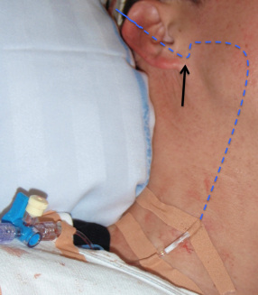
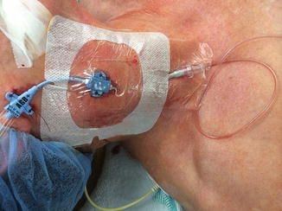
Jugular venous oxygen saturation (SjvO2)
Normal jugular venous oxygen saturation (SjvO2) ranges from 55 to 75%.
Causes of desaturation include
ICP the most common.
Hypocapnia the second most common.
Hypotension the third most common.

Slide 15
Monitoring for Systemic Causes of Secondary Insults
Hypotension
Hypocapnia
Hypoxia
Anemia
Fever
Hypotension
Autoregulation is the ability of the brain to maintain a normal CBF over a wide range of blood pressures, normally from a mean blood pressure of 50 mm Hg to 150 mm Hg.
It mean Systolic blood pressure less than 90 mm Hg.
The consequence is that low Bp can result in cerebral ischemia after a TBI.
Hypotension is common on admission to the hospital in head injured patients.
Hypotension on admission increased the mortality rate by 150%.
The goal should be a MAP greater than 80 to 90 mm Hg, so that CPP remains at least 60 mm Hg.
Normal CPP = 60 – 80 mm Hg

Slide 16
Hypocapnia
Induced hyperventilation constricts cerebral blood vessels, reducing global CBF and cerebral blood volume.
The effects of hyperventilation on ICP are immediate, but the duration of the effect is brief.
Hyperventilation clearly will reduce ICP, but this potentially beneficial effect is at the expense of cerebral perfusion.
Hypoxia
Normally, a decrease in arterial PO 2 is compensated for by increases in CBF and does not result in a decrease in overall cerebral oxygen delivery, unless the hypoxia is very severe.
The increase in cerebral blood volume that results from the cerebral vasodilation can markedly increase ICP.
Hypoxia that persists after the initial resuscitation or develops within the first 24 to 48 hours after injury can be due to lung contusion, atelectasis, fat embolus, pneumonia, or adult respiratory distress syndrome.

Slide 17
Fever
Methods for reducing temperature include external cooling, intravascular cooling devices, and antipyretics.
Intracranial temperature was 0.5° to 2.0°C higher than body temperature in patients with TBI.
Intracranial hypertension (IC-HTN)

Slide 18
Normal Values of Intracranial Pressure
Normally, resting ICP in adults is less than 10 mm Hg.
ICP between 20 and 40 mm Hg is considered moderate.
ICP greater than 40 mm Hg represents severe, usually life-threatening.
Indications for Intracranial Pressure Monitoring:
In patients with a severe TBI, a GCS score of 3-8 after resuscitation, and an abnormal CT scan (with hematomas, contusions, swelling, herniation, or compressed basal cisterns).
In patients with severe TBI and a normal CT scan if two or more of the following features are noted at admission:
Age >40 yr.
Unilateral or bilateral motor posturing.
Systolic blood pressure <90 mm Hg.
Patients with a GCS score greater than 8 might be considered for ICP monitoring if they require
Prolonged anesthesia for surgery of multiple injuries.
Prolonged pharmacologic paralysis for ventilatory management.
If they require a treatment that might raise ICP, such as positive end-expiratory pressure (PEEP).

Slide 19
Traumatic IC-HTN may be due to any of the following
Cerebral edema
Hyperemia: the normal response to head injury. Possibly due to vasomotor paralysis (loss of cerebral autoregulation). May be more significant than edema in raising ICP
Traumatically induced masses (EDH, SDH, IPH, foreign body [bullet], depressed skull fracture
Hydrocephalus due to obstruction of CSF absorption or circulation
Hypoventilation (causing hypercarbia → vasodilatation)
Systemic hypertension (HTN)
Venous sinus thrombosis
Increased muscle tone and Valsalva maneuver as a result of agitation or posturing → increased intrathoracic pressure → increased jugular venous pressure → reduced venous outflow from head
Sustained posttraumatic seizures (status epilepticus)

Slide 20
A secondary increase in ICP is sometimes observed 3–10 days following the trauma, and may be associated with a worse prognosis, causes include:
Delayed hematoma formation (delayed EDH, SDH, IPH)
Cerebral vasospasm
Severe adult respiratory distress syndrome (ARDS) with hypoventilation
Delayed edema formation: more common in pediatric patients
Hyponatremia
Contraindications of ICP monitoring
Awake patient: monitor usually not necessary, can follow neuro exam.
Coagulopathy (including DIC).
Duration of monitoring
D/C monitor when ICP is normal (2-3 days after withdrawal of ICP therapy).
Caution: ICP may have delayed onset (often starts on day 2–3, and day 9–11 is a common second peak, especially in peds).

Slide 21
Delayed deterioration
Intracranial hematoma (delayed EDH, SDH, delayed traumatic contusions)
Post-traumatic diffuse cerebral edema
Hydrocephalus
Tension pneumocephalus
Seizures
Metabolic abnormalities, includes: hyponatremia, hypoxia, hypoglycemia
Vascular events:
dural sinus thrombosis,
carotid (or rarely, vertebral) artery dissection,
SAH,
carotid-cavernous fistula (CCF),
cerebral embolism: including fat embolism syndrome
Meningitis
Hypotension (shock)

Slide 22
Types of monitors
Intraventricular catheter (IVC): AKA external ventricular drainage (EVD), connected to an external pressure transducer via fluid-filled tubing.
Advantages:
Most accurate (can be recalibrated to minimize measurement drift)
Lower cost
Allows therapeutic CSF drainage
Disadvantages:
May be difficult to insert into compressed or displaced ventricles.
Obstruction of the fluid column (e.g. by blood clot, or by coaptation of the ependymal lining on the catheter as the ventricle collapses with drainage) may cause inaccuracy
IVC problems and IVC trouble shooting
Transducer must be consistently maintained at a fixed reference point relative to patient’s head (must be moved as HOB is raised/lowered)

Slide 23
Intraparenchymal monitor
Similar to IVC but more expensive.
Less accurate monitors
Subarachnoid screw (bolt): At high ICPs, surface of brain may occlude lumen → false readings (usually lower than actual, may still show ≈ normal waveform)
Subdural
Epidural
In infants, one can utilize an open anterior fontanelle (AF)
Complications of ICP monitors
Infection
Hemorrhage
Malfunction or obstruction: with fluid coupled devices, higher rates of obstruction occur at ICPs > 50 mm Hg.
Malposition

Slide 24
Normal functioning of the IVC system
The system should be checked for proper functioning at least every 2–4 hours.
Check for presence of good waveform with respiratory variations and transmitted pulse pressures
Check for patency, open the system to drain and lower the drip chamber below level of head and observe for 2–3 drops of CSF (normally do not allow more than this to drain).
For systems open to drainage:
Volume of CSF in drip chamber should be indicated every hour with a mark on a piece of tape on the drip chamber, and the volume should increase with time unless ICP is less than the height of the drip chamber (in practice, under these circumstances the system would usually not be left open to drainage).
A typical amount of drainage would be ≈ 75 ml every 8 hrs
Drip chamber should be emptied into drainage bag regularly (4 or 8 hours) and any time the chamber begins to get full (record volume)
Is the monitor is actually reflecting ICP, lowering the HOB towards 0°should increase ICP. Gentle pressure on both jugular veins simultaneously should also cause a gradual rise in ICP over 5–15 seconds that should drop back down to baseline when the pressure is released.

Slide 25
1 mm Hg = 1:36 cm H2O
1 cm H2O = 0:735 mmHg

Slide 26
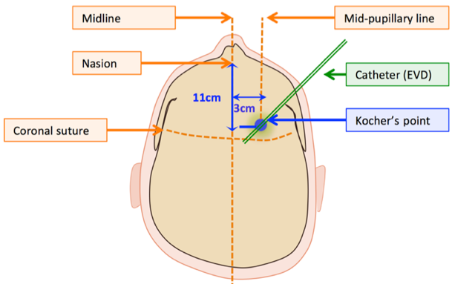
Kocher’s point from the superior axial view (10–11cm posterior to nasion in the midline, 1cm anterior to coronal suture, and 3cm lateral to midline)

Slide 28
IVC problems
Air filter on drip chamber gets wet (prevents air from passing through filter)
Result: fluid cannot drain freely into drip chamber (the pressure is no longer regulated by the height of the drip nozzle)
if the outflow from the drip chamber is clamped, then no flow at all is possible
if the clamp on the drip chamber outlet is open, then the pressure is actually regulated by the height of the nozzle in the collection bag and not the nozzle in the drip chamber
Solution: if a fresh filter is available, then replace the wet one. Otherwise one must replace the wet filter with a filter from an IV set, or with a sterile gauze taped over the opening.
Air filter on collection bag gets wet: this will make it diﬃcult to empty the drip chamber into the bag.
Improper connections
Changing position of head of bed: must move drip chamber up or down to keep it level with the same external landmarks (e.g. level of auditory canal).
Drip chamber falls to floor:
Over-drainage, possible seizures and/or subdural hematoma formation
solution: securely tape chamber to pole, bed-rail…, check position regularly

Slide 29
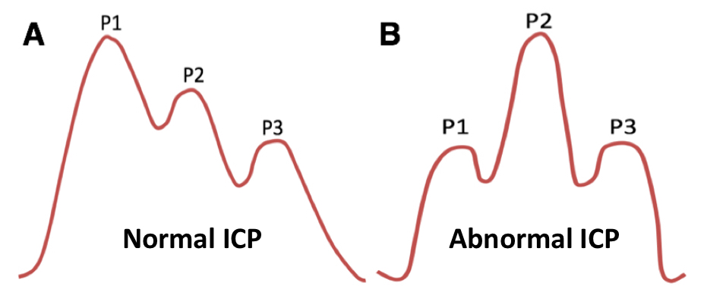
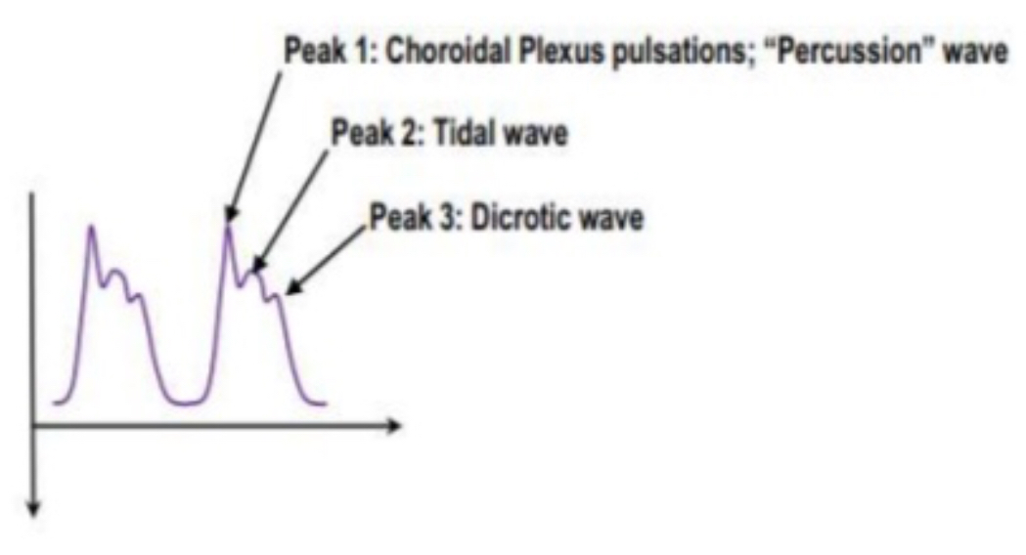
Types of ICP waveforms
Normal waveforms
Flow of 3 upstrokes in one wave
P1 (Percussion wave) reflects arterial pulsation.
P2 (Tidal wave) reflects intracranial compliance.
P3 (Dicrotic wave) reflects aortic valve closure.
The normal ICP = P1 > P2 > P3.
Increase ICP there is reduced intracranial compliance = P1 < P2 > P3.

Slide 30
Normal ICP waveform
Peak | Wave | Origin
First large peak | Percussion wave W1 (pulsatile) | Systolic pressure, large intracranial arteries and choroid plexus
Second small peak | Tidal wave W2 (pulsatile) | Central venous wave from right atrium, from brain increased elastance/ decrease compliance
Inverted | Inverted | Miscalibrated monitor
Third small peak | Dicrotic wave W3 | Arterial pulse
Expiration | Increase overall wave | Increasing central venous pressure
Inspiration | Decrease overall wave | Decreasing central venous pressure

Slide 31
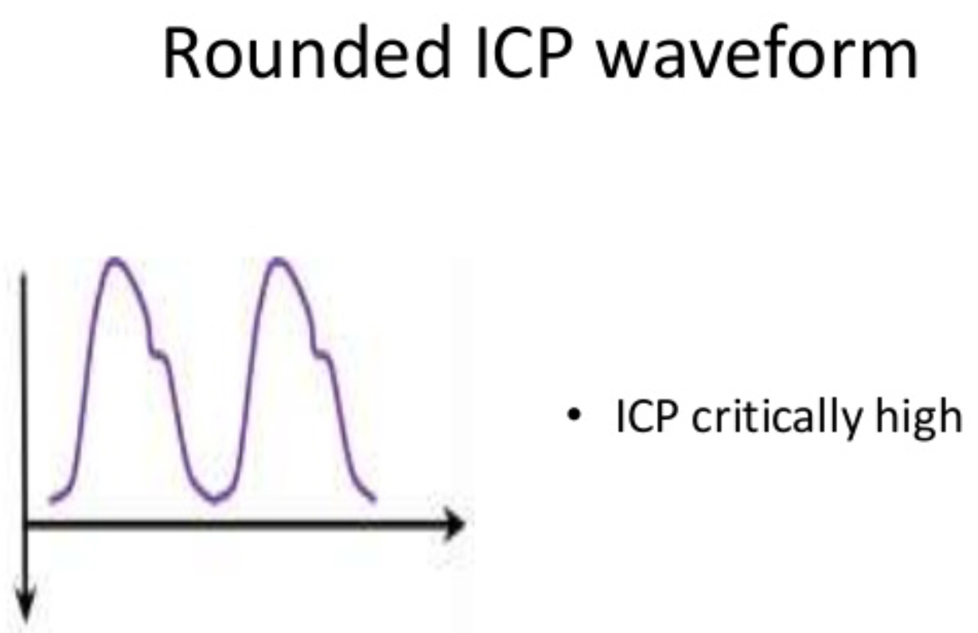

Slide 33
Pathological ICP waves
Lundberg A waves (plateau waves):
ICP elevations ≥ 50 mm Hg
Last 5-20 minutes then return to slightly elevated baseline
Reduced intracranial compliance.
The patient will likely have neurological deterioration.
Mechanism:
Cerebral vasodilatation can be provoked by several different situations (hypoxia, hypercapnia, hypotension or use of vasodilatory drugs).
Intracerebral vasodilatation results in an increased cerebral blood volume leading to a rise in ICP and a concomitant decrease in CPP.
4 phases
Drift phase: CPP —> Vasodilatation
Plateau phase: Vasodilatation —> ICP
Ischemic response phase: CPP —> Cerebral ischemia —> Brainstem vasomotor —> Cushing response.
Resolution phase: Cushing response —> Restore ICP

Slide 35
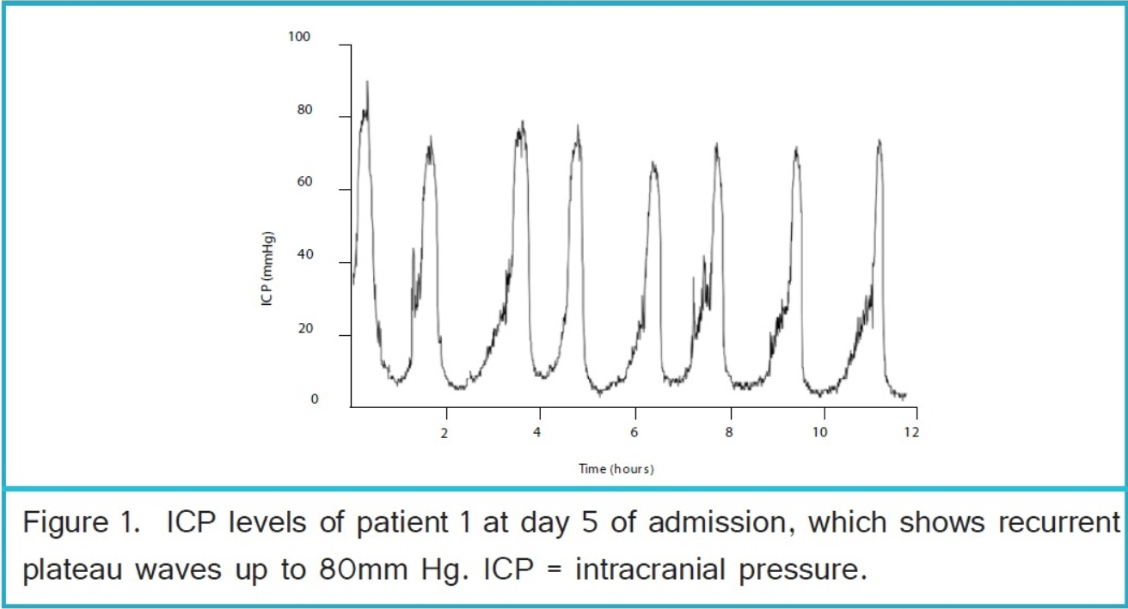

Slide 37
Lundberg B waves (pressure pulses):
Mean wave 20-50 mm Hg.
Last 30 secs–2 mins.
Indicator of failing intracranial compensation (ICP rising in a crescendo manner to levels 20–30 mmHg higher than baseline, with a subsequent sharp decline).
May be due to variation with respiratory changes and CBF.
Lundberg C wave
Mean wave <20 mm Hg.
Frequency of 4–8/min
Low amplitude C waves (Traube Hering Meyer waves) may be seen in the normal ICP waveform.
High amplitude C-waves may be pre-terminal, and may sometimes be seen on top of plateau waves.

Slide 38
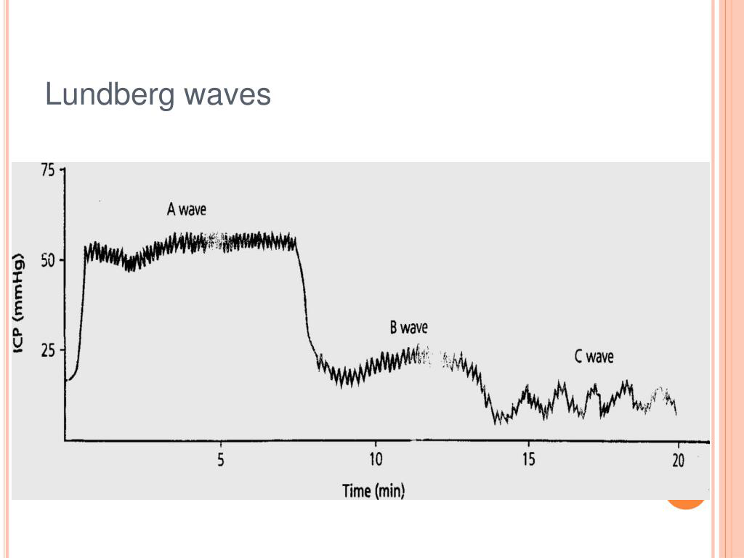

Slide 39
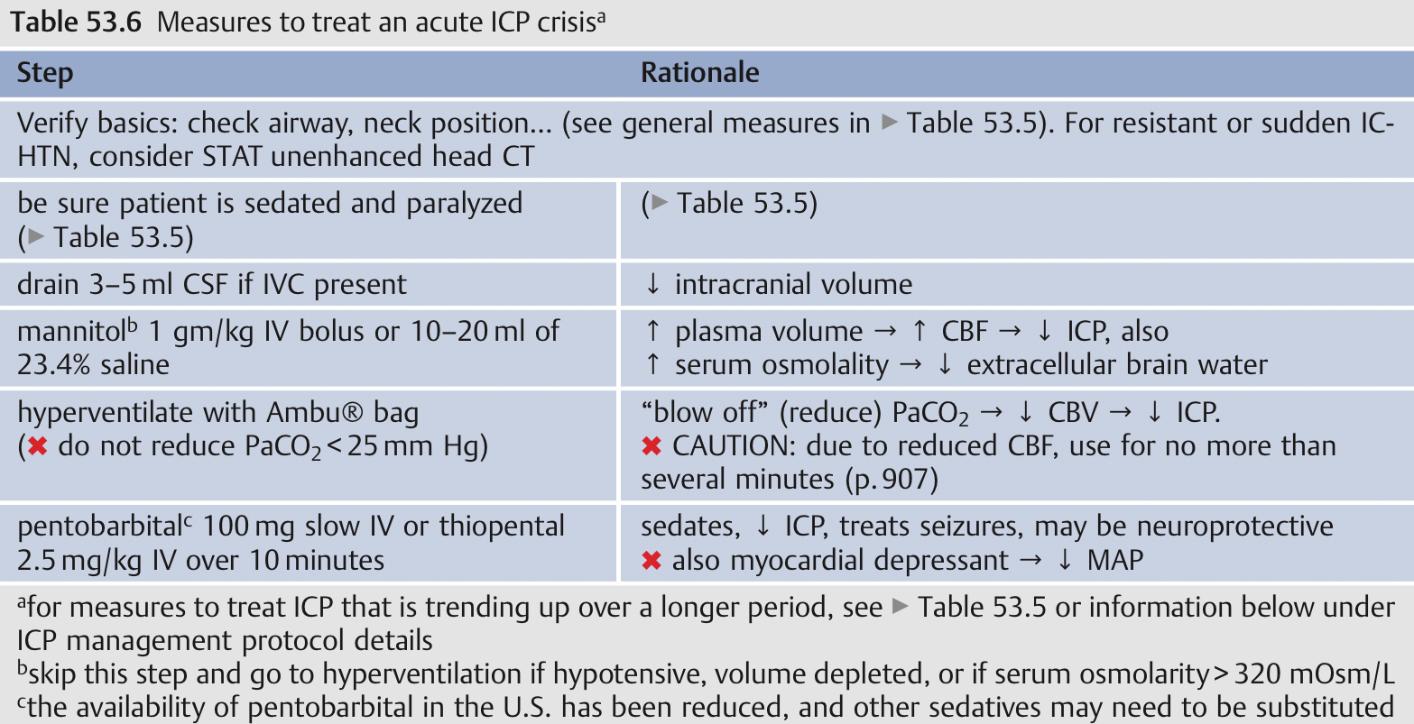
Treatment measures for elevated ICP
Treatment for IC-HTN should be initiated for ICP > 22 mm Hg.
Goals of therapy
keep ICP ≤ 22 mm Hg (prevents “plateau waves” from compromising cerebral blood flow (CBF) and causing cerebral ischemia and/or brain death).
keep CPP ≥ 50 mm Hg. The primary goal is to control ICP; simultaneously, CPP should be supported by maintaining adequate MAP.

Slide 42
Measures to use for documented IC-HTN
Heavy sedation and/or paralysis
Uses
Assists treatment of HTN
When patient is agitated
To blunt the elevation of ICP that occurs when moving the patient to CT table.
Caution: with heavy sedation or paralysis, the ability to follow the neurologic exam is lost (follow ICPs)
For heavy sedation (intubation recommended to avoid respiratory depression → elevation of PaCO 2 → ↑ ICP): e.g. one of the following:
morphine
fentanyl
sufentanil
midazolam
propofol drip
pentobarbital
Paralysis (intubation mandatory): e.g. vecuronium (PV per vaginal lead to paralysis)

Slide 43
Osmotic therapy when there is evidence of IC-HTN:
Mannitol
Uses
Effective for control of IC-HTN after severe TBI
Signs of transtentorial herniation or progressive neurological deterioration not attributable to systemic pathology.
Mechanism
Lowering ICP
Immediate plasma expansion: reduces the hematocrit and blood viscosity (improved rheology) which increases CBF and O2 delivery. This reduces ICP within a few minutes, and is most marked in patients with CPP < 70 mm Hg
Osmotic effect: increased serum tonicity draws edema fluid from cerebral parenchyma. Takes 15–30 minutes until gradients are established. Eﬀect lasts 1.5–6 hrs, depending on the clinical condition
Supports the microcirculation by improving blood rheology
Possible free radical scavenging

Slide 44
Guidelines to go mannitol
Intermittent boluses may be more effective than continuous infusion.
Effective doses range from 0.25–1 gm/kg body weight.
Avoid hypotension (SBP < 90 mm Hg) which can lead to ↓ circulating fluid volume.
Euvolemia should be maintained (hypovolemia should be avoided).
Serum osmolarity should be kept < 320 mOsm when concern about renal failure.
Cautions with mannitol
Mannitol opens the BBB, and mannitol that has crossed the BBB may draw fluid into the CNS which can aggravate vasogenic cerebral edema.
May be minimized by repeated bolus administration vs. continuous infusion.
when it is time to D/C mannitol, it should be tapered to prevent ICP rebound.
Corticosteroids + phenytoin + mannitol may cause hyperosmolar nonketotic state with high mortality.
High doses of mannitol carries the risk of acute renal failure (acute tubular necrosis), especially in the following : serum osmolarity > 320 mOsm/L, use of other potentially nephrotoxic drugs, sepsis, pre-existing renal disease

Slide 45
Furosemide
Loop acting diuretics may reduce ICP by reducing cerebral edema (possibly by increasing serum tonicity) and may also slow the production of CSF.
They also act synergistically with mannitol: 10–20 mg IV every 6 hrs.
Hypertonic saline (HS)
May reduce ICP in patients refractory to mannitol.
℞: Continuous infusion: 3% saline at 25–50 ml/hr IV.
HS should be discontinued after ≈ 72 hours to avoid rebound edema.
Glucocorticoids
Reduce vasogenic cerebral edema (e.g. surrounding brain tumors) and may be effective in lowering ICP in pseudotumor cerebri.
They have little effect on cytotoxic cerebral edema, which is the more prevalent derangement following trauma.

Slide 46
Hyperventilation
Intra-arterial carbon dioxide (PaCO2 ) is the most potent cerebrovascular vasodilator, the effect of which is probably mediated by changes in pH caused by the rapid diffusion of CO 2 across the BBB.
Hyperventilation lowers ICP by
🔻 PaCO 2 —> cerebral vasoconstriction —> 🔻cerebral blood volume (CBV) —> 🔻 ICP.
Vasoconstriction also lowers cerebral blood flow (CBF) which could produce focal ischemia in areas with preserved cerebral autoregulation as a result of shunting.

Slide 47
Indications for hyperventilation (HPV)
HPV for brief periods (minutes) at the following times
Prior to insertion of ICP monitor: if there are clinical signs of IC-HTN.
After insertion of a monitor: if there is a sudden increase in ICP and/or acute neurologic deterioration, HPV may be used while evaluating patient for a treatable condition (e.g. delayed intracranial hematoma)
HPV for longer periods: when there is documented IC-HTN unresponsive to sedation, paralytics, CSF drainage, and osmotic diuretics.
HPV may be appropriate for IC-HTN resulting primarily from hyperemia.
Caveats for hyperventilation
Avoid during the first 5 days after head injury if possible (especially first 24 hrs), because CBF in severe head trauma patients is already about half of normal during the first 24 hrs after injury (typically < 30 cc/100 g/min during the first 8 hours, and may be < 20 during the first 4 hours in patients with the worst injuries).
Do not use prophylactically.

Slide 48
Reducing PaCO2 from 35 to 29 mm Hg
Lowers ICP 25–30% in most patients.
Onset of action: ≤ 30 seconds.
Peak effect at ≈ 8 mins.
Duration of effect is occasionally as short as 15–20 mins.
HPV must be weaned slowly.
Effect may be blunted by 1 hour by which it is difficult to return to normocarbia without rebound elevation of ICP.

Slide 49
Second tier therapy for persistent IC-HTN
If IC-HTN remains refractory to the above measures, and especially if there is loss of previously controlled ICP.
Repeat CT to rule out a surgical condition.
Consider an EEG to rule out subclinical status epilepticus; some medications are effective for both seizures and ICHTN, e.g. pentobarbital, propofol.
High dose barbiturate therapy: initiate if ICP remains > 20–25 mm Hg
Hyperventilate to PaCO2 = 25–30 mm Hg.
Hypothermia: Avoid shivering which raises ICP.
Hypertensive therapy.
Lumbar drainage: showing some promise. Watch for “cerebral sag”
Decompressive surgery:
Decompressive craniectomy removal of portion of calvaria.
Removal of large areas of contused hemorrhagic brain (makes room immediately; removes region of disrupted BBB),
Consider temporal tip lobectomy (no more than 4–5 cm on dominant side, 6–7 cm on non-dominant) or frontal lobectomy.

Slide 50
Adjunctive measures
Lidocaine
1.5 mg/kg IVP (watch for hypotension, reduce dose if necessary) at least one minute before endotracheal intubation or suctioning.
Blunts the rise in ICP as well as tachycardia and systemic HTN.
High frequency (jet) ventilation
Consider if high levels of positive end-expiratory pressure (PEEP) are required.
PEEP ≤ 10 cm H2 O does not cause clinically significant increases in ICP.
Higher levels of PEEP > 15–20 are not recommended.
Rapid elimination of PEEP may cause a sudden increase in circulating blood volume which may exacerbate cerebral edema and also elevate ICP

Slide 51
High-dose barbiturate therapy
Recommended for IC-HTN refractory to maximal medical and surgical ICP-lowering therapy.
Benefits of barbiturates in head injury derive from
Vasoconstriction in normal areas (shunting blood to ischemic brain tissue).
Decreased metabolic demand for O2 (CMRO2 ) with accompanying reduction of CBF.
Free radical scavenging.
Reduced intracellular calcium, and lysosomal stabilization.
The limiting factor for therapy is usually
Hypotension due to barbiturate-induced reduction of sympathetic tone (causing peripheral vasodilatation).
Direct mild myocardial depression.
Barbiturate coma vs. high-dose therapy:
If barbiturates are given until there is burst suppression on EEG, this is considered true “barbiturate coma.” This results in near maximal reductions in CMRO2 and CBF.

Slide 52
Benzodiazepines cause reduction in CMRO 2 and CBF, with no effect on ICP.
The narcotics have no effect on CMRO2 or CBF but may increase ICP.
Ketamine not used in TBI patient with known intracranial pathology as it increase ICP.
Propofol has the advantage of a short half-life, which allows intermittent neurological examination, but is a potent systemic vasodilator and can cause hypotension that exceeds the reduction in ICP so that CPP can be significantly reduced.
Propofol infusion syndrome
Result as a consequence of the use of high doses of propofol.
Some clinical features are hyperkalemia, hepatomegaly, lipemia, metabolic acidosis, myocardial failure, rhabdomyolysis, and renal failure.
Extreme caution must be taken when using doses greater than 5 mg/kg per hour or when usage of any dose exceeds 48 hours in critically ill adults.

Slide 53
Surgical treatment
Traumatic intracranial masses should be treated as indicated.
Patients with hemorrhagic contusions (“pulped brain”) showing progressive deterioration may benefit from surgical excision of portions of the contused brain tissue, especially if not eloquent brain.
Decompressive craniectomy may be considered for IC-HTN that cannot be controlled medically.
Late complications from traumatic brain injury
Posttraumatic seizures.
Communicating hydrocephalus.
Posttraumatic syndrome (or postconcussive syndrome):
Hypogonadotropic hypogonadism.
Chronic traumatic encephalopathy.
Alzheimer’s disease (AD).

Slide 55
Hypopituitarism
The most common pathologic findings are
Hemorrhage of the hypothalamus.
Hemorrhage of the posterior lobe.
Infarction of the anterior pituitary lobe.
The pituitary axis most commonly involved at 3 months post injury
Gonadotropic axis, followed by the corticotropic, somatotropic, and thyrotropic axes.

Slide 56
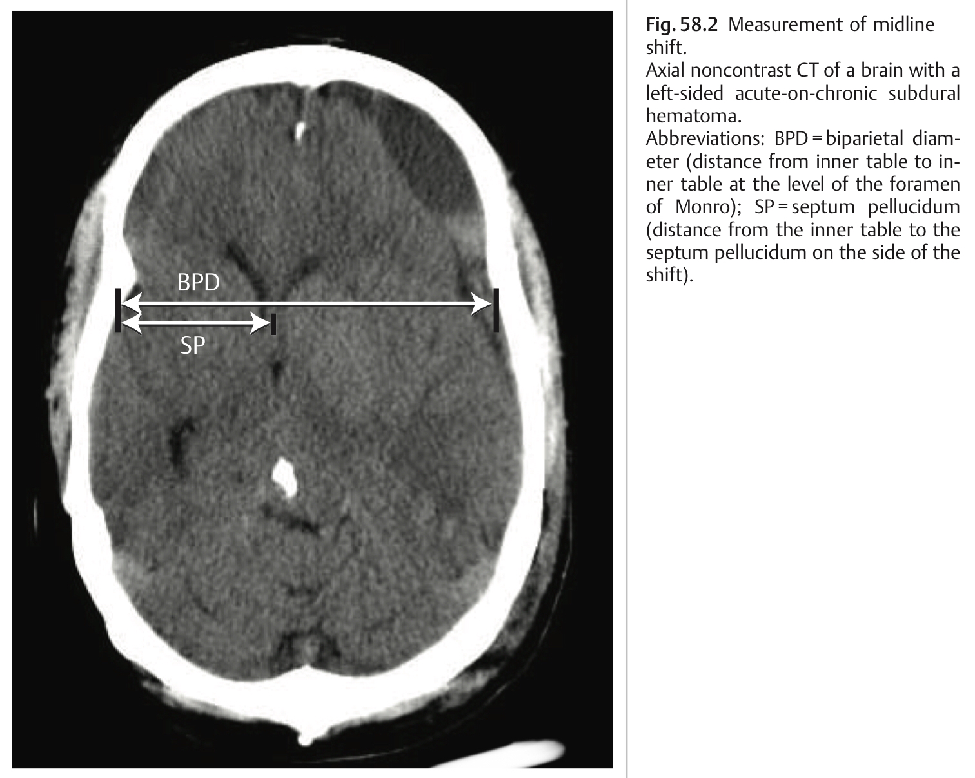
Midline shift (MLS)
MLS is defined at the level of the foramen of Monro.
Calculated by dividing the biparietal diameter (BPD) (the width of intracranial compartment at this location) by 2, and subtracting SP (the distance from the inner table to the septum pellucidum on the side of the shift).
MLS = BPD/2 - SP

Slide 57
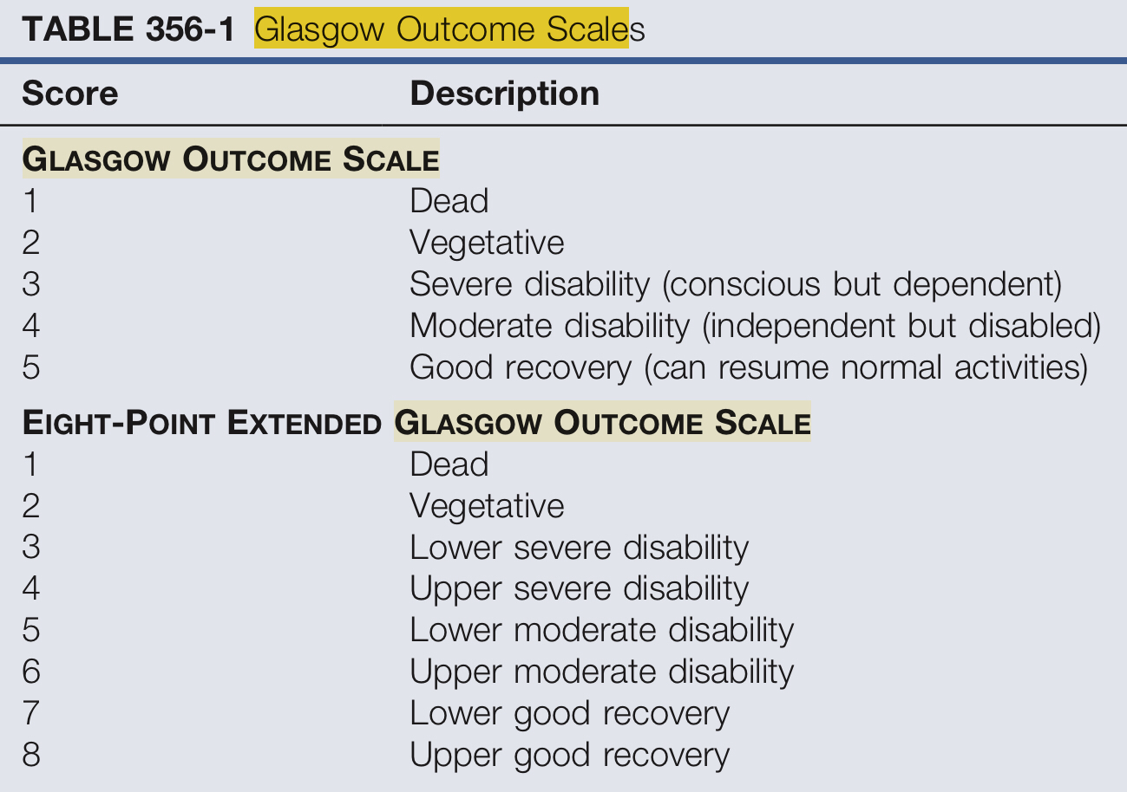

Slide 58
Vegetative stat or Apallic syndrome
Dissociation of an apparent recovery of behavioral wakeful arousal associated with periods of eye opening that alternate with periods of eye closure in patients who show no evidence of awareness of self environment.
If lasting longer than 30 days called “persistent vegetative state.”
The two most common causes of VS are severe TBI and cardiac arrest (after both diffuse axonal injury from brain trauma and oxygen deprivation associated with cardiac arrest).
Pathophysiology
Extensive loss of thalamic neurons, particularly within the central thalamic intralaminar nuclei and closely adjacent components of thalamic association nuclei.
The behavioral fragment more typically identified in chronic VS patients are stereotyped emotional-limbic responses such as grimaces.
These emotional displays most probably reflect isolated limbic networks tightly linked to brainstem and basal forebrain structures that operate without functional connection to the thalamocortical systems that are typically severely damaged in VS patients.

Slide 59
Thank you

