Slide 1
Traumatic and Penetrating Head Injuries Youmans Chap. 352

Slide 2
Penetrating brain injury (PBI)
Gunshot wounds to the head (GSWH) account for the majority of PBI.
Primary injury from GSWH results from a number of factors including:
Injury to soft tissue
Direct scalp and/or facial injuries
Soft tissue and bacteria may be dragged intracranially.
Pressure waves of gas combustion may cause injury if the weapon is close.
Comminuted fracture of bone: may injure subjacent vascular and/or cortical tissue (depressed skull fracture). May act as secondary missiles
Cerebral injuries from missile
Direct injury to brain tissue in path of bullet, exacerbated by
Fragmentation of bullet
Ricochet oﬀ bone
Deviations of the bullet from a straight path as it travels
Deformation of bullet at impact: e.g. mushrooming
Injury to tissue by shock waves, cavitation
Coup + contrecoup injury from missile impact on head (may cause injuries distant from bullet path)

Slide 3
MANAGEMENT:
Imaging
CT scan demonstrate
Entry site and trajectory of the fragment into the brain, terminal ballistics (perforating, penetrating, and tangential).
Involvement of the paranasal sinuses, orbits, skull base, and mastoids.
The penetration crosses the midsagittal or midcoronal planes.
The presence or absence of intracranial hematomas.
The extent of brain edema and ischemia and brainstem involvement.
Initial management
General measures
CPR as required; endotracheal intubation if stuporous or airway compromised.
Additional injuries (e.g. chest wounds) identified and treated appropriately.
Precautions taken for spine injury.
Fluids as needed to replace estimated blood loss which may be variable: exercise restraint to avoid excessive hydration (to minimize cerebral edema).
Pressors to support MAP during and after fluid resuscitation.

Slide 5
Specific treatments
Initial steps
Control bleeding from scalp and associated wounds.
Shave scalp to identify entrance/exit sites.
Medical treatment (similar to closed head injury)
Assume ICP is elevated:
elevate HOB 30–45°with head midline (avoids kinking jugular veins)
mannitol (1 gm/kg bolus)
hyperventilate to PaCO2 = 30–35 mm Hg if indications are met
steroids: (unproven eﬃcacy) 10 mg dexamethasone IV
Prophylaxis against GI ulcers: H2 antagonist or proton pump inhibitor, NG tube to suction
Begin anticonvulsants
Antibiotics
Tetanus toxoid administration

Slide 6
The optimal choice for pressure monitoring is uncertain, although external ventricular drains are the gold standard for monitoring because they may also be used for targeted treatment.
Treatment typically is indicated for ICP greater than or equal to 20 to 25 mm Hg, with guideline goals of ICP less than 20 mm Hg and cerebral perfusion pressure (CPP) 50 to 70 mm Hg.
Goals of surgery
Debridement of devitalized tissue.
Evacuation of hematomas: subdural, intraparenchymal.
Removal of accessible bone fragments.
Retrieval of bullet fragment for forensic purposes.
Obtaining hemostasis.
Watertight dural closure (usually requires graft).
Separation of intracranial compartment from air sinuses traversed by bullet.
Identification of entry and exit wounds for forensic purposes.

Slide 7
Late Complications
Cerebral abscess: Usually associated with retained contaminated material (bullet, bone, skin…) but may also result from persistent communication with nasal sinuses.
Traumatic aneurysm: typically in distal ACA
Seizures
Fragment migration
Migration of a bullet: often indicates abscess or, less commonly, a hematoma cavity.
Intraventricular fragments may migrate and cause obstructive hydrocephalus
Lead toxicity

Slide 8
Outcome
Prognostic factors:
Level of consciousness is the most important prognostic factor: ≈ 94% of patients who are comatose with inappropriate or absent response to noxious stimulus on admission die, and half the survivors are severely disabled
The path of the bullet: poor prognosis is associated with:
Bullets that cross the midline
Bullets that pass through the geographic center of the brain
Bullets that enter or traverse the ventricles
The more lobes traversed by the bullet
Hematomas seen on CT are poor prognostic findings
Suicide attempts are more likely to be fatal

Slide 9
Cranioplasty
Cranioplasty should be delayed 6–12 months to reduce risk of infection.
Criteria for patient selection
Excellent soft-tissue coverage of the graft site.
No clinical evidence of infection.
No biochemical evidence of infection (ESR, CRP, leukocytosis).
No radiographic evidence of infection (CT scan).
6 months’ demonstrated survivorship.

Slide 15
Depressed skull fractures
A skull vault fracture is considered to be significantly depressed if the inner table fragments are depressed by at least the thickness of the skull.
Indications for surgery
Open (compound) fractures
Surgery for fractures depressed > thickness of calvaria and those not meeting criteria for nonsurgical management listed below.
Nonsurgical management may be considered if
There is no evidence (clinical or CT) of dural penetration (CSF leak, intradural pneumocephalus on CT)
Depression is < 1 cm
No significant intracranial hematoma
No frontal sinus involvement
No wound infection or gross contamination
No gross cosmetic deformity
Closed (simple) depressed fractures: may be managed surgically or nonsurgically.

Slide 16
Timing of surgery:
Early surgery to reduce risk of infection
Surgical methods:
Elevation and debridement are recommended
Option: if there is no evidence of wound infection, primary bone replacement
Antibiotics should be used for all compound depressed fractures
There is no evidence that elevating a depressed skull fracture will reduce the subsequent development of posttraumatic seizures, which are probably more related to the initial brain injury.

Slide 17
Technical considerations of surgery
Surgical goals
Debridement of skin edges
Elevation of bone fragments
Repair of dural laceration
Debridement of devitalized brain
Reconstruction of the skull
Skin closure
Techniques
With open (compound) contaminated fractures, it may be necessary to excise depressed bone (follow the patient for 6–12 months to rule out infection before performing a cosmetic cranioplasty).
Elevating the bone may be facilitated by drilling burr holes around the periphery and either using rongeurs or craniotome to excise the depressed portion

Slide 18
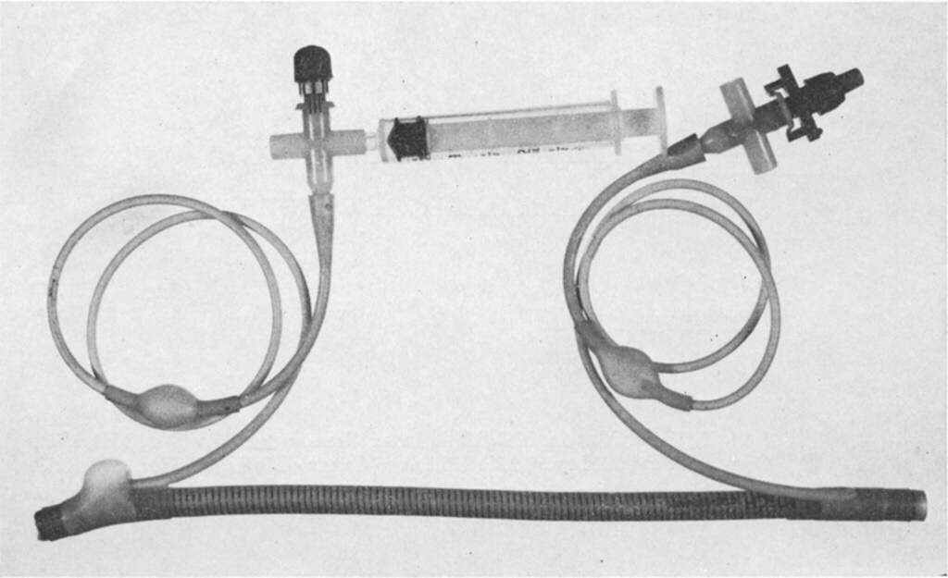
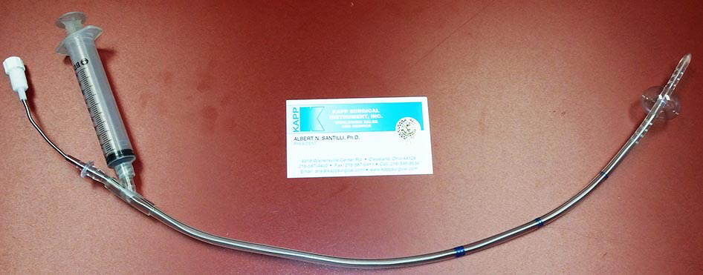
In cases where laceration of a major dural sinus is suspected and surgery is mandated, adequate preparation must be made for dural sinus repair.
Prepare for massive blood loss
Have small Fogarty catheter ready to temporarily occlude sinus
Have dural shunt ready (Kapp-Gielchinsky shunt, if available, has an inflatable balloon at both ends)
Prep out saphenous vein area for vein graft
Bone fragments that may have lacerated sinus should be removed last

Slide 19
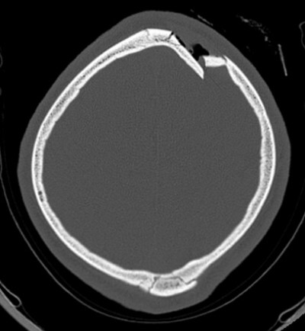

Slide 20
Clival fractures
3 categories (75% are longitudinal or transverse):
Longitudinal: may be associated with injuries of vertebrobasilar vessels, including:
Dissection or occlusion: may cause brainstem infarction
Traumatic aneurysms
Transverse: may be associated with injuries to the anterior circulation
Oblique
Clival fractures are highly lethal. May be associated with:
Cranial nerve deficits: especially III through VI; bitemporal hemianopsia
CSF leak
Diabetes insipidus
Delayed development of traumatic aneurysms

Slide 21
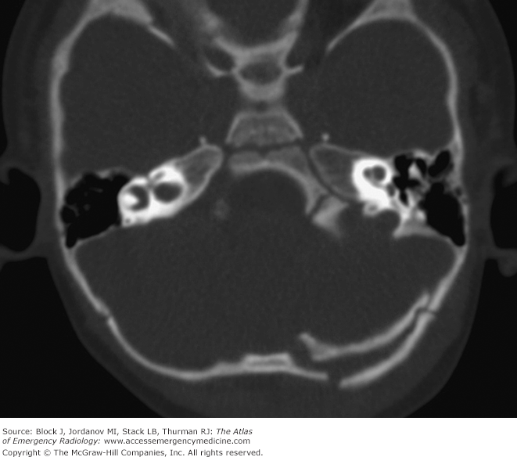
Longitudinal #
Transverse #

Slide 22
Depressed skull fractures in pediatrics
General information
Most common in frontal and parietal bones.
One third are closed, and these tend to occur in younger children as a result of the thinner, more deformable skull (tended to follow accidents at home).
Open fractures tended to occur with RTAs.
Dural lacerations are more common in compound fractures.
Indications for surgery for pediatric simple depressed skull fracture:
Definite evidence of dural penetration
Persistent cosmetic defect in the older child after the swelling has subsided
± focal neurologic deficit related to the fracture

Slide 23
Ping-pong ball” fractures
A green-stick type of fracture → caving in of a focal area of the skull as in a crushed area of a pingpong ball.
Usually seen only in the newborn due to the plasticity of the skull.
No treatment is necessary when these occur in the temporoparietal region in the absence of underlying brain injury as the deformity will usually correct as the skull grows.
Indications for surgery
Radiographic evidence of intraparenchymal bone fragments
Associated neurologic deficit (rare)
Signs of increased intracranial pressure
Signs of CSF leak deep to the galea
Technique
Frontally located lesions may be corrected for cosmesis by making a small linear incision behind the hairline, opening the cranium adjacent to the depression, and pushing it back out e.g. with a dissector.
Mean age from few hours to 1.5 year

Slide 24
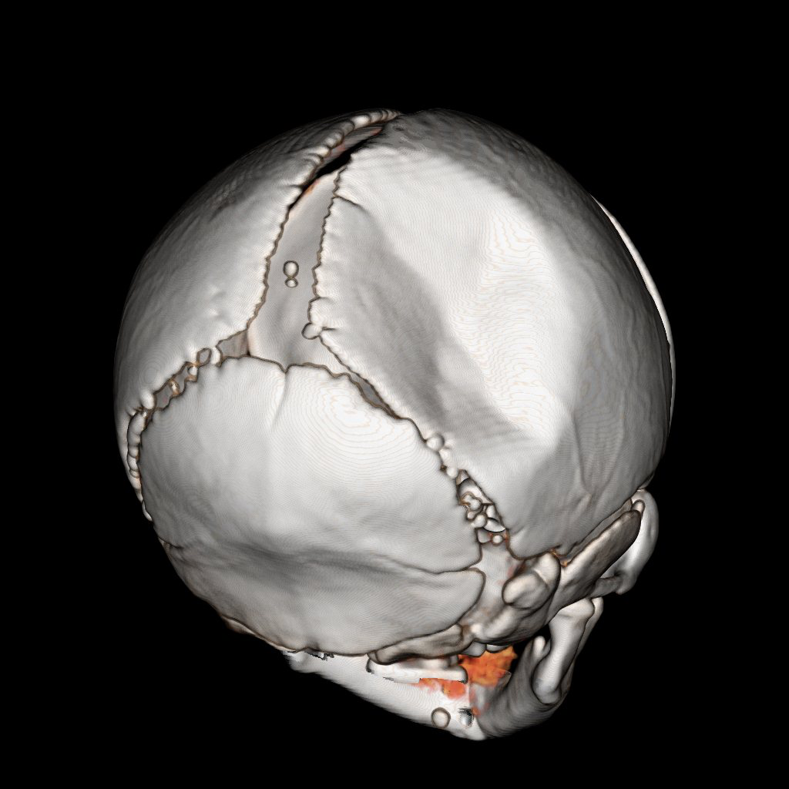

Slide 25
Skull fractures in child abuse
The parietal bone was the most common site of fracture
Depression of skull fractures missed clinically due to overlying hematoma
Clinical features in patients with skull fractures did not reliably differentiate child abuse from trauma (note that Retinal Hrg. is more common in “shaken child” syndrome which is not commonly associated with skull fractures)
3 characteristics more frequently seen after child abuse than after other trauma:
Multiple fractures
Bilateral fractures
Fractures that cross sutures

Slide 26
Thank you

