Slide 1
Traumatic Cerebrospinal Fluid Fistulas Youmans Chap. 357

Slide 2
Traumatic cerebrospinal fluid (CSF) fistulas
Result from a skull fracture with associated durotomy and arachnoid tear that lead to CSF leak within the nasal cavity, paranasal sinuses, or middle ear.
CSF fistulas can be
Secondary to trauma.
Result from congenital abnormality.
Due to surgical sequelae.
Head injuries associated with craniofacial fractures account for 80%.
Fistulas may also occur with midface fractures of the Le Fort III pattern, without an associated head injury.
Most fistulas heal spontaneously, particularly when the primary impact is to the facial skeleton.
The natural history of this process includes the possibility of meningitis, brain abscess, and tension pneumocephalus.

Slide 3
Accidental head trauma carries a 30% overall risk of meningitis.
The risk of meningitis is highest within the first year of CSF leak.
Fistulas that do not heal or recur necessitate surgical treatment.
The most common causes of neurotrauma in order of frequency are
Motor vehicle accidents.
Falls.
Assaults.
Cranionasal fistulas are more common than cranioaural fistulas and less likely to cease spontaneously.

Slide 4
PATHOPHYSIOLOGY
Blunt Injury
Traumatic CSF fistulas usually occur
More commonly with fractures of the anterior and middle cranial fossae.
Less commonly, a posterior fossa fracture may extend through the petrous bone to the middle ear or through the clivus to the sphenoid sinus.
Anterior Fossa
Rhinorrhea mostly caused by a fracture of the frontal, ethmoid, sphenoid bones.
The dura is firmly adherent to the thin bone of the anterior fossa floor and is readily torn by fractured bone edges.
The most frequent sites of rhinorrhea are the cribriform-ethmoid junction and the ethmoid bone itself.
Cribriform plate is naturally weak due to penetrations by the anterior ethmoidal A.
Fistulas communicate with the nasal cavity directly or via the ethmoid air cells.
With impact to the facial skeleton, fracture lines usually run through the thin bone of the cribriform plate and ethmoid area (the upper third Le Fort III fracture pattern or “craniofacial dislocation”).

Slide 6
Middle and Posterior Fossae
Fractures through the petrous bone that extend to the middle ear may lead to
Otorrhea if the tympanic membrane is torn.
Otorhinorrhea if leakage occurs via the eustachian tube into the nasopharynx.
Temporal bone # types
Longitudinal fractures 70-90%
Damage the ossicular bones and result in conductive hearing loss.
Damage to the seventh cranial nerve.
The tympanic membrane is often torn.
Transverse fracture 10-30%
More commonly associated with deficits of the eighth cranial nerve.
Sensory neural hearing loss.
Facial palsy.
The tympanic membrane is usually intact, and CSF leaks via the nose (otorhinorrhea).
CSF fistulas occur with equal frequency with either type of fracture.
A middle fossa fracture that extends to the greater wing of the sphenoid may enter a lateral extension of the sphenoid sinus, which is present in nearly a third of skulls, and result in rhinorrhea.

Slide 10
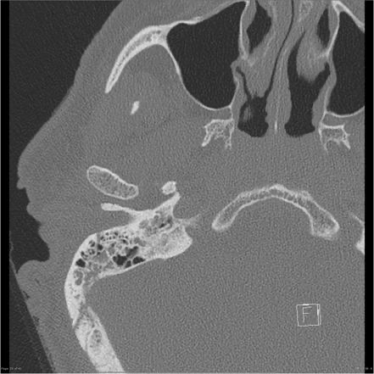
Longitudinal fracture
Transverse fracture

Slide 11
Oculorhinorrhea
In rare cases, a cranio-orbital fracture together with a laceration of the conjunctival sac may allow CSF to leak from the eye.
Penetrating Injury and Gunshot Wounds
The incidence of skull base fractures is high 30%.
Either rhinorrhea or otorrhea may develop in approximately 50% of these injuries.
High-velocity missile injuries can cause substantial bony and soft tissue loss and disruption, and repair and reconstruction are often complex.
CSF Fistulas After Endoscopic Sinus Surgery
Functional endoscopic sinus surgery (FESS) is one of the most commonly performed procedures in otolaryngology; with major complications, including CSF fistulas.

Slide 12
Cranioaural Fistula
Most cases of traumatic otorrhea and otorhinorrhea cease spontaneously.
High- and Low-Pressure Leaks
In the early stages after severe head injury, potentially increased ICP may be partly “controlled” by a CSF leak, but in most instances, persistent fistulas are not associated with increased ICP.
High-pressure leaks are more common with spontaneous, nontraumatic CSF leakage.
if the leak is accompanied by posttraumatic hydrocephalus, it may be maintained by the high CSF pressure, and the hydrocephalus should be managed initially by insertion of a lumboperitoneal shunt.

Slide 13
Cerebrospinal Fluid Fistulas in Children
CSF fistulas are less common in childhood, 15% occur in children younger than 15y.
The Tegmen tympani is thin and rigid at birth.
The Ethmoid sinuses are present at birth, by the age of 3 years is equivalent to that in adults.
The Frontal sinus is not developed until the age of 4 years or older.
The Sphenoid sinus is very small at birth and becomes related to the anterior fossa between the ages of 5 and 10 years.
Mastoid air cells are very small at birth but increase up to the age of 5 years.

Slide 15
Time of Onset of Leakage of Cerebrospinal Fluid After Trauma
Early Onset
After nonpenetrating injuries, CSF rhinorrhea usually begins within 48 hours.
If the defect is small, the bone may heal, and 60% to 70% of cases cease spontaneously within 1 week.
The fistula is unlikely to heal spontaneously in the following situations:
The bone defect is large with wide separation of the fractures and the torn dural margins or the dura is penetrated by bony spikes.
There is inadequate support for the dura because of extensive loss of bone.
Tissue healing is impaired by metabolic disease.
Intracranial pressure (ICP) is raised.
Delayed Onset or Recurrence
Possible reasons for this are as follows:
Shrinking of blood clot or swollen brain that was adhering to the dural-arachnoid tear and preventing healing.
Maturation and shrinkage of the dural scar.
Devascularization and necrosis of the bone and soft tissue

Slide 16
Very-Late-Onset Cerebrospinal Fluid Leakage or Infection
CSF rhinorrhea may first develop after a considerable delay, or infection alone may be the first sign of a fistula.
Possible explanations for this are as follows:
Age-related shrinkage of brain tissue that had been plugging a dural defect.
A cerebral-dural scar formed from contused brain tissue at the site of the fistula, which sealed the tear but did not provide a reliable barrier to infection.
Growing fractures of the ethmoid that lead to the formation of a herniated encephalocele that stretched and ruptured as a result of intracranial pulsations.
Note
The side of rhinorrhea cannot be relied on to locate the fistula, Although usually ipsilateral to the fracture site, it is frequently contralateral or bilateral.

Slide 17
CLINICAL FEATURES
History of a head or facial injury from a frontal impact.
In an unconscious patient with signs of a skull base fracture, evidence of CSF leakage should be sought actively.
A conscious patient may complain of a
Nasal discharge.
Salty taste in the back of the throat (because of the sodium content of CSF)
Fullness of the ear with some hearing loss.
Patients may complain of nasal dripping in the morning after sitting up, leaning forward, or straining.
Headaches can be either high pressure or low pressure.
A high-pressure headache may be experienced repeatedly as a steady buildup of pain that is relieved by fluid drainage.
Low pressure headaches are less marked in the recumbent position and are increased by the upright position.

Slide 18
Examination
Anterior Cranial Fossa signs:
Periorbital bruising (raccoon sign).
Palpable depression in the forehead.
Anosmia suggests a fracture near the cribriform plate (intact olfaction does not exclude the possibility of a cribriform fracture).
Defects in vision or visual fields indicating optic nerve injury
Sensory loss of the first division of the trigeminal nerve.
Middle and Posterior Cranial Fossa signs
Bruising of the scalp over the mastoid process (Battle’s sign) indicates a petrous fracture, which can take several hours to appear.
The external auditory canal should be examined to determine if:
Tympanic membrane is intact.
Tympanic membrane is ruptured, flow of blood or of clear fluid may be visible.
Bubbles of air or an air-fluid level behind it.
7th & 8th CN Palsies and impaired balance suggest a fracture of the temporal bone involving the labyrinth.

Slide 19
INVESTIGATION
Identifying Cerebrospinal Fluid Bedside Tests
Characteristics of the fluid suggesting the presence of CSF:
Fluid is as clear as water (unless infected or admixed with blood).
Fluid does not cause excoriation within or outside the nose.
Patients with CSF rhinorrhea describe the taste as salty.
Confirmatory tests
β2-transferrin:
Present in CSF, but absent in tears, saliva, nasal exudates and serum (except for newborns and patients with liver disease).
The only other source is the vitreous fluid of the eye.
It may be detected by protein electrophoresis.
A minimum of ≈ 0.5 ml needs to be collected, placed in a sterile urine container, packed in dry ice, and shipped to a lab that can perform this study.
Very sensitive and specific.

Slide 20
Glucose oxidized test strips
Collect fluid and obtain quantitative glucose.
Test the fluid shortly after collection to minimize fermentation.
Normal CSF glucose is > 30 mg (usually lower with meningitis), whereas lacrimal secretions and mucus are usually < 5 mg.
A negative test is more helpful since it rules out CSF.
“Ring sign” (so-called “double ring” or halo sign):
When a CSF leak is suspected but mixed with blood, allow the fluid to drip onto linen (sheet or pillowcase).
A ring of blood with a larger concentric ring of clear fluid suggests the presence of CSF.
Reservoir sign:
A gush of fluid that occurs with a certain head position. Most common when first sitting up after a period of recumbency.
Thought to indicate drainage of CSF pooled in the sphenoid sinus.
A chlorine concentration test if greater than 110 mEq/L suggests that the fluid is probably CSF.

Slide 21
Locating the Fistula
CT
The most useful investigation for determining the possible site of a CSF fistula.
For examining the skull base, the standard format consists of fine cuts (0.6- to 1-mm intervals).
Axial bone scans show the walls of the frontal sinuses and posterior aspect of the sphenoid sinus.
Coronal scans show the ethmoid complex, the roof of the sphenoid sinus, and the tegmen of the middle ear.
MRI
It may help distinguish between mucopurulent discharge and CSF.
On T2: CSF appears white, and perimucosal discharge are darker.
MRI signs indicative of a CSF fistula include brain arachnoid hernia through the bone defect and a CSF signal in the perinasal sinuses that is continuous with intracranial CSF.
A fistula may also be suspected if there is fluid in only one of the paranasal sinuses, even though the fluid is not continuous with intracranial CSF.

Slide 24
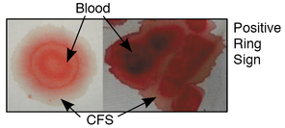
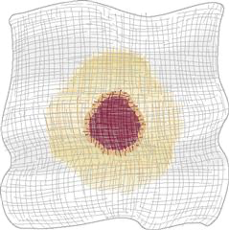
Tracer Studies
Intrathecal Fluorescein
Aid in the identification of the leak, to rule out multiple sites of leak, and to verify a complete repair.
Fluorescein-stained CSF appears bright yellow to green.
CT Cisternography
MRI With Intrathecal Gadolinium Enhancement

Slide 25
MANAGEMENT
Treatment of infection
Pneumococcal meningitis is the most common pathogen.
Untreated CSF rhinorrhea has been associated with a 25% risk for meningitis, with mortality rate 10%.
Risk for meningitis is greater with the following situations:
Delayed CSF leakage
Longer duration of CSF leakage
Concurrent infection
Because the risk of infection is considerably lower with lumbar catheters, the use of ventricular catheters in patients with basal fractures must have a sound clinical indication.
Treatment with
Prophylactic antibiotics
Pneumococcal vaccine

Slide 26
Conservative Care Versus Surgery
Initial conservative treatment indications:
CT scans show nondisplaced and linear fractures.
Patients with a facial impact but without a vault fracture.
Conservative treatment consists of the following:
Bed rest with the head elevated moderately (e.g., 30 degrees).
Avoidance of actions that might cause a sudden increase in ICP, such as nose blowing, straining of stool, coughing, and sneezing (Tx laxatives).
CSF drainage.
If the leak does not cease within 3 days, intermittent or continuous drainage of lumbar fluid may be considered.
Overdrainage can lead to intracranial aeroceles, severe brain displacement, and coma, and emergency drainage of the aerocele is necessary.
Intermittent drainage of 20 to 30 mL over an 8-hour period into a closed system is safer.
If continuous drainage is used, the drain should be placed no lower than shoulder height, with the head elevated about 10 to 15 degrees.

Slide 27
Non-surgical treatment
Measures to lower ICP:
Bed rest.
Avoid straining (stool softeners) and avoid blowing nose.
Acetazolamide (250 mg PO QID) to reduce CSF production.
Modest fluid restriction.
if leak persists (caution: first R/O obstructive hydrocephalus with CT or MRI)
LP
Continuous lumbar drainage (CLD): via percutaneous catheter. Two management options:
keep HOB elevated 10–15°and place drip chamber at shoulder level and leave open to drain.
Allow 15–20 cc to drain, then clamp tubing. Repeat q 1 hour
ICU monitoring. If patient deteriorates with drain in place:
Immediately stop drainage.
Place patient flat in bed (or slight Trendelenburg).
Start 100% O2.
Get CT or bedside skull X-ray (to R/O tension pneumocephalus due to drawing in of air).
Surgical treatment in persistent cases.

Slide 28
Timing of Surgery
Early surgery indications:
Penetrating injury, including gunshot wounds.
Anterior fossa surgery indicated for other reasons such as intracranial hematoma or to repair compound facial fractures, with accessible dural tears being treated at the same time.
Meningitis (once treated).
A large intracranial aerocele, particularly if intracerebral.
Herniation of brain tissue through the nose.
Radiologic appearances that indicate a low probability of natural dural repair:
Anterior fossa fractures that are widely comminuted or separated and communicate with the nose or paranasal sinuses.
Displaced bony fragments and spikes of bone.
Fractures with soft tissue between the bony edges.

Slide 29
Delayed Surgery indications:
Failure of conservative management, such as persistence of a CSF leak beyond 10 days.
Recurrent or delayed CSF leakage after 10 days.
Recurrent aerocele after 10 days.
Meningitis or abscess at any time after injury.

Slide 30
Types of Repair
Intracranial Repair of Frontal Sinus Fractures.
Intracranial Repair of Anterior Fossa Fistulas.
Intracranial Repair of Middle Fossa Leaks.
Intracranial Repair of Posterior Fossa Leaks.
Cerebrospinal Fluid Shunting.
Endoscopic Repair.
Cerebrospinal Fluid Shunting → → →
CSF shunting is appropriate in certain situations
A high-pressure leak in the presence of hydrocephalus is likely lead to failure of a transcranial or extracranial repair unless the hydrocephalus is treated first or simultaneously.
A persistent or recurrent small leak of uncertain location is present.
After failure of previous exploration, a fistula can be treated effectively by lumboperitoneal shunting.
A shunt is contraindicated in patients with a profuse leak because of the risk for pneumocephalus and meningitis.
Presence of hydrocephalus
Unknown site of fistula
Failed previous exploration

Slide 31
Pneumocephalus

Slide 32
Pneumocephalus
Intracranial air is present in 20% to 30% of patients with posttraumatic CSF fistulas, but it may also occur without rhinorrhea.
Mechanism
It may be caused by
Ball-valve effect combined with episodic increased pressure within the nasopharynx on coughing
Inverted bottle effect whereby there is a discontinuous exchange of air and CSF when change in posture reduces ICP below atmospheric level.
Very small volumes of intracranial air (less than 1-2 mL) is common after head injury, and they usually resolve without treatment.
Larger volumes are predictive of a greater likelihood of persistent fistula.
A large volume of air occasionally produces a succession sound (“splash”) with head movement.
Tension pneumocephalus is an uncommon but serious complication.

Slide 33
Etiologies of pneumocephalus
Skull defects
Post neurosurgical procedure (craniotomy, shunt insertion, burr hole drainage of chronic subdural hematoma).
Posttraumatic fracture.
Congenital skull defects: including defect in tegmen tympani.
Neoplasm (osteoma, epidermoid, pituitary tumor).
Infection with gas-producing organisms or mastoiditis.
Post invasive procedure:
Lumbar puncture
Ventriculostomy
Spinal anesthesia
Spinal trauma (LP could be included here as well)
Barotrauma: e.g. with scuba diving (possibly through a defect in the tegmen tympani)
CSF drainage device in the presence of a CSF leak.

Slide 34
Presentation
Headache
N/V, seizures, dizziness, and obtundation.
An intracranial succussion splash is a rare but pathognomonic finding (bruit hydroaerique = splashing noise on head movement).
Tension pneumocephalus may additionally cause signs and symptoms just as any mass (may cause focal deficit or increased ICP).
Diﬀerential diagnosis
Epidermoid
Lipoma
CSF
The Hounsfield units should be close to -1000.

Slide 35
Tension pneumocephalus
Mechanism
When nitrous oxide anesthesia is not discontinued prior to closure of the dura.
When a “ball-valve” eﬀect occurs due to an opening to the intracranial compartment with soft tissue (e.g. brain) that may permit air to enter but prevent exit of air or CSF.
In the presence of continued production by gas-producing organisms.

Slide 36
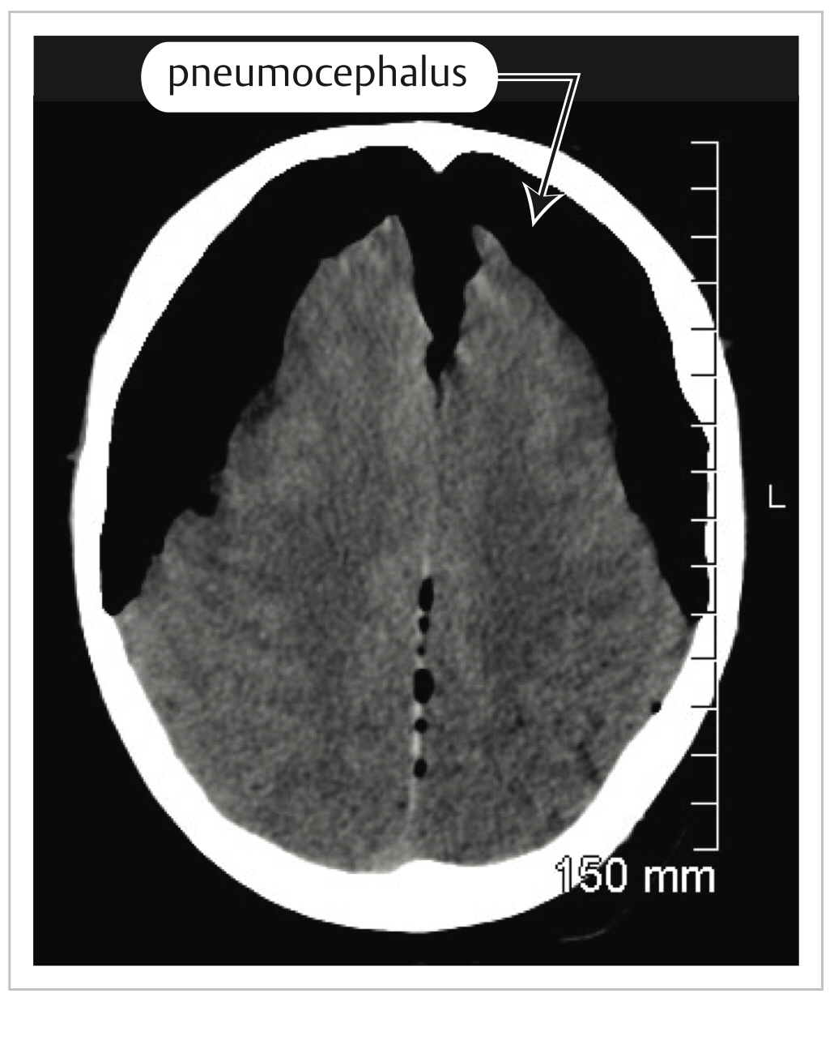
Mt. Fuji sign with bilateral pneumocephalus

Slide 37
Treatment
Treatment of pneumocephalus due to gas-producing organisms,
Treatment of the primary infection is initiated and the pneumocephalus is usually followed.
Treatment of non-infectious simple pneumocephalus depends on whether or not the presence of a CSF leak is suspected.
If there is no leak the gas will be resorbed with time.
if the mass effect is not severe it may simply be followed.
If a CSF leak is suspected, management is as with any CSF fistula.
Treatment of significant or symptomatic post-op pneumocephalus
By breathing 100% O2 (can be tolerated for 24–48 hours without serious pulmonary toxicity).
Tension pneumocephalus producing significant symptoms
Evacuated similar to that of an intracranial hematoma.
Options include placement of new twist drill or burr holes, or insertion of a spinal needle through a pre-existing burr hole (e.g. following a craniotomy).

Slide 38
Intracranial hypotension

Slide 39
Intracranial hypotension
Etiology
Shunt overdrainage.
Trauma.
Procedures that violate the intraarachnoid space.
Following minor traumatic injuries or with disk protrusion.
Connective tissue disorders such as Marfan syndrome or Ehlers-Danlos syndrome.
More common in adult females.

Slide 40
Clinical
The syndrome of spontaneous intracranial hypotension is characterized by the following in the absence of antecedent trauma or dural puncture:
Low CSF pressure (generally < 6 cm H2 O)
Typically associated with orthostatic headache: dramatically worse when upright, improved in recumbency.
Diffuse pachymeningeal enhancement (cerebral and/or spinal) on MRI
Cerebral hypotension classically presents with
Positional headaches; however, the headaches may generalize over time, may never respond to positional changes, or may be absent altogether.
Headaches are often frontal or occipital and triggered by coughing, sneezing, and exertion.
Other symptoms observed include nausea, hearing loss and vertigo, galactorrhea, cognitive changes, unsteady gait, stupor, and coma.
Since some patients may have normal intracranial pressure, the term “CSF hypovolemia” has been suggested.
Normal ICP = 7.5 - 20 c.m H2O
To convert to cm H2O multiply *1.3

Slide 41
Classical imaging signs of low ICP are recalled by the acronym of “SEEPS,”
S= Subdural hygromas or hematomas.
E= Enhancing dura (Diffuse pachymeningeal enhancement).
E= Engorged veins.
P= Pituitary enlargement.
S= Sagging brain with brainstem ptosis and posterior crowding.
Brain sagging Associated with
Low-lying cerebellar tonsils.
Effacement of perichiasmatic and prepontine cisterns.
Bowing of the optic chiasm.
Flattening of pons, and ventricular collapse.
If a leak is suspected, other procedures such as Chiari decompression surgery or drainage of subdural fluid should be avoided.
25% of subdural collections in a nongeriatric population are caused by low CSF pressure or leaks.

Slide 46
Management
Conservative medical management: bed rest, hydration, analgesics, caffeine, and abdominal binder.
Epidural blood patch (EBP): Injection of autologous blood (10–20 ml) into epidural space.
Blood 🩸 or fibrin injection.
Surgical closure is occasionally needed and effective only with accurate localization.
Caffaine increase production of CSF.

Slide 47
Thank you

