Slide 1
Traumatic Hematomas Youmans Chap. 338, 351, 344, 346

Slide 2
Epidural Hematoma
EDHs are accumulations of blood between the inner table of the skull and the outer surface of the dura mater.
Usually occurs in young adults, and is rare before age 2 yrs or after age 60 (because the dura is more adherent to the inner table in these groups).
EDH is seen in 2% of all types of head injury and in up to 15% of lethal head injuries.
EDH is less common than SDH.
Etiology
Skull fracture involving the groove of the middle meningeal artery which is lacerated by the jagged edges of bone.
Less commonly, venous epidural hematomas are seen.
Disruption of venous dural sinuses, emissary veins, or venous lakes within the dura mater
tend to occur in children.
are not always associated with a skull fracture.

Slide 3
They rarely occur spontaneously in patients with infections, sinusitis, vascular anomalies, or chronic renal failure.
Approximately 10% of EDHs are due to venous bleeding, often from laceration of a dural venous sinus.
These venous epidural hematomas occur most commonly
Along the anterior aspect of the middle cranial fossa or fracture of the greater sphenoid wing → laceration of the sphenoparietal sinus.
Occipital skull fracture → laceration of the superficial transverse sinus.
At the vertex → injury to the superior sagittal sinus caused by either skull fracture or diastasis of the sagittal suture, crossing the midline because of the relatively weak attachment of the outer periosteal dural layer to the sagittal suture.

Slide 6
Site in decreasing manner:
The temporoparietal regions (middle meningeal artery).
The anterior cranial fossa (anterior meningeal artery).
The parasagittal regions (sagittal sinus).
The posterior fossa (occipital meningeal artery and transverse and sigmoid sinuses). 5%
Clinically
Initial loss of consciousness after trauma, transient complete recovery (“lucid interval”), then rapid progression of neurological deterioration.
Typical clinical symptoms of EDH include
Hemiparesis (contralateral or ipsilateral because of Kernohan’s notch).
Decreased level of consciousness.
Dilation of the ipsilateral pupil (occurs in less than 50% of patients).
Neurological deterioration from an expanding EDH typically results in obtundation, decerebrate rigidity, arterial hypertension, cardiac arrhythmias, respiratory disturbances, and, finally, apnea and death.

Slide 7
Radiology
EDHs classified by radiographic progression into three appearances:
Type I (acute or hyperacute—day 1, associated with “swirl” of unclotted blood)
Type II (subacute—days 2-4, solid)
Type III (chronic—days 7-20, mixed or lucent with contrast enhancement)
Classic” CT appearance occurs as:
High density biconvex (lenticular) shape adjacent to the skull.
Sometimes the side against the skull is convex and that along the brain is straight, and in 5% it is crescent shaped (resembling SDH).
Cross the falx at the vertex (distinct from SDH, which is limited to one side of the falx).
Cross the tentorium cerebelli, therefore may be seen to extend between the posterior fossa and the supratentorial space.
Do not cross suture lines of the skull.
Mass effect is frequent.
Mottling of density (Swirl sign) described as a finding in hyperacute EDH.

Slide 8
EDHs in the posterior fossa
Rare finding, 5%.
Challenging to manage because these patients may remain conscious until late in the evolution of the hematoma, when they may suddenly lose consciousness, become apneic, and die.
Often extend into the supratentorial compartment by stripping the dura over the transverse sinus, resulting in significant intracranial hemorrhage during surgical evacuation.
Outcome is generally better in children and correlates with
GCS score on admission.
CT evidence of hydrocephalus (caused by compression of the fourth ventricle).

Slide 9
Delayed epidural hematoma (DEDH)
Definition: an EDH that is not present on the initial CT scan, but is found on subsequent CT.
Risk factors for DEDH include the following
Lowering ICP either medically (e.g. osmotic diuretics) and/or surgically (e.g. evacuating contralateral hematoma) which reduces tamponading eﬀect.
Rapidly correcting shock (hemodynamic “surge”) may cause DEDH.
Coagulopathies.
DEDH tend to occur in patients with severe head injury and associated systemic injuries.
Presence of a skull fracture has been identified as a common feature of DEDH.

Slide 10
There are concurrent brain injuries such as A-SDH, contusions, and lacerations in 30% of cases of EDH, and these patients are usually unconscious from the time of injury.

Slide 11
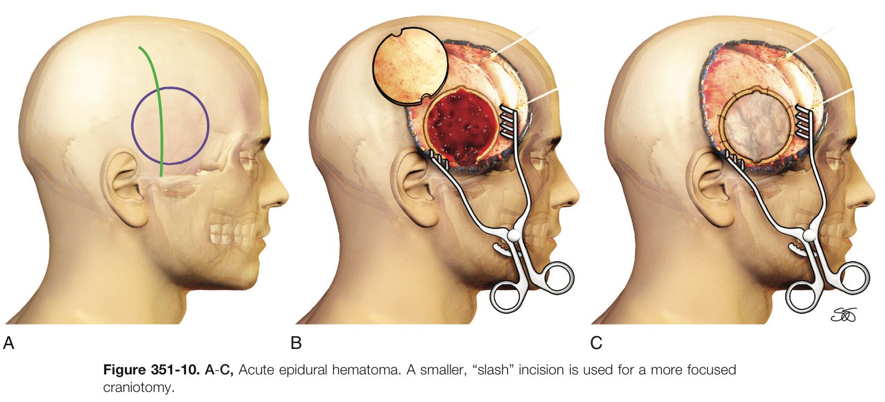
Operative notes
Low temporal exposure is necessary to visualize the foramen spinosum, which can be packed with bone wax to control the bleeding.
After evacuation of the hematoma, meticulous hemostasis is obtained and bone wax is applied to the bone edges.
Dural tack-up sutures are placed at intervals no larger than 2.5 cm in a circumferential fashion
Central dural tack-up sutures are also placed in the center of the bone flap to obliterate the central dead space under the bone flap.

Slide 12
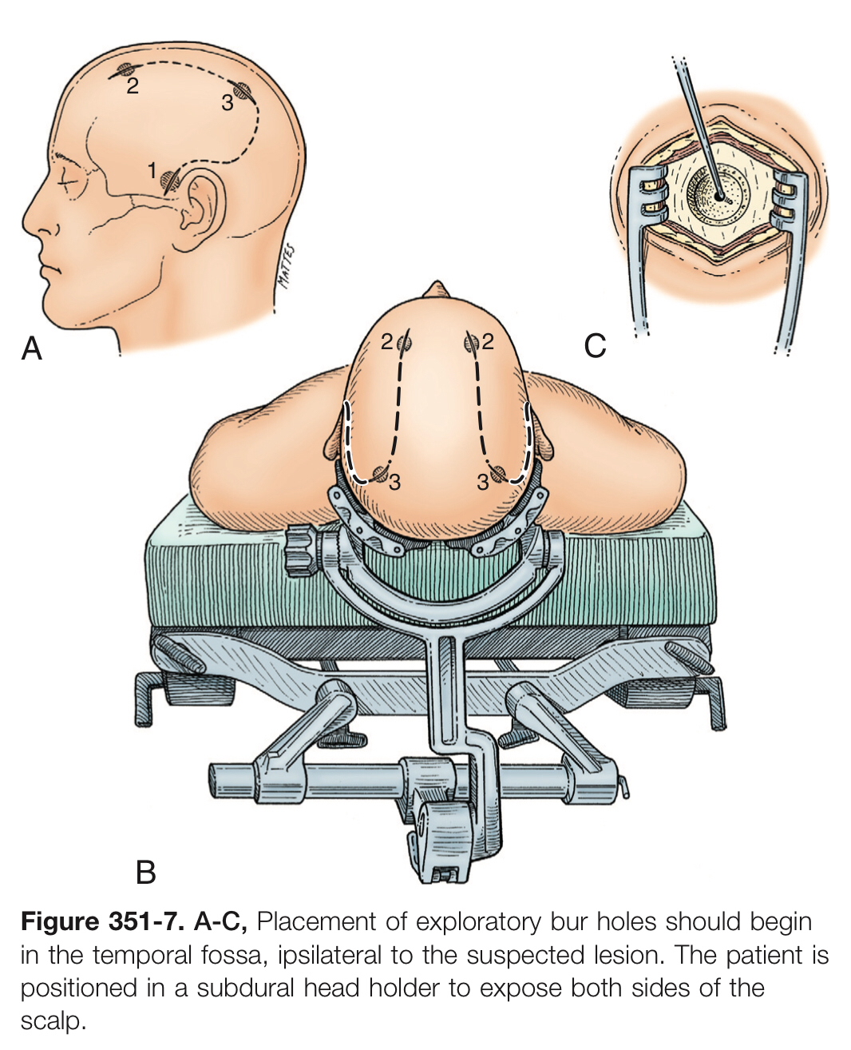
Initially,
bur hole is placed in the temporal region 2.5 cm above the zygomatic arch.
After diagnosis of either an acute subdural or extradural hematoma or no hematoma,
two additional bur holes can be placed appropriately in the parietal and frontal regions.

Slide 13
Choice of side for initial burr hole
Start with a temporal burr hole (see below) on the side:
ipsilateral to a blown pupil. This will be on the correct side in > 85% of epidurals and other extra-axial mass lesions
if both pupils are dilated, use the side of the first dilating pupil (if known)
if pupils are equal, or it is not known which side dilated first, place on side of obvious external trauma
if no localizing clues, place hole on left side (to evaluate and decompress the dominant hemisphere)

Slide 14
Burr hole locations
first (temporal) burrhole: over middle cranial fossa just superior to the zygomatic arch. Provides access to middle fossa (the most common site of epidural hematoma) and usually allows access to most convexity subdural hematomas, as well as proximity to middle meningeal artery in region of pterion
if no epidural hematoma, the dura is opened if it has bluish discoloration (suggests subdural hematoma (SDH)) or if there is a strong suspicion of a mass lesion on that side
if completely negative, usually perform temporal burr hole on contralateral side
if negative, further burr holes should be undertaken if a CT cannot now be done
proceed to ipsilateral frontal burr hole
subsequent burr holes may be placed at parietal region and lastly in posterior fossa

Slide 15
Outcome
Surgical decompression of acute EDH and SDH within 2 hours of onset of coma was associated with increased rates of survival and good outcome.
Patients with pure EDHs have an excellent prognosis after surgical evacuation, whereas those with associated intradural lesions experience good outcome.
Patients with evidence of brainstem dysfunction as evident by anisocoria have significantly more favorable outcomes when treated promptly after the onset of neurological deterioration.
EDH volume greater than 50 cm3 before evacuation experience worse neurological outcome and increased mortality.
Patients treated with more extensive craniectomies were significantly more likely to have favorable outcomes.
A small craniectomy less than 10 cm is associated with increased craniectomy-associated hemorrhages because of
Mushroom-like herniation of edematous brain through the limited skull opening.
Increased shearing forces and venous distortion at skull edges.

Slide 18
Acute Subdural Hematoma
Acute SDH is seen in approximately one third of patients with severe TBI.
Most acute SDHs result from venous vascular injury resulting in two types:
1st type produced by contact forces and associated with contusions or lacerations, and is most common at the temporal pole. This complex of SDH and damaged and necrotic brain is termed burst lobe.
2nd type located over the cerebral convexity and is produced by inertial forces that tear bridging veins (The underlying brain damage usually milder, caused by local ischemia from mass effect or compromised venous outflow).
ASDH can sometimes result from
Most commonly result from tearing of cortical bridging veins.
Less commonly, result from disruption of penetrating branches of superficial cerebral arteries, pial vessels, or arachnoid granulations.
Ruptured bridging vein ASDH, there may be little or no concomitant contusion or laceration, may experience a lucid interval. (Type 2)

Slide 19
Neuroimaging
Characteristic of SDH
Most commonly appears as a crescent shaped extra-axial collection overlying a cerebral convexity.
Freely crosses suture lines.
Cannot cross the thick dural reflections formed by the falx cerebri and tentorium cerebelli.
More often located at the contrecoup site than at the coup site.
SDH also frequently extends
Along the anterior or posterior falx, recognized as a thickened “shaggy” falx.
Along the tentorium cerebelli, either bilaterally asymmetric or bilaterally symmetric.
Rebleeding into a chronic SDH can result in
Laminated appearance, with alternating hyperdense and hypodense layers or internal septations.
Such acute-on-chronic SDHs can also appear as a heterogeneous collection with a fluid-fluid level
Calcifications occur after months to years in CSDH.

Slide 21
Acute Subdural Hematoma.
Account for 50% - 60% of all SDHs.
They are most common after sudden head movements that occur with assaults or falls.
Rarely, acute SDH may occur spontaneously (or after minor trauma) in patients
Receiving chronic anticoagulation therapy
After rupture of a posterior communicating artery aneurysm.
Prognosis
Timely clot evacuation (within 4 hours) generally results in significantly improved neurological outcome.
Patients with initial CT evidence of significant hemispheric or generalized brain swelling have extremely poor outcome with or without early surgery.

Slide 22
Poor prognostic Factors
Low Glasgow Coma Scale (GCS) score at admission
Advanced age.
Postoperative intracranial hypertension.
The presence of associated intraparenchymal hemorrhage (IPH).

Slide 23
Operative notes
Skin flap:
The standard trauma incision begins at the zygomatic arch, approximately 1 cm anterior to the tragus.
The incision extends cranially to the level of the top of the pinna then turns posteriorly and travels medially just above the level of the transverse sinus.
At the external occipital protuberance, the incision turns anteriorly, sweeping over the parietal and frontal regions and staying approximately 2 cm lateral to the midline to end at the hairline.
Bone flap
Large 12 × 15-cm frontotemporoparietal bone flap is planned.
Bur holes are placed at
Keyhole in the frontal bone behind the zygomatic arch.
Adjacent to the root of the zygoma,
Over the parietal bone at the most posterior extent of the planned bone flap.
The keyhole approximates the floor of the anterior fossa, and the root of the zygoma approximates the floor of the middle fossa.

Slide 24
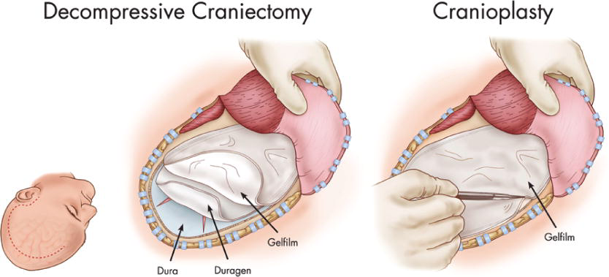
Dura opening
The dura should be opened over the thickest portion of the underlying hematoma, or else over the anterior frontotemporal region.
The dura can be opened either in a stellate fashion or in a C-shape.
Closure
If the bone is not replaced, the dural leaflets are loosely reapproximated and covered with an onlay dura substitute, such as DuraGen
Gelfilm: thin nonadhesive gelatin film, can be placed epidurally to prevent scar formation and adhesion of the galea and temporalis muscle to the dura to facilitate future cranioplasty.

Slide 25
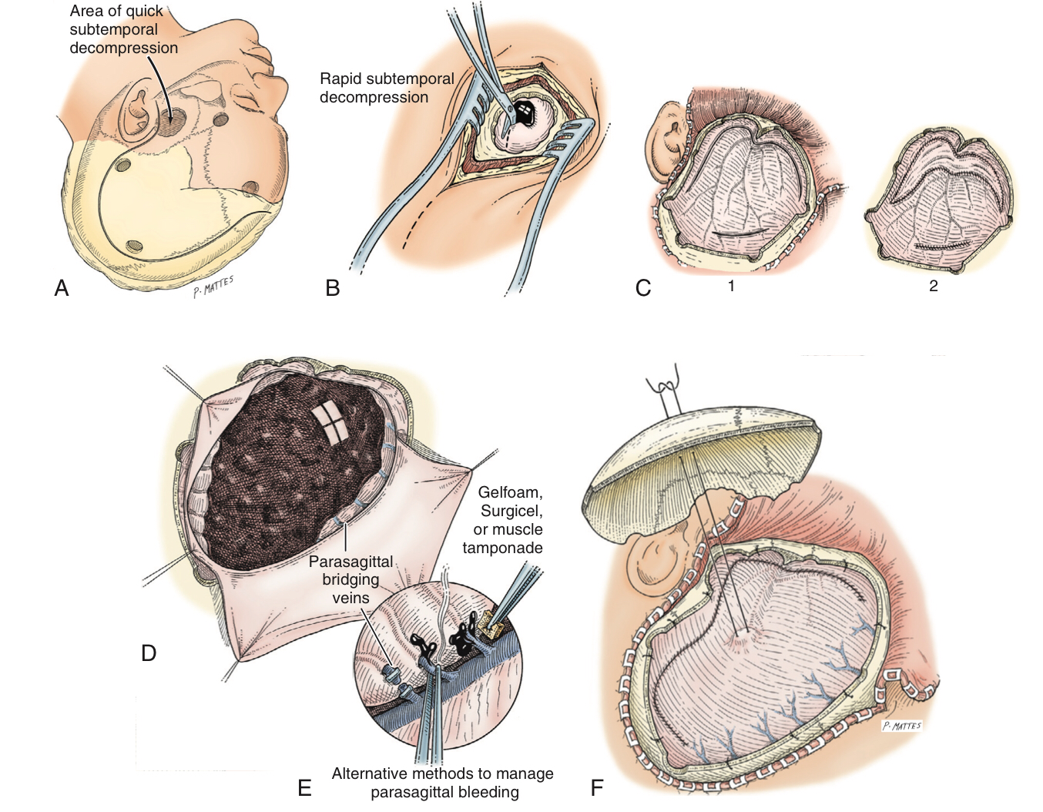
Figure 351-8.

Slide 28
Intracerebral Hematoma
ICHs account for 20% to 30%
Contusions lesions characterized by mixed blood and brain tissue.
Consists of an area of hemorrhagic necrosis usually occurring on the crests of gyri in contrast to watershed infarcts that occur in the depths of sulci.
Contusions are frequently seen on the subfrontal and anterior temporal cortical surfaces (irregular boney contours of the floor of the anterior and middle cranial fossa) by which the brain being jostled against intracranial boney and dural surfaces.
Coup caused by contact loading.
Contra-coup caused by acceleration-deceleration.
Contra-coup contusions occur 180 degrees away from the impact site on the opposite side of the brain.
Histologically:
Acute contusions consist of hemorrhagic necrosis.
The yellow-tan color of remote contusions lead to the designation plaques jaunes

Slide 29
Sudden deterioration is a feature especially of patients with severe bifrontal contusions, temporal pole pulping, and “burst” lobes.
Contusions are also one of the causes of neurological deterioration after a lucid interval, mimicking EDH.
In Simple contusion, the overlying pial membrane remains intact.
In Laceration, disruption of the pial membrane with tearing of the underlying tissue.
Contusions increase in size over hours to days because of
Recurrent hemorrhage.
Vasogenic edema.
Inflammation.
Ischemic necrosis.
Small contusions may be completely resorbed within 2 to 3 weeks.
Larger lesions can take weeks to months to resorb.

Slide 30
Intermediate contusions (gliding contusions)
Are intracerebral contusions that occur
Deep within the neuroglial parenchyma between the impact and opposite side of the brain.
In the parasagittal regions.
Its due to the rostrocaudal movement of the brain resulting from impact or impulsive loading forces.
The hemorrhages involve the deeper layers of the cortex and the convolutional white matter, but they spare the surface of the gyrus.
Intraparenchymal hematoma
Collection of confluent, relatively homogeneous of frank blood, rather than bruised brain tissue within the brain parenchyma” exceeding 5 mm in size.
There tends to be less surrounding edema than with contusions.
Located deeper in the brain than contusions are, frequently in the frontotemporal white matter.

Slide 31
Imaging
On both CT and MRI, the brain contusion appears either
Focal area of patchy hemorrhage and edema within a superficial portion of the brain that lies immediately adjacent to the skull (cortical contusions).
Or more extensive and involve both the cortex and subjacent cortical white matter.
Multiple focal contusions have a “salt and pepper” appearance on CT scan.
The most common locations are
The anterior temporal lobes along the greater sphenoid wings (50%)
The frontal lobes (30%), particularly the orbitofrontal brain.
Parietal and occipital (13%)
Cerebellar (10%)

Slide 32
Hyperacute and acute stage:
Blooming is a highly characteristic feature (brain contusion with associated hemorrhage and edema, expand over the first few hours after injury, to a degree ranging from minimal to devastating).
The burst temporal lobe refers to severe contusion of the anterior temporal lobe, and it can result in new neurological deficit when expansion results in medial temporal lobe herniation and compression of the midbrain.
Subacute stage
the lesion demonstrates ring enhancement on postcontrast CT and MRI, because of the proliferation of new capillaries lacking a complete blood-brain barrier.
Chronic stage:
Hemosiderin deposition from an old contusion with a common appearance of wedge-shaped area of peripheral encephalomalacia with the broad base facing the skull (mimic an old ischemic infarction).

Slide 33
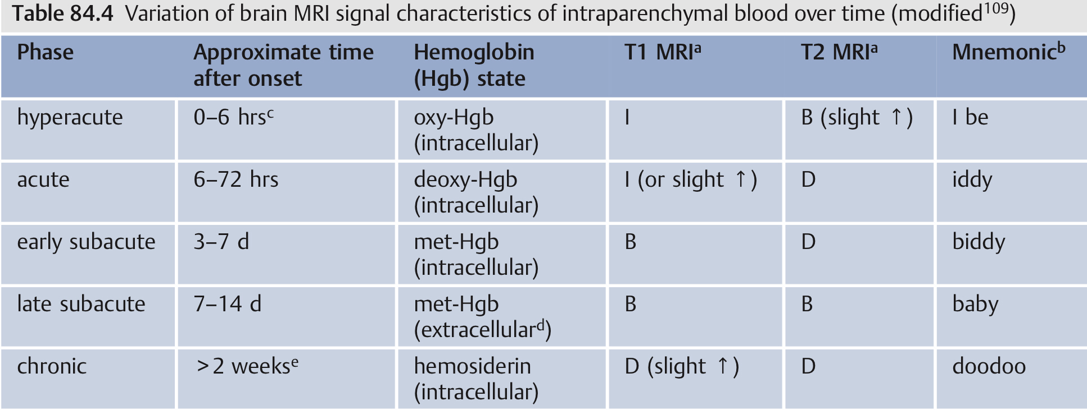

Slide 34
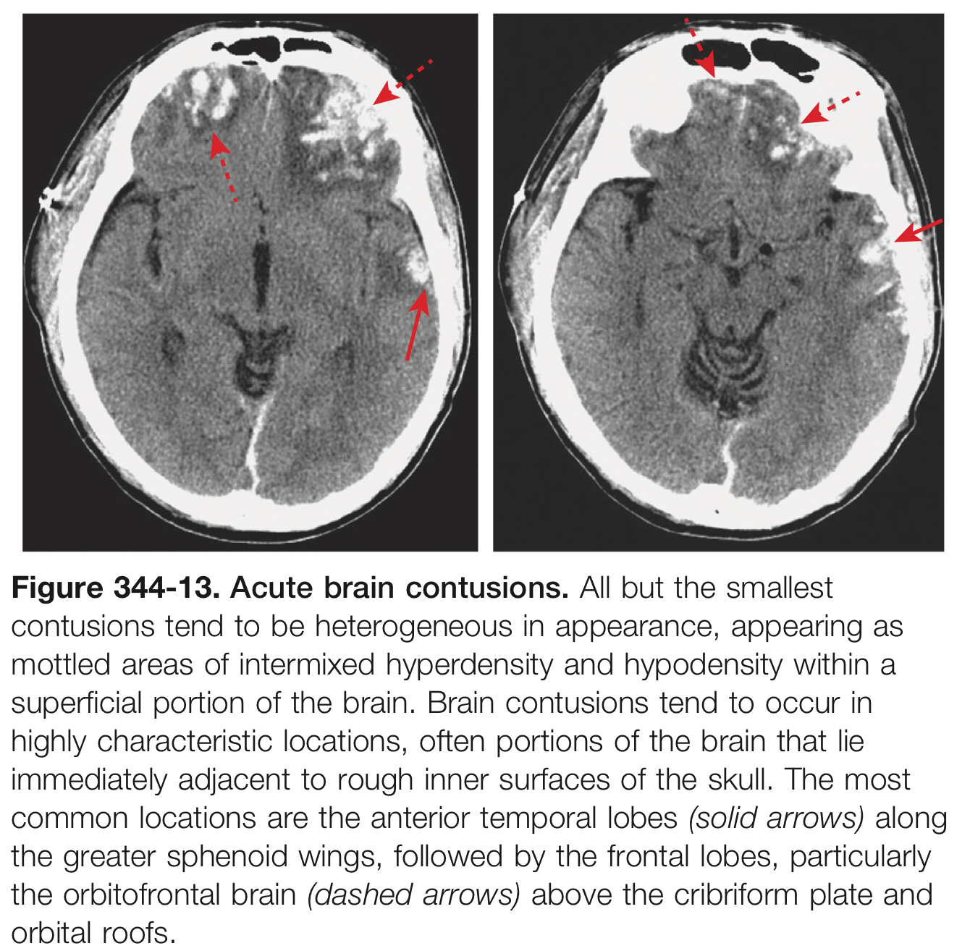

Slide 36
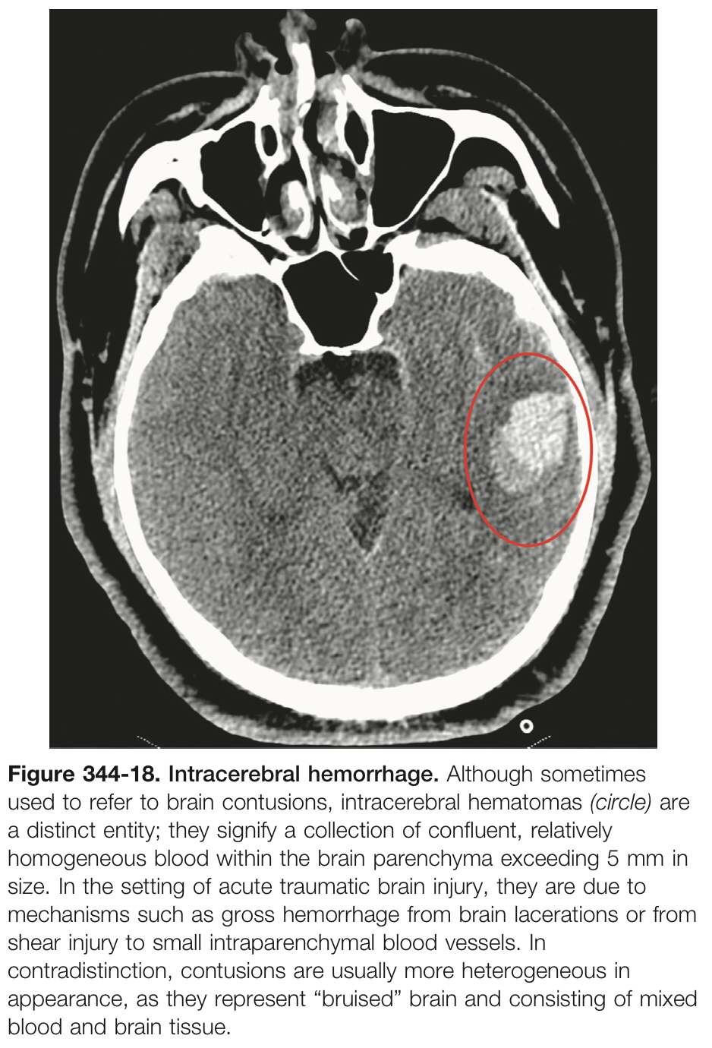

Slide 37
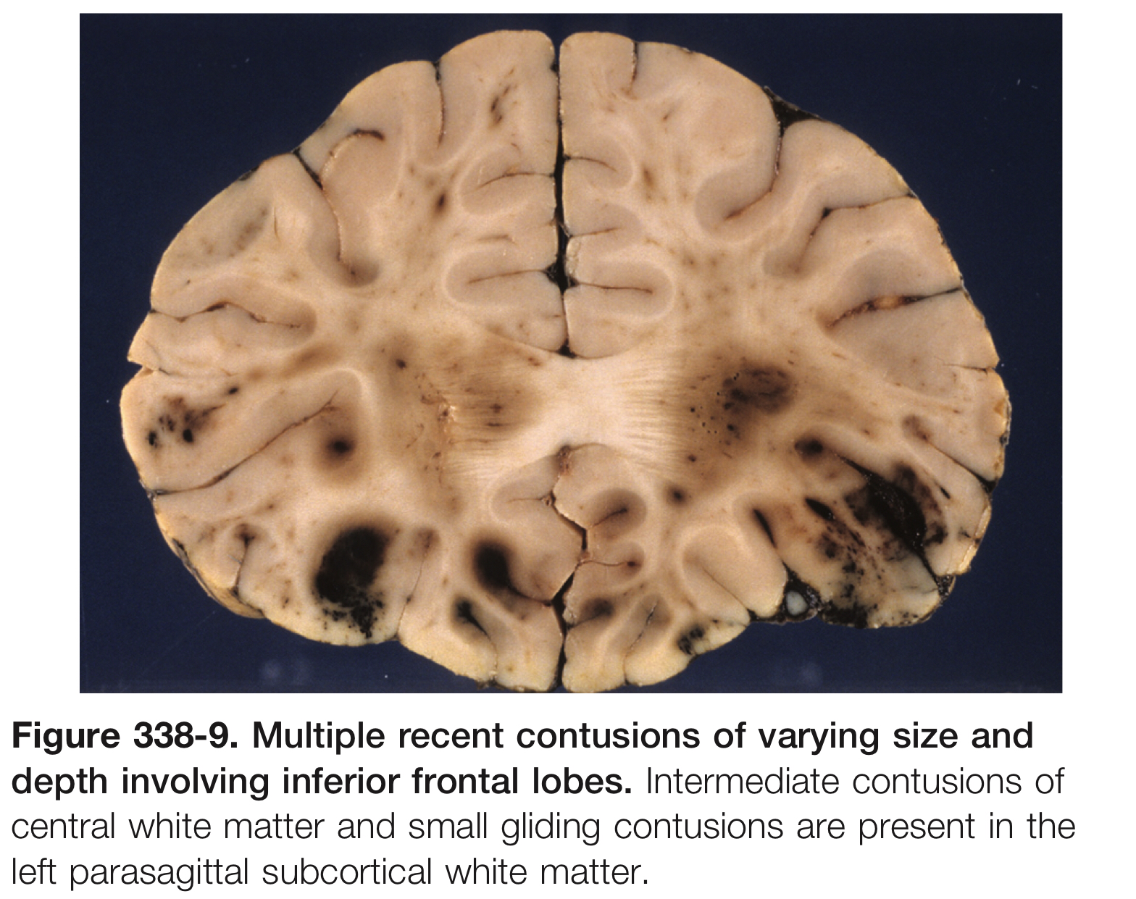

Slide 42
Operative notes
If bifrontal contusions or SDH are present or if frontobasal access is required, the most proximal superior sagittal sinus is double-ligated and cut as close to the crista galli as possible.
Using bipolar cautery, the pia mater and superficial vessels are cauterized over the cortical area with the most damage, swelling, and contusion.
If significant brain swelling is present,
Partial resection of the right frontal (no more than 3 to 4 cm) or temporal lobe (no more than 5 to 6 cm) can be performed to minimize the pressure effects of postoperative brain swelling.
On the left side, only contused, amorphous tissue should be removed.
In the frontal lobe, most prone to hemorrhagic contusions are the inferior orbital aspects of the gyrus rectus and inferior frontal gyrus.
In the temporal lobe, the anterior tips of the temporal lobes are most susceptible to injury.

Slide 43
Figure 351-11. Schematic showing a bifrontal craniotomy. A bicoronal scalp incision is placed behind the hairline (A). A piece of pericranial flap is harvested and preserved for closure of frontal sinus. Multiple burr holes are placed, especially with respect to the superior sagittal sinus (B). After the scalp incision, multiple bur holes are placed, especially with respect to the superior sagittal sinus. After the large craniotomy opening, the dura is opened down to the frontobasal regions (C). If required, the anterior aspect of the sagittal sinus is ligated close to the crista galli (D to F). The surface contusions and hemorrhages are then evacuated with a combination of suction and bipolar diathermy (G). a., artery; n., nerve.

Slide 45
Traumatic Subarachnoid Hemorrhage
SAH results from the disruption of small pial vessels along the brain surface.
It is also commonly seen immediately adjacent to brain contusions.
Common sites for traumatic SAH include
The sylvian fissures.
The frontal and parietal sulci near the vertex.
Anterior interhemispheric fissure.
Small quantities of traumatic SAH sometimes seen within the basal cisterns.
T2 FLAIR MRI is the most sensitive for both acute and subacute SAH.

Slide 47
Indications and Techniques for Cranial Decompression after Traumatic Brain Injury Youmans Chap. 354

Slide 48
INDICATIONS
Traumatic brain injury with 2ry insults and injury, including brain edema, elevated intracranial pressure (ICP), and decreased cerebral perfusion pressure (CPP).
Uncontrolled ICP after aneurysmal subarachnoid hemorrhage.
Malignant MCA infarction.
Refractory intracranial hypertension.
Other indications such as brain tumor, meningitis, acute encephalitis, toxoplasmosis, encephalopathy caused by Reye’s syndrome, subdural empyema, and cerebral venous and dural sinus thrombosis.
Early decompression (within 4 hours of injury) results in profound decreases in the mortality rate and improvement in functional outcome 6 months later.

Slide 49
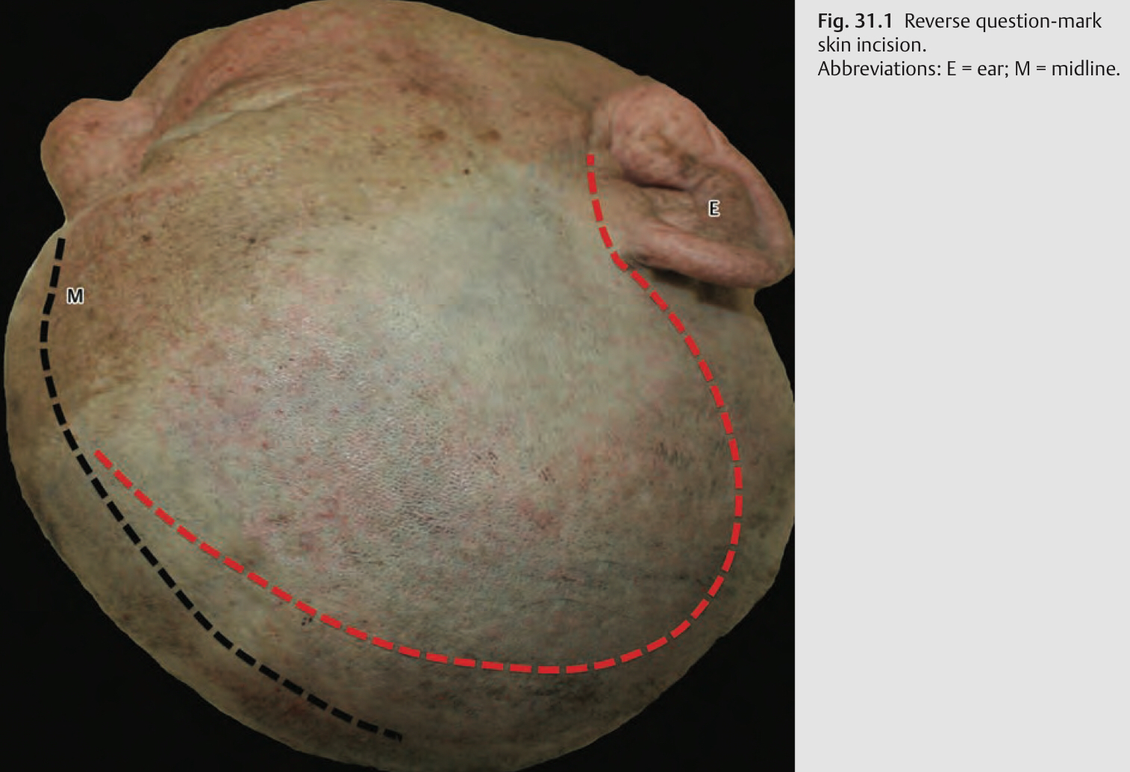
Techniques
Skin Incision
Reverse question-mark incision
Starting point: Incision starts at the zygomatic arch, < 1 cm anterior to the tragus.
Run: Incision line runs superiorly and then curves posteriorly at the level of top of the pinna till 4-8 cm behind the pinna, then it is taken superiorly.
Ending point: It ends 1-2 cm lateral to the midline, behind the hairline.

Slide 51
Craniotomy
Burr holes
The first burr hole is placed at the low temporal area (temporal squama), right above the zygomatic arch.
The second burr hole is made at the keyhole.
The third burr hole might be placed, as preferred, along the planned craniotomy route.
Craniotomy landmarks
Anterior: Orbital rim.
Lateral: Zygomatic arch.
Medial: 1 cm from the midline, sagittal suture.
Posterior: Lambdoid suture.

Slide 54
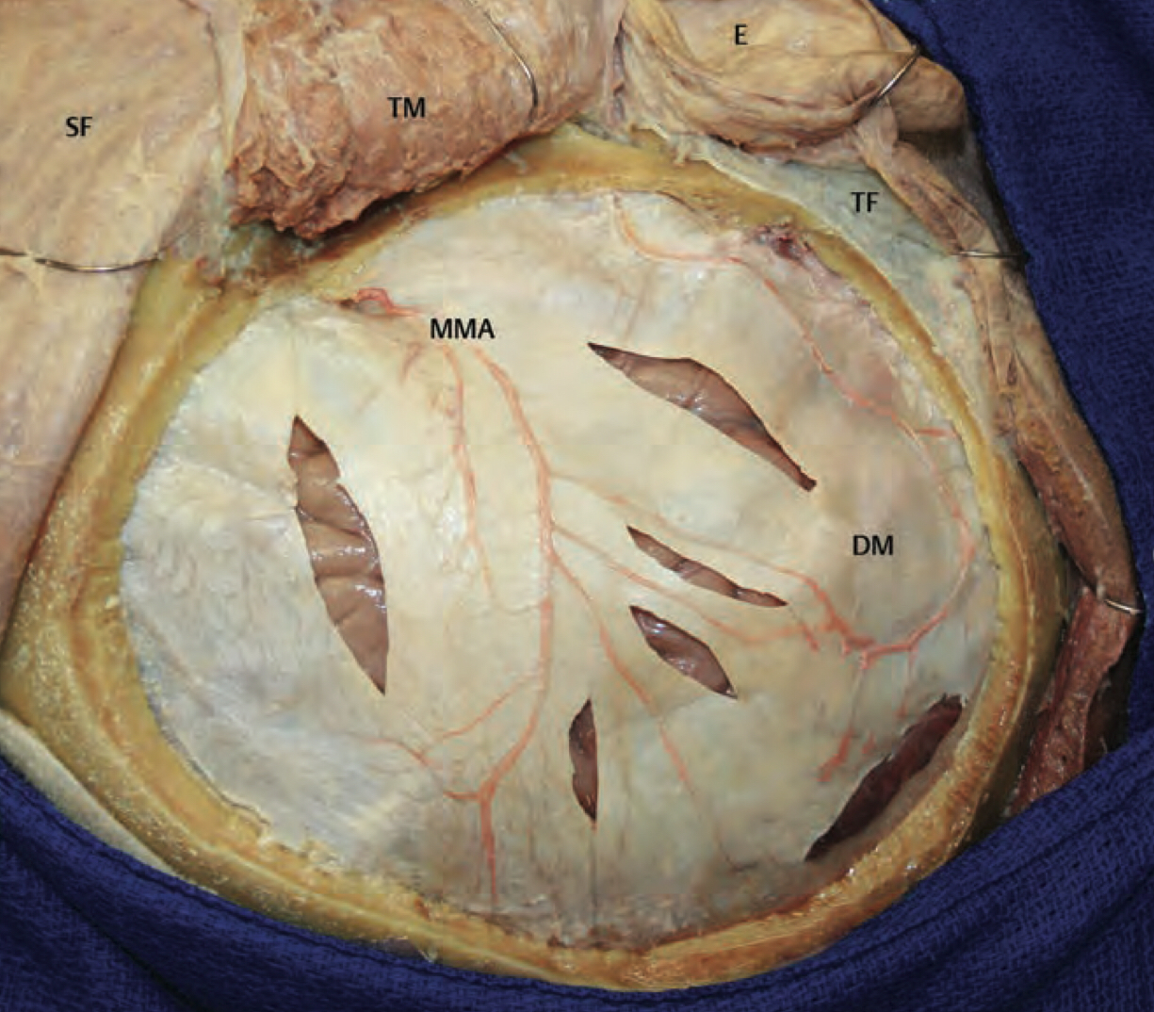
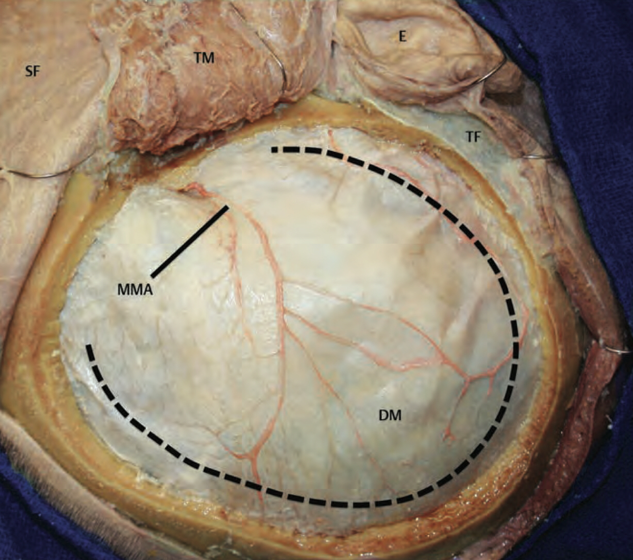
Dural Opening
Cruciate/stellate or in a C-shaped fashion.

Slide 57
Operative Notes
The craniotomy itself for a unilateral DC must be large enough area to prevent brain herniation and strangulation,
Lateral to the superior sagittal sinus.
Frontally to the midpupillary line.
Inferiorly to the floor of the temporal fossa.
Posteriorly to the parieto-occipital area.
Typically, the anteroposterior length of the bone flap measures 14 to 15 cm in an adult.
Superoinferior 12 c.m
The skin incision should extend beyond the margins of the bone flap
The incision does not overlie brain tissue (when the brain is swollen and there is a potential for CSF leak).
For future cranioplasty (incision directly over brain tissue makes dissection of the flap more difficult).

Slide 58
In cases of intraparenchymal hemorrhages, especially mixed-density contusions, aggressive débridement of contusion may be avoided in order to preserve potentially viable tissue, particularly in the posterior temporal lobe.
In cases in which the bone flap will be left out after evacuation of a mass lesion or after a primary DC, durotomy must be employed; otherwise, the operation is ineffective for reduction in ICP.
Whatever the dural opening technique, it is imperative to open the temporal dura in order to decompress the temporal lobe to relieve brainstem compression.
Duroplasty importance
Provide brain protection and to prevent the temporalis muscle and galea from adhering to the underlying brain.
Restores more normal CSF circulation and prevent or minimize the development of postoperative hygromas and CSF leakage from the wound.
Abdominal storage of bone flap associated with resorption, rhabdomyolysis, and infection, and an additional incision and procedure are required at both storage and retrieval.
Storage at a deep freeze less than -28 degree

Slide 59
Partial or anatomic lobectomies may also be performed
In conjunction with DC for intractable intracranial hypertension.
In conjunction with evacuation of cortical contusions or IPH, and it is limited to frontal and anterior temporal lobes, preferably on the nondominant side.
Lobectomy does not preclude a good outcome.
Lobectomy is seldom necessary and is reserved for:
Pulped or necrotic lobe with malignant cerebral edema at surgery.
Pulselessness of the hemisphere.
Vessel occlusion or infarction (which can be related to a blunt vascular injury).
Profound coagulopathy in the presence of multiple ICH.

Slide 60
Early replacement of bone flap
The interval between DC and secondary bone flap replacement varies from 4 weeks to 12 months.
Advantages
Reduce the incidences of
Scalp contraction (which can contribute to wound dehiscence).
Temporalis muscle atrophy (which can contribute to TM joint complaints and cosmetic asymmetry).
Trephined syndrome (which can cause severe headache, excessive somnolence, and neurological deficit).
Neurological improvements in motor activity and speech.
Reduction in seizure frequency and cognitive improvements.
Reduce the development of severe encephalomalacia (eliminates the potential dead space under the flap postoperatively, so decreasing the postoperative risk of epidural hematoma, pneumocephalus, and fluid collections).
Provides cerebral protection during the phases when patients are still likely to experience imbalance, incoordination, and orthostatic hypotension, which increases their risk for falls.

Slide 61
Before reimplantation, a CT scan of the brain should be obtained to rule out (hydrocephalus or subdural or subgaleal fluid collections).
In hydrocephaly: lumbar drain or ventricular catheter be used to decompress the ventricles and allow for the bone flap to be replaced without pressure on the underlying brain.
A fluid collection can be drained during surgery to allow for relaxation sufficient for replacement of the bone flap.

Slide 62
Complications after DC are generally related to:
Cerebral complications (2ry brain injury, seizures, trephined syndrome ).
CSF dynamics (hygromas and hydrocephalus).
Wound problems (most commonly infection or dehiscence).
Mechanism of 2ry brain injury
Hyperemic state caused by metabolic changes due to dilation and refilling of previously compressed vessels and high demand for oxygen to the brain after pressure is relieved by the operation.
Perfusion breakthrough hemorrhage may occur as a result of cerebral vasodilation and hyperemia.
Prophylaxis against seizure in the first 7 days after trauma in patients experiencing EDH, SDH, ICH, contusion, penetrating injury, or depressed skull fracture and for those with a GCS score of less than 10.

Slide 63
The complications that occur most frequently with DC are
Hygromas
Occur on the ipsilateral side after DC.
Result of altered CSF dynamics.
Most resolve spontaneously without intervention.
Mx. :
Single or serial lumbar punctures, temporary continuous lumbar drainage, lumboperitoneal shunt, or ventriculoperitoneal shunt.
Percutaneous drainage of associated epidural CSF collections may be used but confer additional risk of wound infection.
Replacement of the bone flap often leads to resolution of hygromas.
Diagnostic lumbar puncture with measurement of opening and closing pressures can assist in distinguishing between simple hygromas and so-called external hydrocephalus.

Slide 64
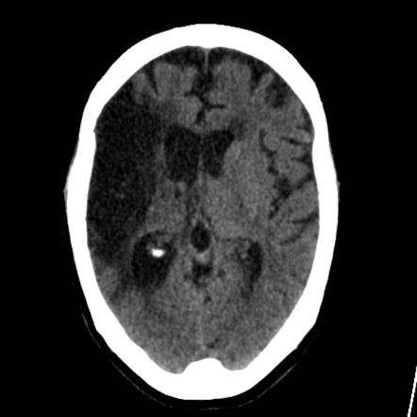
Hydrocephalus ex vacuo
Enlargement of the ventricles due to loss of cerebral tissue (cerebral atrophy), usually as a function of normal aging.
In which the lateral ventricle can migrate toward the craniectomy defect.
Causes (Alzheimer’s disease, Creutzfeldt-Jakob disease, TBI).
Does not represent altered CSF hydrodynamics.

Slide 65
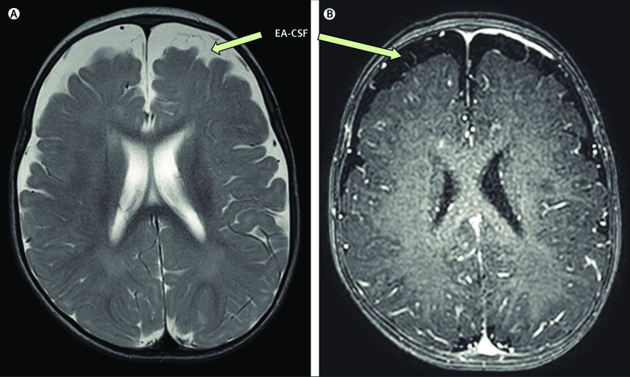
External hydrocephalus (AKA benign external hydrocephalus)
Enlarged subarachnoid spaces over the frontal poles in the first year of life.
Ventricles are normal or minimally enlarged.
May be distinguished from subdural hematoma by the “cortical vein sign” which absent with SDH.
Usually resolves spontaneously by 2 years of age.

Slide 66
Outcome
Mean mortality rate of 20% to 30%, in comparison with 70% to 80% of patients treated conservatively.

Slide 67
Thank you

