Slide 1
Growing Skull Fractures Youmans Chap.226

Slide 2
Pathogenesis of Growing skull # (Posttraumatic leptomeningeal cysts)
Occur almost exclusively during the first years of life.
Dura: Dural laceration is necessary for the development of an enlarging defect.
CSF: CSF that became trapped in a herniated section of arachnoid membrane and enlarged by means of a ball-valve mechanism.
Bone: The cysts prevented bone reapproximation and, because of their increasing size and the pulsations of the underlying brain, led to bone resorption.
Brain: was abnormal with areas of gliosis often admixed with focal areas of necrosis and combination of old and new damage.
Growing fractures occur in only settings in which there is
Rapid brain growth
Less commonly, increased ICP.
Dysfunction has been attributed to brain injury caused by
Local brain herniation and consequent ischemia.
Repetitive trauma to the exposed brain on the bone edge or by direct concussion.
Physical distortion of the brain related to its displacement.

Slide 3
EPIDEMIOLOGY
Enlarging skull fractures are extremely uncommon.
They account for less than 1% of skull fractures in pediatric.
Almost all enlarging fractures are found in children less than 3 years old; two thirds of them occur in children less than 1 year old.
The parietal region is most commonly affected.
Growing fontanelle is due to an underlying leptomeningeal cyst in infants without a history of significant trauma; in these children the dural injury apparently occurred during delivery.
Common presenting complaints
Pain at the fracture site.
Epilepsy.
Progressive neurological deficit.

Slide 4
EVALUATION
The typical patient with a growing fracture has the following characteristics:
Youth. Almost all of the patients with enlarging fractures are younger than 3 years and the clear majority younger than 1 year.
A subgaleal fluid collection, which may or may not be pulsatile, overlying the fracture (although the collection may resolve soon after injury).
Presence of a neurological deficit caused by the injury.
Skull radiographs that demonstrate a diastatic fracture with bone edge separation of at least 3.5 mm.
Obtaining skull radiographs 6 weeks and again several months after the injury, a
Palpable ossification defect,
Larger than that initially present,
Usually overlaid by a soft, often pulsatile subgaleal collection.

Slide 5
If Ossification defect is small or only minimally different from its appearance at presentation and no overlying collection is present.
It is probably best to reexamine these children several weeks later as fracture may heal without intervention.
If patients who have been described with what has been termed “pseudo-growing” fractures.
Fractures that had enlarged slightly in the weeks immediately after injury ultimately healed after a few months.
TOP DIFFERENTIAL DIAGNOSES
Epidermoid
Congenital Calvarial Defects
Langerhans cell histiocytosis
Calvarial metastasis
Osteomyelitis

Slide 6
Radiology
Plain X-ray
They appear as smooth-edged ossification defects, often scalloped and occasionally, depending on their age, with sclerotic margins.
CT
Bony abnormalities and, almost uniformly, injury and cystic degeneration of the underlying brain
Brain is seen to protrude into the fracture; ventricular asymmetry, with the ventricles drawn to the fracture site, is also common.
MRI
show clear delineation of the parenchymal injury, although CSF may occasionally be identified going through the bony defect into the subgaleal space.
Color Doppler or B-mode ultrasonography
Detection of dural tears that may be missed on initial CT scans.

Slide 7
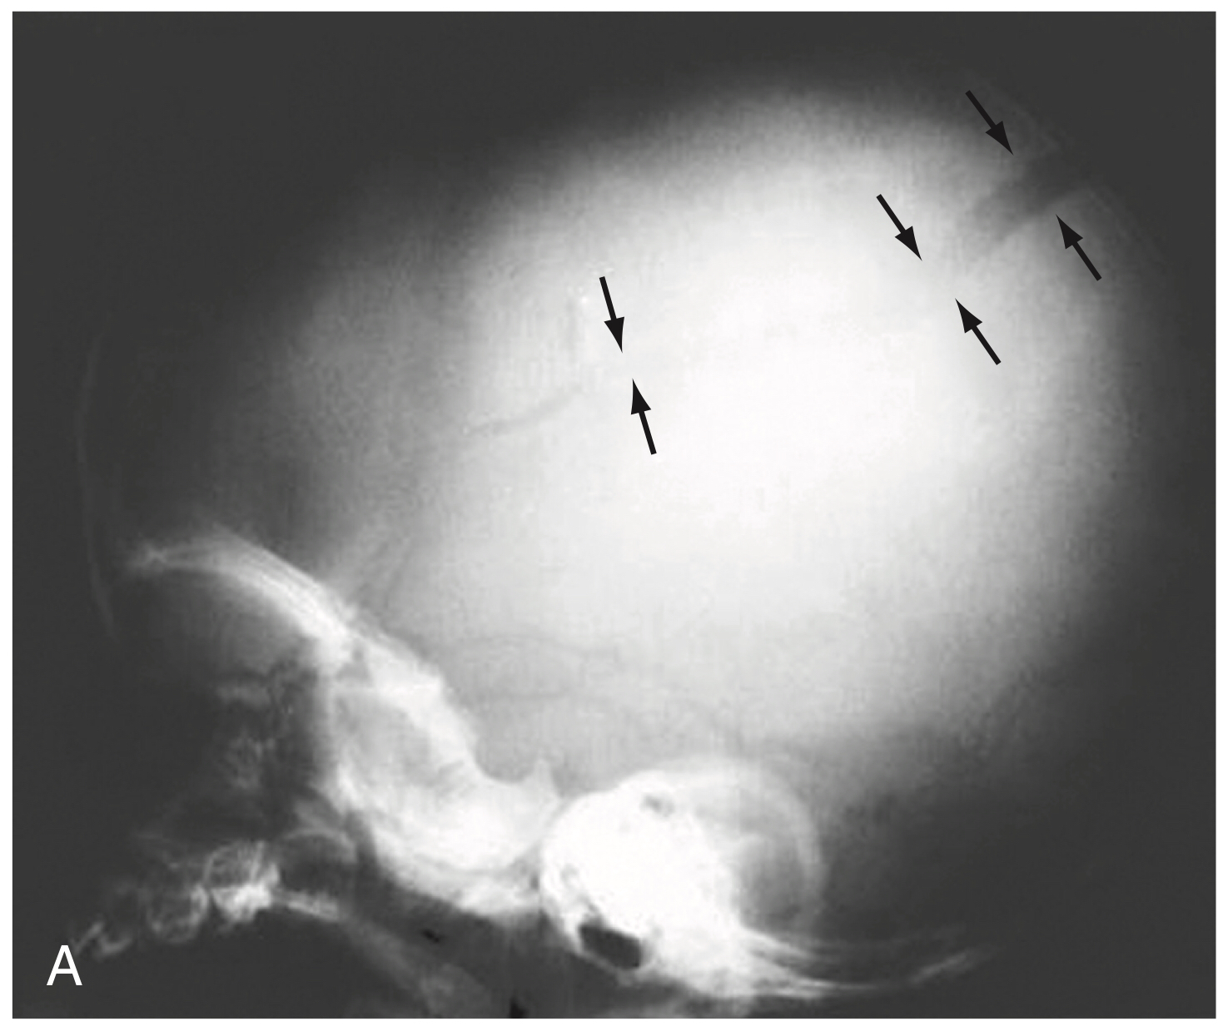
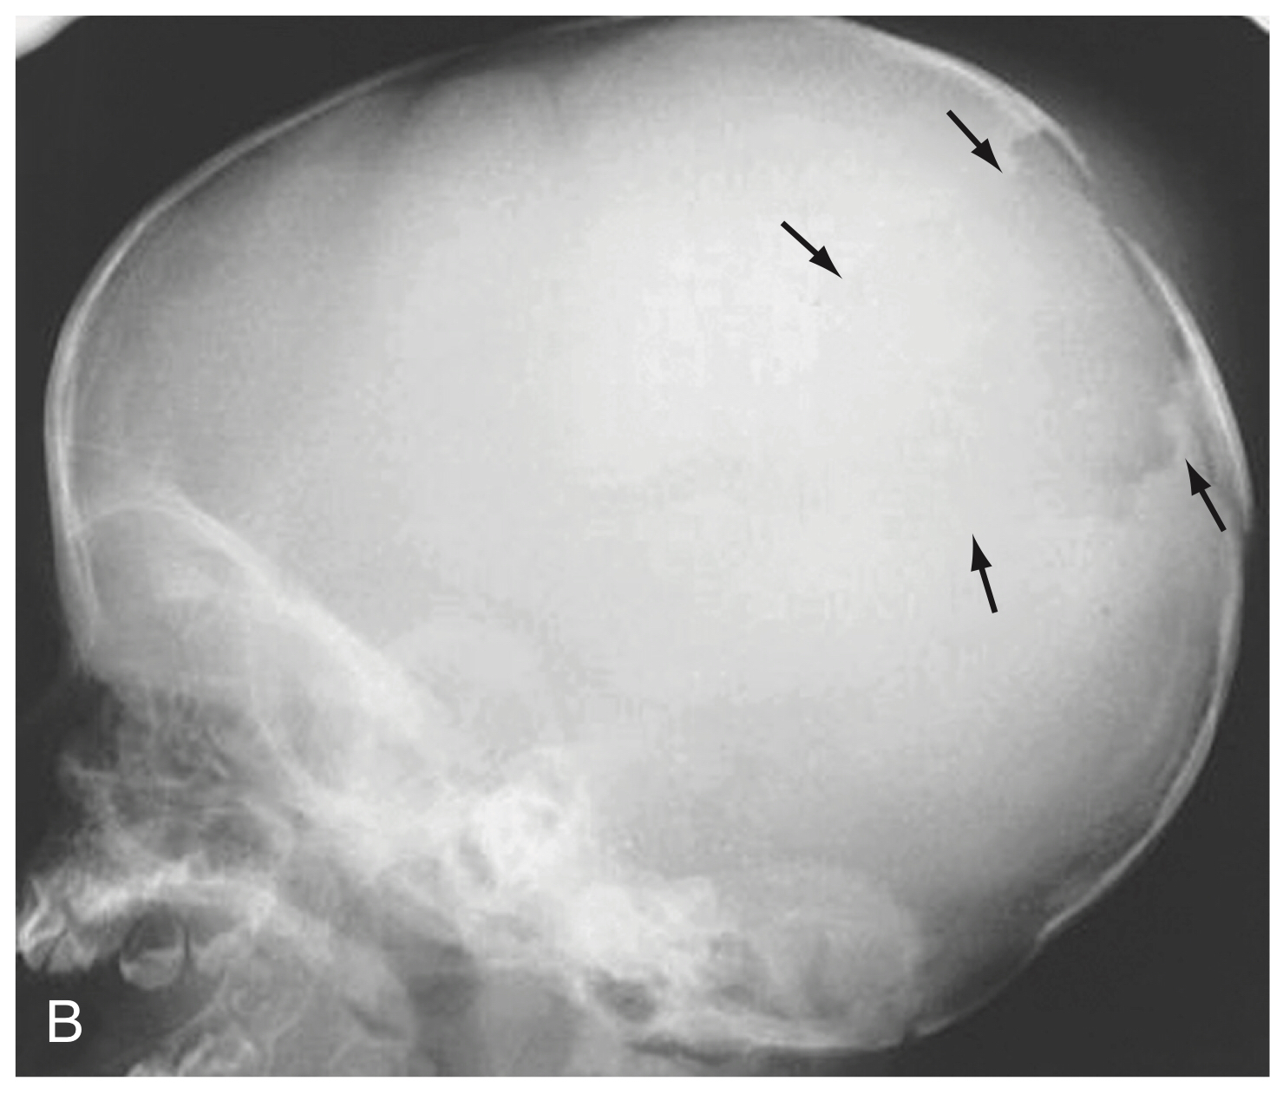
Figure 226-1. Radiographic monitoring of growing skull fracture of childhood. A, A parietal skull fracture is easily seen on this lateral view of the skull (arrows). B, A skull film obtained 2 months later shows that the fracture line has become very wide (arrows) owing to a leptomeningeal cyst and continued pressure erosion of the bone.

Slide 9
TREATMENT
The treatment of a growing fracture is operative.
Successful repair requires identification of the dural margin, repair of the dural defect, and coverage of the missing bone.
A large incision is needed; it must extend beyond the margins of the skull defect.
The dural edge has a tendency to recede and is often located well back from the bone edge.
It can be found with progressive removal of bone from the margins of the defect until the dura is circumferentially exposed.
Once the dural defect is exposed, the underlying brain is carefully dissected. If a large area of cortex herniates through the dural defect, an attempt to reduce it should be made.
Its advocated to resect herniated gliotic tissue which is best avoided in potentially eloquent areas.

Slide 10
Closure of the dural defect is necessary to prevent recurrence of the growing fracture by :
Pericranium
Synthetic dural patch: lyodura
There are several options for bony coverage: most frequently used are
Split-thickness calvarial grafts,
Full-thickness calvarial grafts,
Synthetic materials.
Split rib grafts.
If the dural closure is good, total bone coverage is less important.
Placement of a shunt is best reserved for patients with clear evidence of hydrocephalus

Slide 11
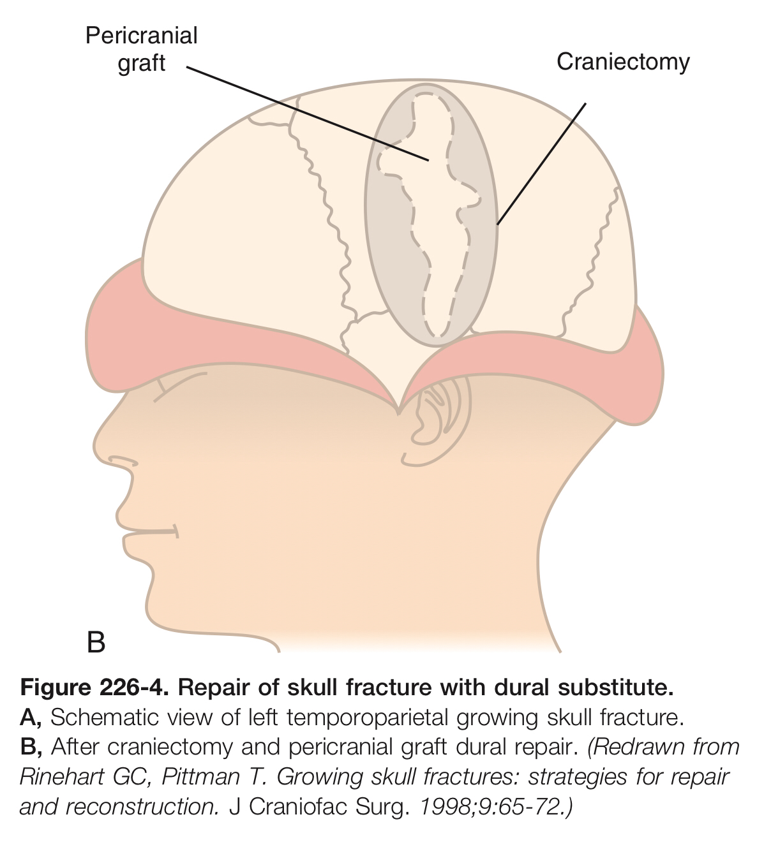

Slide 13
Thank you

