Slide 1
Glomus Tumors
Youmans 156

Slide 2
Glomus Tumors
Other name Paragangiloma, chemodectoma.
A rare, slow-growing, highly vascular craniocervical tumors.
Specialized collections of neuroendocrine cells that migrate in close association with the cranial nerves (CNs), large blood vessels, autonomic nerves, and ganglia.
Generally associated with the parasympathetic system.
Often familial and are unlikely to be malignant.
  Most are slow growing (the median growth rate is reported as 1.0 mm/year.
  Do not metastasize.
  Typically, they do not hypersecrete catecholamines.
  They often remain undetected until they provoke mass effects.
Metastasis
  The most common metastasis sites are the regional lymph nodes followed by the skeleton, lung, and liver.
  More common in Jps than Cps.

Slide 3
Origin :
The paraganglionic system develops from the neural crest and consists of two components:
The adrenal medulla
Diffuse collection of extra-adrenal paraganglia, which have a roughly symmetrical distribution on either side of the midline, and can be classified into two types:
  Sympathetic localized in the paravertebral and para-aortic regions.
  Parasympathetic situated almost exclusively in the head and neck.
Both sympathetic and parasympathetic paraganglia produce catecholamines which is important for homeostasis, in response to stress or acting directly as chemical sensors.

Slide 4
The classic main sites of origin
Carotid body : Carotid paragangliomas (CPs) most common
  Originate in the paraganglia sited within the periadventitial tissue in the posteromedial aspect of the bifurcation of the common carotid artery.
Jugular bulb : Jugular paragangliomas (JPs)
  Generally arise in the paraganglia located within the adventitia of the jugular bulb dome in the jugular foramen.
  Other sites of involvement may include
  Jacobson’s nerve: tympanic branch of 9th C.N, arising from its inferior ganglion It enters the middle ear cavity through the inferior tympanic canaliculus, runs in a canal on the cochlear promontory
  Arnold’s nerve: the auricular branch of 10th C.N in the mastoid canaliculus.
  From these sites the tumor mass can extend superolaterally into the floor of the middle ear cavity, being then termed a jugulotympanic paraganglioma (JTP).
Middle ear : Tympanic paragangliomas (TPs)
  Along the tympanic nerve on the cochlear promontory

Slide 5
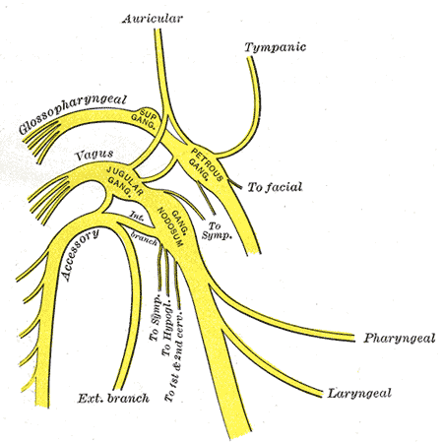
Vagus nerve : Vagal paragangliomas (VPs)
  Originate within or adjacent to the vagus nerve, most often from its inferior ganglia, deep in the neck in the retrostyloid compartment of the parapharyngeal space between the jugular vein and the internal carotid artery.
  From here, they may grow upward to the skull base, through the jugular foramen, or posterior to the mastoid tip.
Laryngeal nerve : Laryngeal paragangliomas (LPs)
  Arise along the paired superior or, most often, inferior laryngeal paraganglia, which are found alongside the superior and inferior laryngeal nerves and arteries.

Slide 7
Incidence and Prevalence
uncommon neuroendocrine tumors.
CPs, commonly in people living at higher altitudes than for those living at the sea level ( afflicted by hypoxic conditions such as chronic obstructive pulmonary disease ).
CPs are the most common HNPs, followed by JPs.
More frequently diagnosed in middle age (mean age, 41 to 47 years),
HNPs are three times more likely to affect females

Slide 8
Functionality
HNPs almost always contain catecholamines (epinephrine, norepinephrine, dopamine, and serotonin), but only 1% to 3% secrete enough into the circulation to produce symptoms.
In clinically significant cases with biochemical evidence of catecholamine excess, the tumor is described as a functional or catecholamine-secreting paraganglioma.
The signs and symptoms suggestive of a hormonally active tumor mimic those seen in pheochromocytoma and include
  Palpitations
  Perspiration
  Facial flushing
  Headaches
  Hypertension, which is the most common finding, can be either paroxysmal or sustained and is triggered by various causes, including anesthesia and several medications.

Slide 9
CLINICAL SIGNS AND SYMPTOMS
Most paragangliomas are indolent, grow slowly, and invade local tissues, infiltrating adjacent skeletal muscle, soft tissue, nerves, and bone.
Major blood vessels are either completely or partially incorporated into the tumor.
Carotid Paragangiloma :
  Most CPs (60% to 70%) present as a painless mass in the lateral neck, near the angle of the mandible, may be pulsatile, with or without carotid bruit.
  Because of their confinement within the carotid sheath, they can usually be moved laterally, but not up or down (Fontaine’s sign).
  lower cranial nerve dysfunction, specifically from 9th to 12th Lead to:
    Pain
    Vocal hoarseness
    Tongue paresis
    Dysphonia
    Dysphagia
    Shoulder drop
    The sympathetic chain may be involved (Horner’s syndrome)
    Intracranial extension is rare

Slide 10
Tympanic Paragangiloma
  Pulsating tinnitus, followed by conductive hearing loss ,vertigo.
  On otomicroscopic examination, the lesion is visible as a reddish-to-bluish mass beneath the eardrum, and the rising sun sign is seen when the tumor rises from the floor of the middle ear.
  Neoplastic invasion of the external auditory canal can lead to tympanic membrane perforation and, rarely, bleeding from the ear.
  TPs can compromise the cranial nerves at later stages.
Jugular Paragangiloma
  Cranial nerve involvement generally occurs earlier in JPs
  Symptoms are similar to those seen in TPs and include :
  Pulsatile tinnitus and , hearing loss, dizziness, ear pain, and bloody otorrhoea.
  JP may compress the nerves around the jugular bulb, lower cranial nerve, and facial nerve, and even the brain or brainstem.
  15% of JTPs grow intracranially.

Slide 11
Vagus Paragangiloma
  asymptomatic, presenting initially as a painless mass in the neck.
  The paralysis of the vagus nerve leads to
    Vocal cord paralysis with hoarseness,
    Inadequate closure of the glottis with aspiration of fluid,
    Bilateral paralysis of the soft palate with liquid regurgitation through the nose during swallowing.
  If the tumor invades the jugular foramen, paralysis of CN 9th , 11th , 12th may result, giving rise to the associated symptoms.
  22% have Intracranial extension and is the main cause of death.
Laryngeal Paragangiloma
  Mainly present as a slow-growing, painless, asymptomatic mass in the supraglottic or infraglottic regions.
  Supraglottic cause hoarseness.
  Subglottic obstruct the airway.

Slide 12
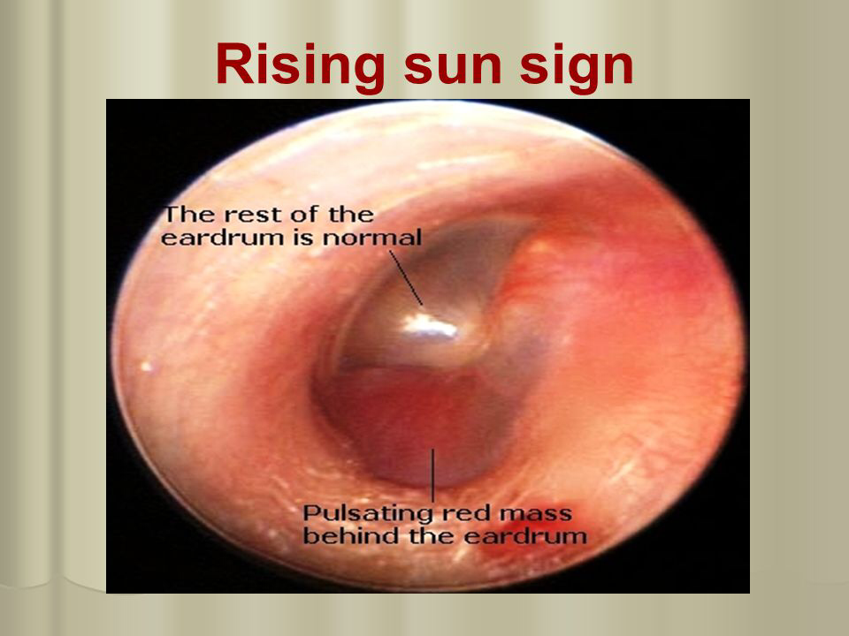
Cranial nerve deficit is frequently seen preoperatively in
  JPs more commonly then VPs and less often in CPs.
CPs are less likely to extend into the cranium, whereas intracranial infiltration is more often seen in VPs.

Slide 13
DIAGNOSIS
Clinical features are key to accurate diagnosis
Otomicroscopic examination is fundamental.
Fine-needle aspiration biopsy is not normally necessary and may even be contraindicated because of
  Risk for precipitating a hypertensive crisis,
  Hemorrhage,
  Tumor cell seeding.
Rarely through plasma or urine testing for fractionated metanephrine or catecholamine.
Doppler ultrasonography is an inexpensive, noninvasive means of ascertaining vascularization in neck paragangliomas and is therefore frequently used as an early diagnostic test.

Slide 14
Neuroradiology is the cornerstone for accurate diagnosis of all HNPs.
Plain skull x-rays:
  Petroclival junction erosion.
  Jugular foramen enlargement.
CT : to clarify the severity of bone involvement
MRI:
  characteristic “salt-and-pepper” T1- and T2 due to slow vascular blood flow or hemorrhage (salt) and flow voids (pepper).
  after gadolinium injection, shows intense enhancement.
Angiography :
  Feeder vessels, and venous drainage.
  In CPs, the lyre sign the splaying of the internal and external carotids is clearly visible.
PET : highly sensitive functional imaging and identify even small HNPs.
Ultrasonography
  B-mode shows a hypoechoic mass.
  color duplex ultrasonography enables blood flow and direction to be analyzed, highlighting the upward flow and significant internal vascularity within such tumors.

Slide 15
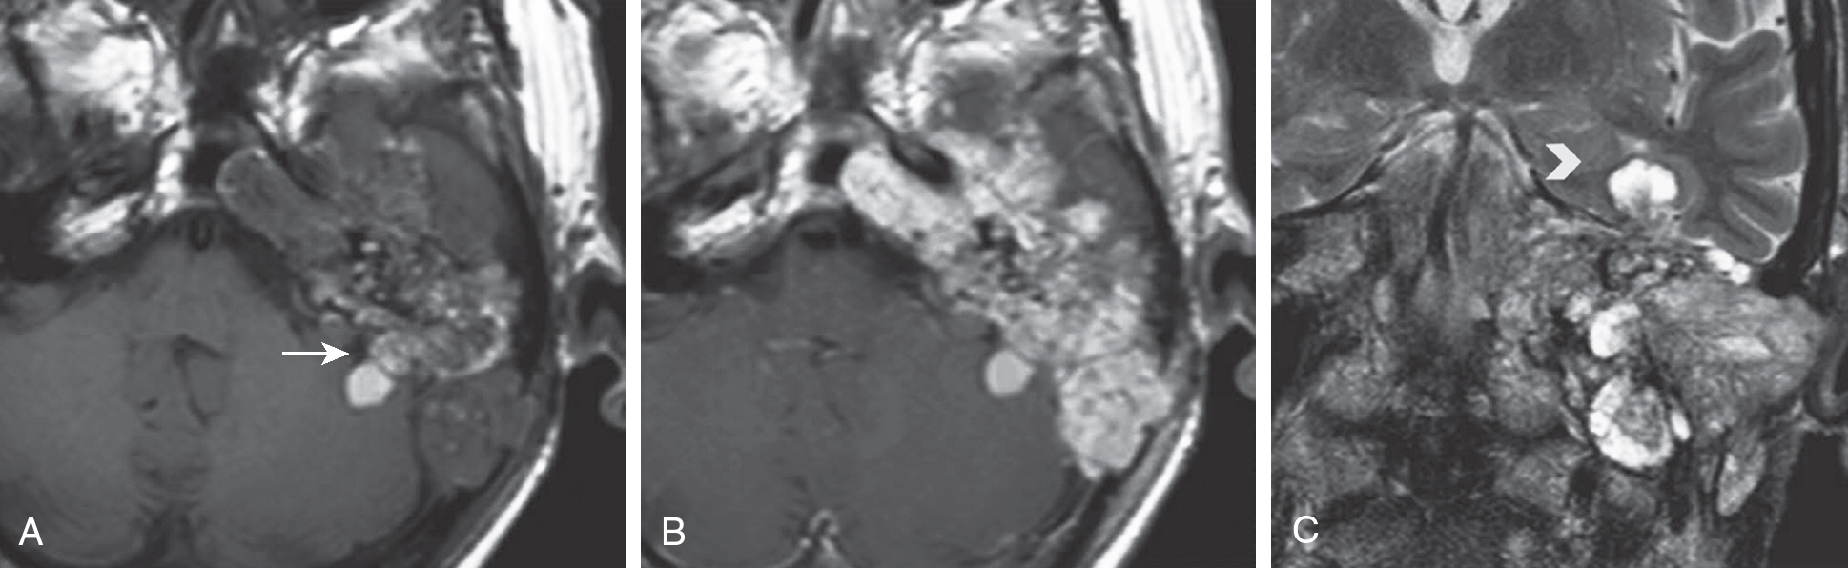
Magnetic resonance imaging (MRI) shows giant paraganglioma with complete left petrous bone involvement.
Axial T1-weighted MRI shows inhomogeneous lesion structure with high signal areas due to degradation of hemoglobin product deposits (arrow).
Axial T1-weighted MRI after contrast injection shows diffuse typical intense lesion enhancement.
Coronal T2-weighted MRI evidences an extension in the middle cranial fossa with temporal lobe dislocation.

Slide 16
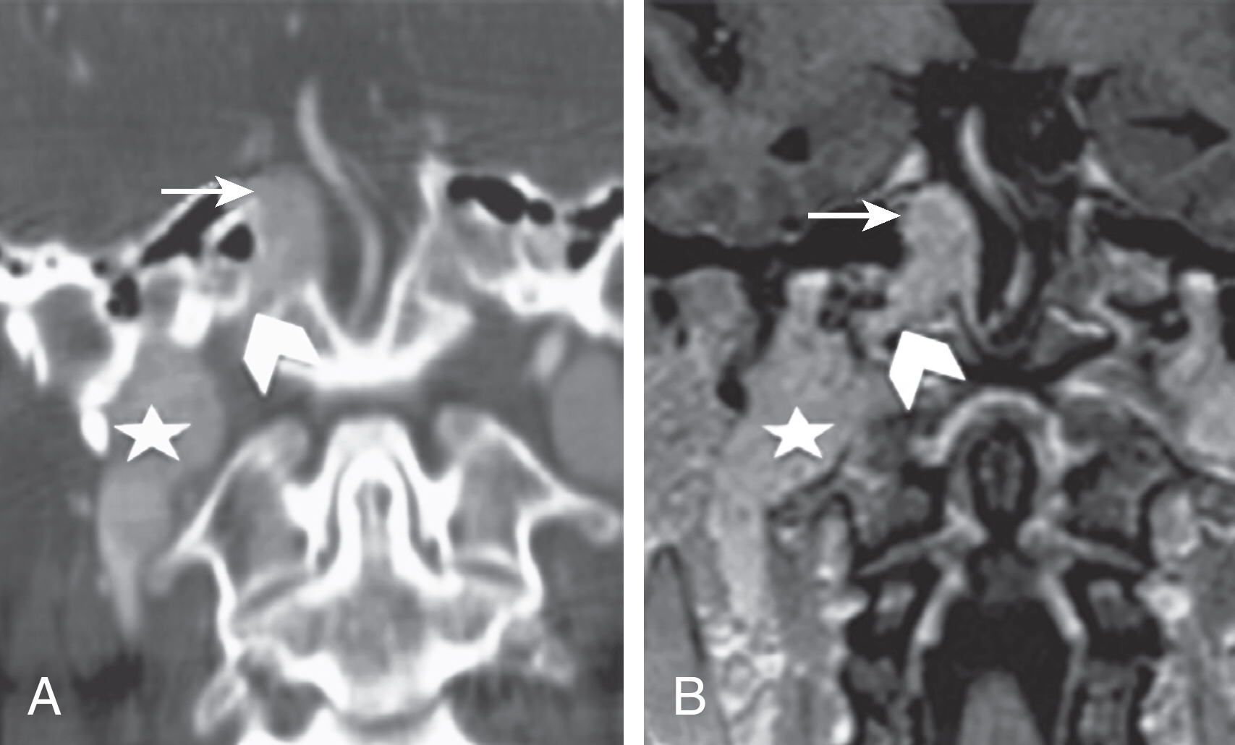
CT angio
Coronal postcontrast spin echo T1-weighted image show a giant jugular aggressive paraganglioma growing into the jugular vein (star) and inferior petrosal sinus (arrowhead) and reaching the cavernous sinus (arrow). The lesion has enlarged the cavernous sinus, bringing about carotid artery occlusion.

Slide 17
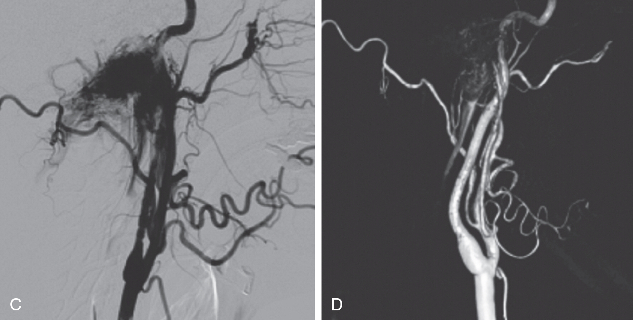
After endovascular embolization, the mass was completely resected, as confirmed by early postsurgical MRI
T2- (MRI) ,the tumor (arrowheads) and many of its arterial feeder branches are visible.
Digital subtraction angiography (DSA) illustrates the hemodynamic characteristics in more detail (C) and shows early opacification of the jugular vein.
Volume rendering reconstruction of DSA reveals all the afferent vessels (D).

Slide 18
TREATMENT
The main treatment options for paragangliomas include:
Embolization
Surgery
RT
Radio-surgery
Wait and scan strategy
to be used alone or in combination.

Slide 19
Embolization
Embolization, combined with immediate surgery, is generally accepted as the best treatment option for resectable paragangliomas.
Advantages
  Improving quality of life by reducing symptoms like tinnitus, vertigo, or dizziness.
  Diminishes the risk for hemorrhage and the neurovascular sequelae of thermocoagulation trauma by reducing intraoperative bleeding, shrinks tumors, and may shorten or spare a patient from dangerous coagulation as well as sinus-packing procedures.
The main routes of embolization
The transarterial route
  embolic agent is injected through a microcatheter into the feeding arteries of the tumor.
Direct percutaneous intratumoral puncture
  close off the arterial supply, capillary bed, and veins to provide more complete reduction of tumor vascularity.
For JTPs, the combined transarterial and transvenous route.

Slide 20
Complications
Lower cranial nerve palsies may be due to
  Tumor embolic infarction, accompanied by swelling.
  Cranial nerve compression.
  Embolic ischemia of the vasa nervorum (posterior meningeal branches of the lower cranial nerves and middle meningeal or stylomastoid branches of the facial nerve).
Stroke (typical brainstem-cerebellar infarction → primary mistake during the endovascular procedure & reflux withdrawal−induced embolism).
Dramatic fall in blood pressure when a very large catecholamine-secreting tumor is embolized → significant complications and even death.
The recommended delay between embolization and surgery should be at least 2 to 3 days.
This will give the edema time to subside but should not be prolonged beyond 2 weeks—otherwise, embolized feeding vessels may reopen, or new feeding arteries may be recruited.

Slide 21
Surgery
Surgical strategies need to be tailored to the specific tumor site and size, considering not only the tumor’s anatomic relationship with nearby neurovascular structures but also the clinical conditions of the patient.
Two main approaches to paragangliomas:
  Extracranial skull base approaches, in particular the infratemporal fossa approach (lateral approach), to tympanic and JPs.
  Transcervical approach to CPs.
Both these approaches are rather complex and often require a multidisciplinary surgical team that includes neurosurgeons and vascular surgeons capable of safely reconstructing carotid vasculature.

Slide 22
Treatment modalities for different types of paragangilioma
JPs
  Surgery (GTR or STR)
  Radiation
CPs
  Surgery
  Embolization reserved for large tumors (>5 cm) or those with significant cranial extension
In both the surgical complication far higher than treatment with radiation.

Slide 23
Extracranial Skull Base Approaches.
Posterior approaches :through the posterior cranial fossa:
  Suboccipital retrosigmoid.
  Transcondylar (with partial resection of the occipital condyle).
  Supracondylar.
  Transtubercular (with partial resection of the jugular tuberculum).
  These are preferred for tumors with intracranial extension. C1 hemilaminectomy is also performed in high cervical approaches.
Lateral approaches : through the mastoid, sacrificing the otic capsule, such as:
  Trans labyrinthine
  Trans cochlear (for larger and more anteriorly based tumors).
  Extra labyrinthine approach ( the otic capsule can be preserved ).
Anterior approaches:
  for instance preauricular subtemporal infratemporal, which provides only limited exposure of the foramen’s bony margin and so tends not to be used alone.

Slide 24
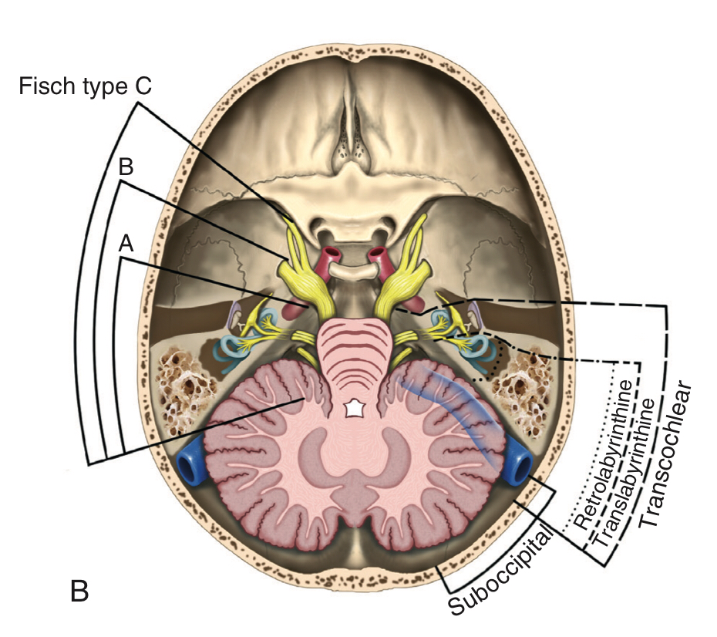
Placement of skin incision of the lateral skull base approach by :infratemporal fossa approach (S-shaped incision).
Bottom: Surgical exposure for removal of jugular paraganglioma after mastoidectomy, anterior rerouting of the facial nerve, and upper neck dissection. CN, cranial nerve; SCM, sternocleidomastoid.

Slide 25
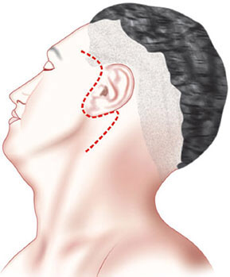
Transcervical Approach.
The transcervical approach is suitable for CPs.
Depending on the patient’s neck configuration.
The choice of surgical incision is usually based on the width and extension of the tumor.
For small tumors, a longitudinal anterior incision parallel to the medial border of the sternocleidomastoid muscle provides adequate exposure of the carotid sheath
For larger tumors (>4 cm), a modified-T neck incision or a sweeping S-shaped preauricular incision is more appropriate.

Slide 26
Radiotherapy
External Beam Radiotherapy
Stereotactic Radiosurgery
Paragangliomas are radiosensitive, but not radiocurable.
Indications
  Recurrent
  Residual disease after microsurgical resection
  Poor surgical candidate owing to old age, extensive comorbidity
  According to tumor size and location.
Unlike surgery, the goal of radiation is not total eradication of the tumor but rather is preventing progression of its volume, which will never disappear completely
The mean volume of tumors that have been treated successfully by SRS ranges from 5 to 13 cm3.

Slide 27
Wait and Scan
Indications
Elderly patients
Tumors of small size.
Slow-growing tumors.
But rapidly growing tumors need to be referred for prompt surgery or RT.
Paragangliomas are defined as radiologically progressive when they show a volume increase of more than 20% over the course of a year.

Slide 28
Postoperative Complications
Jugular Paragangliomas
  Lower cranial nerves palsies most commonly 11th followed by 9th then 10th & 12th for both surgery (GTR, STR)
  Facial nerve palsy
  Hearing deterioration
  Trigeminal or oculomotor damage ( less common ).
  Hemorrhagic sequelae (stroke, brainstem hematoma)
  CSF leakage followed by meningitis
life-threatening complications of JP surgery
  CSF leakage is the most common, followed by
  Severe aspiration pneumonia
  Wound infection
  Meningitis
  Stroke

Slide 29
Carotid Paragangliomas
  More commonly, Cranial nerve injuries( CN X and CN XII),Mostly transient.
  Permanent stroke
  Hemorrhage
  TIA
In patients with bilateral tumors
The risk for vascular and cranial nerve lesions can be lowered by:
Treating these sequentially rather than in one sitting → reduce the risk for damage to baroreceptor function → loss of Hering’s nerve (carotid sinus nerve, a branch of the glossopharyngeal nerve), leading to baroreflex failure syndrome.
Baroreflex failure syndrome: fluctuations in blood pressure with episodes of severe hypertension (high blood pressure) and elevated heart rate.

